Slide 1


Remote sensing applications for soil erosion assessment
Supervisors: A/Prof. Bertram Ostendorf (UoA)
Tim Herrmann (DEWNR)
Amelie Jeanneau
Monday 26th of June 2017

Slide 2
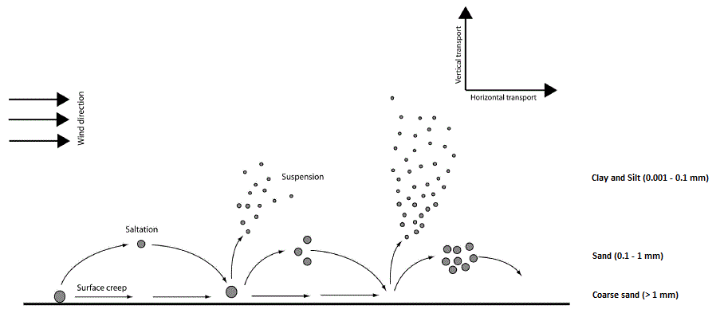
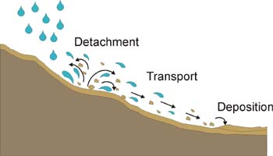
Introductory Background
Types of erosion processes:
Waterborne
Aeolian
Clay and Silt (0.001 - 0.1 mm)
Sand (0.1 - 1 mm)
Credit: DEWNR
Coarse sand (> 1 mm)
UBC Centre for Teaching, Learning and Technology
Adapted from (Ravi et al., 2011)

Slide 3
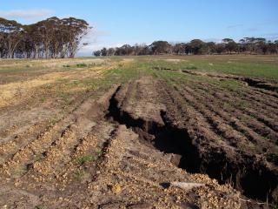
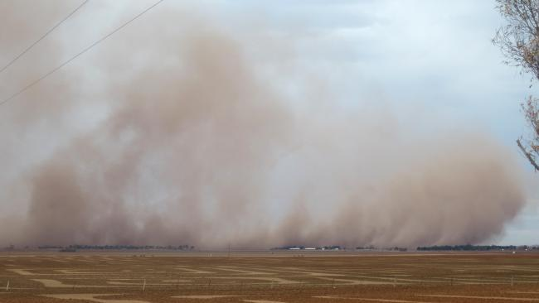
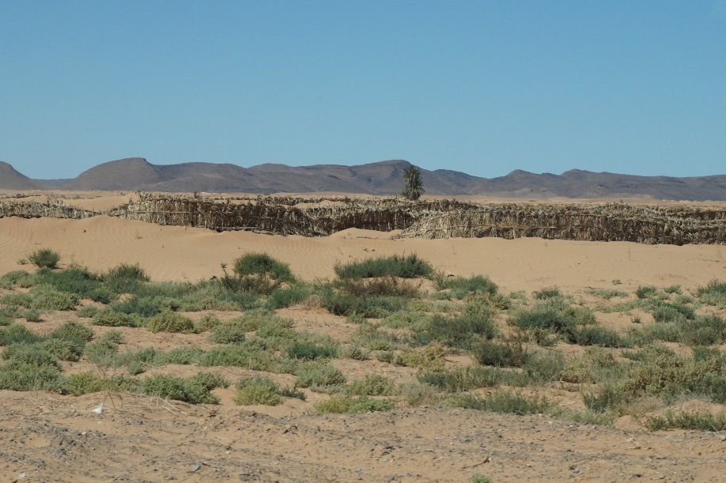
Introductory Background
Types of erosion processes:
Waterborne
Aeolian
Credit: DEWNR and WA_DAF
Credit: DEWNR
Adapted from (Ravi et al., 2011)
Credit: Matthew Bowie

Slide 4
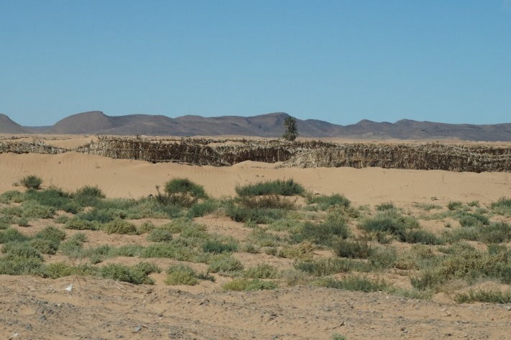
Introductory Background
Types of erosion processes:
Waterborne
Aeolian
Drivers of soil erosion:
Topography Soil properties Vegetation cover | Weather conditions Land use/management

Slide 5
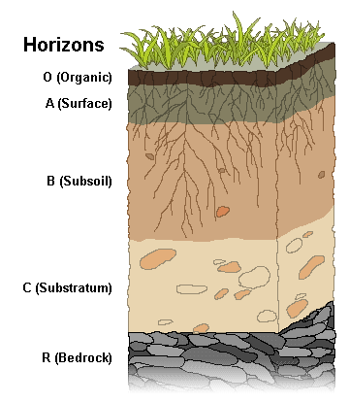
Introductory Background
Why erosion in low rainfall agricultural regions?
Low rainfall (250 - 600 mm per year).
Thin A-horizon layer (nutrients stock).
  Yield and productivity ↘. (Bui et al., 2010)
15 cm
Adapted from trade time-series data, from the Department of Foreign Affairs and Trade

Slide 6
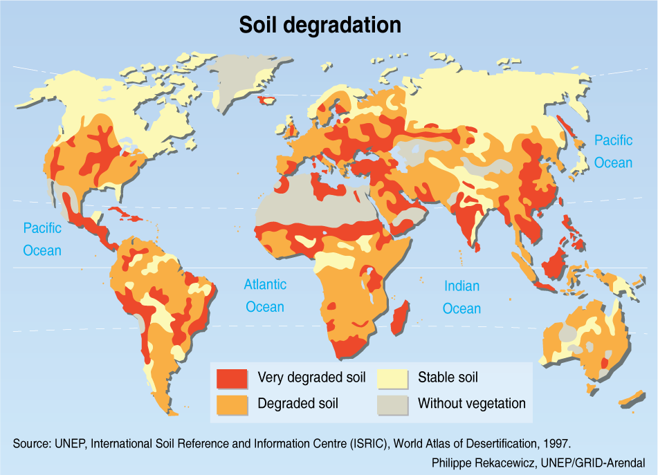
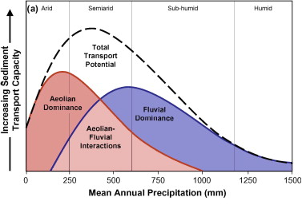
Introductory Background
Why erosion in low rainfall agricultural regions?
Low rainfall (250 - 600 mm per year).
Thin A-horizon layer (nutrients stock).
  Yield and productivity ↘. (Bui et al., 2010)
Need to study two processes simultaneously. (Field et al., 2009)
  Impact majority of arable lands.
15 cm
Field et al. (2009)
Low rainfall regions
Low rainfall regions

Slide 7

Introductory Background
Low rainfall regions are highly sensitive to changes in climate
Current predictions (CSIRO & BoM, 2015)
Less reliable rainfall / more intense precipitations
Drier overall conditions / more frequent droughts
Hotter and longer heatwaves
Increased risk of bushfire events
Soil moisture
Variable biomass
Lower production
Higher production
Less protective cover
Poorer soil stability
More exposure to erosion

Slide 8
Introductory Background
Low rainfall regions are highly sensitive to changes in climate
Current predictions (CSIRO & BoM, 2015)
Less reliable rainfall / more intense precipitations
Drier overall conditions / more frequent droughts
Hotter and longer heatwaves
Increased risk of bushfire events
Soil moisture
Variable biomass
Lower production
Higher production
Less protective cover
Poorer soil stability
More exposure to erosion

Slide 9
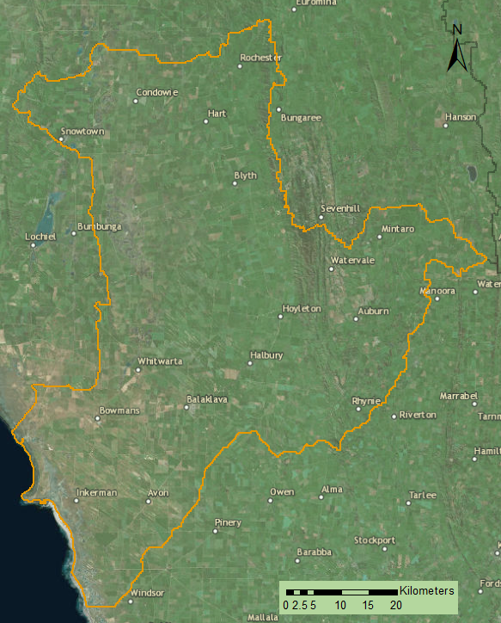
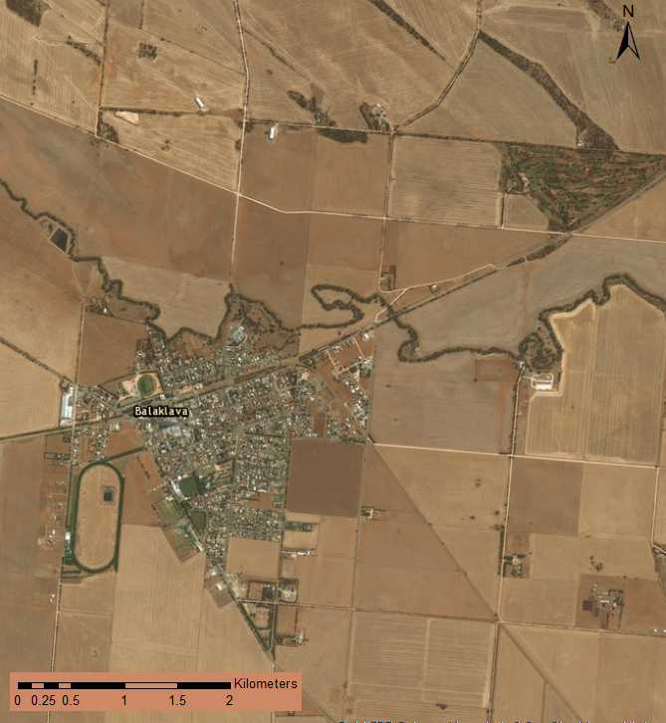
Introductory Background
Erosion controlling factors and remotely sensed data
Lack of funding
Environmental policies

Slide 10
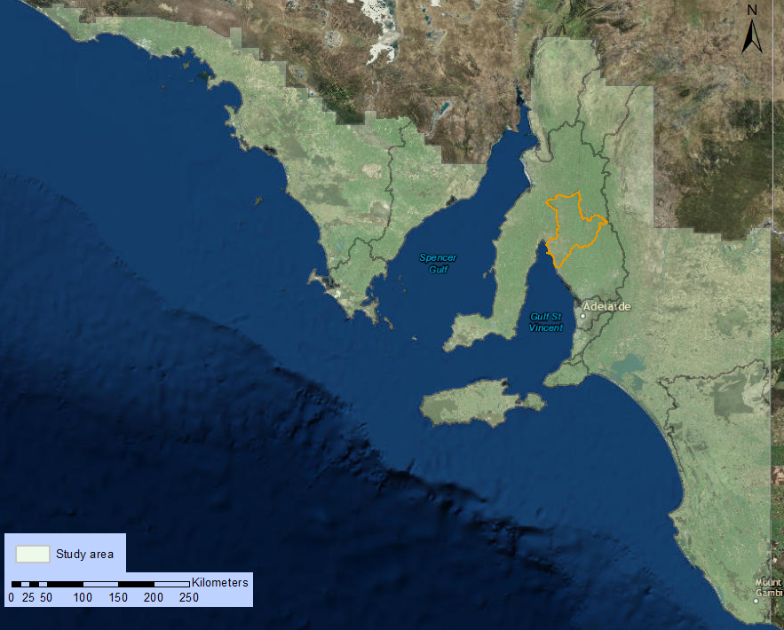
Introductory Background
Erosion controlling factors and remotely sensed data
Lack of funding
Environmental policies

Slide 11





Introductory Background
Erosion controlling factors and remotely sensed data
Consistent data
Large regions
Regular revisit
Readily available
  NASA, ESA, BoM, CSIRO, etc.
Expensive
Time-consuming
Low quality

Slide 12
Introductory Background
Erosion controlling factors and remotely sensed data
Consistent data
Large regions
Regular revisit
Readily available
  NASA, ESA, BoM, CSIRO, etc.
Expensive
Time-consuming
Low quality

Slide 13

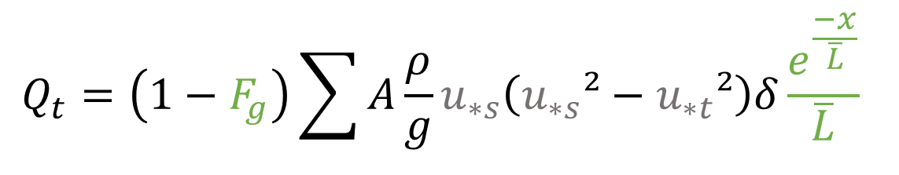
Introductory Background
Soil erosion modelling
Water: RUSLE
Wind: WEMO
$$Q_{t}=\left(1−F_{g}\right)\sum{A\frac{ρ}{g}u_{∗s}\left(u_{∗s}²−u_{∗t}²\right)δ\frac{e^{\frac{−x}{\overline{L}}}}{\overline{L}} }$$
$$A=R×K×LS×C×P$$
Weather conditions
Topography
Soil properties
Soil properties
Vegetation cover
Land management
Topography
Weather conditions
Vegetation cover
Land management

Slide 14

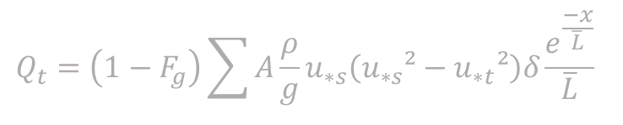
Introductory Background
Soil erosion modelling
Water: RUSLE
Wind: WEMO
$$Q_{t}=\left(1−F_{g}\right)\sum{A\frac{ρ}{g}u_{∗s}\left(u_{∗s}²−u_{∗t}²\right)δ\frac{e^{\frac{−x}{\overline{L}}}}{\overline{L}} }$$
$$A=R×K×LS×C×P$$
Weather conditions
Topography
Soil properties
Soil properties
Vegetation cover
Land management
Topography
Weather conditions
Vegetation cover
Land management
Quantitative approaches
Best models available
Easy GIS assimilation
Need re-parameterisation
Validation
No full integration of future changes

Slide 15
Literature Gaps
Combined studies on wind and waterborne erosion are scarce.
Accuracy and relevance of 1990’s models’ input parameters are obsolete.
Models’ validation is a recurrent issue.
Future changes in land management and climate are not fully integrated in erosion modelling.

Slide 16
Research Questions
How can traditional soil erosion modelling integrate future changes in land use and climate conditions?
Can modern remote sensing improve current and future modelled erosion estimates?
What impacts do changes in land use and land management have on soil erosion?

Slide 17
Aims and Objectives
Parameterise and run the models.
Apply the models to assess the influence of past and new land management and climate conditions on soil erosion.
Scrutinize the broad-scale validity of the models.

Slide 18
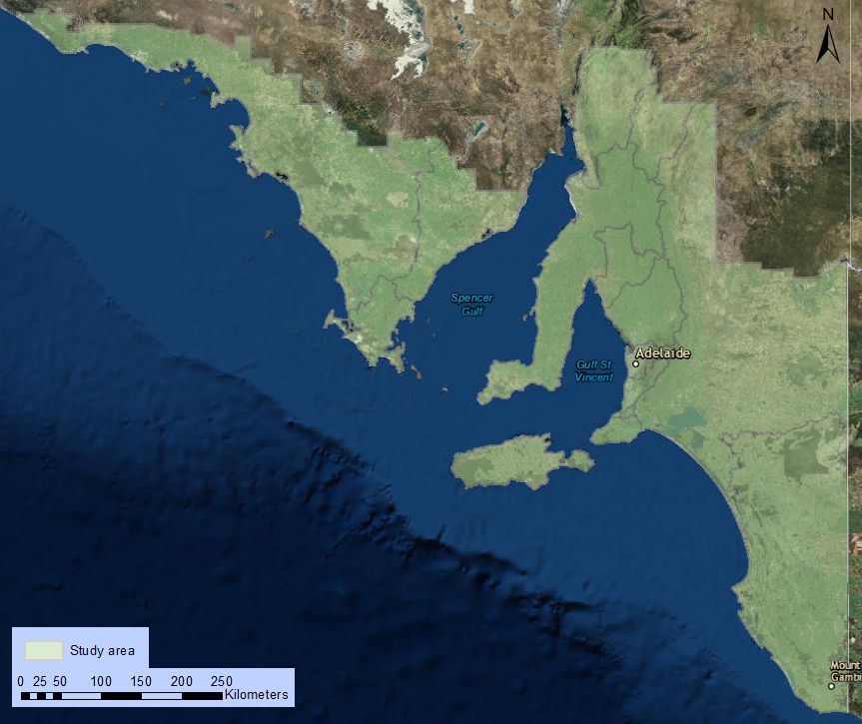
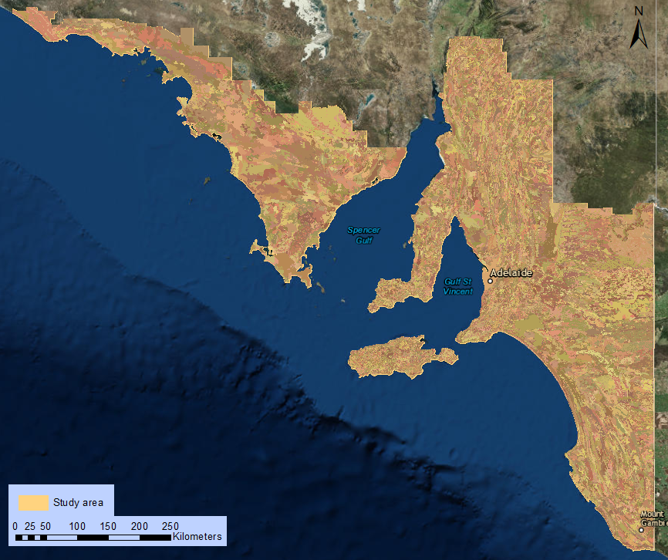
Methodology
Parameterise and run the models
Smaller manageable units:
  Homogeneous Response Units (HRU)
    Uniform:
      Topography
      Soil properties
      Land cover
      Land management
  Average size: 265 ha
  Total size: 15.7 million ha
        (= 157,700 km²)

Slide 19
Methodology
Parameterise and run the models
Soil properties
Soil Landscape Grid of Australia (CSIRO)

Topography
SRTM DEM (Geoscience Australia)

Vegetation cover
MODIS Fractional Cover: 16-days composite (CSIRO)
✓
Land management
Land use maps (ABARES)

Weather conditions
TRMM (NASA)
✓
+ Wind records (BoM)

Slide 20
Methodology
Model applications
Changes in erosion patterns under altered land management regimes.
  Herbicide resistant weeds / ban on herbicides (e.g. Europe).

Slide 21
Methodology
Model applications
Changes in erosion patterns under altered land management regimes.
  Herbicide resistant weeds / ban on herbicides (e.g. Europe).
Interaction between erosion controlling factors and extreme environmental conditions.
  Years of extreme weather conditions as analogues for “global-change-type” year of extremes.

Slide 22
Methodology
Model applications
Changes in erosion patterns under altered land management regimes.
  Herbicide resistant weeds / ban on herbicides (e.g. Europe).
Interaction between erosion controlling factors and extreme environmental conditions.
  Years of extreme weather conditions as analogues for “global-change-type” year of extremes.
Relative balance of wind and waterborne erosion under past and future climate and land use changes.
  Wind-to-water transport ratio. (Field et al., 2011)

Slide 23
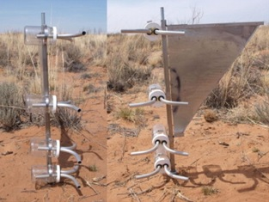
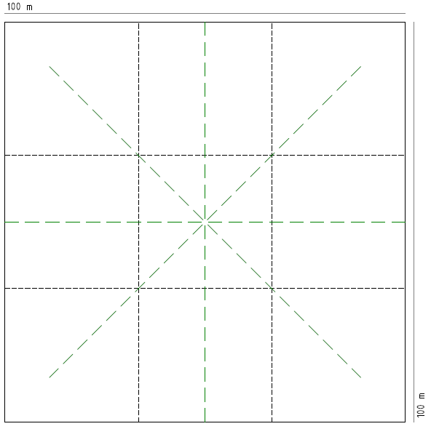
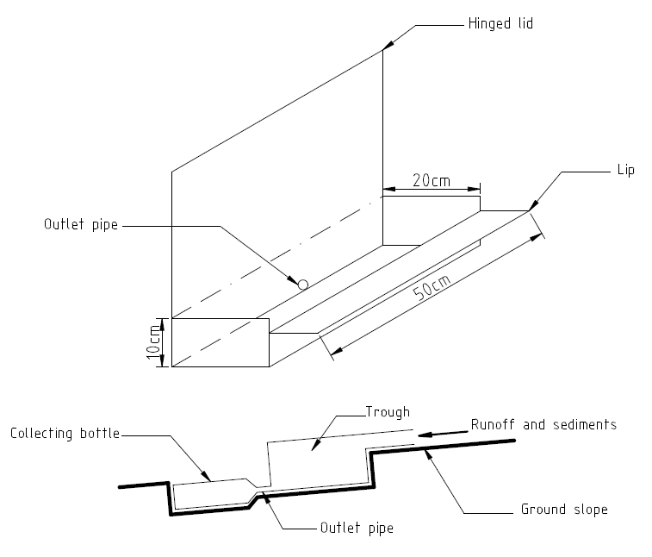

Methodology
Broad scale validity
M
M
M
M
M
M
M
M
M
M
M
Modified Wilson and Cooke (MWAC) dust sampler, adapted from Acosta-Martinez et al. (2015)
M
M
M
M
M
M
M
M
M
M
M
M
M
M
M
M
M
MWAC dust sampler (27)
Vegetation transects
Sediment troughs
Sediment trough, adapted from Morgan (2009)

Slide 24
Conclusion
Integrated soil erosion methodology
  Decision Support System (DSS) for future adaptations.
  Possible application to WA or low rainfall agricultural regions (e.g. US wheat-belt).
GIS and remotely sensed data
  Broad-scale applications.
  Cost effective.
Future soil erosion estimates
  Altered land uses (e.g. back to old tillage systems).
  Extreme events (e.g. bushfires, floods).

Slide 25

Acknowledgements
Bertram Ostendorf
Cameron Grant
Spatial Information Group
Applied Ecology and Conservation
Tim Herrmann
Trevor Hobbs
Craig Liddicoat
Giles Forward

Slide 26
Thank you !

Slide 27
References
Acosta-Martinez, V., Van Pelt, S., Moore-Kucera, J., Baddock, M. C. & Zobeck, T. M. 2015. Microbiology of wind-eroded sediments: Current knowledge and future research directions. Aeolian Research, 18, 99-113.
Bui, E. N., Hancock, G. J., Chappell, A. & Gregory, L. J. 2010. Evaluation of tolerable erosion rates and time to critical topsoil loss in Australia. Caring for our Country publication, Commonwealth of Australia, Canberra [nrmonline. nrm. gov. au/catalog/mql: 2237], 3.
CSIRO & BoM 2015. Climate Change in Australia Information for Australia’s Natural Resource Management Regions: Technical Report. In., CSIRO and Bureau of Meteorology, Australia.
Field, J. P., Breshears, D. D. & Whicker, J. J. 2009. Toward a more holistic perspective of soil erosion: Why aeolian research needs to explicitly consider fluvial processes and interactions. Aeolian Research, 1, 9-17.
Morgan, R. P. C. 2009. Soil erosion and conservation, John Wiley & Sons.
Okin, G. S. 2008. A new model of wind erosion in the presence of vegetation. Journal of Geophysical Research: Earth Surface, 113.
R Development Core Team 2010. R: A Language and Environment for Statistical Computing. In., R Foundation for Statistical Computing, Vienna, Austria.
Ravi, S., D'Odorico, P., Breshears, D. D., Field, J. P., Goudie, A. S., Huxman, T. E., Li, J., Okin, G. S., Swap, R. J. & Thomas, A. D. 2011. Aeolian processes and the biosphere. Reviews of Geophysics, 49.
Renard, K. G., Foster, G. R., Weesies, G., McCool, D. & Yoder, D. 1997. Predicting soil erosion by water: a guide to conservation planning with the Revised Universal Soil Loss Equation (RUSLE), US Government Printing Office Washington, DC.
Rosewell, C. 1993. SOILOSS: a program to assist in the selection of management practices to reduce erosion. Soil Conservation Service of NSW, Sydney, NSW. In.
Viscarra Rossel, R. A. & Webster, R. 2012. Predicting soil properties from the Australian soil visible-near infrared spectroscopic database. European Journal of Soil Science, 63, 848-860.
Webb, N. P., Herrick, J. E. & Duniway, M. C. 2014. Ecological site‐based assessments of wind and water erosion: informing accelerated soil erosion management in rangelands. Ecological Applications, 24, 1405-1420.

Slide 28
Glyphosate or not Glyphosate?
European controversy
  European Food Safety Authority (EFSA) + European Chemical Agency (ECA)
    Reviewed glyphosate status in June 2016.
      Licence extended until late 2017 to complete the review.
      More research needed (co-formulant composition).
  International Agency for Research on Cancer (IARC)
    “Probable” human carcinogen, but for high concentrations
http://www.sciencemag.org/news/2016/06/why-europe-may-ban-most-popular-weed-killer-world

Slide 29
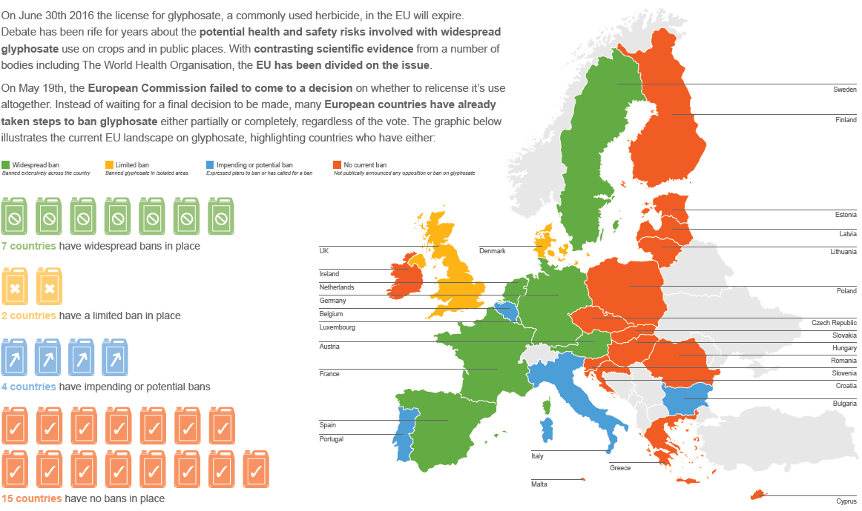
Glyphosate or not Glyphosate?
https://www.weedingtech.com/where-glyphosate-is-used-in-europe/

Slide 30
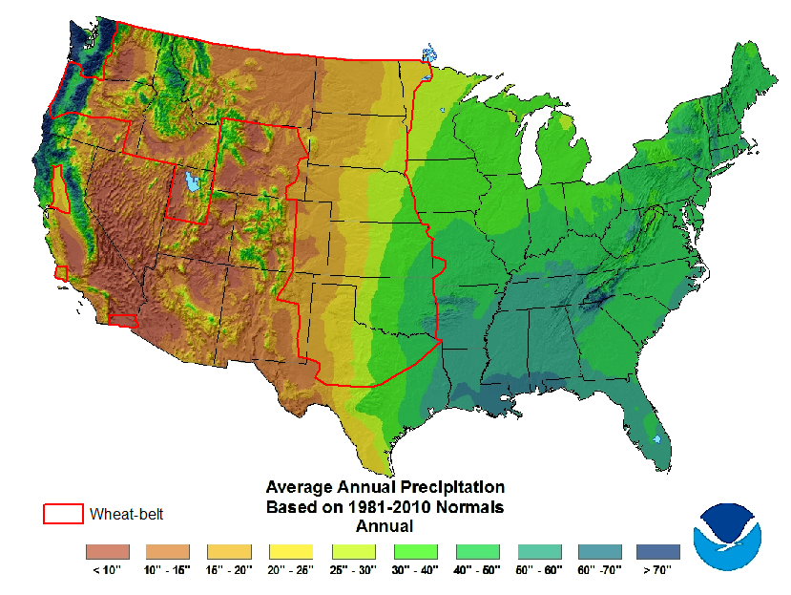
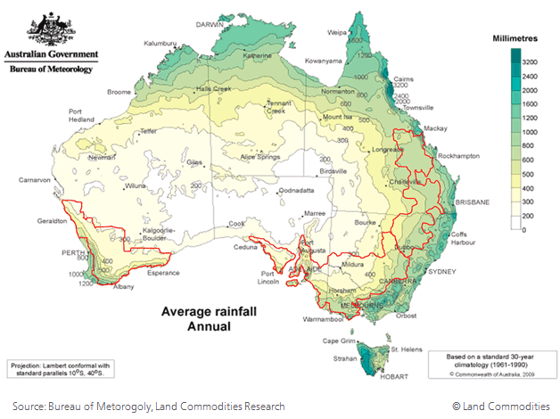
Applications outside SA
250-600 mm

