Slide 1
Requirements, choices and challenges
Implementing figshare for institutions at two Amsterdam universities
Mariëtte van Selm
RDM Support Services Coordinator, UvA/AUAS Library // Institutional RDM Programme Manager
figshare fest Europe, June 28th, 2017

Slide 2
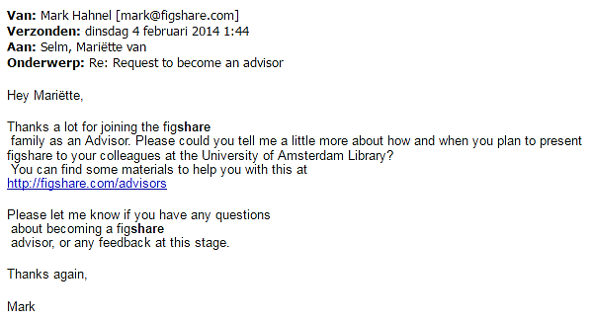

Slide 3
± 3.500 researchers
± 450 researchers
Dentistry
Economics & Business
Humanities
Law
Medicine
Science
Social & Behavioural Sciences
Applied Social Sciences & Law
Business & Economics
Digital Media & Creative Industries
Education
Health
Sports & Nutrition
Technology
Library UvA/AUAS

Slide 4
Research data management
My future self (or another researcher) can find, assess, understand and reuse my research data with a minimum of time and effort

Slide 5
Institutional RDM programme
Support
Infra-structure
Policies
clarity:
researchers know what is expected of them
ability:
researchers have the facilities they need to meet expectations
understanding:
researchers understand what is important, when, why and to whom

Slide 6
Central UvA/AUAS RDM guidelines
data management plan for each new research project
data steward per research unit
minimal retention period of 10 years
open sharing of data if possible
publication of data with persistent identifier

Slide 7
Existing data infrastructure
Scattered storage: central, faculty, individual
Filesharing troublesome (hence: Dropbox very popular)
Library’s publications repository not suited for data
No institutional facilities for short to medium term archiving
No institutional facilities for publishing digital data

Slide 8
Needed: data repository
Safely storing data during research projects
Controlled sharing of data during research projects with people within and outside UvA/AUAS
Publication of data during and after research projects, with a persistent identifier, embargoed if needed
Archiving data after research projects for at least 10 years

Slide 9
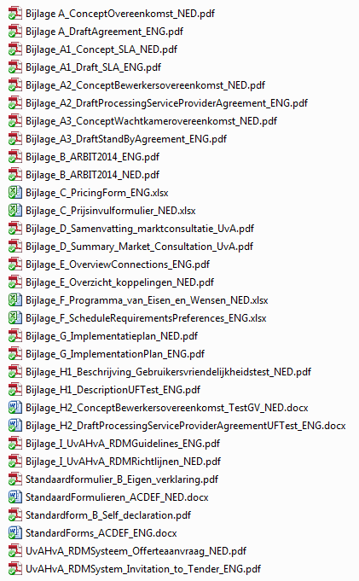
Request for tender (RFT)
Data safety & security
Ease of use for researchers
Meeting institutional guidelines
Pricing & scalability

Slide 10
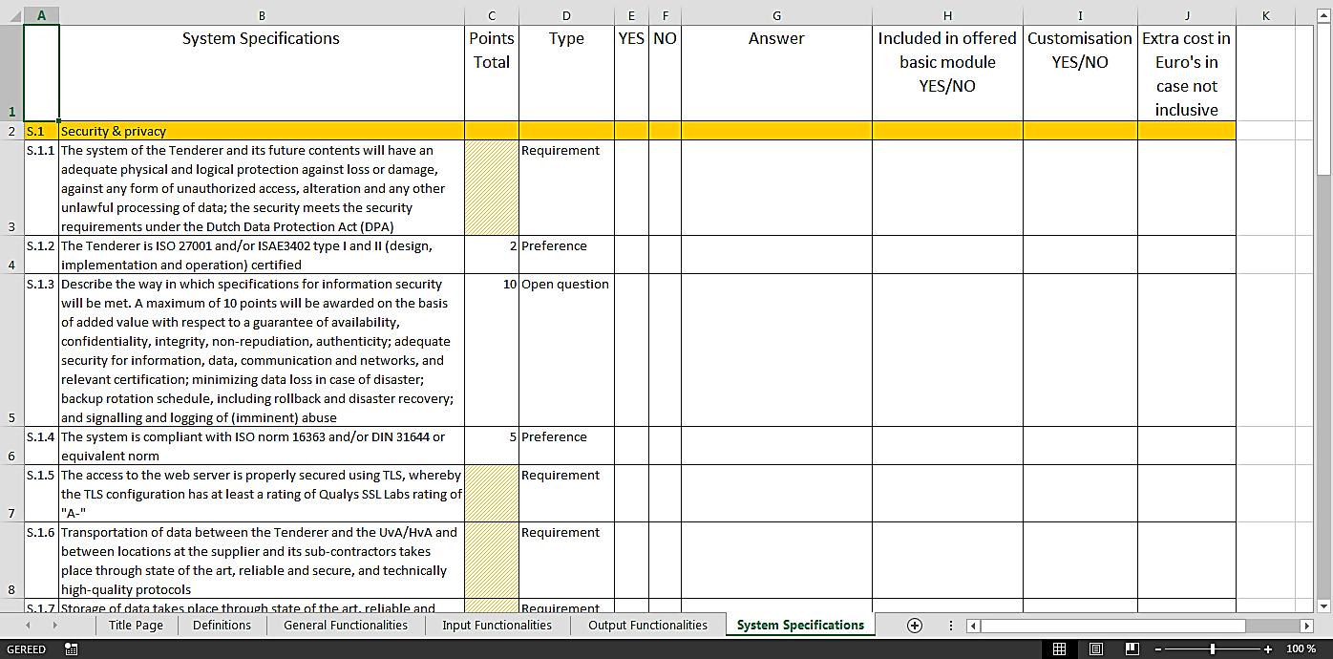
Requirements and preferences

Slide 11
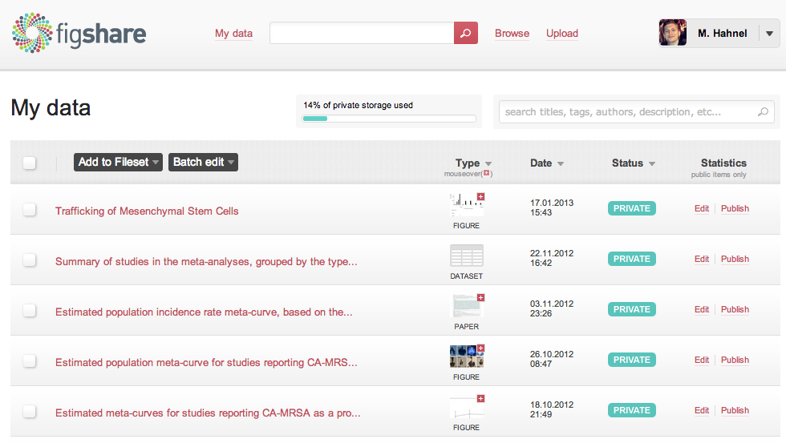
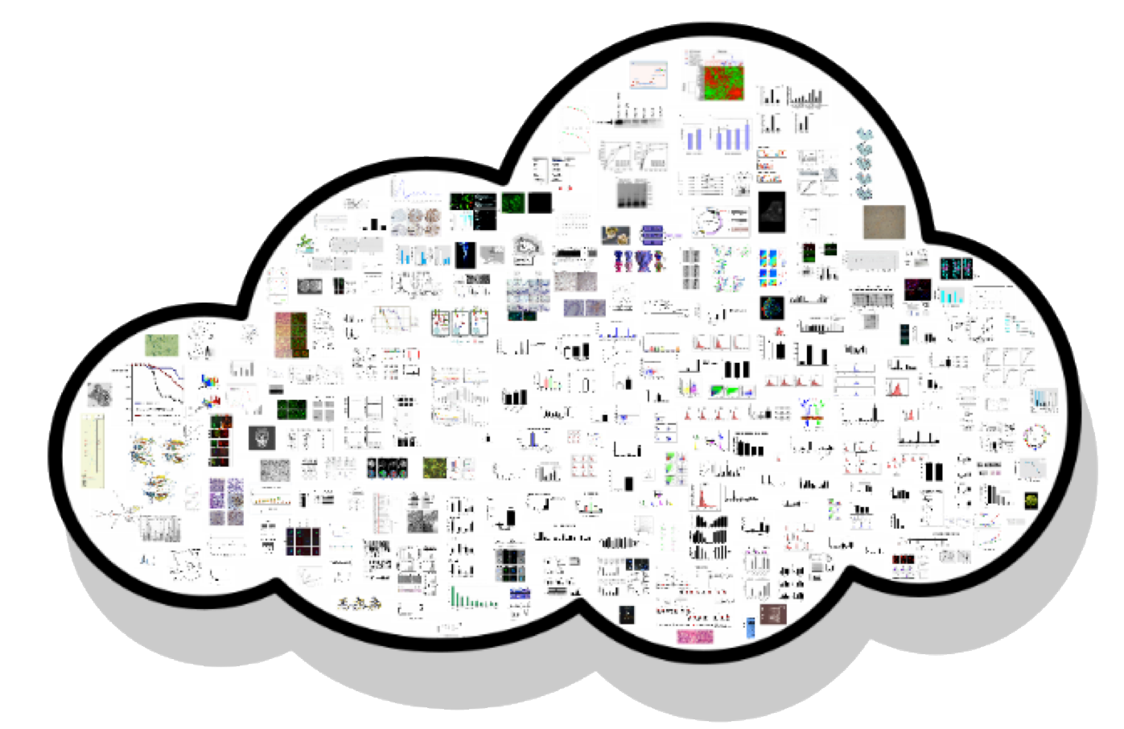
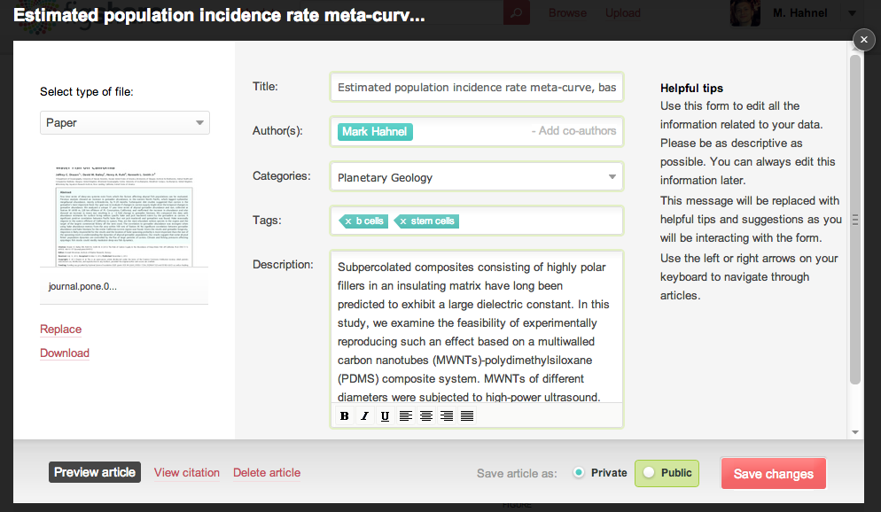
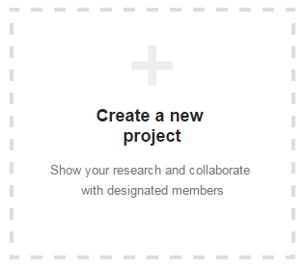
figshare for institutions
Ease of use
Scalable cloud storage in Europe
Cooperation through Projects
Persistent identifiers
11

Slide 12
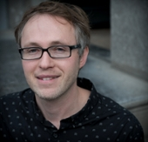
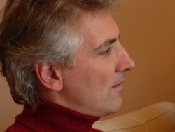
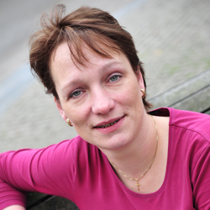
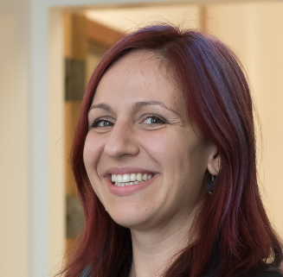
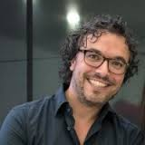
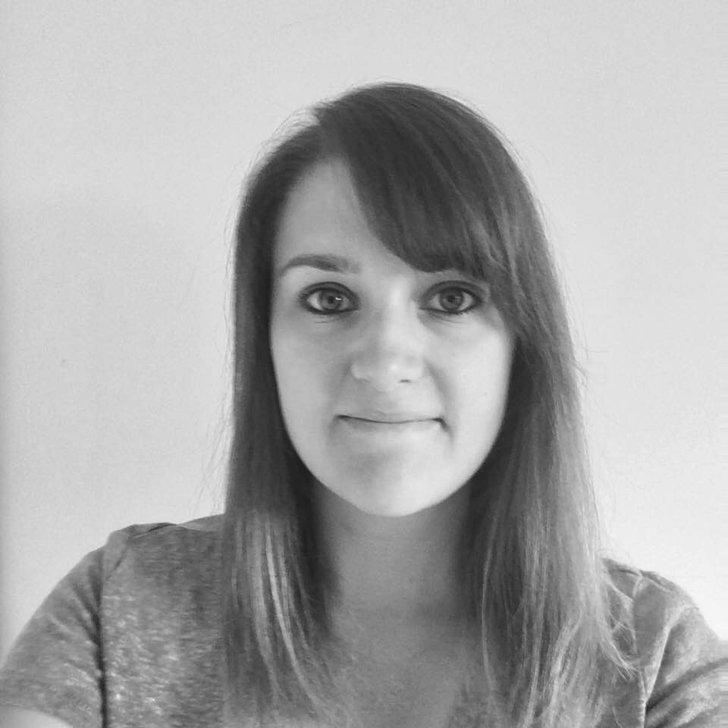
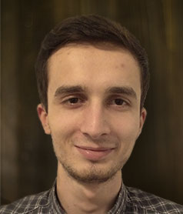
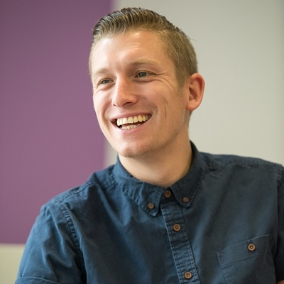
Implementation
Small project team from Library and IT Services
Every 3 weeks: consulting faculty representatives
Every 1-2 weeks: call with figshare implementation team

Slide 13
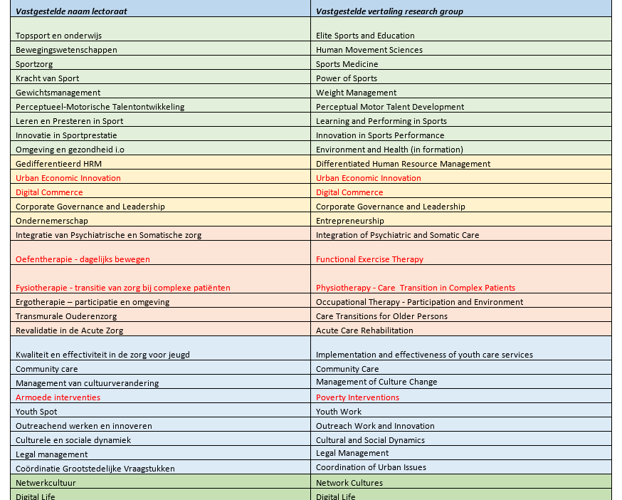
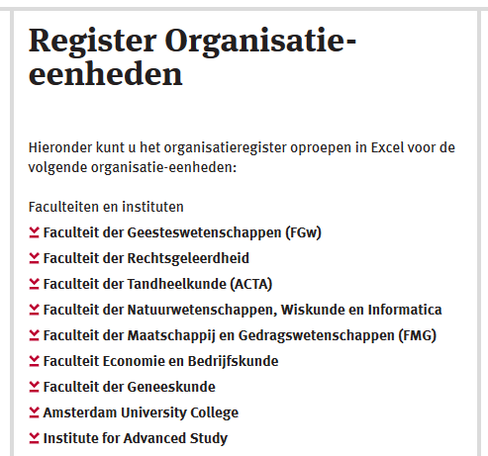
Implementation: groups
Groups: ad hoc or fixed?
Fixed group structure
Controllable amount of institutional admin work
Assigning faculty and institute admins to groups
Public pages per faculty and institute

Slide 14
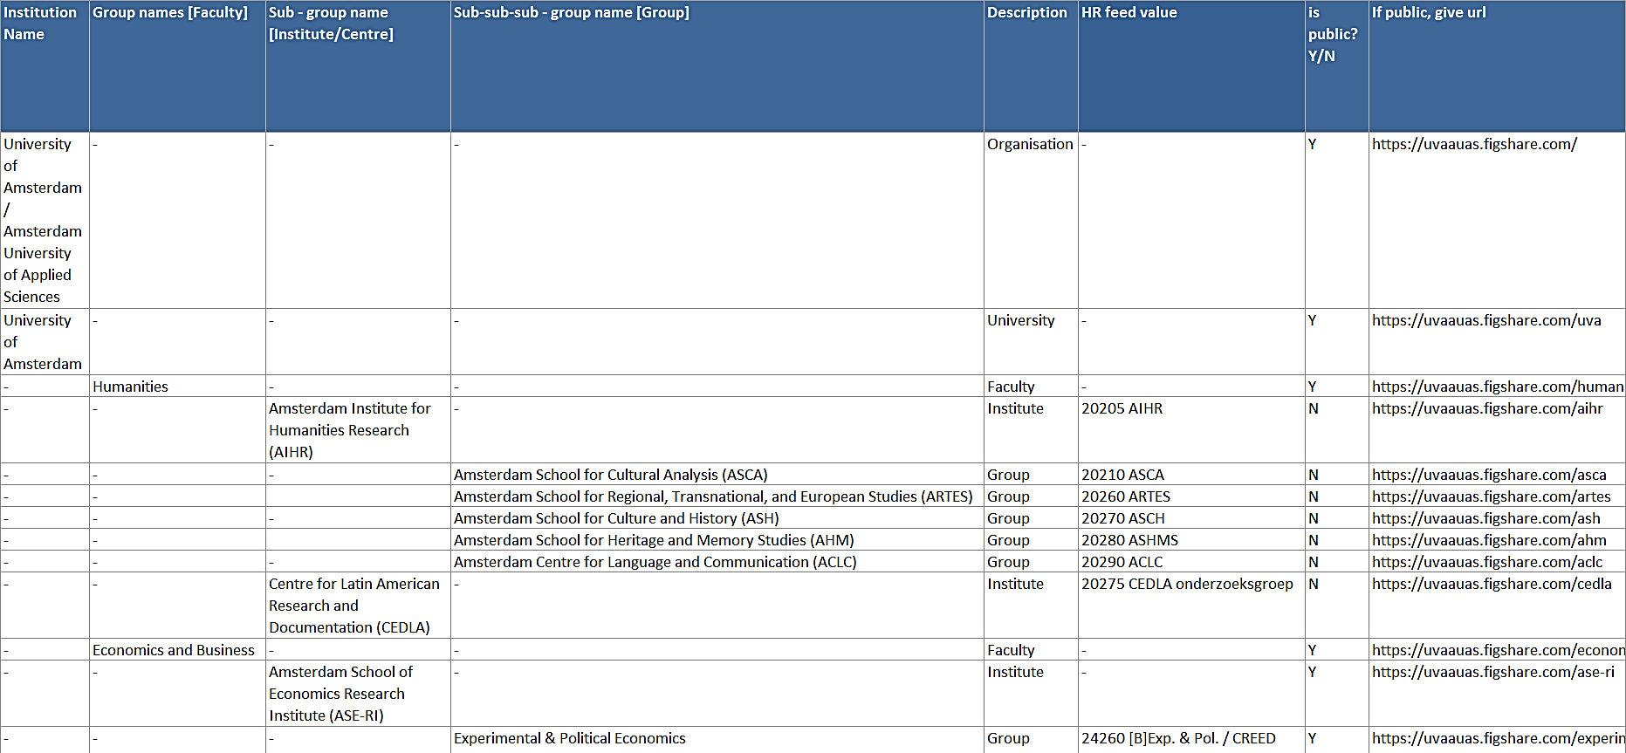
Implementation: groups

Slide 15
Implementation: accounts
Account creation: upon first login or beforehand?
Beforehand
Ease of use for researchers
Institutional credentials (SURFConext & 2FA)
HR feed

Slide 16
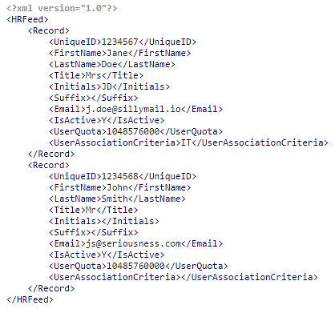
Implementation: accounts

Slide 17
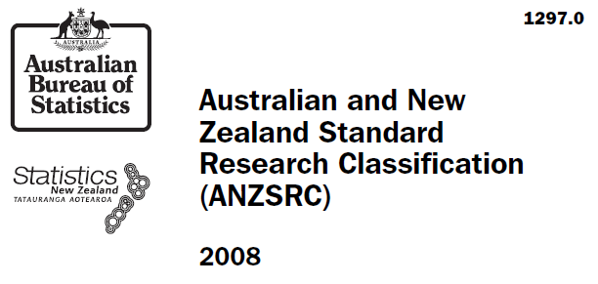
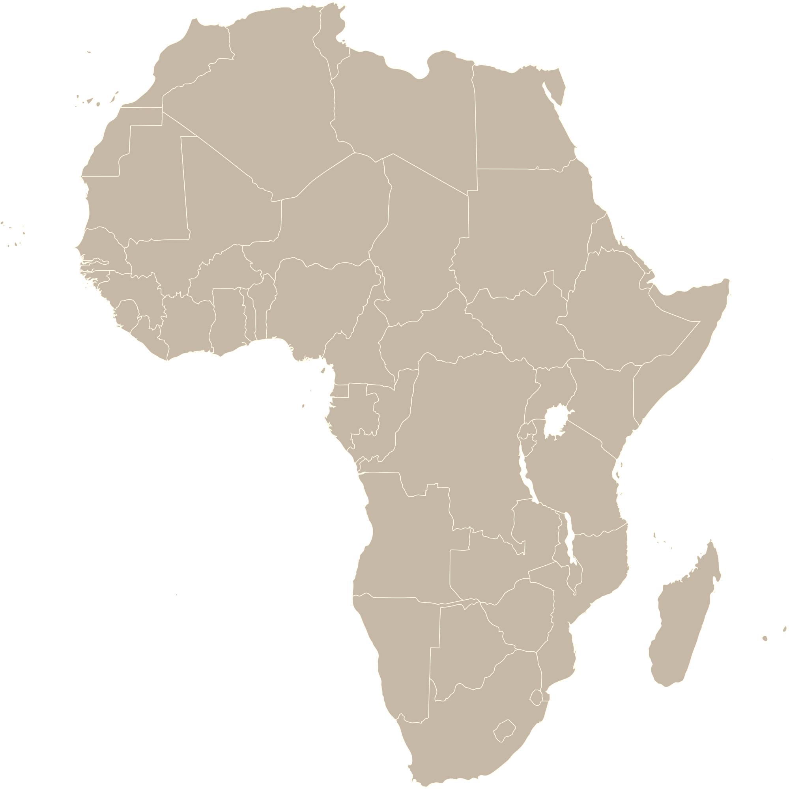
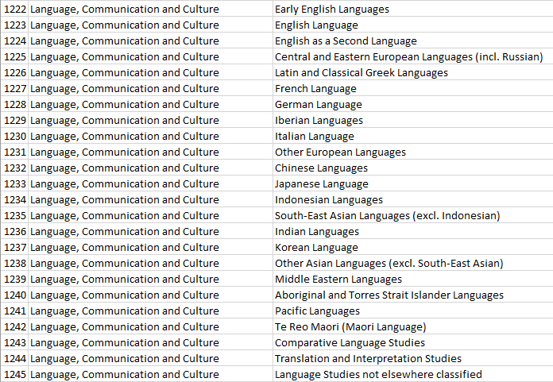
Implementation: category list
Fields of Research (FoR)
20 main headings, not selectable
1.062 subheadings, selectable

Slide 18
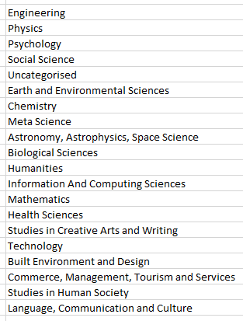
Implementation: category list
Fields of Research (FoR)
20 main headings
1.062 subheadings (selectable)
refine with (free text) keywords
, selectable

Slide 19
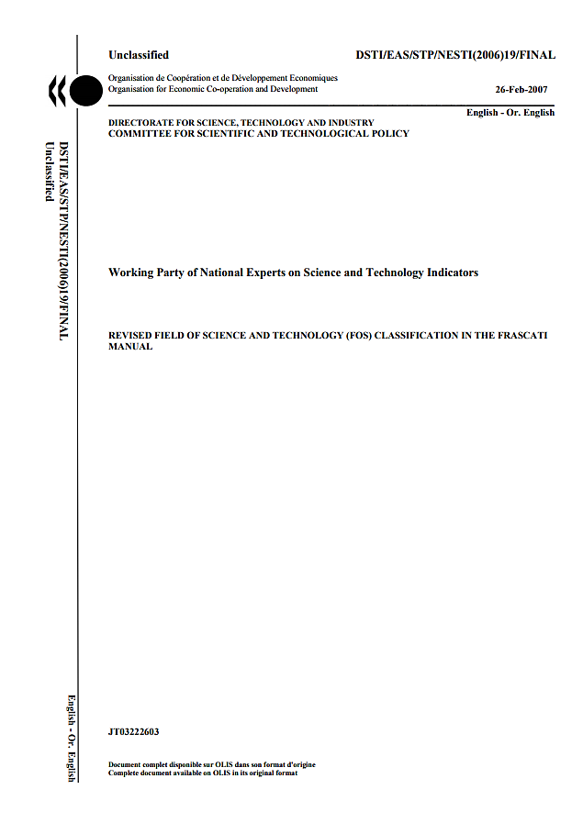
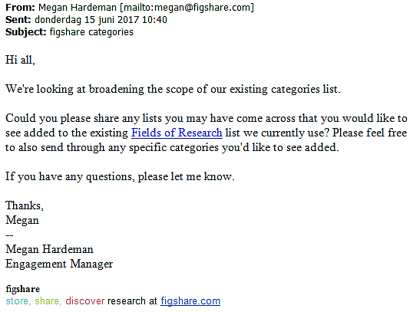
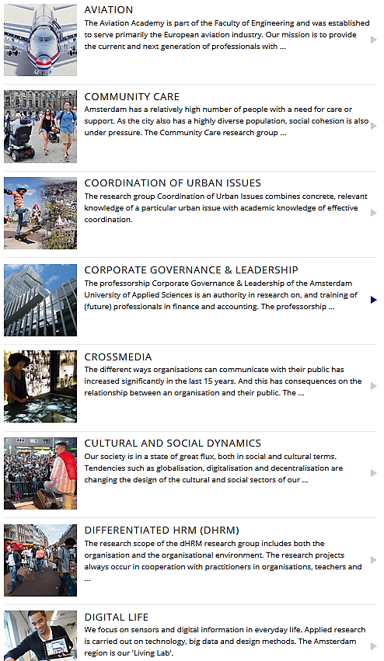
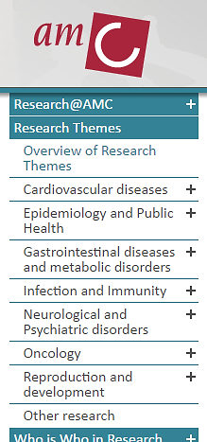
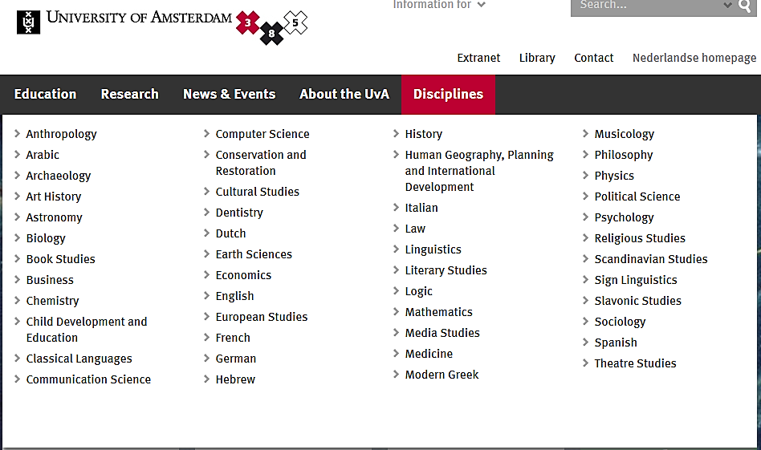
Implementation: category list
https://www.oecd.org/science/inno/38235147.pdf

Slide 20
Implementation: data steward role
storage quota requests
curation workflow requests
impersonation
data steward can manage items in user accounts that have been disabled (researchers that have left UvA/AUAS)

Slide 21
Wish list: figshare improvements
improved category list functionality
multiple affiliations
allowing jointly owned items
shared and/or transferable project ownership
Dropbox-like integration instead of up- and downloading
improved admin capabilities

Slide 22
Our to do list: connecting UvA/AUAS figshare to
UvA and AUAS Pure, to simplify the registration of data publication (2017)
research environments/software, to simplify the transfer of data and documentation to UvA/AUAS figshare (2018)
external data archives, for long term archiving of data (2018)

Slide 23
rdm.uva.nl: general and discipline specific information on RDM, available 24/7 in Dutch and English
one stop shop for all RDM questions: tailored advice during office hours from university-wide network
RDM Support
website
service desk
training
repository
elective introductory workshops on RDM for (early career) researchers from all disciplines, in Dutch and English
uvaauas.figshare.com: data repository, including support of data stewards and researchers

Slide 24
Thank you!
Presentation: Mariëtte van Selm | selm@uva.nl
Images slides 4, 6-8, 14, 15: Jørgen Stamp | http://www.digitalbevaring.dk/
Maps slide 17: Wikimedia Commons, public domain
M. van Selm, Requirements, choices and challenges. Implementing figshare for institutions at two Amsterdam universities, Presentation figshare fest Europe, 28 June 2017. This work is licensed under the Creative Commons Attribution-ShareAlike 4.0 International licence.

