Slide 1
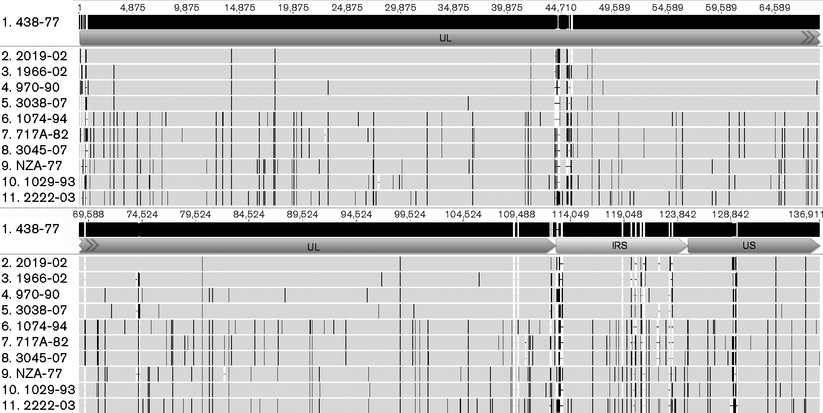
- Fig. 1.
Microbiology Society © 2016

