Slide 1
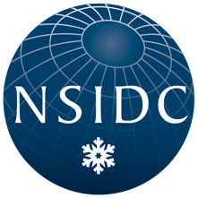
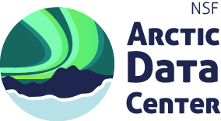
QGreenland-NET
Open, connected data infrastructure for Greenland-focused geoscience (& beyond)
Twila Moon¹ & Matt Jones²
¹ National Snow & Ice Data Center, Cooperative Institute for Research in Environmental Science, University of Colorado Boulder
² Arctic Data Center, University of California Santa Barbara

Slide 2
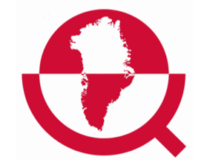
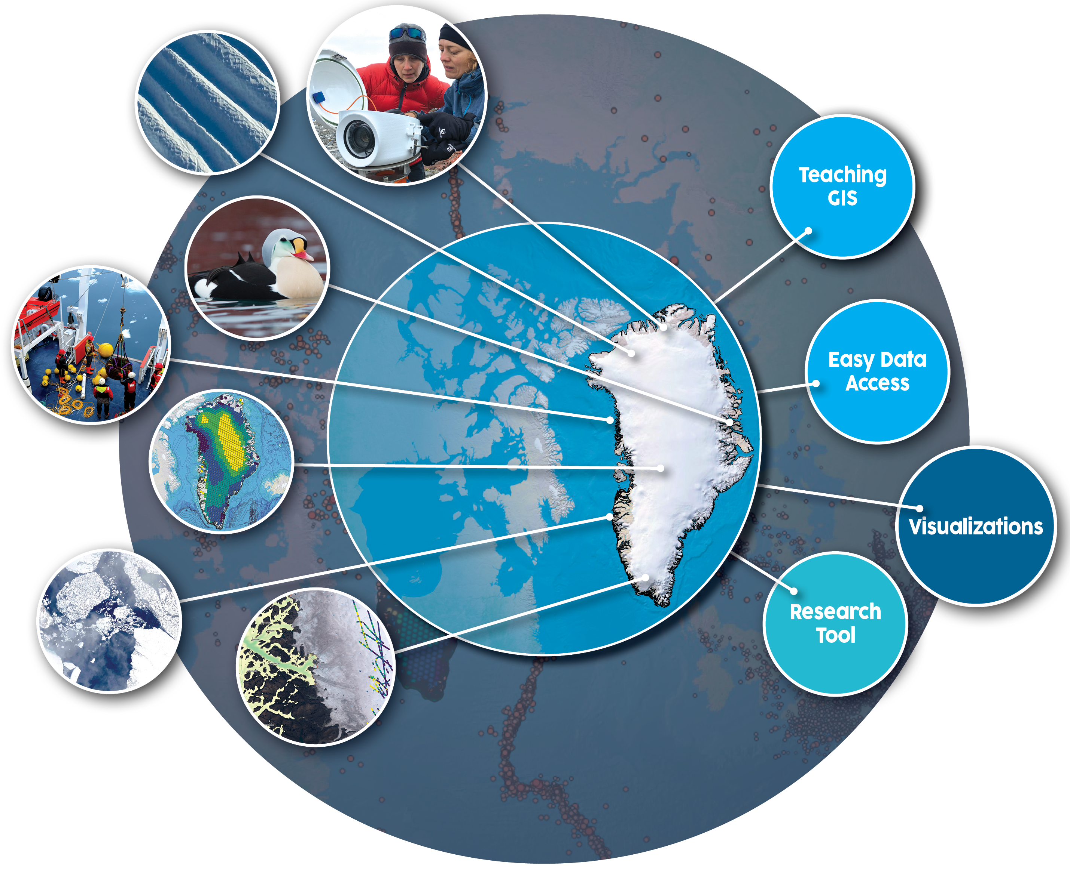
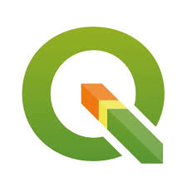
What is QGreenland?
All-in-one Greenland-focused GIS environment for offline and online use with QGIS (free & open source software)
Curated interdisciplinary data package for research, learning, decision making, and collaboration
Notes:
And collaboration

Slide 3
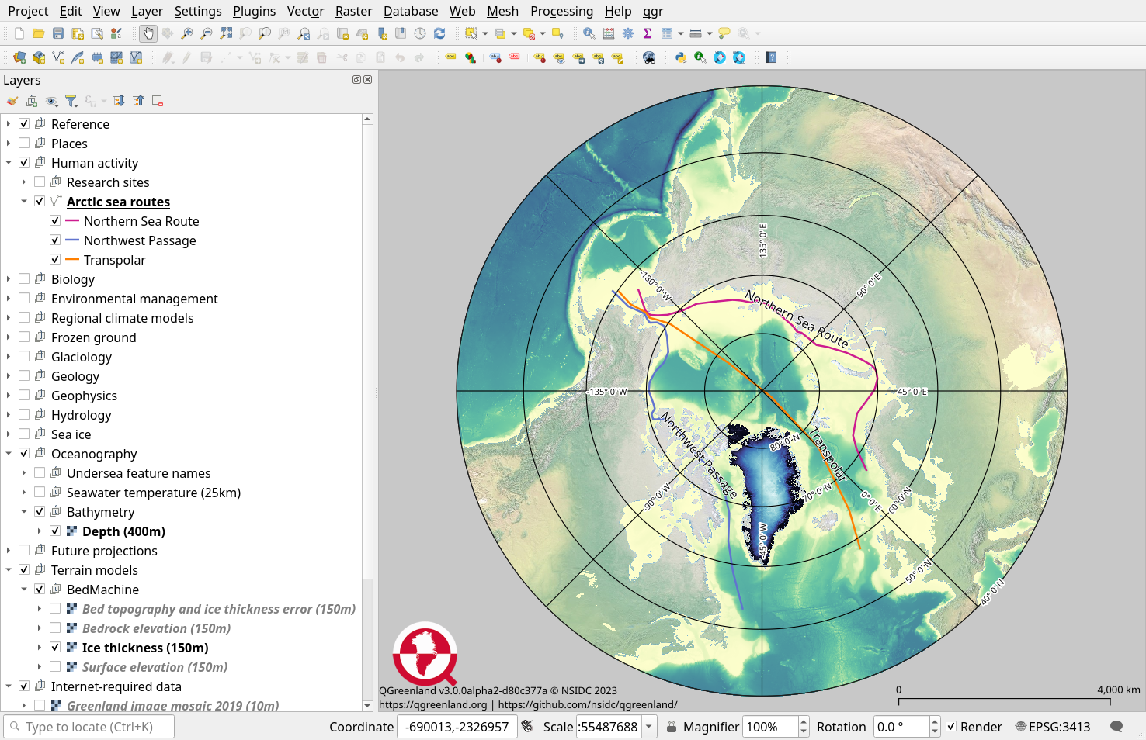
What is QGreenland?
All-in-one Greenland-focused GIS environment for offline and online use with QGIS (free & open source software)
Curated interdisciplinary data package for research, learning, decision making, and collaboration
Notes:
And collaboration

Slide 4
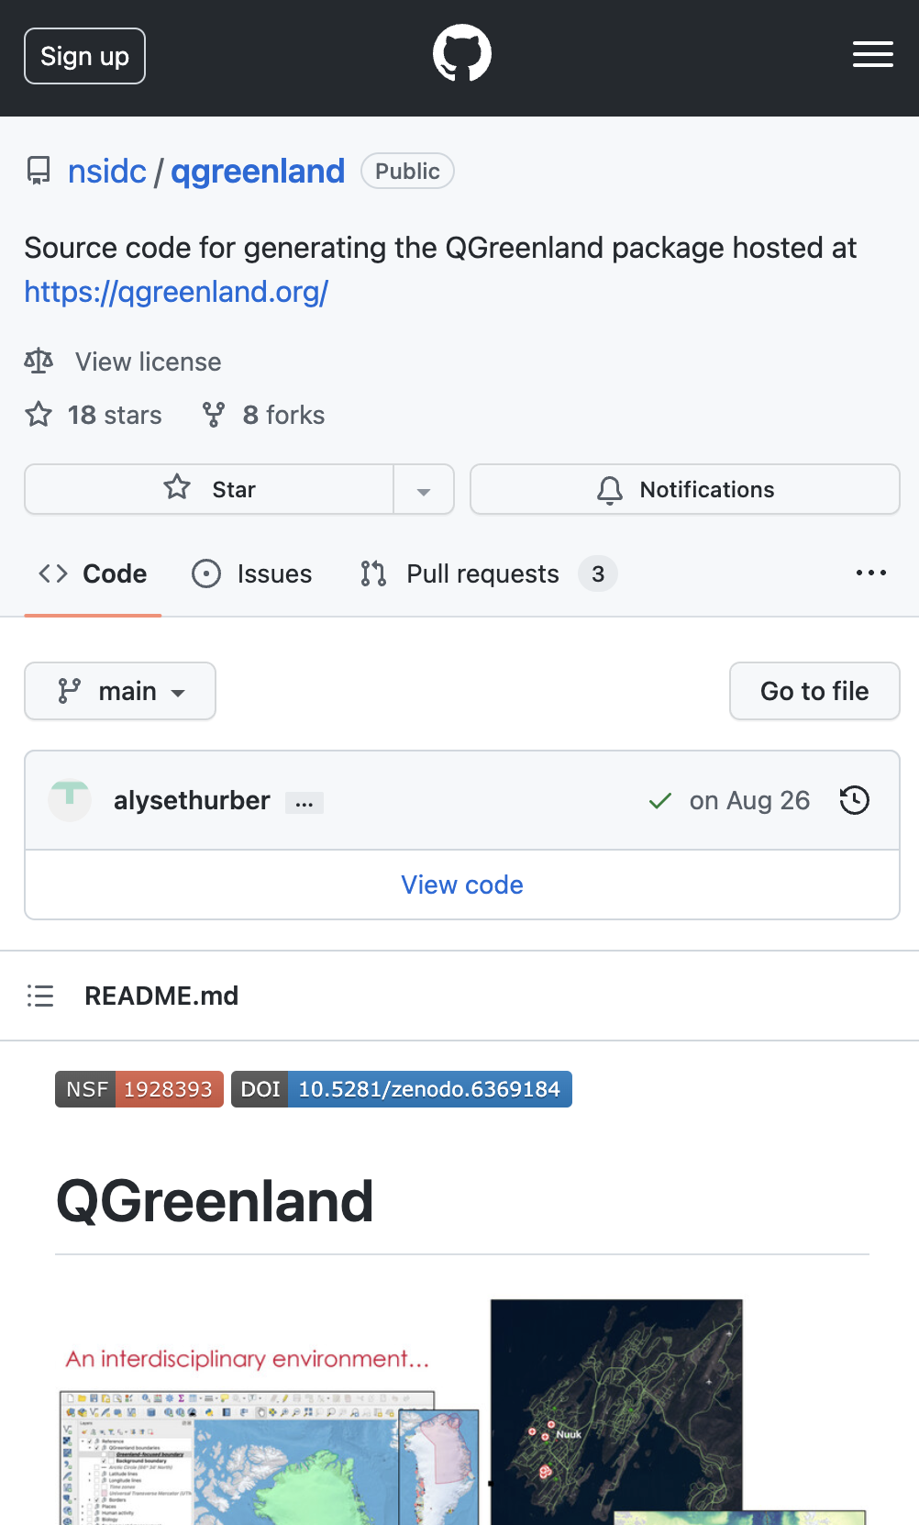
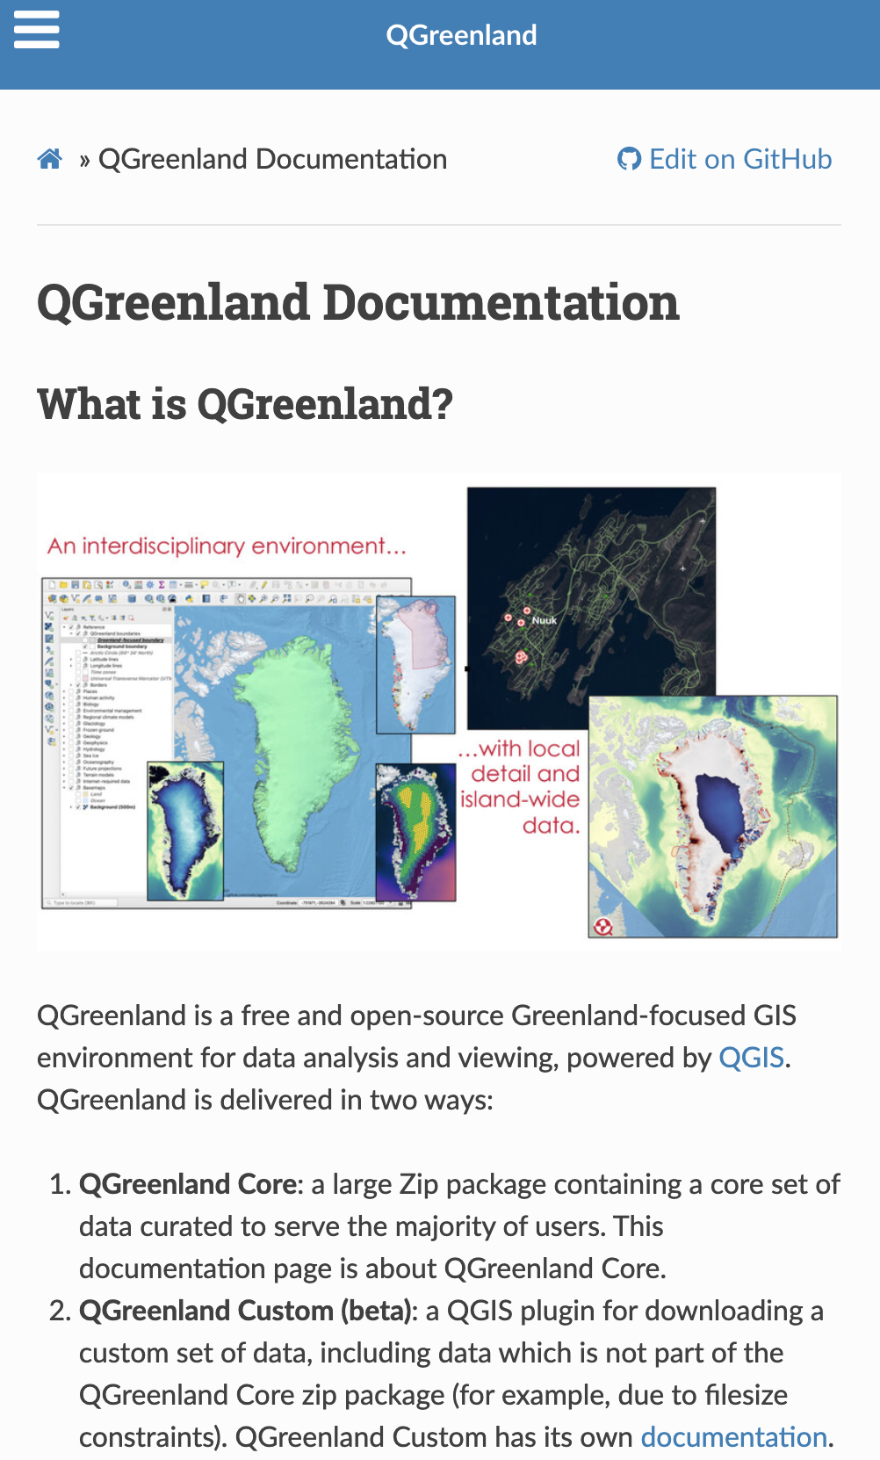
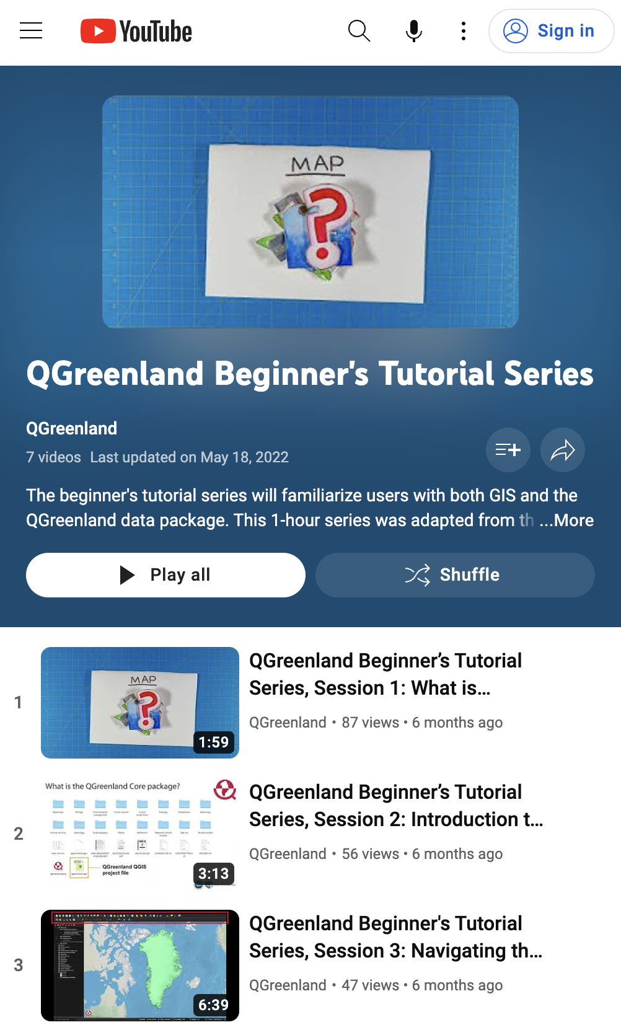
Open & Easy to Use
Open Development
Thorough + Organized
Tutorials + Updates
Notes:
4

Slide 5
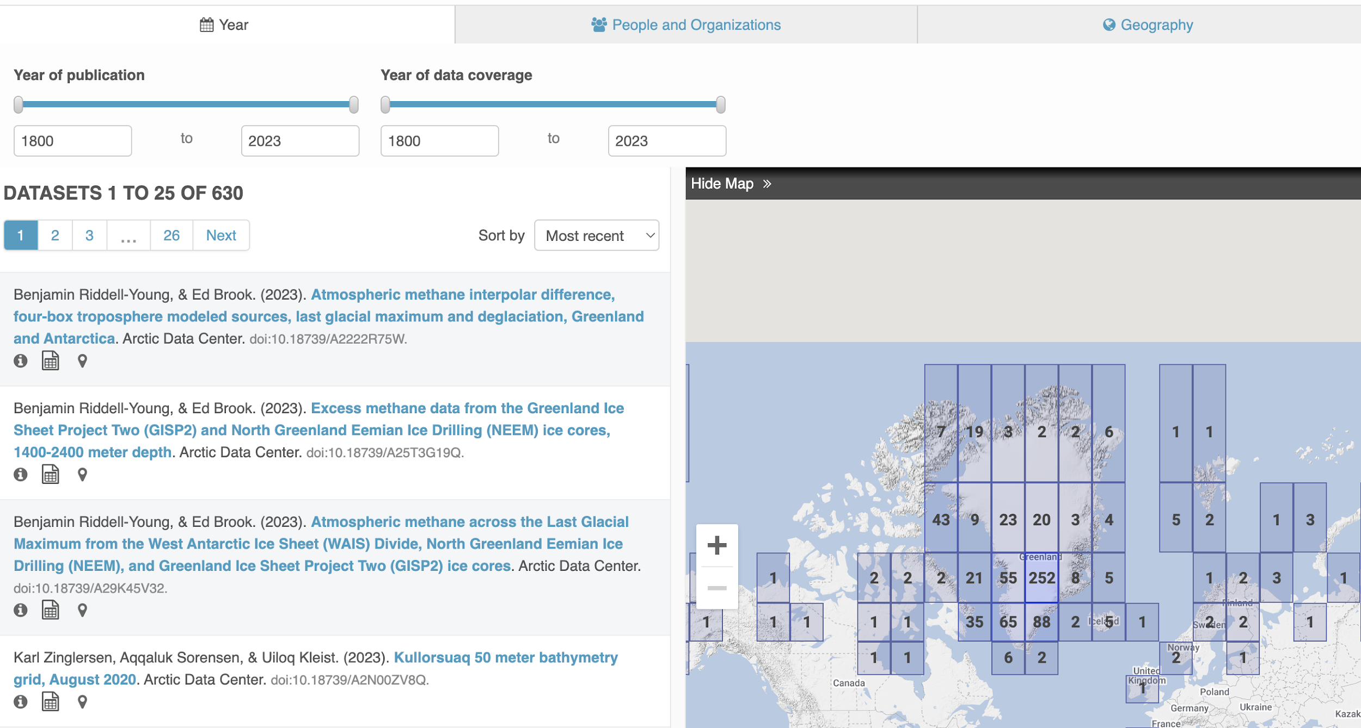
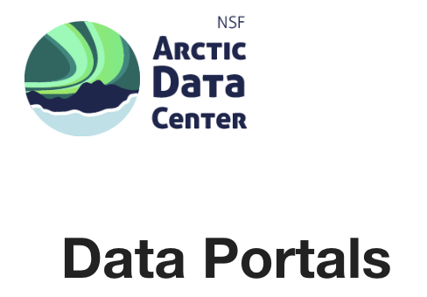
More data…but highly variable usability
630 datasets with Greenland + geospatial data!
Notes:
And collaboration

Slide 6
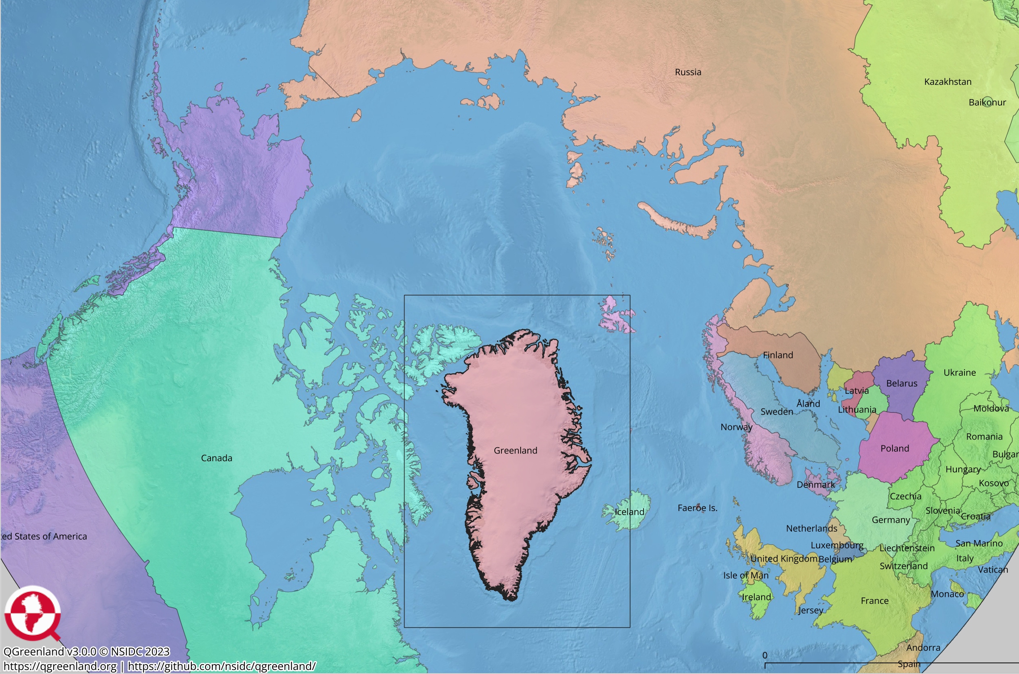
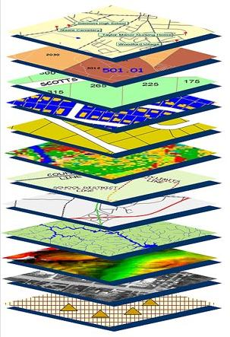
Tools for FAIR & usable data needed
File formats.
Geographic details.
Data integration.
Notes:
Format problems – Receiving data that comes to us with a different format each time, metadata are incomplete or give wrong geospatial information.
Translation needed – 1) Sometimes literal translation, 2) Translation for data to be used outside disciplinary experts – jargon, cryptic data field descriptors. And we have mostly opted not to endeavor the scientific translation.
Incomplete picture – Key information is missing – for example, details on time period of observations is sometimes difficult to find even from the original source

Slide 7
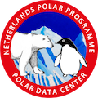
4500 Greenland datasets

Slide 8
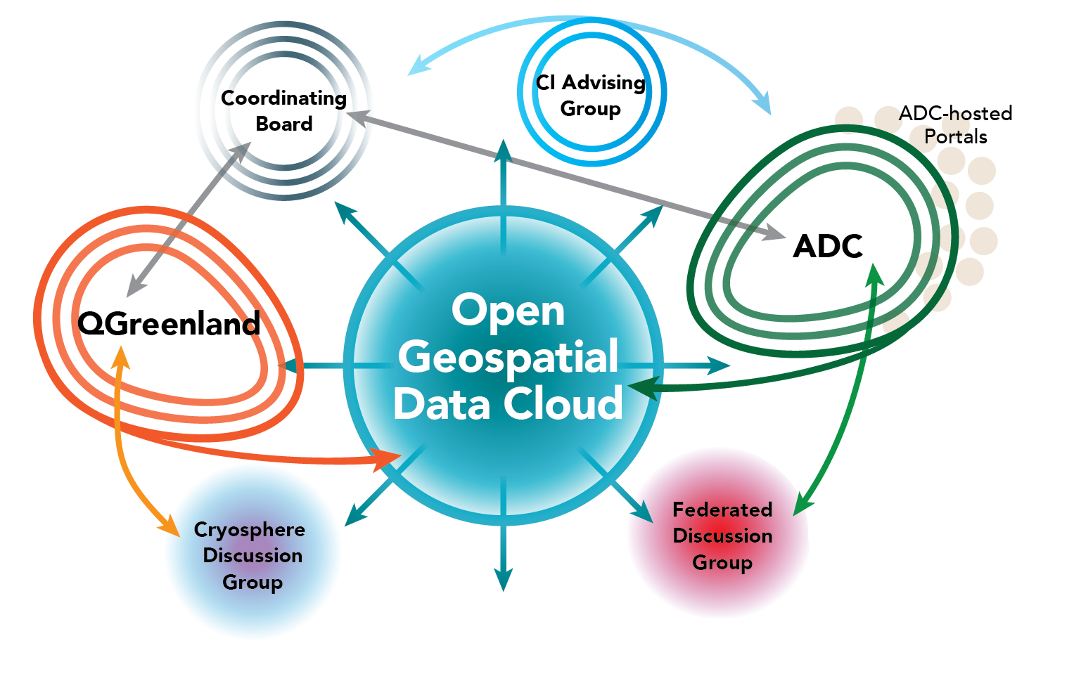
Moving to QGreenland-NET
Notes:
And collaboration

Slide 9
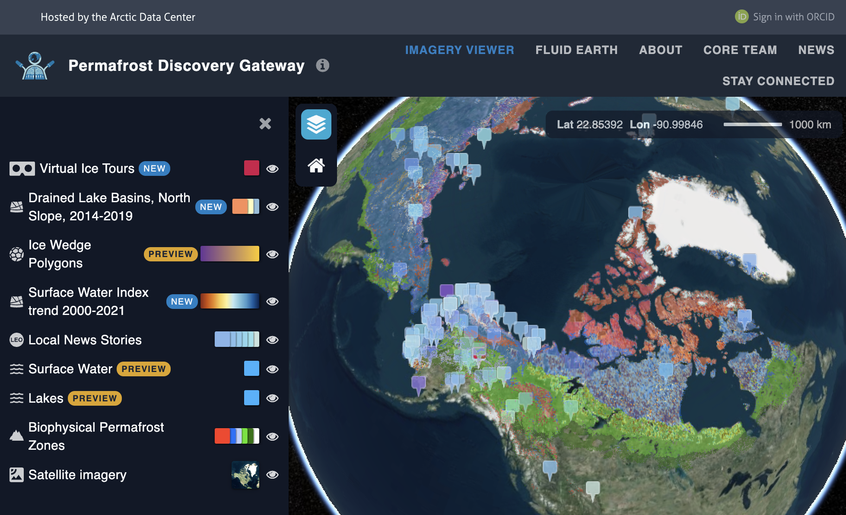
Leveraging ADC skills & hosting
Notes:
And collaboration

Slide 10
Tools for many uses
Notes:
And collaboration

Slide 11
Year 1 focus areas (February work start)
Community Coordination
Geospatial Tools
Support Materials
Link QGreenland-Net data repositories
Geodata-harmonization service
Mosaic/tiling service
Deploy and test OGDC services one-by-one
Group discussions for: cryosphere, federated data, cyberinfrastructure advising, Coordinating Board
Coordinating improvement of community data sets
Improving U.S.-Greenland metadata/data archive links
Creation of evergreen education materials, including tutorials
Ongoing community communications: QGreenland newsletter, GitHub Discussions, etc.
Notes:
And collaboration

Slide 12
Thank you!
QGreenland.org
github.com/nsidc/qgreenland/
Contact – qgreenland.info@gmail.com
DataOne GitHub: github.com/DataONEorg/
Collaboration opportunities include:
Connect on GitHub and leverage code
Express interest in federated data or cryosphere discussion group, or CI advising group
Collaboration on OGDC tooling and building data products

