Slide 1
An Analysis of Publication Trends by Income Level in the Directory of Open Access Journals 1987–2020
David Druelinger | Touro University, USA
Lai Ma | University College Dublin, Ireland | Lai.Ma@ucd.ie | @erasurist (X & bsky)

Slide 2
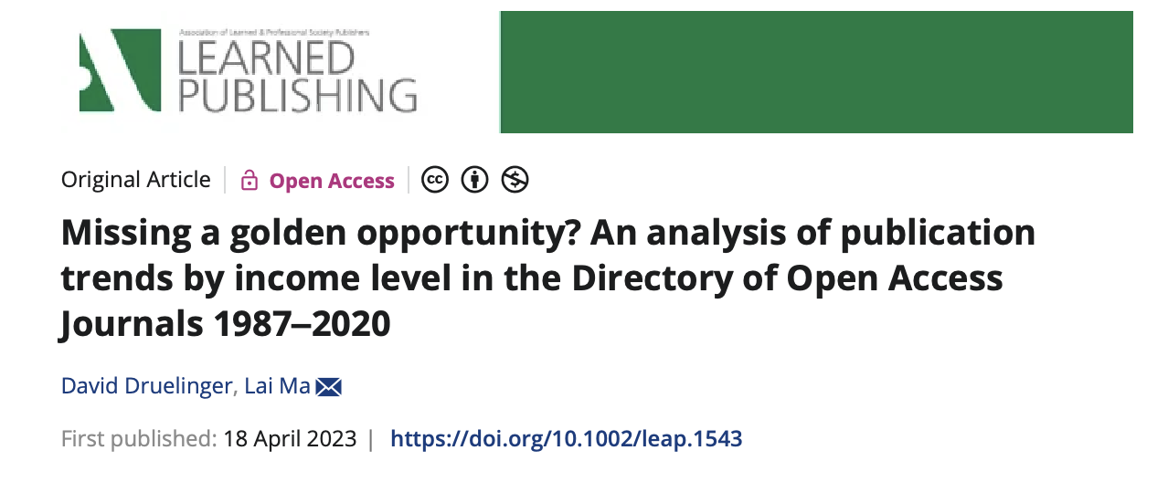

Slide 3
Background
Gold OA as the most common open access model
APCs are paid by
institutions in higher GNP countries
authors in lower GNP countries
APC waivers and discounts
similar rates in both higher and lower GNP countries (12% vs 14%)
a small minority of articles in major OA journals received a waiver or discount

Slide 4
Methods
journal metadata from the Directory of Open Access Journals (DOAJ) to retrieve individual article metadata from the OpenAlex academic database
DOAJ – instead of journals indexed on WoS or Scopus – because DOAJ is committed to equity and inclusion, and it also has a more comprehensive coverage of non-English language journals
article meta- data was categorized using global country income data from the World Bank

Slide 5
World Bank income level
High-income countries (HICs), currently including Chile, New Zealand, Sweden
Upper-middle income countries (UMICs), currently including China, Iraq, Mexico
Lower-middle income countries (LMICs), currently including India, Kenya, Ukraine
Low-income countries (LICs), currently including Afghanistan, Ethiopia, Rwanda

Slide 6
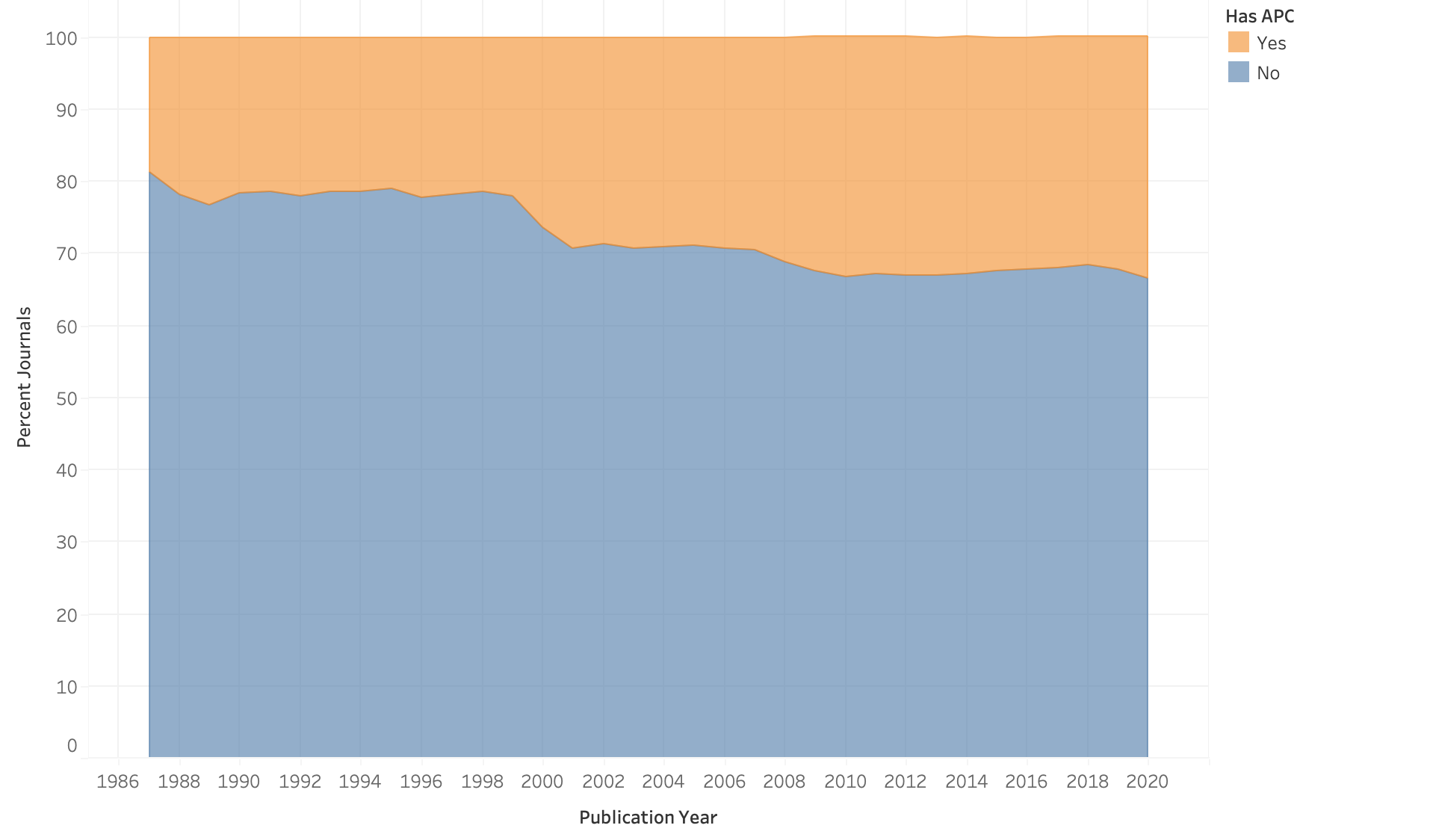
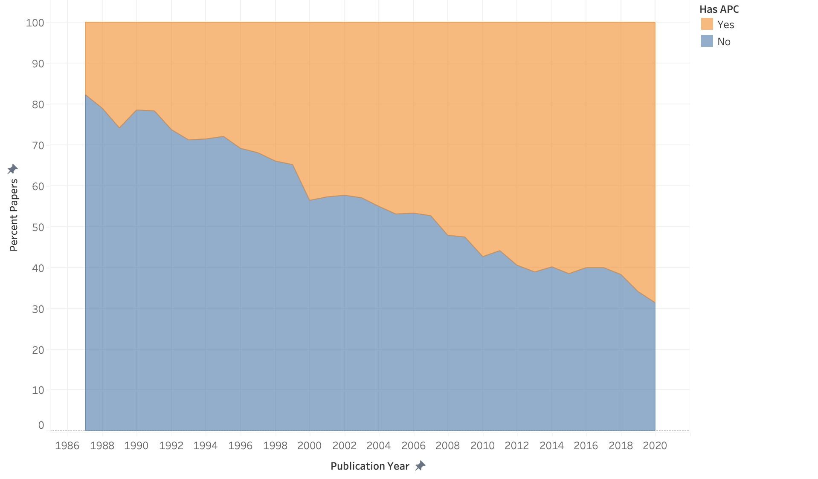
Percentage of DOAJ Journals and Articles by APC
Limitations: Any article that was published before the year in which its journal started to publish all contents under an open licence was removed from consideration. At the journal level, each journal is treated as having a grace period within the confines of the year in which that journal switched to open access. During this grace period, all articles are treated as having always been open access.

Slide 7
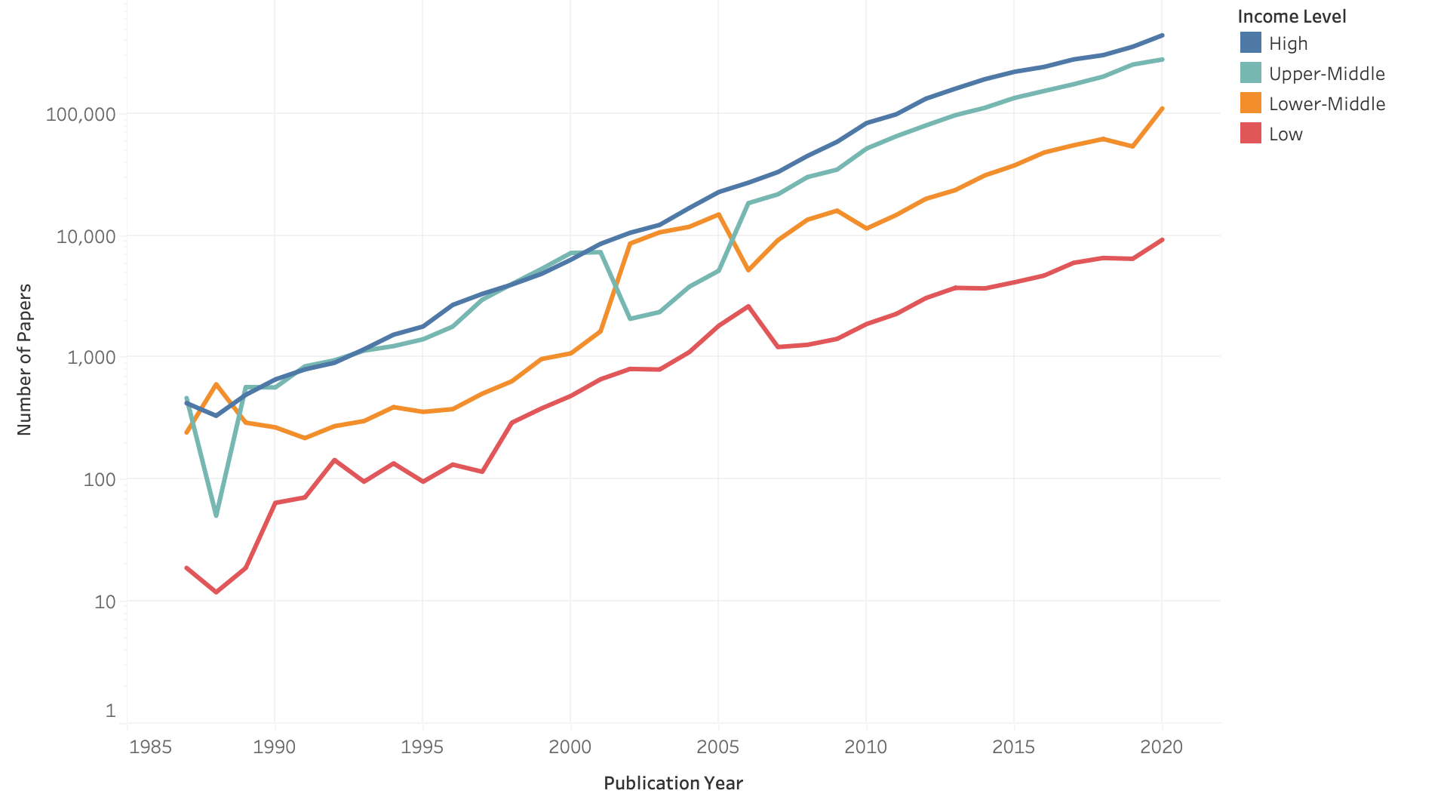
Number of articles by income level (logarithmic)
Limitations: This analysis relies heavily on journal metadata sourced from the DOAJ. The metadata reported by the DOAJ is self-reported by the journals themselves and is reviewed by an editor who may be a volunteer (Directory of Open Access Journals, n.d.). The accuracy of the DOAJ metadata relies heavily on the honesty and accuracy of the applying journals and the scrupulousness of the editor reviewing the application.

Slide 8
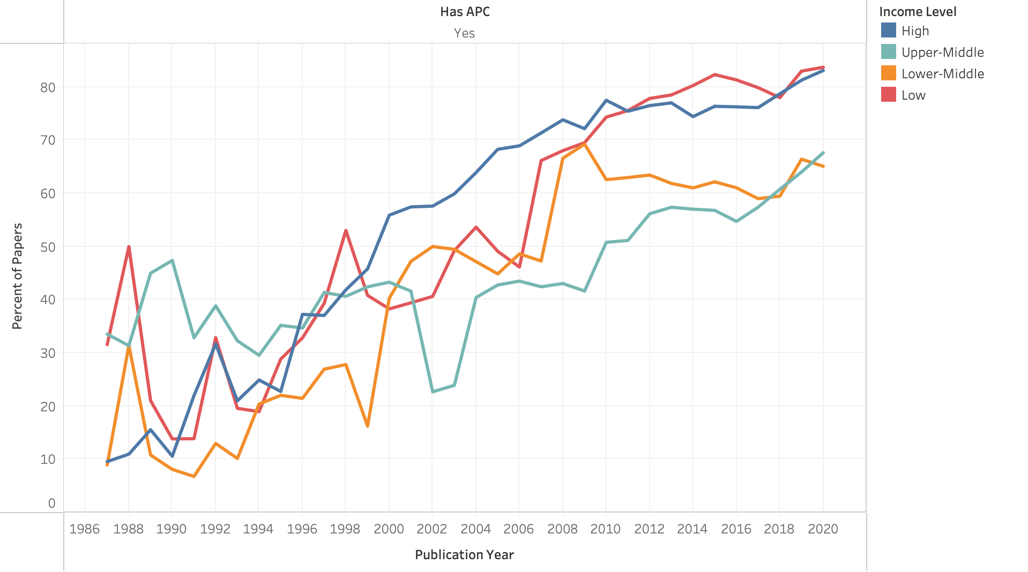
Percentage of articles published in gold open access by income level
Limitations: This analysis relies heavily on journal metadata sourced from the DOAJ. The metadata reported by the DOAJ is self-reported by the journals themselves and is reviewed by an editor who may be a volunteer (Directory of Open Access Journals, n.d.). The accuracy of the DOAJ metadata relies heavily on the honesty and accuracy of the applying journals and the scrupulousness of the editor reviewing the application.

Slide 9
Other highlights
Nearly 70% of DOAJ articles were published in gold open access journals in 2020
Over 80% of DOAJ articles by authors from high- and low-income countries were published in gold open access journals in 2020
Less than 70% of DOAJ articles by authors from middle- income countries were published in gold open access journals in 2020
In 2020, authors in low-income countries only accounted for just over 1% of articles published in DOAJ journals

Slide 10
Issues & Policy implications
Equity in knowledge production: APC waiver for LIC authors, international collaborations
Benefits of non-profit and institutional publishing
Challenges of bibliodiversity and global epistemic justice
Considerations about open access mandates

Slide 11
Selected references
[1] Piwowar, H., Priem, J., Larivière, V., Alperin, J. P., Matthias, L., Norlander, B., Farley, A., West, J., & Haustein, S. (2018). The stateof OA: A large-scale analysis of the prevalence and impact of open access articles. PeerJ, 6, e4375.
[2] Piwowar, H., Priem, J., & Orr, R. (2019). The future of OA: A large-scale analysis projecting open access publication andPiwowar, H., Priem, J., & Orr, R. (2019). The future of OA: A large-scale analysis projecting open access publication andreadership (p. 795310). bioRxiv. https://doi.org/10.1101/795310
[3] Jurchen, S. (2020). Open access and the serials crisis: The role of aca- demic libraries. Technical Services Quarterly, 37(2), 160–170. https://doi.org/10.1080/07317131.2020.1728136
[4] Solomon, D. J., & Björk, B.-C. (2012). Publication fees in open access publishing: Sources of funding and factors influencing choice of journal. Journal of the American Society for Information Science and Technology, 63(1), 98–107. https://doi.org/10.1002/asi.21660
[5] Solomon, D. J., & Björk, B.-C. (2013). Erratum: Publication fees in open access publishing: Sources of funding and factors influencing choice of journal 63(1) 2012, 98–107. Journal of the American Society for Information Science and Technology, 64(5), 1089–1089. https://doi.org/10.1002/asi.22967
[6] Smith, M., Anderson, I., Bjork, B.-C., McCabe, M., Solomon, D., Tananbaum, G., Tenopir, C., & Willmott, M. (2016). Pay it forward: Investigating a sustainable model of open access article processing charges for large North American research institutions. University of California Libraries https://escholarship.org/uc/item/8326n305 ​
[7] Smith, A. C., Merz, L., Borden, J. B., Gulick, C. K., Kshirsagar, A. R., & Bruna, E. M. (2021). Assessing the effect of article processing charges on the geographic diversity of authors using Elsevier's “Mirror Journal” system. Quantitative. Science Studies, 2(4), 1143. https://doi.org/10.1162/qss_a_00157

