Slide 1
EQUITY IN THE GLOBAL SCIENCE SYSTEM
Cassidy R. Sugimoto
Tom and Marie Patton Chair
School of Public Policy Chair
Georgia Institute of Technology

Slide 2
AN EMPIRICAL BASIS FOR SCIENCE DIPLOMACY
Cassidy R. Sugimoto
Tom and Marie Patton Chair
School of Public Policy Chair
Georgia Institute of Technology

Slide 3
SCIENCE OBSERVATORIES AS INSTRUMENTS OF SCIENCE DIPLOMACY
Cassidy R. Sugimoto
Tom and Marie Patton School Chair
School of Public Policy Chair
Georgia Institute of Technology

Slide 4
SCIENCE DIPLOMACY
Diplomacy for science | The use of diplomatic action to facilitate international scientific collaboration, e.g., by negotiating R&D agreements and exchange programmes or enabling the establishment of international research infrastructures
Science for diplomacy | The use of science as a soft power to advance diplomatic objects, e.g., for building bridges between nations and creating good will on which diplomatic relations can be built
Science in diplomacy | The direct support of diplomatic processes through science, e.g., by providing scientific advice and evidence to inform and support decision-making in foreign and security policies

Slide 5
MADRID DECLARATION (2019)
BENEFITS OF
SCIENCE DIPLOMACY
PRINCIPLES TO FOSTER
SCIENCE DIPLOMACY
Address global challenges (e.g., SDGs)
Productive and sustainable IRs
Evidence-informed foreign policy
Improved scientific conditions (e.g., joint programs, capacity)
Bridging science and policymaking
Value for citizens
Methodological diversity
Demonstrable impact
Evidence-informed
Collaboration and inclusion
Capacity building
Independence

Slide 6
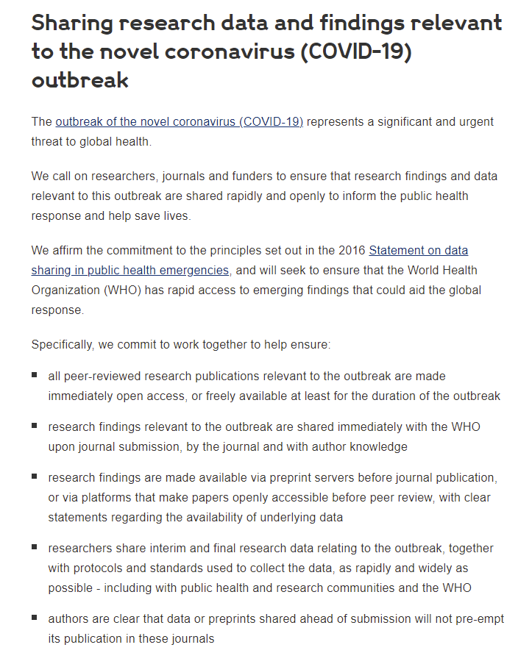
COVID AND OPEN ACCESS
30 publishers, including Elsevier, the American Chemical Society, Springer Nature, Science Journals, Taylor & Francis, and Wiley signed

Slide 7
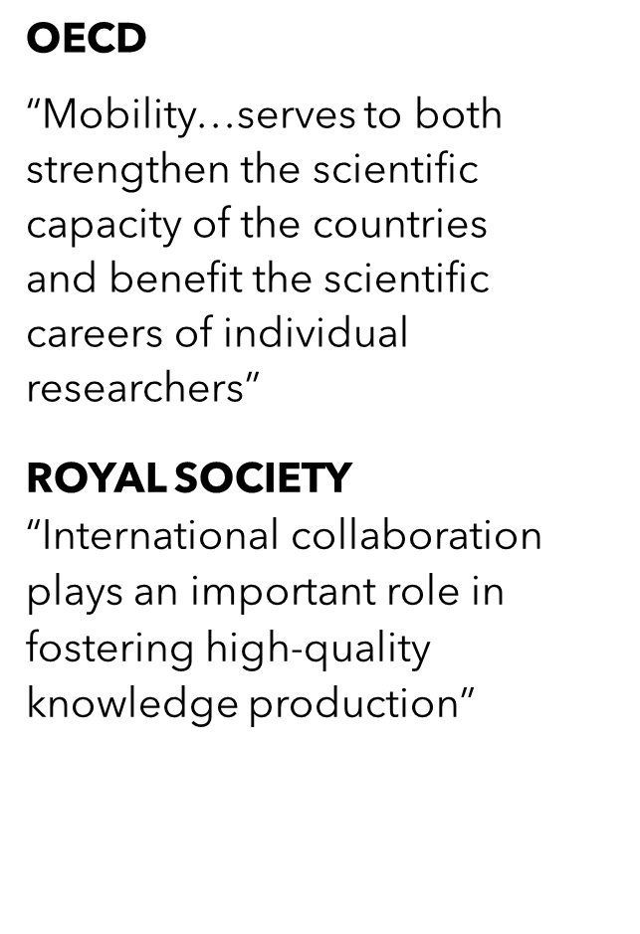


Slide 8
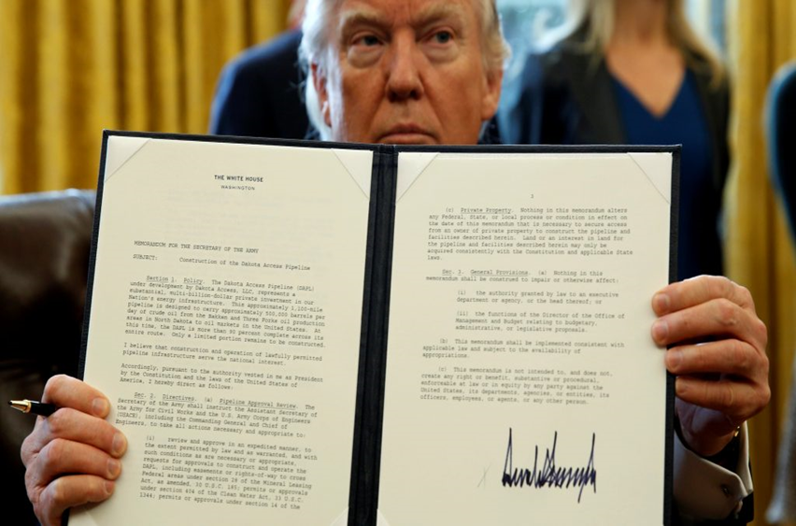
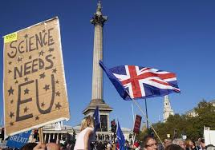

Rising nationalism
The executive order: temporarily suspend entry of individuals from Iran, Iraq, Libya, Somalia, Sudan, Syria, and Yemen and place restrictions on visa renewals for additional 38 countries. (Jan 2017)
Brexit hinders scientific mobility, collaboration, and has implications for funding
Visa scheme for graduates from top 50 non-UK universities is launched
Air traffic reduced by 95% during the pandemic, with effects on student enrollment
Post-pandemic behavior towards conferencing changes

Slide 9


COOPERATION V. COMPETITION
China increasingly challenges American dominance of science (June 3)
“ It will invest in research and development, science and technology, and the workforce of the future to keep the United States the leader in the industries of tomorrow.” CHIPS and Science Act

Slide 10
OPEN QUESTIONS
Could scientometrics provide the empirical base for science diplomacy?
Where do scientometric datasets and indicators fail and how could we create more inclusive datasets and indicators for social good?
Is a global network of science observatories viable and might it be productive towards the goals of science diplomacy?

Slide 11
COLLABORATION

Slide 12
COLLABORATION & LEADERSHIP
Proportion of output in international collaboration, national collaboration, and not in collaboration; percentage of papers in international leadership

Slide 13
PRODUCTION & INVESTMENT
Percent of papers in international/national collaboration by number of papers and GERD/GDP; demonstrates relationship between scientific capacity and international portfolio

Slide 14
GAIN IN MNCS WHEN LEADING

Slide 15
Self-citation at the continent level
Notes:
This figure shows that citations have a strong geographical bias: both from the point of view of citations received and references made, papers are more likely to be cited from scholars from the same region.
We also see this geographical effect (it it is not really a bias in the negative sense) is stronger for Asia and Europe than for the other continents.
To explain in more details, let’s take the case of South America: 31.2% of citations received by South American scholars are coming from other South American Scholars (that is the left panel), and those account for 25.5% of the references made by South American researchers (right panel).
When looking at the global picture, we also see that most of the citations are received by three continents (Asia, NA, EU)—left panel—and that most of the references are made by the same three continents (right panel).

Slide 16
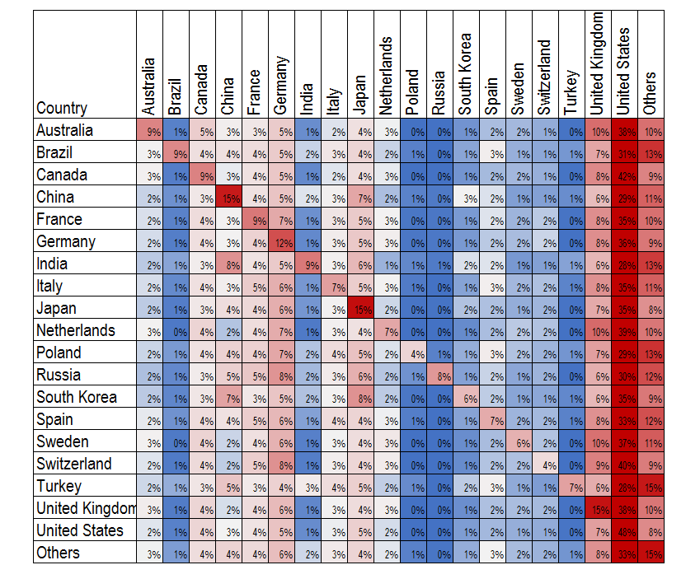
Self-references at the country level

Slide 17
CHINA: FROM 9% - 15%
Notes:
This figure shows that citations have a strong geographical bias: both from the point of view of citations received and references made, papers are more likely to be cited from scholars from the same region.
We also see this geographical effect (it it is not really a bias in the negative sense) is stronger for Asia and Europe than for the other continents.
To explain in more details, let’s take the case of South America: 31.2% of citations received by South American scholars are coming from other South American Scholars (that is the left panel), and those account for 25.5% of the references made by South American researchers (right panel).
When looking at the global picture, we also see that most of the citations are received by three continents (Asia, NA, EU)—left panel—and that most of the references are made by the same three continents (right panel).

Slide 18
CITY-LEVEL CO-AUTHORSHIP

Slide 19
Point of diminishing return

Slide 20
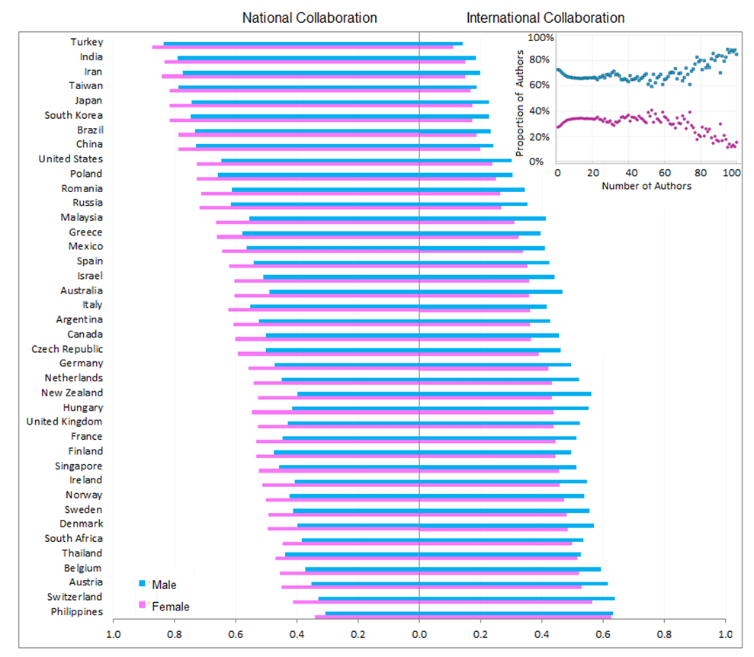
Individual level factors
Difference in international v. domestic collaboration by gender

Slide 21
Intersectional differences in impact
Role of international collaboration in visibility

Slide 22
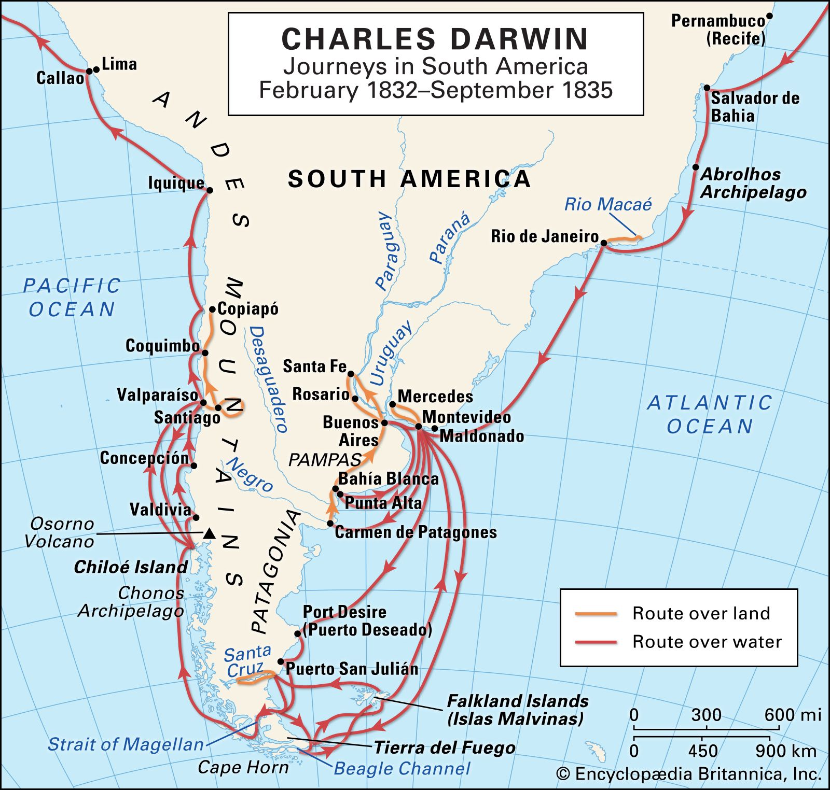
Helicopter science
Scientists from wealthy nations visiting lower-income countries, collecting samples, publishing the results with little or no involvement from local scientists, and providing no benefit for the local community.
Local researchers cannot decide the priority of international collaboration
Less recognized conditioned on the scientific performance
Notes:
Abount 200 years ago, Charles Darwin left england and traveled through South America. The research he has done during this eventually led to the publication of the famous book -On the Origin of Species which is considered as the foundation of modern biological science. But whatever Darwin learnt from the local people, the knowledge contributed to his book is unknown

Slide 23
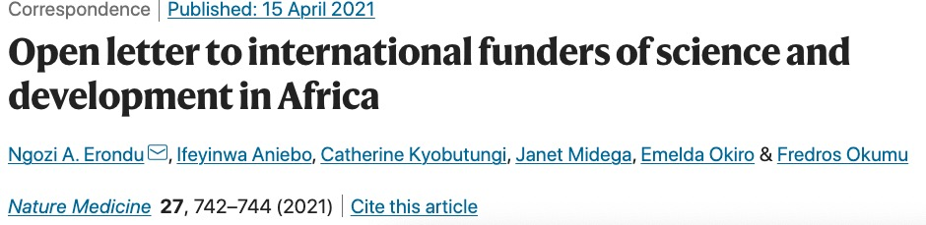
Notes:
Unfortunately, even today, we can still see similar things of what happended a hundred years ago. For instance, in this letter, a group of African scientistis argued that local researchers, communities and institutions have been consistently marginalized in the scientific international collaboration with their western funders and collaborators.

Slide 24
Authorship distribution
Notes:
Authorship distribution across different scientific capacity groups.

Slide 25
Conditional authorship distribution
Notes:
Distribution of authors across participant countries.

Slide 26
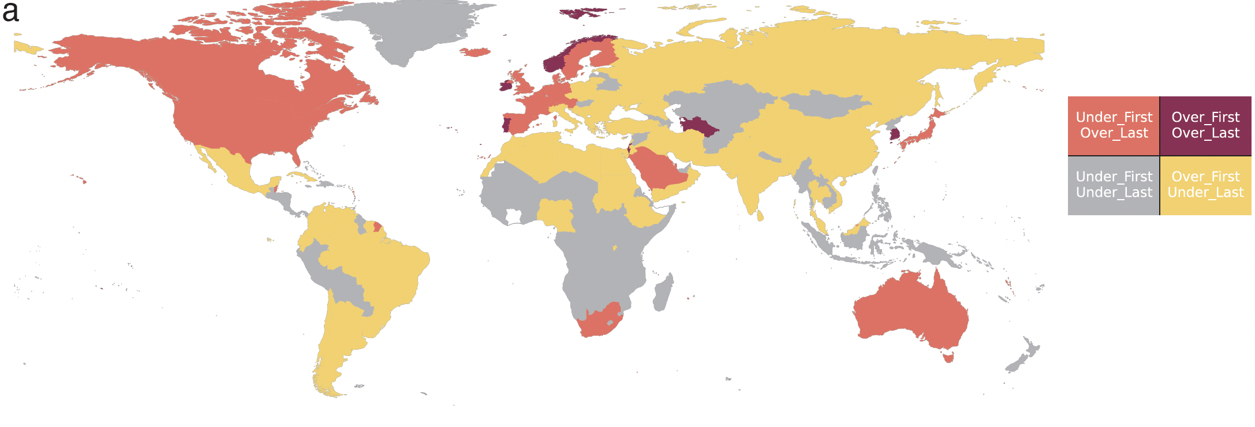
Hierarchical structure in authorship
Notes:
Countries are color-coded to indicate their representation in first and last authorship positions. Dark red represents that researchers from the focal country are overrepresented in both first and last authorship. Light red indicates researchers from the focal country are underrepresented in first authorship while overrepresented in last authorship. Yellow represents researchers from the country are overrepresented in first authorship but underrepresented in last authorship. The gray area represents researchers from the country are underrepresented in both first and last authorship.

Slide 27
Hierarchical structure in authorship
Notes:
Temporal trend of the previous results. Normalized values are logarithmed, above 0 represents overrepresented than the expected value and below 0 represents underrepresented. The shaded area indicates the confidence interval, which is derived from aggregating countries in the same scientific group.

Slide 28
Researchers from non-advanced countries are disadvantaged in being the last author

Slide 29
Researchers from non-advanced countries are disadvantaged in being the last author even if they are funded

Slide 30
MOBILITY

Slide 31
The motivation
“Mobility—and in particular international mobility—of skilled human resources plays an important role in innovation. It contributes to the creation and diffusion of knowledge, particularly tacit knowledge, which is more effectively shared within a common social and geographical context.” --OECD (2010)

Slide 32

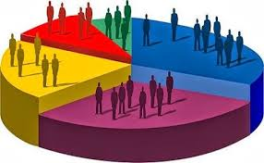



EXTANT DATA
(EUROSTAT, OECD, NSF, ETC.)

Slide 33
THE PROBLEM
(OECD, 2008)
Quantitative evidence on the impact of mobility patterns is not readily available.
(OECD, 2008)
Stock, rather than flow
Aggregate, rather than individual
Does not account for short-term stays
Delays in reporting
Idiosyncratic practices
Response bias
Conceptualization of “highly skilled”
The construction of internationally comparable mobility indicators for the scientific workforce is a persistent policy need.

Slide 34

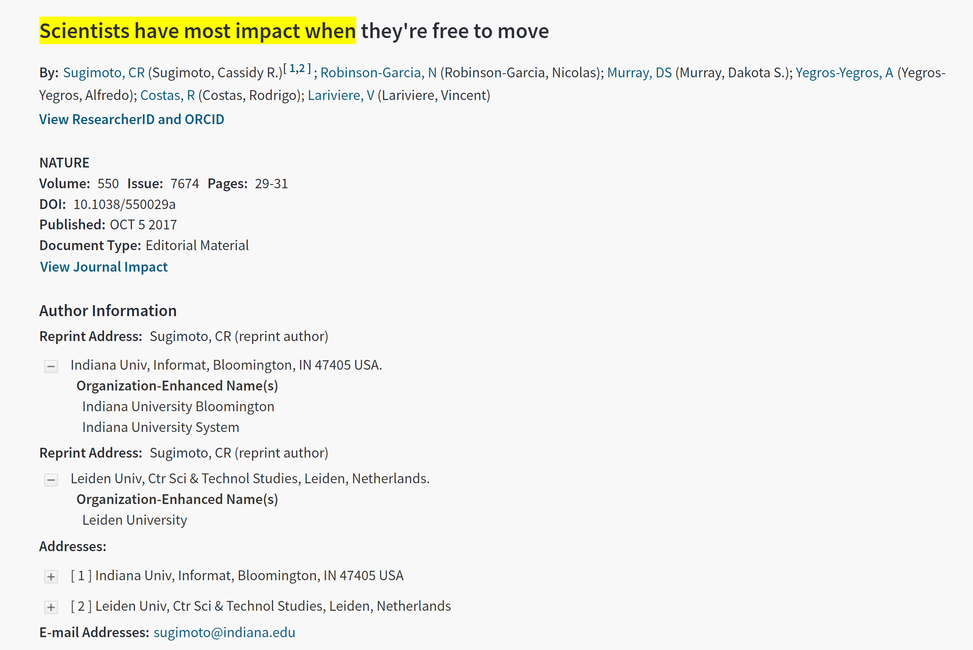


BIBLIOMETRIC APPROACHES TO MOBILITY
(2008-PRESENT)

Slide 35
DEFINING MOBILITY
RESEARCHER A |  |  | RESEARCHER B
Year | Country | Pubs | Year | Country | Pubs
0 | Greece | 2 | 0 | Spain | 1
1 | Greece | 1 | 1 | Spain | 3
2 | Belgium | 1 | 2 | Spain | 1
3 | Belgium | 1 | 3 | United Kingdom | 2
3 | Greece | 2 | 4 | United Kingdom | 1
4 | Greece | 1 | 5 | UK*/Italy* | 1
4 | Belgium | 1 | 6 | Italy | 1
5 | United Kingdom | 1 | 7 | Italy | 3
6 | United Kingdom | 3
RESEARCHER C |  |  | RESEARCHER D
Year | Country | Pubs | Year | Country | Pubs
0 | Spain | 15 | 0 | United Kingdom (UK) | 3
1 | Spain | 13 | 1 | United Kingdom | 2
2 | Germany*/Spain* | 1 | 1 | UK*/USA* | 1
2 | Spain | 14 | 2 | United Kingdom | 3
2 | USA*/Spain* | 2 | 2 | UK*/USA*/Spain* | 1
3 | USA*/Spain* | 7 | 3 | UK*/Spain* | 3
3 | USA | 5 | 4 | UK*/Spain* | 2
4 | USA*/Spain* | 11 | 5 | UK*/Spain* | 3
4 | USA | 9 | 6 | UK*/Spain*/France* | 2
Mobility Event | t_{n} | t_{n+1} | Directionality | Country rupture
E1 | C₁ |  | No | No
E2 | C₁ | C₁ | No | No
E3 | C₁ | C₂ | Yes | Yes
E4 | C₁ | C₁; C₂ | Yes | No
E5 | C₁ | C₁*; C₂* | Yes | No
E6 | C₁; C₂ |  | No | No
E7 | C₁*; C₂* |  | No | No
E8 | C₁*; C₂* | C₁ | No | No
E9 | C₁*; C₂* | C₂ | No | No
E10 | C₁; C₂ | C₁; C₂ | No | No
E11 | C₁; C₂ | C₁*; C₂* | No | No
E12 | C₁; C₂ | C₁ | No | No
E13 | C₁; C₂ | C₂ | No | No
E14 | C₁*; C₂* | C₁; C₂ | No | No
E15 | C₁*; C₂* | C₁*; C₂* | No | No

Slide 36
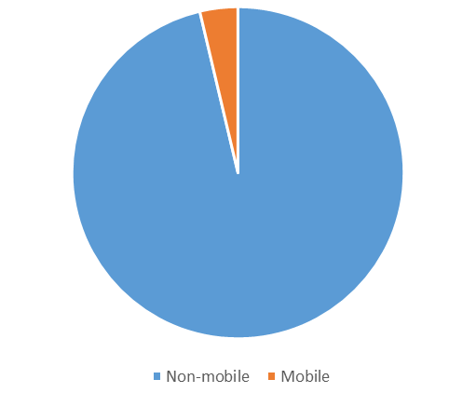
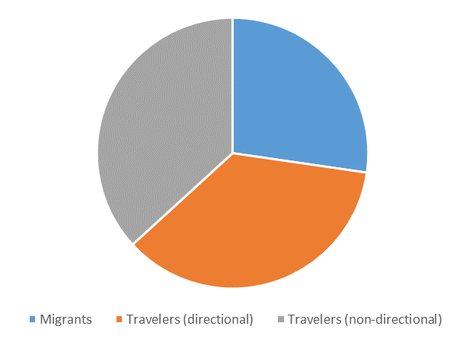
Mobility types (2008-2015)

Slide 37
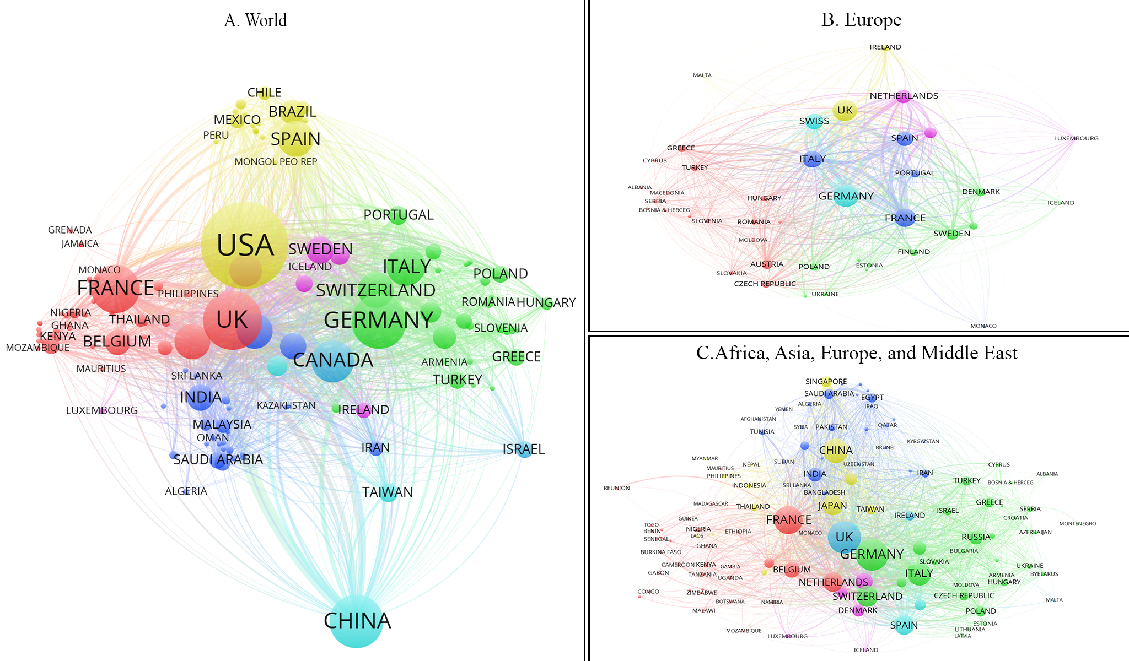
NETWORKS
Co-affiliation network by mobility

Slide 38
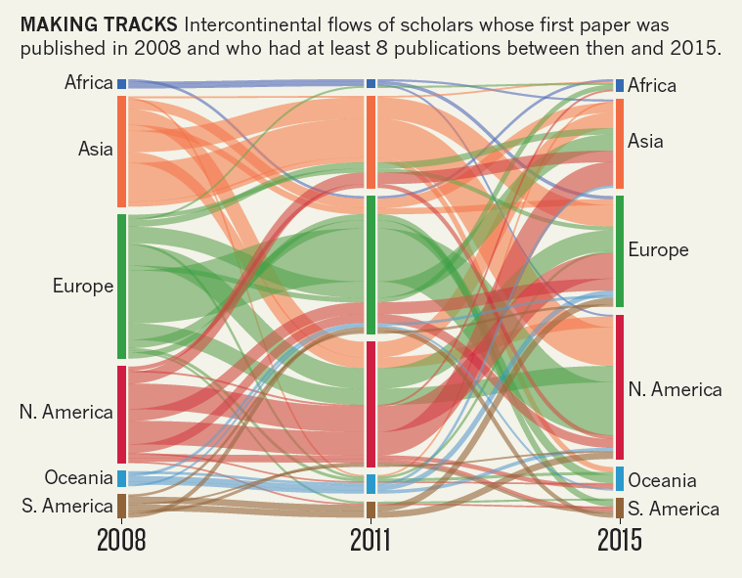
CIRCULATION

Slide 39
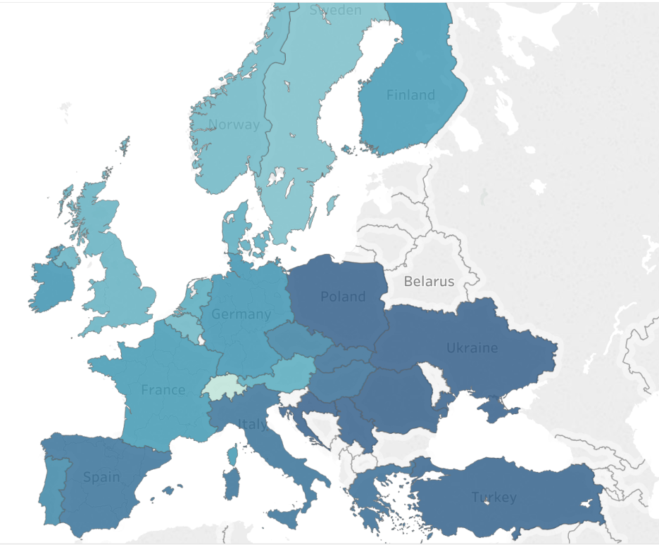
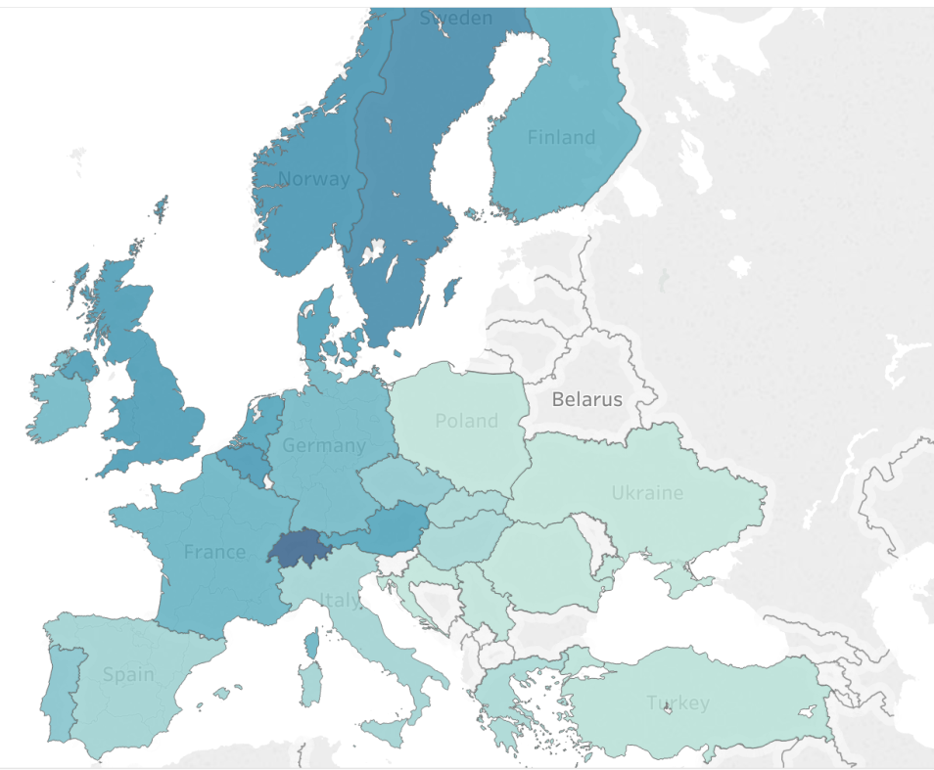
Normalized share of migration
Sending Countries
Receiving Countries
Visualization by Dakota Murray

Slide 40
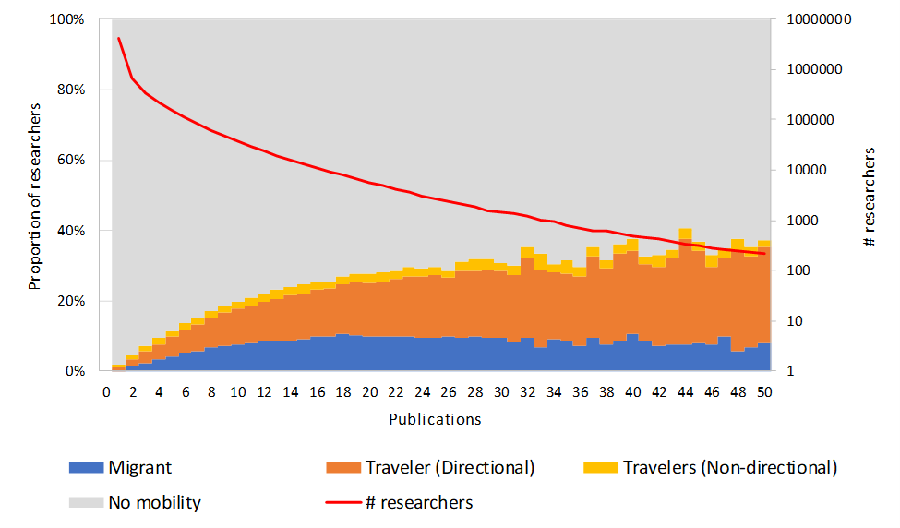
Production advance in mobility
Proportion of researchers by number of publications (left axis) and number of researchers in logarithmic scale by number of publications (right axis)

Slide 41
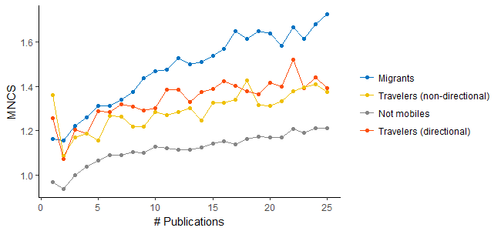
Citation advantages of mobility
MNCS values at the researcher level by mobility type controlling by number of publications

Slide 42
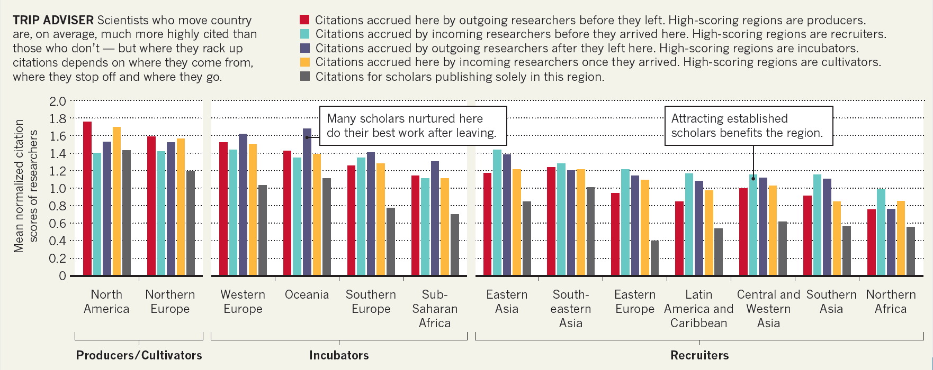
Citation typologies

Slide 43
Exchange matrix
Average MNCS for individuals by region of origin and region of destination, and for non-migrants

Slide 44
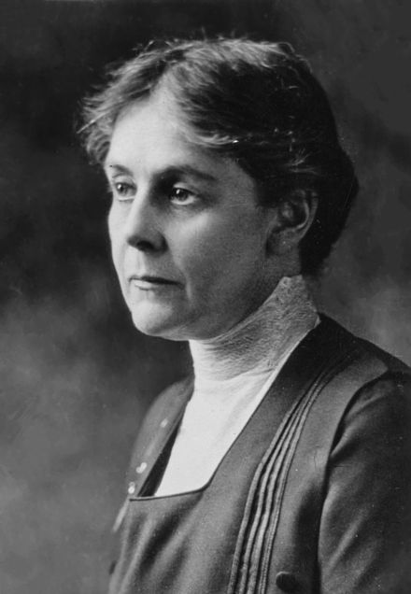
Gendered mobility in the late 1800s
“We were told that the only reason women wanted a university education was to make trouble for the government. If foreign governments did not object, that was all right, but Germany had more sense.”
–Alice Hamilton

Slide 45
Gender differences in mobility
First paper between 2008-2010
6.1% international mobility
61.3% of researchers had a single paper; 82.1% have ≤ 5
Travelers: 1.7% of women; 1.9% of men
Migrants: 4.0% for women; 4.5% for men

Slide 46
Country differences in mobility

Slide 47
Region of destination

Slide 48

Horizon Europe
“Over the next seven years, the European Union’s giant research-spending scheme will distribute a record €95.5 billion (US$116 billion) to basic-science projects and cross-border research collaborations to be carried out by tens of thousands of researchers across 27 member states and more than a dozen other countries.”

Slide 49
FUNDING

Slide 50













The Problem with Studying Funding

Slide 51
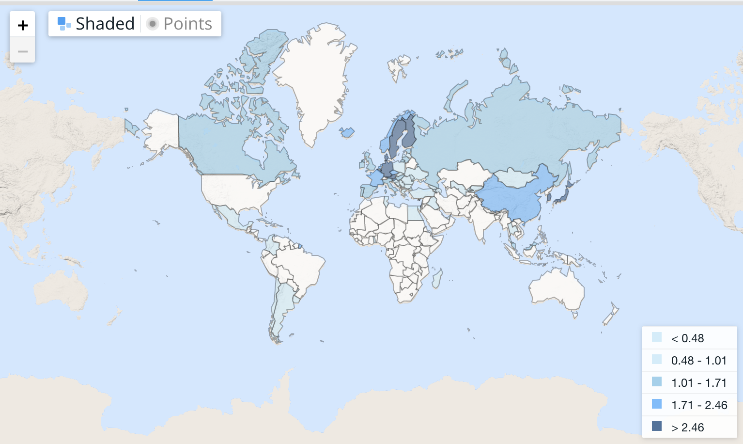
Limitations of the conventional approach

Slide 52
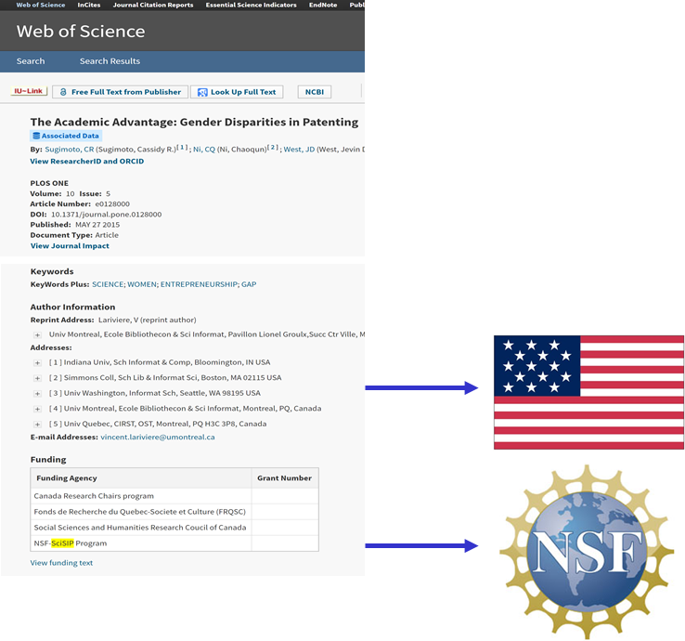

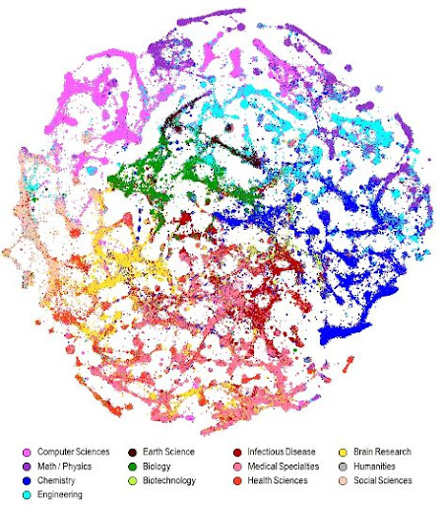

Deriving funding from bibliometric sources

Slide 53
The Method: Extracting funders
754,539 distinct strings
NIH
National Institutes of Health (NIH)
National Cancer Institute of the NIH
National Institute of Neurological Disorders and Stroke of the NIH
NIH/NCATS Clinical and Translational Science Award
NIH (Pediatric Heart Network)
NIH from the NIDDK
2009
2018
12,241

Slide 54
Country-funder strings and # of papers

Slide 55
How is global science funded?

Slide 56
Which countries are funding global science?

Slide 57
Funding intensity across countries
Notes:
(a) The funding intensity of countries. To emphasize the variations across countries, the color bar threshold is set at 0.85. Three countries have a funding intensity larger than 0.85. They are Crimea, Niue and Sao Tome & Principe. (b) The distribution of funding intensity of countries across continents. In the box plot, the box is draw from the first quartile to the third quartile of the distribution. The vertical line represents the median value of the distribution. The lower whisker extends from the box to the smallest non-outlier value within 1.5 times the interquartile range below the first quartile. The upper whisker extends from the box to the largest non-outlier value within 1.5 times the interquartile rang above third quartile. The yellow triangle labels the mean value within each group.

Slide 58
Funding portfolio of countries

Slide 59
Exclusively funded by authorship country

Slide 60
Publication reduction
40%
24%
11%
Notes:
(a) The proportion of reduced publications after the internationally funded publications are removed. (b) the country-level publication reduction grouped by continents. In the box plot, the box is draw from the first quartile to the third quartile of the distribution. The vertical line represents the median value of the distribution. The lower whisker extends from the box to the smallest non-outlier value within 1.5 times the interquartile range below the first quartile. The upper whisker extends from the box to the largest non-outlier value within 1.5 times the interquartile rang above third quartile.

Slide 61
Change of portfolio
Notes:
(c) The difference between actual research profile and the counterfactual research profile. The difference is measured by the Kullback-Leibler divergence. Large KL-divergence value represents the counterfactual research profile is distant from the actual research profile and vice versa. To highlight the difference among countries, we set the threshold of the maximum value to 0.3 There are 23 countries have KL-value large than 0.3. (d) the profile change of countries by continents.

Slide 62
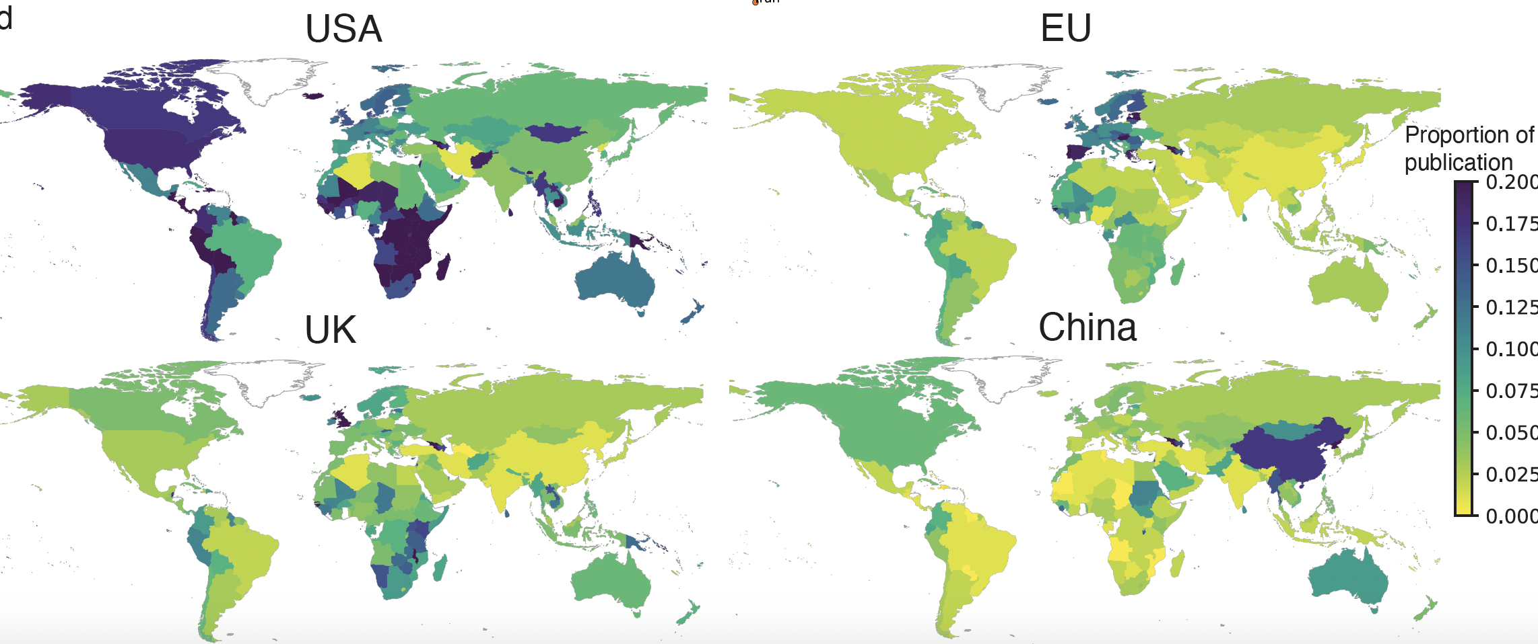
Notes:
Influence sphere of selected countries. Countries are colored by the proportion of publication reduction after removing the internationally funded publications from the focal country. Dark colors represent larger reduction and vice versa.

Slide 63
EPISTEMIC
CONSEQUENCES

Slide 64
Notes:
Here, colored countries represent they have advantage in the discipline. We see countries have advantage in tropical medicine are locted around tropical area.

Slide 65
Notes:
Cancer resourch is largely concentrated in rich countries.

Slide 66
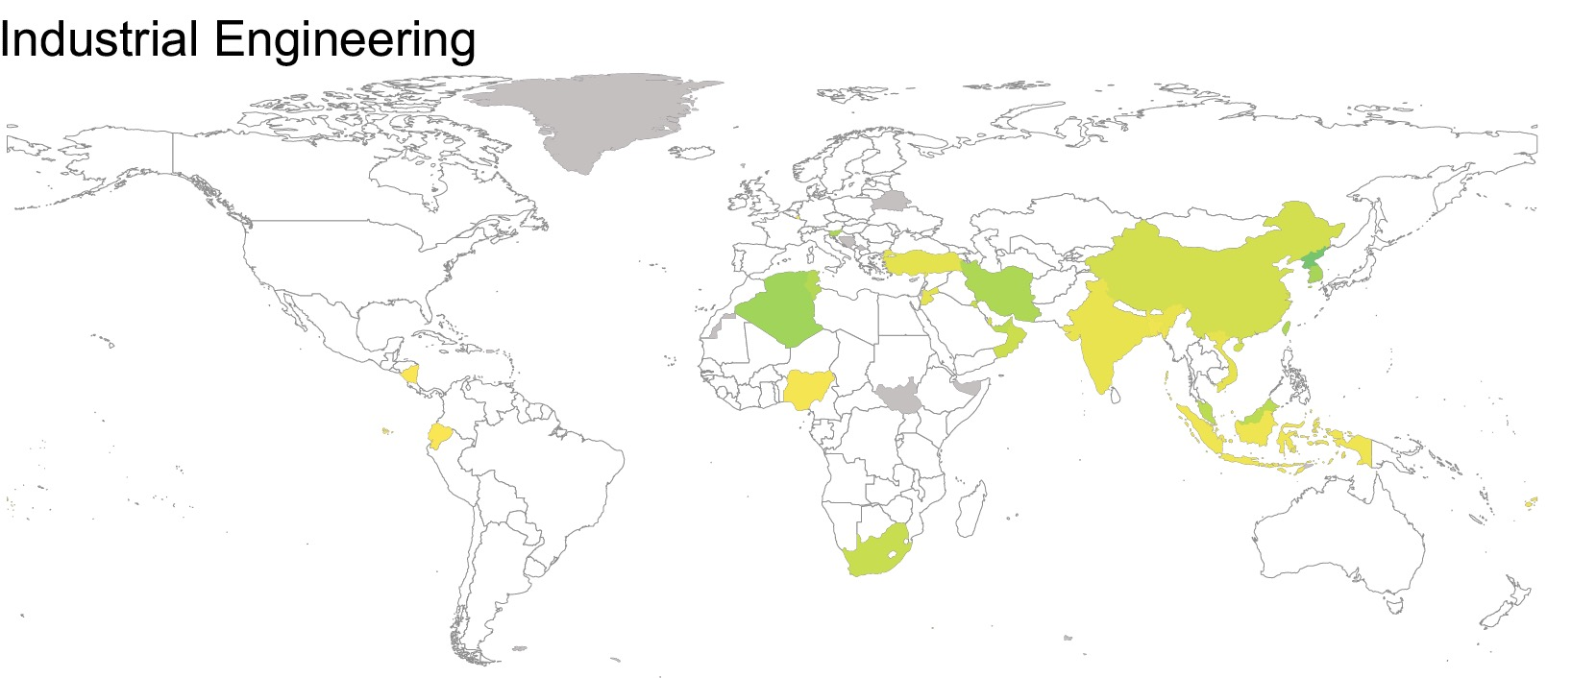
Notes:
Large emerging countries like china shows advantage in Industrial Engineering.

Slide 67
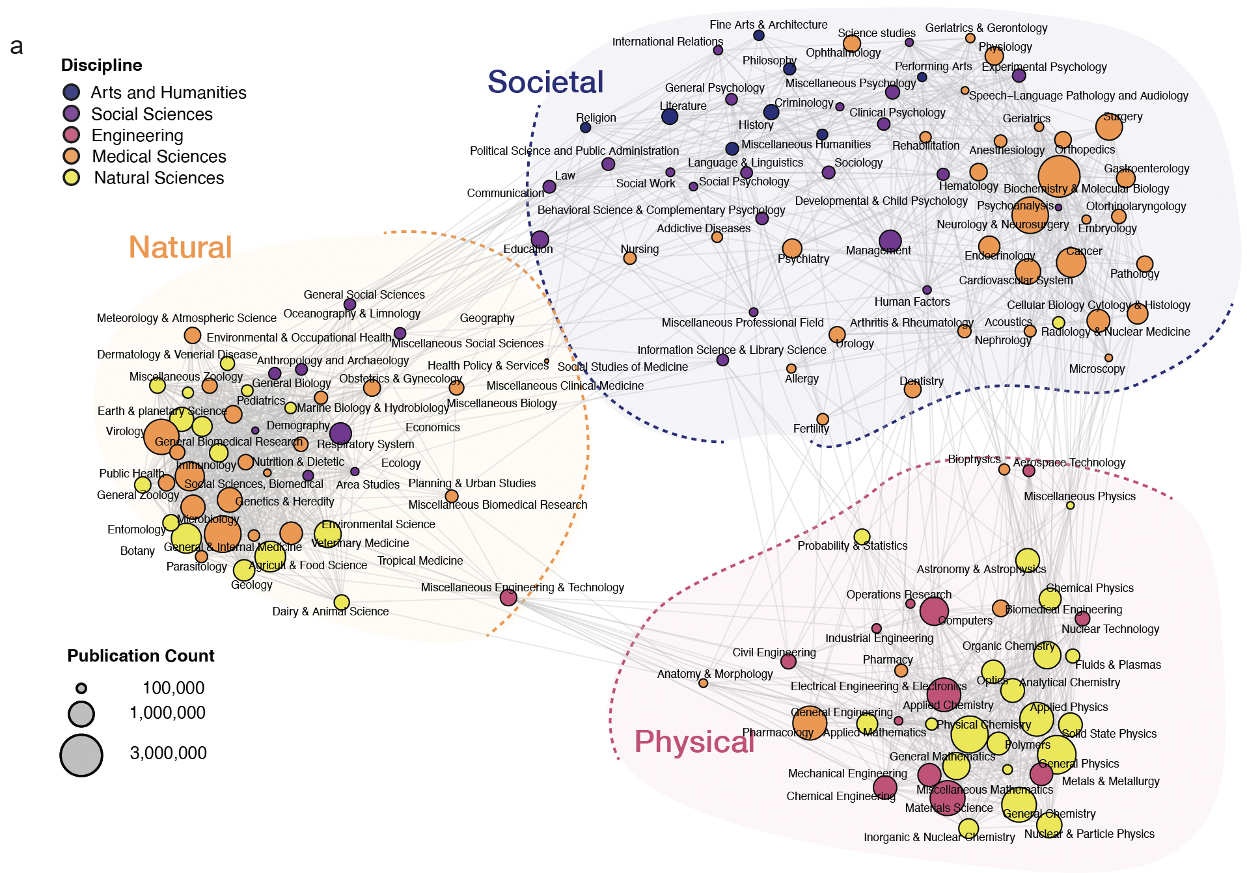
Notes:
By filtering out those edges with small weights, we extracted the structure of the knowledge space.

Slide 68
Ethiopia
(2013-2017)

Slide 69
China
(2013-2017)

Slide 70
USA
(2013-2017)

Slide 71
Three Clusters Simplex
Societal
Natural
Physical
Notes:
We mapped the three clusters into the simplex. Countries locate close to the corner represent country has more production advantage in the corresponding cluster.

Slide 72
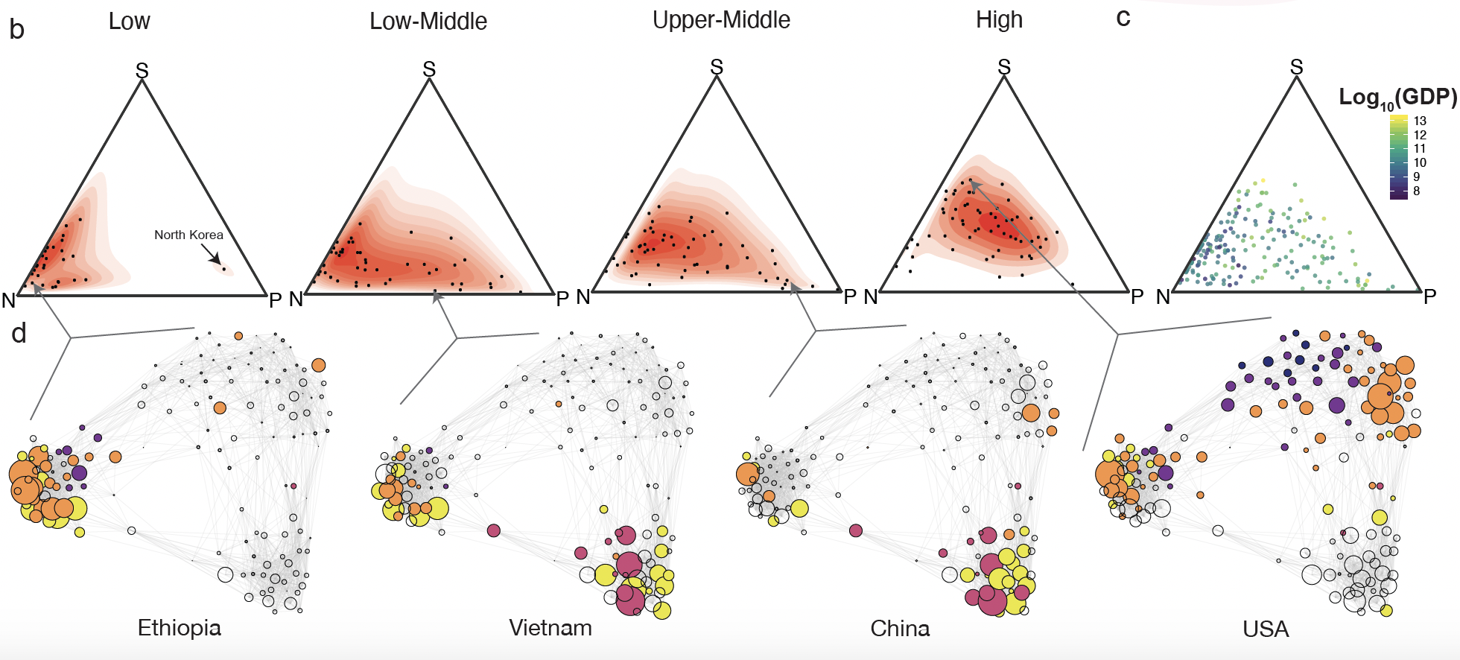
Aggregated by Income Level
Notes:
Here countries are aggregated by their income group. We find low income countries they tend to produce more natural resource related knowledge. Middle income countries tend to show advantage in both resource cluster and applied science cluster. High income countries they have more diverse research advantage that they are located in the middle of simplex while they also show advantage in social science cluster.

Slide 73
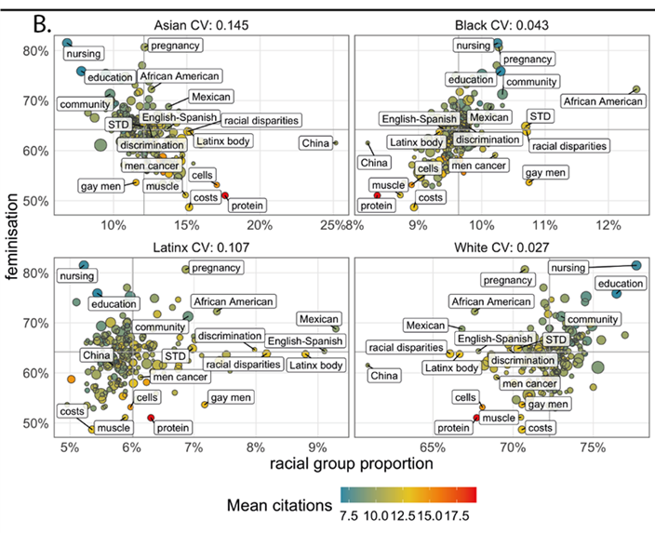
Role of topic selection: health

Slide 74
There is strong homophily between research topics and research demographics.
Were the race and gender distribution of authors consistent with that of the U.S. Census, there would be 29% more articles on public health, 20% more articles on gender-based violence, 18% more on tropical diseases, and 17% more research on families.

Slide 75
CONCLUDING THOUGHTS

Slide 76
Can scientometrics provide the empirical base for science diplomacy?
Diplomacy for science | The use of diplomatic action to facilitate international scientific collaboration, e.g., by negotiating R&D agreements and exchange programmes or enabling the establishment of international research infrastructures
Science for diplomacy | The use of science as a soft power to advance diplomatic objects, e.g., for building bridges between nations and creating good will on which diplomatic relations can be built
Science in diplomacy | The direct support of diplomatic processes through science, e.g., by providing scientific advice and evidence to inform and support decision-making in foreign and security policies

Slide 77

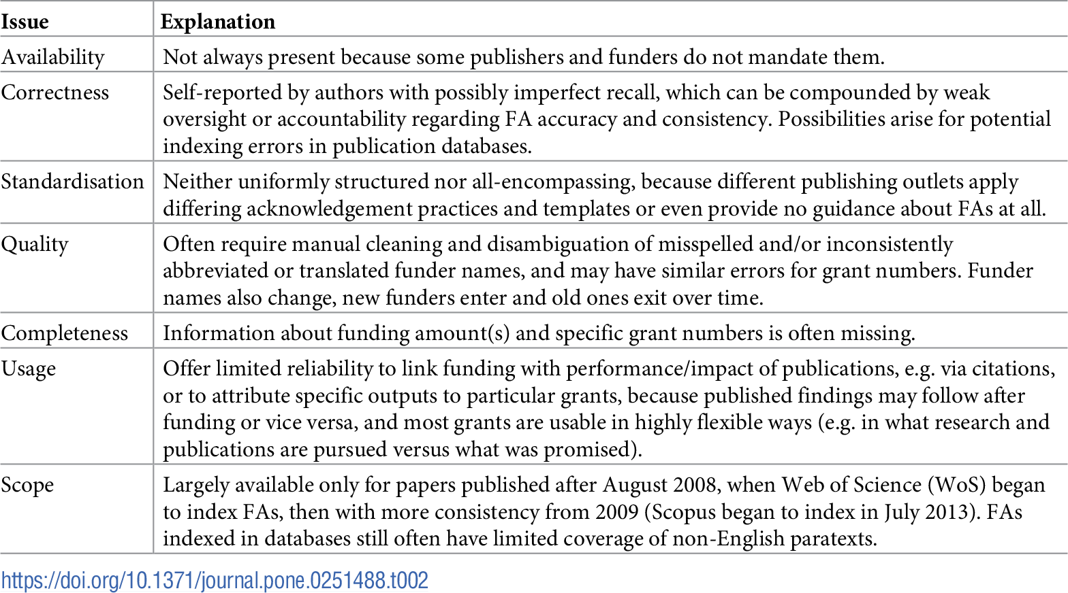
What are the limitations?
Aargaard et al. (2021)

Slide 78
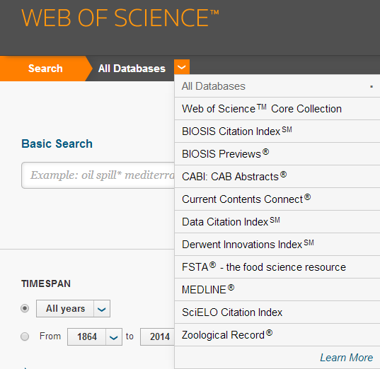
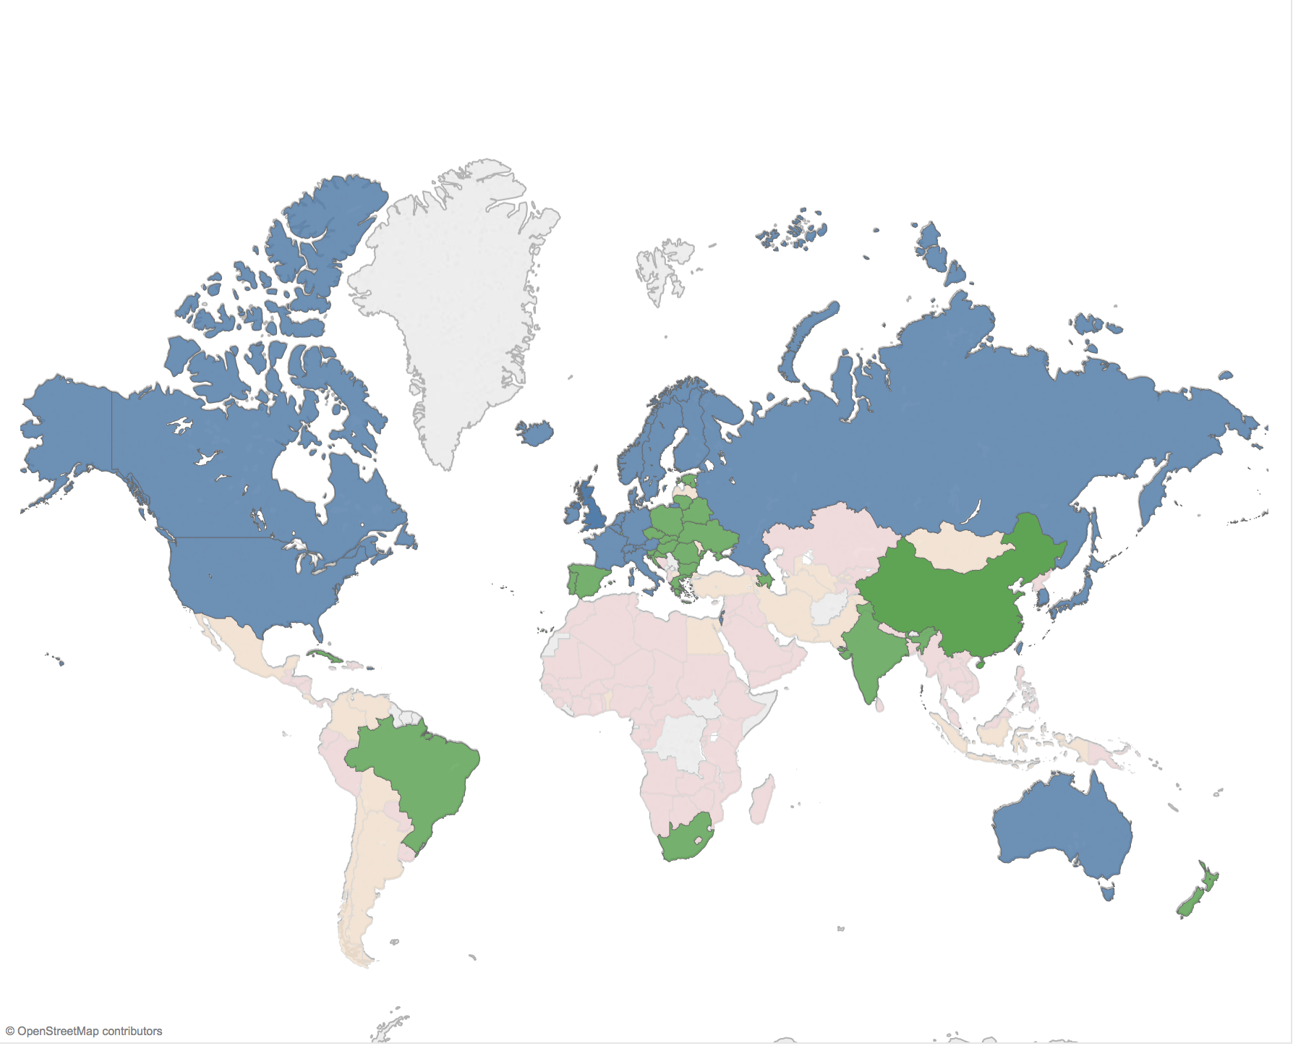
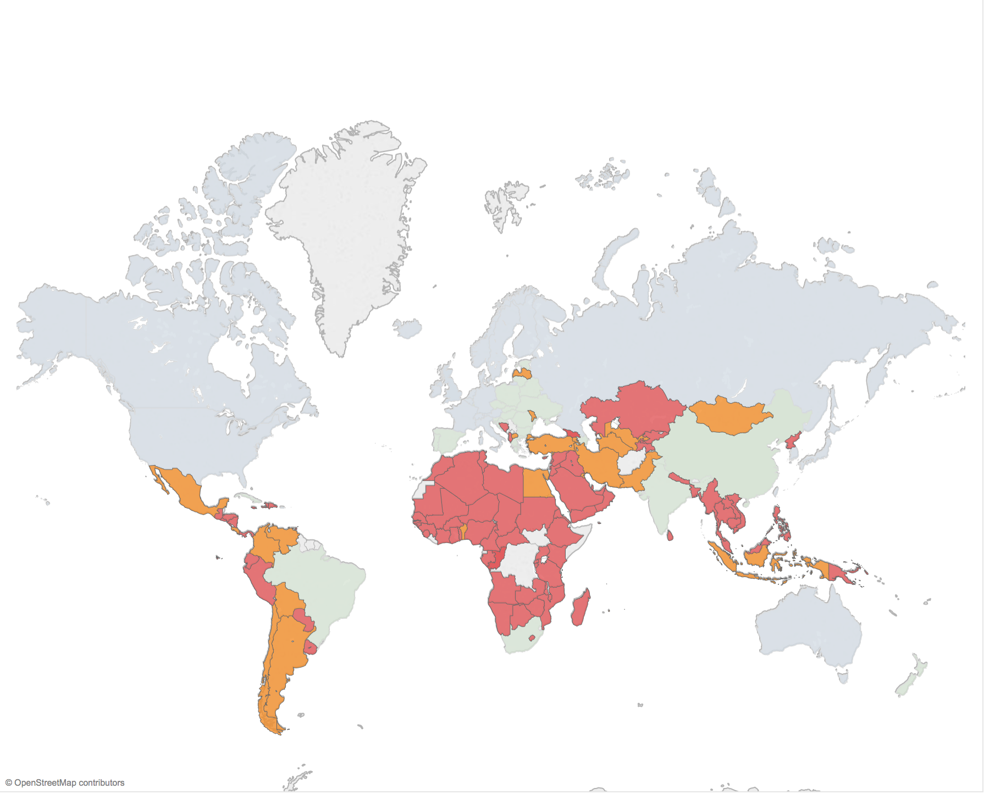
Avoid reinforcing “core/periphery”

Slide 79
Reclaiming indicators for social good
An indicator is a measure of a concept.
In research evaluation, that concept should represent values.
The indicators, therefore, provides evidence of values, but should not replace values.
Indicators can provide an assessment of past achievements and be used to motivate future decisions and policies.
Citations
H-indices
JIFs
Altmetrics
Interdisciplinarity
Diversity
Collaboration
Societal Impact

Slide 80

GLOBAL SCIENCE: RECOMENDATION
To understand the global system of science, we must move away from fragmented, isolated, and elitist models of science and towards a comprehensive analysis of international scientific relationships
This requires networking across science observatories to ensure scientific data is open, inclusive, and comprehensive; science observatories should work towards collective good in building capacity and creating standardization.
Notes:
Therefore, we will focus on several types of relationships in this talk: mobility, collaboration, leadership, citations

Slide 81

Thank you! Questions?
Cassidy R. Sugimoto
Chair and Professor
School of Public Policy
Georgia Institute of Technology
@csugimoto
Vincent Lariviere
UNESCO Chair and Professor
EBSI
Universite de Montreal
@lariviev
Lili Miao
Doctoral candidate
SICE
Indiana University Bloomington

