Slide 1
Mapping the global landscape of journals
Mikael Laakso & Janne Pölönen
Notes:
This presentation will focus on the limitations we currently have in understanding the full global scholarly journal landscape. Substantial shares of published works are currently invisible to most bibliometric studies due to the composition of current leading bibliographic databases. Based on findings so far this affects non-English and multilingual journals more than others. We will present what we know about the current problems in global representation, and suggest some paths forward.

Slide 2
Contents
The problem
What are the consequences
Towards a solution
Multilingualism
Conclusions
References

Slide 3
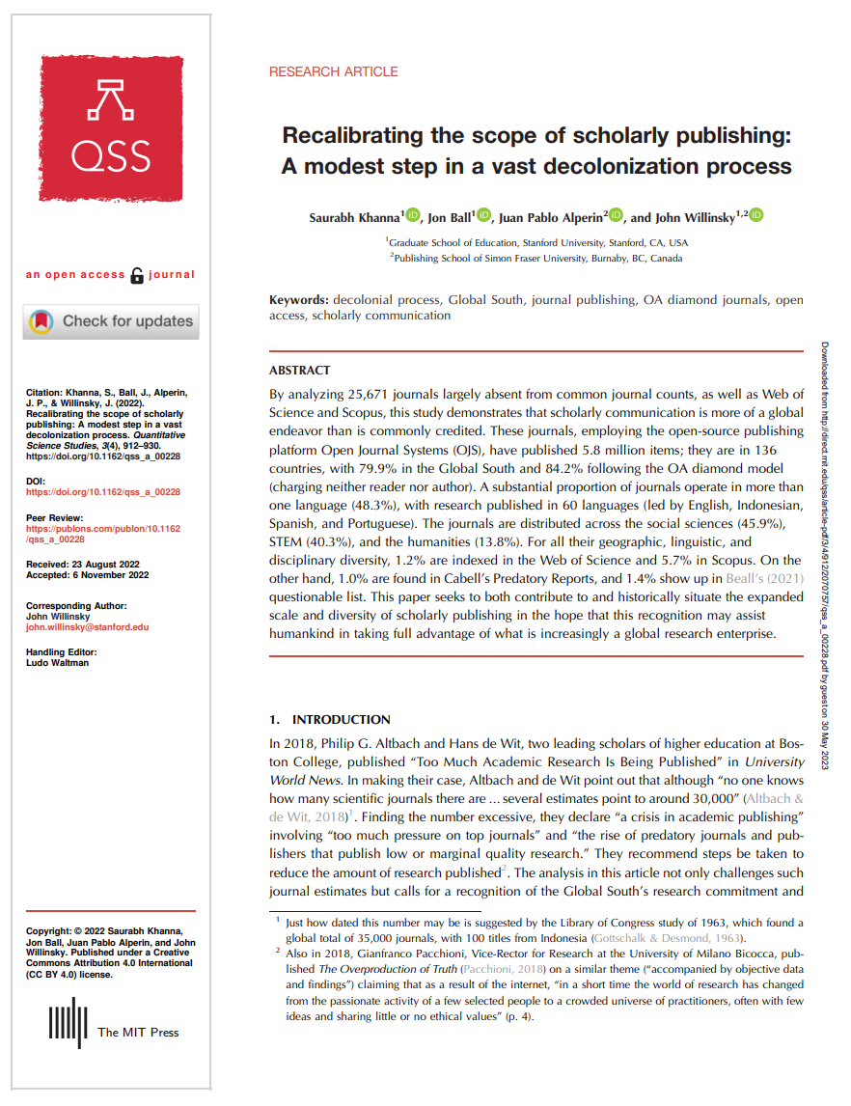
A major inspiration and strong reading recommendation for anyone interested in this topic
Khanna, S., Ball, J., Alperin, J. P., & Willinsky, J. (2022). Recalibrating the scope of scholarly publishing: A modest step in a vast decolonization process. Quantitative Science Studies, 3 (4): 912–930. https://doi.org/10.1162/qss_a_00228

Slide 4
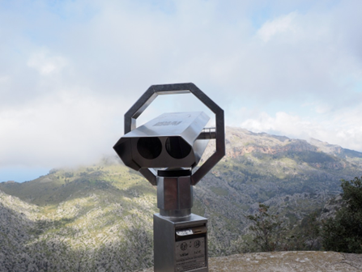
The problem
There are now more scholarly journals than ever before, publishing an increasing total number of articles every year (Bornmann, Haunschild & Mutz 2021).
Change in this space is constant, yet comprehensive knowledge about what and why changes are happening still lacks a lot of scope and depth, mostly due to the limitations in available data.
There is a large number of journals that are currently invisible to most bibliometric research (see e.g. Khanna, Ball, Alperin et al 2022) .
Even if data sources would be more complete the key obstacle for their extended use in research purposes following open science approaches is their commercial and proprietary nature.

Slide 5
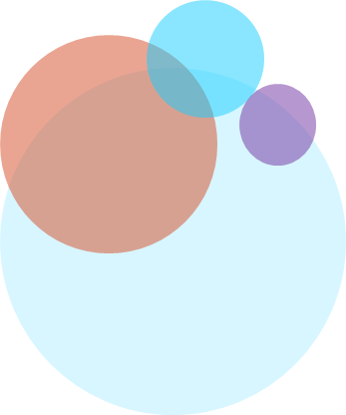
What are the consequences
What might come as a surprise to many is that we do not have comprehensive answers to the following questions:
How many scholarly journals are there?
How many articles do they publish?
In what languages do they publish?
How are they divided into publishers?
How many are associated with a scholarly society?
How are they divided across research areas?
How are they divided geographically?
How many are publishing Open Access?
Notes:
A challenge to consider in the pursuit of answers to these questions are the three interrelated entity levels: individual articles, journals, and publishers.

Slide 6
What are the consequences (cont.)
If we would have a solid common data foundation it would enable research into the changing landscape of journal and studying e.g. the following phenomena:
Creation of new journals
Publisher changes for journals
Merging journals
Journal renaming/re-scoping
Momentum of journals towards internationalization
Changing publication models
Discontinued journals
Disappeared journals
?
Notes:
The purpose of this paper is to argue for the need for broader, and more open datasets for creating a better information environment for research on the scholarly journal landscape. It will take a long time before the technical sophistication and standardisation of metadata provided directly by all journals (e.g. through Crossref) can be used to create comprehensive data, thus other approaches at reaching better detail need to be developed. We provide an initial demonstration and dataset of an approach that can achieve some of the foundational goals that we are striving for, with the intention that this can be expanded and iterated on through dialogue, interaction, and collaboration with the research community.

Slide 7
Towards a solution
There is a lot of public data available about journals available in different datasets and through different services
The ISSN International Center provides free access to standardised metadata for all journals
The/One approach to start building a foundation based on open data:
Collect as wide and broad list of journals globally based on ISSN numbers
Deduplicate
Query the ISSN center for standardised metadata for all journals

Slide 8
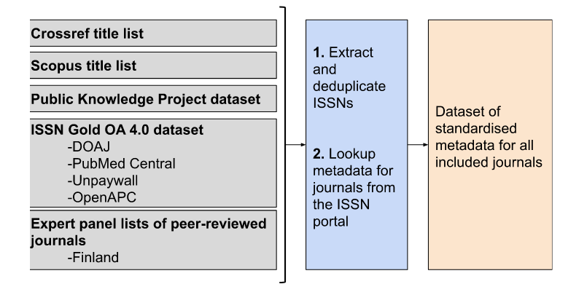
Towards a solution (cont.)

Slide 9
Towards a solution (cont.)
Our preliminary dataset is aggregated from five local and global information sources including a total of 152,644 unique journals matched with bibliographic metadata records from the International ISSN Centre

Slide 10
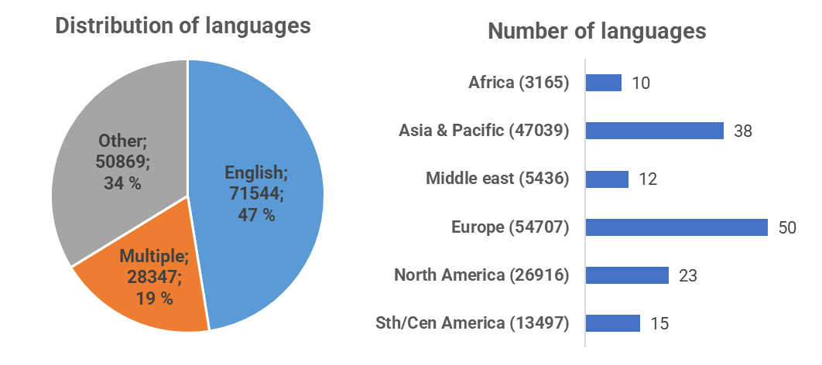
Multilingualism

Slide 11
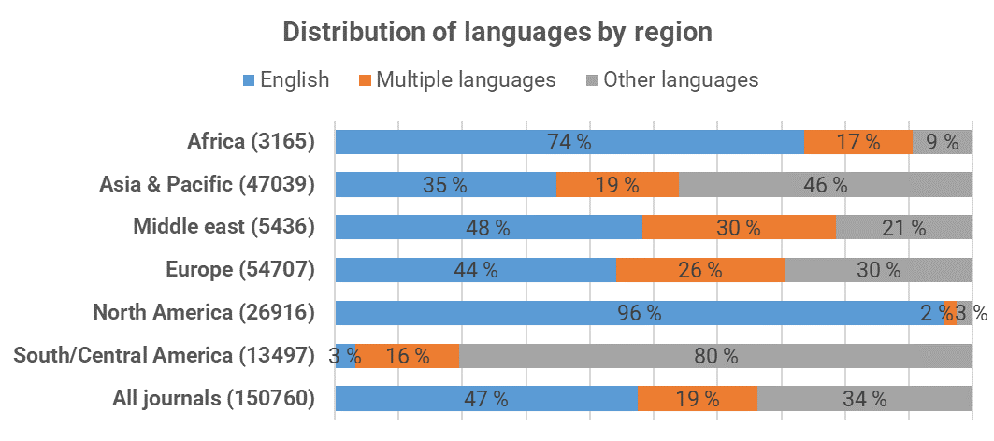
Multilingualism (cont.)

Slide 12
Conclusions
Recently started ongoing research, but…
Early evidence paints a much more globally diverse and multilingual landscape than selective commercial databases can provide.
There is a lot of potential for increasing the visibility, discoverability, and inclusion of more scholarly journals into bibliometric research.
Some way of crowdsourcing metadata for these journals would be needed.
Methods for managing data additions, changes, and forks could probably lean towards systems and practices familiar from open source software development.

Slide 13
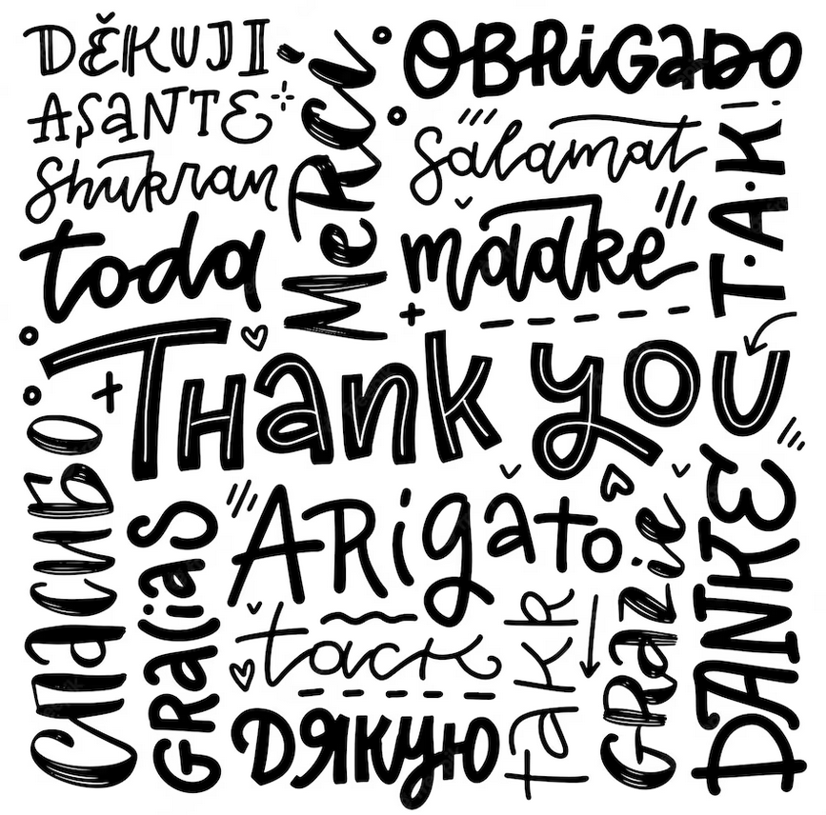

Slide 14
References
Bornmann, L., Haunschild, R. & Mutz, R. (2021). Growth rates of modern science: a latent piecewise growth curve approach to model publication numbers from established and new literature databases. Humanit Soc Sci Commun 8, 224. https://doi.org/10.1057/s41599-021-00903-w
Bruns, A., Cakir, Y., Kaya, S., & Beidaghi, S. (2022). ISSN-Matching of Gold OA Journals (ISSN-GOLD-OA) 5.0. Bielefeld University. https://doi.org/10.4119/unibi/2961544
Crossref (2023). Crossref title list. http://ftp.crossref.org/titlelist/titleFile.csv
Scopus (2023). Scopus source title list. https://www.elsevier.com/__data/assets/excel_doc/0015/91122/extlistMarch2023.xlsx
Khanna, S., Ball, J., Alperin, J. P., & Willinsky, J. (2022). Recalibrating the scope of scholarly publishing: A modest step in a vast decolonization process. Quantitative Science Studies, 3 (4): 912–930. https://doi.org/10.1162/qss_a_00228
Khanna, S., Raoni, J., Smecher, A., Alperin, J., Ball, J., Willinsky, J. (2022). Details of publications using software by the Public Knowledge Project. Harvard Dataverse. Version 3 https://doi.org/10.7910/DVN/OCZNVY
TSV (2023). Listing of publication outlets included in the publication indicator http://www.tsv.fi/julkaisufoorumi/kokonaisluettelo.php

