Slide 1
Panel discussion: Responsible Research Assessment - with or without the Nordic bibliometric indicator
Nordic Workshop on Bibliometrics and Research Policy
13.10.2023 Göteborg

Slide 2
Schedule
Presentation of the panel
Introduction to the Nordic indicator
Panel discussion
What is the most important change in the use of the Nordic bibliometric indicator in your country/institution?
What have been the main concerns about the uses of the indicator with respect to the RRA agenda and the CoARA Agreement?
What is the role of journal evaluation (by citation metrics or experts) in addressing predatory, questionable, deceptive and low-quality publishing practices?
Questions & Comments

Slide 3
Panel
Moderator: Janne Pölönen (Federation of Finnish Learned Societies)
Panelists
Denmark: Marianne Gauffriau (IT University of Copenhagen)
Finland: Laura Niemi (University of Turku)
Iceland: Baldvin Zarioh (University of Iceland)
Norway: Gunnar Sivertsen (Nordic Institute for Studies in
Innovation, Research and Education)
Sweden: Björn Hammarfelt (University of Borås)

Slide 4
Nordic Publication Indicator
Complete national Publication Data
Level rating of Publication Channels
Norway (2005-2023): Publiseringsindikatoren (NPI) or Tellekantene
Denmark (2007-2021): Den bibliometriske forskningsindikator (BFI)
Finland (2015-2024?): Julkaisufoorumi (JUFO)
Sweden (Not in PRFS): Norska listan or Norska modellen in Sweden used internally by thirteen Swedish universities
Iceland: (2019-): The Norwegian, Danish and Finnish lists used as supporting tool since 2019 and the Finnish list more extensively since 2022
Funding Formula
Level 1: 1 point
Level 2: 3 points
Block-grant to Universities

Slide 5
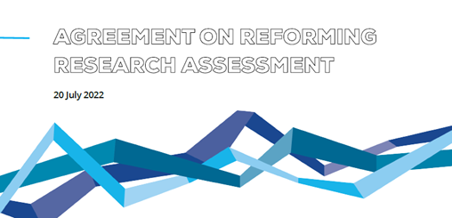
CoARA – Coalition for Advancing Research Assessment
4 Core Commitments:
Recognise the diversity of contributions to, and careers in, research.
Base research assessment primarily on qualitative evaluation... supported by responsible use of quantitative indicators
Abandon inappropriate uses of journal- and publication- based metrics (JIF, H-index)
Avoid the use of rankings of research organisations in research assessment
Agreement for Reforming Research Assessment published in July 2022
Over 600 organisations have signed
Nordic countries (organisations):
Denmark: 8
Finland: 33
Iceland: 2
Norway: 19
Sweden: 24

Slide 6
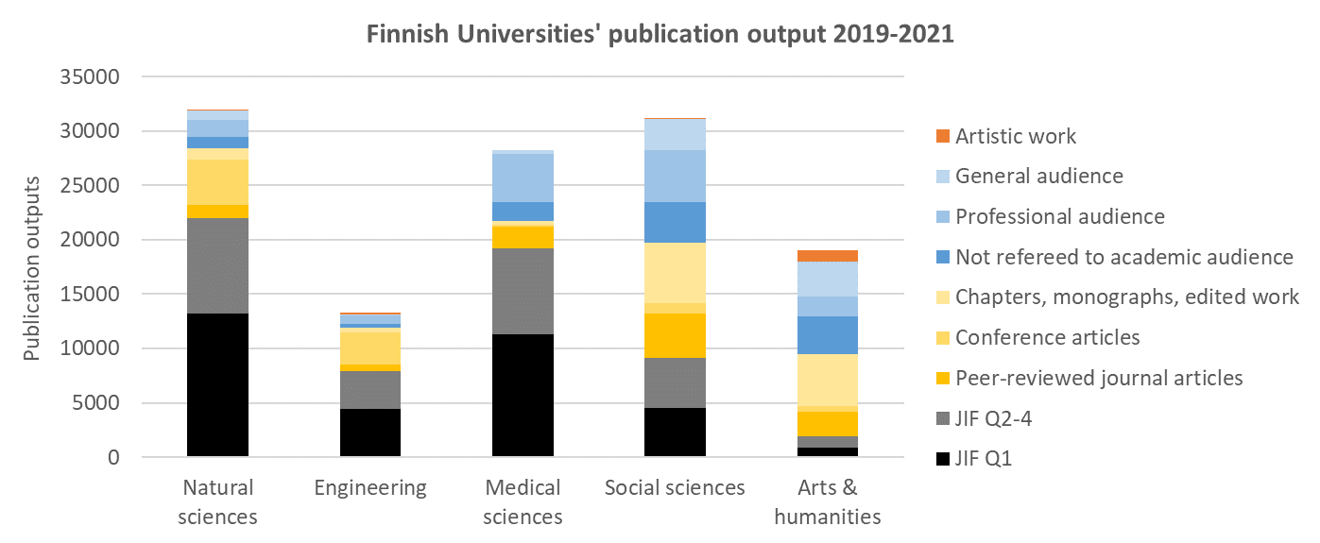
Finnish Universities’ publication output 2019-2021: CRIS vs JIF based assessment
Articles in JIF Journals

Slide 7
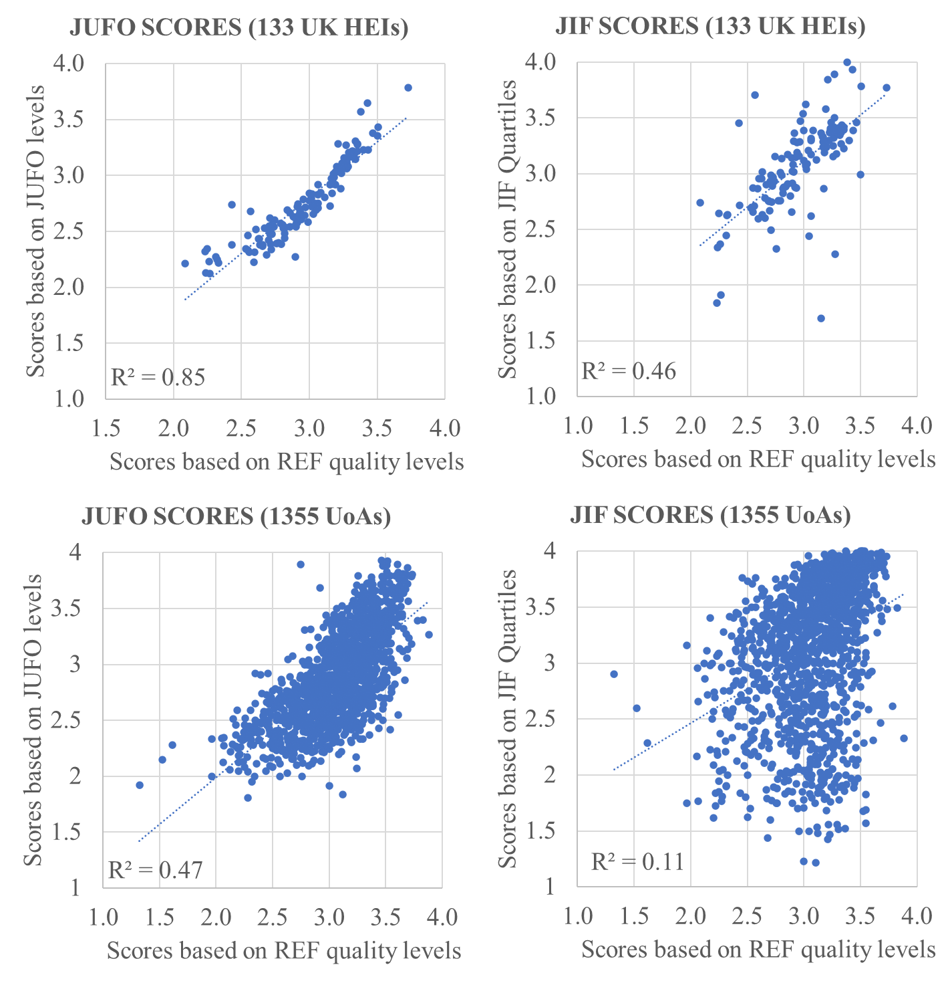
Expert-based journal evaluation vs JIF-based rankings
The Finnish expert-based JUFO level ratings of journals produce scores correlating more strongly with expert-based REF2021 scores than those based JIF Quartiles
Journal metrics show a much weaker correlation with REF-based scores at the lower aggregate level of institutional Units of Assessment
Pölönen, Guns & Engels (2023) Journal metrics as predictors of Research Excellence Framework 2021 results: Comparison of impact factor quartiles and Finnish expert-ratings, STI2023 Leiden

Slide 8
Journal Quality Concerns
Council calls on the Commission and the member states to support scholarly publishing model that is not-for-profit, open access and multi-format, with no costs for authors or readers.
Rigorous peer-review, ensuring scientific standards, validity and quality
Awareness of predatory, questionable, deceptive and low-quality publishing

Slide 9
What is the most important change in the use of the Nordic bibliometric indicator in your country/institution?

Slide 10
Denmark (Marianne Gauffriau)
Nordic Publication Indicator: Going from with to without
National level 2009-2021: Updated BFI points contributed to a performance- based funding system. 2022-?: Monitoring and ad hoc analyses of Danish research publications via RPD and international databases. | Institutional level, two cases 2023-?: Aalborg University: New ‘BFI’ for a budget model and other purposes. (The AAU Research Indicator) 2022-?: IT University: BFI used in scoring system. Open question whether a replacement for BFI will be introduced.

Slide 11
Finland (Laura Niemi)
Scientific publications have been used as a quantitative indicator of university funding since 2007 and until 2009, 0.3% of the basic funding of universities was granted on the basis of publications.
Publication Forum – in Finnish Julkaisufoorurumi, or JUFO was created in 2010 and in 2010–2012 the number of publications accounted for 1.7% of the basic funding of universities.
Since 2021, the importance on publications was grown from 13% to 14%, and a coefficient of 1,2 is applied to openly accessible peer-reviewed publications.
Since 2015, 13 % of the universities' basic funding from the Ministry of Education and Culture is based on publications.
Most Finnish universities make use of the JUFO classification for monitoring and developing their publishing activities.
Many Finnish universities have incorporated the JUFO classification within their internal funding allocations as well as reward schemes for individual academics.

Slide 12
Iceland (Baldvin Zarioh)
The Nordic bibliometric indicators have been used in Iceland as part of a yearly research evaluation exercise of public universities but along with other tools (WOS, Scopus, domestic journal evaluation).
Hasn’t had any influence on public funding of universities in Iceland.
Results from the yearly evaluation influences the internal distribution model of the University of Iceland.
A new funding model of Icelandic universities introduced on the 18th of September 2023, which will include incentives for “publication indicators”
This new model may have influence on the yearly evaluation, how that is performed, and on the internal distribution model of the University of Iceland but there are a lot of uncertainties.

Slide 13
Norway (Gunnar Sivertsen)
In March 2023, the Norwegian Government decided that the indicator will cease to influence the funding of higher education institutions as of 2025.
It will still influence the basic research funding in the institute sector (20% of the publications) and the hospital sector (17%).
Publications will still be reported in all three sectors and used for statistics and other purposes. The Register of journals, series and publishers will continue.
The Government has commissioned a project running until June 2024 to investigate the consequences of its decision, for example the motivation of researchers and their institutions to report complete data of good quality.

Slide 14
Sweden (Björn Hammarfelt)
The influential model that never was (Hammarfelt 2018)
Not used on the national level, but applied in various ways across institutions.
Focus on the list - not the model. The list is used for both evaluation and benchmarking.
Creative use. Combination with other systems, extra points, or points for artistic work.

Slide 15
What have been the main concerns about the uses of the indicator with respect to the RRA agenda and the CoARA Agreement?

Slide 16
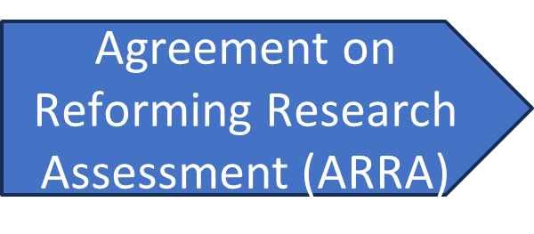
Denmark (Marianne Gauffriau)
Three independent developments
Danish Agency for Higher Education and Science: No decision has been taken on a replacement for the BFI. ARRA signatory: BFI was terminated before we signed ARRA. RPD: We facilitate the discovery and exploration of Danish research. | 🤔 An opportunity to discuss national research portals and RRA? o Portals are not an assessment tool, but … o Dynamic portals versus static evaluation reports. o Easy to add metrics: SDG, … (See also preliminary work, L. Himanen)

Slide 17
Finland (Laura Niemi)
The Finnish higher education system consists of 13 universities and 22 universities of applied sciences.
Currently 12 universities and 17 universities of applied sciences are CoARA signatories
The core CoARA commitments include two commitments to enable better recognition of the diverse practices and activities that maximise the quality of research as well as two commitments to enable a move away from inappropriate uses of metrics.
The main concern: Changing an existing culture!

Slide 18
Iceland (Baldvin Zarioh)
This discussion has not started in Iceland (even though both the University of Iceland and RANNÍS, the Icelandic Centre for Research have signed the CoARA Agreement).
The principles of the the Icelandic research evaluation system haven’t changed drastically for over 20 years but the system is not only evaluation publications (also other dissemination of research, teaching and services for the academic community and for the public), so that should give us room for improvements in accordance to RRA and the CoARA agreement

Slide 19
Norway (Gunnar Sivertsen)
The use of the indicator at the individual level, which is an organizational level responsibility, has been a concern all the time.
The National Publishing Board (responsible for the indicator and representing academia) has addressed this concern in two ways: 1) by redesigning the indicator to make it technically difficult to apply to the level of individuals, and 2) by issuing guidelines for individual level bibliometrics which explain the implications of DORA and the Leiden Manifesto more concretely and extensively.
The same guidelines were republished in NOR-CAM (2021), the Norwegian forerunner of the CoARA agreement (2022). The latter agreement has not evoked new discussions about the indicator.
Motivated by the strive for Open Access, DORA was used as a critique of the indicator until 2019, which was the start of entering Publish and Read agreements with the major publishers of the core scientific journals that are at the highest level in the indicator.

Slide 20
Sweden (Björn Hammarfelt)
Universities seem to agree on the principles of CoARA, but this is yet to be reflected in practice
Somewhat dependent on research policy in Sweden more generally. Is ‘excellence’ back as the primary goal?
Bibliometricans are sceptical to the strong focus on peer review in CoARA. Key question: What is responsible in this context? And when may it be irresponsible to use peer review?
(See document on CoARA authored by the “SUHFs working group on bibliometrics: https://suhf.se/arbetsgrupper/arbetsgruppen-for-bibliometri/)

Slide 21
What is the role of journal evaluation (by citation metrics or experts) in addressing predatory, questionable, deceptive and low-quality publishing practices?

Slide 22
Denmark (Marianne Gauffriau)
Journals and publications in research assessments
Complex journal landscape Many publication types and different routes to publication. Different definitions of predatory, questionable, etc. publishing practices, e.g., is open science important? | In practice, whitelists (based on citation metrics and/or experts’ evaluation) seem important: o BFI o Aalborg University’s ‘BFI’: Scopus, Norwegian list, and Finnish list. o 🤔RPD: Inclusion > exclusion. o 🤔RRA: Peer review > metrics.

Slide 23
Finland (Laura Niemi)
Evaluation is needed because it…
shapes the operating culture by creating assumptions
serves as a tool for research organizations
advance and improve the impact of research

Slide 24
Iceland (Baldvin Zarioh)
Iceland does not have the capacity to evaluate journals qualitative and maintain an independent list of reputable journals, so the Icelandic evaluation system relies on information from Scopus, WOS and the nordic lists.
Inclusion in Scopus and/or WOS (and impact factors) have been the main indicators used for the evaluation of publications in Iceland, which is far from ideal and have presented problems.

Slide 25
Norway (Gunnar Sivertsen)
The Norwegian Register of Scientific Journals, Series and Publishers has gradually developed to serve the additional purpose of a “whitelist” of journals recommended by experienced researchers in all fields of research.
The need for this function has now been strongly emphasised and will be supported by the Government.
Quantitative journal evaluation (e.g. Journal Impact Factors) has proved unsuccessful in detecting questionable publishing practices.
Qualitative journal evaluation performed by panels of experienced researchers is the future.
We need to return to the idea of the Nordic List to move forward with a good example of a solution to predatory and grey-zone publishing.

Slide 26
Sweden (Björn Hammarfelt)
The Norwegian list seems to work as a kind “white list” at some universities (for example Linköping)
Marker of quality also when marketing journals to authors, funders etc.
Increasingly hard to use metrics, impact factors or various lists to evaluate journals? Do we need a updated understanding of what a journal is, and what it does?

Slide 27
Comments & Questions

