Slide 1
20 years of performance-based research funding in Flanders, Belgium
Tim Engels & Raf Guns
Nordic Workshop on Bibliometrics and Research Policy Chalmers University of Technology Gothenborg, 11 October 2023

Slide 2
A brief poll
Who thinks that performance-based funding of research helps to strenghten the research system of a country?

Slide 3
A brief poll
Who thinks that performance-based funding of research helps to strenghten the research system of a country?
Who feels that performance-based funding of research is incompatible with the aims of open science and reforming research assessment?
Notes:
So perhaps we can go straight to the reception?

Slide 4
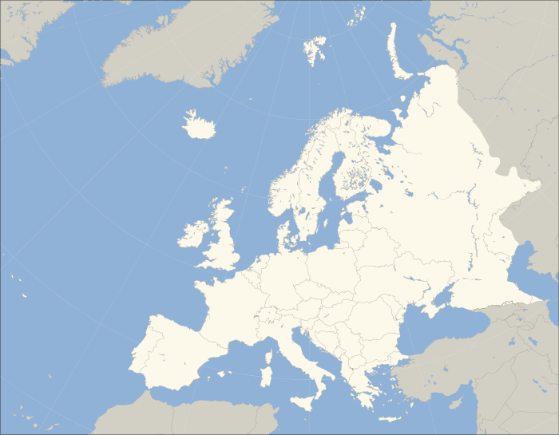
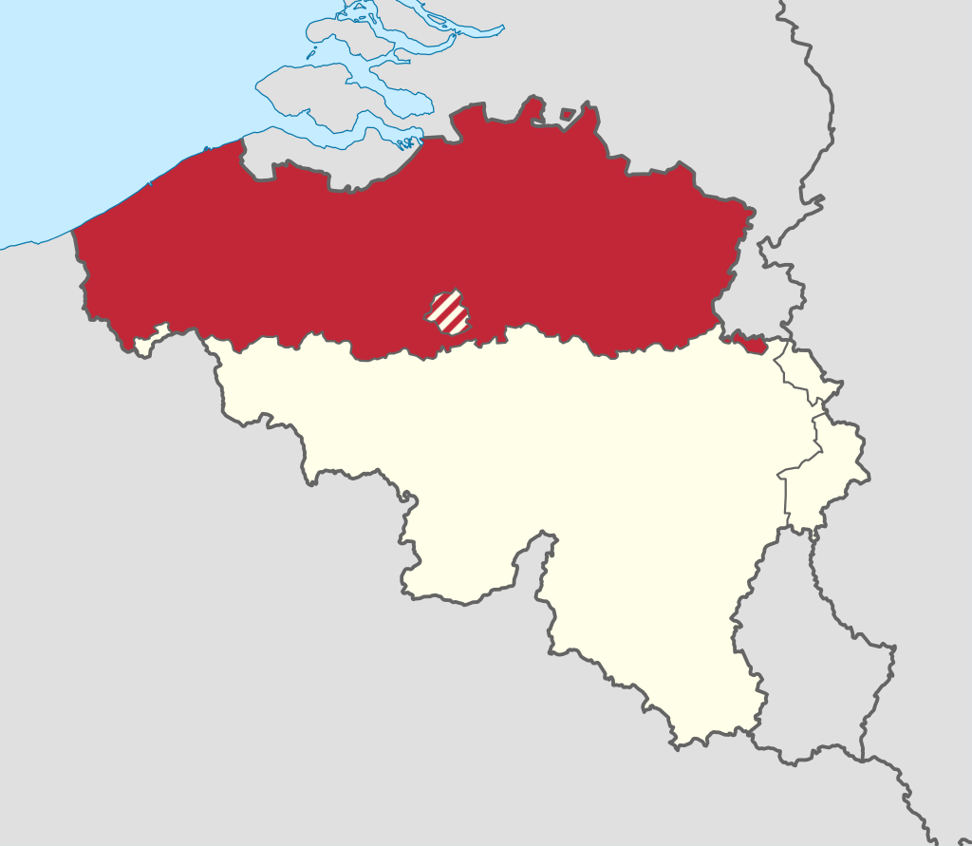
Belgium and Flanders
Flanders is the northernmost region of Belgium.
Local language: Dutch
Population: 6.6 million
High degree of autonomy, including in science policy
5 universities

Slide 5
Research evaluation vs funding distribution
Research evaluation
How well does this person/research group /… perform? How can they perform (even) better in the future?
Preferably carried out by peers
Bibliometrics can inform but not replace this process
Funding distribution
How much funding should go to each institution or unit?

Slide 6
Performance-based research funding
A performance-based research funding system (PRFS) is a system that:
is used to distribute research funding
is national: university-internal evaluations are excluded
is based on research (rather than, e.g., teaching)
is based on research output
Hicks, D. (2012). Performance-based university research funding systems. Research Policy, 41(2), 251–261. https://doi.org/10.1016/j.respol.2011.09.007
Notes:
Add DOI

Slide 7
PRFS in Flanders - the godfathers
Marc Luwel
Koenraad Debackere
Wolfgang Glänzel
Initiator of many bibliometric studies in Flanders in the ’90s and early ‘00s
Many high-level science advisory roles throughout his career
Affiliated with CWTS Leiden
Initiator and Promotor-spokesperson of ECOOM, the Flemish Center for R&D Monitoring
Chair of Association KU Leuven
Chair of Leuven R&D
Chair of KBC Banking Group
Professor of bibliometrics at KU Leuven

Slide 8
PRFS in Flanders - how we have been involved – declaration of Conflict of Interest
Tim:
initiated research assessments at the team level at University of Antwerp in 2006
started Antwerp branch of ECOOM in 2007
coordinated the preparation of the Flemish Bibliographic database for the social sciences and humanities (VABB) in 2008-2010, as well as the first five annual updates
directly involved in negotiations regarding BOF-key since 2009
head of research, innovation and valorisation at University of Antwerp since 2015
Raf:
Coordinator of ECOOM-Antwerp, the unit responsible for the annual update of the VABB, one of the parameters in the BOF-key, since 2015

Slide 9
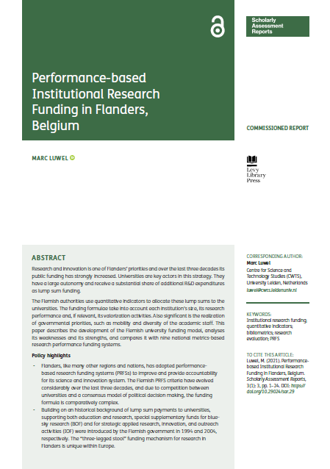
PRFS in Flanders - literature
Engels, T. C. E., & Guns, R. (2018). The Flemish performance-based research funding system: a unique variant of the Norwegian model. Journal of Data and Information Science, 3(4), 45–60. DOI: https:// doi.org/10.2478/jdis-2018-0020
Luwel, M. (2021). Performance-based Institutional Research Funding in Flanders, Belgium. Scholarly Assessment Reports, 3(1): 3, pp. 1–24. DOI: https:// doi.org/10.29024/sar.29
Notes:
We will give bird’s eye view of the Flemish system -> more details, see these recent publications

Slide 10
BOF
IOF
Bijzonder Onderzoeksfonds (University Research Fund)
For universities to fund basic research, mainly via research professor positions and projects
Distribution key: BOF key
Industrieel Onderzoeksfonds (Industrial Research Fund)
For universities and university colleges to fund application oriented projects that aim at economic impact
Distribution key: IOF key

Slide 11
BOF key evolution
1994
Input indicators
2003
Introduction bibliometric parameters
2008
Expansion to include social sciences & humanities
2013
Refined weighting of publications
2019
New policy accents: excellence and internationalization; 50% stable part
2024
No further changes (current consensus, to be officialized in the next few months)
Notes:
2003: pubs & cits in SCIE, 10%
2008: (31.6%)
other WoS indexes
VABB
Publication weighting
2013: binning of IFs per research subfield (weight bibliometrics increased to 40% in 2016)
2019:
- Characteristic Scores and Scales -> 4 citation classes
- i18n: EU funding and intl co-pubs

Slide 12
BOF key changes 2003 and 2008
Evolution from input to output indicators
2003: introduction bibliometric parameters based on SCIE (10%)
Publications
Citations
2008: expansion to include social sciences & humanities; increased weight for bibliometric parameters (40% from 2016 onwards)
Other WoS indexes SSCI and AHCI
VABB-SHW: comprehensive, local database of research output by Flemish SSH scholars
Publication weighting by JIF
Notes:
Critique on weighting:
-Non transparant
-Flanders instead of the world was taken as a reference
-The weight attributed to publications varied by a factor up to 4000
-The highests weights were heavily concentrated in (some areas) of the biomedical sciences

Slide 13
BOF key changes 2013 and 2019
Refinement and new policy accents
2013: refined weighting of publications
Based on binning of JIFs per research subfield
2019: new parameters and introduction stable part
Excellence: Characteristic Scores & Scales to divide publications into four citation classes
Internationalization: EU funding + international co-publications
BOF key now consists of 50% competitive part (calculated each year) and 50% structural part (calculated every 5 years, based on previous period)

Slide 14
BOF-evaluation 2023
Different opinions among international panel members regarding the impact of and the need for a BOF-PRFS
Consensus among panel members, universities and consultants that a parameter to measure interdisciplinarity should not be implemented
Suggestion by consultants that, given the annual amount of work, calculating the BOF-key every 3 to 5 years only should be considered
Current consensus among universities: no changes for the period 2024-2028, debate on possible alternatives to be started
Notes:
The BOF and IOF are evaluated every five years. This evaluation is carried out by a consultant agency and comprises a site visit by an international panel.
Parameter IDR: idea was raised in 2019

Slide 15
IOF-evaluation 2023 took place in parallel
The IOF-key takes into account
income from industry (contract research, clinical studies and licence income)
EU-grants (Horizon)
patents filed and granted
spin-offs launched (see Luwel 2021)
Interestingly, the international panel unequivoqually expressed support for the IOF-key mechanism, even though there is no stable part and the time windows are mostly shorter than those in the BOF-key
Current consensus: no changes for the period 2024-2028
Notes:
USPTO
European Patent Office
Patent Cooperation Treaty

Slide 16
► How have the BOF-shares of the five Flemish universities evolved?
Notes:
Who thinks especially larger universities will have fared well (aka, Matthew-effect)?

Slide 17
Evolution university shares in BOF
KU Leuven
Ghent University
Antwerp University
VUB (Brussels)
Hasselt University

Slide 18
► How has the number of publications per FTE evolved?
Notes:
Who thinks productivity will have increased markedly?
Crude measure of productivity, since we are not taking the different roles into accoutn but gives a first idea

Slide 19
Evolution FTE researchers in Flanders
Notes:
Lables nog aanpassen naar ‘Professors’, ‘Research & teaching assistant’ and ‘Researchers’

Slide 20
Evolution publication counts in Flanders
Notes:
Hoe ziet de evolutie van productiviteit er grafisch uit? Want van 1 naar 1,2 en schommeling tussen 1,2 en 1,4 lijkt eigenlijk hetzelfde? Afgaande op de literatuur zou er vooral in het eerste decennium een effect te verwachten zijn

Slide 21
Publications/FTE
Notes:
Initial increase, followed by stabilization around 1.3

Slide 22
► How has the citation impact of publications evolved?
Notes:
Who thinks scholarly impact will have increased?

Slide 23
Evolution of field-weighted citation impact (Relative Citation Rate)
Schubert, A., Glänzel, W., & Braun, T. (1986). Relative indicators of publication output and citation impact of European physics research, 1978–1980. Czechoslovak Journal of Physics B, 36(1), 126–129. https://doi.org/10.1007/BF01599744
Notes:
red = world average; Y-axes gives MOCR/MECR; add reference to paper on MOCR/MECR
MOCR: #cits / #pubs
MECR: average citation rate of all papers published in the same journal in the same year
RCR = MOCR/MECR

Slide 24
Evolution of share of papers that achieve high or exceptional citation impact (CSS)
Glänzel, W., & Schubert, A. (1988). Characteristic scores and scales in assessing citation impact. Journal of Information Science, 14(2), 123–127. https://doi.org/10.1177/016555158801400208

Slide 25
► How has the share of international co-publications and the share of SSH papers in English evolved?

Slide 26
Share of international co-publications and English in SSH
Notes:
Increase of both (~60 -> 70%)

Slide 27
► Have the BOF-key and the IOF-key had any impact at all on universities? More specifically, on university information management, on research assessments at universities and/or on individual researchers?

Slide 28
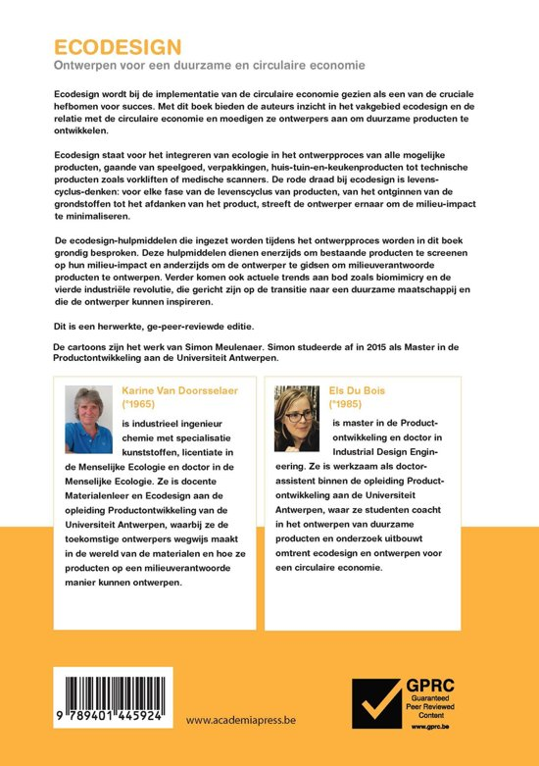
Possible impacts on researchers and research teams
Luwel (2021): lack of evidence, except for some research on SSH publication patterns
Before VABB, researchers put efforts into publishing more in journals indexed in Web of Science and getting locally relevant journals indexed in the Web of Science (Ossenblok, Engels & Sivertsen, 2012)
Later, some SSH researchers put efforts into having their book publications peer-reviewed and thus included in VABB, using (among others) the Guaranteed Peer Reviewed Content label (Verleysen & Engels, 2014; Vandewalle, Guns & Engels, 2022)
In general, the idea that research activity, especially in the case of funded research, should result in recognizable output, seems to be widely held

Slide 29
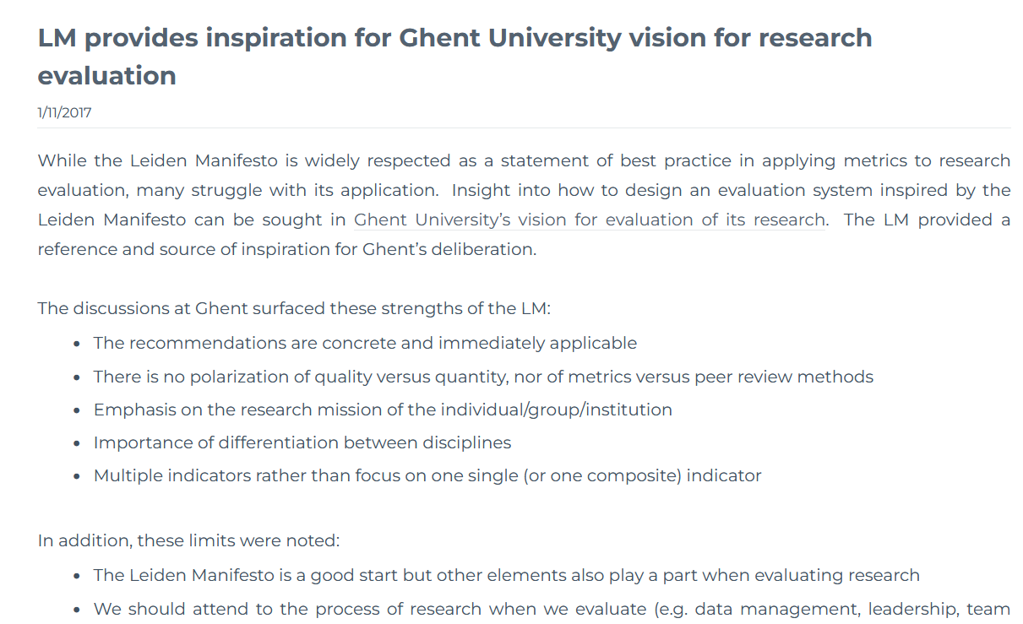
Research evaluation
Assessment of research at universities is largely decoupled from the BOF and IOF-keys. Examples:
Research visitations by peers for group-level evaluation
Reform of individual evaluations, including narrative CVs and individual goal-setting
Flemish universities among first signatories of CoARA

Slide 30
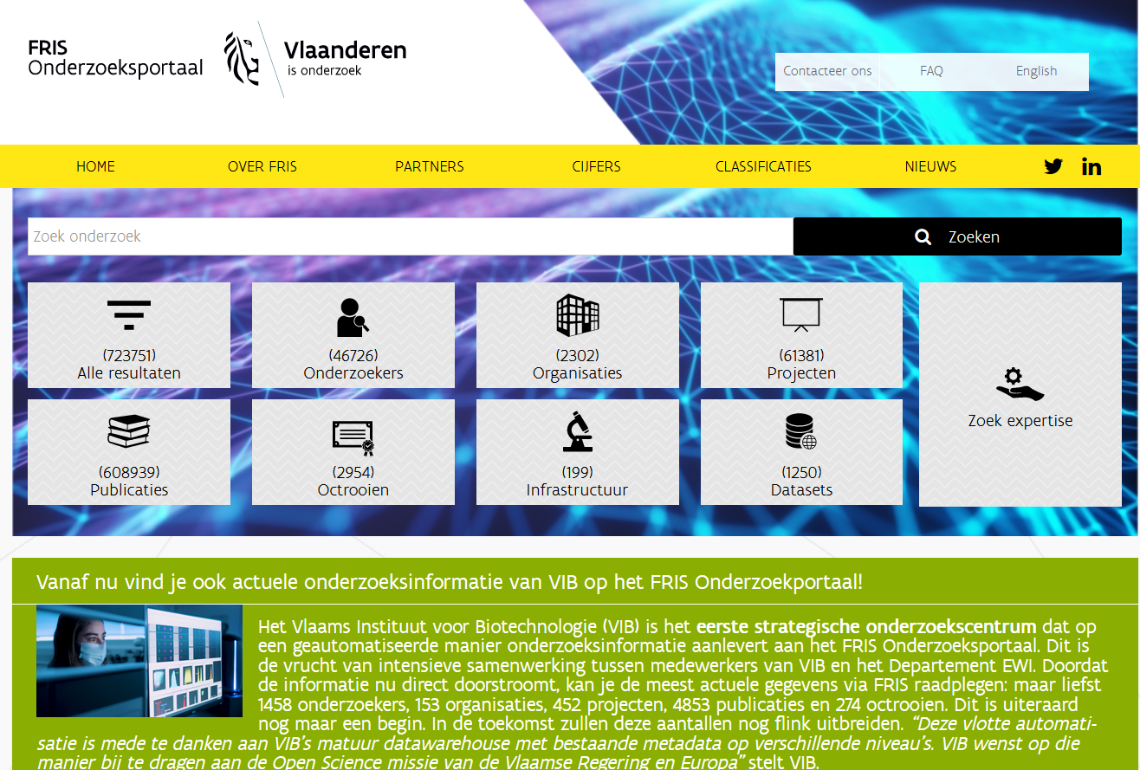
Possible impacts on university information management
Universities have invested substantially in building up expertise and in registering and curating broad range of research information.
Only in one case this is partly a commercial solution.
The Flemish Government has gradually stepped up expectations regarding reporting to the Flemish Research Information Space (FRIS)
Open availability of research information data remains patchy
https://researchportal.be/en
Notes:
Hier wilde ik nog een afbeelding van FRIS invoegen, maar lukt om een of andere reden niet

Slide 31
Conclusion
Evidence of any possible direct impact of the BOF-key and IOF-key is patchy
The fact that funding for research (BOF) and innovation (IOF) comes as ringfenced funding driven by output parameters emphasizes government expectations in these areas
An international comparative analysis of the relative costs of different funding mechanisms would be of interest to many

Slide 32
Thank you for your attention and participation
tim.engels@uantwerpen.be; raf.guns@uantwerpen.be

