Slide 1
Locally oriented, globally visible? Geographic orientation of social sciences and humanities
Raf Guns, Cristina Arhiliuc, and Hongyu Zhou
Nordic Workshop on Bibliometrics and Research Policy October 13, 2023

Slide 2
Social sciences and humanities
Characterized by
Importance of multiple languages, in particular local language (Kulczycki et al., 2020)
Importance of book publications (Engels et al., 2018)
Importance of local journals and publishers (Larivière & Macaluso, 2011)
Why?
“differences in methods, material and missions” (Sivertsen & Larsen, 2012)
Heterogeneity and diversity (Verleysen & Weeren, 2016)
Leading to
Less international visibility (e.g, in WoS or Scopus)
CC-BY 2.0; https://commons.wikimedia.org/wiki/File:Books_in_a_stack_%28a_stack_of_books%29_-_Flickr_-_austinevan.jpg#filelinks
Notes:
Methods: how do you study? -> certain approaches to resarch lend themsleves better to e.g. monograph form
Material: what do you study?
Missions: reaching practitioners, local policy makers etc.

Slide 3
Geographic orientation of research
Locally oriented publication: oriented to own country (🇧🇪) or own language area (🇧🇪+🇳🇱)
[…] Aan de hand van een actor-netwerk analyse, zal getoond worden dat de verankering van de sector in de regio Gent zwak is. Maar net zijn enige sterkte, de doorgedreven assemblage specialisatie, blijkt op het eerste zicht ervoor te zorgen dat net de andere Volvo automotive sector in Gotenburg, die economisch meer gediversifieerd is en waar tot op heden het bestuur van Volvo Cars zit, met sluiten bedreigd is. […]
Notes:
TODO Assumption + how to test -> separate slide
TODO Local outlets: give one or two examples

Slide 4
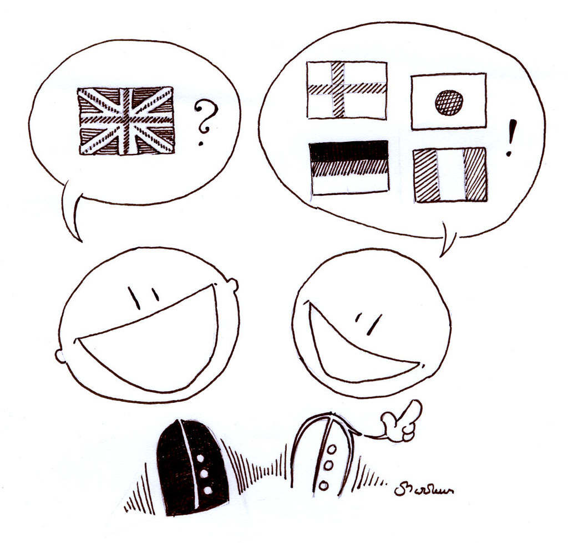
This study
Assumption: Locally oriented literature is most often communicated in own language and in local outlets.
We test this assumption by comparing publication variables like language to the occurrence of geographic entities in the abstract.
CC-BY-NC 2.0; https://www.flickr.com/photos/16591741@N00/278649026

Slide 5
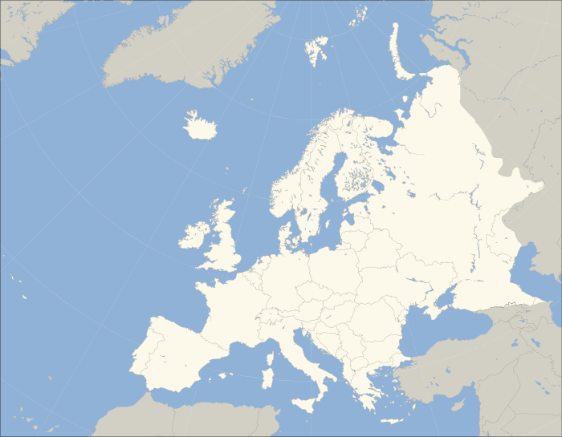
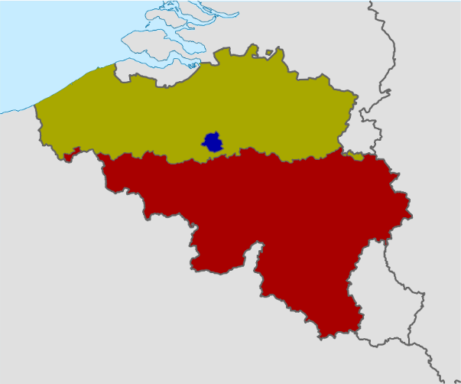
Data: VABB
Comprehensive database of Flemish publications in social sciences & humanities
Multiple languages and publication types
Abstracts of publications 2010-2020 submitted to VABB
N = 47,159
Notes:
Caveat: x% zonder abstract

Slide 6
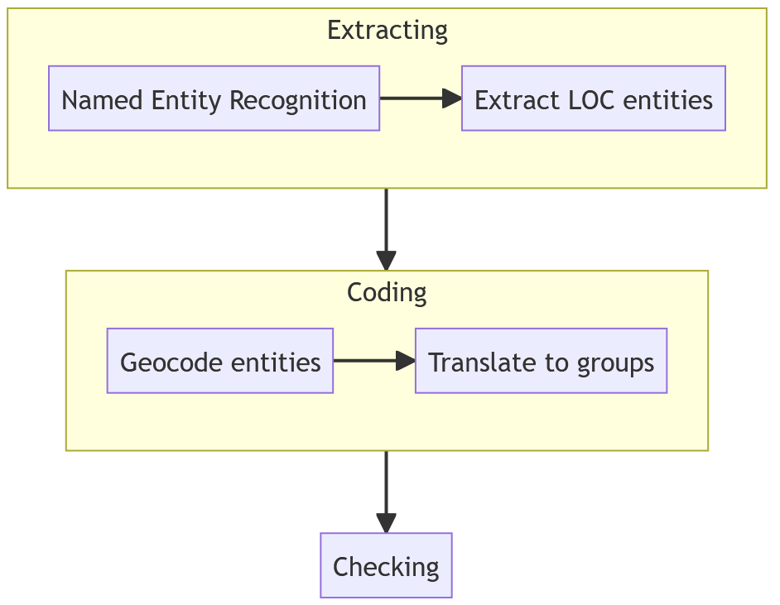
Methods
We approximate geographic orientation of a publication by
extracting geographic entities from the abstract and
coding those into four groups (Belgium, Netherlands, Europe, Rest of the world)

Slide 7
Methods
Multilingual transformers model for named entity recognition (Babelscape/wikineural-multilingual-ner)
Found to be most accurate in comparison of multiple approaches
Notes:
9 languages (de, en, es, fr, it, nl, pl, pt, ru)
This method was found to be most accurate (only one method with slightly higher recall, but had far worse precision). We compared mutliple models, incuding language-specific models for Dutch and English as well as simple extraction of known locations based on list of geonames.

Slide 8
Methods
All LOC entities are geocoded using OpenStreetMap (through geopy, Nominatim). Resulting countries are translated to the four groups (Belgium, Netherlands, Europe, Rest).
Some entities span groups: Russia is partly Europe, partly Asia.
Entity | Geocoded | Country | Group
Wolfsdonk | Wolfsdonk, Aarschot, Leuven, Flemish Brabant, Flanders, 3272, Belgium | Belgium | Belgium
Quang Tri | Quảng Trị Province, Vietnam | Vietnam | Rest of the world
Miocene - | Miocene, Area F (Horsefly/Likely/150 Mile House), Cariboo Regional District, British Columbia, Canada | Canada | Rest of the world
Notes:
Nominatim is the tool that powers the search interface on OSM

Slide 9
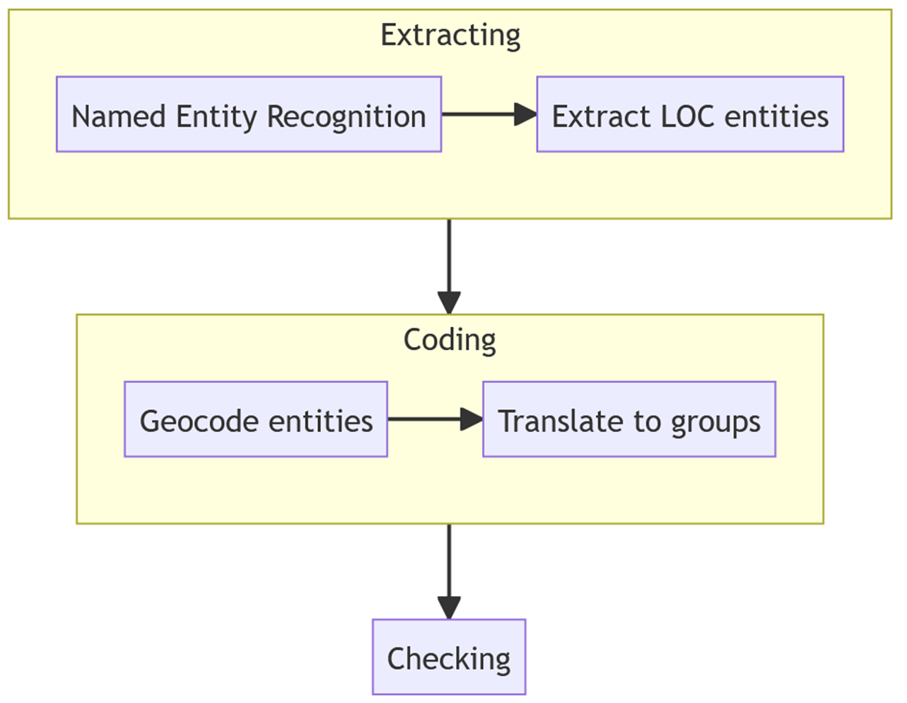
Methods
Results manually checked and corrected:
Is entity really a location? Is geocoding correct? Is group correct?
➔ 18, 379 publications mention a location (39%)
Entity | Geocoded | Country | Group
Wolfsdonk | Wolfsdonk, Aarschot, Leuven, Flemish Brabant, Flanders, 3272, Belgium | Belgium | Belgium | ✅
Quang Tri | Quảng Trị Province, Vietnam | Vietnam | Rest of the world | ✅
Miocene - | Miocene, Area F (Horsefly/Likely/150 Mile House), Cariboo Regional District, British Columbia, Canada | Canada | Rest of the world | ❌
Notes:
On to the results

Slide 10
Countries with highest number of mentions
Country | Mentions |  | Example locations
Belgium | 7848 |  | North Belgium - Hospital Leuven
Netherlands | 1701 |  | Arnhem - Radboud Universiteit Nijmegen
United States | 1653 |  | City of New York - Grand Rapids, Mich.
United Kingdom | 862 |  | Noord-Ierland – Ealing Abbey
France | 858 |  | Tour Bois-le-Prêtre - Normandy
Italy | 746 |  | Bergamo - Sicilië
Germany | 739 |  | Berlin Holocaust Memorial - Regensburg
China | 672 |  | Tien Shan – Hubei
Spain | 520 |  | Galicia - Spanish Court
DR Congo | 324 |  | Zaire - Lubumbashi
Notes:
- Belgium is clearly highest, as one would expect
Other countries in list are geopolitically important (globally or at least within Europe)
Other:
NL: same language, main collaboration partner
DR Congo: former colony, strong historic ties

Slide 11
Language
Notes:
Other includes French. Very low number (15 mentions).
Both English and Dutch ~40% of publications mention a location (~75% for other, but the numbers there are too low to be reliable)

Slide 12
Local journals
Because of the difficulty of defining ‘local journal’, we looked at specific examples. These suggest a wide variability but overall greater focus on Belgium.
Location can be implicit
Only 26% of articles in Tijdschrift voor Belgisch burgerlijk recht mention any location
Some local journals have deliberate international orientation
Belgian Review of International Law, Internationale Spectator
Notes:
Tijdschrift voor Belgisch burgerlijk recht: 83% Belgium but only 26% of publications mention any location

Slide 13
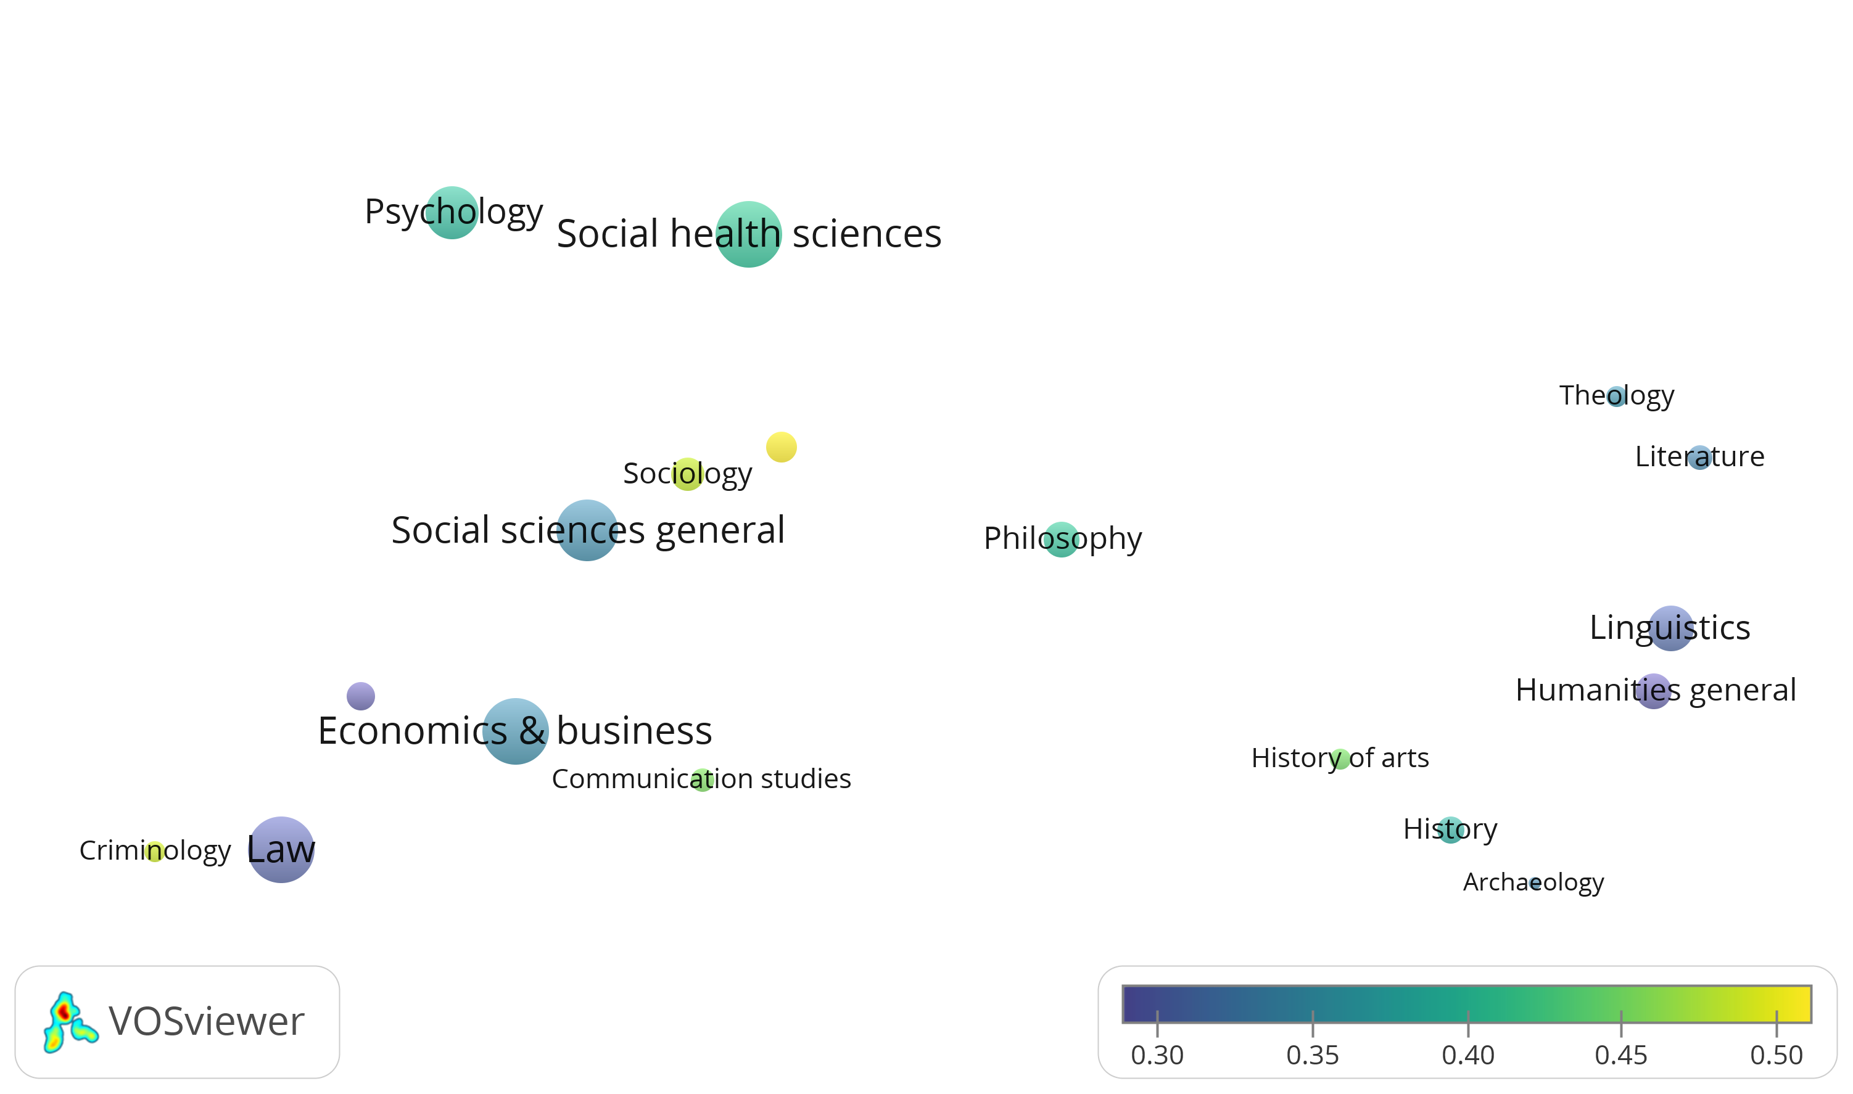
Disciplines: share of Belgium mentions
Educational sciences
Political sciences
Notes:
Left: social sciences, right: humanities
Highest shares in sociology, criminology, educational sciences

Slide 14
Conclusions and next steps
39% of Flemish SSH studies refer to some geographic context.
Most commonly (43%) Belgium, with the Netherlands second (9%) → common language Dutch
Publications reflect attention to specific countries and parts of the world (cf. DR Congo)
Locally oriented publications occur far more often in Dutch
Local language publications more likely to aim at direct, local societal impact
Local journals? probably
Next steps: broaden to other disciplines and countries
Notes:
Belgium (43%) , followed by Europe (37%), and the rest of the world (36%)
Decreasing share of Belgium: Why? -> likely multiple reasons, including growing number of non-Belgian researchers in Flanders and overall globalization
NL second most common: well before other (larger) neighbouring countries like France (5%) and Germany (4%)
+ in particular disciplines (educational sciences, sociology, criminology).

Slide 15
Thanks!
CC0; https://negativespace.co/globe-world-map/
Raf Guns
raf.guns@uantwerpen.be
@rafguns@mastodon.social
Cristina Arhiliuc
cristina.arhiliuc@uantwerpen.be
Hongyu Zhou
hongyu.zhou@uantwerpen.be

