Slide 1
Field affinity
Henrik Karlstrøm and Dag W. Aksnes, NIFU
Nordic Workshop on Bibliometrics and Research Policy, 2023

Slide 2
What is interdisciplinarity?
No consensus on the definition and operationalization
Different approaches provide inconsistent and sometimes contradictory results
Both references from and citations to scientific publications have been used to operationalize interdisciplinarity
We think outgoing references is most appropriate as unit of analysis as these reflect the knowledge base used
Also recommended by recent review by Wang and Schneider (2020)
Q Wang, JW Schneider. 2020. Consistency and validity of interdisciplinarity measures. Quantitative Science Studies 1 (1): 239–263.

Slide 3
Field affinity
Adhere to Rafols et al. (2012)
Interdisciplinarity as “knowledge integration”, establishing links between cognitively distant or separate bodies of knowledge
Utilize a distributional measure combined with a distance function
Method is source agnostic, and can be used on any collection of documents with citation relations
Cases today applied to the WoS classification system (~250 categories)
Rafols, I. et al. 2012. How journal rankings can suppress interdisciplinary research: A comparison between innovation studies and business & management. Research Policy, 41(7), 1262–1282

Slide 4
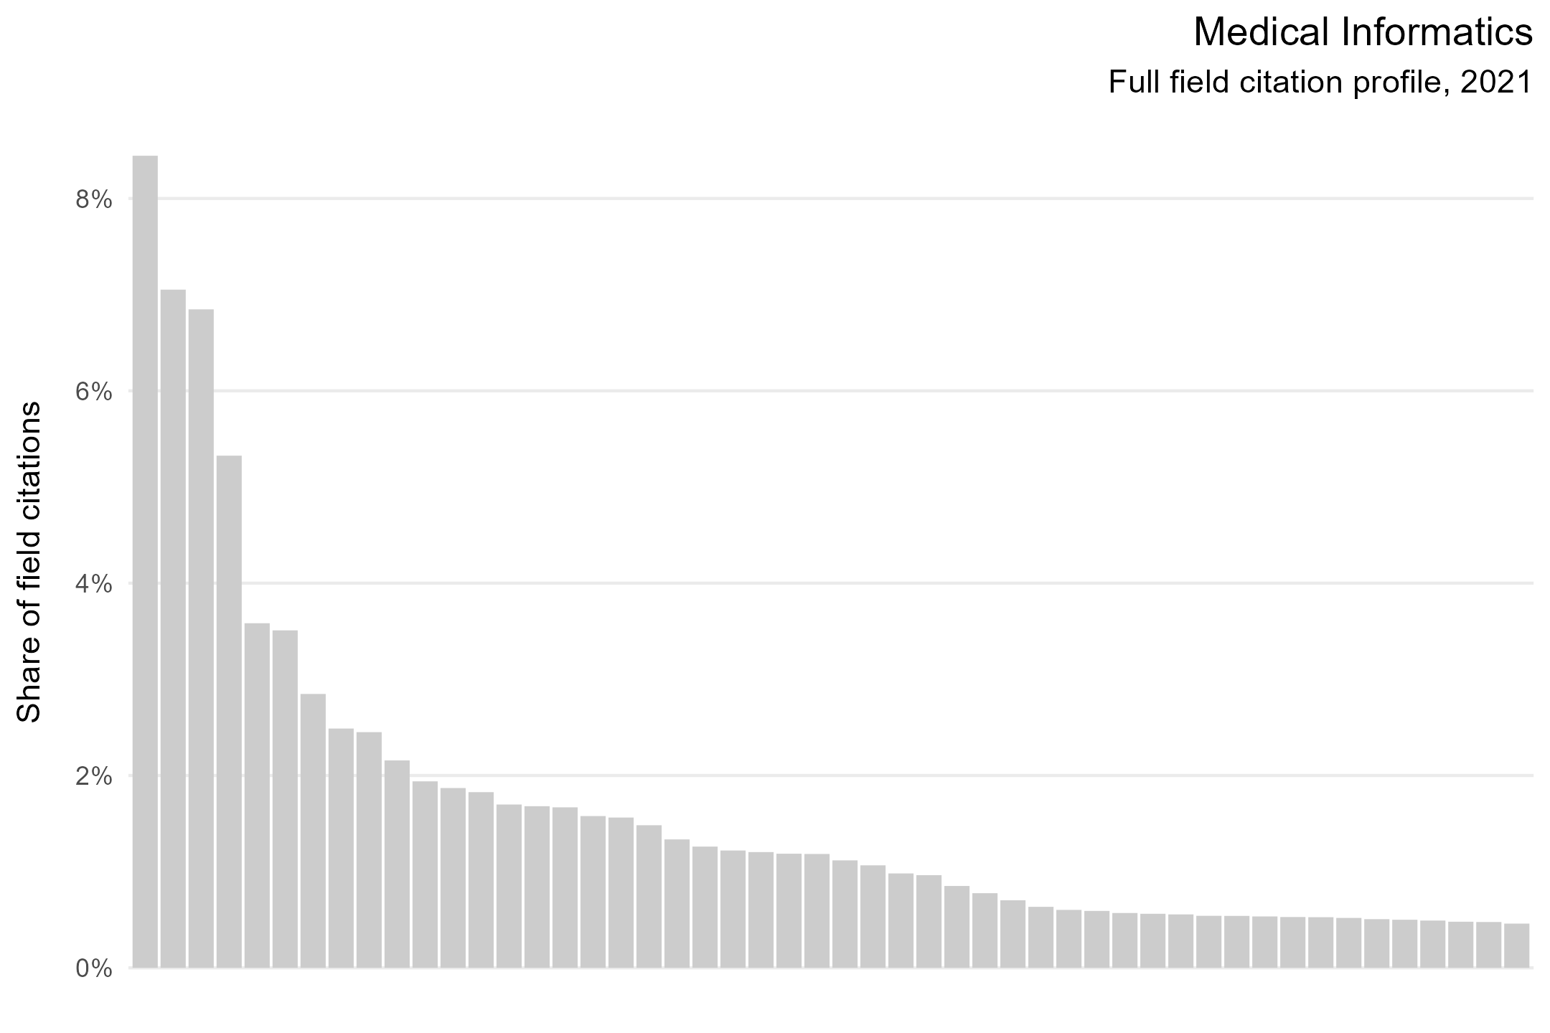

Slide 5
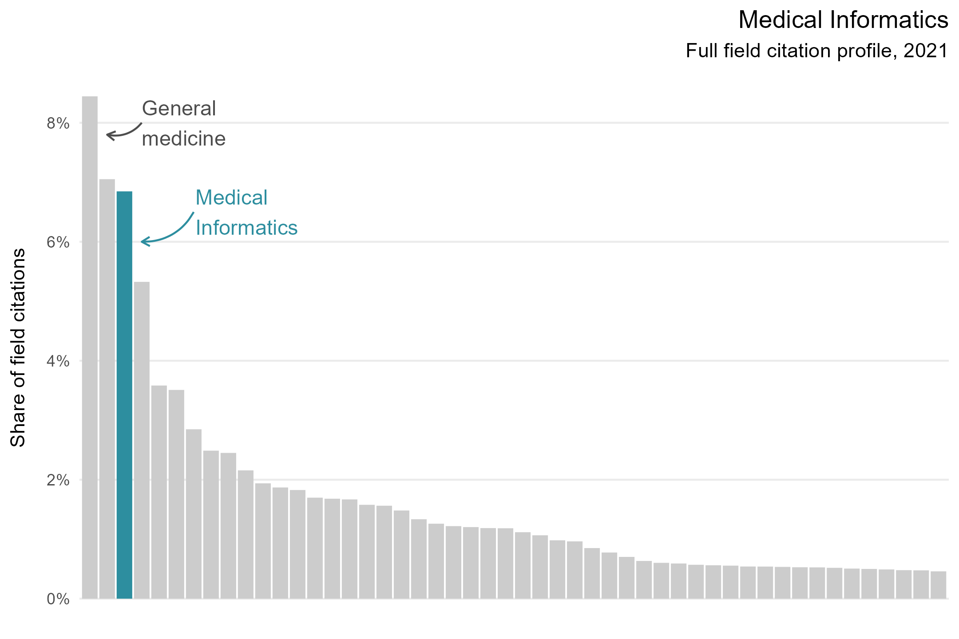

Slide 6
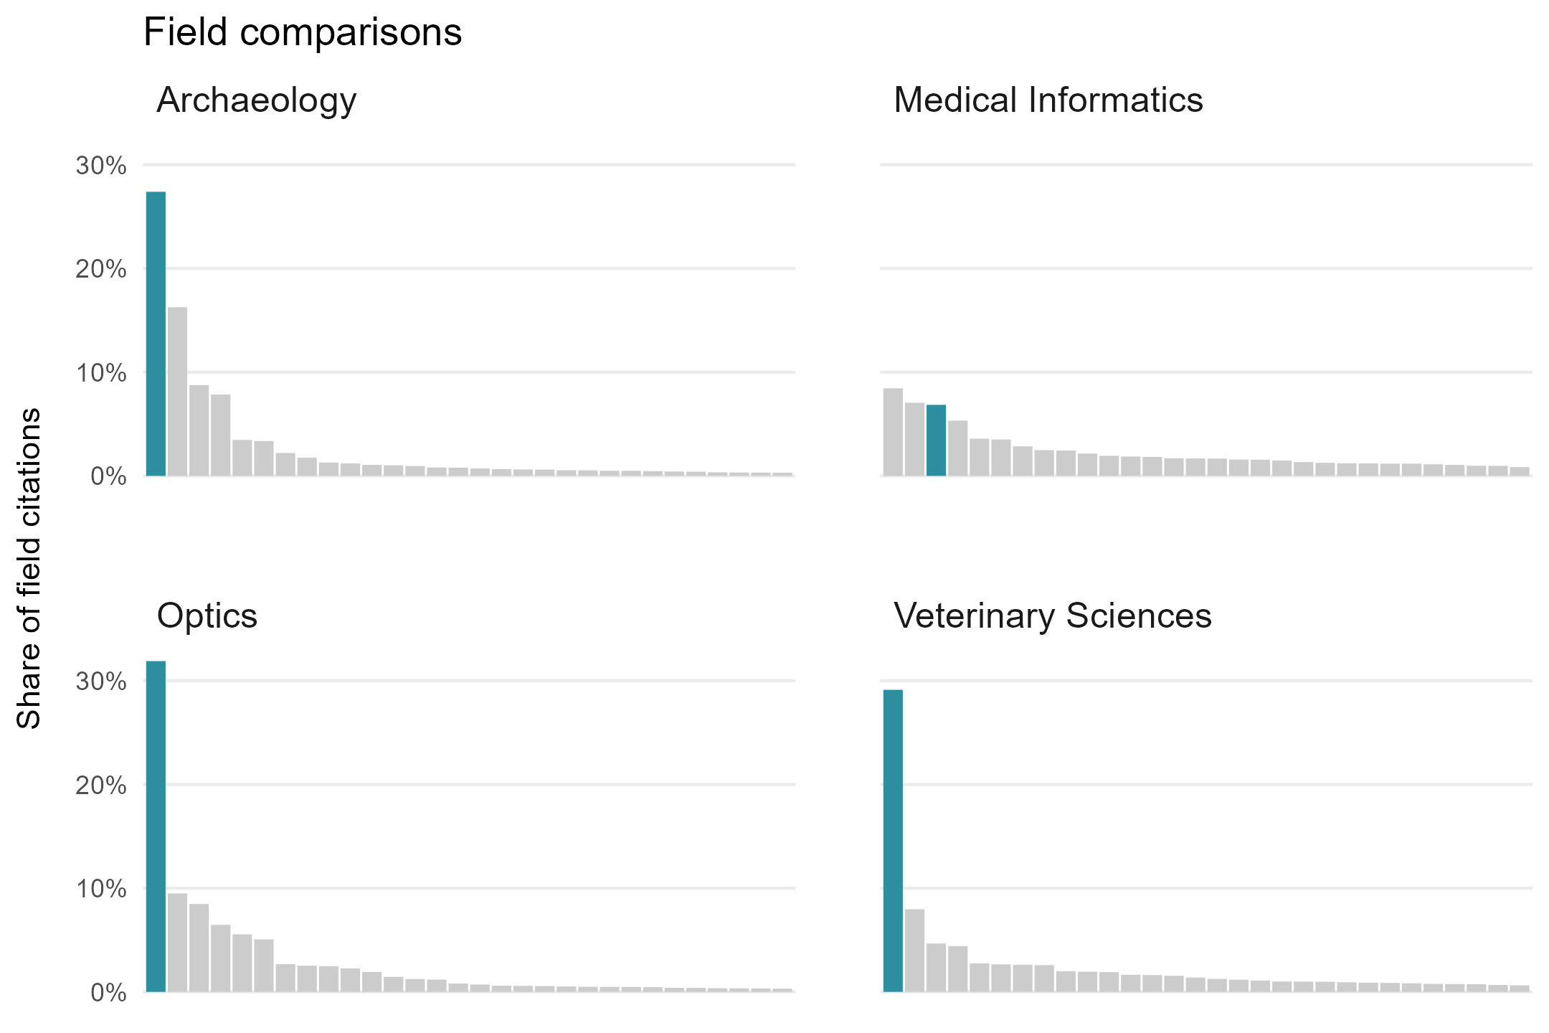

Slide 7
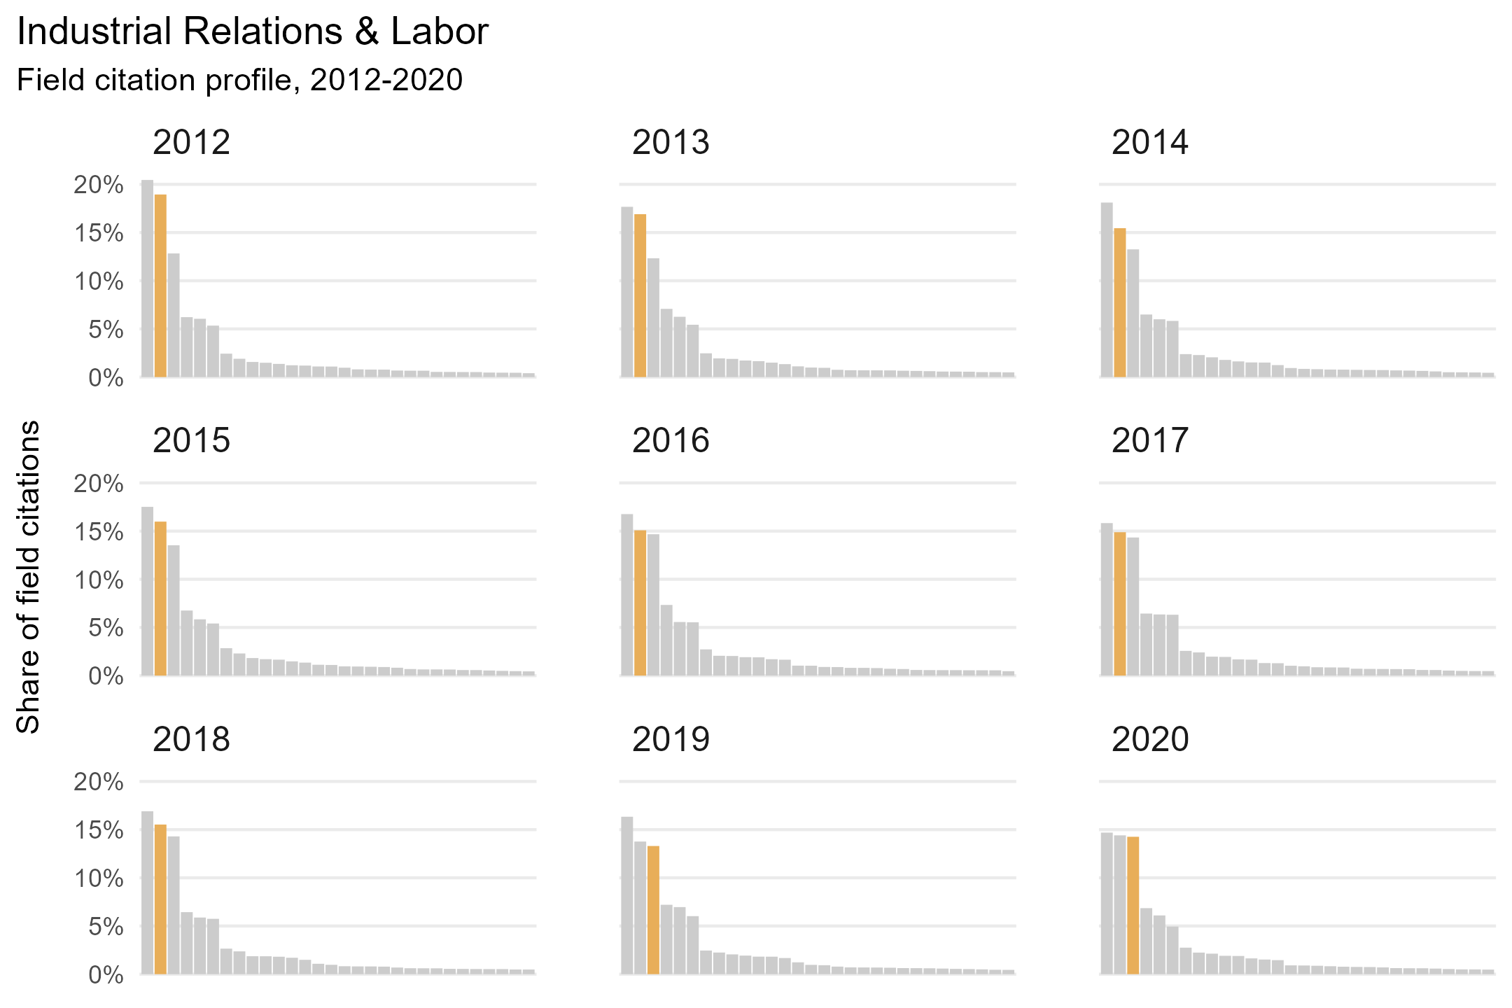

Slide 8


Distributions are not sufficient
$$i= \sum{\frac{\frac{f_{c}}{c}}{m_{n}}}$$
[1]
Need a measure of difference and distance
Difference
Ratio between global and field distributions
Distance
Application of weighted differences to local instances
Interdisciplinarity score
Penalizes references to high-affinity fields
Weights are averaged in cases of multi-field publications
$$m_{n}=\frac{m_{i}−1}{m_{i}+1}+1$$
[2]
$$m_{i}=\frac{P(f)}{P(g)}$$
[3]
$$P\left(f\right)=\frac{\sum{f_{c}}}{\sum{f_{d}}}$$
[4]
$$P\left(g\right)=\frac{\sum{f_{d}}}{\sum{f_{g}}}$$
[5]

Slide 9
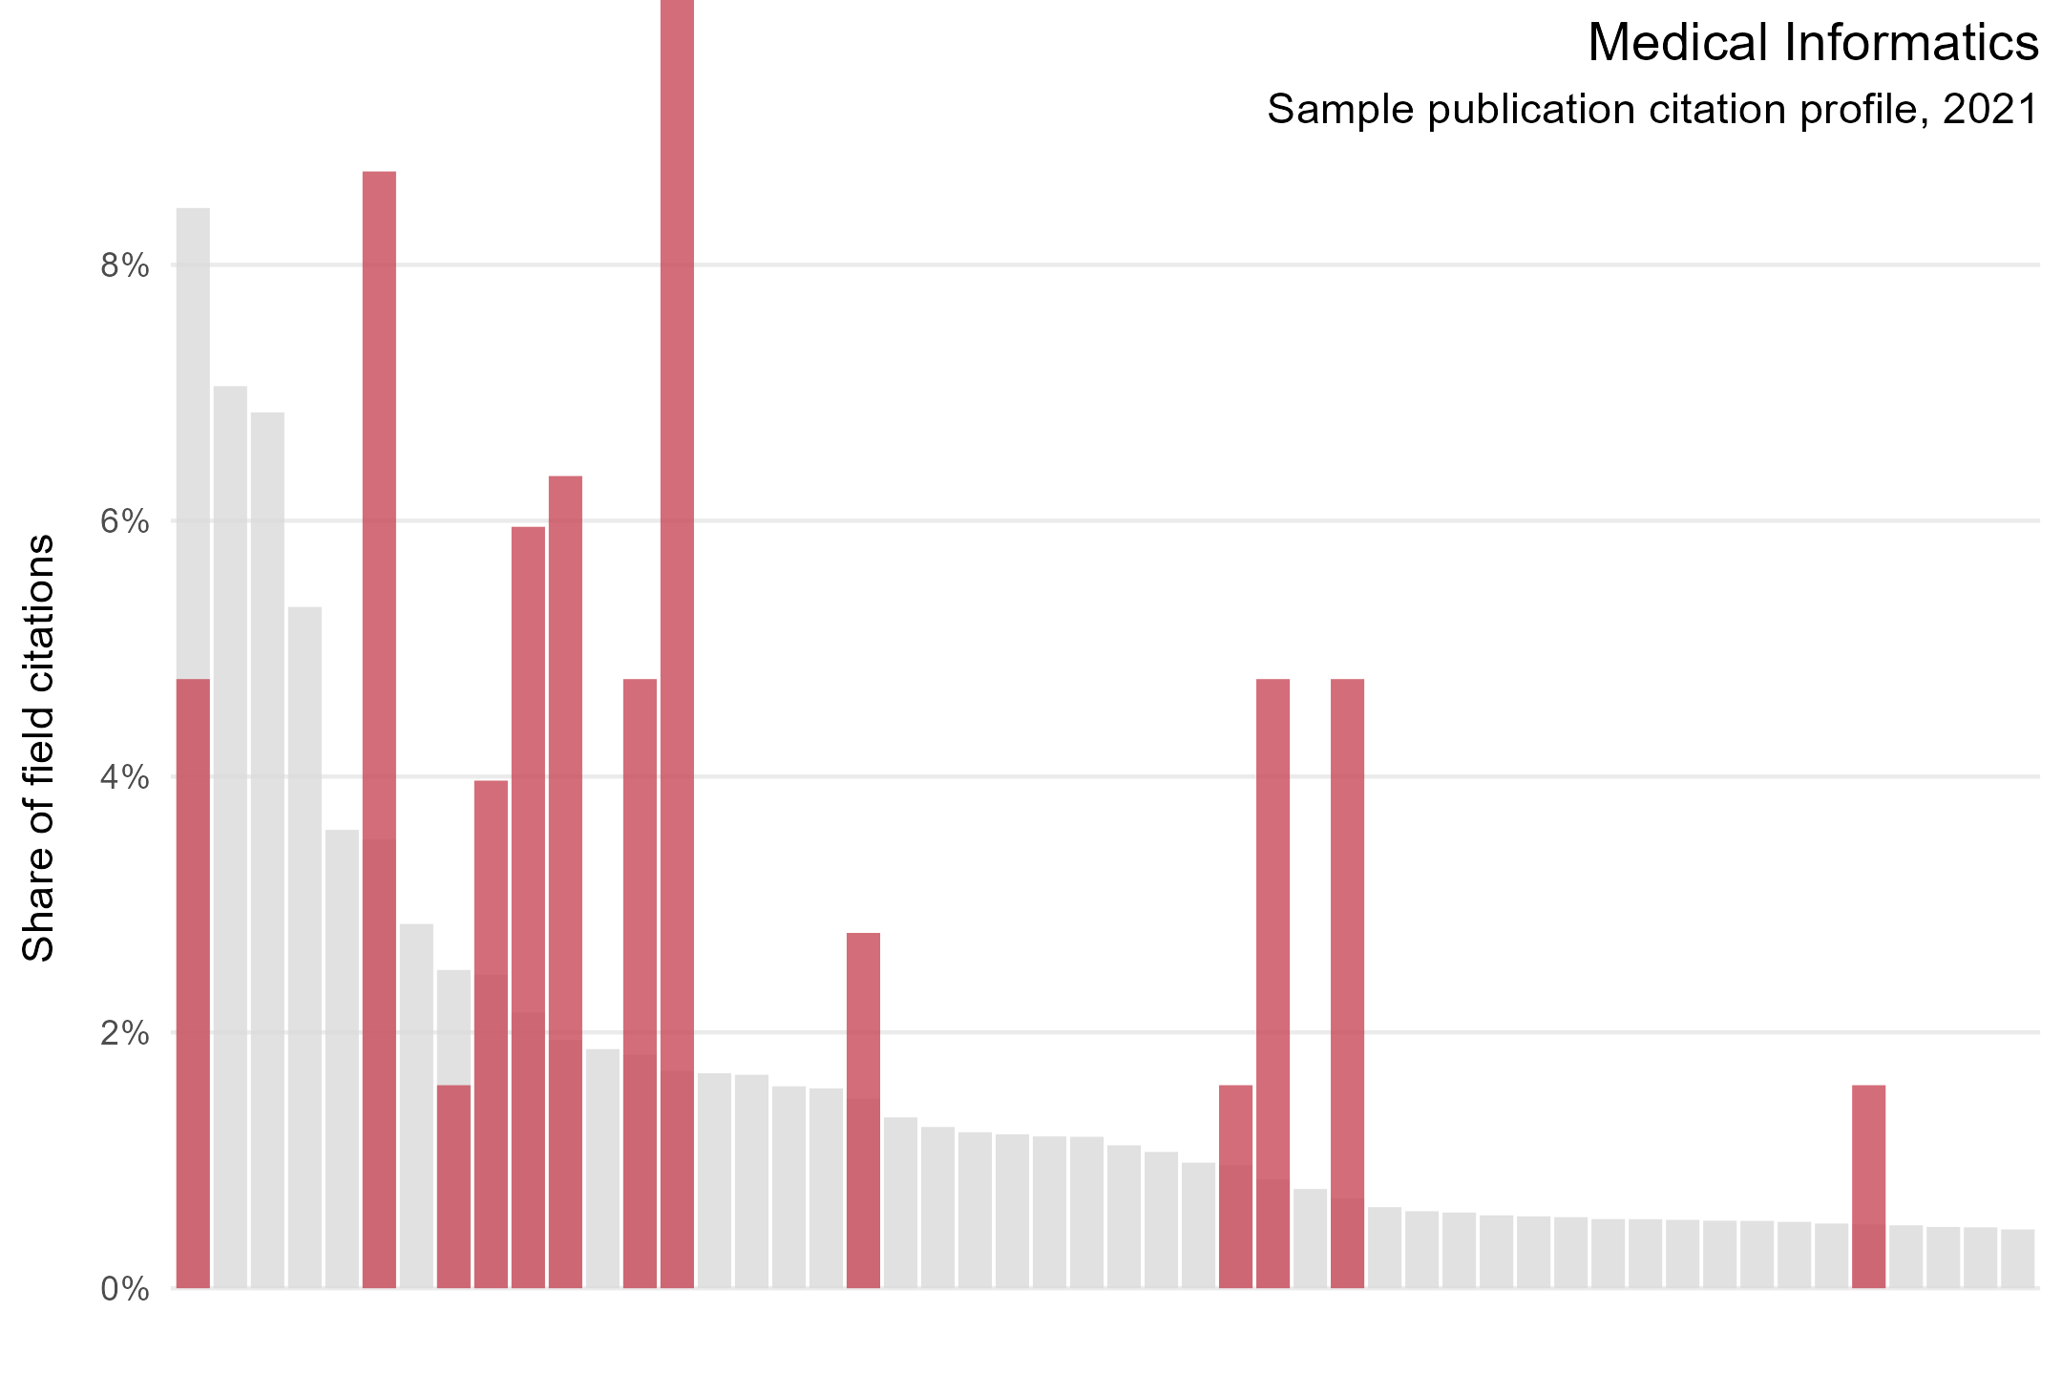

Slide 10
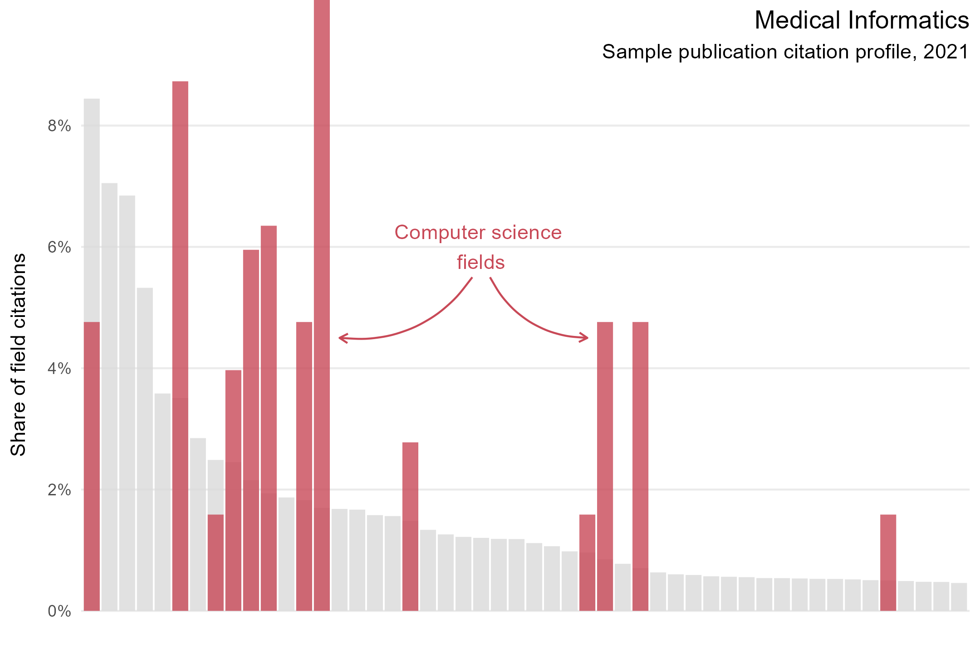
Zero references to Medical Informatics

Slide 11
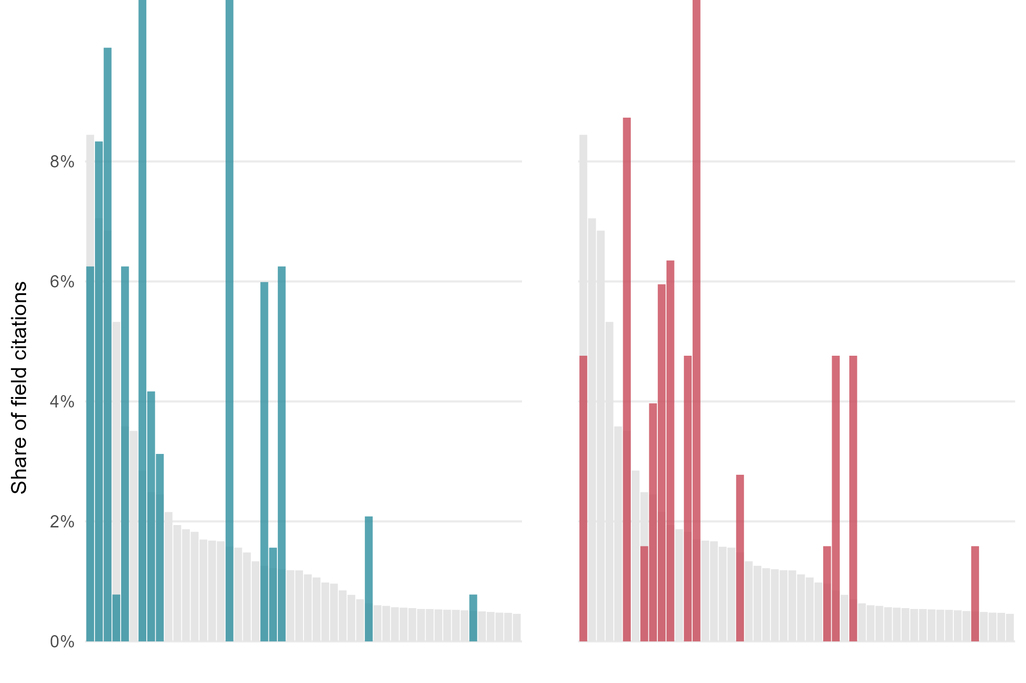
0.19
0.66

Slide 12
Use cases
Bespoke analysis
Profiling research units
Identifying boundary research
Bibliometric housekeeping
Integrate citation clustering into other classification systems
Time series analysis of field developments
Modifier in field normalization?

