Slide 1
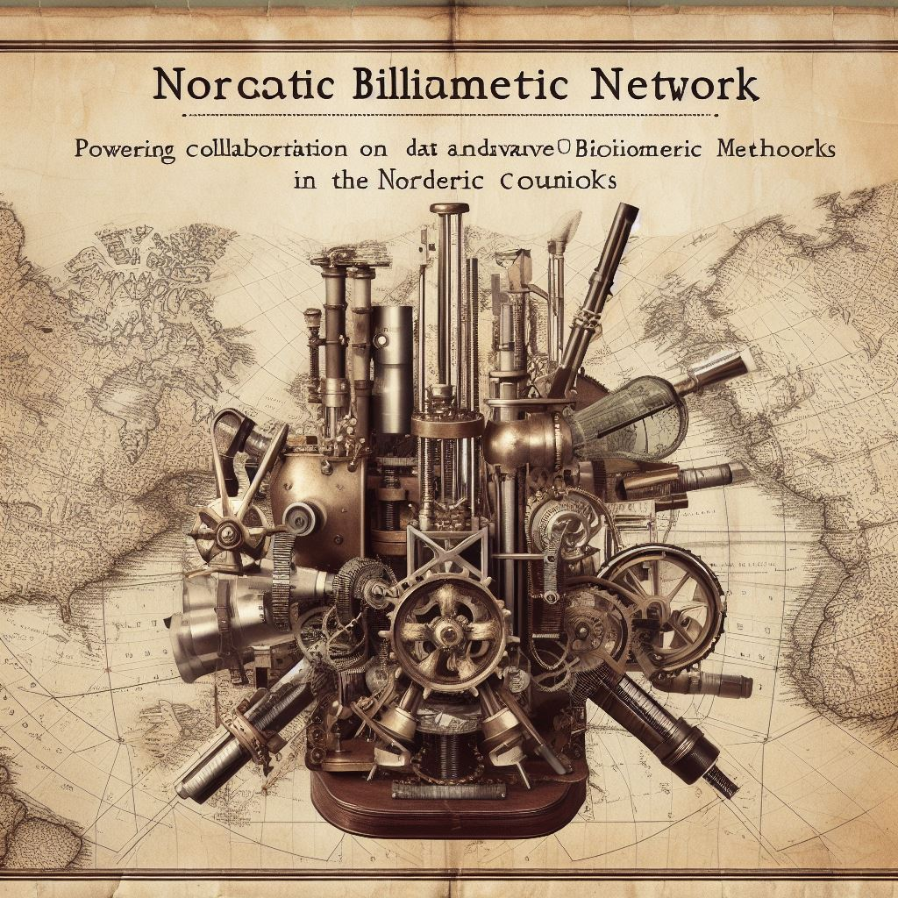
Proposal for a Nordic Bibliometric Infrastructure
Powering collaboration on data and advanced bibliometric methods
in the Nordic countries
Gustaf Nelhans, SSLIS, SE
Ivar Ternsell Torgersen, SIKT, NO
2023-10-11

Slide 2
Agenda
Gustaf Nelhans: Nordic Bibliometric Infrastructure: What, why and how?
Peter Sjögårde: Science mapping in practice: Experiences from Karolinska Institutet
Henrik Karlstrøm: Sources for data on research activities
Ivar Ternsell Torgersen: Invitation to Spring meeting
Open discussion: What, why and how? Arguments for a Nordic collaboration for methods

Slide 3
Nordic Bibliometric Infrastructure
Focus on advanced bibliometric methods (coding in R and Python) and sources to bibliometric data
Basic and advanced courses: recruit to the network
The first basic course on R programming was held in Gothenburg in August 2023
Platform to discuss advanced bibliometric methods – Teams area, Git for code
For both evaluation, funding and explorative bibliometrics
Knowledge transfer – best practice – policy positioning;
e.g. CoARA, national evaluation efforts, funding models at different levels
Collaboration on enhancing open sources with bibliometric data
Promote plurality in bibliometric sources; openness for transparency and interoperability
Yearly spring meeting/workshop
to elaborate on advanced methods
and an option for thematic courses on advanced topics

Slide 4
«Invitation» to Spring meeting...
... will soon arrive in your mailbox: email: ivarto@sikt.no
Oslo, Fredrikstad, Karlstad or Gothenburg? (up for grabs)?
Two and a half day one of the tree last weeks of April 2024
Five half day’s sesions, e.g.:
Intermediate course in R (for people with basic course)
Parallel session ggplot/text mining (course)
Parallel session other topics using existing R packages, linked data, combining sources
Expert meeting 1: Automatic subject classification
Expert meeting 2: Leveraging scholarly language models

