Slide 1
Cocreating open science ecosystem to foster the reform of research and researchers assessment
The 28th Nordic Workshop on Bibliometrics and Research Policy (NWB2023) Session VIII: Open Science
Susanna Nykyri, Chief Specialist, Tampere University
Laura Niemi, Development Specialist, University of Turku
Ilmari Jauhiainen, Senior Expert, TSV
Ari Rouvari, Lead enterprise architect, CSC

Slide 2
AGENDA
CONTEXT
AIM AND PROCESS
CONCLUSIONS

Slide 3
CONTEXT

Slide 4
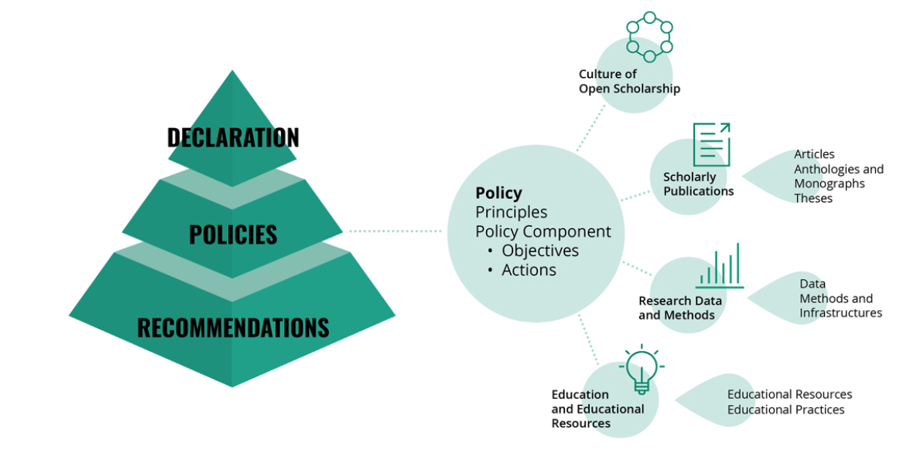
THE NATIONAL COORDINATION OF OPEN SCIENCE
In Finland, The Ministry of Education and Culture has transferred the responsibility for communication on open scholarship issues to the Federation of Finnish Learned Societies.
→ under The Federation of Finnish Learned Societies works Secretariat for the National Open Science and Research Coordination.
The Finnish research community has jointly created a Declaration for Open Science and Research.
The Secretariat for the National Open Science and Research Coordination will monitor the level of Open Science in Finnish research organisations.
More information: https://avointiede.fi/en

Slide 5
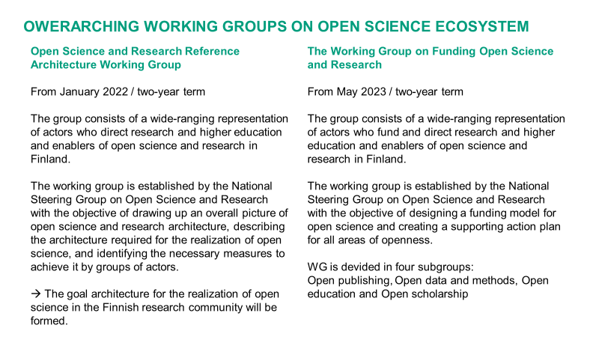
Both of these WGs conduct mid-term reporting about the progress for the Ministry of Culture and Education

Slide 6
INTERNATIONAL CONTEXT AND INITATIVES OF RESPONSIBLE RESEARCH AND RESEARCHER ASSESSMENT
SAN FRANSISCO DECLORATION ON RESEARCH ASSESSMENT
The DORA Decloration published in 2012 aims to improve the quality of evaluation of research outputs. https://sfdora.org/
LEIDEN MANIFESTO FOR RESEARCH METRICS
The Leiden Manifesto for Research Metrics published in 2015 was designed so that researchers can review the methods that are used to assess their work and that the evaluators can justify the used indicators. http://www.leidenmanifesto.org/
THE HONKONG PRINCIPLES FOR ASSESSING RESEARCHERS
The Hong Kong Principles for Assessing Researchers published in 2019 aims to develop researcher assessment to more sustainable in regard to research ethics and more versatile and of a higher quality. https://www.wcrif.org/guidance/hong-kong-principles
UNESCO RECOMMENDATION ON OPEN SCIENCE
The UNESCO Recommendation on Open Science provides an international framework for open science policy and practice that recognizes disciplinary and regional differences in open science perspectives. https://www.unesco.org/en/open-science
EUROPEAN AGREEMENT ON REFORMING RESEARCH ASSESSMENT
The Agreement sets a shared direction for changes in assessment practices for research, researchers and research performing organisations, with the overarching goal to maximise the quality and impact of research. https://coara.eu/
The Finnish higher education system consists of 13 universities and 22 universities of applied sciences.
Currently 12 universities and 17 universities of applied sciences are CoARA signatories.
TSV will be coordinating CoARA’s Finnish National Chapter.

Slide 7
AIM AND PROCESS

Slide 8
AIM OF THE ARCHITECTURE
In order to cocreate an Open Science Ecosystem, we need a roadmap for:
1) developing policies and legislation to support OS
2) creating and developing skills and services for OS
3) services to be in place for the ecosystem to work 4) defined actors to take the responsibility for providing these capacities, skills and services

Slide 9
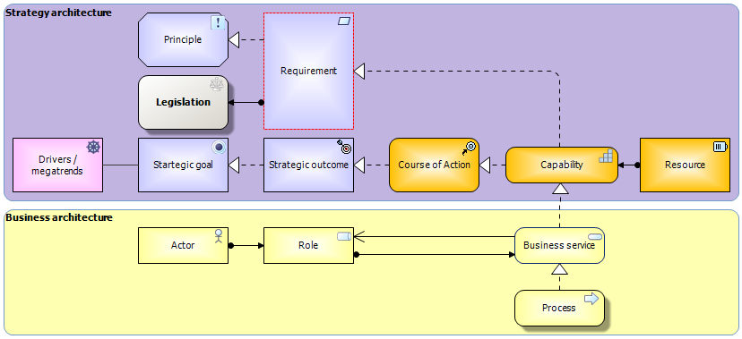
OPEN SCIENCE AND RESEARCH REFERENCE ARCHITECTURE (OScaR) – OBJECTIVES
Capabilities realize the strategic goals and legal requirements
For steering open science and research at the national level
Implementing Finnish open science declaration and policies
Visualizing Finnish open science declaration and policies
The OScaR reference architecture steers organizations’ enterprise architecture definitions
Business services realize the capabilities
Business services are delivered by business processes
Deliverables: a document guiding the development of the field of open science and guidelines for its use

Slide 10
FINNISH OPEN SCIENCE AND RESEARCH ACTORS
Research and education funding and steering actors
Research and education steering and assessing actors
Open science and research enablers
Authors owning copyrights and related rights
Other copyrights and related rights owners
Research and education administration and support service providers
Research and science actors
OS users

Slide 11
6 SERVICE AREAS
Overarching services
Open access scholarly publication
Research data, infrastructures & methods
Education and educational resources
Participatory science
Responsible assesment

Slide 12
STEPS TOWARDS OPEN SCIENCE ECOSYSTEM
2022
Open Science and Research Reference Architecture Working Group starts to work
NWB2023
Presentation of the current state of the OScaR architecture
2024 Implementation of the OScaR architecture in the RPOs
Influential National Open Science Ecosystem
Spring 2023
Open commentary on the OScaR architecture
Autumn 2023-spring 2024 Finalizing the OScaR architecture

Slide 13
CONCLUSIONS

Slide 14
THE STRENGTHS OF THE OScaR ARCHITECTURE
Covers organizational, national and international level and includes the maturity evaluation of the service areas
Provides concrete support for research organizations in their architecture development
Solid base for the OS Funding WG
Supports updating the Finnish national OS guidelines and recommendations
Strenghtens co-operation (which the current OS monitoring model does not)

Slide 15
THE CHALLENGES OF THE OScaR ARCHITECTURE
Dynamic content
Creation and keeping up-to-date very labor-intensive and requires broad co-operation and shared understanding
Works as a stimulant and knowledge-base, but further development needed at the organizational level a lot
Requires implementation support and resources for the organizations
Who takes and carries the actual responsibility?

Slide 16
THE OPPORTUNITIES OF THE OScaR ARCHITECTURE
Supports and develops knowledge based management
Strengthens infrastructures for OS
Strengthens co-operation between various actors and bring their perspective in to the national level development of OS ecosystem
Makes visible those skills and co-operation required to fulfill the aims of OS
Can (and should) be used in steering of the development of OS monitoring
OScaR Architecture could be used as a base for OS development also in European level

Slide 17
QUESTIONS, COMMENTS AND MORE INFORMATION
Susanna Nykyri, Tampere University, susanna.nykyri@tuni.fi
Laura Niemi, University of Turku, laura.niemi@utu.fi
Ilmari Jauhiainen, TSV, ilmari.jauhiainen@tsv.fi

