Slide 1
An Investigation of Policy Citations to Nordic Scientific Publications
Ashraf Maleki and Kim Holmberg
University of Turku
ashraf.maleki@utu.fi
kim.j.holmberg@utu.fi
NWB 2023

Slide 2
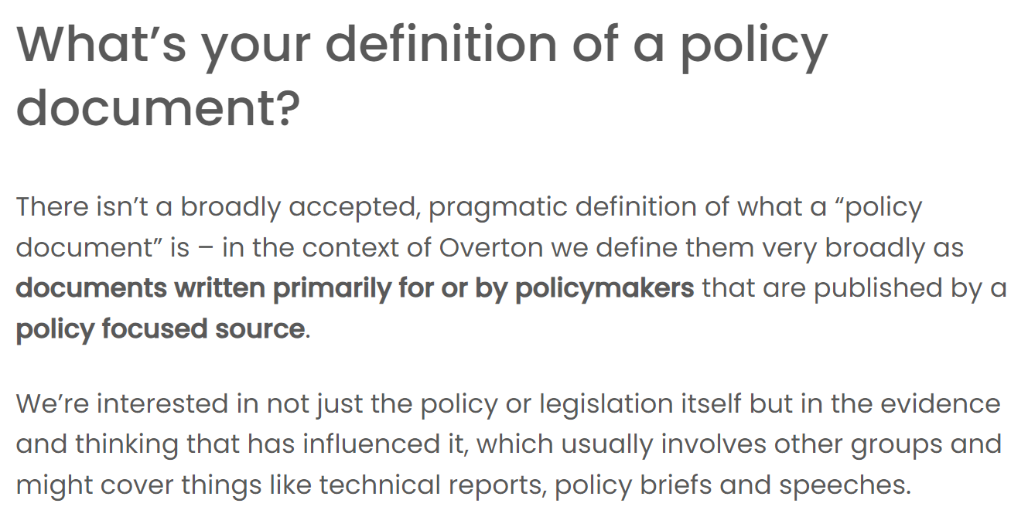
Introduction
Policy documents help evidence research impact.
What is a policy document? (A need for an operationalized definition)
Overton.io as a source of policy citations
Source: overton.io
Source: overton.io

Slide 3
Research Questions
Goal: To investigate Overton.io policy citations to scholarly articles of Nordic countries
RQ1: What type of policy sources are covered and what overall information they give about policy uptake of Nordic research across Nordic countries?
RQ2: What are the challenges and areas of improvement?

Slide 4
Method
Scopus publication of Nordic countries 2015-2021
837,119 publication with DOIs were examined in Overton for policy citations
Two datasets are acquired from Overton
Policy documents citing 93,378 scholarly articles with author from Nordic countries
All policy documents produced by Nordic countries

Slide 5
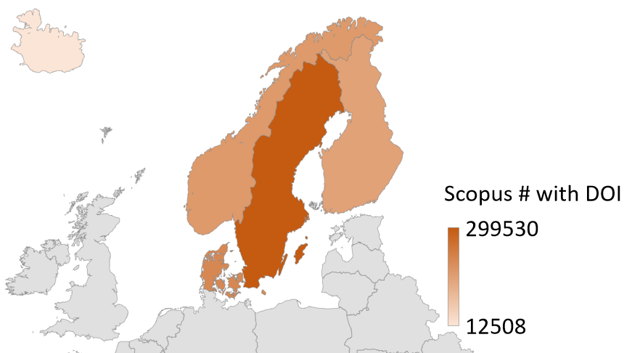
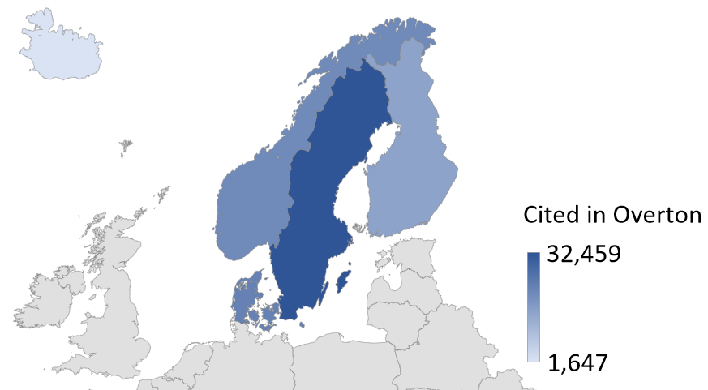
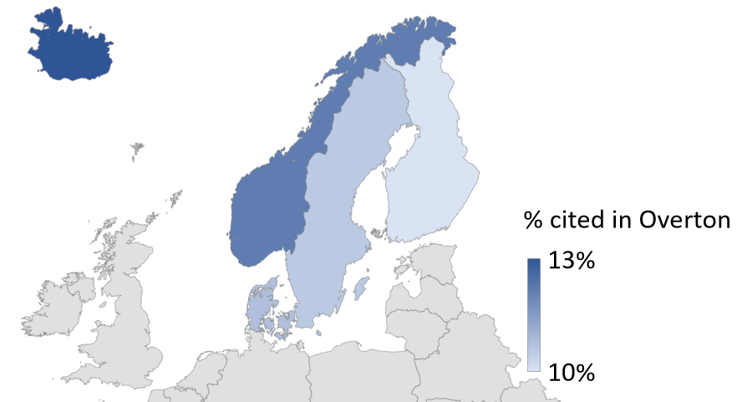
Scientific publications cited in policy documents across Nordic countries

Slide 6
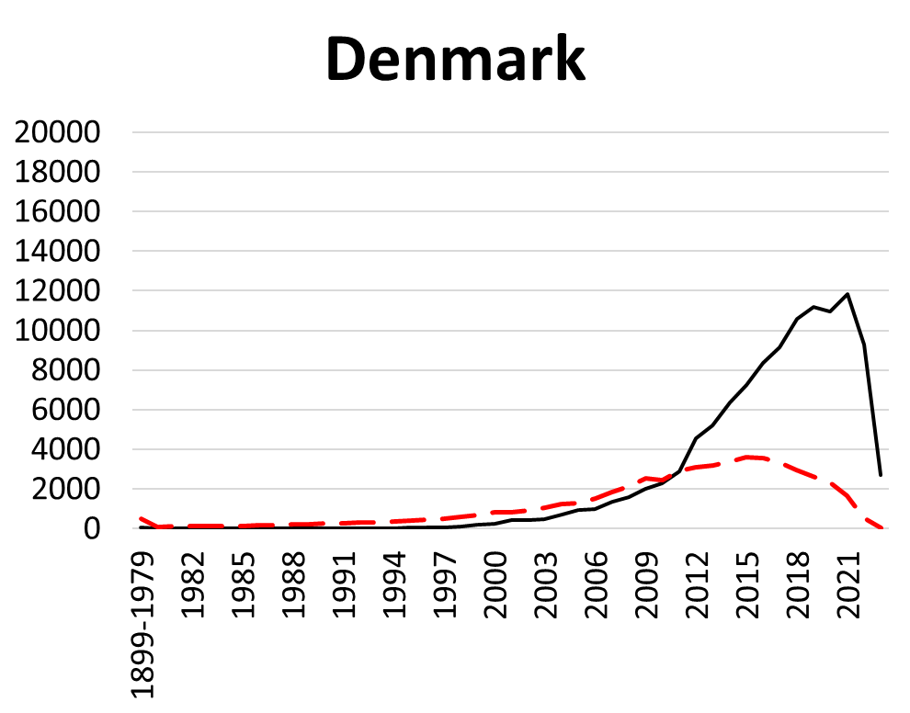
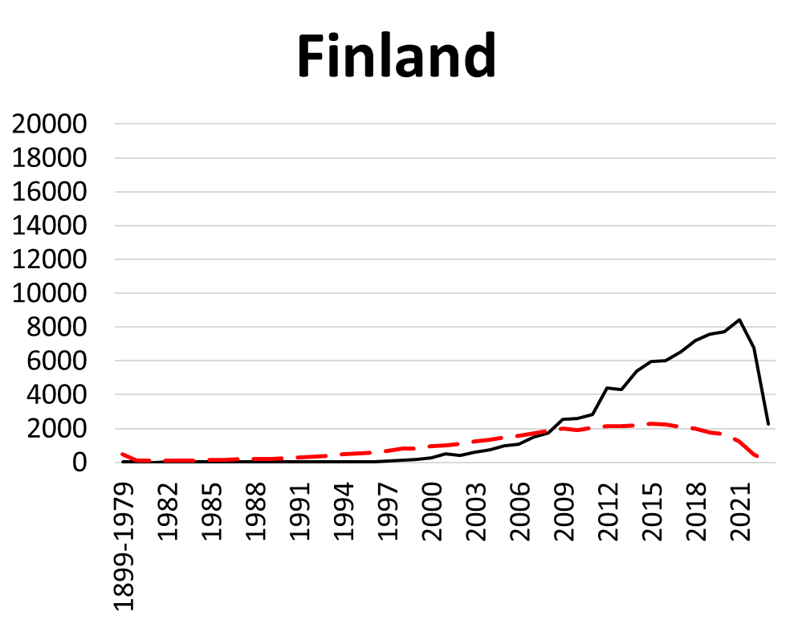
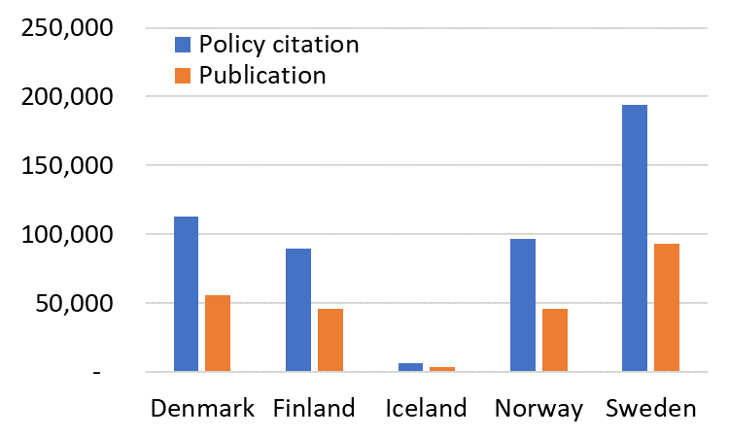
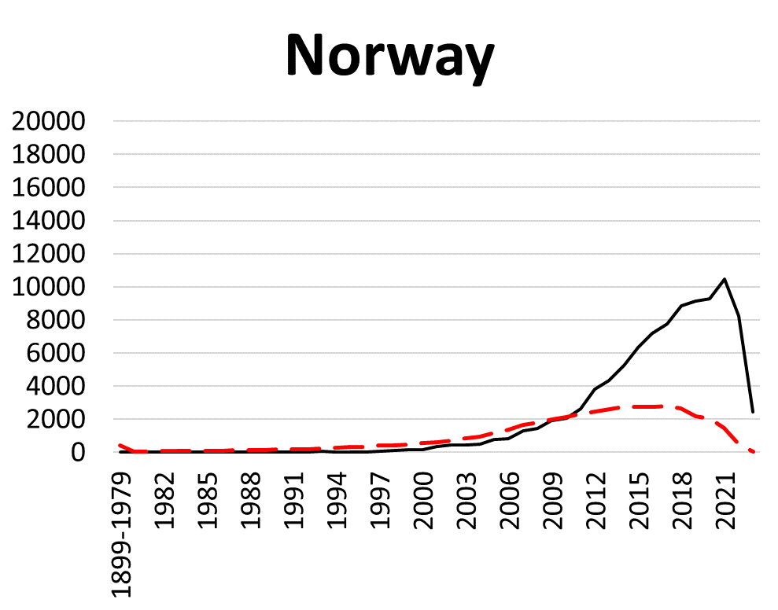
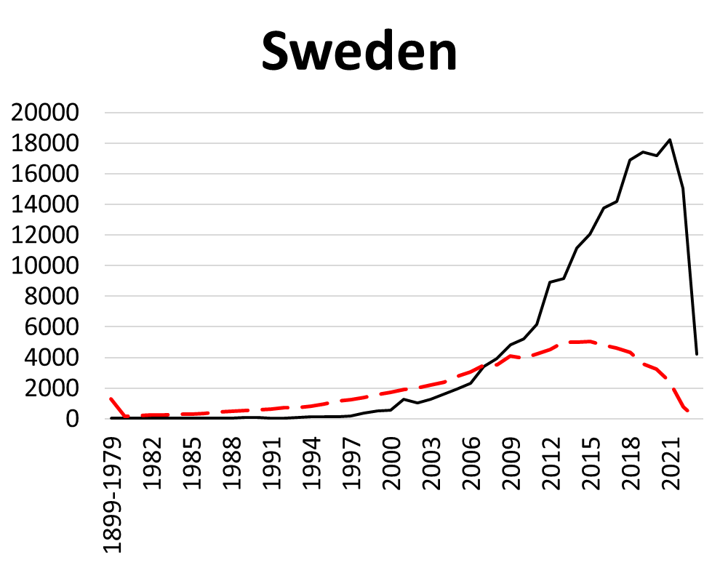
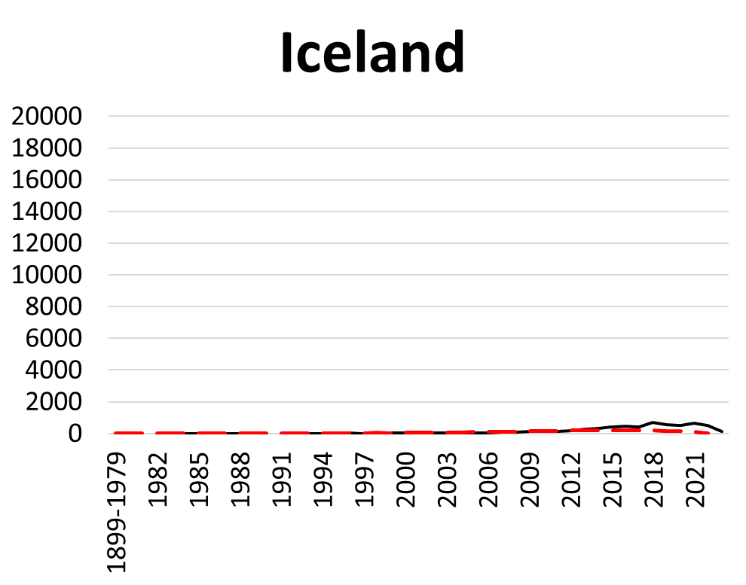
Proportion of scientific publications cited in policy across Nordic countries over time
12%
5%

Slide 7
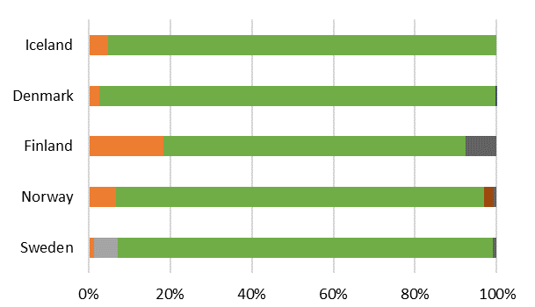
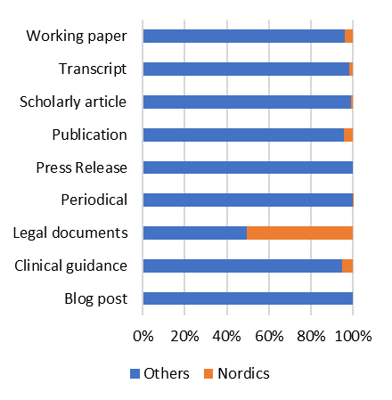
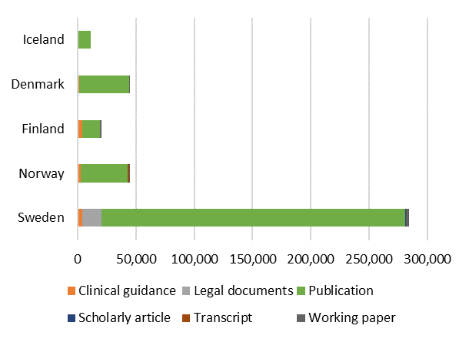
Policy document types
Notes:
This slide introduces the core focus of the presentation, which is to explore the differences between original tweets and retweets in the context of altmetric research on Twitter.

Slide 8
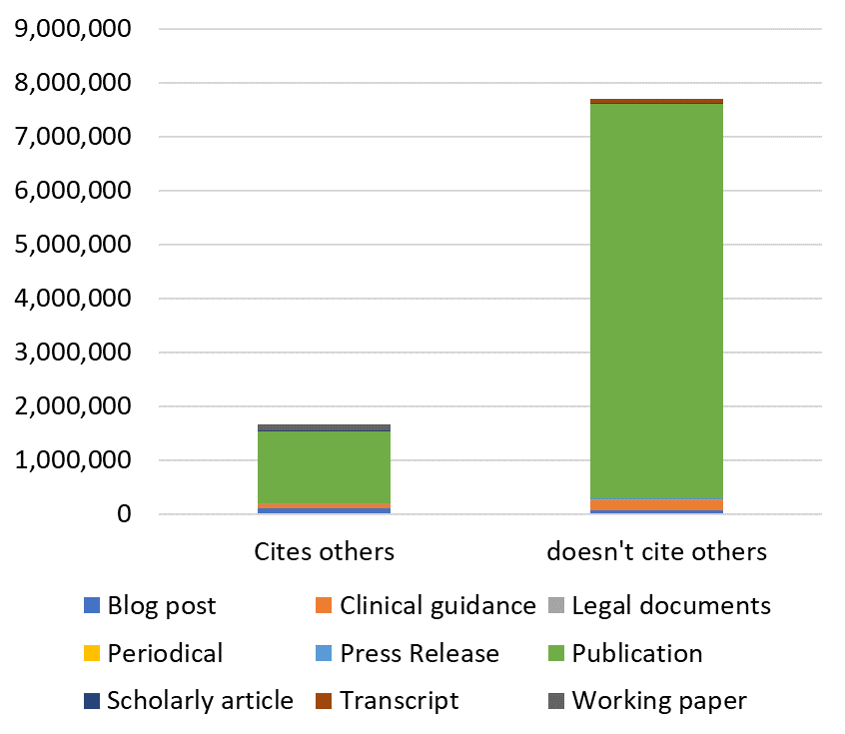
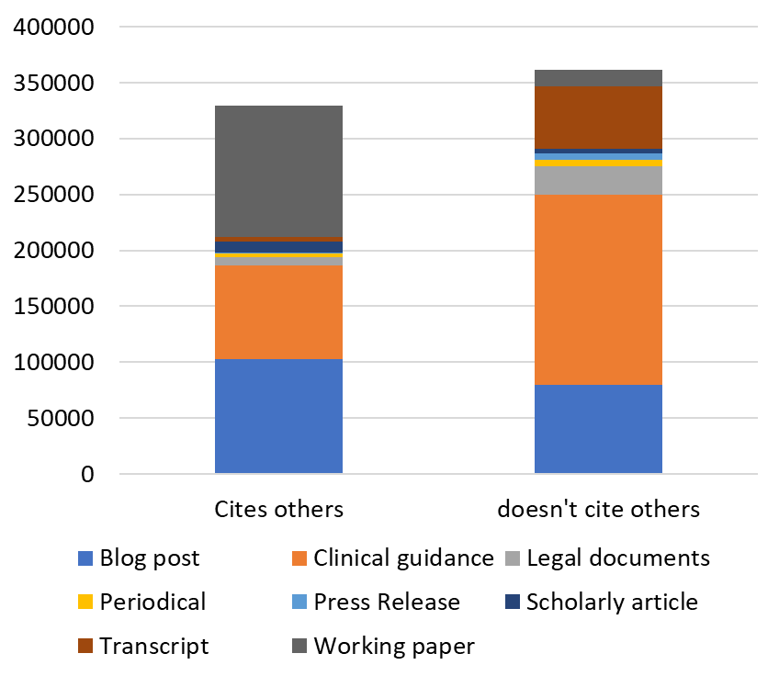
Tracking Path of policy impact
Academic researchers (journal article, clinical guidance, blog, news or press interview, etc.)
Think tank researchers (working papers, publications)
Non-journal outputs of academics cited by policy:
Blog post
Clinical guidance
Working paper
Noise: Non-citable documents in data
> Problem of normalization of data!

Slide 9
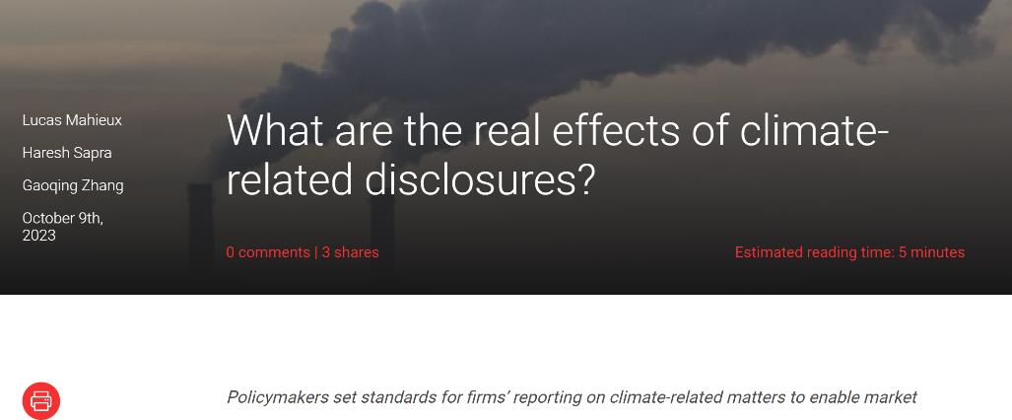
Does this blog post indicate
policy impact of research?
environmental impact of research?
Both?
Neither?

Slide 10
https://ifs.org.uk/people/
Does this Working paper indicate
policy impact of research?
Market impact of research?
Both?
Neither?

Slide 11
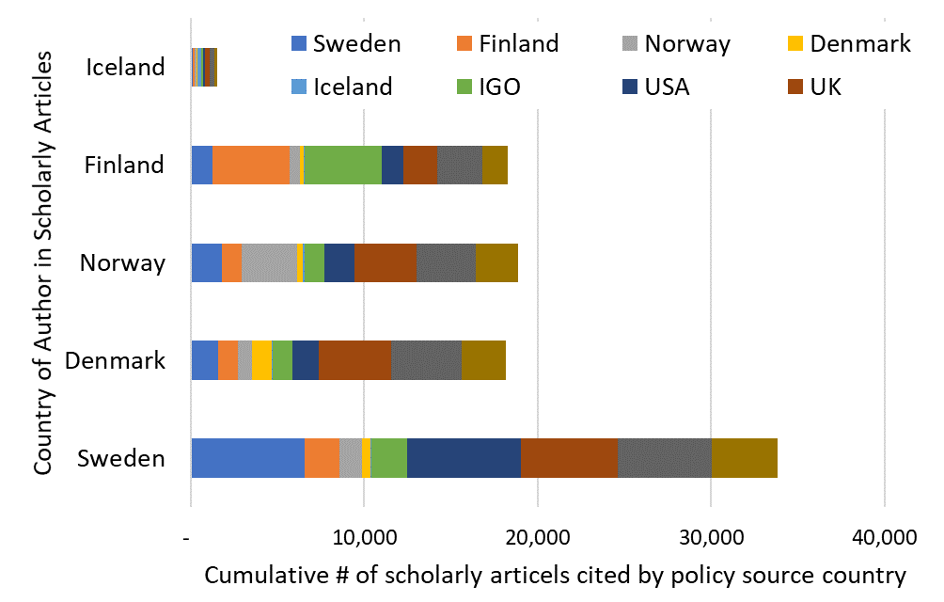
Co-authors of policy cited scientific articles

Slide 12
Topic assignment in
For scholarly articles:
with_journal_subject (WITH JOURNAL SUBJECT - beta)
medline_mesh (PUBMED MESH TERM)
For policy sources:
citing_topics (CITED BY POLICY WITH TOPIC)
citing_classifications (CITED BY POLICY WITH SUBJECT AREA)

Slide 13
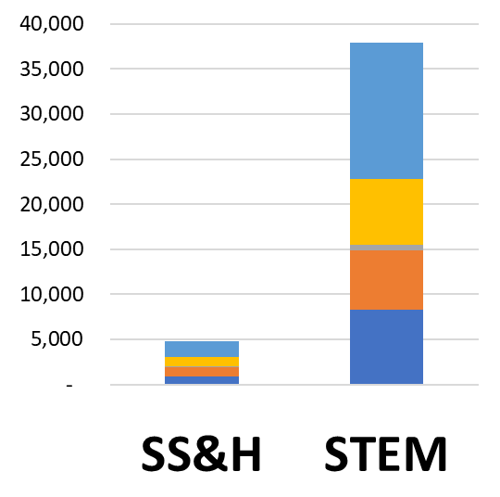
Policy cited scholarly articles across field
STEM
SS&H

Slide 14
Scholarly fields policy uptake across Nordics
1. Aquatic Science and Oceanography > Norway and Iceland
2. Forestry, Pediatrics and Education > Finland
3. Oncology > Denmark
4. Public health > Sweden

Slide 15
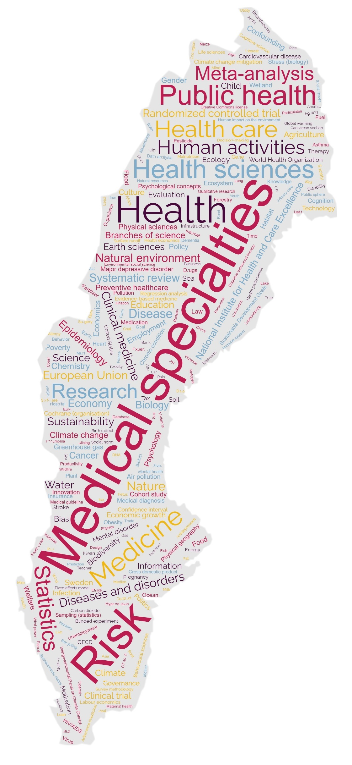
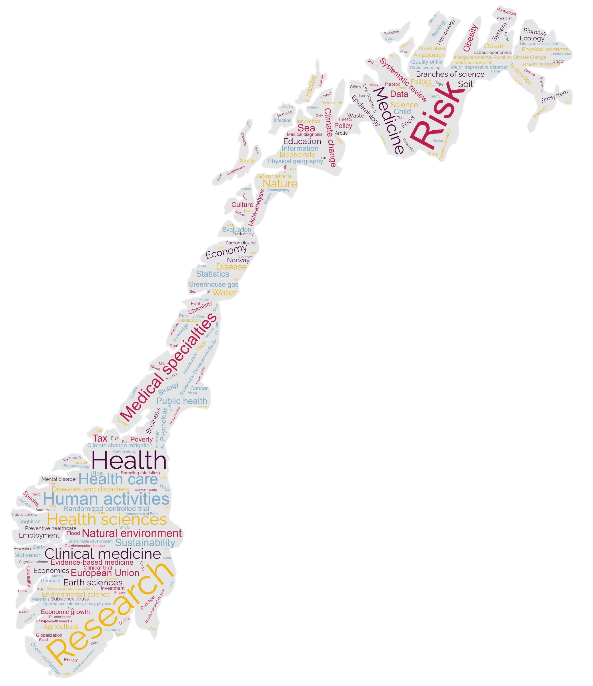
Policy topics in policy documents

Slide 16
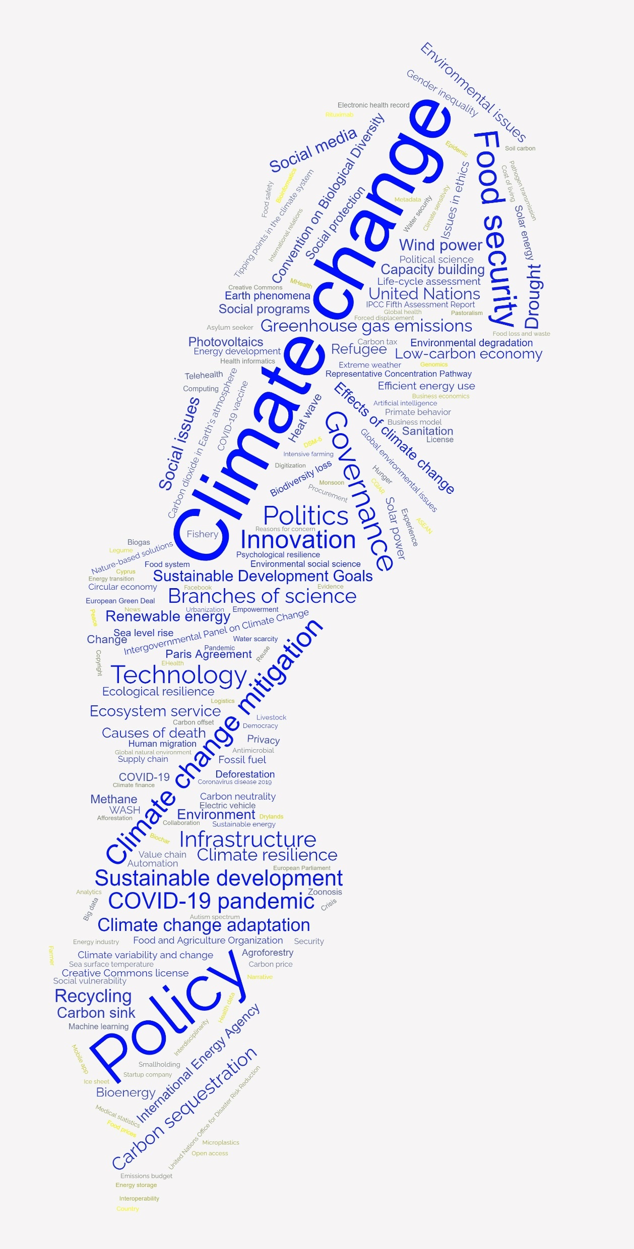
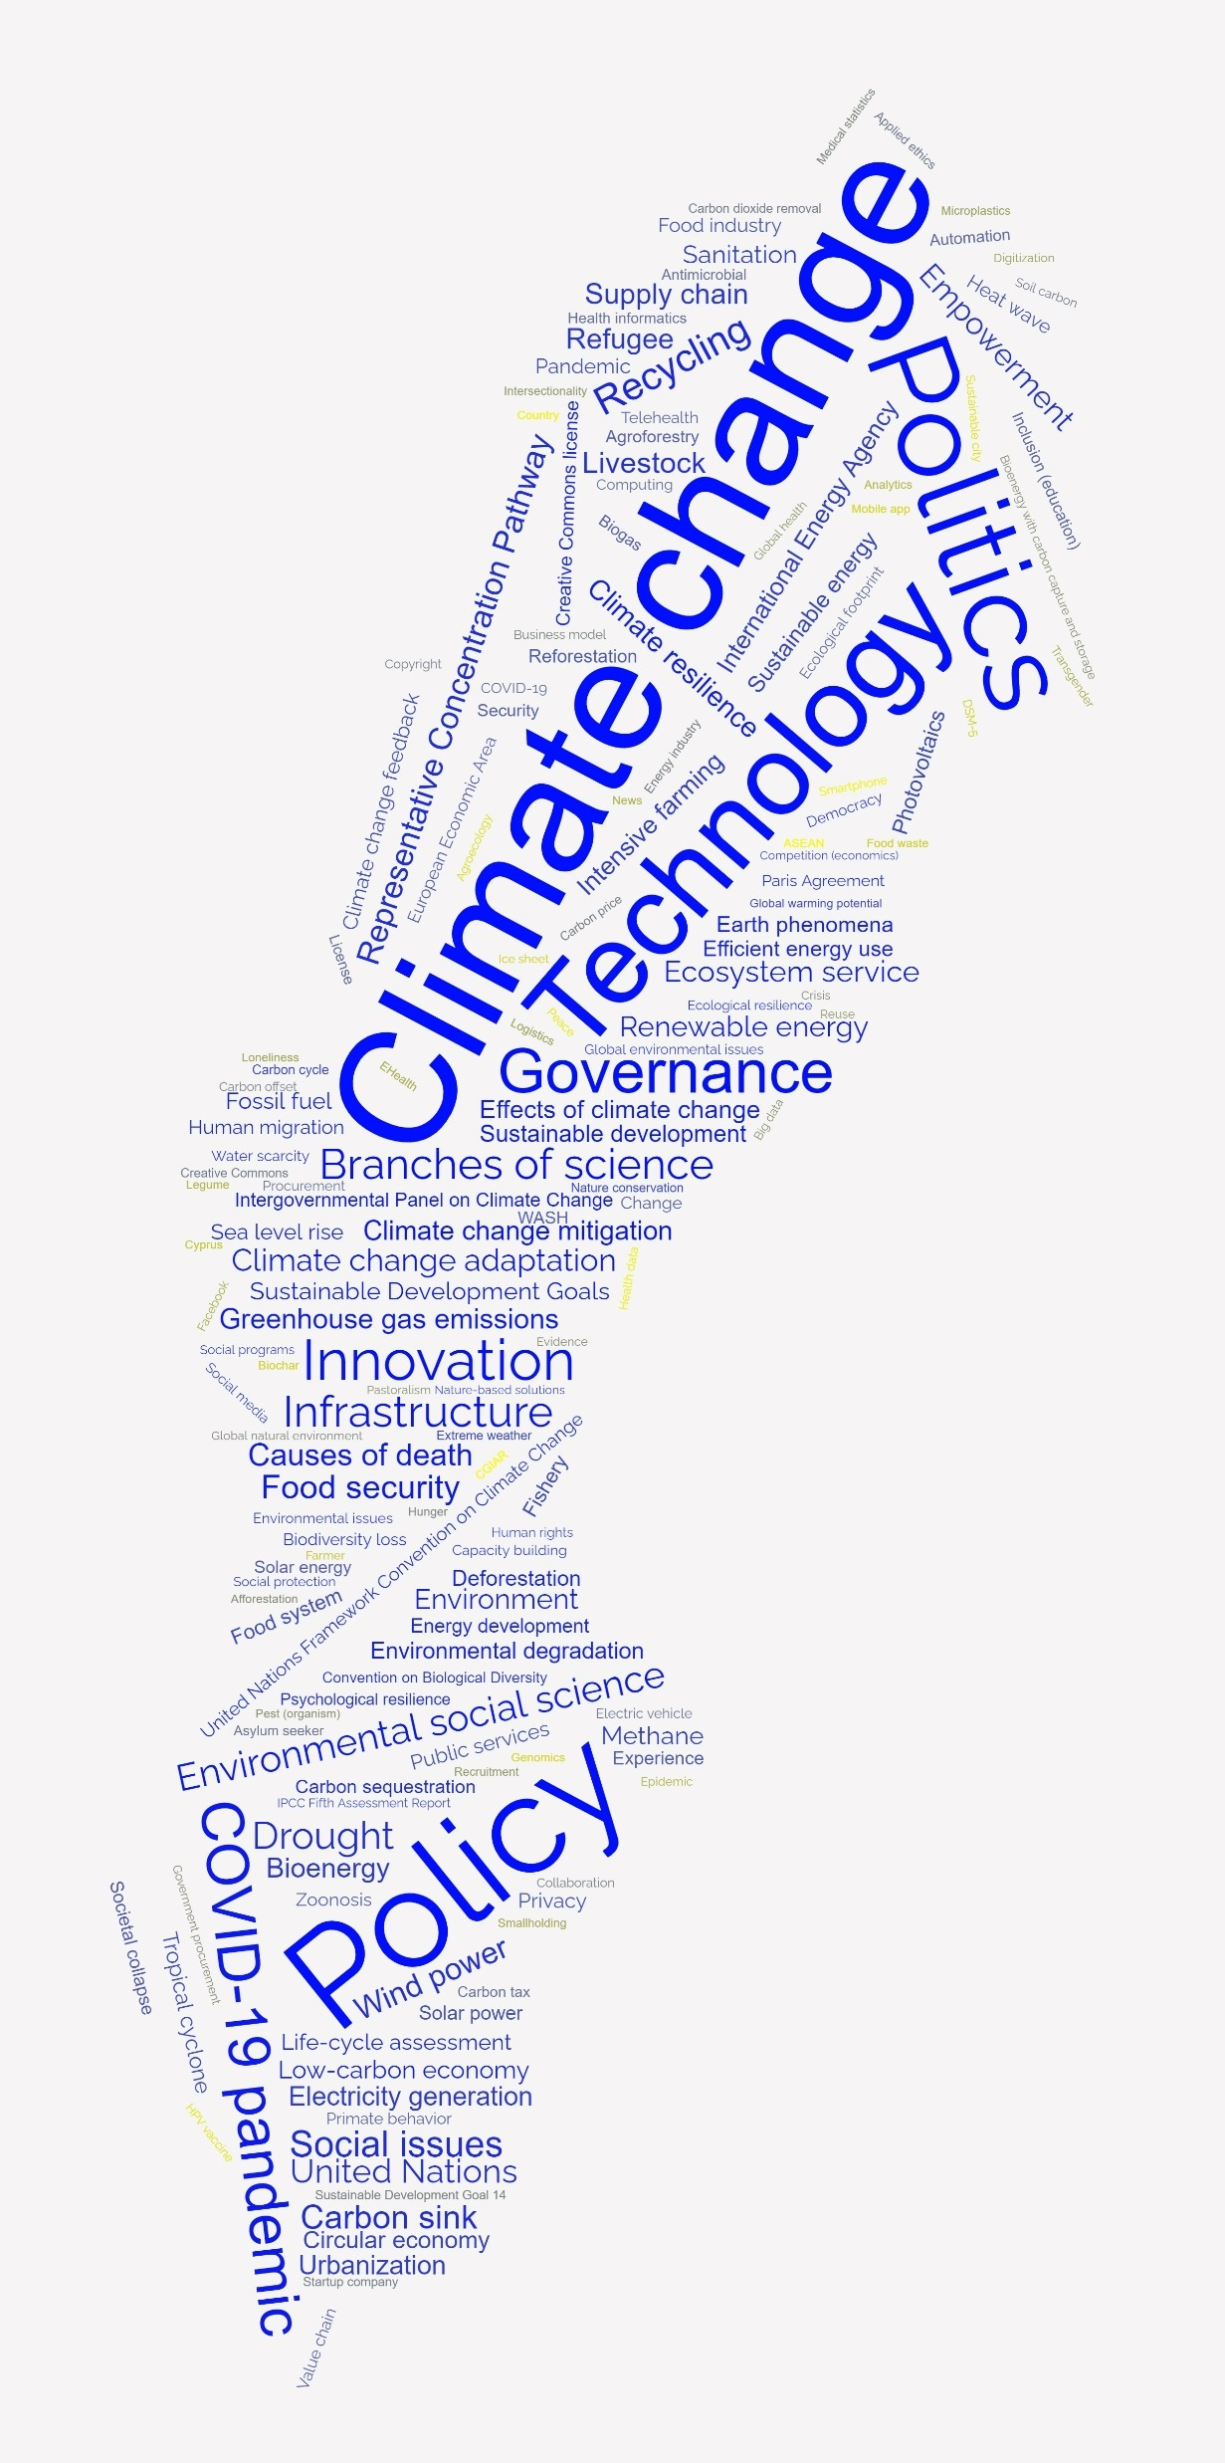
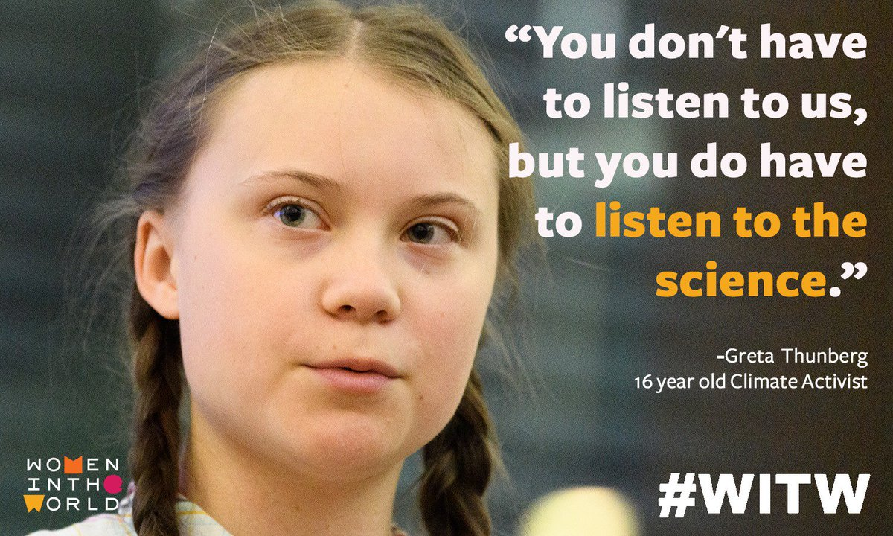
Policy topics
World policy citing Swedish scholarly articles
in all Swedish policy documents
Greta Thunberg effect?
Lowly or Do Not Cite Science
Highly Cite Science
Highly Cite Science
Lowly Cite Science

Slide 17
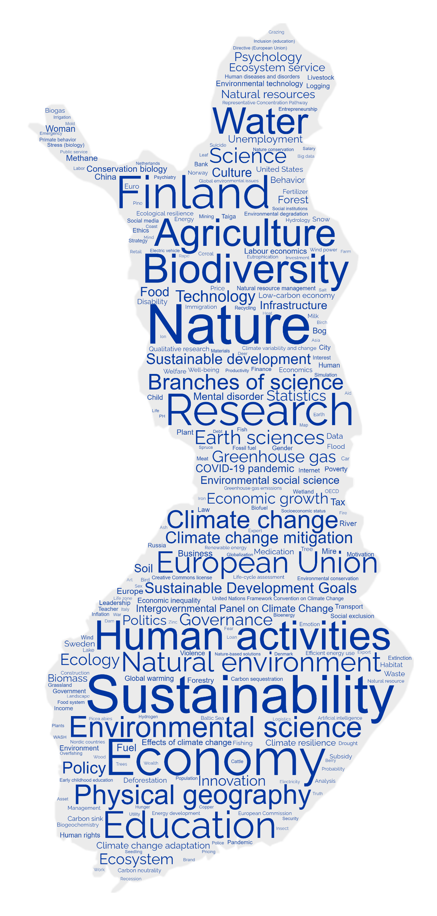
Policy topics
Finnish policy citing Finnish scholarly articles
in all Finnish policy documents
>=12% Cite Science
<12% Cite Science
>=12% Cite Science
<12% or Do Not Cite Science

Slide 18
Word association mining
The analysis compares prevalence of each word (in title, keywords and abstract of scholarly articles) in one year compared to all other when mentioned in scholarly articles in the category of Information and Computer Science and policy (Altmetric.com policy citations!).

Slide 19
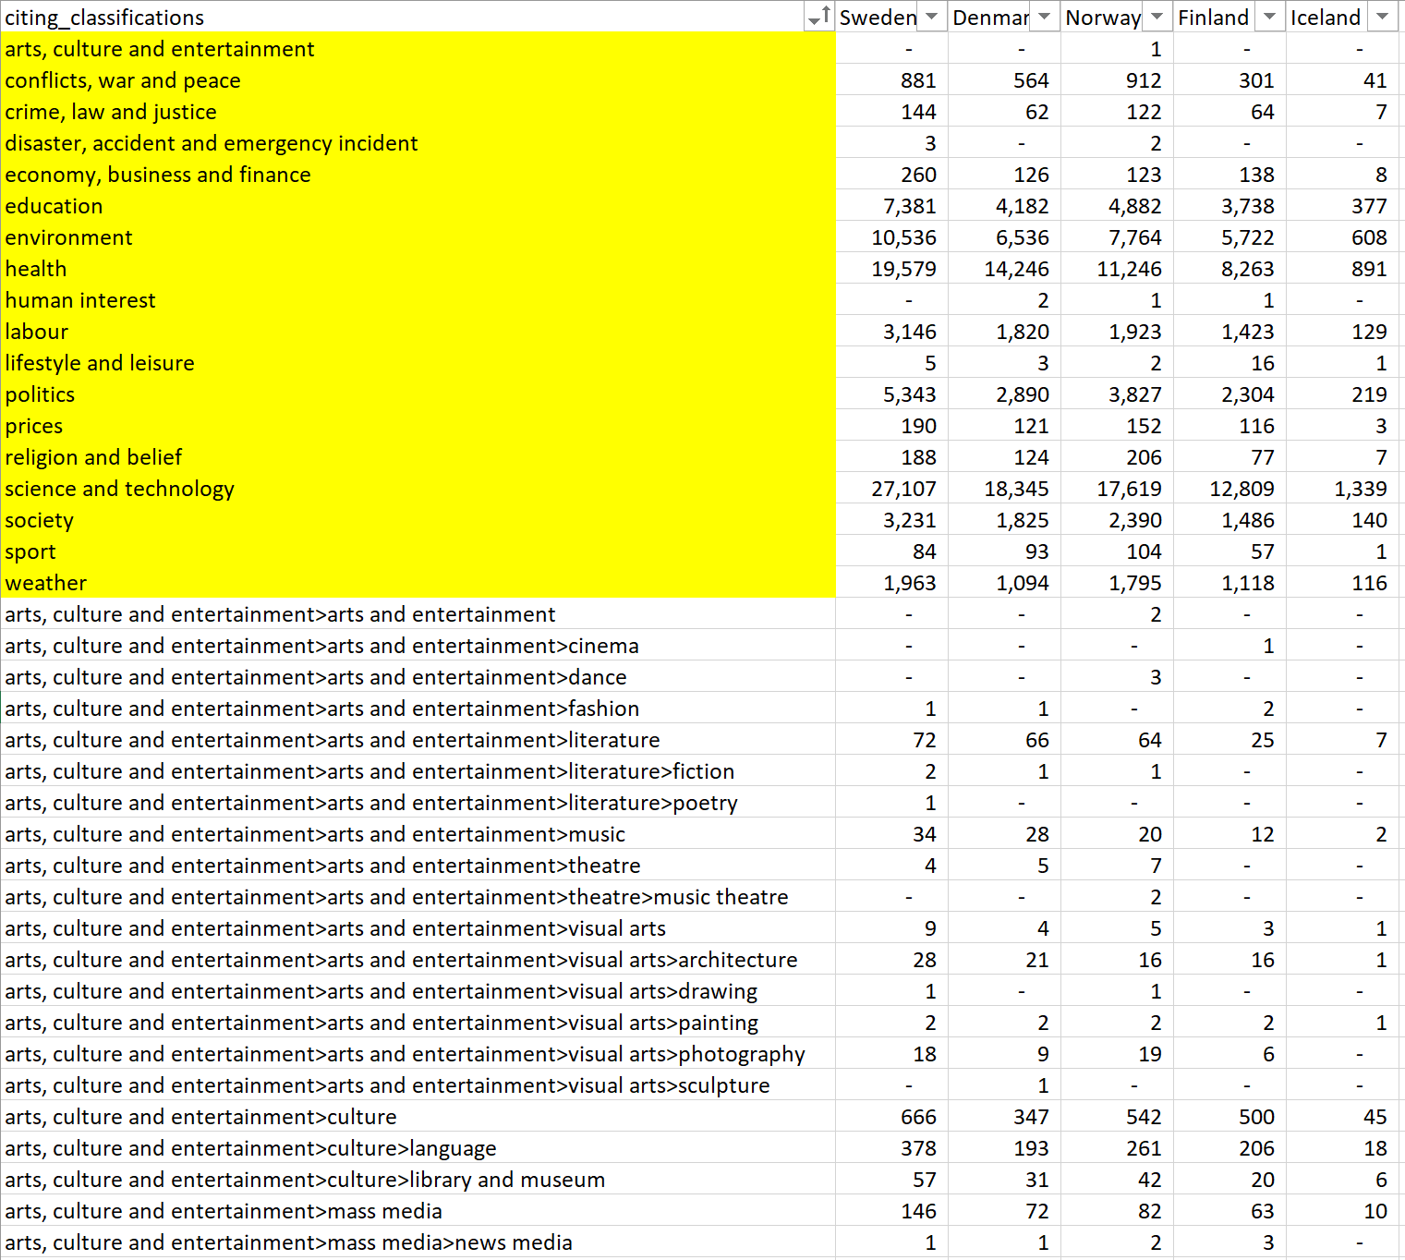
Policy Classifications
IPTC Media Topic
Classification is hierarchical but practically,
they do not inherit statistics
So do that manually
Notes:
I checked their information about how they assign subject areas to policy documents. Overton is using IPTC news media topics which is a hierarchical classification as you see examples of it in this Excell snapshot. Overton assignes these classes to policy sources using machine learning and then they then check manually. I brought this sheet because as you see despite the classification has a tree style, the categories do not add up in hierarchical tree to the upper level categories. Which sounds strange to me. Because I thought that a work on library and museum based on this categorization need to return in art, culture and entertainment but apparently it is not working in that way. So the counts do not add-up. In fact, categorization is a suffisticated task as all these categories can be co-assigned to a single policy document. But despite that you would expect to reach your content using the higher level categories, but its not the case here. So expect to use the most detailed higherarchy.

Slide 20
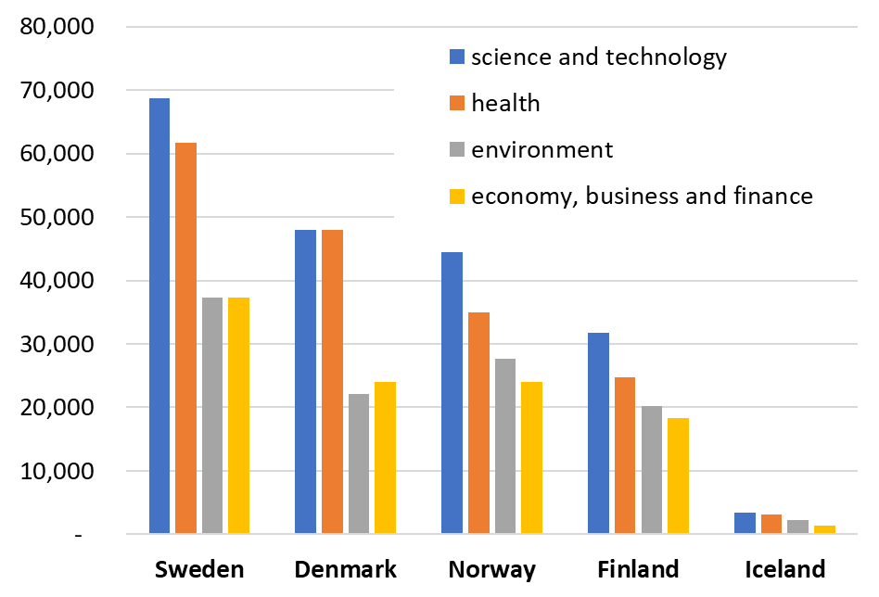
Policy subject areas (cumulative counts)
Notes:
I added all in the highest classes and four categories of Science and Technology, health, environment and economy, business and finance were the largest policy categories in all Nordic countries. The subject patterns sound quite consistent perhaps only except for Denmark where economy is slightly bigger than environment and lifestyle and leisure larger than labour and society.

Slide 21
Citing Policy Sources

Slide 22
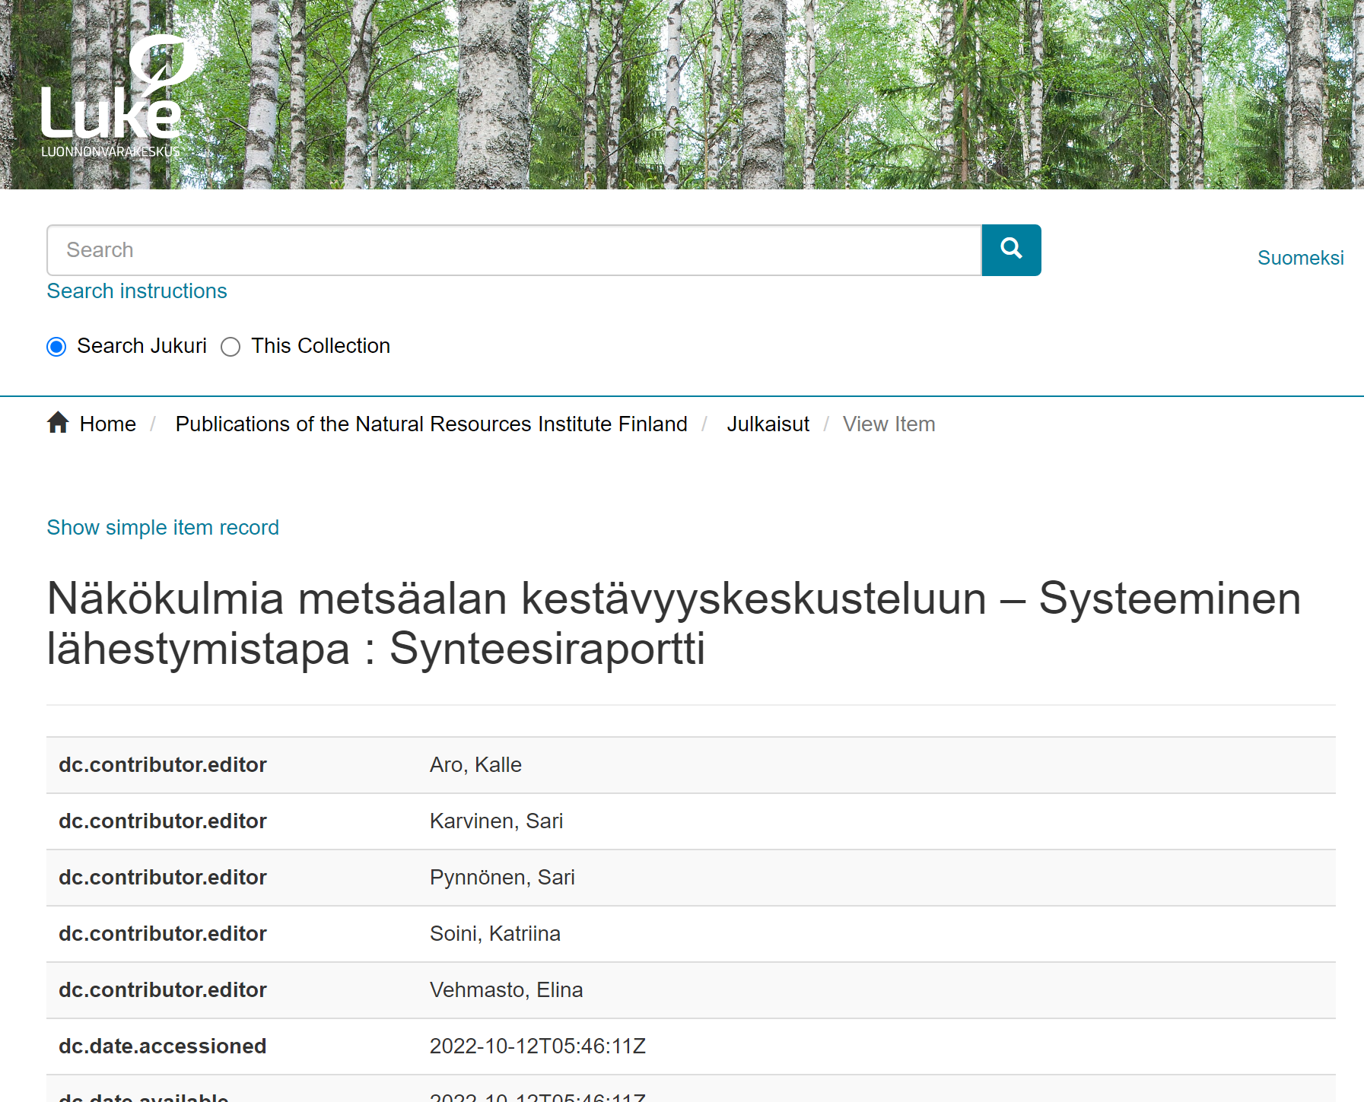
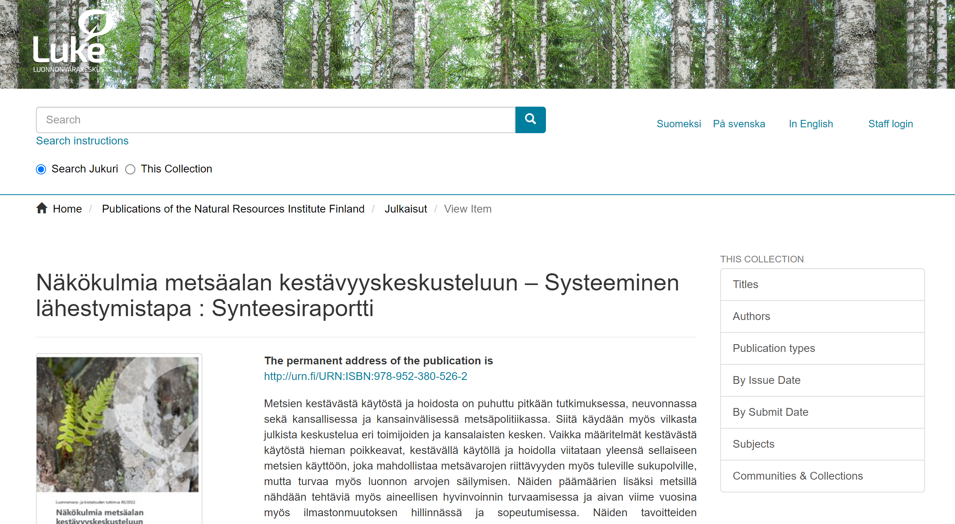
Example of Policy Document Meta-data (In Finland)
dc.contributor.editor
dc.date.accessioned
dc.date.available
dc.date.issued
dc.identifier.isbn
dc.identifier.uri
dc.description.abstract
dc.language.iso
dc.publisher
dc.relation.ispartofseries
dc.subject
dc.title
dc.type
dc.identifier.urn
dc.type.okm
dc.description.vuosik
dc.teh
dc.kiekuperson
dc.contributor.orcid
dc.relation.issn
dc.relation.numberinseries
dc.okm.discipline
dc.okm.corporatecopublication
dc.okm.selfarchived
dc.okm.internationalcopublication
dc.okm.openaccess
dc.format.pagerange
dc.contributor.departmentid
dc.contributor.organization
dc.format.bitstream
> Subject in original document and language
> en=D4 Published development or research report or study|

Slide 23
Discussion
For bibliometricians:
go beyond publication citations and use academics non-journal article publications cited in policy (blogs, news interviews etc.)
Be careful about noise in the data or non-citable documents in your data when normalizing!
search name of academics mentioned in policy content (transcripts)
For policy data collectors:
Using Policy document meta-data might be useful in improving the categorization and discovery of policy impact.

Slide 24
Thank you!
Ashraf Maleki and Kim Holmberg
University of Turku
ashraf.maleki@utu.fi
kim.j.holmberg@utu.fi

