Slide 1
“I am against open peer review, because if I’m supposed to reveal my identity to the authors, I will have to do a much better job when I review, and I don’t have time for that…..” 3rd year PhD student
Narrowing the gap between demand and supply of peer review
Dr. Charlotte Wien, VP of European Library Relations, Professor of Scholarly Communication, UiT,
Dr. Gustaf Nelhans, Senior lecturer, Swedish School of Library and Information Science, University of Borås.

Slide 2
I am
Dr. Charlotte Wien
Vice President of European Library Relations and Professor of Scholarly Communication at Arctic University in Tromso
Before: Professor of scholarly Communication and Head of Researcher Services at the University Library of Southern Denmark
My task:
To build stronger and better relations between the European Libraries and Elsevier
My tools:
knowledge about the scholarly communication ecosystem and its major stakeholders

Slide 3
Gustaf Nelhans
PhD in Theory of science
Senior Lecturer at the Swedish School of Library and Information Science (University of Borås)
Director, Data as Impact Lab (UofB)
Chair of the Nat’l Libraries’ Researcher board
My research is presently funded by a grant from Riksbankens Jubileumsfond:
“Publishing platforms for research in light of disciplinary differences and research evaluation”

Slide 4
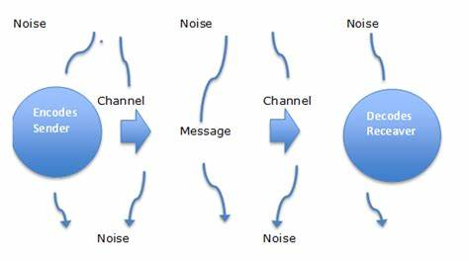
Is peer review communication?

Slide 5
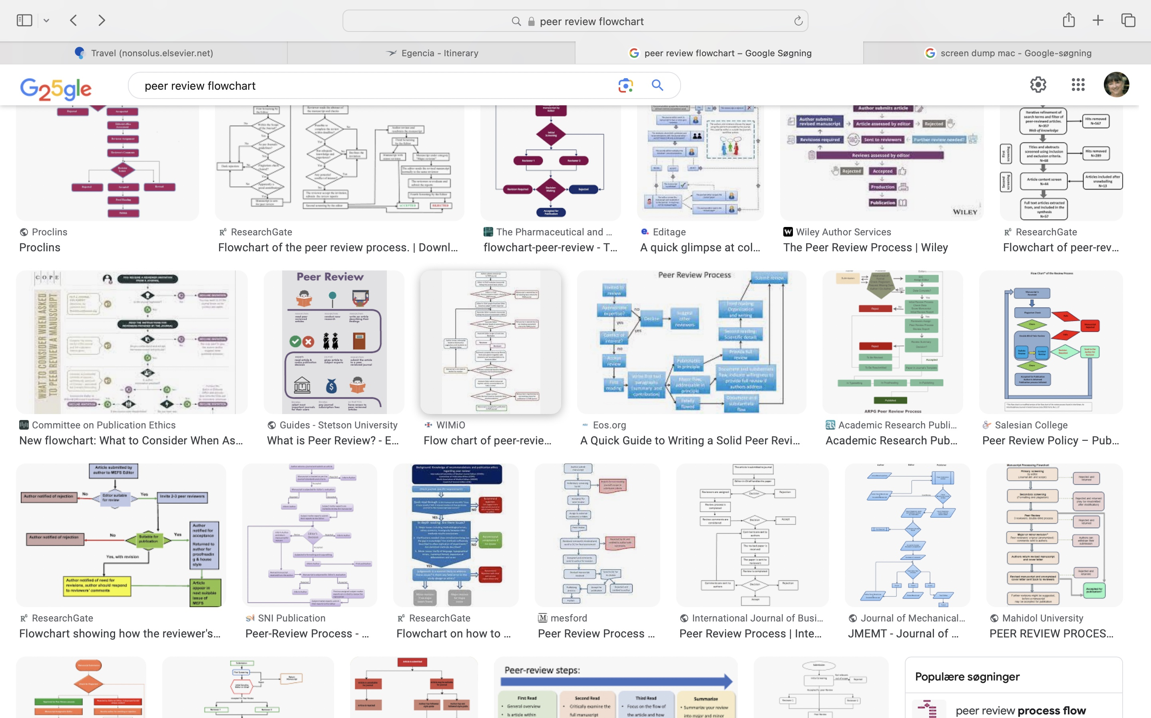
Is peer review communication?

Slide 6
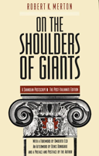
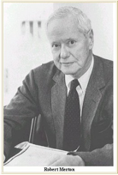
Merton’s norm system of science
Communalism
Universalism
Disinterestedness
Organized Scepticism
Merton, R. K. 1973 (1942). The Normative Structure of Science. In The sociology of science: theoretical and empirical investigations. Chicago: The University of Chicago Press. 267-278.

Slide 7
CUDOS vs. PLACE
Communalism
Universalism
Disinterestedness
(Originality)/
/-zed Scepticism
Proprietary
Local
Authoritarian
Commissioned
Expert
Ziman, J. (1984). An Introduction to science studies. Cambridge: Cambridge University Press.
Mitroff, I (1974).Norms and Counter-Norms in a Select Group of the Apollo Moon Scientists:
A Case Study of the Ambivalence of Scientists. American Sociological Review 39, 579-595

Slide 8
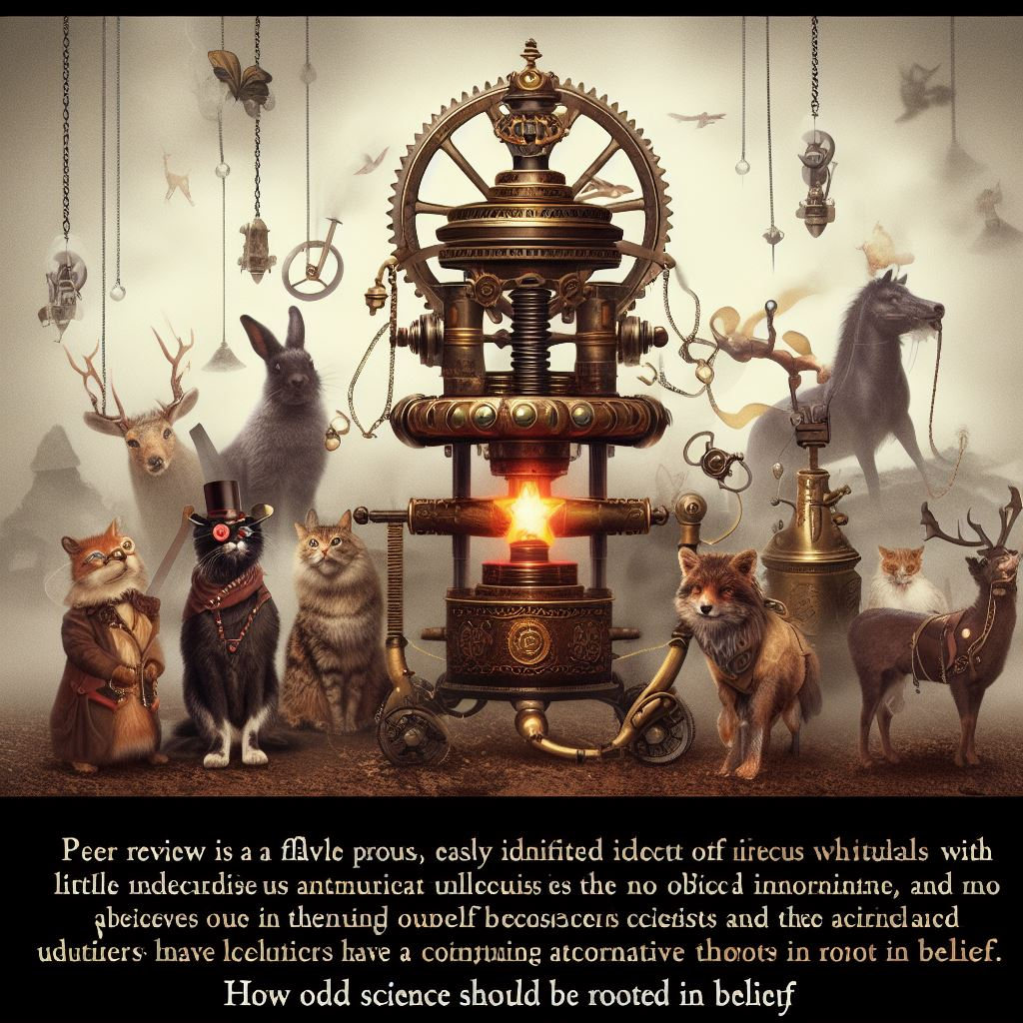
Is peer review biased?
“(…) peer review is a flawed process, full of easily identified defects with little evidence that it works. Nevertheless, it is likely to remain central to science and journals because there is no obvious alternative, and scientists and editors have a continuing belief in peer review. How odd that science should be rooted in belief”.
- (Our italics) Richard Smith, former editor of BMJ and chief executive of the BMJ publishing group.
Reviewer A: ‘I found this paper an extremely muddled paper with a large number of deficits’
Reviewer B: ‘It is written in a clear style and would be understood by any reader’.

Slide 9
Is peer review expensive?
4.7 Mio. new articles indexed in largest research database (2020)
55% percent of what is submitted is published
3.8 mio. additional articles are submitted
Assuming that:
each published article on average needed 3 peer review reports
each rejected article gets on average 2.
Consequently (4.7x3) + (3.9x2)=21.8 Mio. peer reviews were done in 2020
1 peer review = 6 working hours
21.8 Mio. peer reviews = 130.8 Mio working hours/45.000 annual workload
https://researchintegrityjournal.biomedcentral.com/articles/10.1186/s41073-021-00118-2

Slide 10
Is there a gap between demand and supply?
Growth rate of Scientific articles 3-4% annually.
Growth rate of of researchers 10-15% over the last decades.
But only 10% are responsible of 50% of all the peer reviews
70% of declines are “outside area of expertise”
Other reasons:
”too many deadlines... I decline due to illness...illness in the family...I am on leave...about to have a child...on maternity leave...on paternity leave...on sabbatical for 6 months...not available at this time; try me another time...sorry, really have no time...due to my work schedule I am unable to do it at this time...not enough time right now...outside my area...don’t have the expertise...current work load does not allow me to do this...this is a busy time...on holidays... won’t review for your journal anymore because you took too long to get my own paper reviewed...”

Slide 11
Is open peer review the answer?
One researcher found 22 different definitions open peer review in 137 papers, ranging from
identities of authors/reviewers being disclosed to each other
open reviewer reports
open participation in the review process.
…more (+ combination of these)
Additionally, open peer review often part of new publishing formats (platforms) including
Role of the editor -> editorial teams
Automated acceptance process
(e.g. 2 accept or 1 accept + 2 provisions)
Publishing as a ”right” rather than as an “achievement”
Pro: The reader can access the review and assess it, as well as who has conducted the review.
Con: Risk of self-selection or reviewers choosing not to criticize researchers they are familiar with.

Slide 12
Is AI the answer?
Check for plagiarism (i.e., IThenticate)
Help editors find suitable reviewers
Formatting checks
Suggestion for alternative journals for rejected manuscripts …
What may come using generative AI for Peer Review?
Company secrets!
but we may dream of language editing at all stages, translation services, reproducibility checks, summaries of articles, abstract and keyword services …

Slide 13
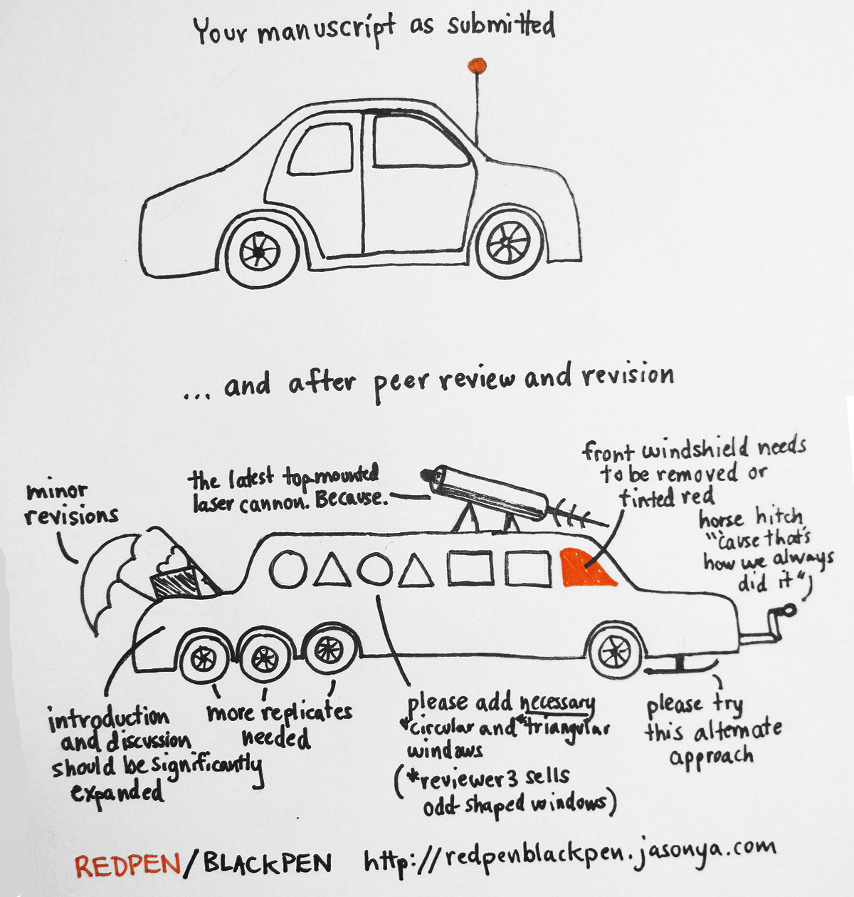
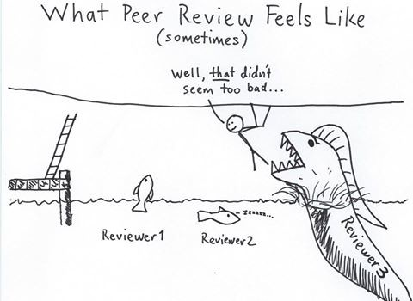
Conclusion
No quick fixes

Slide 14
”The only thing that can actually prevent that bad research is being published is when the authors run out of stamps …”
-Fiona Godlee, Former editor of BMJ
Thank you!
Selected references:
Aczel, B., Szaszi, B., & Holcombe, A. O. (2021). A billion-dollar donation: estimating the cost of researchers' time spent on peer review. Res Integr Peer Rev, 6(1), 14. https://doi.org/10.1186/s41073-021-00118-2
Bravo, G., Grimaldo, F., Lopez-Inesta, E., Mehmani, B., & Squazzoni, F. (2019). The effect of publishing peer review reports on referee behavior in five scholarly journals. Nat Commun, 10(1), 322. https://doi.org/10.1038/s41467-018-08250-2
Checco, A., Bracciale, L., Loreti, P., Pinfield, S., & Bianchi, G. (2021). AI-assisted peer review. Humanities and Social Sciences Communications, 8(1). https://doi.org/10.1057/s41599-020-00703-8
DeLisi, L. E. (2022). Editorial: Where have all the reviewers gone?: Is the peer review concept in crisis? Psychiatry Res, 310, 114454. https://doi.org/10.1016/j.psychres.2022.114454
Petrescu, M., & Krishen, A. S. (2022). The evolving crisis of the peer-review process. Journal of Marketing Analytics, 10(3), 185-186. https://doi.org/10.1057/s41270-022-00176-5
Ross-Hellauer, T. (2017). What is open peer review? A systematic review. F1000Res, 6, 588. https://doi.org/10.12688/f1000research.11369.2
Smith, R. (2006). Peer review: a flawed process at the heart of science and journals. Journal of the Royal Society of Medicine, 99(4), 178-182. https://doi.org/10.1177/014107680609900414

