Slide 1
Challenges of causality in Open Science
Vincent Traag
Nordic Workshop on Bibliometrics and Research Policy | Gothenburg, 11 October 2023

Slide 2
PathOS project
Better understanding and measuring Open Science impacts and their causal mechanisms
https://pathos-project.eu/

Slide 3
Open Science Impact Pathways
Financial resources
Legal frameworks
Data repositories
Preprint repositories
Open/FAIR Data
Preprints
Data reuse
Reproducibility
Productivity
Reliability
Innovation & progress
Trust in science

Slide 4
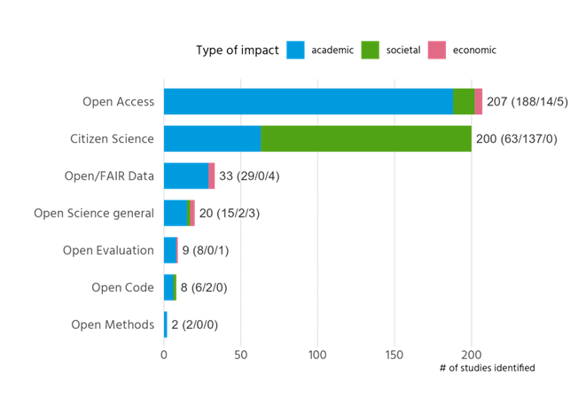
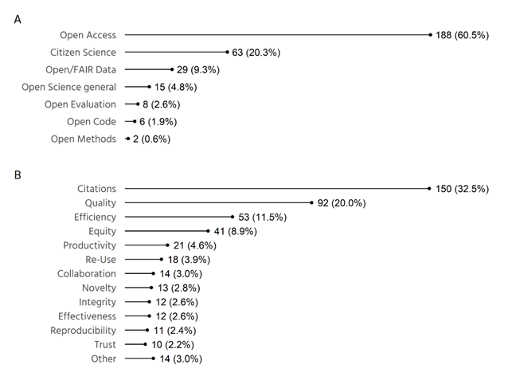
Scoping review of Open Science impact
Academic impact
https://doi.org/10.5281/zenodo.7883699

Slide 5
Evidence of Open Science Impact
Academic Impact
Open Access
Citation advantage
APCs limit access; concerns of "predatory publishing".
Open/FAIR Data
Citation advantage
Open Code/Software
Boosts software efficiency
Citizen Science
Enhances data collection speed
Open Peer Review
Generally neutral/positive impact on review quality.
Societal Impact
Open Access
Benefits include education, environment, policy, and community engagement.
Economic Impact
Gap
Open Access
Limited evidence
Open/FAIR Data
Limited evidence
Limited studies (13) with a focus on health/biomed.
Concerns about data quality.
Citation advantage
Promotes public interaction, policy inclusion, and health outcomes.
Citizen Science

Slide 6
Investigative Case Studies
Bioinformatics
COVID-19
Climate
RCAAP - Portugal
Gender
EASY – The Netherlands
FRANCE
Innovation from open research resources - ELIXIR
Open science practices during the Covid-19 pandemic
Fostering innovation in climate change - Horizon 2020
Open science on remedying structural inequalities
Cross cutting effects due to open research data from national repository
Research data and knowledge use / uptake in non-academia
Accelerating collaborations within academia & industry

Slide 7
handbook.pathos-project.eu

Slide 8
Impact of Open Science ≠ Effect of Openness on impact

Slide 9
Impact indicators
Combinatorial number of possibilities
No indicators for causal effect on impact
 | Citation impact | Collaboration | Reproducibility | Public engagement | …
Open access
Open data
Open code
Open review
Open methods
…

Slide 10
Interpretation of indicators requires causal thinking

Slide 11
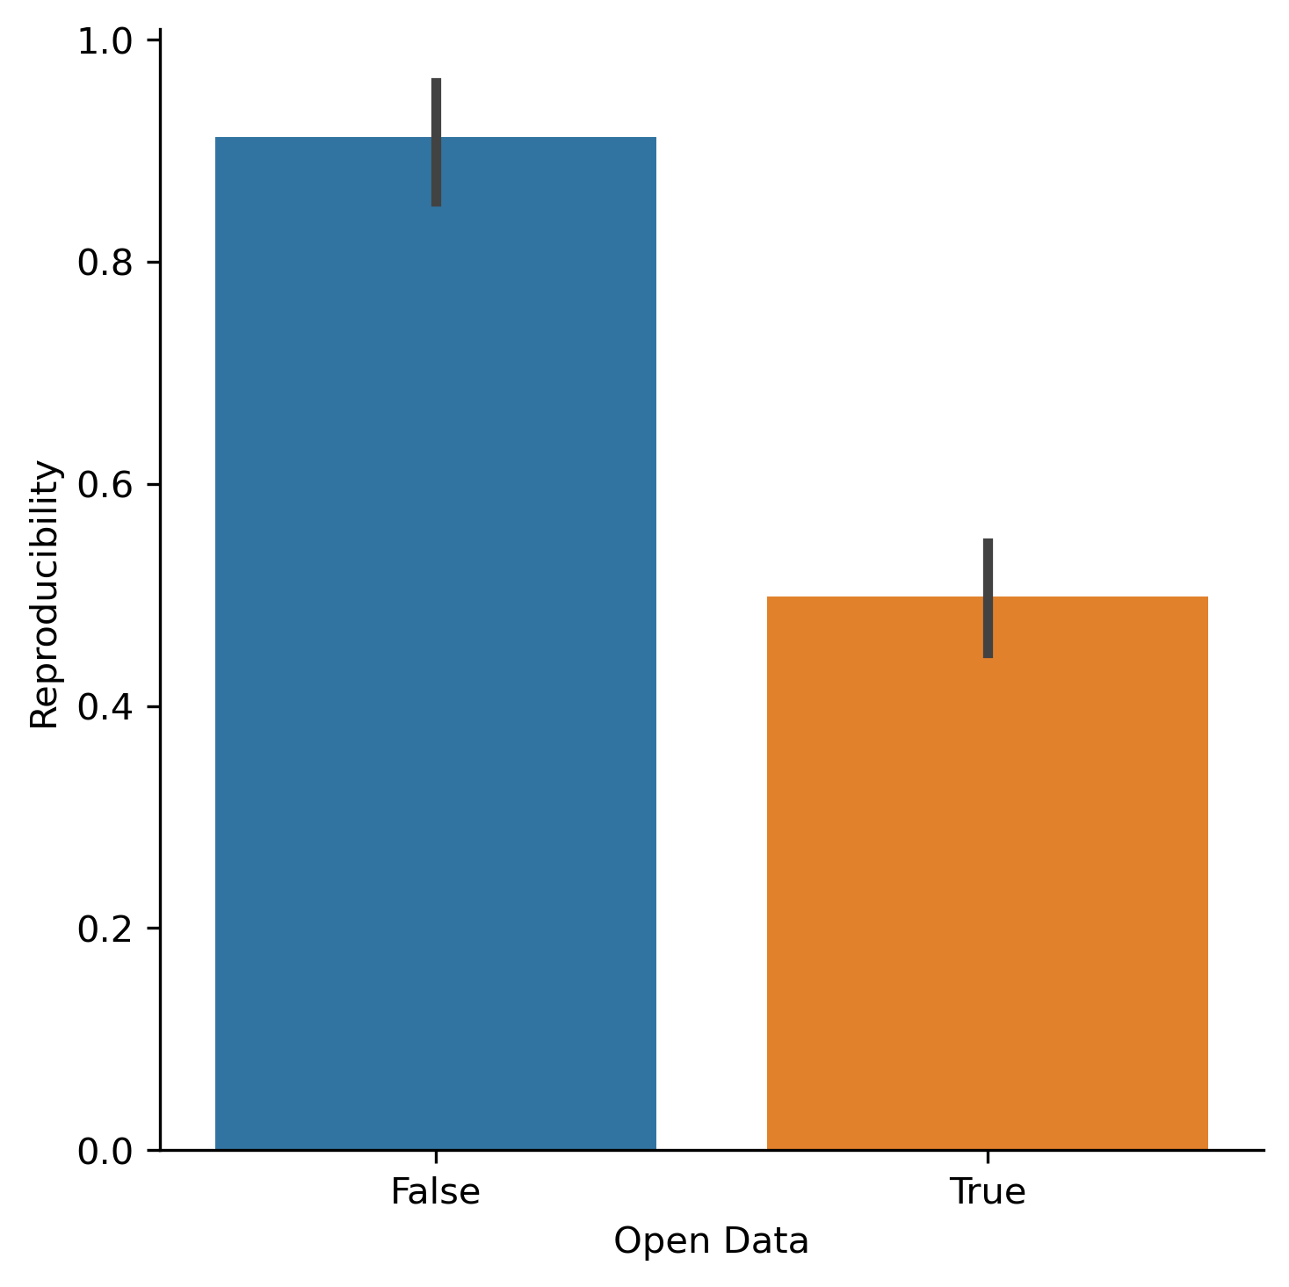
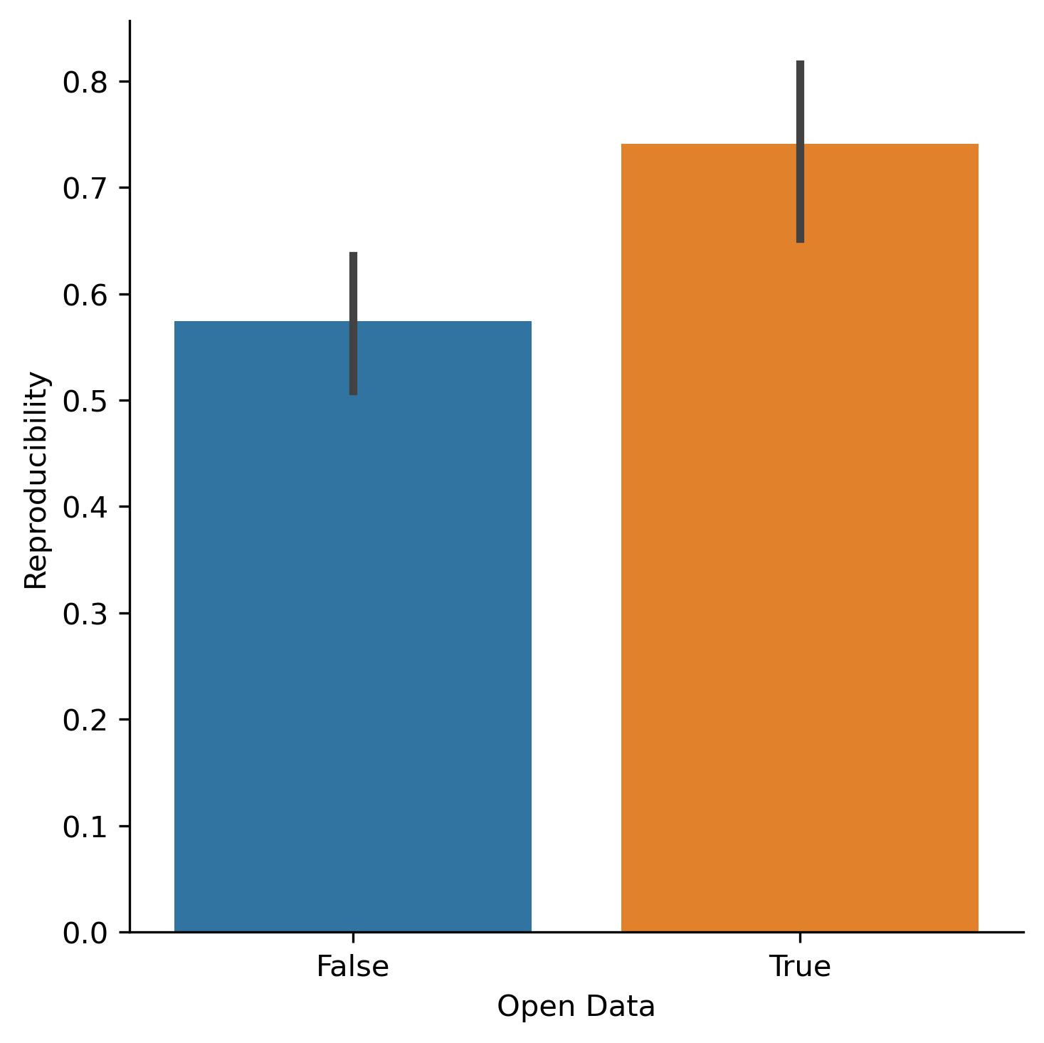
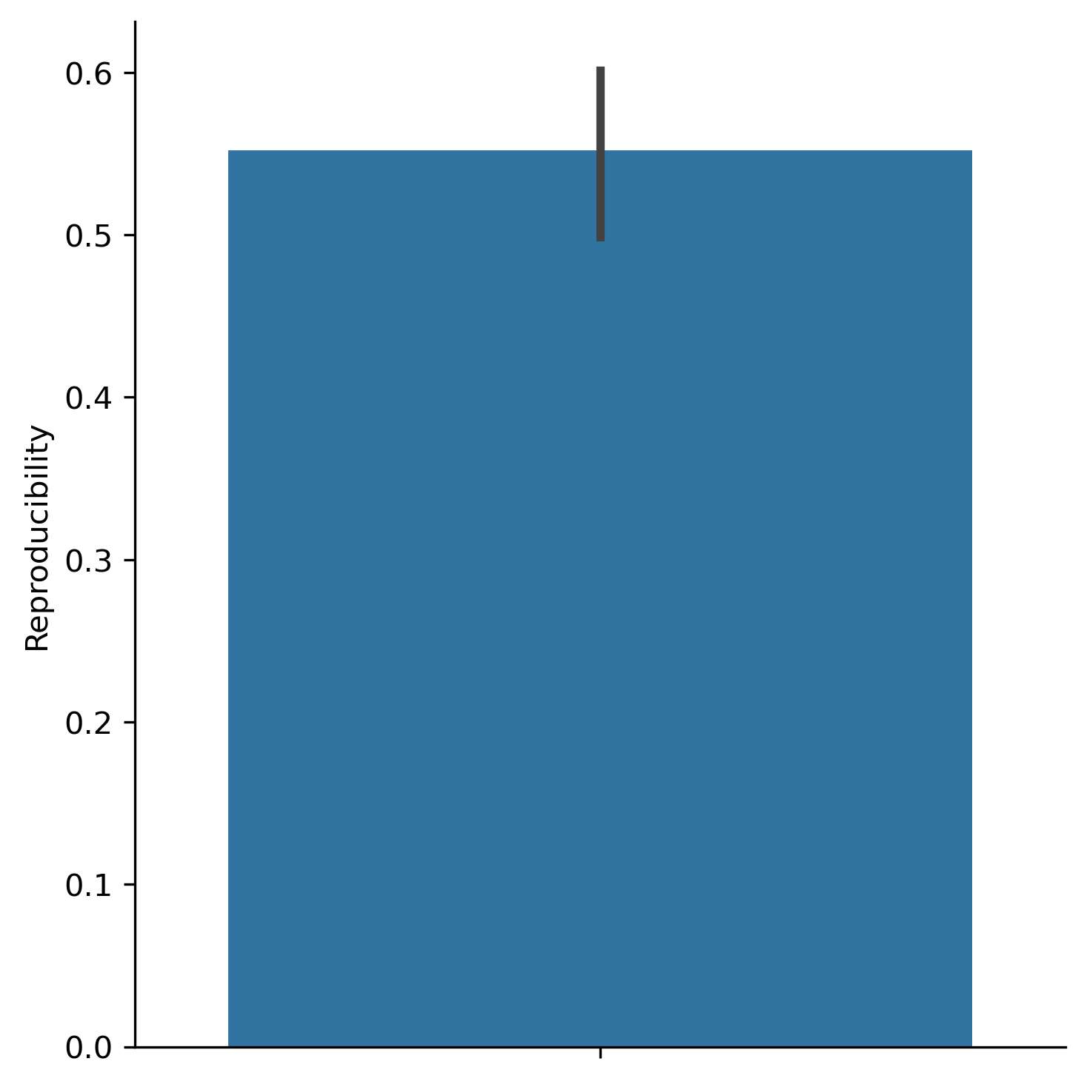
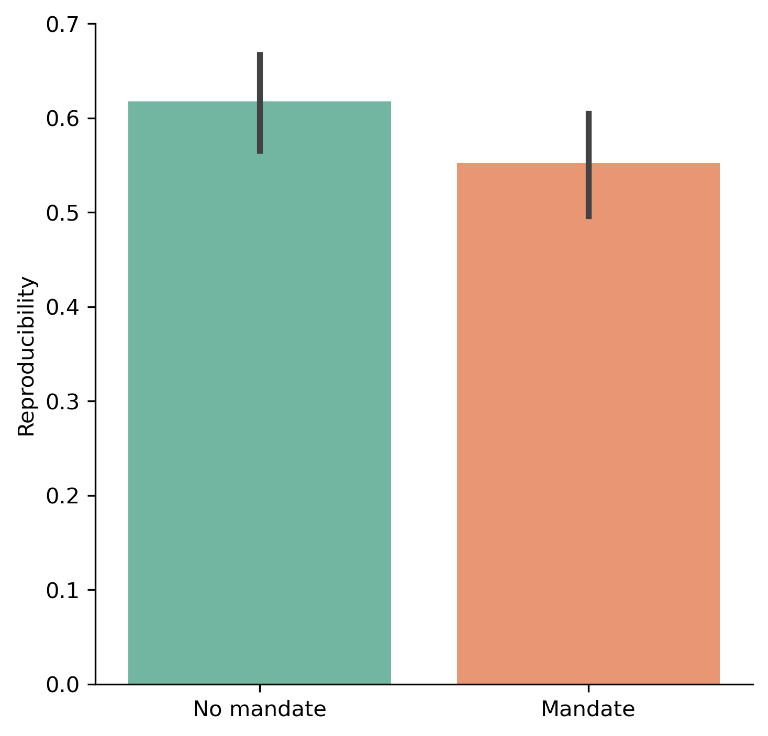
Illustrative simulation
Clear causal effect of open data on reproducibility.
Assume this effect comes from experimental study.
Introduce open data mandate in journal peer review.
Indicator for reproducibility of publications.
May be relevant, but not necessarily directly of interest.
Surprisingly, indicator goes down after mandate.
Separate indicators for publications with and without open data?
Suggests open data actually decreases reproducibility.
?

Slide 12
Paradox resolved
Open data
Rigour
Reproducibility
Published

Slide 13
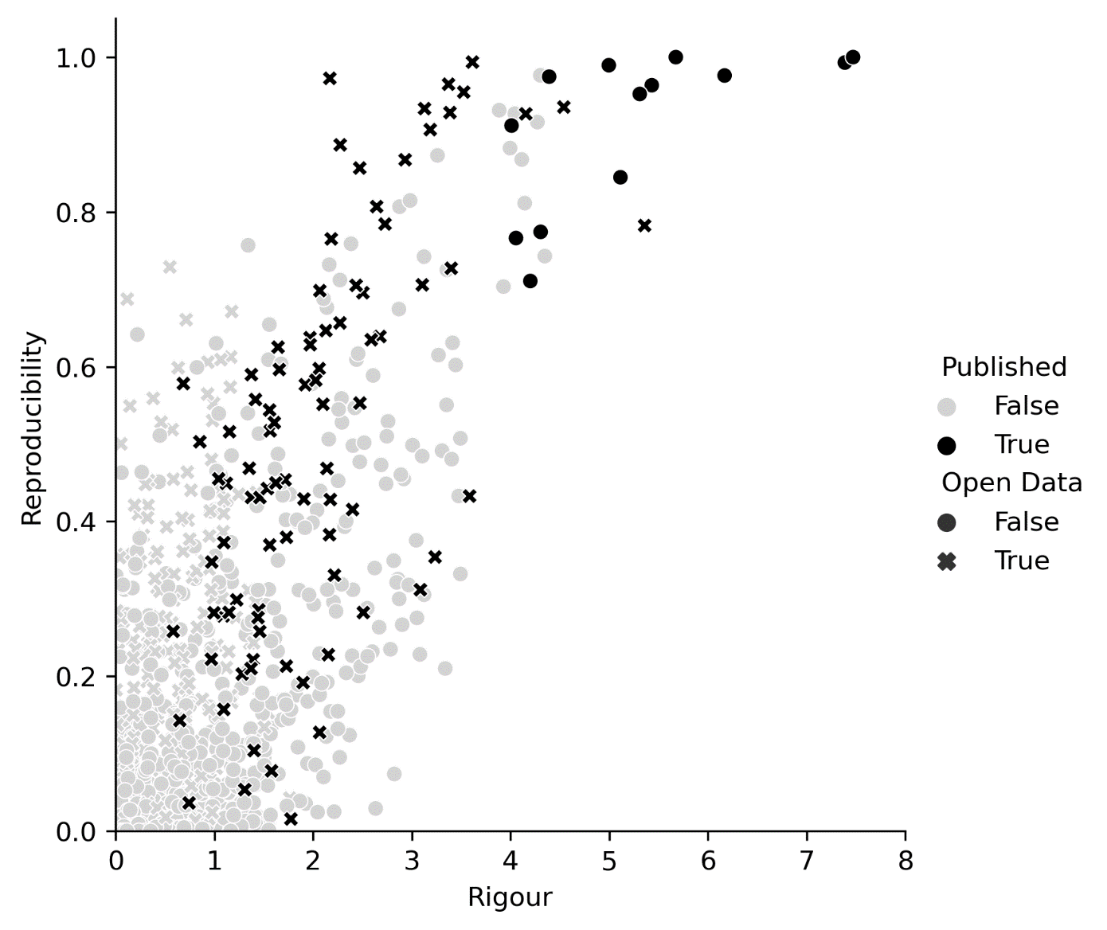
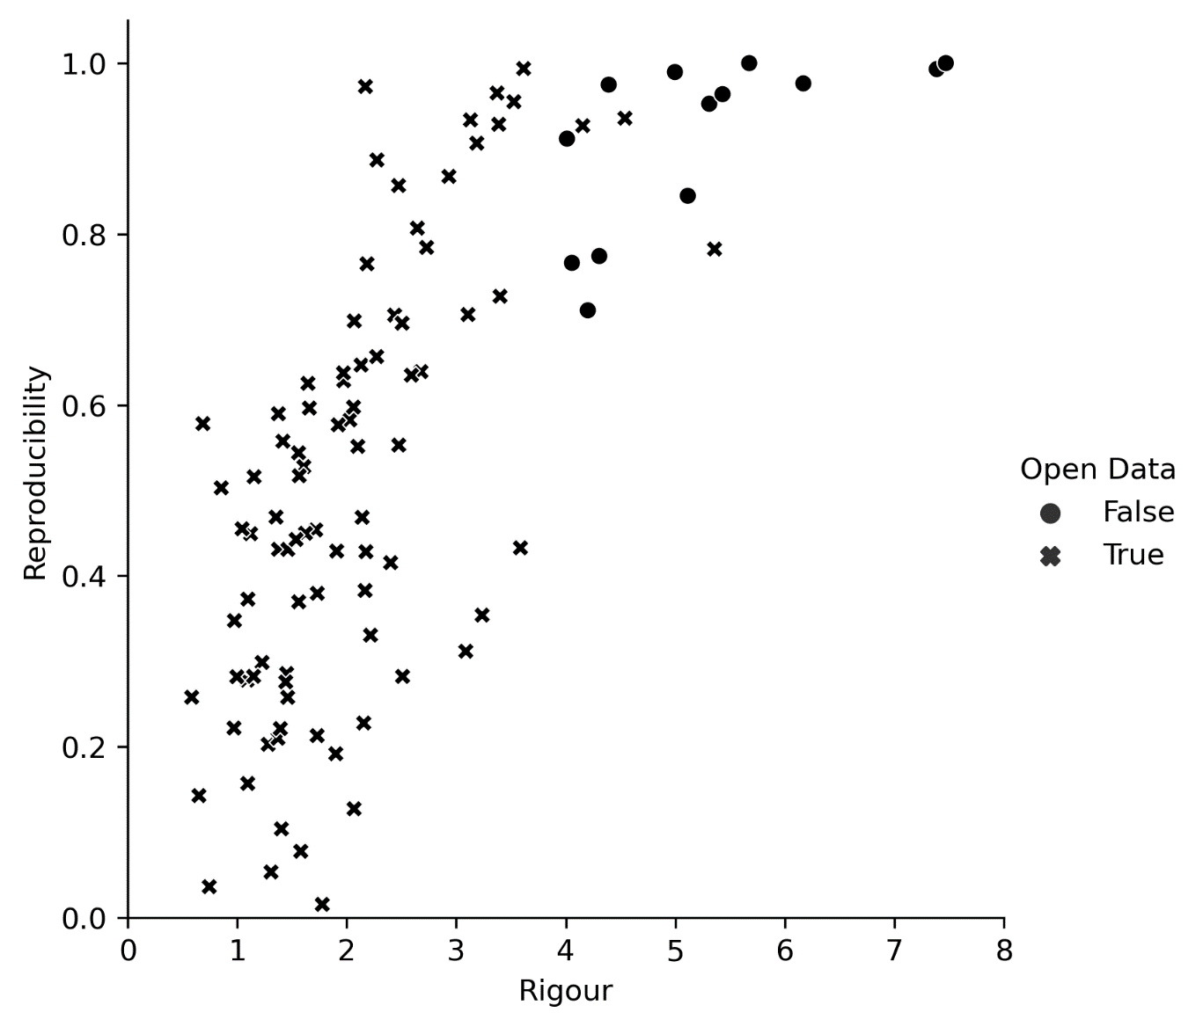
Open data and publishing
Peer review considers rigour and open data.
Less rigorous research with open data more likely to be published.
Open data makes research reproducible, but rigour more.

Slide 14
No causal conclusions without causal assumptions.
Notes:
Fundament problem: counterfactual not observed. Need causal assumptions to go from observations to causal conclusions? Build up evidence gradually.

Slide 15
What to control for?
Resources
Rigour
Formal theory
Open data
Reproducibility
Notes:
Experimental studies may help, but no panacea.
Interest in causal pathways and mediating variables.
Some elements cannot be randomised (e.g. repository availability).
Observational studies can infer causality.
Identify what factors to control for (not all factors should be controlled for).
Sometimes, impossible to infer causality.

Slide 16
Prediction ≠ causation
For example, interested in pre-registration and reproducibility.
Observe that pre-registered studies are more reproducible.
Will pre-registering a study make it more reproducible?
Should we recommend a policy for pre-registration?

Slide 17
Strengthening the evidence base
More research on impacts of Open Science is needed.
Pay careful attention to causality.
Spell out causal assumptions.
Check observable implications.
Given causal assumptions, make causal interpretation
Causal identification not always possible: be honest, do not hide it.
Try to provide clarity what is estimated and how it may still be confounded.
Sensitivity analysis may provide some answer.

Slide 18
Conclusion
Limited evidence of Open Science impact.
Open Science indicator handbook on outputs, outcomes & impacts.
Consider causality when interpreting indicators.
No plea for inaction in the absence of causal evidence, but think before acting.
handbook.pathos-project.eu
Chapter on causality to be added, collaboration with Thomas Klebel.

Slide 19
Vincent Traag
v.a.traag@cwts.leidenuniv.nl
Mastodon: @vtraag@social.cwts.nl

