Slide 1
Policy citing science:
A study of references in Swedish governmental reports (SOUs)
Linus Salö (Stockholm University, Sweden) Björn Hammarfelt and Gustaf Nelhans (University of Borås, Sweden).

Slide 2
This study:
Collaborative, explorative and cross-disciplinary work. Shared interests in:
How research comes to matter
The role of language in communicating research
Ways of measuring and studying societal impact (esp. policy impact)
The role of the social sciences and humanities in society
What characterizes the sources of policy? Are some text types more likely to have an impact on policy than others? How can this be studied, if only exploratively?
To appear in: Salö, L., Hammarfelt, B. & Nelhans, G. Sources of policy: Knowledge brokering in governmental reports. In Mattson, P., Perez Vico, E. & Salö, L. (Eds.) Making Universities Matter: Collaboration, Engagement, Impact. Springer. Open Access.
Preprint already available @ SocArXiv, https://osf.io/preprints/socarxiv/82y3a/

Slide 3
Background: old and new concerns
Long-standing Nordic traditions of utilizing academic knowledge in reformist agendas, state policy, social engineering, and the like – not least via the very frequently used commission system
Long-standing embrace of English in Nordic societies but also concerns over the dominance of English as a scientific language (e.g. Ammon 2001) – calls for “parallel language use” at Nordic universities through the Nordic Council of Ministers’ Declaration on a Nordic Language Policy (2007)
Recent and increasing focus on how science comes to matter (social impact, productive interactions, knowledge brokering)
Recurring conversation regarding the role and impact of the humanities and social sciences in terms of societal and political influence (e.g., Benneworth 2015; Salö ed. 2021)
Attempts to measure impact through literature of the professions, such as clinical guidelines and policy reports (e.g. Nelhans 2016)
Current policy discussions on the value of “non-English” publications (Helsinki Initiative 2019; inspired by work by colleagues such as Sivertsen, Pölönen, Kulczycki, others)

Slide 4
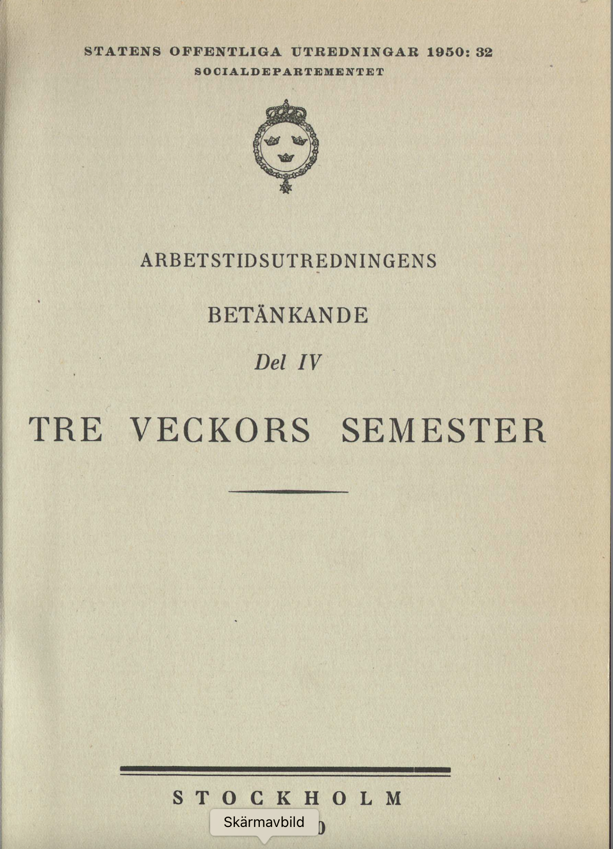
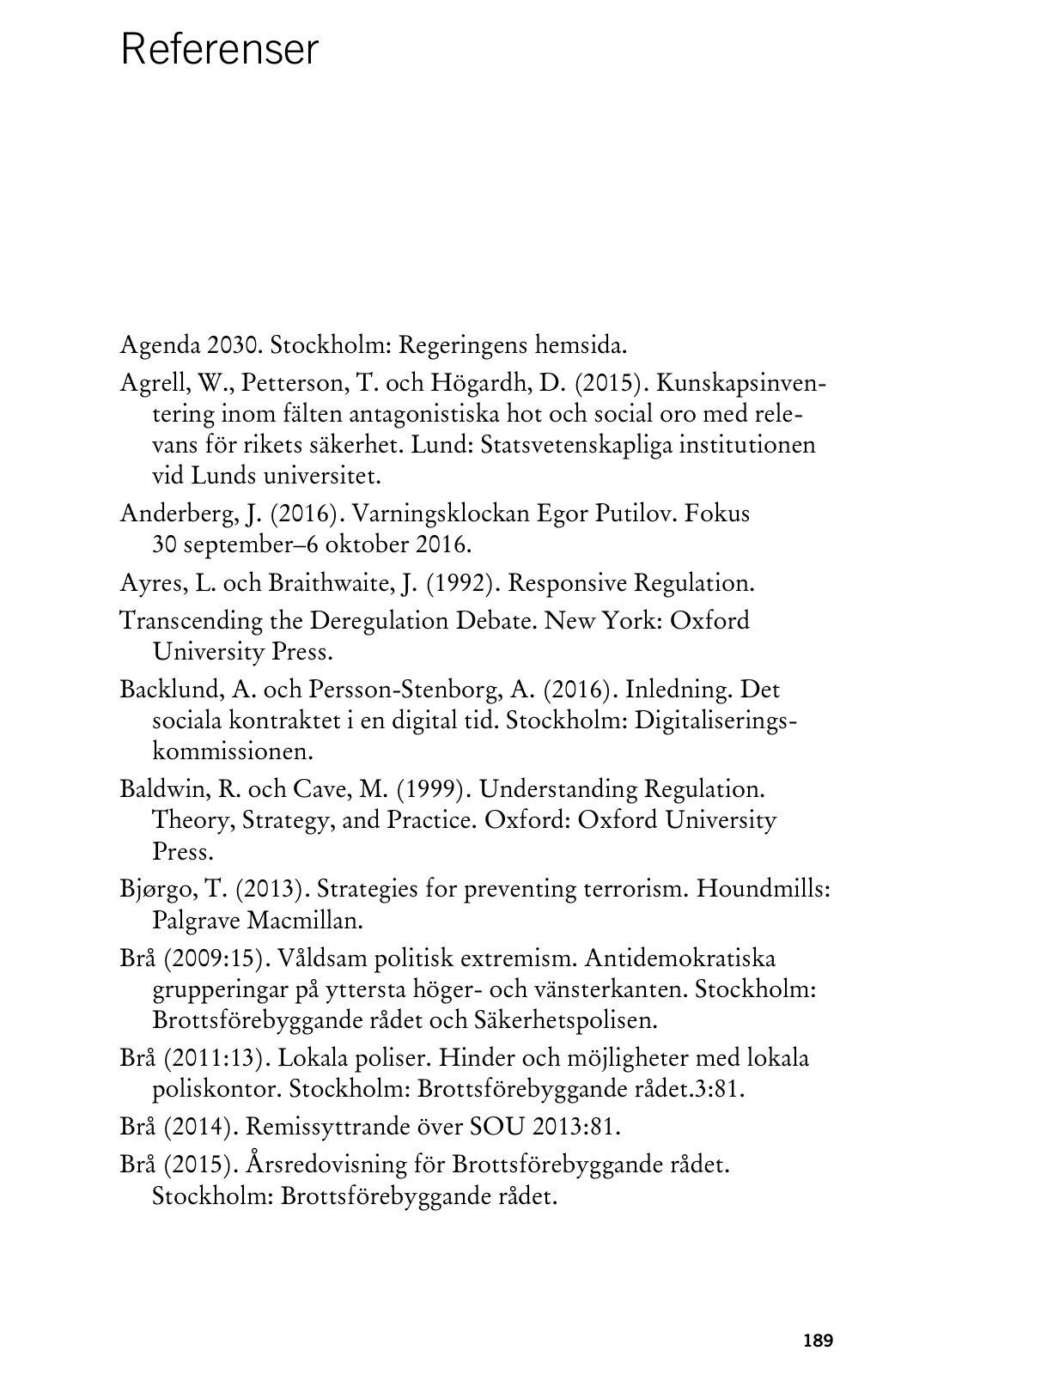
Question:
In this day and age, to what extent is research – most of which is published in English – “taken up” in the reports that buttress national policy?
Such reports – governmental reports (SOUs) – are the material outcomes of commission work, operating in the “science–policy interface”
Being signifiers of knowledge-driven politics in Sweden; they have played a decisive role in Swedish politics for at least a century.
SOUs precede important political decisions; in them, commissions present the stock of knowledge available on a given subject matter
Openly available

Slide 5
Key concepts
An interest in knowledge uptake and knowledge brokering (e.g., Bandola-Gill 2023) – in our case, indirect, text-based knowledge brokering that does not require in-person involvement on the part of researchers.
An interest in agency: if some text types are shown to be particularly influential in policy circles, impact is to some extent up for grabs.

Slide 6
Methods
20 SOUs from ten ministries (two each) were selected
Had to be published in 2017–2021 and contain reference lists (not footnotes);
These were analysed manually and semi-automatically, focusing on:
Language of reference (Swedish, English, other)
Type of references (scholarly or non-scholarly)
References matched with a DOI in CrossRef had metadata retrieved from Dimensions
Ministries:
Culture
Defence
Education and research
Employment
Enterprise and Innovation
Environment
Finance
Health and social affairs
Infrastructure
Justice

Slide 7
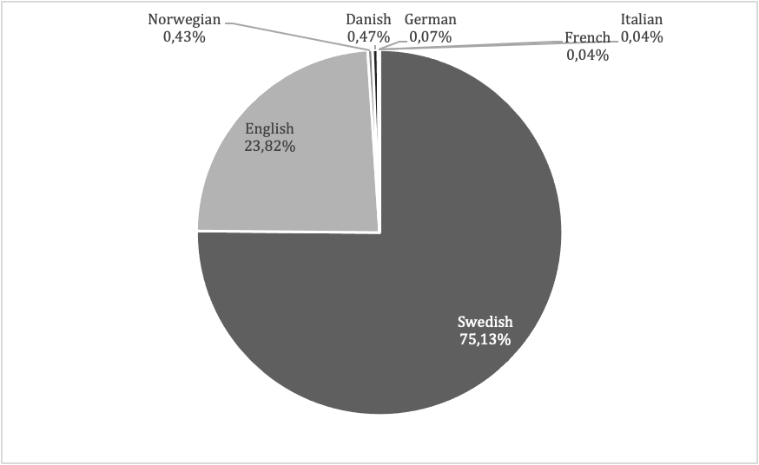
Findings
Language of cited sources (20 SOUs, 2,787 references)
Share of (20 SOUs, 2,787 references)

Slide 8
Share of scholarly references at the ministry level, two SOUs analyzed for each ministry, and the language of the cited documents
Ministry | No. of refs | Scholarly refs | Swedish | English
Culture | 117 | 3 (2.6 %) | 114 | 3
Education and research | 560 | 273 (48.8 %) | 353 | 194
Environment | 357 | 62 (17.4 %) | 205 | 152

Slide 9
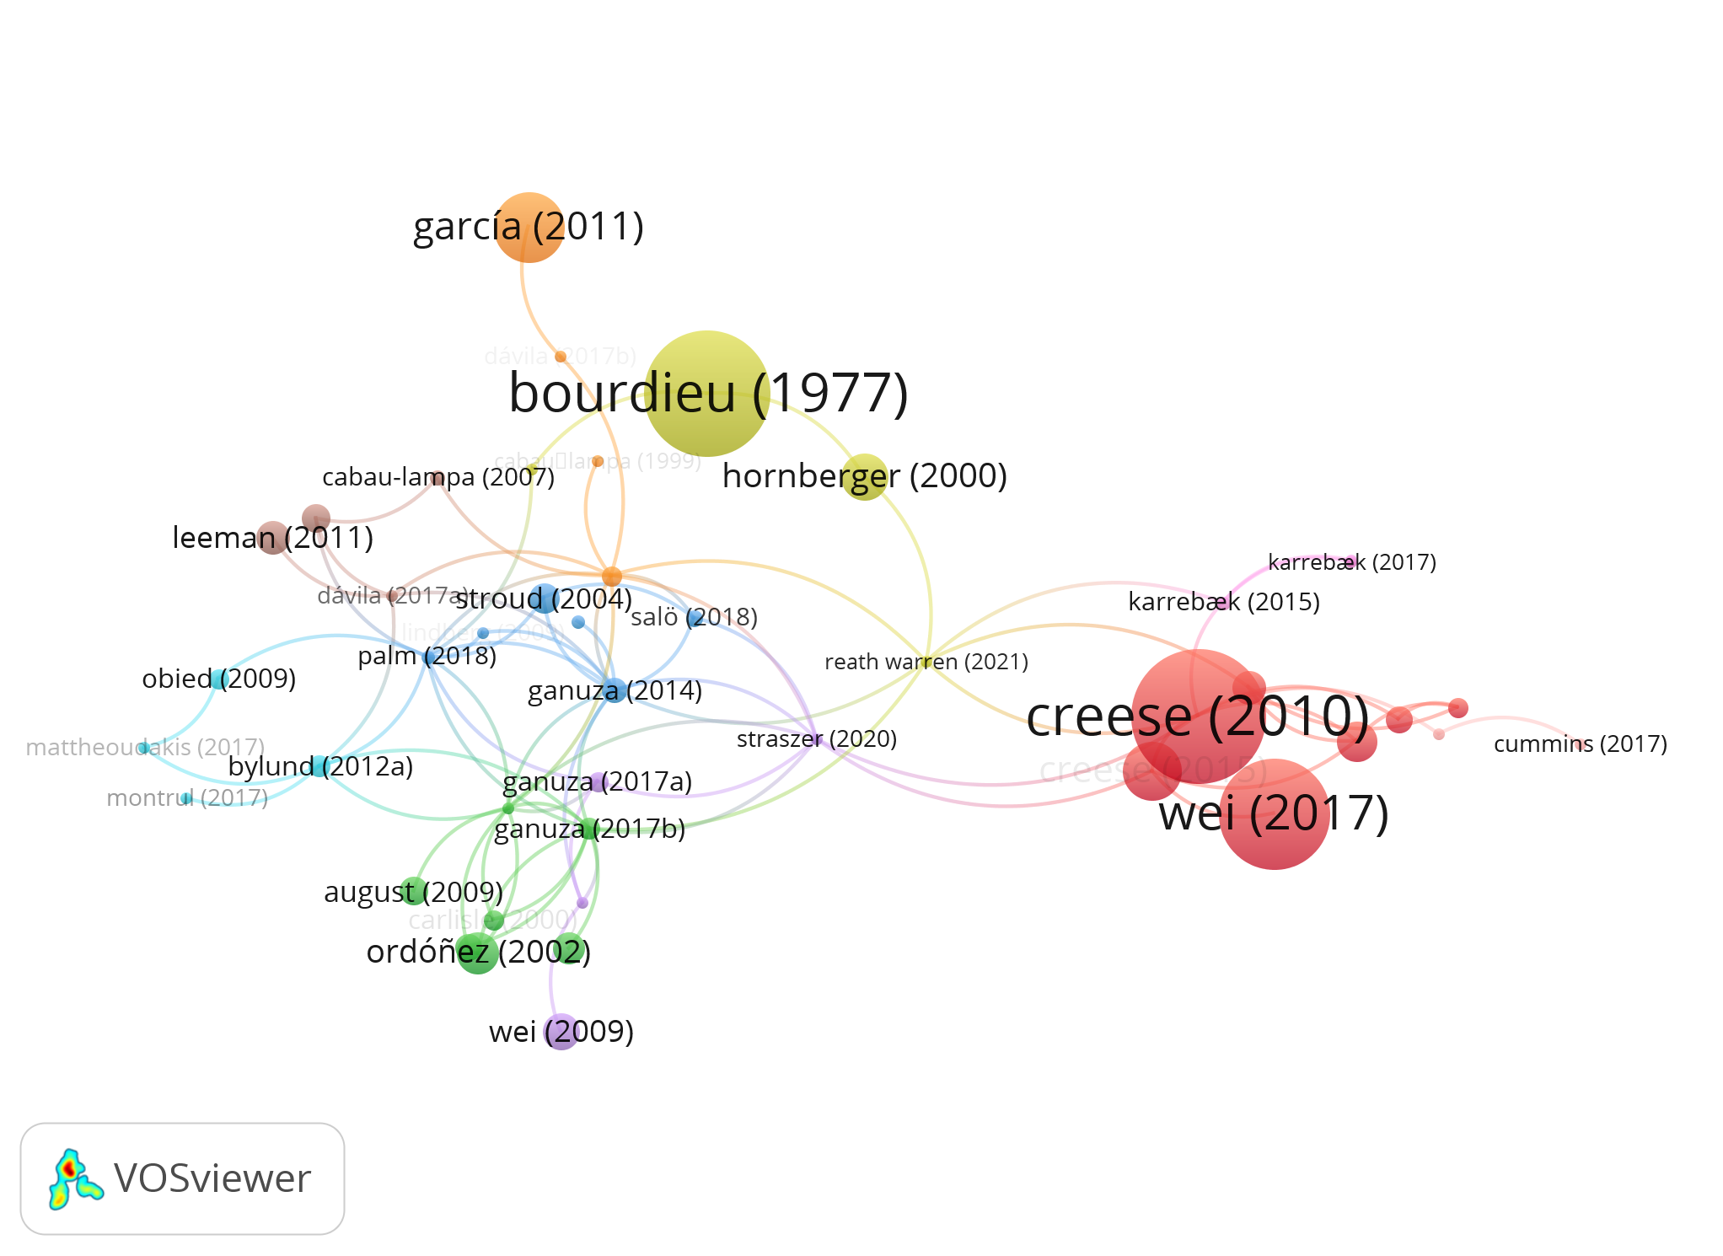
The example of SOU 2019:18
För flerspråkighet, kunskapsutveckling och inkludering – modersmålsundervisning och studiehandledning på modersmål
Network of 45 (of 242) identified references in the Dimensions database. Clustering based on direct citation (e.g., references from one document to another document in the same set. Based on references with DOIs from SOU 2019:18).

Slide 10
Concluding remarks
At first glance, the uptake of academic knowledge in the SOU sample is low (22% scholarly sources), and Swedish is the dominant language of the cited publications (75%)
A somewhat rushed conclusion: “if you want to influence policy, write only gray literature in Swedish”
Note though, that such literature is rarely rewarded when researchers are evaluated; additionally, reports often cited in SOUs in turn often build upon (and cite) research literature published in English-language scholarly journals
Yet, it is interesting to think of text types – for example grey literature in Swedish – as knowledge brokering devices in themselves
Agency: When research has an influence, it is not always by chance or coincidence, but often through active knowledge brokering; hence, scholars who want to their knowledge to have an impact on policy should consider communicating it in other ways than through the English-language journal article

Slide 11
A lot to discuss – not least concerning method
Scholarly sources account for just 22% of all references, with significant variations observed across different policy contexts, (i.e. between ministries).
Important to acknowledge that an analysis of references captures only a small portion of the ways in which research influences policy.
More comprehensive studies of SOUs may uncover changes over time, (i.e number of references, variation between policy areas)
An challenge in utilizing SOUs is the lack of standardized referencing patterns, making automated detection a difficult and time-consuming process.

Slide 12
Thank you!
References
Ammon, U. (ed.). 2001. The Dominance of English as a Language of Science. Effects on Other Languages and Language Communities. Berlin: de Gruyter.
Bandola-Gill, J. (2023). Knowledge brokering repertoires: Academic practices at science-policy interfaces as an epistemological bricolage. Minerva, 61, 71–92
Benneworth, P. (2015). Tracing how arts and humanities research translates, circulates and consolidates in society. Arts & Humanities in Higher Education, 14(1), 45–60
Helsinki Initiative. (2019). Helsinki Initiative on Multilingualism in Scholarly Communication. Federation of Finnish Learned Societies, Committee for Public Information, Finnish Association for Scholarly Publishing, Universities Norway & European Network for Research Evaluation in the Social Sciences and the Humanities
Nelhans, G. (2016). Professional impact of clinical research. In I. Rafols, J. Molas-Gallart, E. Castro-Martínez, & R. Woolley (Eds.), Proceedings of the 21st International Conference on Science and Technology Indicators, València (Spain), September 14–16, 2016
Salö, L. (Ed.). (2021) Humanvetenskapernas verkningar: Kunskap, samverkan, genomslag. Dialogos
Img credit: Microsoft Bing Image Creator

