Slide 1
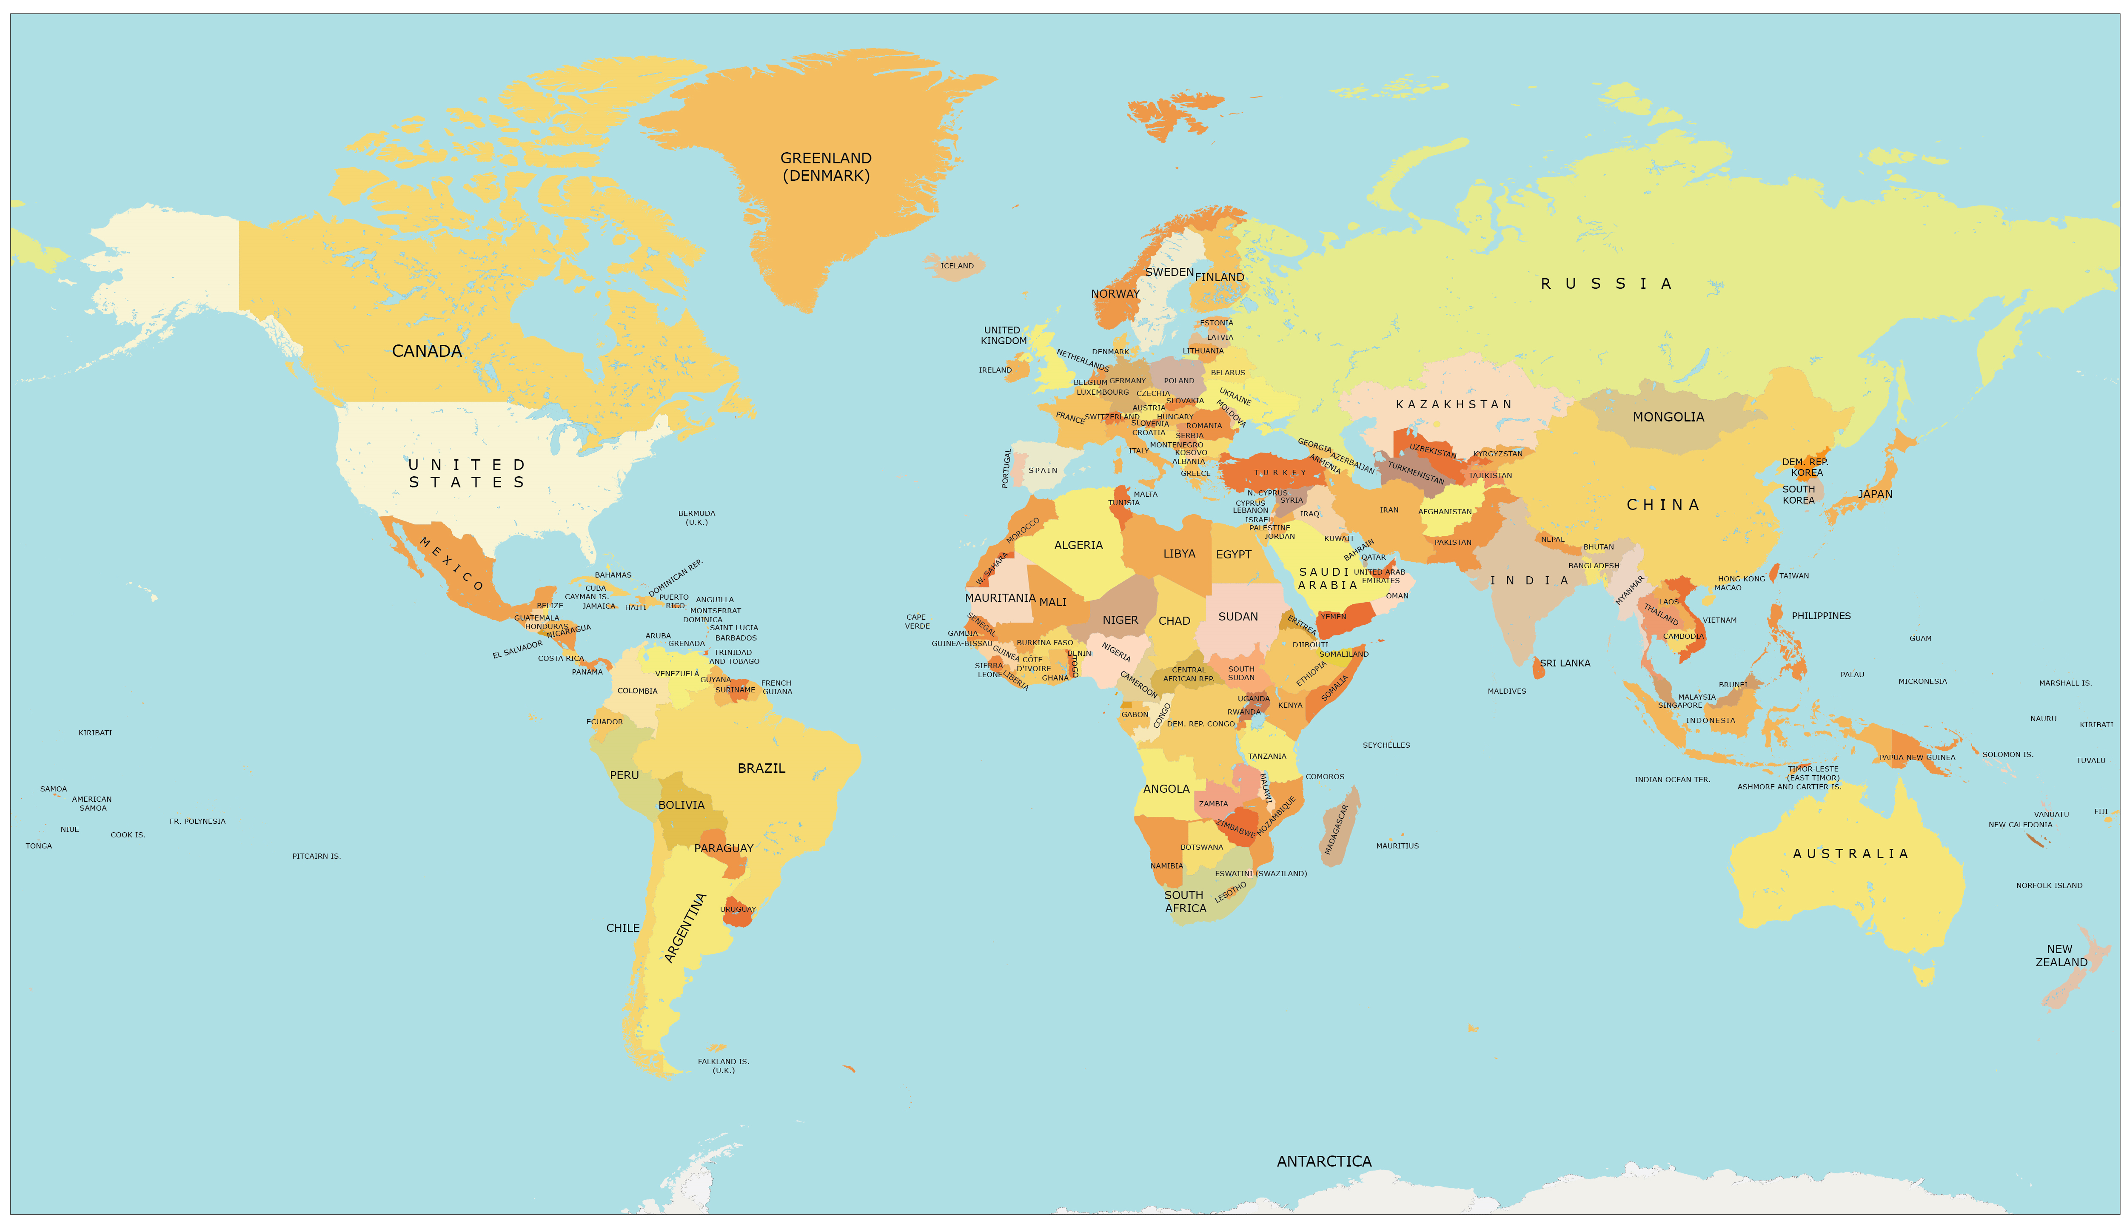
Geopolitical influences on global collaboration patterns in science and how they affect the Nordic countries
Nordic Workshop on Bibliometrics and Research Policy, Gothenburg October 2023
Gunnar Sivertsen

Slide 2
Overview
Introduction: From Open Science to Security Issues
Data and methods
A general finding: Global research collaboration does not follow the borders of defense alliances – quite the opposite!
Exceptions:
Our relations to Russia after February 2022
Norway and China after 2010
The deterioration of the USA-China relation in recent years
Conclusions

Slide 3
Overview
Introduction: From Open Science to Security Issues
Data and methods
A general finding: Global research collaboration does not follow the borders of defense alliances – quite the opposite!
Exceptions:
Our relations to Russia after February 2022
Norway and China after 2010
The deterioration of the USA-China relation in recent years
Conclusions

Slide 4
Introduction: From Open Science to Security Issues
PET (2021), ”Er jeres forskning i fare? – Gode råd til forskere og medarbejdere om håndtering af udenlandsk indblanding og spionage”, maj 2021.
”Afrapportering” fra Udvalg om Retningslinjer for Internationalt Forsknings- og Innovationssamarbejde (URIS), 2022.
Per Thiemann, ””Vi har været for naive”: Minister vil indføre stramme regler for at undgå spionage”, Politiken, den 24. maj, 2022

Slide 5
Introduction: From Open Science to Security Issues
Finland’s Governmental Action Plan on China (2021)
Recommendations for academic collaboration with Chinese partners (2021)
Mäkinen, Sirke. (2022). Nothing to do with politics? International collaboration in higher education and Finnish-Russian relations, European Journal of Higher Education 13:2, 216-237,

Slide 6
Introduction: From Open Science to Security Issues
Politiets Sikkerhetstjeneste. 2021. Nasjonal trusselvurdering 2021.
Direktoratet for høyere utdanning og kompetanse og Forskningsrådet. 2023. Retningslinjer og verktøy for ansvarlig internasjonalt kunnskapssamarbeid. Rapport nr 01/2023.
Huitfeldt, Anniken. 2023. Kunnskap, forskning og eksportkontroll i en sikkerhetspolitisk urolig tid, tale på NTNU 11.01.23.

Slide 7
Introduction: From Open Science to Security Issues
Utbildningsdepartementet (2023). Myndigheter ska ta fram riktlinjer för ansvarsfull internationalisering.
Shih, T., Gaunt, A. & Östlund, S. (2020). Responsible internationalisation: Guidelines for reflection on international academic collaboration. Stockholm: STINT.
Lindholm, A. & Sallinen, J. (2023). Minister: Nu är det slut med passiv politik. Svenska Dagbladet, 2023-02-20.

Slide 8
Network for Research on Knowledge Relations (KNOWREL)
Maj Grasten & Stine Haakonsson, CBS
Sirke Mäkinen, University of Helsinki
Hans Jørgen Gåsemyr & Kristin Fjæstad, NUPI; Gunnar Sivertsen, NIFU
Tommy Shih, Lunds Universitet
All members except me are political scientists who read and speak Chinese or Russian.

Slide 9
Overview
Introduction: From Open Science to Security Issues
Data and methods
A general finding: Global research collaboration does not follow the borders of defense alliances – quite the opposite!
Exceptions:
Our relations to Russia after February 2022
Norway and China after 2010
The deterioration of the USA-China relation in recent years
Conclusions

Slide 10
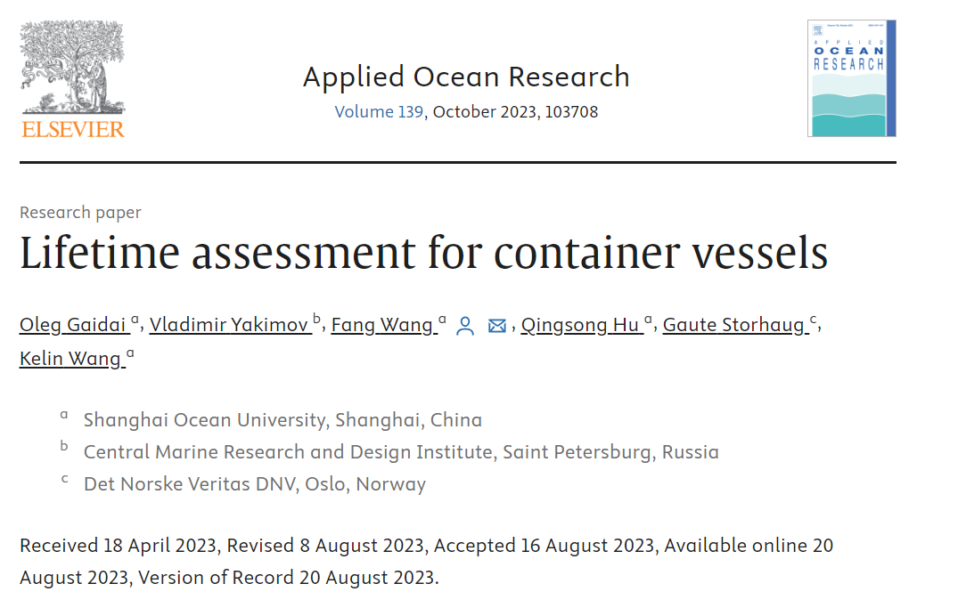
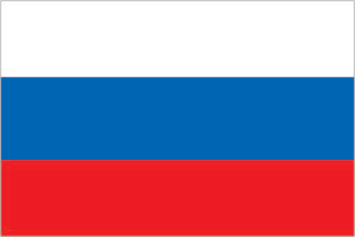
The analysis is based on collaborating countries as indexed in author affiliations in 32 million artices in Web of Science from 2004 to August 2023

Slide 11
Treating size differences in collaboration analysis is demanding
Russa’s share is reduced to 1,8 percent by August 2023

Slide 12
China and USA are each other's largest collaboration partners

Slide 13
Using the totals in columns and rows to relativize size in a matrix representing the whole collaboration network
 | A | B | C | D | E | F | G | H | I | J | Total
A |  | 18 | 35 | 21 | 5 | 2 | 2 | 30 | 24 | 34 | 171
B | 18 |  | 143 | 45 | 50 | 91 | 4 | 37 | 69 | 12 | 469
C | 35 | 143 |  | 113 | 94 | 27 | 26 | 299 | 41 | 69 | 847
D | 21 | 45 | 113 |  | 35 | 51 | 137 | 57 | 50 | 55 | 564
E | 5 | 50 | 94 | 35 |  | 29 | 14 | 32 | 75 | 26 | 360
F | 2 | 91 | 27 | 51 | 29 |  | 25 | 27 | 45 | 31 | 328
G | 2 | 4 | 26 | 137 | 14 | 25 |  | 21 | 24 | 31 | 284
H | 30 | 37 | 299 | 57 | 32 | 27 | 21 |  | 25 | 85 | 613
I | 24 | 69 | 41 | 50 | 75 | 45 | 24 | 25 |  | 33 | 386
J | 34 | 12 | 69 | 55 | 26 | 31 | 31 | 85 | 33 |  | 376
Total | 171 | 469 | 847 | 564 | 360 | 328 | 284 | 613 | 386 | 376 | 4398

Slide 14
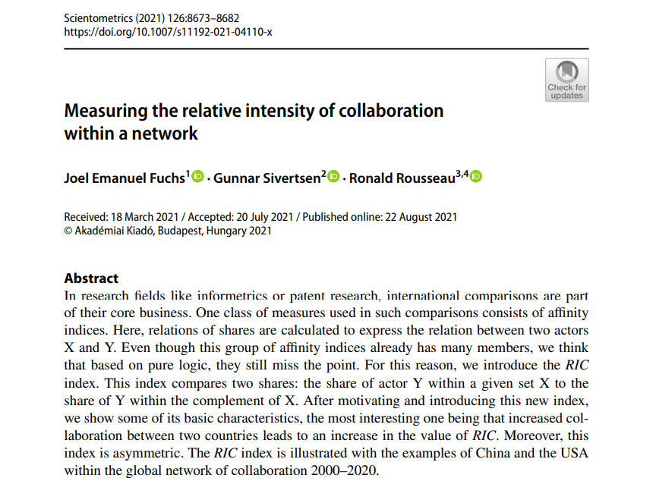
How to measure the relative intensity of collaboration while taking the activities in the whole network into account

Slide 15
Overview
Introduction: From Open Science to Security Issues
Data and methods
A general finding: Global research collaboration does not follow the borders of defense alliances – quite the opposite!
Exceptions:
Our relations to Russia after February 2022
Norway and China after 2010
The deterioration of the USA-China relation in recent years
Conclusions

Slide 16
The collaboration profile of the five Nordic countries Relative intensitiy in relation to the largest partners
Average

Slide 17
Prioritized collaboration partners Mainly Europe

Slide 18
The collaboration profile of the USA Relative intensitiy in relation to the largest partners + four Nordics

Slide 19
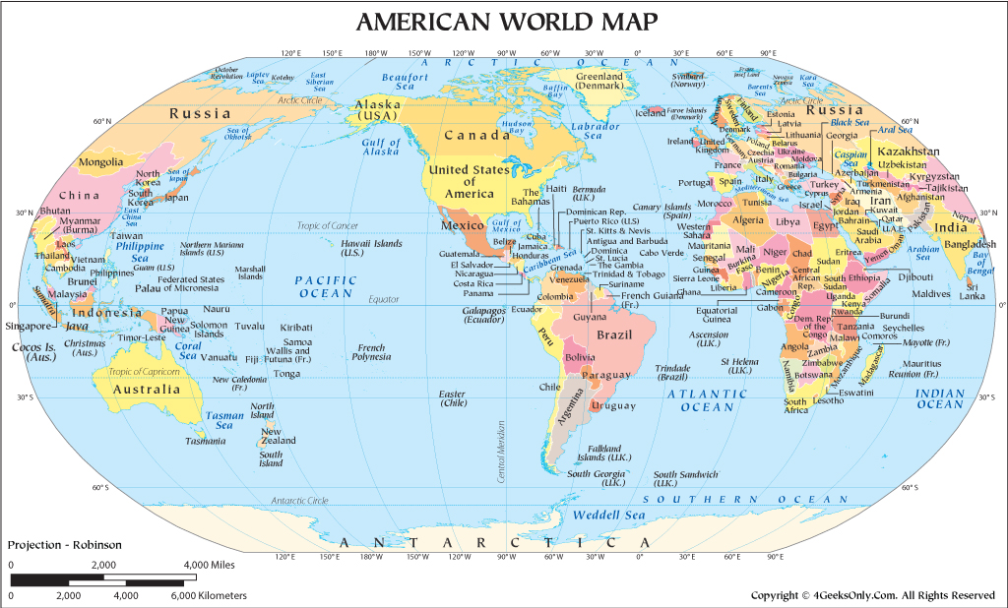
Prioritized collaboration partners China, Canada, South-Korea, Japan, Brazil and Israel. In Europe: Only UK

Slide 20
The collaboration profile of China Relative intensitiy in relation to the largest partners + four Nordics

Slide 21
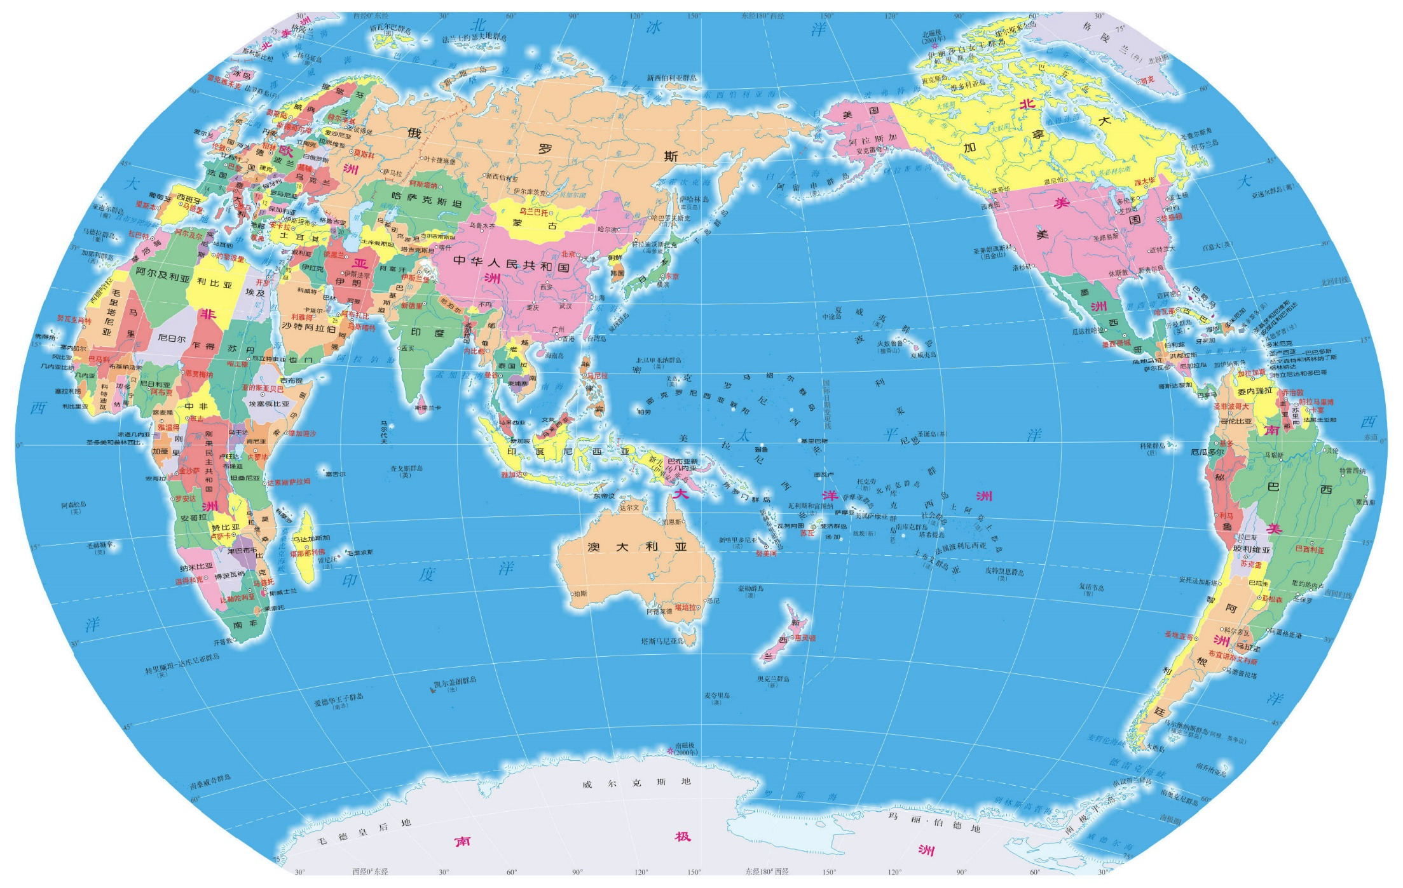
Prioritized collaboration partners The neighbors plus the USA and other English speaking countries

Slide 22
Overview
Introduction: From Open Science to Security Issues
Data and methods
A general finding: Global research collaboration does not follow the borders of defense alliances – quite the opposite!
Exceptions:
Our relations to Russia after February 2022
Norway and China after 2010
The deterioration of the USA-China relation in recent years
Conclusions

Slide 23
Our relations to Russia after February 2022

Slide 24
The degree of international collaboration only slowly decreases A decrease in domestic publishing in Russia is the most important factor

Slide 25
China has been the largest nation in Web of Science since 2018
China passed Sweden in 1996, Russia in 2000, and UK in 2006

Slide 26
Denmark, Finland, Sweden and the EU: The increase in collaboration with China has followed the general growth of China in science

Slide 27
Iceland, Norway and the USA: These countries have departed from the general trend

Slide 28
Norway and China 2010-2016

Slide 29
The main recent change in global scientific collaboration is the decrease in the China-USA relation

Slide 30
For comparison, collaboration is stable in the relations to the UK

Slide 31
Overview
Introduction: From Open Science to Security Issues
Data and methods
A general finding: Global research collaboration does not follow the borders of defense alliances – quite the opposite!
Exceptions:
Our relations to Russia after February 2022
Norway and China after 2010
The deterioration of the USA-China relation in recent years
Conclusions

Slide 32
Conclusions
The Nordic countries are most focused on Europe
The relative intensity of collaboration
Has recently decreased in the relation to Russia
Is low in the relations to China, particularly for Iceland and Norway
Global scientific collaboration so far does not follow the borders of defense alliances
However, the recent relative decrease in the China-USA relation
is a sign that this might be changing
and seems to already affect research policy in the Nordic countries

Slide 33
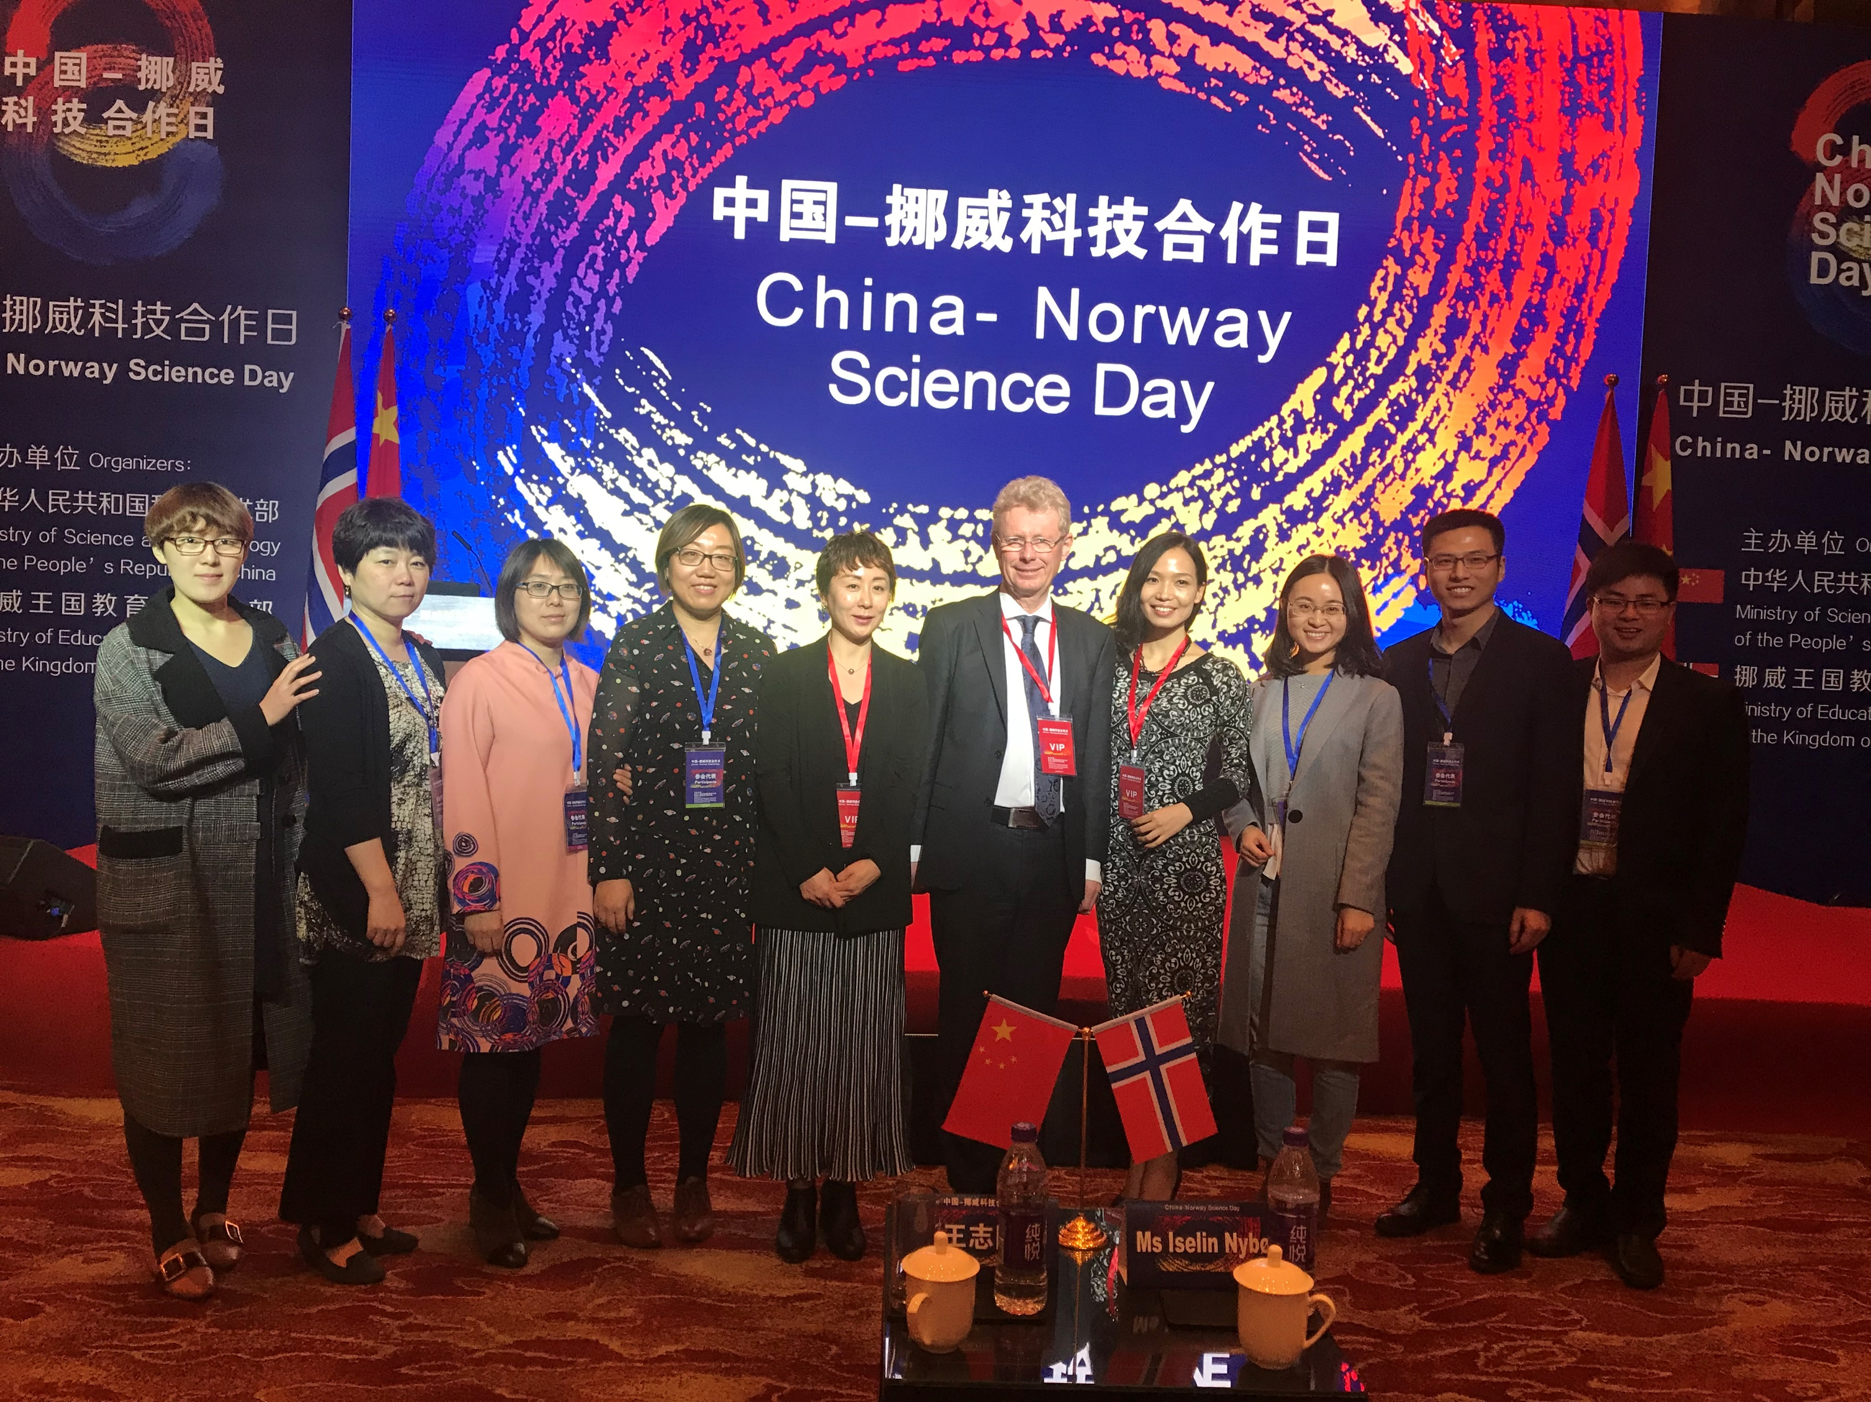
Thank you for your attention!

