Slide 1
Researchers’ mobility in Nordic countries
Milovan Kovač
Ross W.K. Potter
Institute for Scientific Information, Clarivate October 2023

Slide 2
Why does institutional researcher mobility matter?
Institutional mobility of researchers refers to their movement or transition from one institution to another during their academic or professional careers.
Mobile researchers contribute to the discovery process by sharing knowledge, expertise, perspectives and ideas with their fellow researchers at other institutions.
In general, researchers’ mobility is considered an indicator of a healthy and efficient research labour market.
The value of analyzing researchers’ mobility for policy-makers:
Identifying talent flows
Retaining and attracting skilled researchers
Fostering international collaboration
Resource allocation & strategic planning for research investments
Overall, monitoring researchers’ mobility supports evidence-based decision-making and the formulation of effective research policies.
It ensures the policies to be responsive to the evolving needs of the research community.
Mobility results in:
Greater productivity
Greater scientific impact
Migration of skilled workforce
Brain drain/gain

Slide 3
Ways of investigating researchers’ mobility
Researchers’ mobility could be investigated through numerous perspectives:
Scientific field level
Regional level
Country level
Institutional level
Group of authors level
Individual level
It can be mixed with various attributes:
Academic age
Affiliation type
Collaboration type
Funding source

Slide 4
Research scope // dataset & method
Investigating geographical and affiliation type-related mobility in Nordics countries.
Data from Web of Science (WoS) were used.
WoS articles and review papers between 2012 and 2021 for Nordic authors that published in 2012.
Ten-year period between 2012 and 2021.
This filtration resulted in 70,739 authors:
27,055 in Sweden
16,590 in Denmark
14,278 in Finland
12,478 in Norway
989 in Iceland
Institutional affiliations for authors were taken from address data within WoS.
Six affiliation types: academic, corporate, government, health, and nonprofit, using data from InCites Benchmarking & Analytics.

Slide 5
Initial look at the dataset
Affiliated country | Number of researchers | % of researchers | Number of articles | % of articles
USA | 4675 | 43.4 | 32008 | 4.9
United Kingdom | 2536 | 23.6 | 20877 | 3.2
Germany | 2400 | 22.3 | 19931 | 3.1
China | 1500 | 13.9 | 41234 | 6.3
France | 1003 | 9.3 | 6862 | 1.1
Australia | 883 | 8.2 | 7502 | 1.2
Canada | 857 | 8.0 | 5436 | 0.8
Switzerland | 830 | 7.7 | 6478 | 1.0
Italy | 764 | 7.1 | 6652 | 1.0
Netherlands | 699 | 6.5 | 5630 | 0.9
25895 (~37%) authors have more than one affiliated country. 20391 (29%) of them added new affiliation country after 2012.
47049 (~84%) of Nordic authors have more than one affiliated institution. 39872 (~56%) of them added new affiliations after 2012.
F
A
E
D
B
C

Slide 6
Top 10 countries that mobile Nordics researchers are also affiliated with
SWEDEN
NORWAY
FINLAND
Affiliated country | No. of res. | % of res. | No. of articles | % of articles
USA | 2179 | 20.2 | 15963 | 6.8
United Kingdom | 1111 | 10.3 | 10723 | 4.6
Germany | 1047 | 9.7 | 9367 | 4.0
China | 759 | 7.1 | 26508 | 11.3
Denmark | 694 | 6.4 | 7517 | 3.2
Norway | 619 | 5.8 | 8120 | 3.5
France | 426 | 4.0 | 4028 | 1.7
Finland | 414 | 3.8 | 5966 | 2.5
Canada | 403 | 3.7 | 2938 | 1.3
Australia | 396 | 3.7 | 3798 | 1.6
Affiliated country | No. of res. | % of res. | No. of articles | % of articles
USA | 658 | 15.9 | 6122 | 6.5
Sweden | 422 | 10.2 | 6491 | 6.9
United Kingdom | 385 | 9.3 | 3202 | 3.4
Germany | 332 | 8.0 | 3395 | 3.6
Denmark | 288 | 7.0 | 3918 | 4.2
France | 182 | 4.4 | 1594 | 1.7
China | 181 | 4.4 | 4661 | 5.0
Australia | 149 | 3.6 | 1179 | 1.3
Canada | 133 | 3.2 | 1610 | 1.7
Italy | 124 | 3.0 | 787 | 0.8
Affiliated country | No. of res. | % of res. | No. of articles | % of articles
USA | 649 | 13.9 | 5253 | 5.3
Sweden | 572 | 12.2 | 7611 | 7.6
United Kingdom | 423 | 9.1 | 4020 | 4.0
Germany | 351 | 7.5 | 2717 | 2.7
China | 233 | 5.0 | 4809 | 4.8
France | 181 | 3.9 | 915 | 0.9
Norway | 154 | 3.3 | 1953 | 2.0
Italy | 130 | 2.8 | 1536 | 1.5
Canada | 128 | 2.7 | 839 | 0.8
Australia | 127 | 2.7 | 1167 | 1.2

Slide 7
Top 10 countries that mobile Nordics researchers are also affiliated with
DENMARK
ICELAND
Affiliated country | No. of res. | % of res. | No. of articles | % of articles
USA | 1206 | 18.3 | 8270 | 5.4
Germany | 695 | 10.6 | 6963 | 4.6
United Kingdom | 632 | 9.6 | 5308 | 3.5
Sweden | 606 | 9.2 | 7232 | 4.8
Norway | 391 | 5.9 | 3700 | 2.4
China | 353 | 5.4 | 8208 | 5.4
Switzerland | 225 | 3.4 | 2326 | 1.5
Australia | 225 | 3.4 | 1571 | 1.0
France | 225 | 3.4 | 1709 | 1.1
Canada | 209 | 3.2 | 1128 | 0.7
Affiliated country | No. of res. | % of res. | No. of articles | % of articles
Sweden | 73 | 18.7 | 597 | 7.9
USA | 68 | 17.4 | 995 | 13.1
Norway | 40 | 10.2 | 248 | 3.3
United Kingdom | 40 | 10.2 | 144 | 1.9
Denmark | 28 | 7.2 | 294 | 3.9
Germany | 21 | 5.4 | 274 | 3.6
Netherlands | 14 | 3.6 | 106 | 1.4
France | 13 | 3.3 | 74 | 1.0
Spain | 12 | 3.1 | 25 | 0.3
Switzerland | 11 | 2.8 | 42 | 0.6

Slide 8
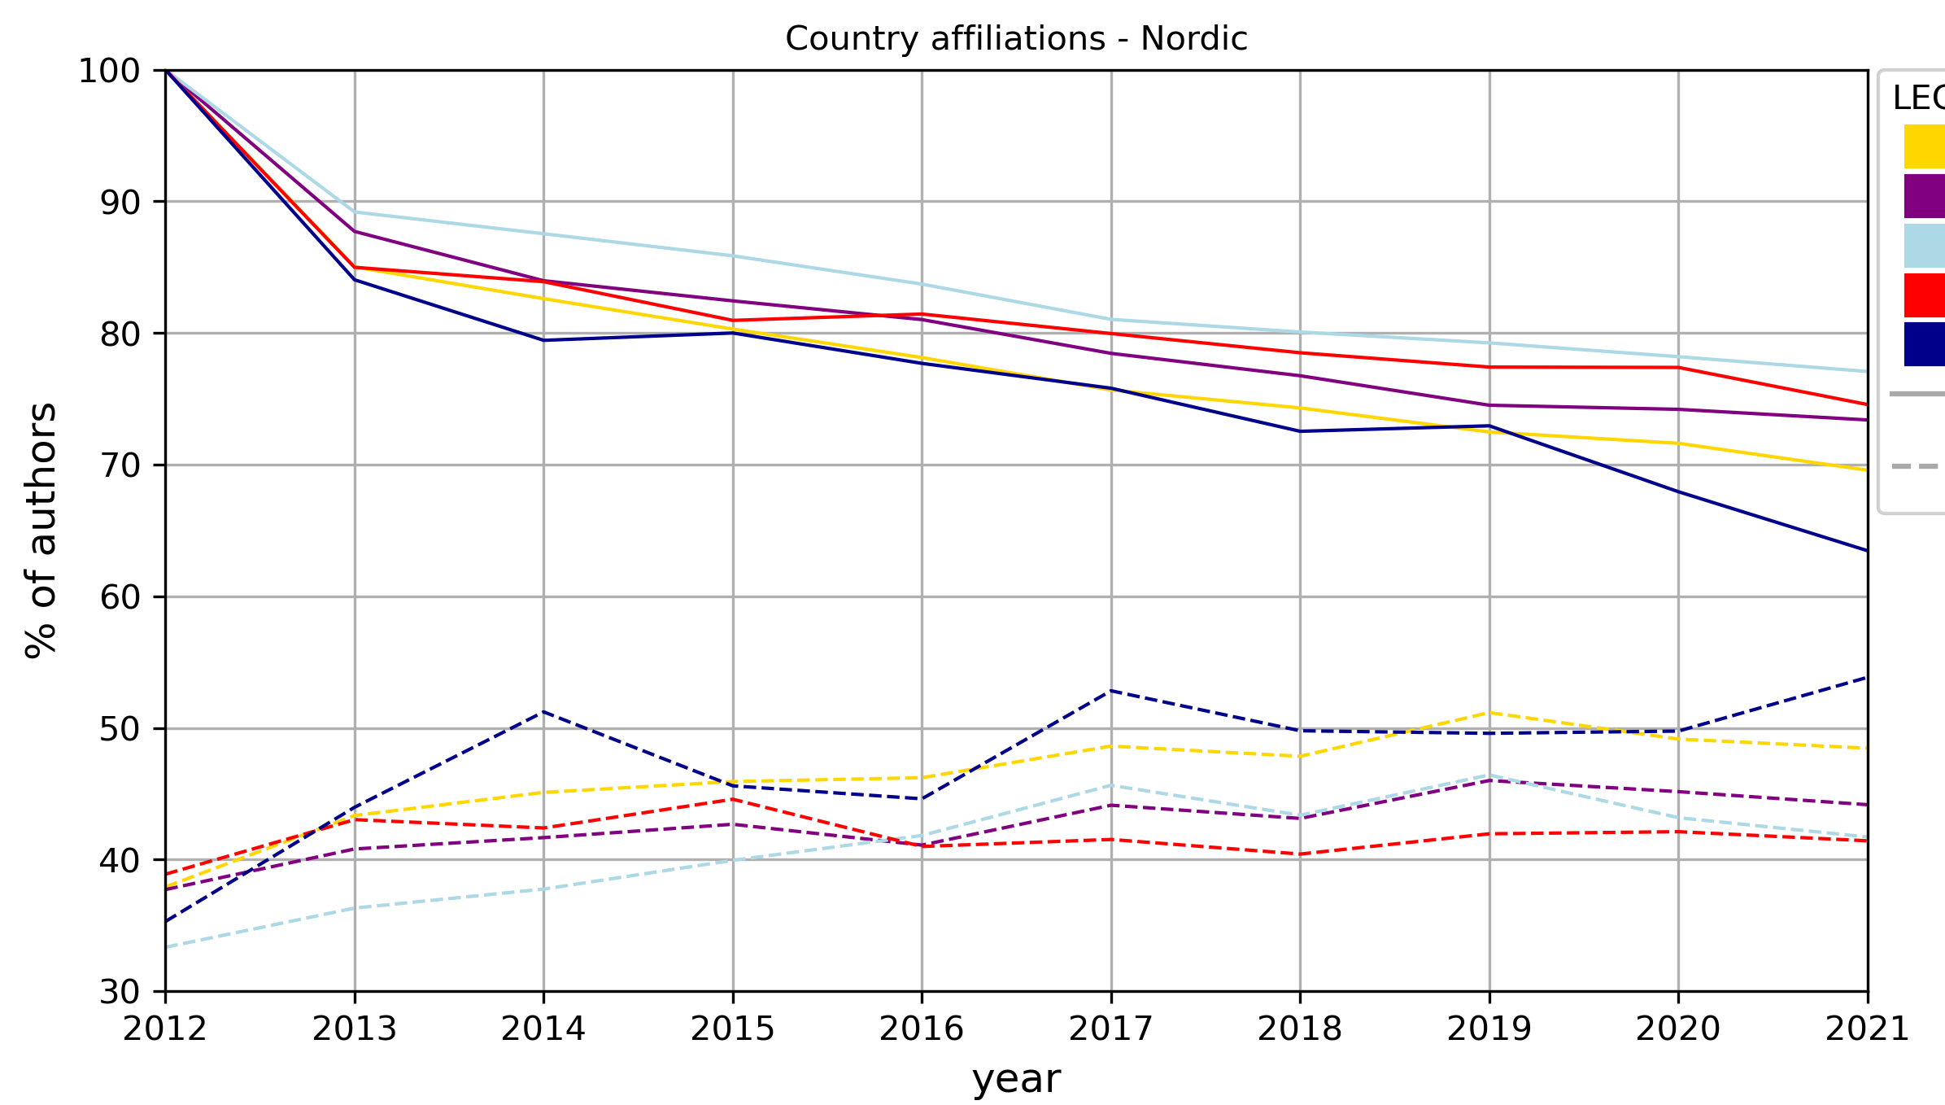
Affiliation country changes
Researchers from all Nordic countries tend to gradually leave their initial affiliated country as their career progresses.
Iceland has the greatest drain of researchers. Less than 70% of its authors remained affiliated with an Icelandic institution in 2021
Sweden
Norway
Affiliated with other
Denmark
Iceland
Affiliated
Finland

Slide 9
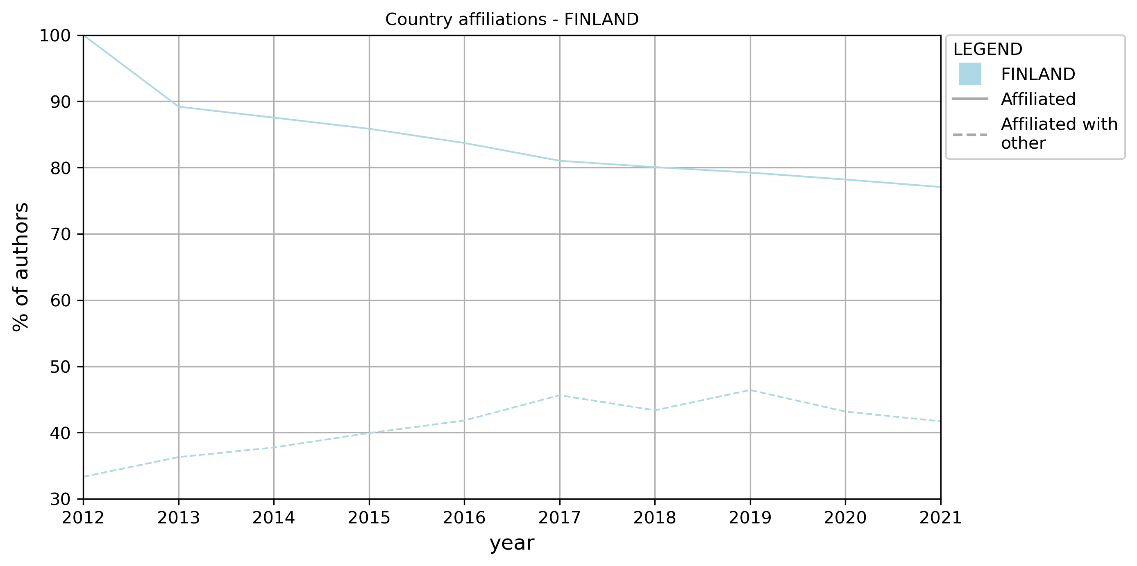
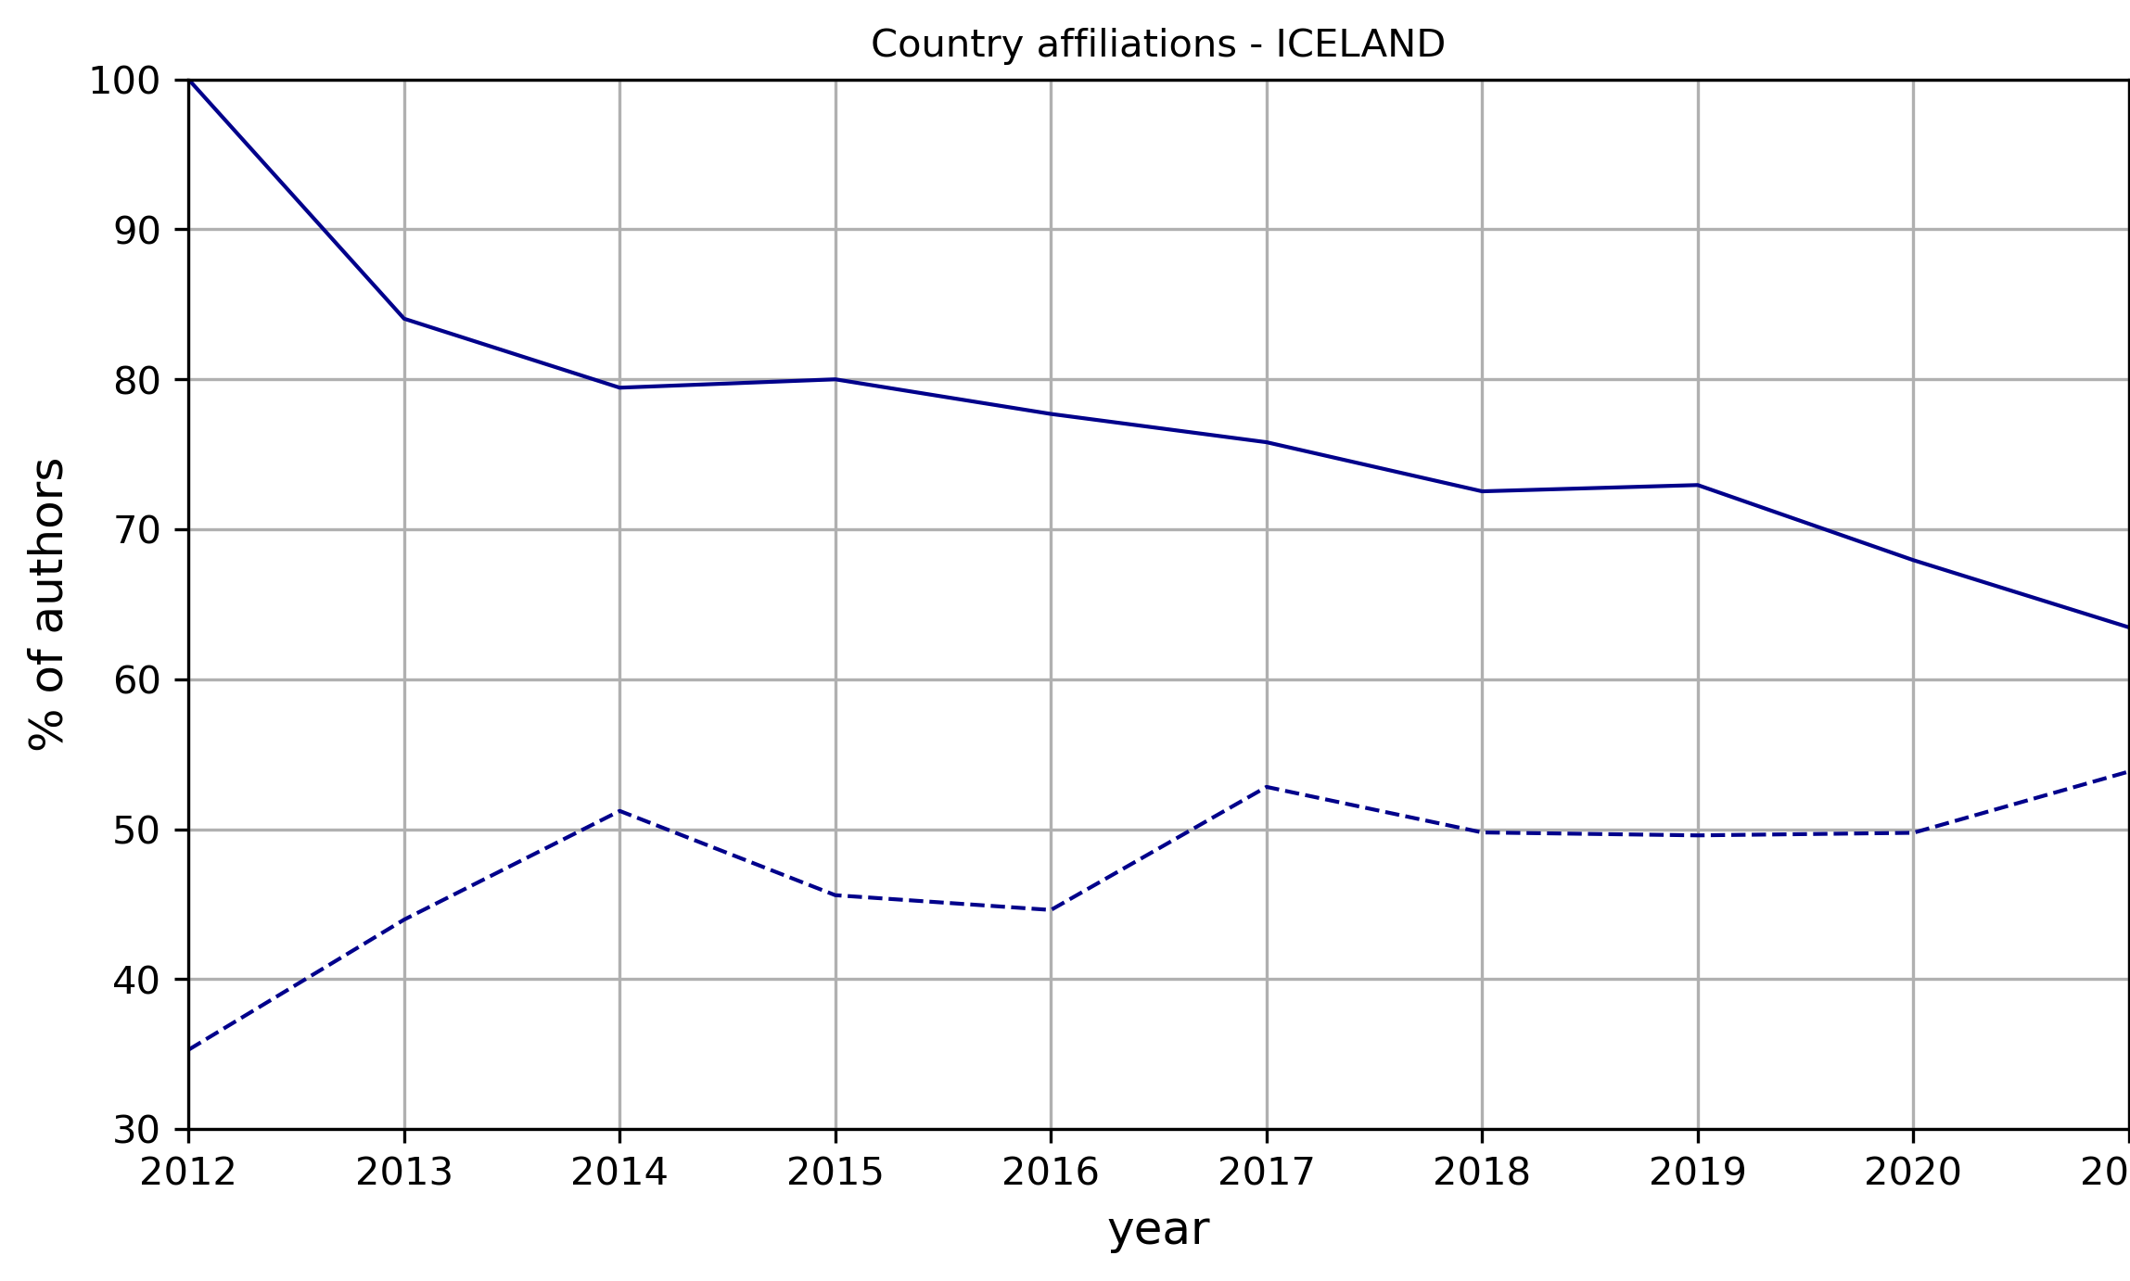
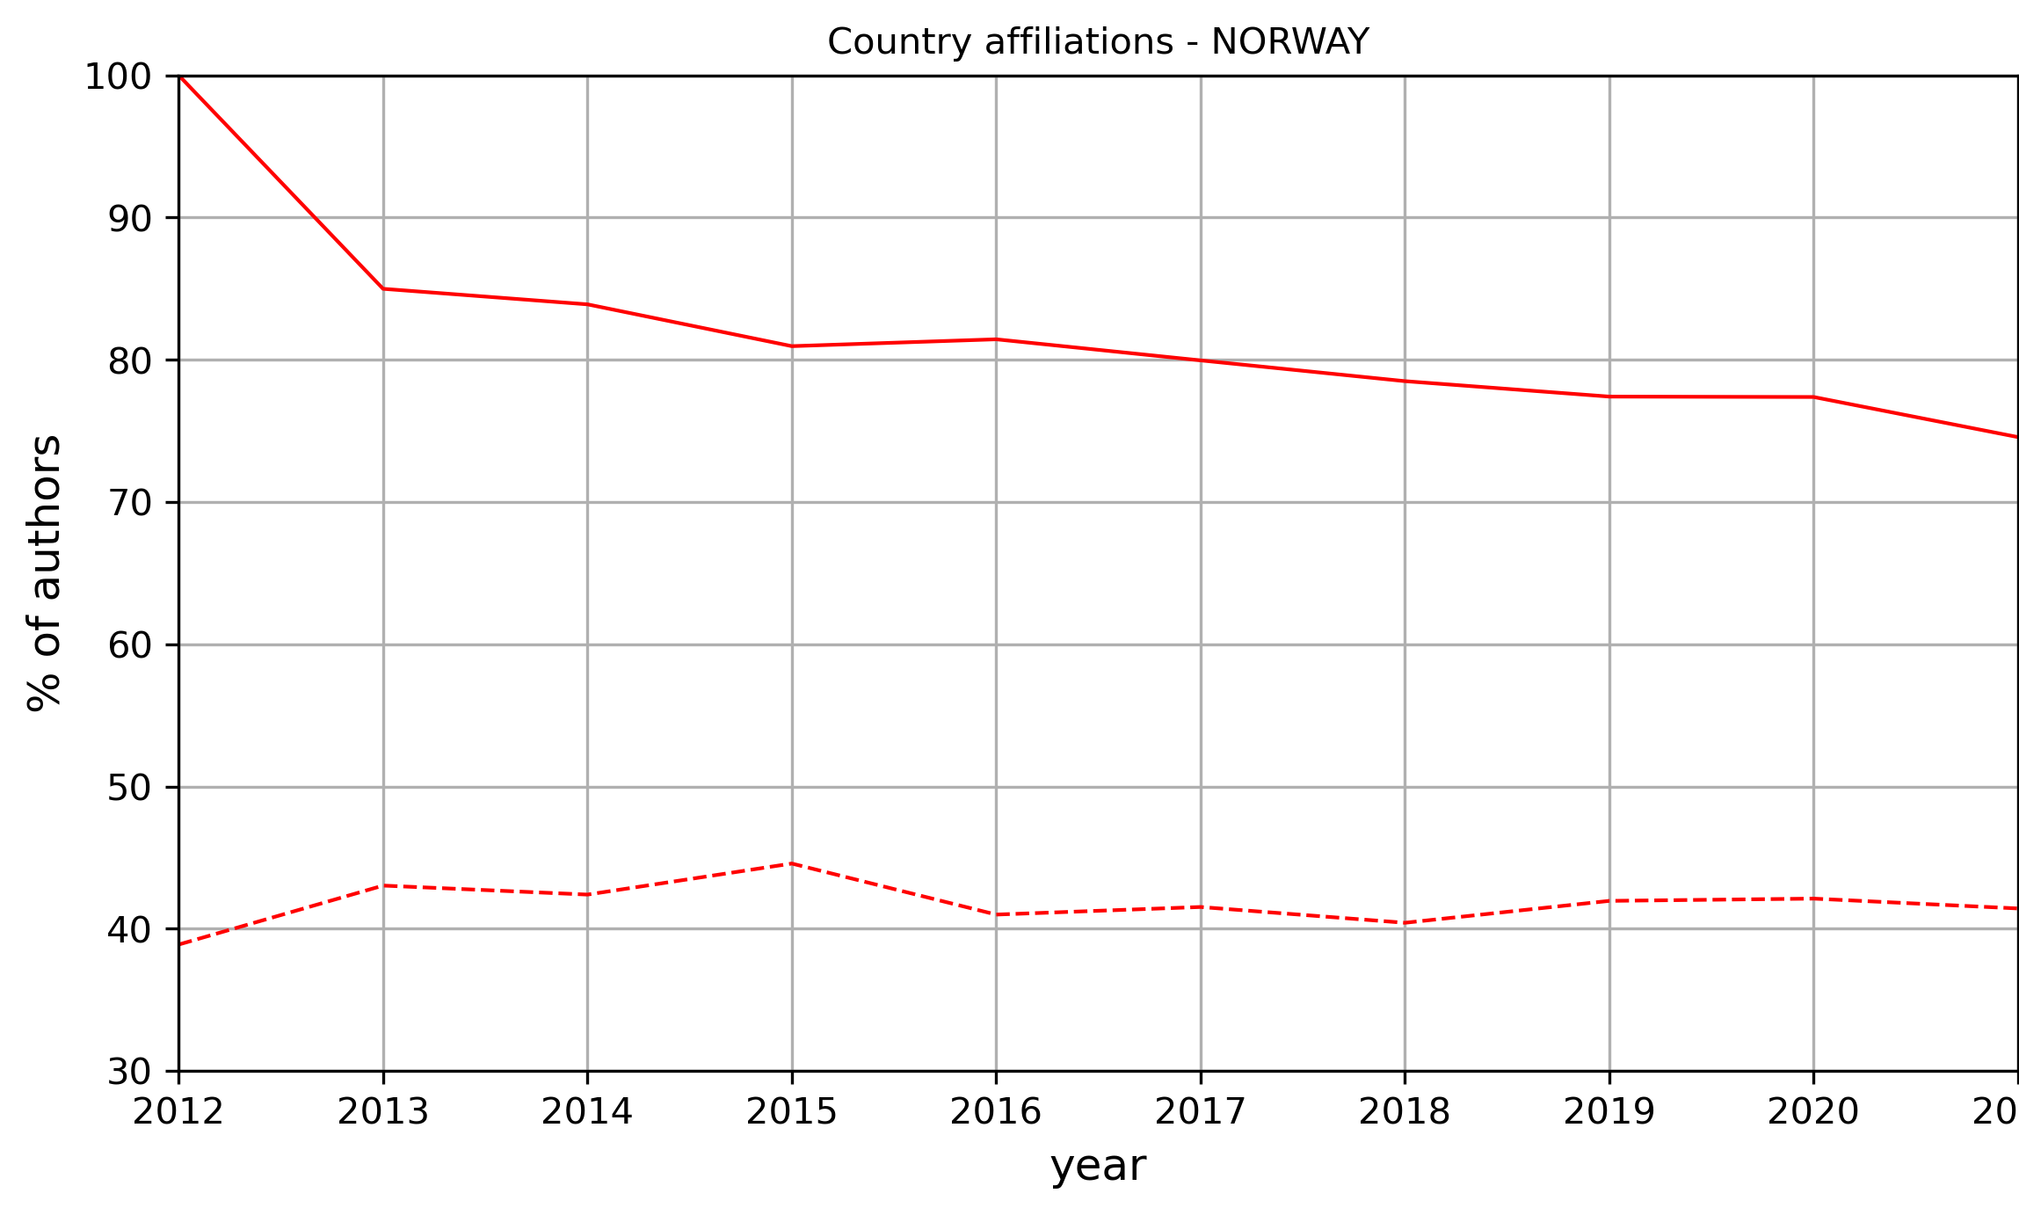
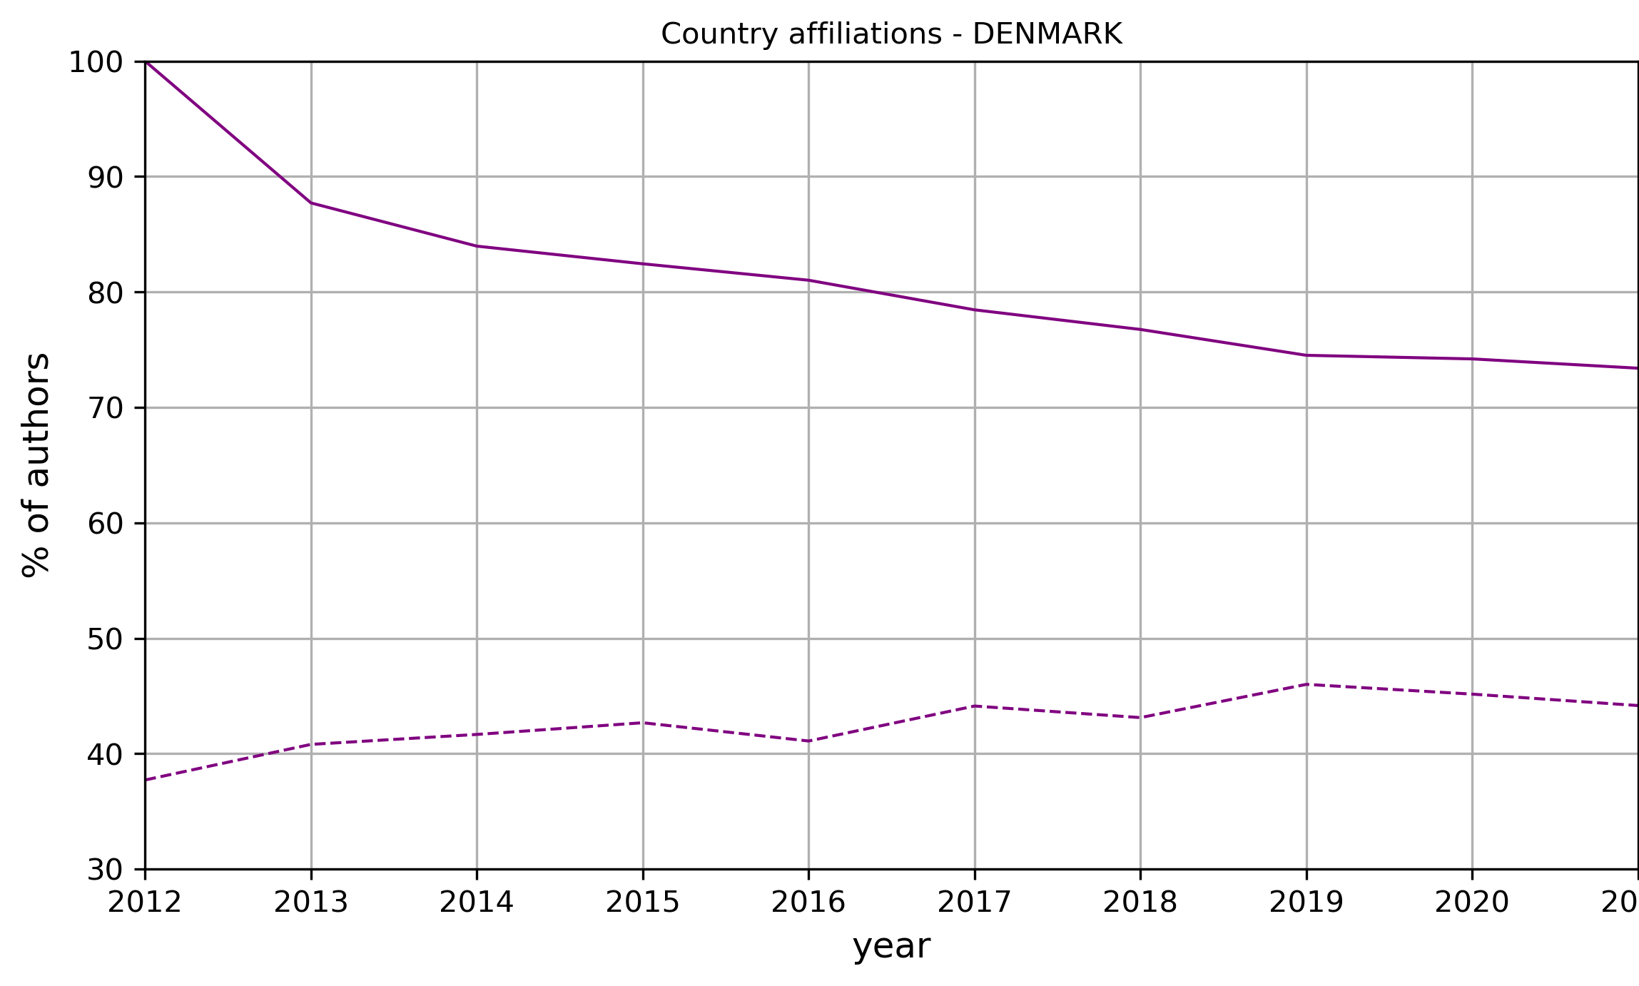
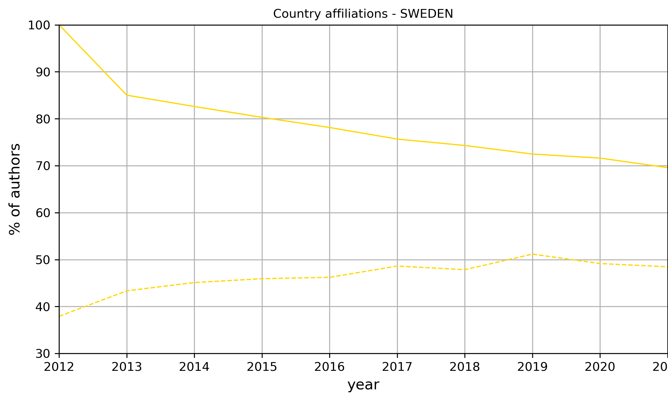
Affiliation country changes
Researchers from all Nordic countries tend to gradually leave their initial affiliated country as their career progresses.
Iceland has the greatest drain of researchers. Less than 70% of its authors remained affiliated with an Icelandic institution in 2021
Sweden
Norway
Affiliated with other
Denmark
Iceland
Affiliated
Finland

Slide 10
Foreign institutions attractive to Nordics researchers
Foreign Institution | Country | Researchers | Articles
CNRS - The French National Centre | France | 10 | 21
University of California | USA | 9 | 250
University of Oxford | United Kingdom | 8 | 12
University of London | United Kingdom | 8 | 37
Harvard University | USA | 7 | 352
University of Luxembourg | Luxembourg | 6 | 62
UDICE - French Research Universities | France | 6 | 22
USA Department of Urology | USA | 5 | 1
Ghent University | Belgium | 5 | 123
USA Department of Surgery | USA | 5 | 1
Mobile Nordic researchers were affiliated with 409 foreign institutions.
94 (~23%) of these institutions have more than one affiliated Nordic author.

Slide 11
Distribution of researchers per affiliation types
Affiliation type | % of researchers in 2012 | % of researchers in 2021
Academic | 93.3 | 95.2
Corporate | 4.4 | 3.7
Government | 2.7 | 2.3
Health | 12.3 | 12.0
Nonprofit | 1.8 | 1.7
Pretty much stable when comparing 2012 and 2021.
A slight increase in the relative number of researchers publishing under academic institutions.
A slight decrease in the relative number of researchers publishing under corporate and government affiliations.

Slide 12
Conclusions
More than four fifths of Nordic researchers have multiple institutional affiliations. More than half of Nordic researchers added a new institution to their initial affiliation list.
Roughly 37% of Nordic authors have more than one affiliated country, while 29% added new a country affiliation after 2012.
Researchers from all Nordic countries tend to gradually leave their initial affiliated country as their career progresses.
USA, UK and Germany are in the top tier of foreign affiliated countries of Nordic researchers.
Sweden stands out as an important mobility destination for authors from other Nordic countries (except for Denmark).
There were no significant shifts of authors from one affiliation type to another when comparing 2012 with 2021.
Future research directions:
A more in-depth analysis of the correlation between the academic age of researchers and mobility patterns;
Investigating the mobility between different affiliation types in the case of different countries and regions.
“Movement is everything, direction is what matters.”
Manfred Hinrich
“Detours increase local knowledge.”
Vietnamese proverb

Slide 13
Questions & Discussion
Milovan Kovač
milovan.kovac@clarivate.com
Institute for Scientific Information

