Slide 1
Trade press as pathways to impact
NWB 2023
Silvia Dobre*, Rachel Herbert*, Diana Hicks**
* International Center for the Study of Research, Elsevier
** School of Public Policy, Georgia Institute of Technology

Slide 2
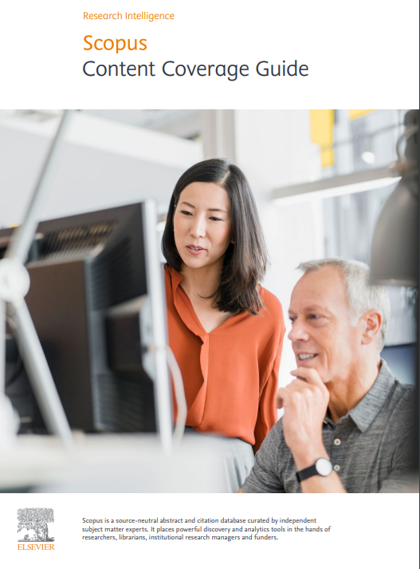
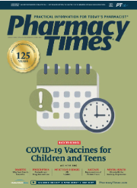
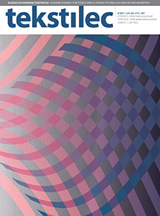
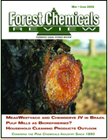
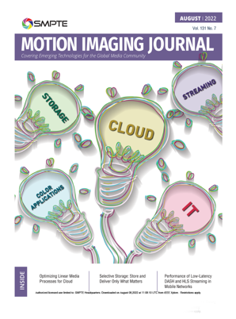
What is trade press?
aiming to reach a specific industry, trade, type of business
articles on topical subjects, news items, reviews, surveys
include advertisements targeted to those in the field
https://www.elsevier.com/__data/assets/pdf_file/0007/69451/Scopus_ContentCoverage_Guide_WEB.pdf
2

Slide 3
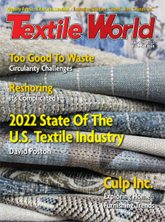
What is the trade press segmentation?
Professional Journals
Content Type:
Academic/
Scholarly
Publisher Name includes Institute OR
Society OR
Professional
Content Type:
Trade
Content Type:
Consumer OR
Government
Serial Type:
Journal OR
Serial Title includes Journal OR
Publisher Name includes:
Association OR
Federation
Consumer Magazine
Trade Journals
Serial Type:
Magazine OR Newsletter OR Bulletin OR Newspaper
Content Type:
Trade
Serial Type:
Magazine
Trade Magazine
3

Slide 4
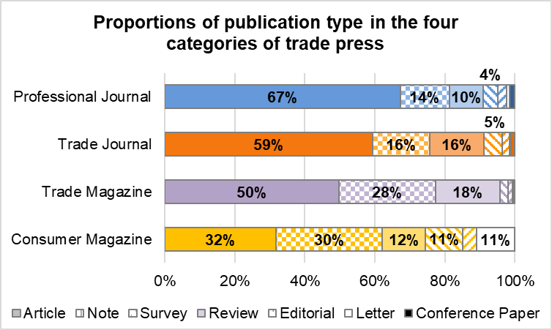
What types of publications could we find in the trade press?
4

Slide 5
Why are we doing this research?
The non-scholarly literature plays a vital role in the transfer of research knowledge into practice by professionals and the public alike
RQ1: What is the role played by non-scholarly (trade) communication in helping the research findings reach end users?
RQ2: Can we identify the thread of knowledge from scholarly to non-scholarly (trade) communications?
RQ3: Could we establish the pathways through which research findings (knowledge production) reach those who can use it (knowledge utilization)?
5

Slide 6
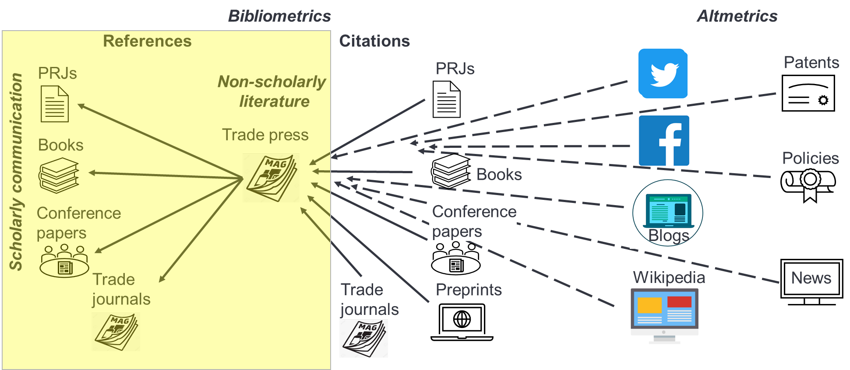
Trade press as pathways to impact
6

Slide 7
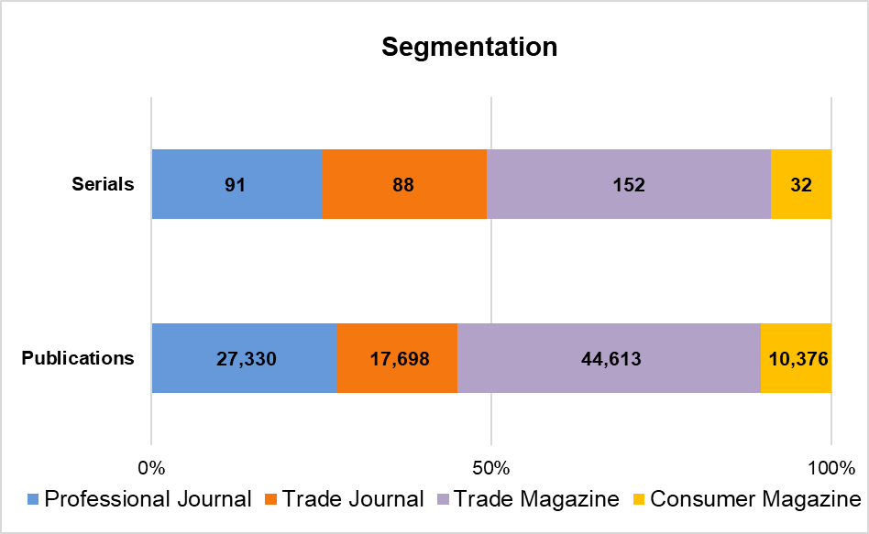
What is the study dataset?
2016 – 2021, indexed by Scopus
363 (out of 803) trade press
100k documents, mostly articles
Scopus indexed content:
serial publications: journals, trade journals, book series and conference materials (that have an ISSN)
non-serial sources: reports, patens, books (a publication with an ISBN).
7

Slide 8
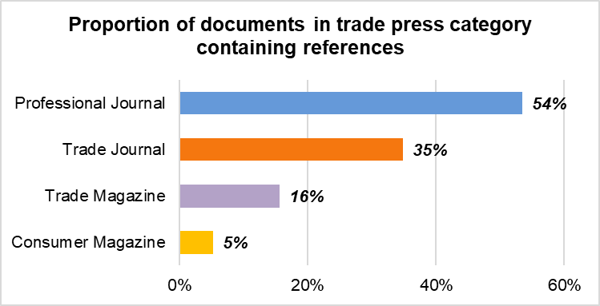
What proportion of trade press cites other works?
28% of the corpus documents have references
8

Slide 9
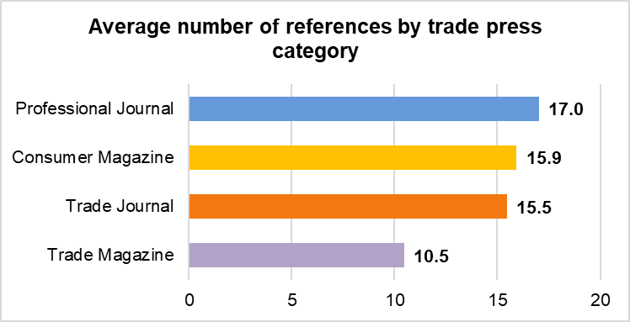
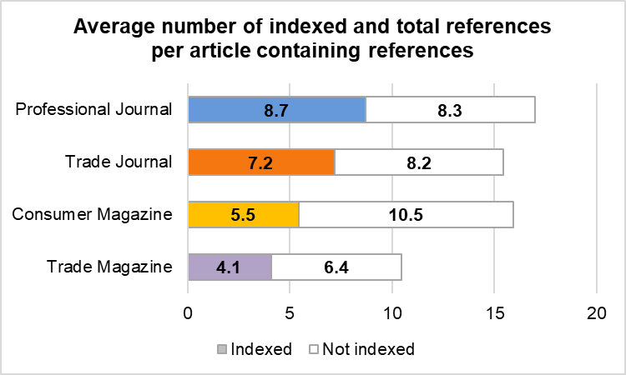
How many citations are used, on average?
15 references / document on average
almost half of these references are indexed in Scopus
9

Slide 10
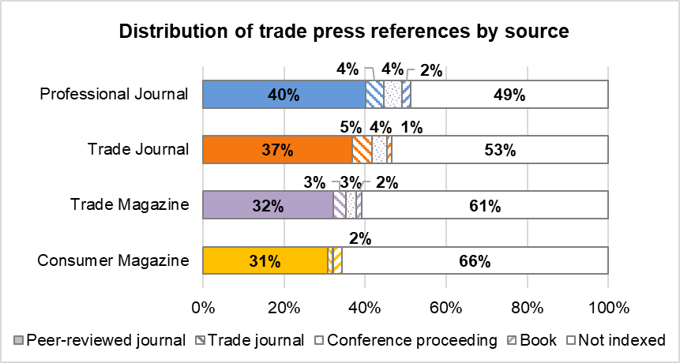
What types of sources are cited?
most of the references cited by trade press publications are to peer-reviewed journals (PRJ): 38%
10

Slide 11
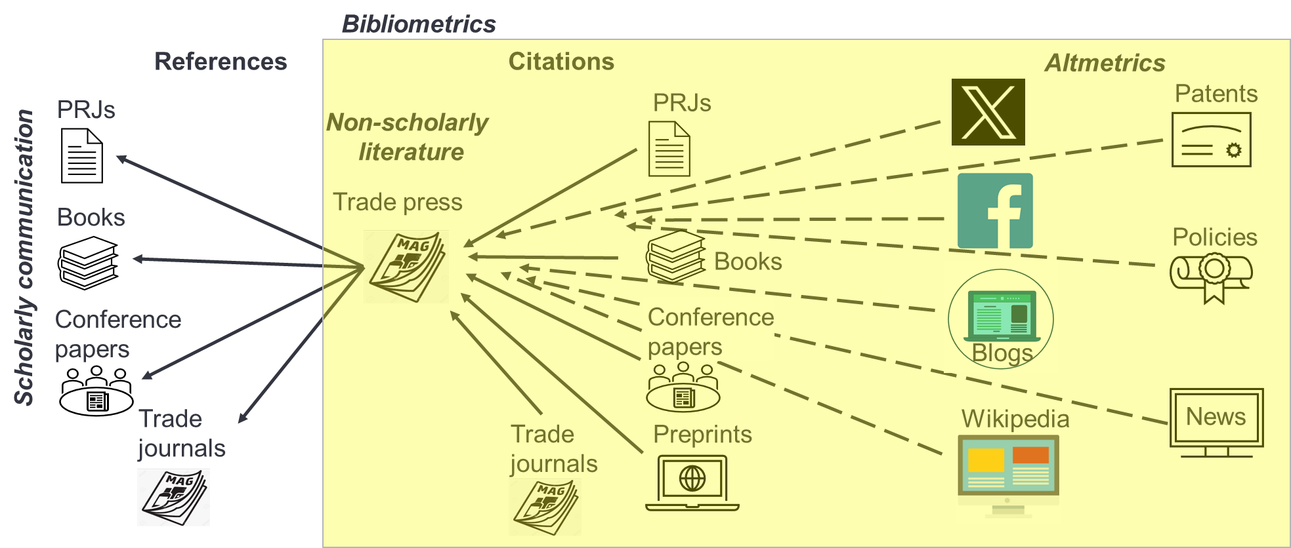
Trade press as pathways to impact
38%
2%
4%
4%
52%
Not indexed in Scopus
11

Slide 12
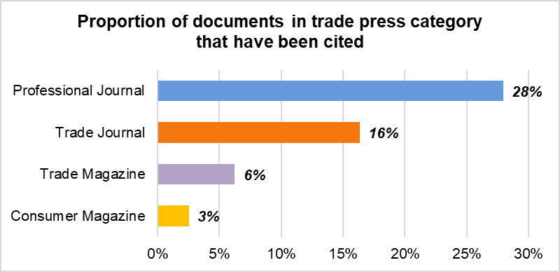
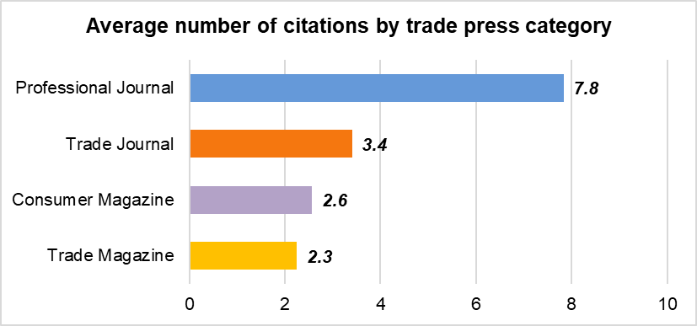
What proportion of trade press is cited?
14% of trade press documents are cited, on average 5.6 times
documents with references are 4 times more likely to be cited
trade press documents are cited by peer-reviewed journals (58%), conference proceedings (21%), trade journals (8%), books or book series (6%), pre-prints (6%)
12

Slide 13
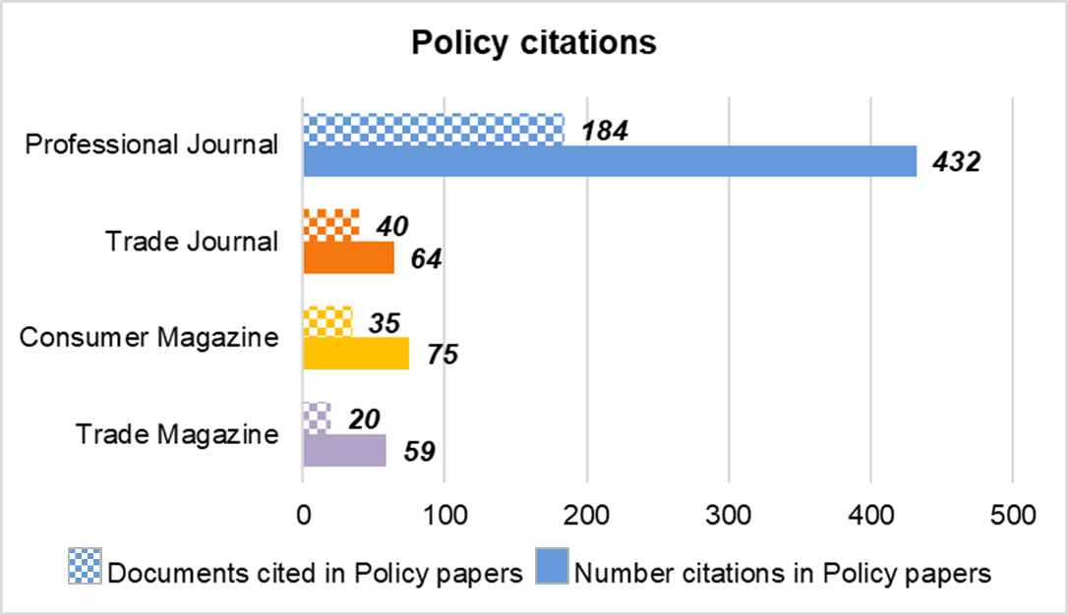
Are any trade press documents cited in policy papers?
13

Slide 14
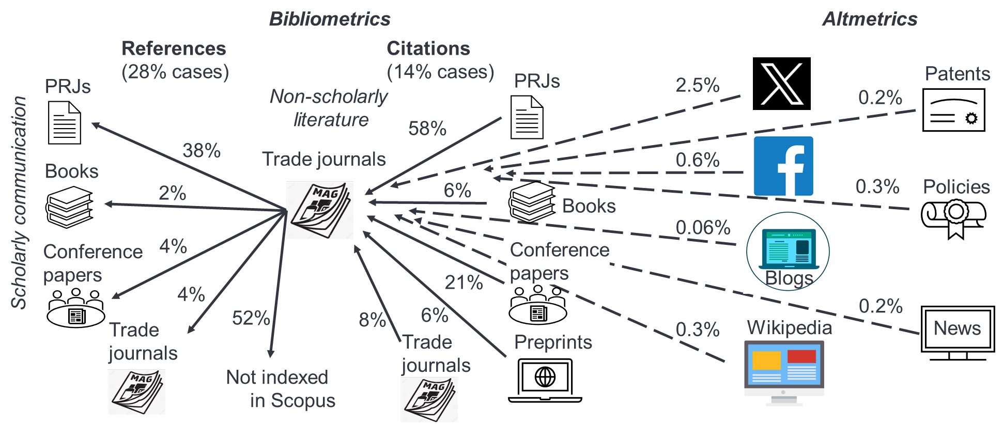
Trade press as pathways to impact
Trade press
14

Slide 15
Completing the pathway to societal impact
Quantitative market research​
17th May – 15th June 2023, 699 users of Science Direct and Knovel platforms
89% of respondents (aware of trade publications) read trade publications
97% practitioners consider that what they read in trade publications is relevant to their professional practice
83% practitioners estimated that something which they read in trade publications changed the way in which they work
15

Slide 16
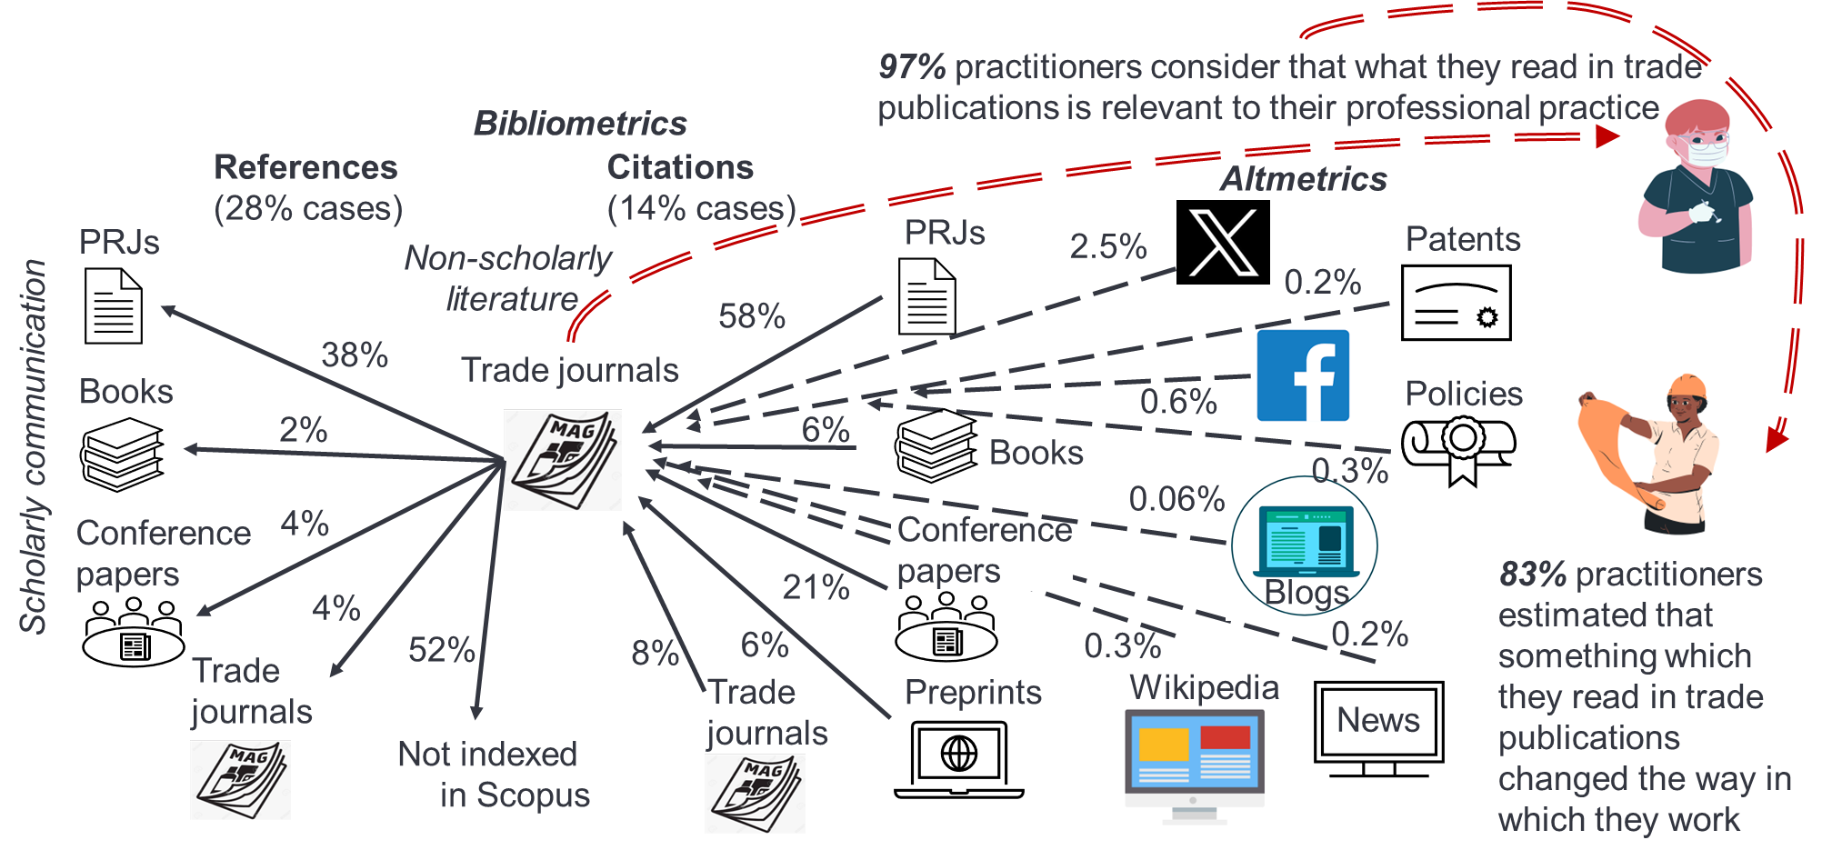
Trade press as pathways to impact
Trade press
16

Slide 17
Thank you!
Silvia Dobre, MBA
Research Evaluation Manager
s.dobre@elsevier.com @SilviaCDobre

