Slide 1
Daniel Richter, Philipp Baaden & Mohammad Saknini
Nordic Workshop on Bibliometrics and Research Policy 12.10.2023
—
Exploring the Thematic Landscape of the Circular Economy: A Comparative Study of Publication and Wikipedia Data

Slide 2
Exploring the thematic landscape of Circular Economy
Our motivation:
Circular economy (CE) is one way to support transition towards a more sustainable future.
Need to identify technologies and innovations that support this transition.
Comparative analysis between established (Publication Data) and more unconventional (Wikipedia) Data sources
(Ena et al. 2016)
Research aim:
How can we contribute to this research with data driven / tech-mining methods?
Representing the thematic landscape of CE by identifying scientific knowledge fields in Publication & Wikipedia Data
Find thematic clusters in Publication and Wikipedia Data
Compare results and approaches between both resources
Find unique advantages and disadvantages of the datasets
What opportunities do Publication and Wikipedia Data offer to enable researchers, managers and policy makers to identify such technologies and trends?
Notes:
Circular economy is a topic of growing interest for society
Research questions and motivation:
How can we as Data or Future scientist support this transition towards a more sustainable future?
A: By representing the research landscape and identifying research needs, new developments as well as possible networking opportunities for researchers
Two basic steps: Identifying and tracking knowledge fields
More specified aims:
Continuous research streams allow to identify possible convergences of knowledge fields as well es growing or decreasing interest in certain knowledge fields
New knowledge elements represent upcoming or trending technologies or topics
Drivers of research streams are organizations with many publications in the research stream and offer possible networking opportunities for other organizations working on the topics of the research stream

Slide 3
The basis of our research
Definitions:
Research landscape consists of different scientific knowledge fields.
Scientific knowledge field is union of scientific knowledge elements, which are information embedded in a scientific article.
(Zhang et al. 2020)
Circular Economy:
Minimizing waste generation and material inputs
Maintaining value of products and resources
Eco-design,
Sharing, repairing, refurbishing,
Recycling and reusing of products.
(Wijkman and Skanberg; 2015; Merli et al. 2018)
Source: AI Art Generator - AI Image Generator API - Hotpot.ai
Notes:
The aims of circular economy

Slide 4
Finding research streams and new scientific knowledge elements
Basic facts:
Query: “circular economy”
(Geissdoerfer et al., 2017)
6,149 publications from 2023
Wikipedia article: „circular economy“
623 in- and outgoing hyperlinks to connected articles
Search query in
Dimensions database
Wikipedia Hyperlinks
Data
Notes:
3 steps: Data, Text Mining and Clustering
Higher growth rate means that the circular economy publication number is relatively growing faster than the overall dimension database
Exponential growth beginning 2017, therefore the bigger time slice at the start

Slide 5
Finding research streams and new scientific knowledge elements
Dimensions
Noun phrase extraction
Example
Abstracts
Because of its nutritious properties, the black soldier fly has emerged as one of the most popular species in advancing circular economy through the re-valorization of anthropogenic organic wastes to insect biomass.
SciBERT
Wikipedia
Data
Text mining
Notes:
First we use Scibert to get quantified representations of the word meanings
SciBERT is a pretrained BERT model specifically trained for scientific texts and data
BERT (Transformers python module): Bidirectional Encoder Representations from Transformers published in 2018 by google
Advantage against other embedding tools like word2vec or doc2vec: Context-sensitive Embeddings
→ Word, Sentence and Document Embeddings
Use Scibert before extracting the noun phrases
For the noun phrase extraction: Spacy library for R and Python

Slide 6
Finding research streams and new scientific knowledge elements
Proxy scientific
knowledge element
Doc. | Sent. | Noun phrase | Embedding
1 | 1 | Black soldier fly | [1.8, 3.0, 4.5 …]
1 | 4 | Black soldier fly | [1.6, 3.1, 5.5 …]
2 | 2 | Black soldier fly | [0.9, 2.8, 4.4 …]
Dimensions
Noun phrase extraction
Sentence specific noun phrase embeddings
Abstracts
768 dimensions
SciBERT
Wikipedia
Data
Text mining
Notes:
First we use Scibert to get quantified representations of the word meanings
SciBERT is a pretrained BERT model specifically trained for scientific texts and data
BERT (Transformers python module): Bidirectional Encoder Representations from Transformers published in 2018 by google
Advantage against other embedding tools like word2vec or doc2vec: Context-sensitive Embeddings
→ Word, Sentence and Document Embeddings
Use Scibert before extracting the noun phrases
For the noun phrase extraction: Spacy library for R and Python

Slide 7
Finding research streams and new scientific knowledge elements
Proxy scientific
knowledge element
Labelling + development of clusters by intersection of noun phrases
Dimensions
Noun phrase extraction
Sentence specific noun phrase embeddings
Cleaning
Abstracts
Summarize + filter noun phrases
kmeans++
SciBERT
Wikipedia
Proxy scientific
knowledge field
Data
Text mining
Clustering + Evaluation
Notes:
First we use Scibert to get quantified representations of the word meanings
SciBERT is a pretrained BERT model specifically trained for scientific texts and data
BERT (Transformers python module): Bidirectional Encoder Representations from Transformers published in 2018 by google
Advantage against other embedding tools like word2vec or doc2vec: Context-sensitive Embeddings
→ Word, Sentence and Document Embeddings
Use Scibert before extracting the noun phrases
For the noun phrase extraction: Spacy library for R and Python

Slide 8
Finding research streams and new scientific knowledge elements
Proxy scientific
knowledge element
Dimensions:
20 clusters
2,810 noun phrases
Wikipedia:
20 clusters
665 noun phrases
Dimensions
Noun phrase extraction
Sentence specific noun phrase embeddings
Cleaning
Abstracts
SciBERT
Summarize + filter noun phrases
kmeans++
Wikipedia
Data
Text mining
Clustering + Evaluation
Notes:
First we use Scibert to get quantified representations of the word meanings
SciBERT is a pretrained BERT model specifically trained for scientific texts and data
BERT (Transformers python module): Bidirectional Encoder Representations from Transformers published in 2018 by google
Advantage against other embedding tools like word2vec or doc2vec: Context-sensitive Embeddings
→ Word, Sentence and Document Embeddings
Use Scibert before extracting the noun phrases
For the noun phrase extraction: Spacy library for R and Python

Slide 9
Clustering results
Cluster | Wikipedia Topic | Dimensions Topic
1 | Carbon emission | Carbon emission
2 | Wastes & Waste management | Wastes & Waste management
3 | Sustainability & Recycling | Sustainability & Environment
4 | Ecosystem & Lifecycles | Supply chains & Lifecycles
5 | Natural resources & Resource management | Natural resources & Resource management
6 | Share logistics & Recycle network | Share logistics & Recycle network
7 | Globalisation & International Associations | Globalisation & Global demands
8 | Business Management & Social sciences | Business Management & Social responsibility
9 | Global demands | Urbanisation
10 | Animal & human rights | Digitalisation
11 | Green Politics & Policies | Challenges & Principles
12 | Climate Change | Materials & Films
13 | Energy production | Liquids & Indicators
14 | Locations, Cities & States | Effects & Impacts
15 | Costs & Markets | Organic materials
16 | Environment & Technologies | Parameters, Approaches & Tools
17 | - | Artificial Intelligence
Summary
4 clusters with identical topic ranges in both resources
4 clusters with very similar themes in Wikipedia and Dimensions
8 and 9 clusters with more individual topics between the two resources
4 and 3 clusters that were filled with stopwords or almost empty
Notes:
First we use Scibert to get quantified representations of the word meanings
SciBERT is a pretrained BERT model specifically trained for scientific texts and data
BERT (Transformers python module): Bidirectional Encoder Representations from Transformers published in 2018 by google
Advantage against other embedding tools like word2vec or doc2vec: Context-sensitive Embeddings
→ Word, Sentence and Document Embeddings
Use Scibert before extracting the noun phrases
For the noun phrase extraction: Spacy library for R and Python

Slide 10
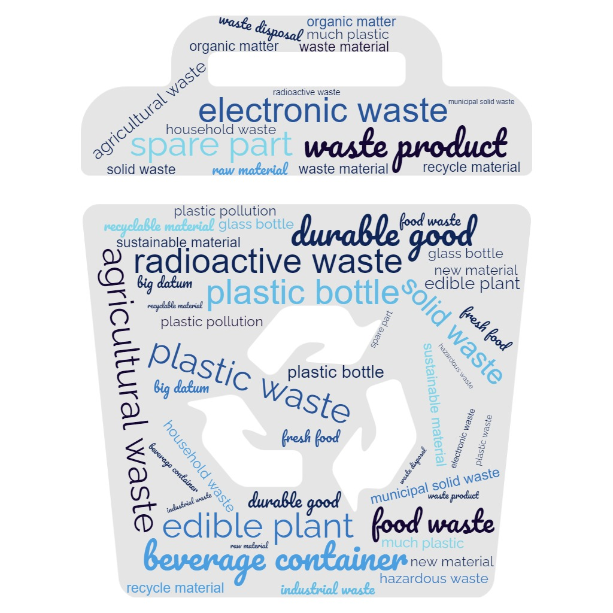
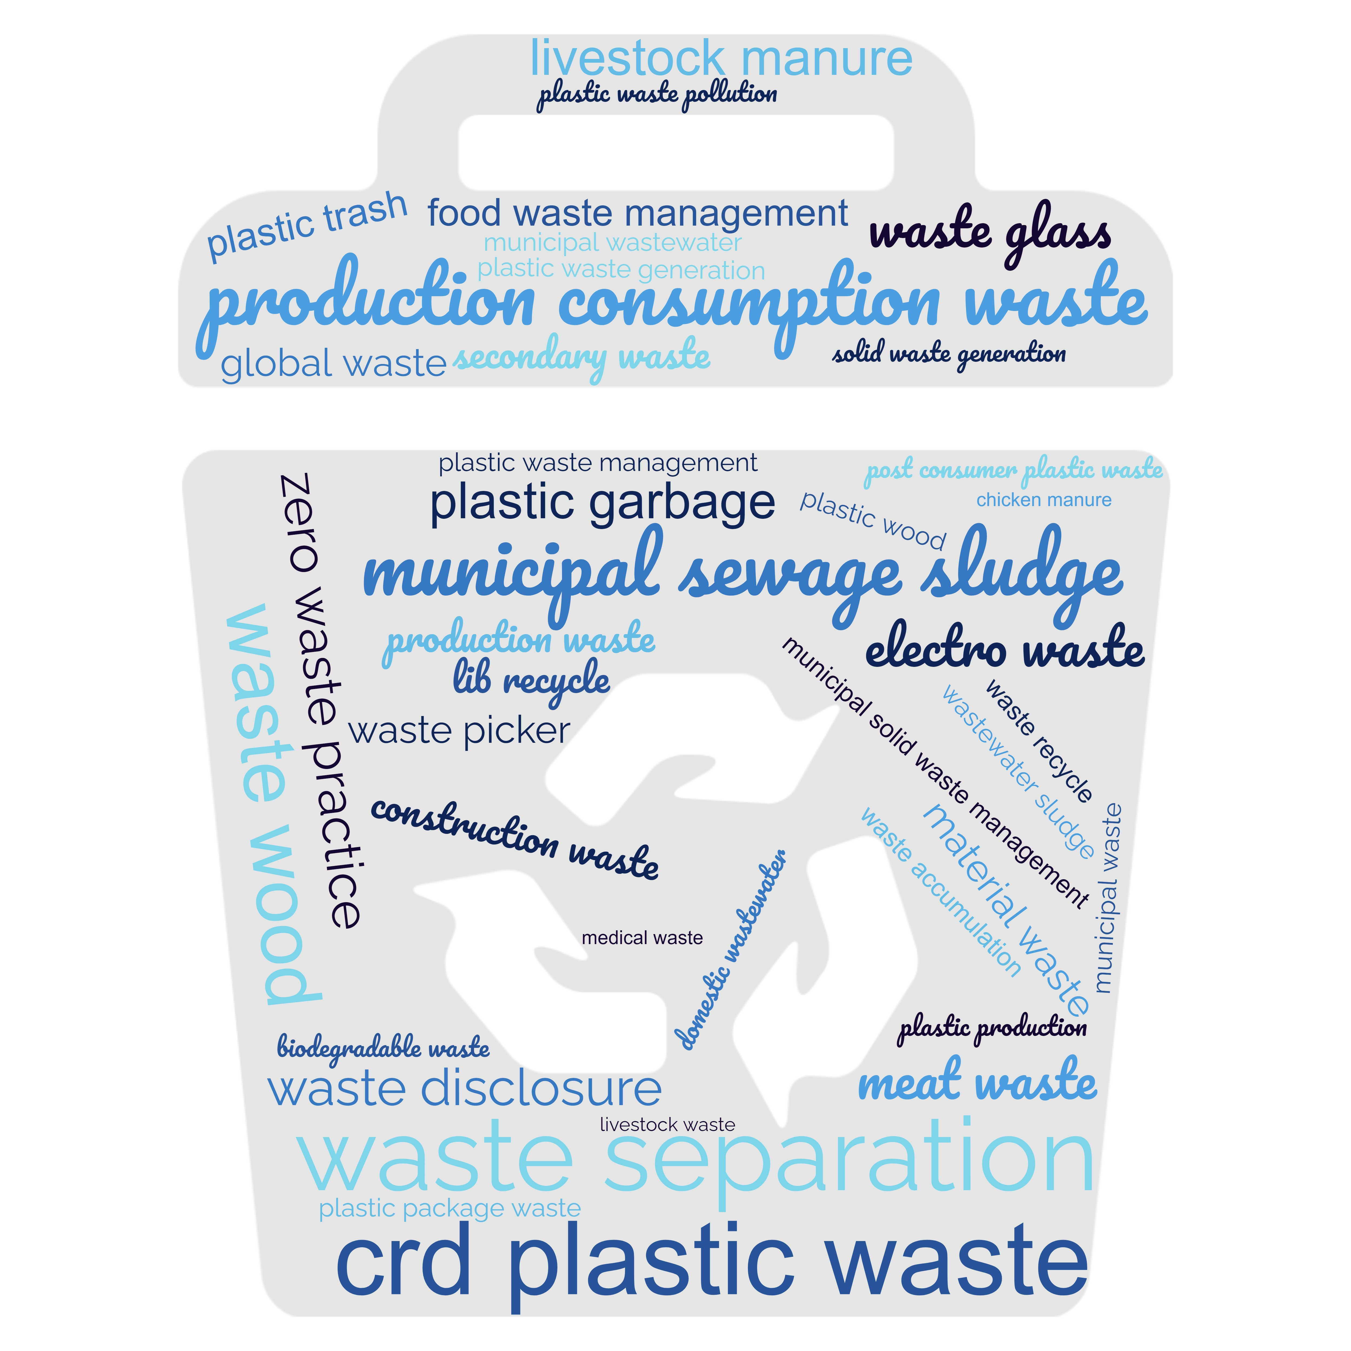
Clustering results
Wikipedia Waste Cluster
Dimensions Waste Cluster
Notes:
First we use Scibert to get quantified representations of the word meanings
SciBERT is a pretrained BERT model specifically trained for scientific texts and data
BERT (Transformers python module): Bidirectional Encoder Representations from Transformers published in 2018 by google
Advantage against other embedding tools like word2vec or doc2vec: Context-sensitive Embeddings
→ Word, Sentence and Document Embeddings
Use Scibert before extracting the noun phrases
For the noun phrase extraction: Spacy library for R and Python

Slide 11
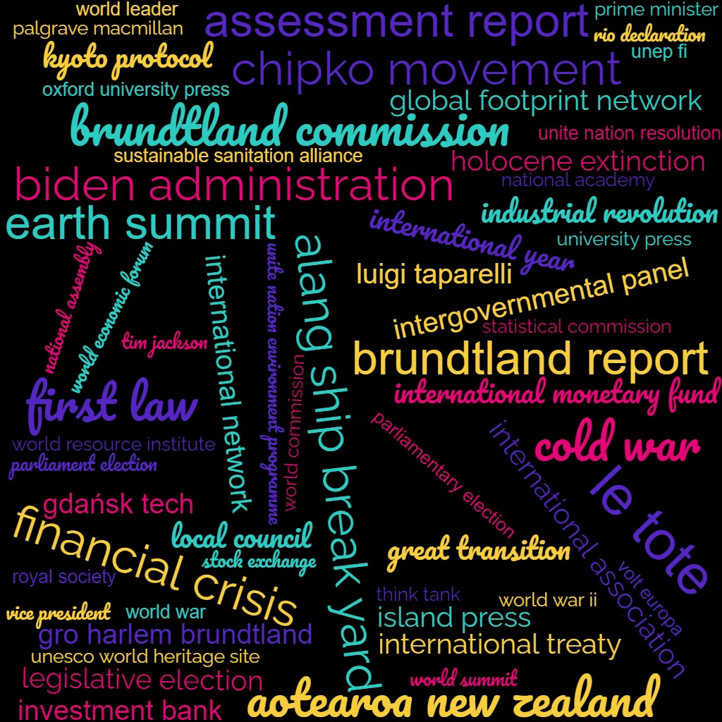
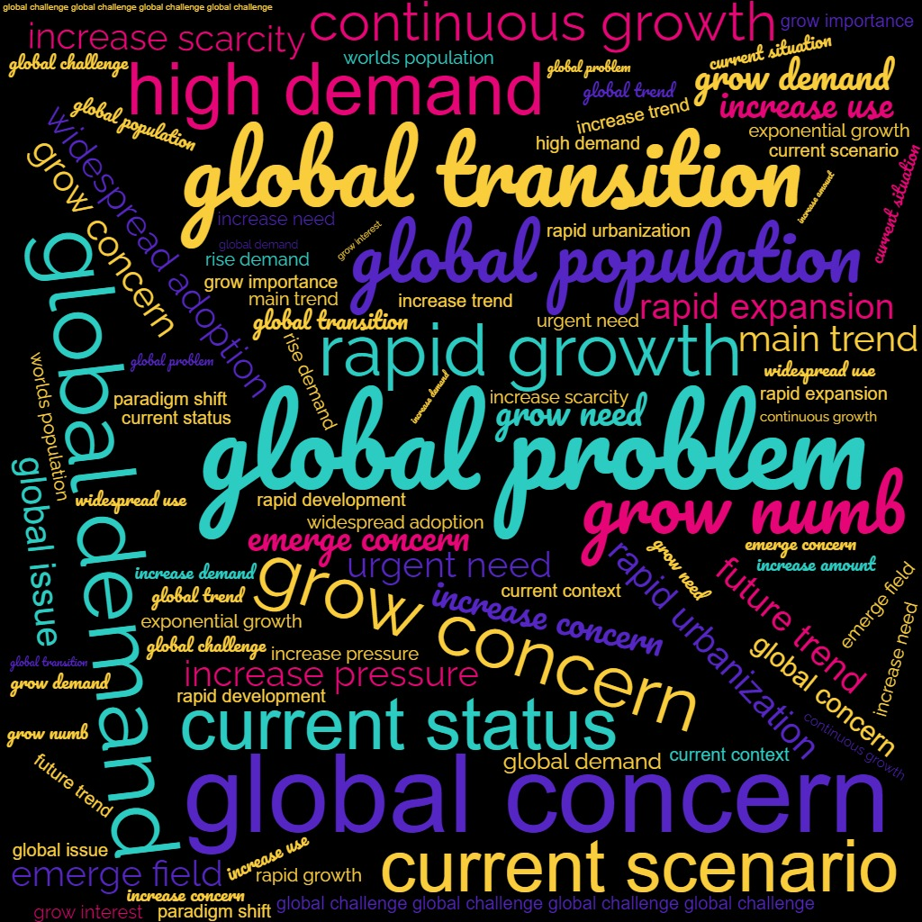
Clustering results
Wikipedia Global Cluster
Dimensions Global Cluster
Notes:
First we use Scibert to get quantified representations of the word meanings
SciBERT is a pretrained BERT model specifically trained for scientific texts and data
BERT (Transformers python module): Bidirectional Encoder Representations from Transformers published in 2018 by google
Advantage against other embedding tools like word2vec or doc2vec: Context-sensitive Embeddings
→ Word, Sentence and Document Embeddings
Use Scibert before extracting the noun phrases
For the noun phrase extraction: Spacy library for R and Python

Slide 12
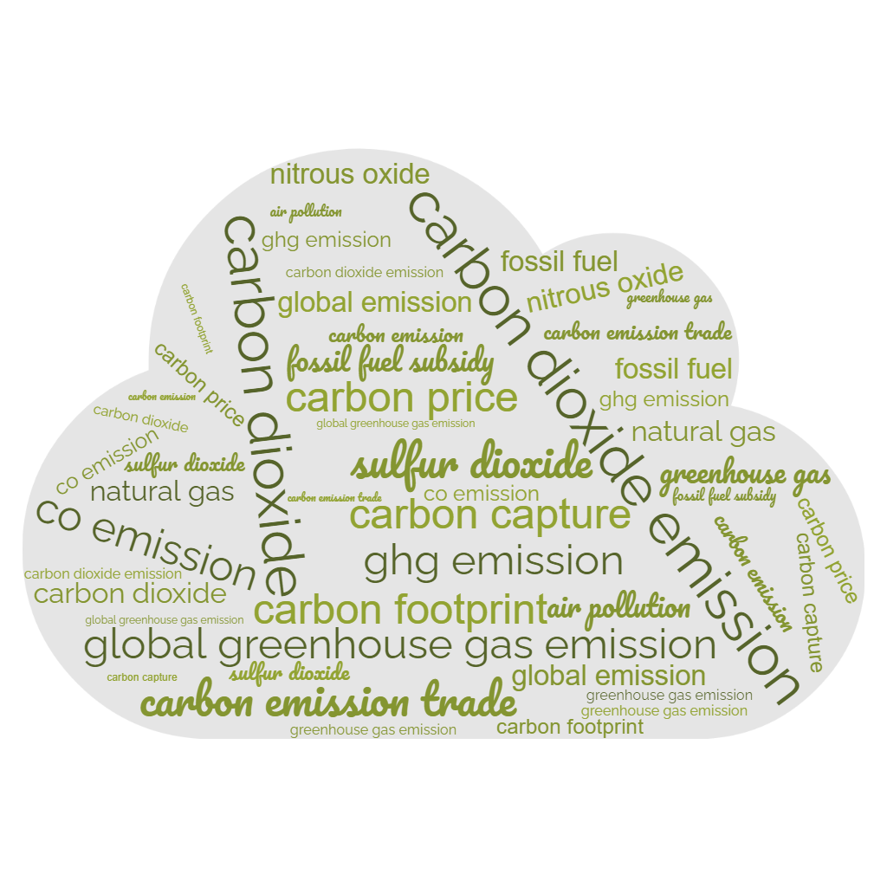
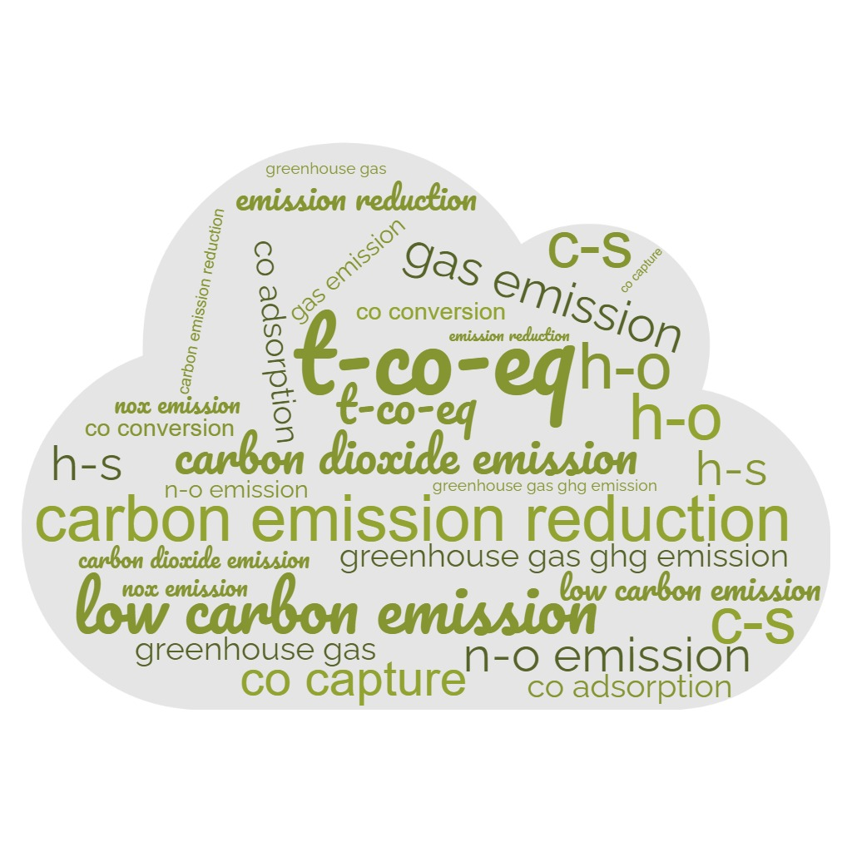
Clustering results
Wikipedia Emissions Cluster
Dimensions Emissions Cluster
Notes:
First we use Scibert to get quantified representations of the word meanings
SciBERT is a pretrained BERT model specifically trained for scientific texts and data
BERT (Transformers python module): Bidirectional Encoder Representations from Transformers published in 2018 by google
Advantage against other embedding tools like word2vec or doc2vec: Context-sensitive Embeddings
→ Word, Sentence and Document Embeddings
Use Scibert before extracting the noun phrases
For the noun phrase extraction: Spacy library for R and Python

Slide 13
Evaluation of the two data resources
Which data resource is better?
Wikipedia and Publication data both allow for an analysis of the topic landscape of circular economy
There are topics that can be found in both data resources but also individual clusters which leads to the assumption that a full analysis should include both approaches
Wikipedia data includes a different perspective on the topic from publication data by offering more noun phrases including specific names of people, locations or associations
It is difficult to evaluate the actual correctness or usefulness of the specific noun phrases in both cases
Our approach for Wikipedia analysis does not yet allow an analysis over time to overview the development of a research landscape while it is possible with publication data thanks to the publication year
The Wikipedia structure and concept of having one article per topic might be useful for a different approach of illustrating the topic landscape

Slide 14
Unique for publication data: Finding research streams
waste management, waste stream, waste prevention, construction waste, e-waste
46%
raw material, waste management, municipal solid waste, waste pcbs, opaque PET, wastewater product, biobased product
natural resource, waste management, recycle material, renewable resource, green chemistry, white mud
23%
natural resource, renewable energy, rare earth element, recycle material, secondary raw material, biodegradable plastic
31%
41%
2010-2017
2018+2019
2020+2021
Notes:
Describe what slide shows / what was done to retrieve these results!
boxes=cluster
Arrow means relative intersection between clusters
Noun phrases with a high TF and TFIDF inside their specific time slot
Of course also have other streams such as rather continous waste managament stream, dealing e.g. with organic and plastic waste
The re-appearance of the same noun phrases in a cluster of a newer time slots means that the research transitions into this new cluster
Here the cluster about natural resources, waste management and recycling transitions into two distinct clusters in 2018+2019 and then comes together again in 2020+2021 as one bigger cluster of growing interest
These streams can be an indication for new knowledge fields with growing interest and therefore the split to an individual cluster or a convergence of two knowledge fields to one cluster
New knowledge elements in a recent cluster of a knowledge streams can help finding new technology, innovations
→ Next step of our method

Slide 15
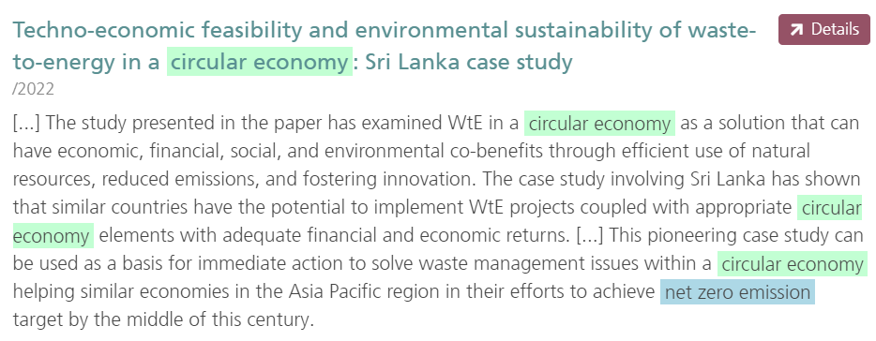
Unique for publication data: Finding new knowledge elements
Cluster 2020+2021:
New Knowledge elements:
climate change, human health
carbon footprint, sustainability impact, social pressure, net zero emission
Notes:
Carbon or ecological footprints as a recently introduced and discussed measurement for the impact of individuals on the climate change
Net zero emission: The point where all emissions can be reduced to 0 and there is no impact on the environment
→ Recent goal in circular econom and sustainability policy

Slide 16
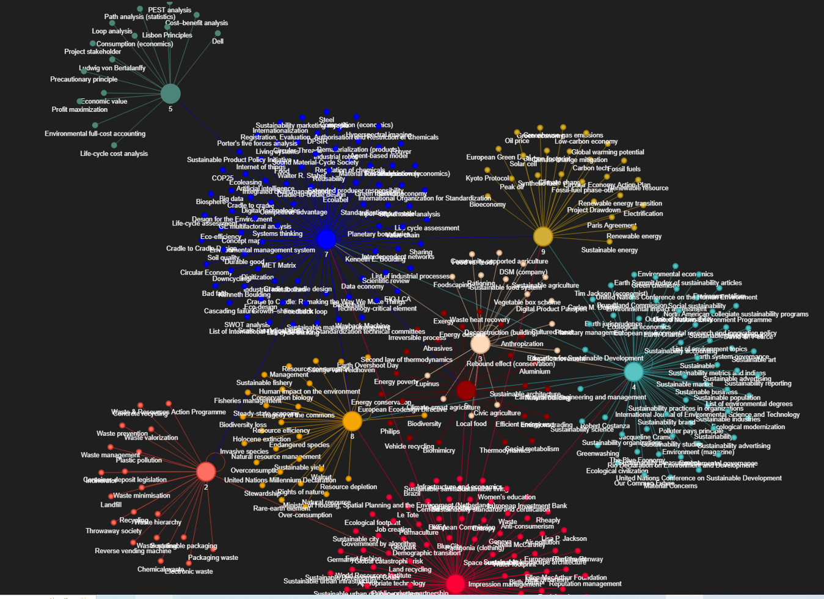
Unique for Wikipedia data: Hyperlink network illustration
Notes:
Next step new scientific knowledge elements
- We substract the previously already existing noun phrases from the most recent cluster to receive topics with increasing interest and trends

Slide 17
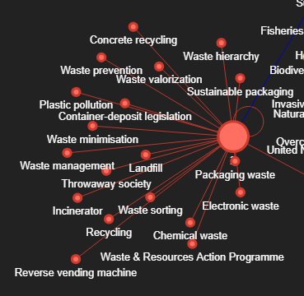
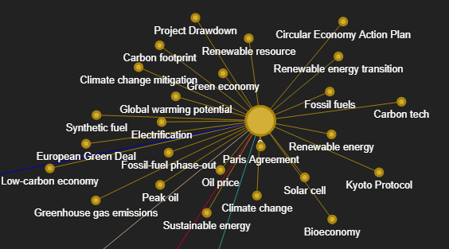
Unique for Wikipedia data: Hyperlink network illustration
Wikipedia articles about waste and waste management
Wikipedia articles about energy production and emissions

Slide 18
Conclusions, Limitations and Future work
Conclusions:
Limitations:
Both data resources allow to investigate clusters and the thematic landscape
The clusters show similarities but also differences between the data resources
The approach illustrates unique strengths and opportunities but also weaknesses of Wikipedia and Publication Data for bibliometric analysis
Design decisions e.g. cluster labelling, selection of hyperlinks,…
Need for extended and research field specific stopword list
No automatic analysis of the clusters possible at this point
Future work:
Improving information extraction
Expert evaluation
Investigate the inclusion of the second layer of hyperlinks in Wikipedia
Find a qualitative method to measure the quality difference between Wikipedia and Publication data
Notes:
Approach worked which means:
clear research streams and scientific research fields can be found → Advantage of less generic and more content specific proxy research fields
New knowledge elements can be found in the streams → Research field specific trends and innovations
Organizations that have high interest in the research streams and drive the evolution of the streams can be identified
Limitiations:
All design decisions can put a bias on the result → Example: which noun phrases describe the research area and how to identify them → Example 2: Different time frames may lead to completely different results and finding the fitting frames is very subjective
Some noun phrases are very generic inside a specific research field and can not be identified by generalised stopword lists
Future work:
→ Maybe find a way to use the full text instead of abstracts only
The convergences of scientific areas are indicated but can‘t be measured by our method. There is a need to find a measurement for the interdisciplinarity and convergence
As data scientists we aren‘t experts for circular economy and therefore need to discuss the quality of our results with research field experts
Overall: Promising approach but still needs a lot of refining and future work

Slide 19
Daniel Richter
daniel.richter@int.fraunhofer.de
Fraunhofer Institute for Technological Trend Analysis (INT)
Appelsgarten 2, 53879 Euskirchen
Notes:
Thank you for your attention

