Slide 1
Who funds Nordic research?
Ross W.K. Potter
Institute for Scientific Information, Clarivate, London
ross.potter@clarivate.com
NWB 2023, Gothenburg

Slide 2
Funding sources
Government
Horizon Europe 2021 – 2027: €96B
Charities
Research councils
UK Research & Innovation €3.2B, Swedish Research Council €670M
National academies
Endowments
Stanford €70B, Japan Science & Technology €75B, King Abdullah University Science & Technology €22B
Industry and private companies
Gates foundation €6.5B
Proportion of grants allocated to scientists almost as large as proportion allocated to universities (e.g., Gläser and Laudel 2016)
Notes:
Funding is imperative for academic research and can be provided by, among others, governments and private companies
, national natural science foundation of china $4b, Academy of Finland €500M,
“In most research systems across Europe, the proportion of project grants allocated to scientists has become almost as large as the proportion of block grants allocated to universities (Gläser and Laudel 2016; Lepori et al. 2007; Skoie 1996). “ - https://link.springer.com/article/10.1007/s11024-023-09501-3
Public ubniversities more reliant on external peerr reviewed funding opportunities. -Consequently, scholars “are forced into a competitive environment driven by evaluation for the allocation of these scarce funds” (Heinze 2008, p. 302). The success in obtaining research funding has been given strong weight in performance evaluations of university professors and researchers, including in decisions on hiring and tenure or promotion. As a result, applying for external research funding has become one of the major activities carried out routinely by scholars at universities

Slide 3
Funding requirements
Open Access publication
Article processing charges
Open data
Burdensome
Specific foci:
Sustainable Development Goals
Socio-economic issues
Notes:
Funding constitutes one of the main channels through which authority is exercised over research
However, it is not always clear how such efforts will be paid for in practice. Other funding agencies should follow the NIH’s lead and require grant applications to set out how this work is to be done, and explicitly underwrite it with earmarked monies. Universities will need to invest in data-science centres and academic data managers. https://www.nature.com/articles/d41586-022-00478-9
.

Slide 4
Research evaluation
Performance based research funding systems
Norwegian Model (Norway, Denmark, Finland, Belgium…)
National research assessment evaluation-based (UK, Australia)
Publication in ‘better’ journals
Evaluation methods may suppress excellence
Equity and excellence balance
Allocation of funding varies - <2% of the total expenses in the Norwegian Higher Education Sector (Sivertsen, 2018, JDIS)
Finnish university productivity increase - quantity and quality (Pölönen, 2018, JDIS)
Researcher incentives
Cash for articles in high JIF journals
A focus on research impact
Normalised citations
Relative performance
Short term focus?
Elite and/or closed network
University rankings
Notes:
PRFSs have emerged in response to the knowledge economy, new public management and a desire for research excellence) (PRFSs will not increase equity or diversity, nor enhance economic relevance.) Hicks 2012 https://www.sciencedirect.com/science/article/pii/S0048733311001752
Norwegian model type of ibndicator based assessment model. In general, countries with indicator-based funding of research institutions do not rely solely on bibliometric indicators. Other indicators may be for example be external funding or the number of doctoral degrees….
…he publication indicator reallocates less than 2% of the total expenses in the Higher Education Sector
Finnish university productivity increase (quantity and quality) (Pölönen, 2018, JDIS)
https://sciendo.com/article/10.2478/jdis-2018-0019

Slide 5
The funding circle
Impactful
research
Get funding

Slide 6
The funding circle
Impactful
research
Get funding
Write proposal

Slide 7
Aim
Understand who funds Nordic research
Over time
By region
To help better inform policy and funding direction
Notes:
derive important and otherwise hidden insights into countries’ research output and therefore

Slide 8
Methods I
Web of Science and Incites Benchmarking & Analytics data
Core collection
Published articles
2016-2021 inclusive
Nordic-authored research
Social sciences, humanities, books etc. not as extensively covered
Notes:
research (articles authored with at least one author from a Nordic country)

Slide 9
Methods II
Funding data
Numerous sources# (Vinnova, Research Fish, Gates Foundation)
Unified funding agencies* (~1200)
30 funders from the Nordic region
Denmark (11), Finland (4), Norway (2), Sweden (13)
Studied dataset
~245,000 research articles (~50% of all articles)
Funders from 68 countries (includes Azerbaijan, Cuba, Oman, Philippines)
#https://support.clarivate.com/s/article/Web-of-Science-Core-Collection-Availability-of-funding-data?language=en_US
*https://incites.help.clarivate.com/Content/Resources/Docs/incites-funding-agencies.xlsx
Notes:
Records entered Web of Science Core Collection since August 2008.
Besides the funding data we capture from the records themselves, Web of Science Core Collection contains funding information from the following sources
Vinnova (government agency that administers state funding for research and development.)
Research fish online reporting system used by funders to collect information on the outcomes and the impact of their research.
Swedish Energy Agency, Swedish Research Council, Research Council of Norway, Academy of Finland, Novo Nordisk
DENMARK 46.30 FINLAND 52.38 ICELAND 44.24 NORWAY 44.54 SWEDEN 54.53

Slide 10
Results
Notes:
derive important and otherwise hidden insights into countries’ research output and therefore

Slide 11
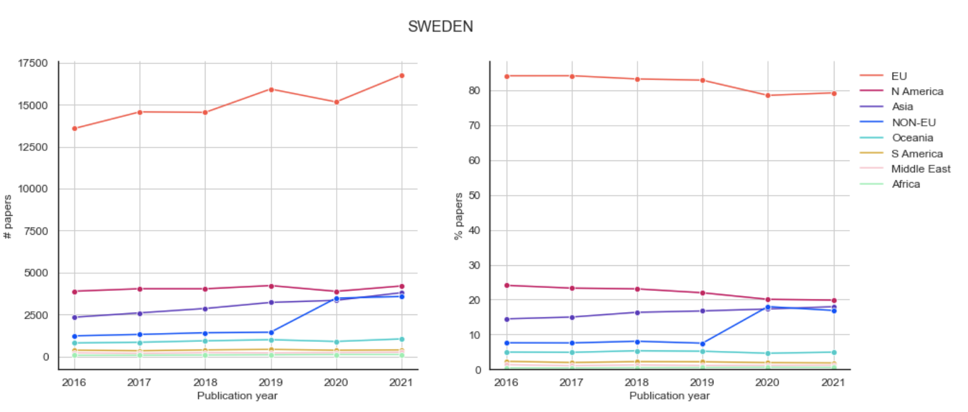
Funding by continent
By continent. Similar view for other Nordic countries
Notes:
noneu = ['UKRAINE','RUSSIA','SWITZERLAND','TURKEY’], northam = ['UNITED STATES','CANADA','PANAMA','MEXICO’,], southam = ['BRAZIL','ARGENTINA','COLOMBIA','CHILE',]
africa = ['EGYPT','SOUTH AFRICA’,], middleeast = ['KUWAIT','UNITED ARAB EMIRATES','SAUDI ARABIA','ISRAEL','IRAN','OMAN']
asia = ['SOUTH KOREA','PHILIPPINES','VIETNAM','TAIWAN','CHINA MAINLAND','INDONESIA','HONG KONG','MALAYSIA','INDIA','THAILAND','PAKISTAN','KAZAKHSTAN’, 'AZERBAIJAN','JAPAN','SINGAPORE']
oceania = ['AUSTRALIA','NEW ZEALAND']

Slide 12
Largest funders overall
Output
Notes:
By country overall EC not top for Finalnd and Norway (nowirway is research council of Norway – 20k vs 14k papers)
For 2021 only change is German research foundation in top 10 and NSF drops out.

Slide 13
Largest funders overall
Output
Finland: Academy of Finland funds ~48%
Norway: Research Council of Norway funds 42%
Sweden: European Commission and Swedish Research Council both fund ~39%
Notes:
By country overall EC not top for Finalnd and Norway (nowirway is research council of Norway – 20k vs 14k papers)
For 2021 only change is German research foundation in top 10 and NSF drops out.

Slide 14
Largest funders overall
CNCI performance

Slide 15
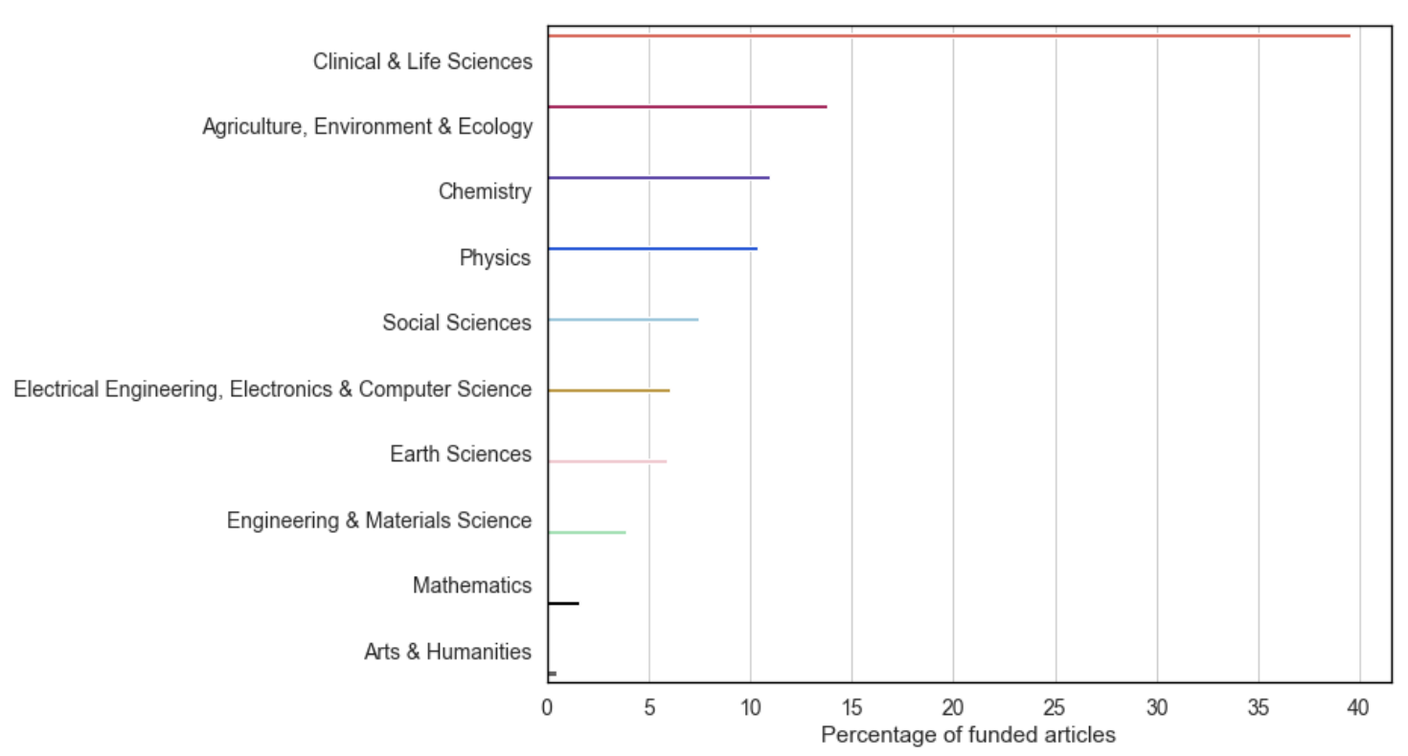
Research funded
Macro Citation Topics
~100,000 articles
~1000 articles

Slide 16
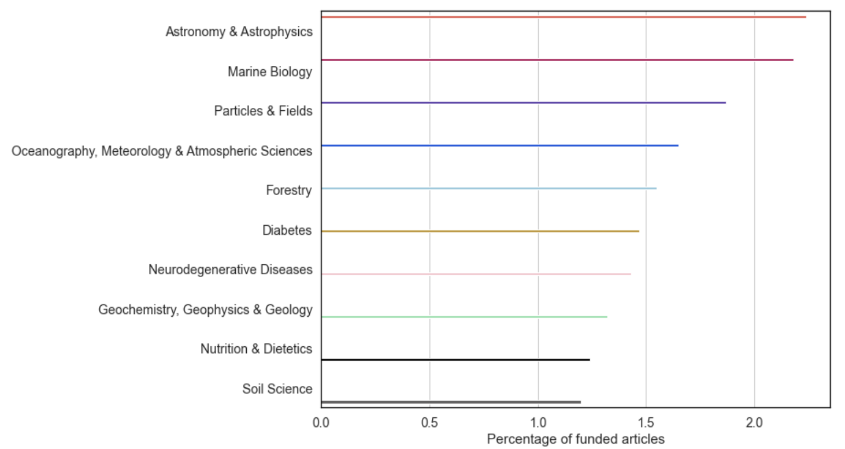
Research funded
Meso Citation Topics
~5,500 articles
~3,000 articles

Slide 17
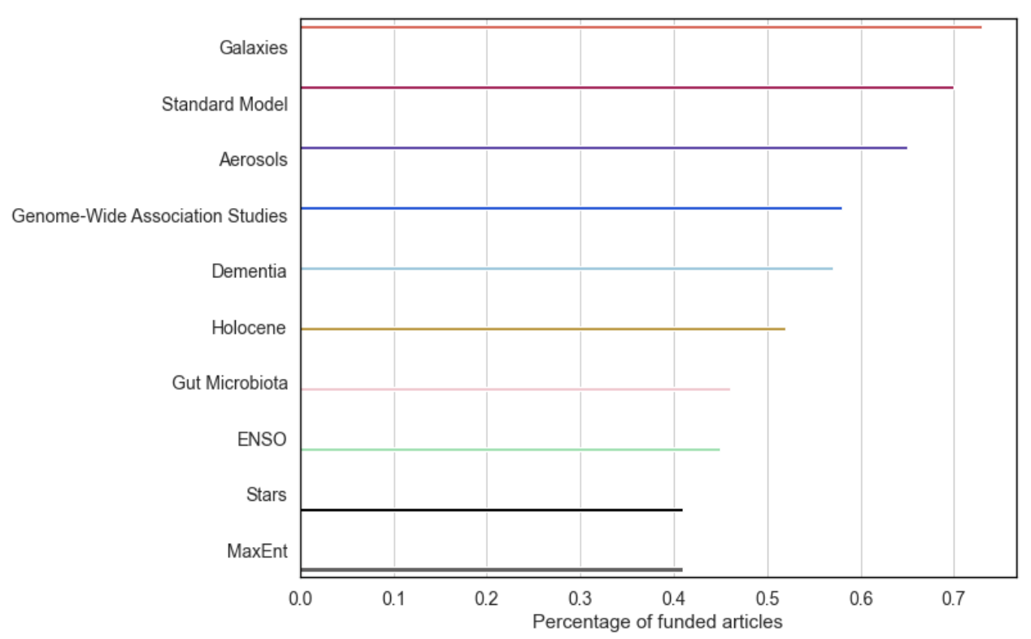
Research funded
Micro Citation Topics
~2,000 articles
~1,000 articles

Slide 18
Research funded
Citation Topics by funder
Clinical and Life Sciences most funded area for all 10 largest funders, bar
National Natural Science Foundation of China (Physics – 18%)
National Science Foundation (Physics – 39%)
NNSFC
Physics 18%,
Chemistry 17%
Electrical Engineering/Computing 16%
Swedish Research Council
Clinical and Life Sciences 44%
Chemistry 14%
Physics 12%
Notes:
NSF = 15% on particules and fields, UKRI 5% standard model, NNSDFC ~6%, NSF 9%, ERC ~6.5%

Slide 19
Research funded
Citation Topics by funder
Swedish Research Council
Meso level
Neurodegenerative Diseases (3%)
Particles & Fields (2.45%)
Astronomy & Astrophysics (1.8%)
Micro level
Dementia (1.4%)
Alzheimer's (0.7%)
Research Council of Norway
Meso level
Marine Biology (~5%)
Oceanography, Meteorology & Atmospheric Sciences (3.2%)
Geology, Geophysics, Geochemistry (3%)
Micro level
Fisheries (1.2%)
El Nino (1.1%)
Rainbow Trout (1.1%)
Notes:
NSF = 15% on particules and fields, UKRI 5% standard model, NNSDFC ~6%, NSF 9%, ERC ~6.5%

Slide 20
Discussion
Funding dominated by European sources
Increasing influence from China
Decline in share of NIH and UKRI funding
Decline in impact of Nordic research
UKRI and NIH CNCI decrease from >6 to ~3
Life sciences funding more diverse and distributed
Physics and Earth Sciences funding more focused and specialized
.
Notes:
National Natural Science Foundation of China doubled share
BREXIT? Uk beome part of Horiizon – may increase but will be lagging
the EU, funding from US government health bodies (e.g., National Institute of Health - NIH) is prominent but has decreased (12% to 9.5%). Funding from UK Research and Innovation (UKRI) has also declined (10.5% to 7.5%) over the period, possibly a consequence of Brexit. Notably, the impact of Nordic research declines over the period - all top 10 funders (by publication count) saw their Category Normalised Citation Impact (CNCI) stagnate or decrease, particularly UKRI and NIH whose values halved from above 6 to around 3
Cnci above world average but ddeclining – could change some change could be noise
Rresearch council of Norway and dacadmey oif finlan dabove worl davearage for collab cnci
Only considering ~50% of Nordic papers

Slide 21
Conclusions
Funding is global, but with European focus
Different foci for different Nordic countries
Impact of Nordic research declining
Notes:
Chinese funding likely to increase

