Slide 1

Rankings and the future of research assessment
Ross W.K. Potter
Lead Data Scientist
Institute for Scientific Information, Clarivate, London
ross.potter@clarivate.com
NWB 2023, Gothenburg

Slide 2
  “When a measure becomes a target, it ceases to be a good measure”
  Goodhart’s Law
Notes:
British economist Charles Goodhart, who is credited with expressing the core idea of the adage in a 1975 article on monetary policy in the United Kingdom

Slide 3
”Whatever one's own views [on rankings], it is impossible to ignore them”
Ellen Hazelkorn
Director of Higher Education Policy Research Unit (HEPRU), Dublin Institute of Technology

Slide 4
”Everyone wants [a world-class university], no one knows what it is, and no one knows how to get one”
Philip Altbach
The Costs and Benefits of World-Class Universities
Notes:
World class universities

Slide 5
Contents
Who, what, why of rankings
Clarivate approach
Profiles, not metrics

Slide 6
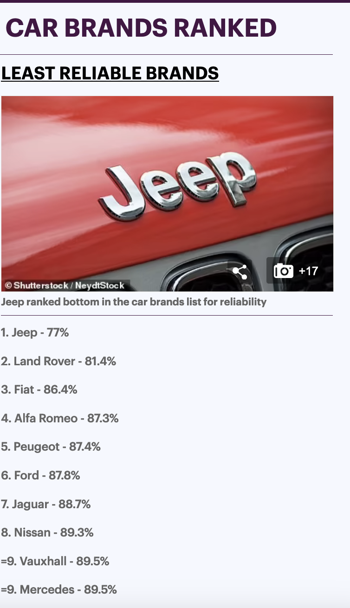
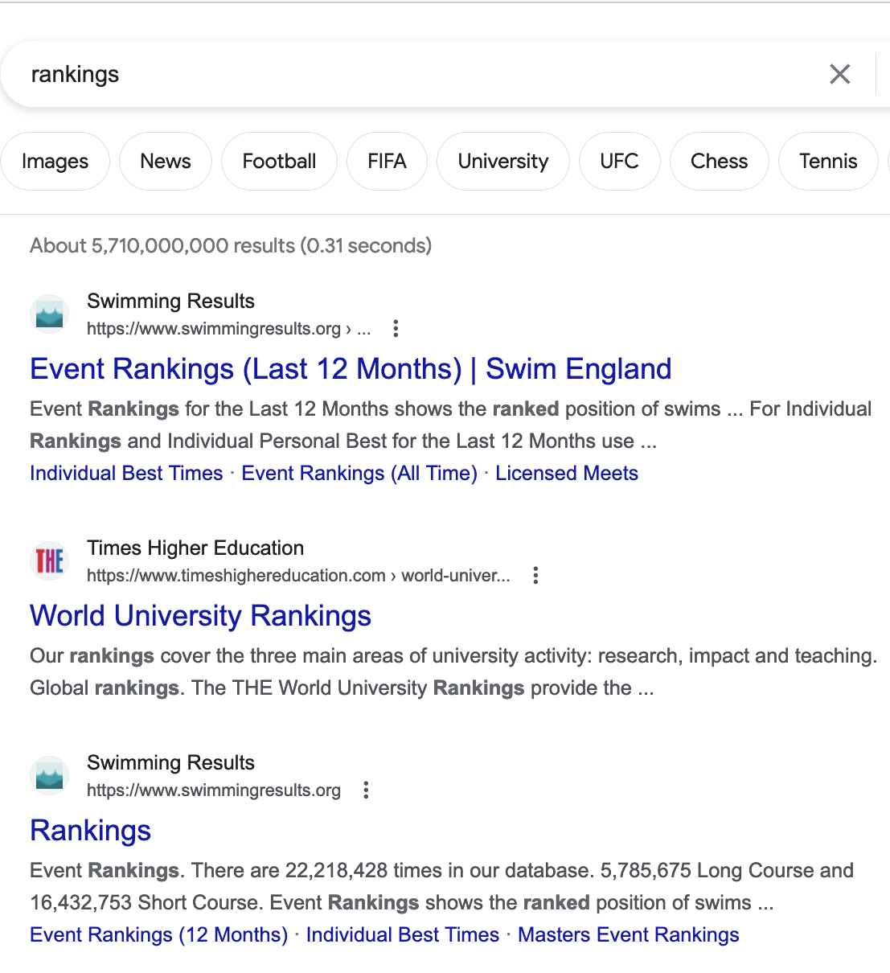
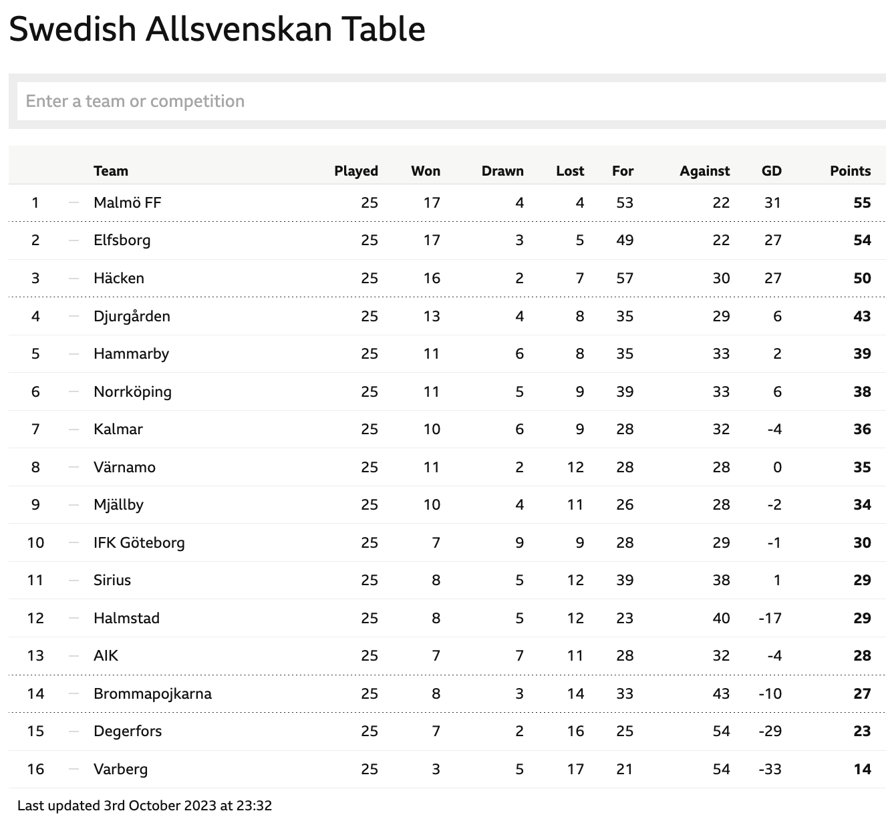
Rankings
Notes:
Everything and everyone is ranked, Search engines, School examinations
Good to know relative performance, Elitism/snobbishness
https://www.thisismoney.co.uk/money/cars/article-11258415/Most-reliable-cars-REVEALED.html

Slide 7
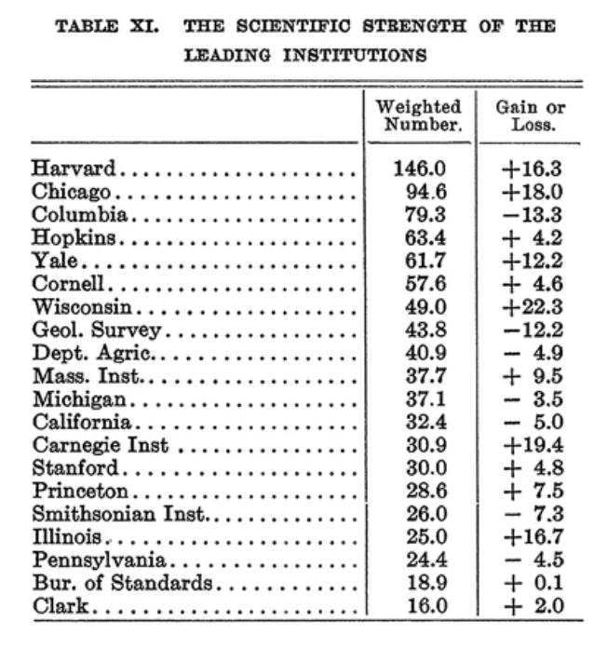
History of university rankings
1910
  James McKeen Cattell (1860–1944)
  ‘Scientific strength of institutions’ listed American universities in descending order depending on the number of eminent scientists employed
  ‘Eminence’ derived from university rosters, scientific journals, bibliographical dictionaries and peer judgements
  Cattell, James McKeen. 1910. A Further Statistical Study of American Men of Science II. Science 32: 672–688.
  Hammarfelt et al. 2017 Minerva
Notes:
Research universities play a critical role in training the professionals, high-level specialists, scientists, and researchers needed by the economy and in generating new knowledge in support of the national innovation system.
The American psychologist James McKeen Cattell (1860–1944) . was an American psychologist and long-time editor of Science Calculation of …professor at Columbia University in 1889
Instead, Cattell came to construct his ranking based on his study of American Men of Science. Crucial for this undertaking was the qualitative judgment made on the relative standing of scientists made by peers. Building on his initial list of prominent scientists—derived from

Slide 8
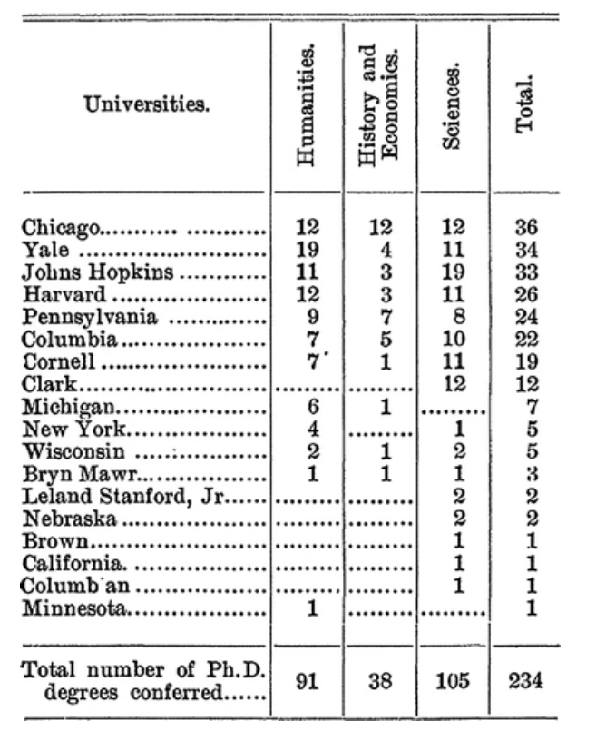
History of university rankings
1898
  Order of universities by the number of doctorates awarded.
  Cattell, James McKeen. 1898. Doctorates Conferred by American Universities for Research. Science 8(190): 197–201
  Reputation was Cattell’s preferred indicator in measuring scientific merit, and this becomes apparent in his attempts of ranking institutions
Notes:
Of note are the early attempts of measuring institutional performance based on output of doctorates.

Slide 9
History of university rankings
Institutional rankings could inform students in their choice of university
Concerns about international competition
University rankings could be used for raising the status and the salary of scientists
  Scientists were underpaid
  Calculate price tags for ‘scientific strength’: “A university can obtain a man of the first rank for from $5,000 to $7,500, or a man in the lower hundreds of the list for from $2,000 to $2,500”
  Competition for highly ranked scientists could be an important factor for the promotion of local universities
  Academic market where universities invest in highly ranked scientists to boost their ‘strength’ and position in the ranking
Cattell, James McKeen. 1910. A Further Statistical Study of American Men of Science II. Science 32: 672–688.
Notes:
He belived… Scientists were underpaid compared to other qualified professions, and this was in Cattell’s view a major hindrance to science as otherwise talented men would choose other careers. One strategy of achieving this was through the production of rankings, of both men and universities.
Clearly, Cattell imagined a market for academics where universities could invest in highly ranked scientists in order to boost their ‘strength’ and position in the ranking. He also suggests that competition for highly ranked scientists could be an important factor for the promotion of local universities (Cattell 1910: 688).

Slide 10
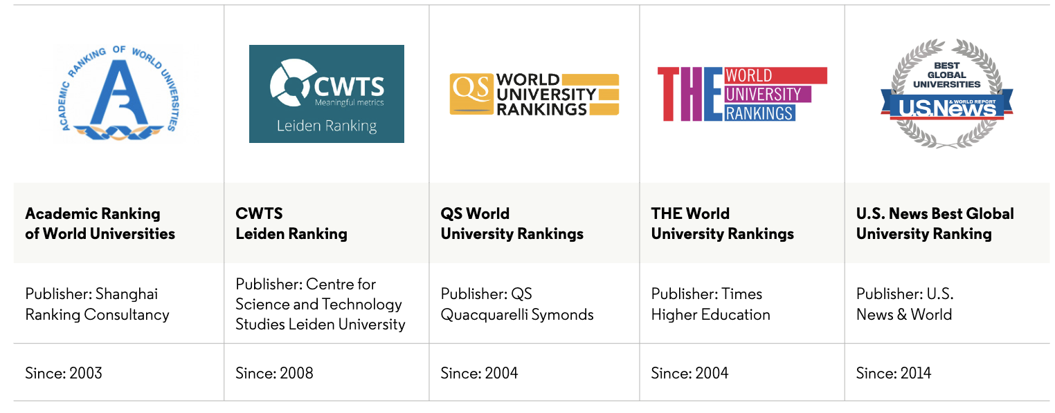
Proliferation of university rankings
Post-WW2
  National levels
  Educational specialists
Post-2000
  Ideological changes
  Policymakers want top universities at the cutting edge of intellectual and scientific development
  Systematic way of identifying and classifying world-class universities
  Integral part of discussions regarding the role and impact of universities and guide evaluation and planning decisions at a global, national, institutional and individual level.
  Cannot present the full picture of institutions
https://clarivate.com/lp/an-introduction-to-global-university-rankings/
Notes:
In the past two decades, there have been dramatic changes in higher education and ideology defining standards and global competiveness. Combined with the impact of globalization and the development of the global "knowledge economy," these competitive forces have resulted in the global competition phenomenon that is currently reshaping higher education including
The arrival of global university rankings, generally seen to start in2003, has changed the global landscape of higher education and is likely to continue to influence development nationally and internationally. In fact, ranking systems have become a standard feature in higher education systems. They are also increasingly accepted as an instrument to inform and guide evaluation and planning decisions at a global, national, institutional and individual level. Rankings serve as a particularly useful lens for the study of power in higher education, as they are used to confer prestige, in the allocation of resources, as a form of agenda setting, as a means of stratifying national higher education systems, as a means of establishing hierarchical relations between nations, and as a lever to impose demands for accountability5 .
However, no ranking system can present the full picture of Higher Education Institutions(HEIs) in their entirety, but they are an important comparator. They impact stakeholders across the full university system: from students, faculty, researchers and research office to national governments and funding bodies.

Slide 11
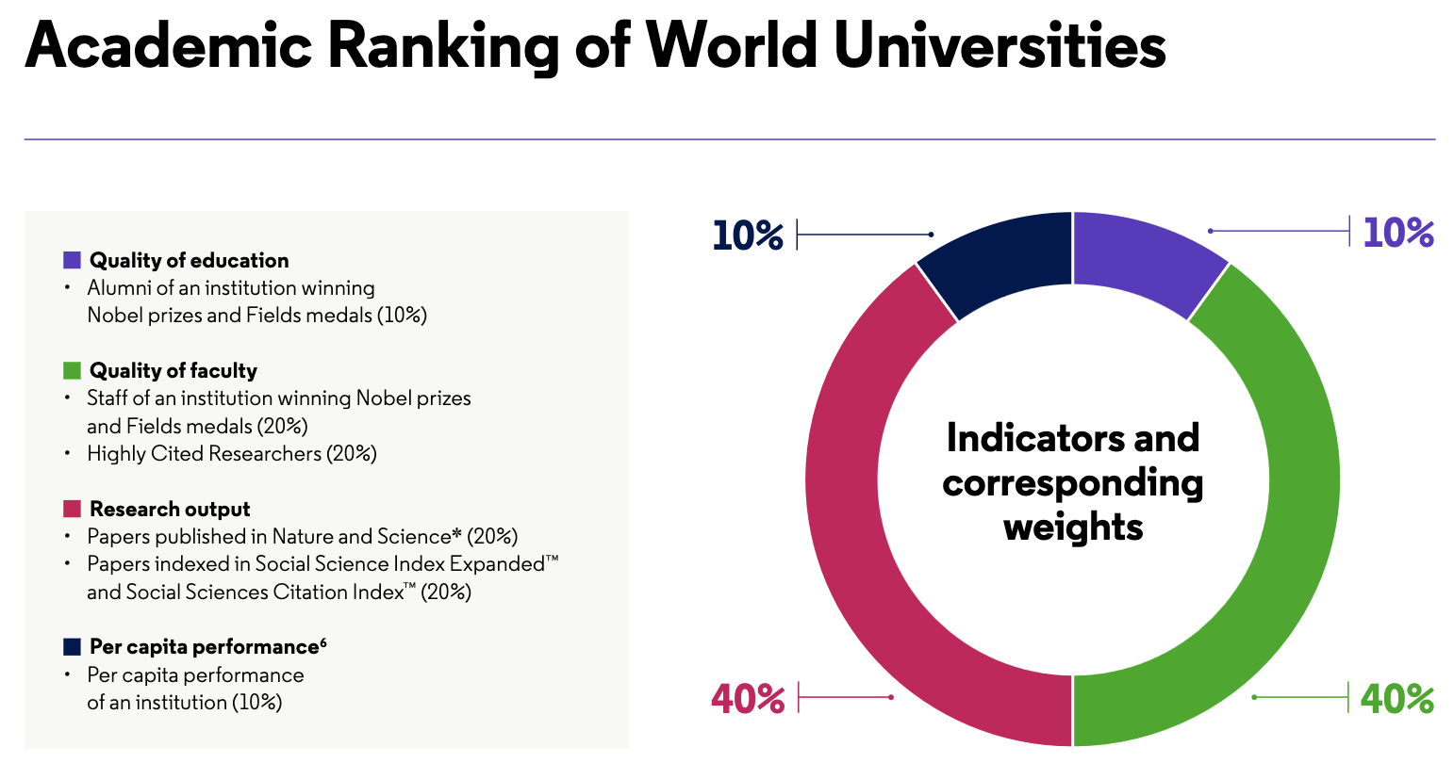
Ranking methodology
Criteria
  Research, patents based
    Citations are a measure (apart from AWRU)
  Others
  Relevant or useful criteria?
  Alumni and staff with Nobel Prizes/Fields medals (AWRU)
  Academic reputation (QS)
    Opinions of >94,000 individuals in higher education regarding teaching/research quality (40%)
  Employer reputation (QS)
    Employers' opinions identifying those institutions from which they source the most competent, innovative, effective graduates (10%)
https://clarivate.com/lp/an-introduction-to-global-university-rankings/
Notes:
Citations are a measure (apart from AWRU – but uses HCR)

Slide 12
Rewards
Cash for publications*
  China
  High impact journals
  Policy reversal (Nature 579, 18, 2020)
  “fewer but better” policy
  South Korea - but does not promote innovation (Nature 606, 229, 2022)
  Pakistan
Strategic self citation
Highly Cited Researchers (AWRU)
  *e.g., Fuyuno & Cyranoski. Cash for papers: putting a premium on publication. Nature 441, 792 (2006)

Slide 13
Publish or perish
Tenure, promotions and funding are still highly influenced by:
  Number of publications
  Publishing in high impact journals
  Number of citations
Highly flawed measures
  Biased datasets
  Disparities between disciplines
  Inability to accurately capture interdisciplinary research
  Inability to accurately capture increasingly specialized science
Notes:
The expression first appeared in an academic context in Logan Wilson's book, "The Academic Man: A Study in the Sociology of a Profession", published in 1942.
…Decades of research has shown that these measures are highly flawed mainly because…
…that do not capture a researcher’s complete body of work

Slide 14





Who are rankings for?
STUDENTS
Reputation derived from league tables/rankings is a critical determinant for student applicants, especially for international students
GOVERNMENT &
FUNDING AGENCIES
Government and funding agencies are more favorably disposed to highly ranked universities
EMPLOYERS
Employers often seek out and prioritize candidates from the most highly respected universities
PARTNERS & COLLABORATORS
Organizations and institutions use rankings as a benchmark when seeking out collaboration partners
UNIVERSITIES & LEADERSHIP
University leadership can see the impact directly in the form of quality and number of students enrolled, which in turn affect their budget
Notes:
Since the millennium, university rankings have become increasingly influential. Key stakeholders use rankings to influence important decisions, including:
Academics, General public
Critical studies usually focus on the ideological level, and rankings are discussed as an indication of a more general development described under headlines such as ‘marketization’ (Bok 2009), ‘commodification’ (Radder 2010), ‘academic capitalism’ (Slaughter and Rhoades 2004) or ‘neoliberalism’ (Shore 2010)

Slide 15
Clarivate supports an evolving approach to research assessment
We are committed to responsible use of metrics and indicators
We discourage inappropriate use of the Journal Impact Factor
We encourage the use of profiles, not metrics
We are exploring:
  A variety of data sources to show multi-faceted impact
  Innovative indicators around diversity, sustainability, mobility, and collaboration.
New data sources
  Policy documents
  Pre-prints
  Patents
  Retraction data
Notes:
As more data sources and data types become available, it raises the question of whether they can be used for research evaluation.
New data sources: policy documents, pre-prints, patents, drug information, and retractions data.
In addition, new usage data such as views and downloads are available.
These can compliment citations data that takes longer to accumulate.

Slide 16
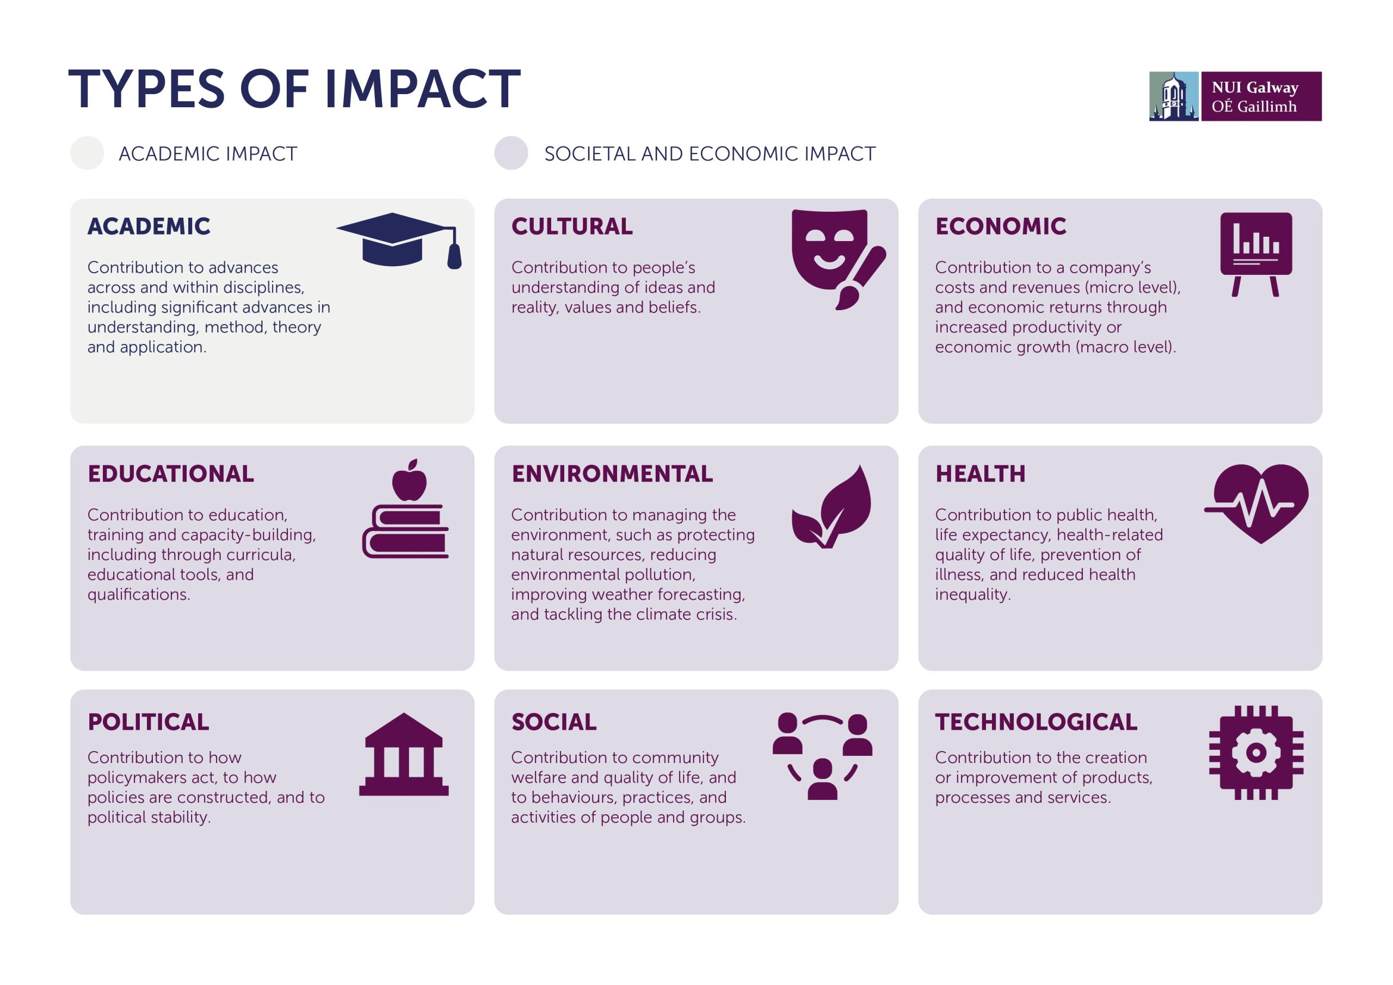
Multi-faceted research assessment framework
https://stories.nuigalway.ie/what-is-research-impact-/index.html
Notes:
The multi faceted research assessment framework provides both principals and guidelines for an evaluation process that takes into account the various ‘impact’ measures
First, it takes into consideration the scholarly, scientific, economic and societal impact of research
Second, it guides the user in defining what is THE UNIT of assessment – this is in order to avoid using the wrong data and indicators. For example, if one is assessing a researcher, they shouldn't use journal metrics that are inappropriate. Therefore, defining what is it that we are assessing helps select the right data and indicators
Third, it calls for the collection of various data sources whenever possible to try and capture impact. (For example ; combining publications, citations and patents)

Slide 17
1. Scholarly impact of research
Traditional focus on using indicators based on publications and citations in peer-reviewed journals, books, and proceedings.
Negative practices and fraudulent research
  Reproducibility issues
  Increasing retractions
Incorporate indicators of integrity, reproducibility, openness, and collaboration.
How collaborative is the unit of assessment (at the author, department, institution levels)?
How trusted is the research output?
How open and transparent is output?
How reliable is output?
Notes:
(e.g., misuse of indicators and citation gaming) … To tackle these issues, we recommend the measurement of scientific impact beyond publications and citations,

Slide 18
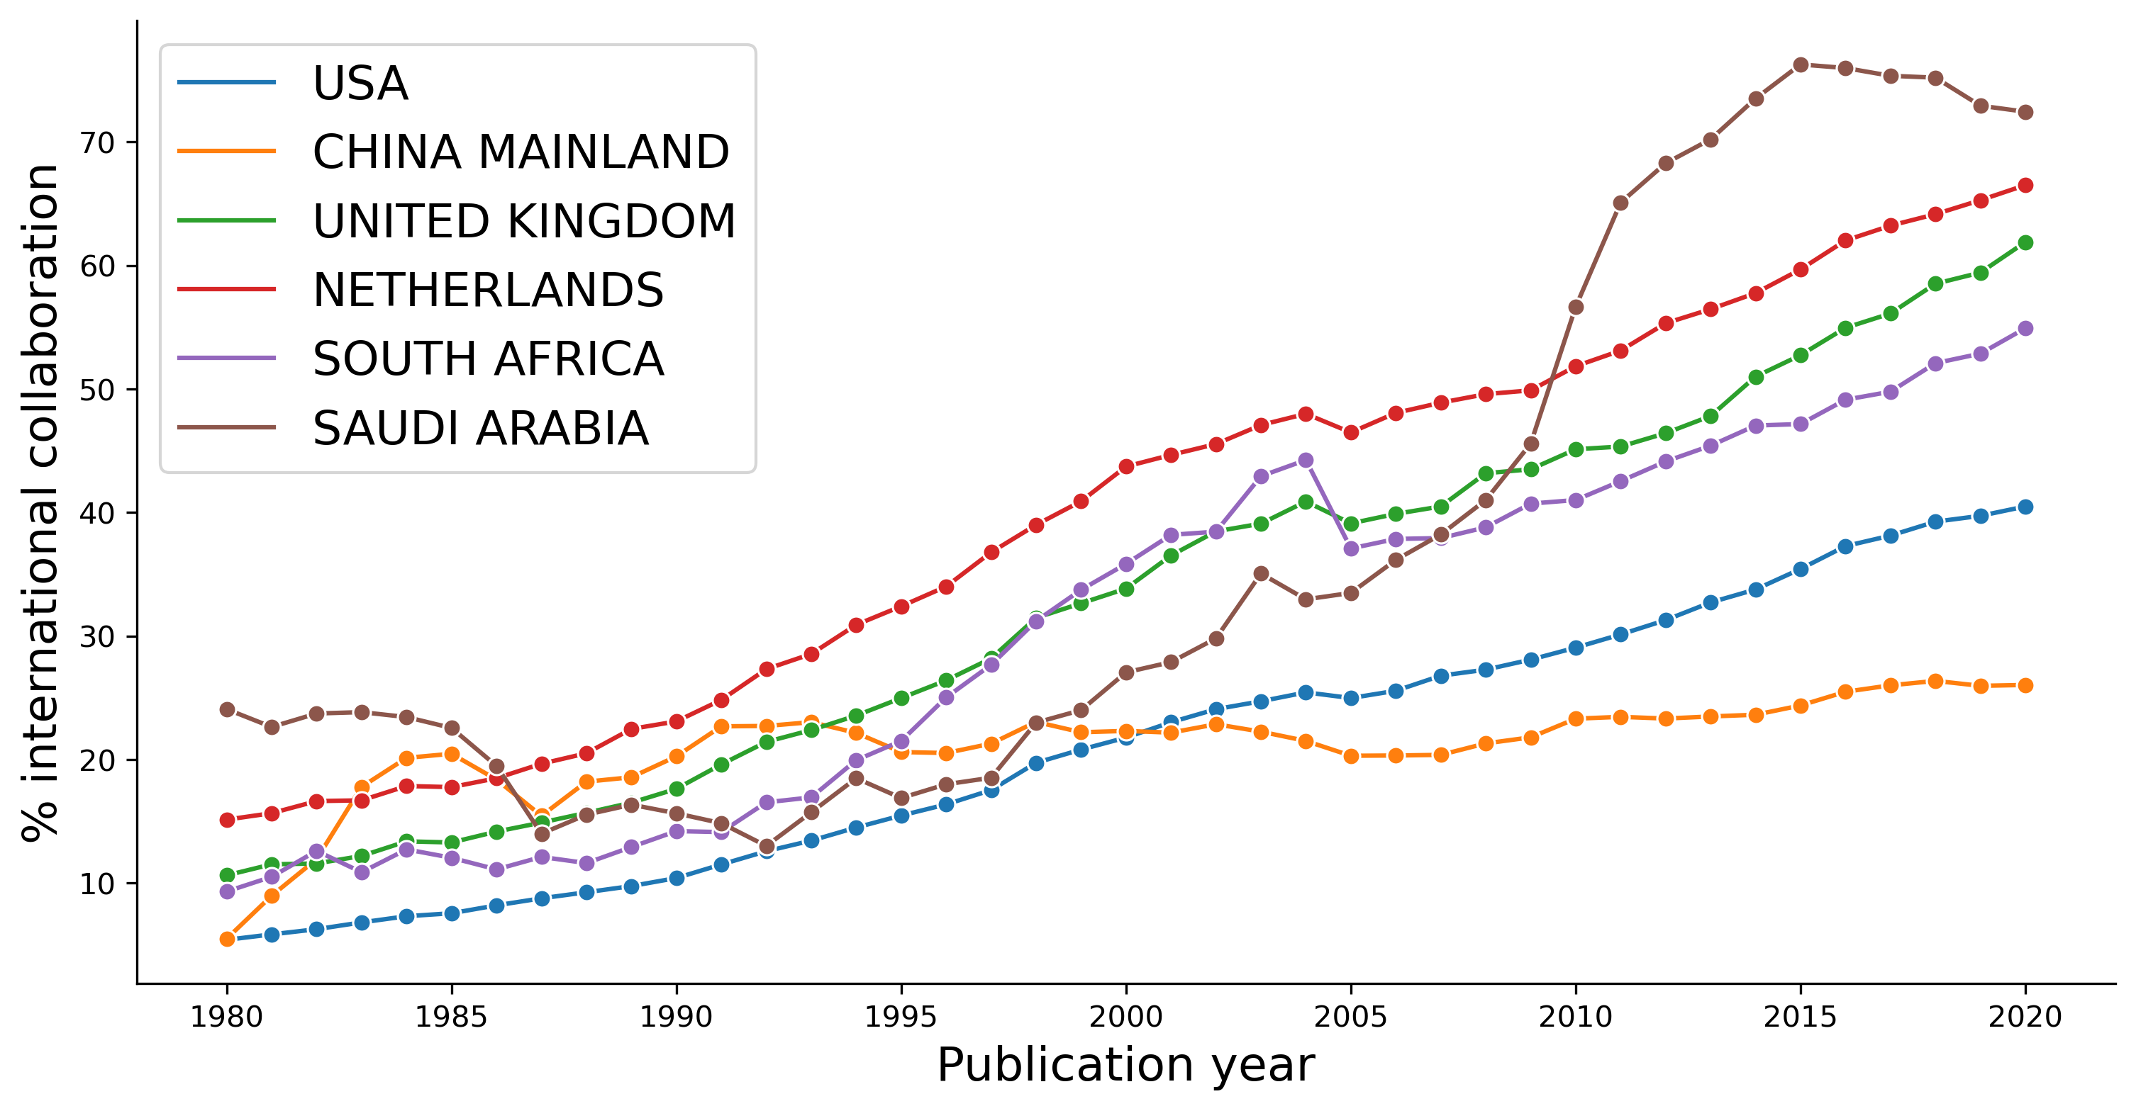
International collaboration
InCites data

Slide 19
International collaboration
Potter & Pearson (2023) npj Ocean Sustainability

Slide 20
International collaboration
Collaboration CNCI
Potter & Pearson (2023) npj Ocean Sustainability

Slide 21
2. Academic impact of research
Evaluation and assessment of the programmatic offerings and results of the unit of assessment – researcher, research group, department, or institution.
Should consider
  Number and success of graduate students and their success rates
  Mentorship programs
  Other specialty practices aimed to advance trainees
How many graduate students and/or trainees does the research support?
What programs or measures exist to support trainees’ advancement?
What is the percentage of graduates finding employment?
Notes:
Academic impact of research calls for … number and success of graduate students and their success rates in advancement and employment

Slide 22
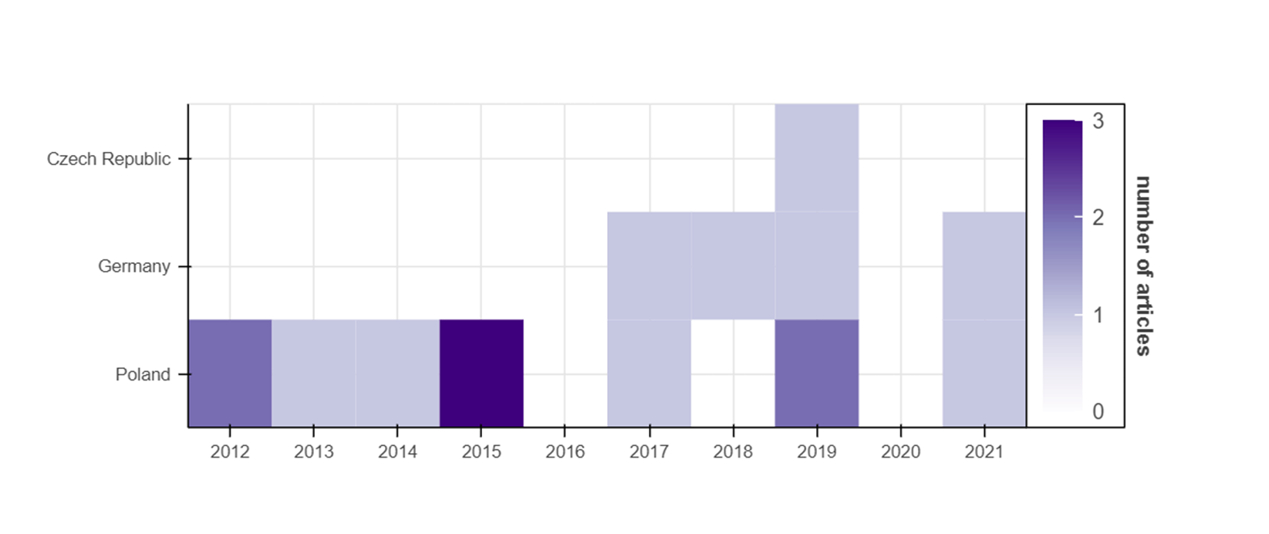

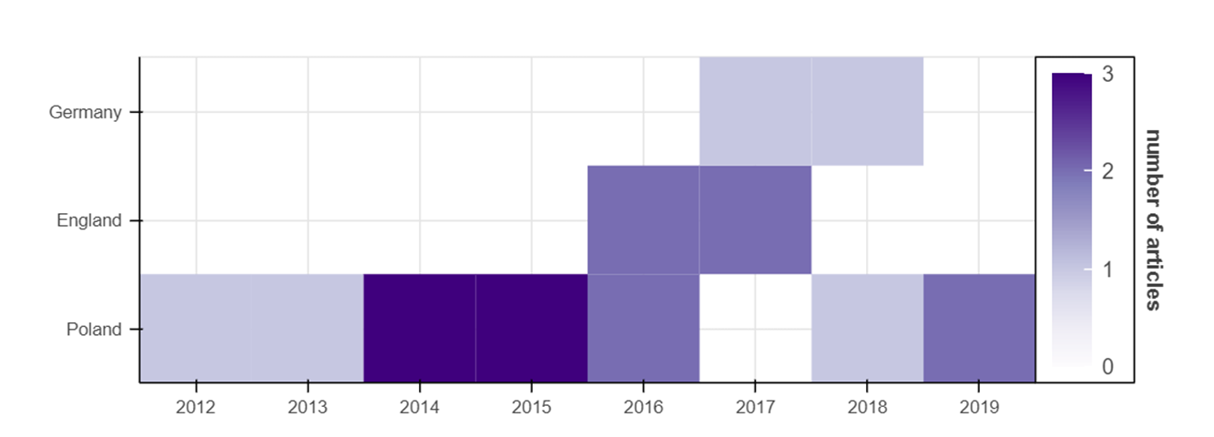

Mobility – international reach
Discipline
Psychology
Discipline
Computer Science

Slide 23
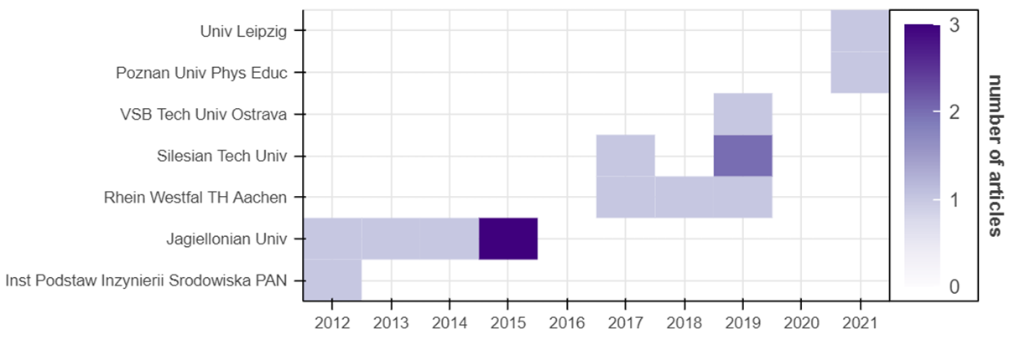
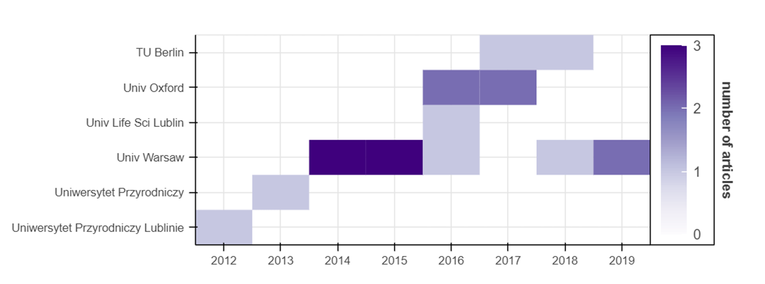
Mobility – institution experience
Discipline
Psychology
Discipline
Computer Science

Slide 24
3. Societal impact of research
  Citations in policy documents or medical guidelines
  Public attention to the research as captured by the news media
  Overall readership of output, etc.
How well does the research map to the UN SDG goals?
Is the unit of assessment display equal?
How diverse is the unit of assessment?
What are the proportion of male/female authors within the body of output being examined?
Notes:
Difficult to define and measure especially for basic sciences, arts and humanities. It should include measures, such as:

Slide 25
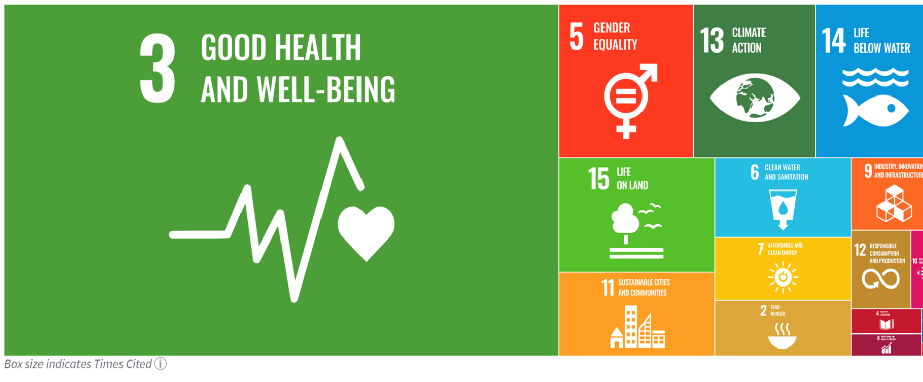
Understanding research contribution to UN SDGs
Notes:
Mapping for all publication years (from 1980 onwards)
16 of the 17 SDGs included
New visualization reporting 16 SDGs

Slide 26
4. Economic impact of research
  Technological development and revenue created from the commercialization of research
  Generated intellectual property (IP)
  Employment creation
  Brain retention
What technological advancements did the research support?
How many patents or other IP did it generate?
How many positions or employment opportunities did the research create or support?
Notes:
The economic impact of research is a part of its societal impact, yet measured through a series of indicators, such as:
Policy documents
Innovation – research fronts mapping
IP data ; institutional mobility

Slide 27
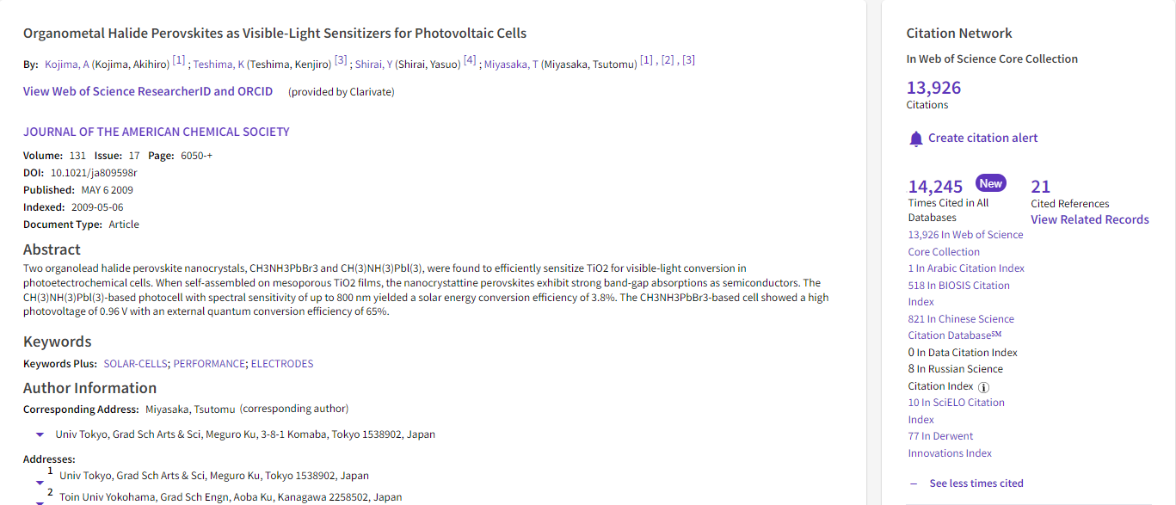
Research and patent connections
Web of Science
View the number of citations from patents to articles
Click to see which patents globally built upon this research

Slide 28

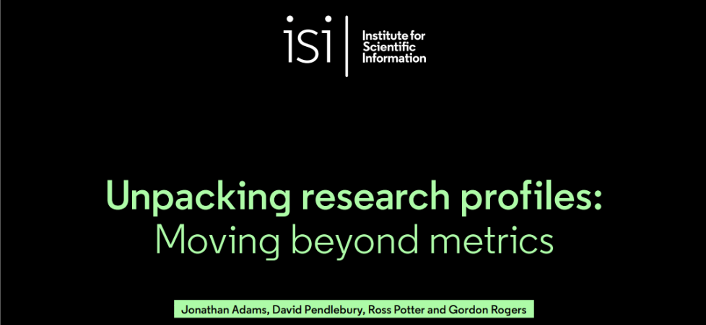
Profiles, not metrics
Profiles not metrics (2019)
  Beam plots (not an h-index)
  Journal Profile (not a JIF)
  Impact Profile (not a summary CNCI value)
  Research footprint (not a university ranking)
Unpacking research profiles: moving beyond metrics (2023)
  Self citation
  Journal characteristics
  Collaboration CNCI
  Research Fronts
Notes:
This is the second report from the Institute for Scientific Information on the value of shifting from simple metrics of research activity and performance to visually more informative profiles. These profiles help us understand what is going on in research and so enable better policy and management decision making. We focus on four key indicators at researcher, journal, institutional and research field levels
This report addresses the conflict between simple metrics and deeper visual exhibits in data analysis, emphasizing the value of profiled data over metrics. We discuss the skewed distribution of research activity data, the limitations of average citation impact and raw citation counts, and the concept of normalization using Category Normalized Citation Impact (CNCI). Through the lens of four key indicators, we examine excessive self- citation, characteristics of journals, the influence of international collaboration on research performance indicators, and the use of Research Fronts™ to identify current impactful research.

Slide 29
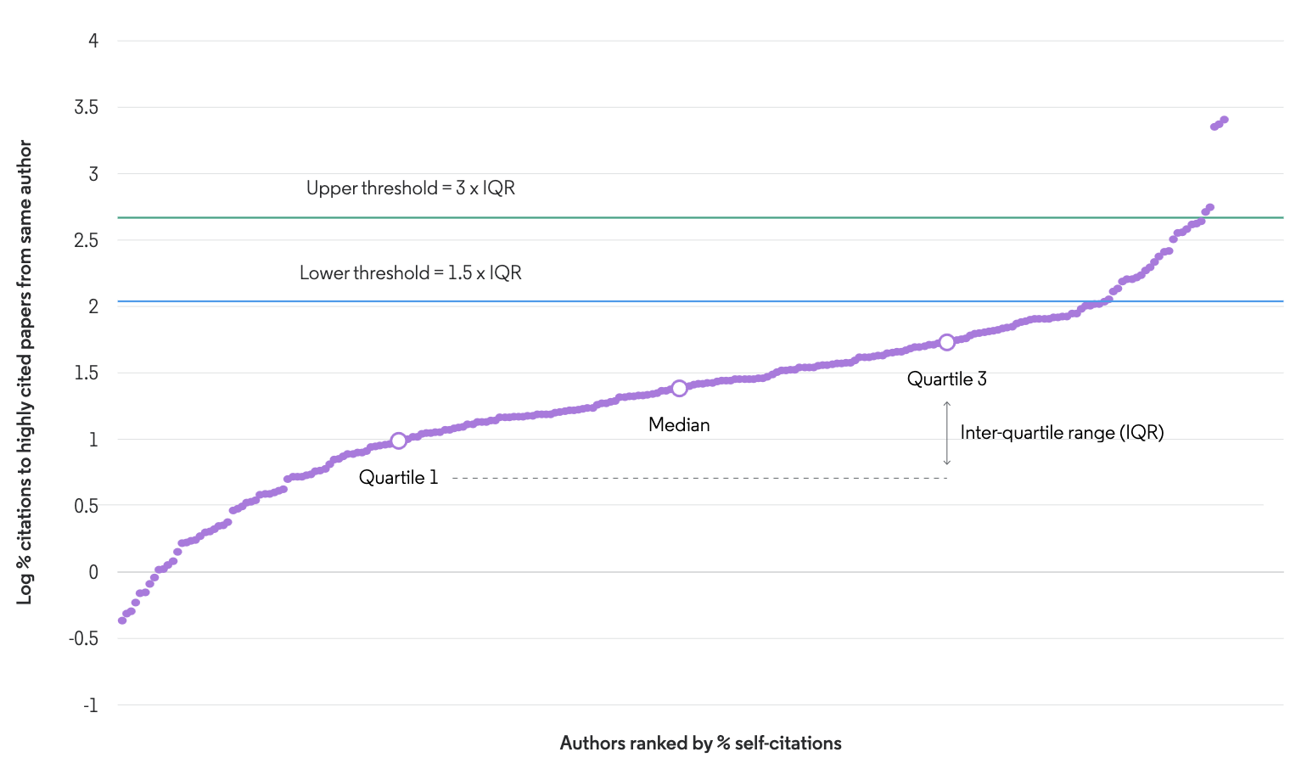
Self citations
High Cited Authors in the ESI field of Chemistry
Notes:
4 is about 50% self cite, 3.5 is ~30%. Lower threshold about 9%

Slide 30
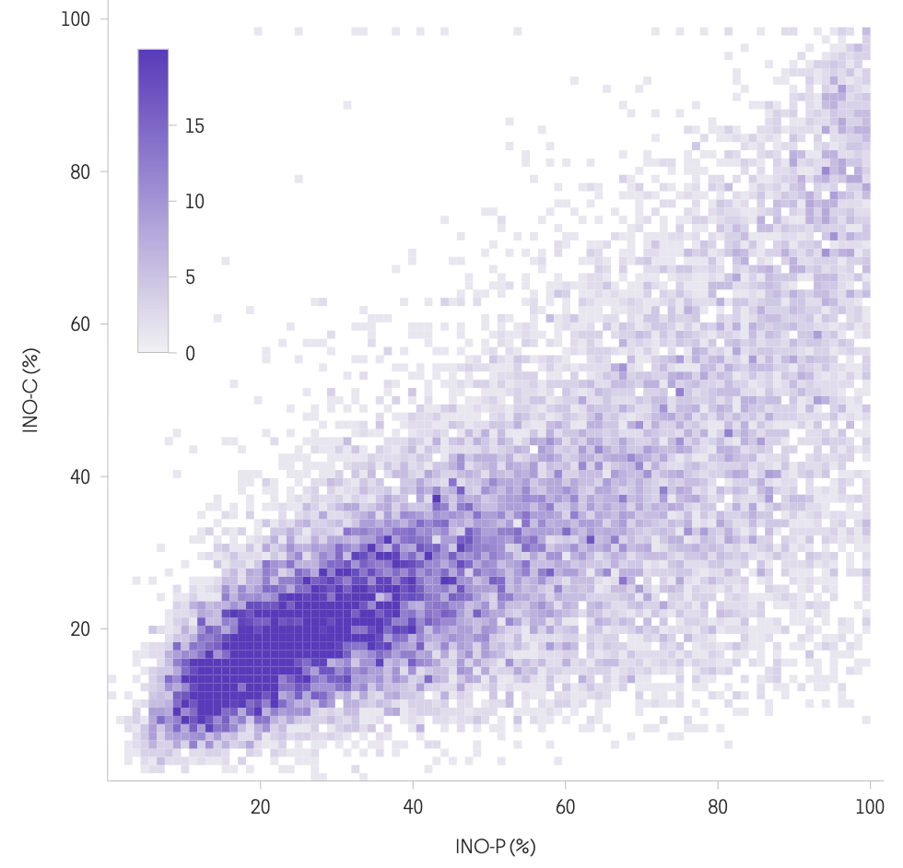
Journal Characteristics
Published and
cited “locally”
INO-P
  Indicator of National Orientation – Publishing
INO-C
  Indicator of National Orientation – Citing
Influence of 'local' journals an important part of the global research ecosystem
Korean J. Applied Statistics
New Eng. J. Medicine
Published and
cited “globally”
Notes:
many journals may include content predominantly authored by researchers from a single country/region, many of those journals receive citations from further afield. The influence of these 'local' journals is therefore an importan part of the international, indeed global, research ecosystem, helping to The Korean Journal of Applied Statisticssurface research results more widely.
…. helping to surface research results more widely

Slide 31
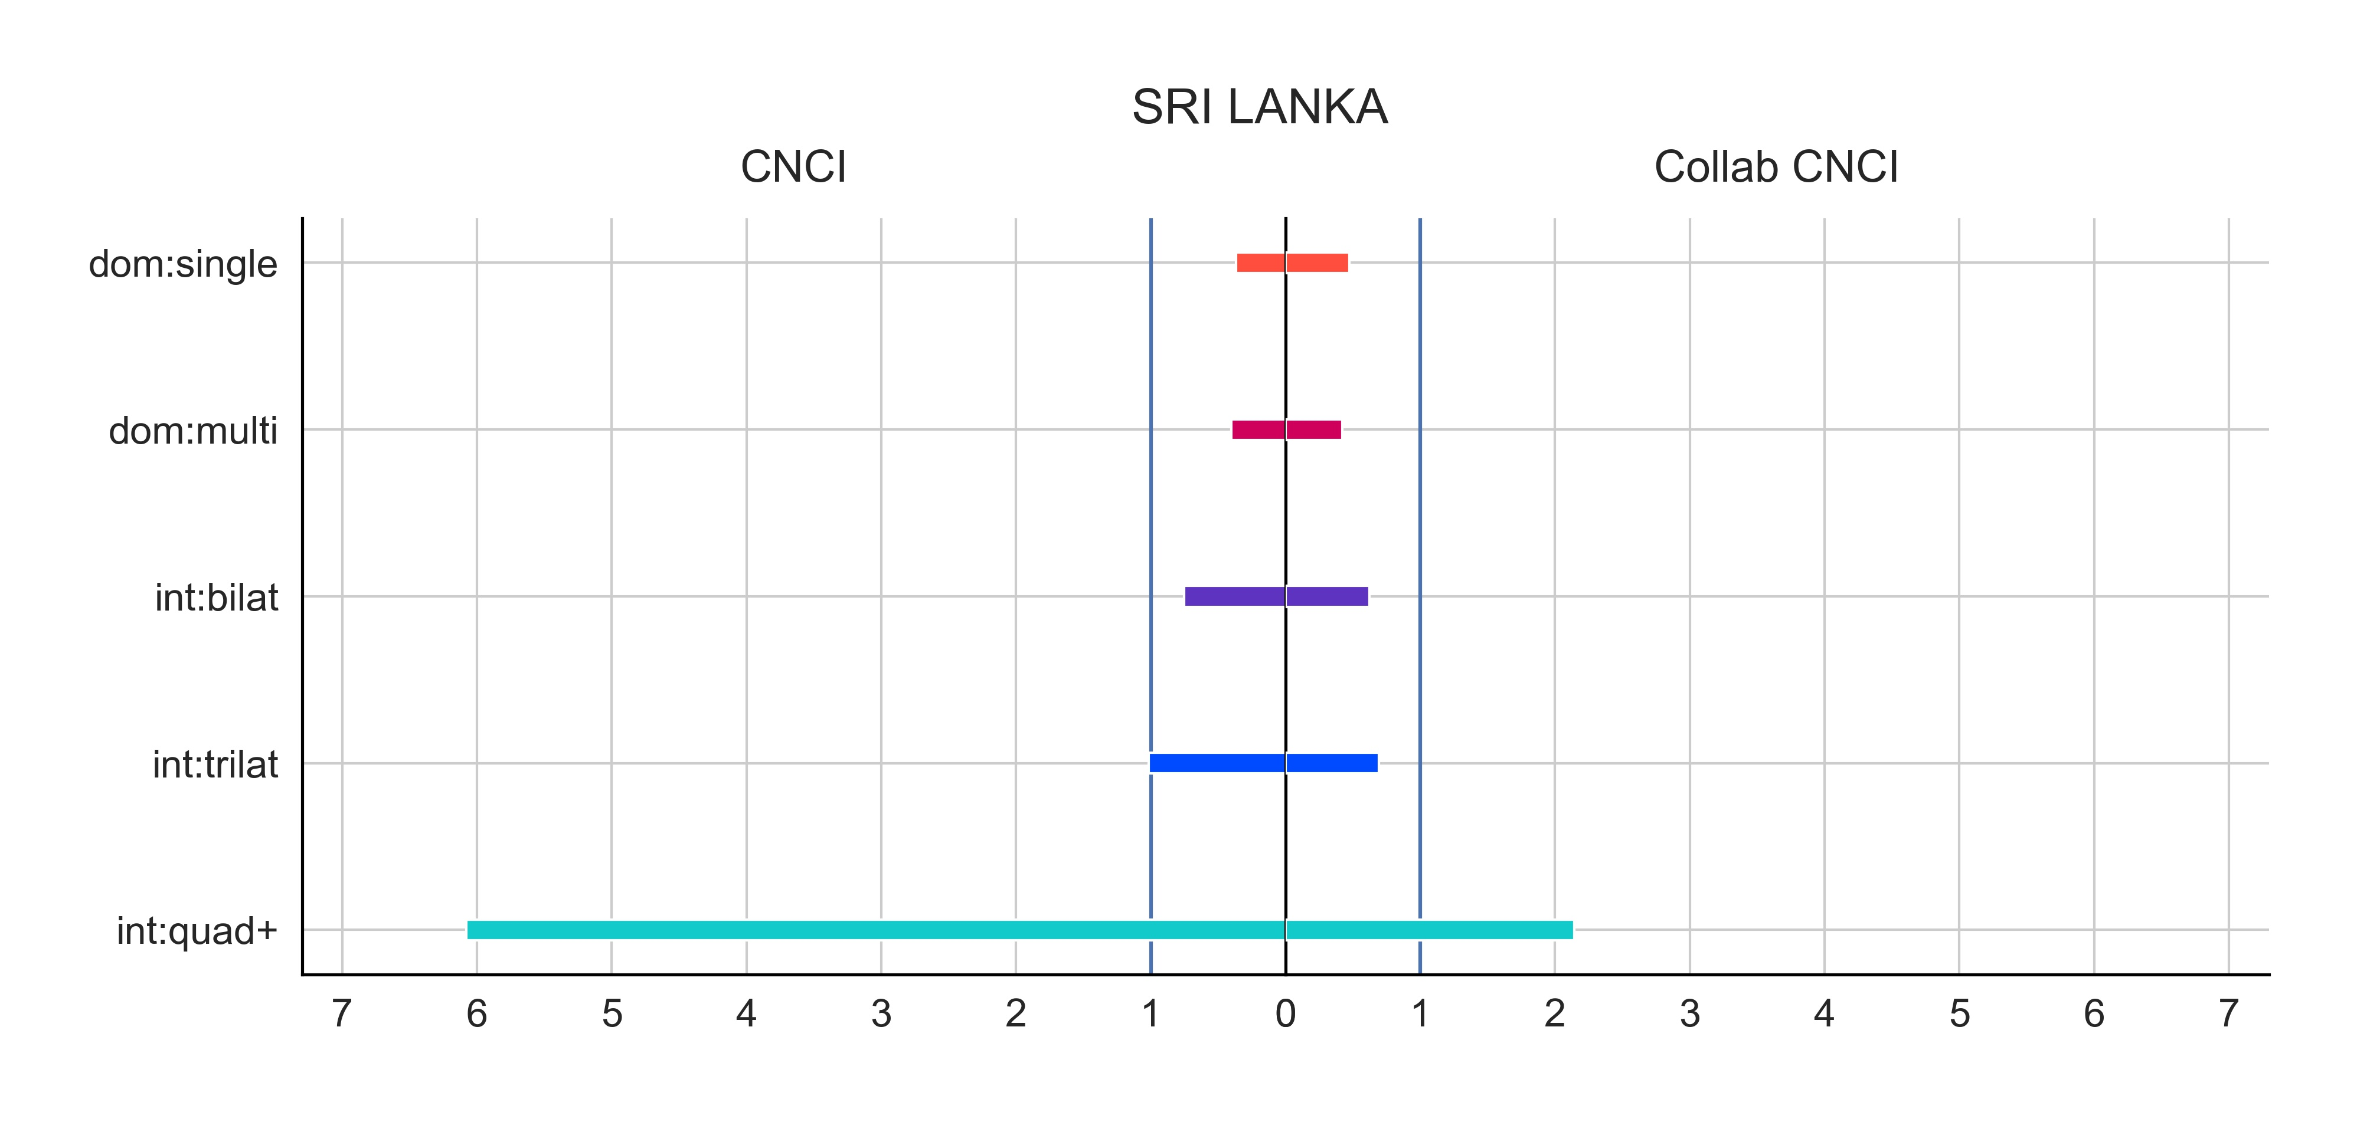
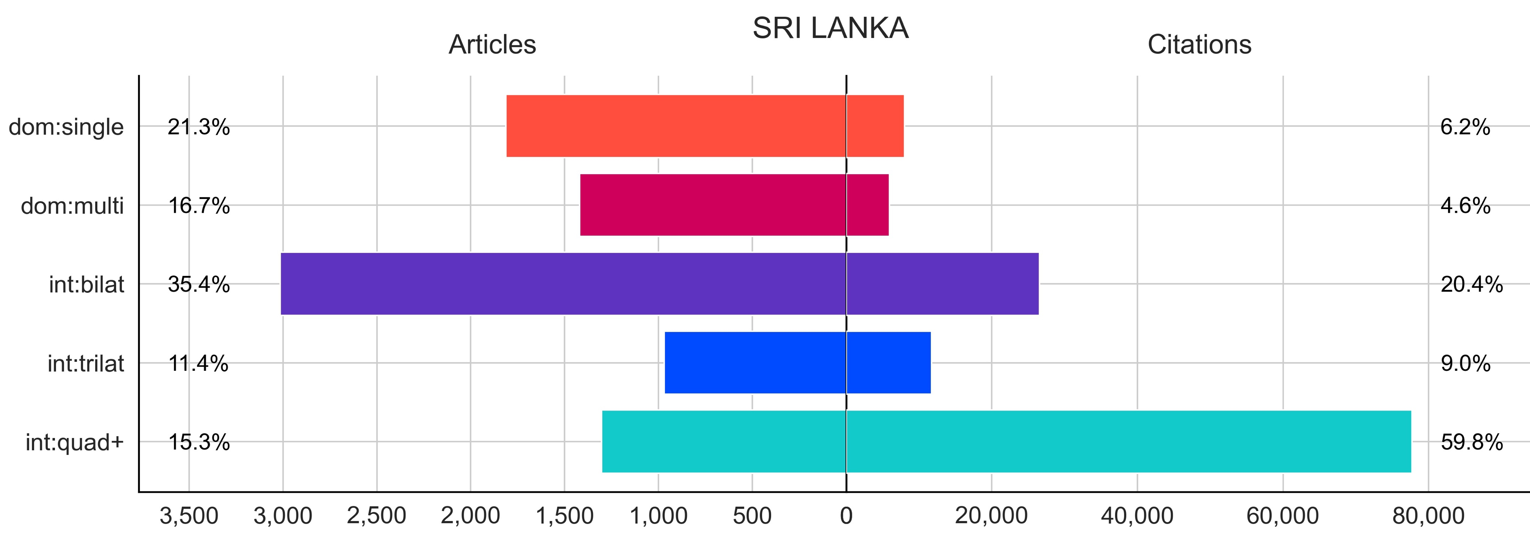
Collaboration CNCI
Citations normalised by
  Publication year
  Subject category
  Document type
  Collaboration type
Domestic
  Single institutional
  Multi institutional
International
  Bilateral
  Trilateral
  Quadrilateral plus

Slide 32
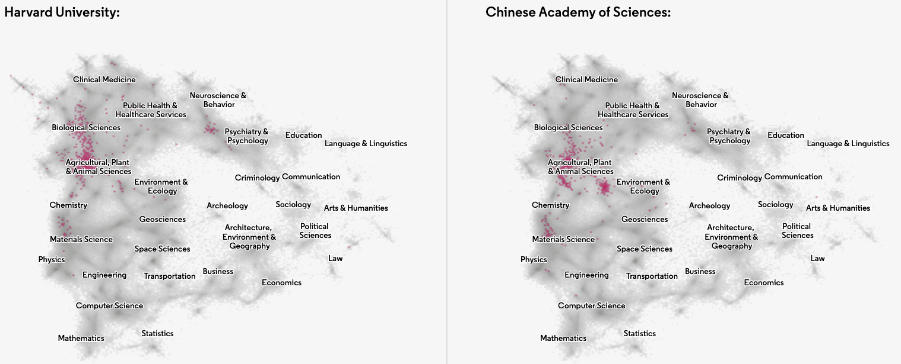
Research fronts
The location of CRISPR papers
A recent paper cites several highly cited papers also cited by another recent paper, then those two new papers must be focusing on the same 'next step'.
Notes:
…illustrating the contrast in their research focus

Slide 33
Conclusions
Rankings are inescapable
Responsible metric use
Greater diversity of indicators (societal, economic etc.)
Avoiding invoking Goodhart’s Law
Profiles, not metrics
Visualize, visualize, visualize

