Slide 1
Evaluating the diversity of scientific discourse on twenty-one multilingual Wikipedias using citation analysis
Mike Taylor, Head of Data Insights
Carlos Areia, Data Scientist
Roisi Proven, VP Product, Altmetric

Slide 2
A little bit about me
Carlos Areia
Physio
Clinical trials
Clinical applied research (wearables and remote monitoring)
Joined Altmetric and Digital Science 2 years ago as a Data Scientist.

Slide 3
Introduction and Research question

Slide 4
What is this study about?
Wikipedia is one of the most important sources of information on the web, and one of the most visited websites
(but it’s importance is far more than this: Wikipedia data is used everywhere – including in large language models)
There’s an assumption that the English Wikipedia is so much larger and active than the others
Somewhat assumed by some that it’s the only one that ‘counts’

Slide 5
Why now?
A couple of years ago, we at Altmetrics decided to go an extra mile to improve diversity
The new pipeline is much better at handling multiple languages and it now contains 35 wikipedia languages (and growing…) and over 12 million mentions

Slide 6
What research questions were we addressing?
First of all, we wanted to quantify the contribution that non-English languages were making to the whole body of “Wikipedia citations”
Second, we wanted to understand whether / to what extent different languages were representing research (through this curious lens of citation analysis…) – which I’m calling “uniqueness of voice”
Third, we wanted to look to see if there was any evidence that there were subject discipline differences
And more stuff … That will be published (hopefully soon!)

Slide 7
Methodology

Slide 8
The methodology…
We identified twenty languages (other than English), representing many parts of the world, but importantly are large, and have over 1,000 editors and 10000 research “citations”
French, Spanish, Catalan, Portuguese, Italian, German, Greek, Turkish, Chinese/Mandarin, Persian/Farzi, Indonesian, Arabic, Vietnamese, Korean, Japanese, Russian, Ukrainian, Polish, Czech, Serbian
All citations identified by Altmetrics were mapped to the relevant cited publications (articles, books, etc) in Dimensions, and mapped to one of six subject areas.

Slide 9
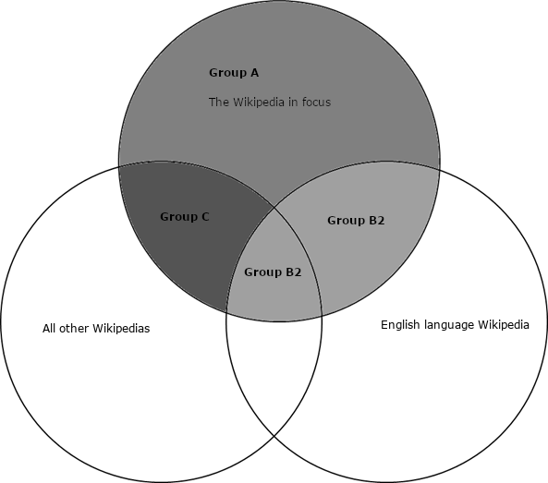
The clever bit (we hope)
Imagine a publication
For each language, we determined the number of articles that are uniquely cited by this Wikipedia (and ONLY this Wikipedia)
And the number of articles cited English and at least one other wikipedia language
Finally, the number of articles cited by this Wikipedia and by at least one other non-English Wikipedia
Mentioned in just Spanish wiki
Spanish + French wiki
Spanish + English wiki
Spanish + English + French wiki

Slide 10
Some results

Slide 11
Number of research outputs cited by our 21 Wikipedias
3,485,474

Slide 12
Number of research outputs cited by EN Wikipedia
2,035,466 (58.4%)
The English Language Wikipedia cites the largest number of outputs

Slide 13
Number of articles cited by EN Wikipedia and not cited by others
Number of articles cited by non-EN Wikipedias and not cited by EN
1,140,160
1,457,138
32.7%
41.8%
The unique contribution of non-English Wikipedias is larger than the English

Slide 14
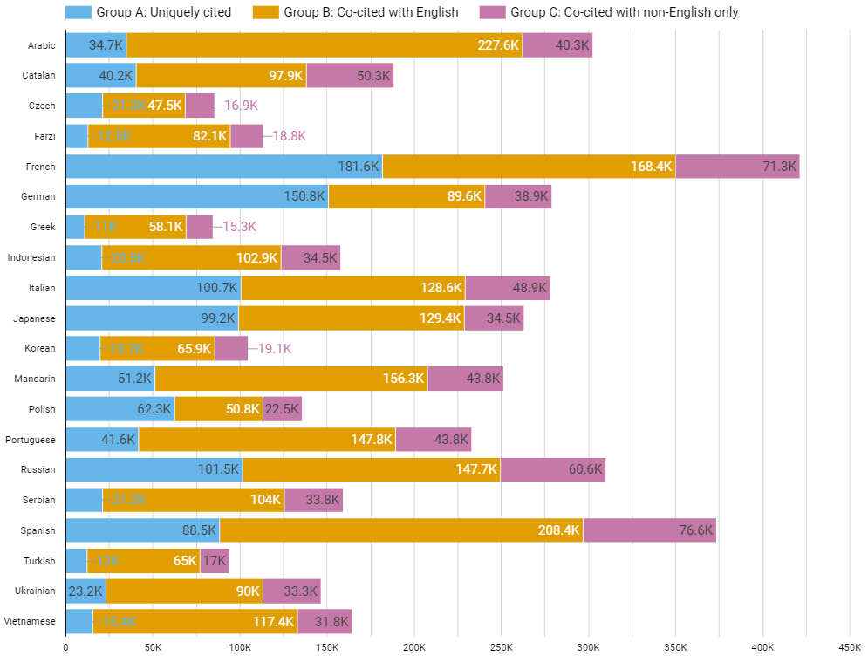
Each non-EN Wikipedia makes a unique contribution
In general, the larger the Wikipedia, the more citations it makes
(Dutch is a crazy outlier)

Slide 15
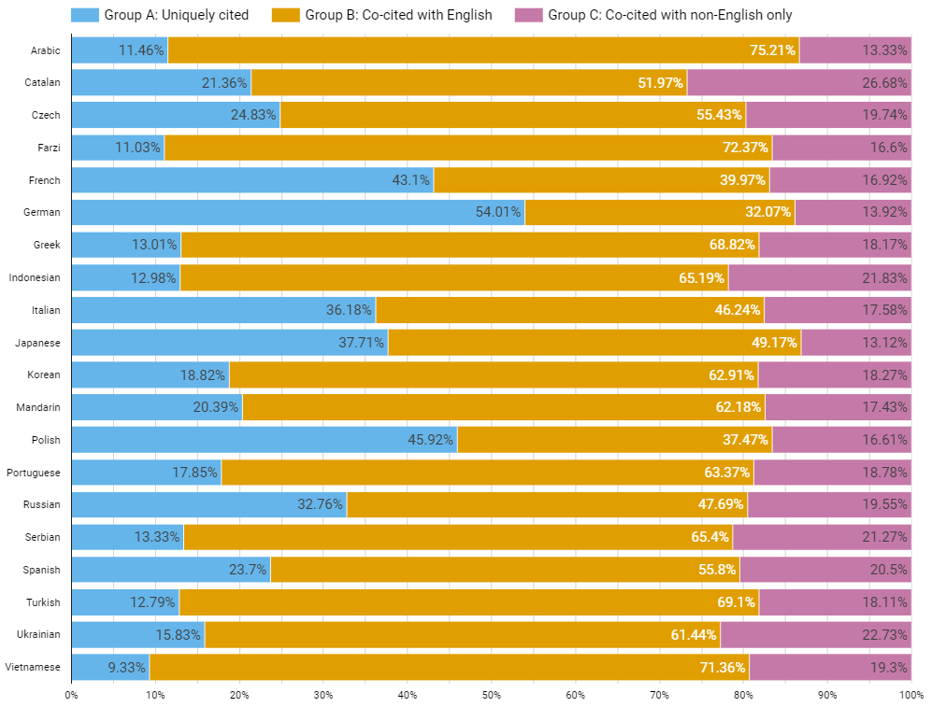
There’s a big variation between Wikipedias – French, German and Polish exceed expected ‘uniqueness-of-voice’
Arabic, Farzi and Vietnamese show significantly less ‘uniqueness of voice’

Slide 16
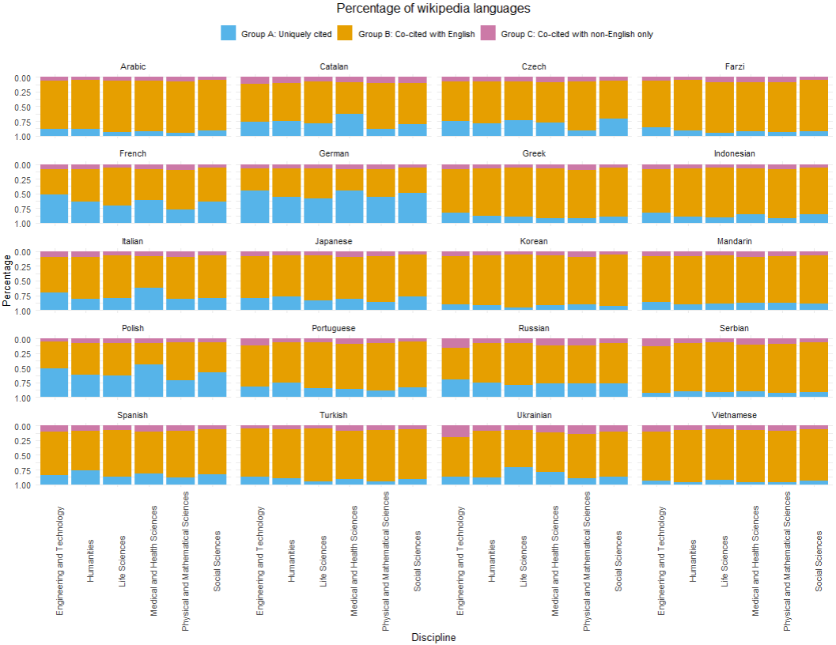
Generally, we can say that some Wikipedia have pronounced uniqueness in MHS
E&T is probably the next
The less unique outliers (Arabic, Farzi, Vietnamese) have less variability
Others – Ukrainian, Polish, Spanish, Catalan, German, French, Italian – show higher

Slide 17
Conclusion

Slide 18
Conclusions
The English Language Wikipedia cites the largest number of outputs
The unique contribution of non-En Wikipedias (combined) is larger than the English
Each non-EN Wikipedia makes a unique contribution
In general, the larger the Wikipedia, the more citations it makes
(Dutch is a crazy outlier)
There’s a big variation between Wikipedias – French, German and Polish exceed expected ‘uniqueness-of-voice’. Arabic, Farzi and Vietnamese show significantly less ‘uniqueness’
Subject area differences seem tied to other factors
We cannot treat non-EN Wikipedias as subsets or translations or samples of English: they make a unique contribution to representations of scholarship and deserve more study

Slide 19
THanks
Notes:
Image - https://www.reactiongifs.us/wp-content/uploads/2018/09/Tom-Hanks-Thank-you.gif

