Slide 1
Metrics, research quality and the research process. An exploration of their interrelations.
Fredrik Niclas Piro & Dag W. Aksnes (NIFU)
NWB, 2023

Slide 2
What influence on the citation rate of articles?
Why are some scientific articles very highly cited while the majority remain uncited or receive few citations?
This question has been extensively discussed in bibliometric literature.
Over the years, numerous studies have investigated factors affecting citation rates of articles (Onodera & Yoshikane, 2014; Tahamtan, Afshar & Ahamdzadeh, 2016).
Looking beyond the specific peculiarities of these studies, three observations may be made.
First, there is a large range of potential factors that influence citation numbers.
Second, the issue has typically been explored by addressing factors that can be investigated bibliometrically, drawing upon information in the publications’ bibliographic metadata.
Third, for several factors studied, there is inconsistency in whether these factors have an impact or not. Some factors show varying effects, or their impact is not consistently observed.

Slide 3
We seek to investigate whether variations in citation numbers and quality assessments can
be primarily attributed to intrinsic and extrinsic aspects of the publication itself
or whether they are influenced by various (self-reported) features of the research process involved in the creation of the scientific paper.
Objective of the paper: to examine the independent contributions from self-reported data on the research process of an article, while controlling for the most significant bibliometric variables identified in the literature
By exploring the interplay between bibliometric and non-bibliometric factors, we can achieve a more comprehensive understanding of the complex dynamics that affect citation rates and shed light on the nuanced mechanisms behind research impact.

Slide 4
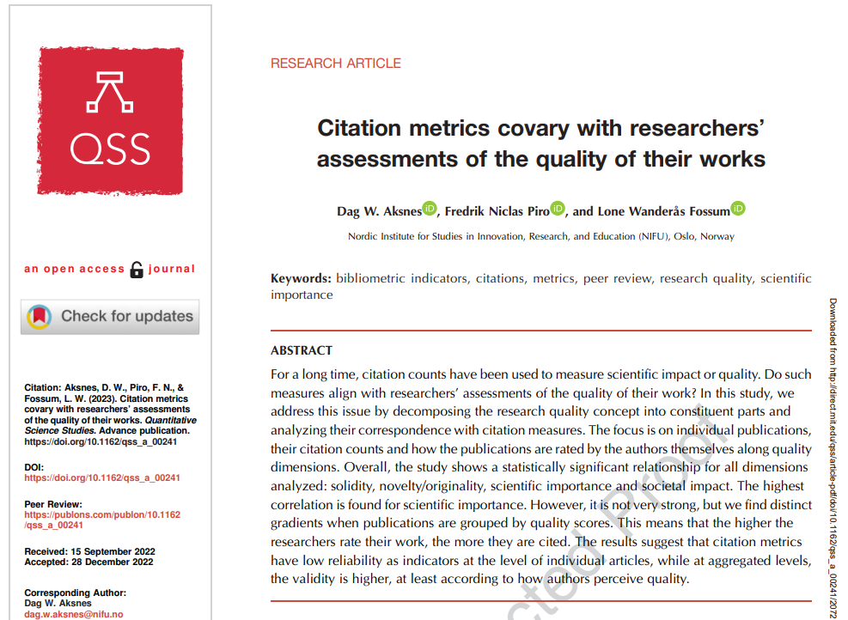
A follow up to our paper

Slide 5
Study population
592 Norwegian scientists’ self-assessments of three of their own papers (from the period 2015-2018).
3 papers for each researcher.
As first- or corresponding author
1 paper: highly cited (top 10%)
1 paper: medium cited (10-50% citation interval)
1 paper: little or not cited (50-100% citation interval)
1,250 researchers invited, good response rate: 47% (n=592)

Slide 6
Aim of the study
To explore non-bibliometric dimensions of the research process that we consider inducive in enhancing the quality of the research.
As such we asked the authors (of papers for which we have citation numbers) to assess five aspects of the research process, that:
have either been entirely neglected in earlier citation studies,
or for which we believe that the authors themselves can provide more meaningful information than what it is possible to extract from the publication itself.
To be used in regression analysis

Slide 7
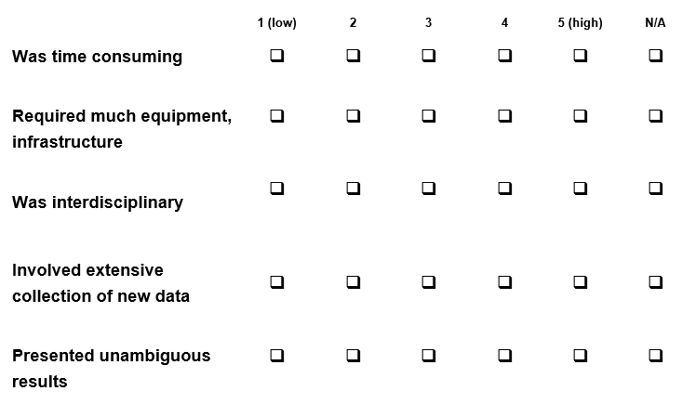
Five (self-assessed) indicators
“For each article (for you and your co-authors), make your assessments on your papers based on what you believe is ‘typical’ within your field of research”

Slide 8
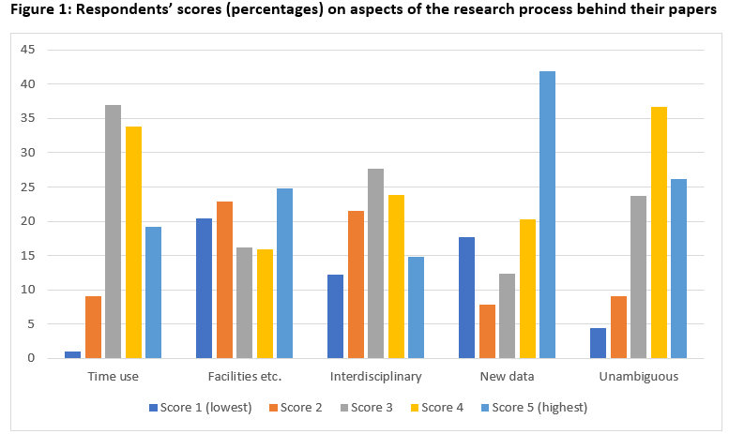
Very different answers by question

Slide 9
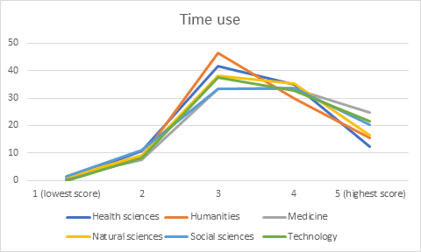
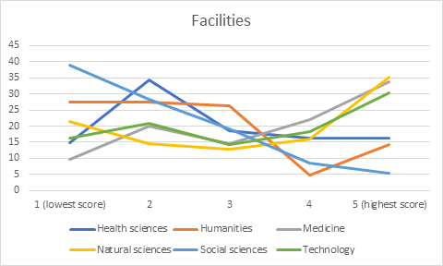
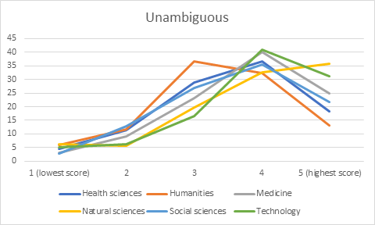
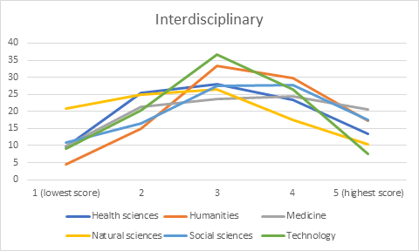
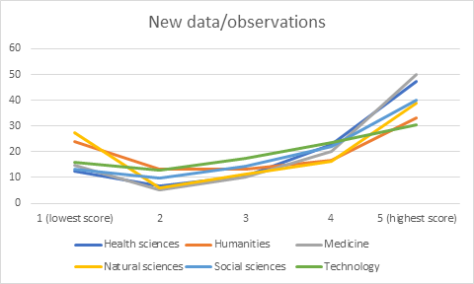
Not so strong differences by field

Slide 10
How are these assessments of the research process associated with research quality dimensions?

Slide 11
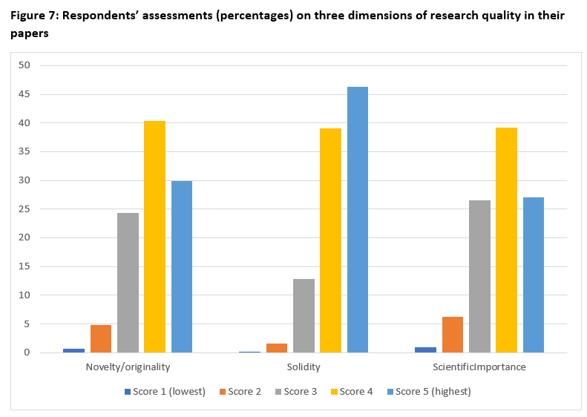
Four dependent variables
Citations: MNCS (log-transformed)
Self-assessments of research
quality dimensions:
Novelty/originality
Solidity
Scientific importance

Slide 12
Independent variables for the regression model
The self-assessments of the research process, in addition to bibliometric control variables identified in the literature:
Number of references (normalized by field)
Number of (author) countries (normalized by field)
Number of authors (normalized by field)
Length of paper (normalized by field)
The Price Index (normalized by field): % of references less than five years old
Quality level of journal: from the Norwegian publication indicator (NPI), where roughly 20% of all journals (within each field) are considered leading journals (level 2), and the remaining journals are at level 1.
Based on 198 citation studies, Tahamtan, Afshar & Ahamdzadeh (2016) identified 28 different factors (with subsequent variables/indicators) that had been explored to explain citation differences

Slide 13
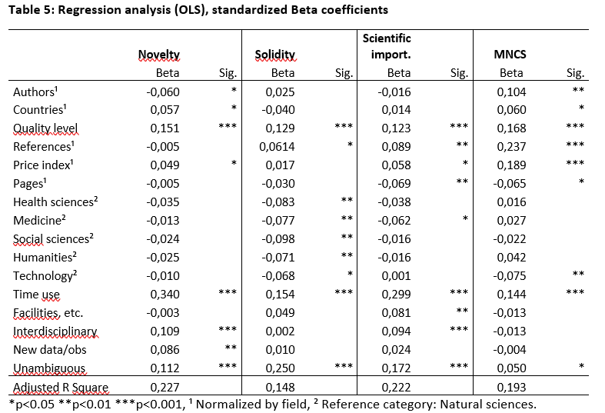
Results from regression analysis
The explanatory variables that consistently are associated with these variables are 1) the quality level of the journal, 2) time use for the research and 3) the unambiguity in presenting results/findings.

Slide 14
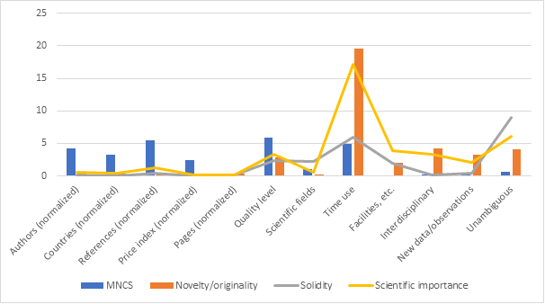
Explained variance (R-Square, per cent) by independent variables (entered separately) in four regression models
Time use: explains almost 20% of the variance in novelty/originality and scientific importance

Slide 15
Main findings
Bibliometric indicators more strongly associated with MNCS
Self-assessed indicators more strongly associated with self-assessed research quality dimensions
However: time use and presentation of unambiguous findings associated with both MNCS and research quality dimensions
No variable has particularly strong effect on its own.
In understanding what impacts on research quality, a limited understanding is obtained if only citations and intrinsic and extrinsic aspects of the publication itself is considered.

