Slide 1
Universities accelerate the use of knowledge in technological development for patenting ​
NWB 2023, Gothenburg, Oct 2023 Alvin Shijie Ding, International Center for the Study of Research, Elsevier
Rachel Herbert, International Center for the Study of Research, Elsevier

Slide 2
Agenda
Background
Data and methodology
Preliminary results
Conclusion and further research

Slide 3
Background
Academic patents are an important resource to analyze a research institution’s role in technology development and university-industry collaborations.
Many previous studies focused on measuring the impact of academic patents through the lens of patent-to-patent forward citations.
In this study, we focused on the backward citations from academic patents specifically to SNPRs (Scientific Non-Patent References) and what it implicates, regarding knowledge sourcing and linkages.

Slide 4
Background
Research Question:
What are the empirical differences regarding Scientific Non-Patent References (SNPRs) of academic patents and non-academic patents, and what are the implications?

Slide 5
Data and Methodology-Definitions
Patent family: DOCDB simple patent family, a collection of patent applications covering the same technical content.
Academic patents: at least one owner of the patent family is a research institution, including universities, hospitals and medical institution
Publication year of the patent family: The year in which the first member of the patent family was published.
Filing year of the patent family: The year in which the first member of the patent family was filed.
Representative of the patent family: Earliest published EP patent, among active authorities of each patent family only. (Default order of authorities when selecting the representative of the family: EP, US, WO, GB, CA, AU, DE etc.)
Patent family with Scopus indexed SNPRs: At least one member of the family had at least one SNPR which can be matched to a Scopus indexed publication (added by examiner and/or applicant)
.
Notes:
*Non-Patent-Literature reference types:
D:When the search report cites documents already mentioned in the description of the patent application for which the search is carried out, these are denoted by the letter “D”
X: Category "X" is applicable where a document is such that when taken alone, a claimed invention cannot be considered novel or cannot be considered to involve an inventive step.
Y: Category "Y" is applicable where a document is such that a claimed invention cannot be considered to involve an inventive step when the document is combined with one or more other documents of the same category, such combination being obvious to a person skilled in the art.
*Reference: https://www.epo.org/en/legal/guidelines-epc/2023/b_x_9_2.html

Slide 6
Data and methodology
Patent family data were extracted from PatentSight®, while SNPRs data were based on Scopus® database (All SNPRs indexed in Scopus referenced by ANY of the members in a patent family), all data analysis works is done in the cloud computing platform Databricks.
We extracted all patent families published in EPO during 2001-2022, considering the lifecycle of patents and the delay in examination process, we only include patent families filed in 2010-2021 in this study, this result in 39,928 academic patent families with 290,371 patent family-SNPR pairs and 482,989 non-academic patent families with 711,955 patent family-SNPR pairs. All statistics is based on patent family not individual patent.
We are able to identify the owner’s sectors (i.e. academic, company etc) by indexed information from the PatentSight® database, and able to link the SNPRs with Scopus scientific publications information via publication ID indexed in Scopus®.
Notes:
In this study, we compared the following two group of patent families:
Group-1: Patent families with the publication year 2001-2022, with at least one member filed to EPO, and at least one active member (as is in the search date, Sept 7th 2023), AND with at least one research institution owner.
Group-2: Patent families with the publication year 2001-2022, with at least one member filed to EPO, and at least one active member (as is in the search date, Sept 7th 2023), AND without any research institution owner.
For both group of patent families, we used PatentSight to get the patents data, and linked them based on NPL references with Scopus scientific publications data.
(All Scientific publications(indexed in Scopus) referenced by ANY of the members in a patent family)

Slide 7
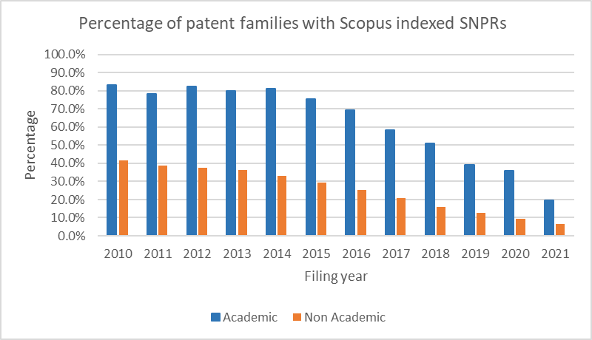
Academic patents more frequently have SNPRs than non-academic patents
The rate of academic patents with SNPRs is almost double the rate of non-academic patents with SNPRs.
Patent examination time lags
Patent Owner sector:

Slide 8
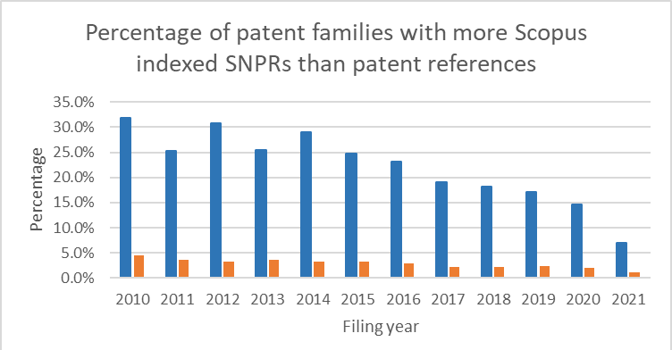
SNPRs play a more significant role for academic patents than non-academic patents
Around 1/4 to 1/3 of academic patents had more SNPRs then patents citations, while the rate is significantly lower for non-academic patents, which generally below 5 percent.
Patent Owner sector:

Slide 9
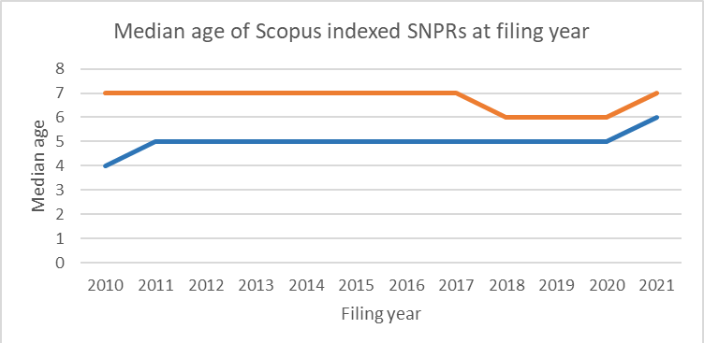
Academic patents tend to have ‘younger’ SNPRs
The median age of SNPRs in non-academic patents is approximately 40% higher than those from academic patents, and the trend remains quite stable.
Patent Owner sector:

Slide 10
Conclusions
Previous studies have suggested that patent citations indicate knowledge linkage, and examiner citations indicate knowledge linkage better than applicant citations (Chen, 2017), combined with our findings we conclude that academic’s engagement to technological development strengthened the knowledge linkage especially with basic research.
If the greater number of SNPR citations equate to more technological novelty (Ortega et al., 2021) and scientific intensity (Callaert et al., 2013 and Sung et al., 2015), combined with our findings we believe that academic’s engagement also strengthened the overall industrial technology originality and accelerated the use of existing scientific knowledges.

Slide 11
Limitations and further research areas
Limitations:
Truncated citations
Differences in patent examination practices in different countries/regions
Un-equal sample size
Further research or improvement on the current study:
Normalization (technology fields, time, etc.)
The impact of reference types (examiner/applicant or inventor)
Look from SNPRs perspective, when did they receive the first patent citation, and from what sectors?
Expand the definition of academic patents, i.e. to patents with academic inventors (not necessarily owned by academic institutions), any change on results?
Notes:
1-The number of citations received by any given publications is truncated because only the citations received so far are known.
2-Differences in patent examination practices across time and offices may produce differences in citation intensities, differences among patent offices in terms of examination procedures may influence the number and type of references cited: At the EPO, as references come essentially from the examiner’s revision of the prior art, it has been argued that citations rarely reflect or coincide with the science used by inventors.
3-The number of citations made per patent varies across field or maturity of technology.
As shown by Callaert et al. (2007) in a comparative study of USPTO and EPO patents, these differences are noticeable both in terms of the occurrence and the type of the reference cited. USPTO patents include on average about three times as many patent references than EPO patents. As regards non-patent literature, 34% of USPTO patents contain non-patent references whereas they are 38% at the EPO. They also find that journal references are more prominent in EPO patents (64% of non-patent references are journal references compared to 54% in USPTO patents).
it is estimated that 60–80% of academic patents are not university-owned patents-(https://www.sciencedirect.com/science/article/pii/S0166497221000687)

Slide 12
Thank you

Slide 13
References
Lixin Chen,Do patent citations indicate knowledge linkage? The evidence from text similarities between patents and their citations,Journal of Informetrics,Volume 11, Issue 1,2017,Pages 63-79,ISSN 1751-1577,https://doi.org/10.1016/j.joi.2016.04.018.
Velayos-Ortega, G.; López-Carreño, R. Non-Patent Literature. Encyclopedia 2021, 1, 198-205. https://doi.org/10.3390/encyclopedia1010019
Hui-Yun Sung, Chun-Chieh Wang, Mu-Hsuan Huang, Dar-Zen Chen,Measuring science-based science linkage and non-science-based linkage of patents through non-patent references,Journal of Informetrics,Volume 9, Issue 3,2015,Pages 488-498,ISSN 1751-1577,https://doi.org/10.1016/j.joi.2015.04.004.
Callaert, J., Van Looy, B., Verbeek, A. et al. Traces of Prior Art: An analysis of non-patent references found in patent documents. Scientometrics 69, 3–20 (2006). https://doi.org/10.1007/s11192-006-0135-8

