Slide 1
Collection directions and the relational library
University of Kentucky 20 July 2023
Lorcan Dempsey
@LorcanD

Slide 2
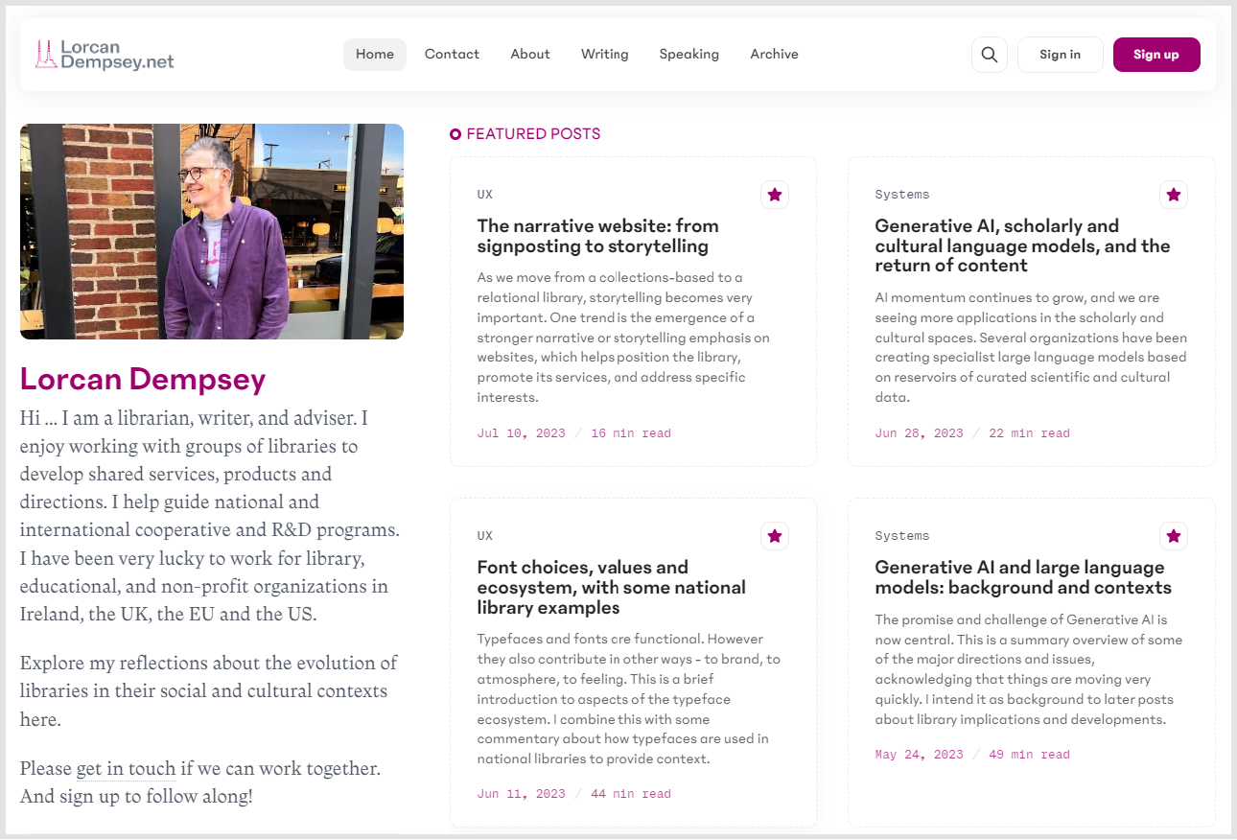

Slide 3
* the relational library * some collection dynamics * collection directions * a note on open

Slide 4
(Almost) no mention of AI!

Slide 5
The relational library

Slide 6
Collections-based library
The management of the collection configures services, organization and spaces
Value and role of library well understood
Optimise fixed capacities
Library develops service according to the
library pattern
Relational library
Changing patterns of research and learning configure services, organization and spaces.
Value and role of library continuously and collaboratively re-evaluated
Mobilize capacities around evolving goals
Service collaboratively developed with
campus partners, faculty, students

Slide 7
Collections-based library
Relational library
Space – configured around collections
Collections – (passive) core of service and identity
Expertise – stable (cataloging, reference, access, IT, instruction)
Org chart – well understood; most libraries same or similar
Systems – manage the collection. ILS
Website – collections search box and signposts
Liaison work - emerging
Space – configured around experiences
Collections – Mobilized in workflows, Facilitated, Inside out, collective, distinctive
Expertise – dynamic (mix of domain and relational – core expertise, social skills, research&pedagogy)
Org chart – evolving. Varies across libraries ..
Systems – manage the whole library and its relationships. Repositories, libguides, research&learning workflow, …..
Website – storytelling, narrative and documentary
Liaison – central relational capacity

Slide 8
Pandemic effects?

Slide 9
Online
A holistic library identity
Optimized
Make everything count
Care-ful
Equity and empathy
Aligned
Focused on community needs / institutional strategy

Slide 10
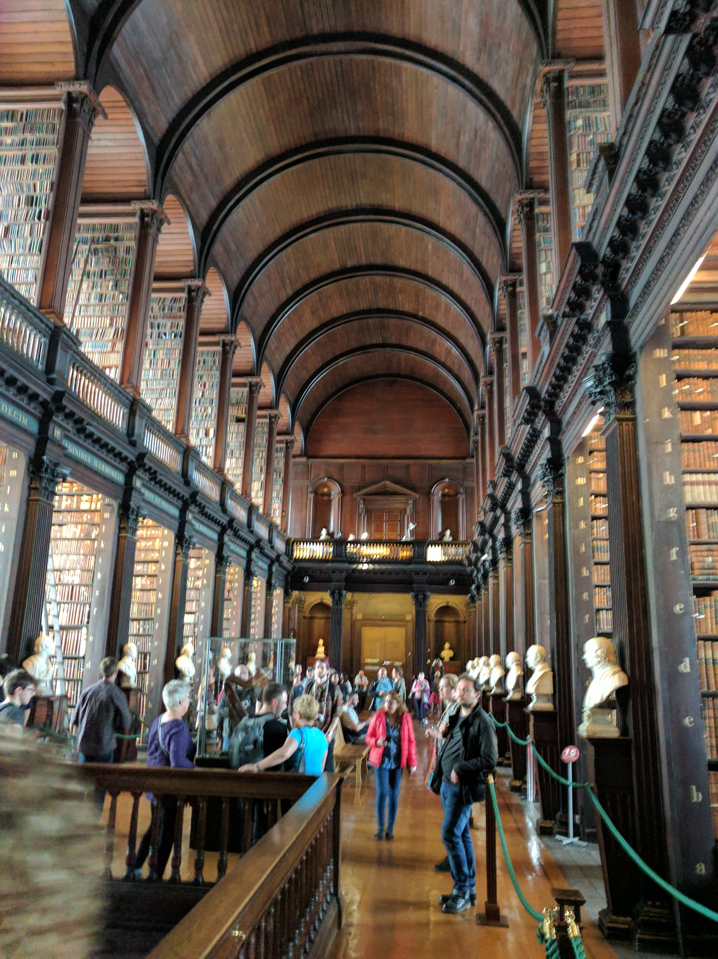
So much of the value and identity of the library
is still bound up with the place and the physical
collection.
Finally changing?
Online
A holistic library identity?
The moment when the library is seen as a service and
expertise rather than as a collection and a building?
The Long Room, Trinity College Dublin, pic by the author

Slide 11
Digital, network, computational, AI
Library collection **one** part of resource rich environment
Researchers and learners used to build workflow around library. Now library has to be in student and researcher (work)flow.
Workflows ‘informationalised’ – consume and create digital materials
OER Research data
Preprints References
Lab books
E-Portfolios
Support needed throughout the **life cycle**

Slide 12
Digital, network, computational, AI
Library collection **one** part of resource rich environment
Researchers and learners used to build workflow around library. Now library has to be in student and researcher (work)flow.
Workflows ‘informationalised’ – consume and create digital materials
OER Research data
Preprints References
Lab books
E-Portfolios
Support needed throughout the **life cycle**
The library is no longer an informational pitstop, rather it provides a range of services throughout the lifecycles of research & learning.
Build new social capital

Slide 13
Full(er) library experience online?
Deliver efficiently into the learning process (LMS) – tailored.
Increased computational element. Support throughout research life cycle.
How to recreate the relational element? Vital for developing good working relationships? Workflow, data, etc, services.

Slide 14
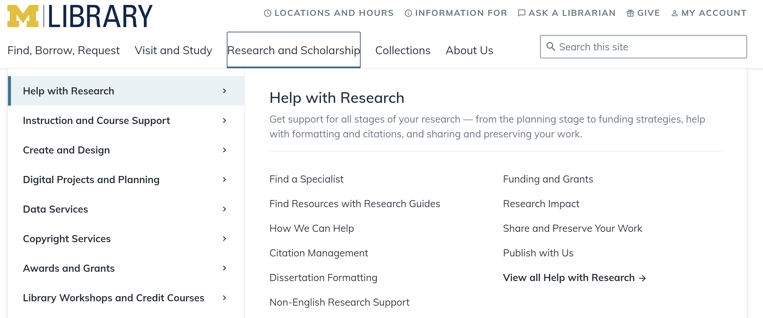
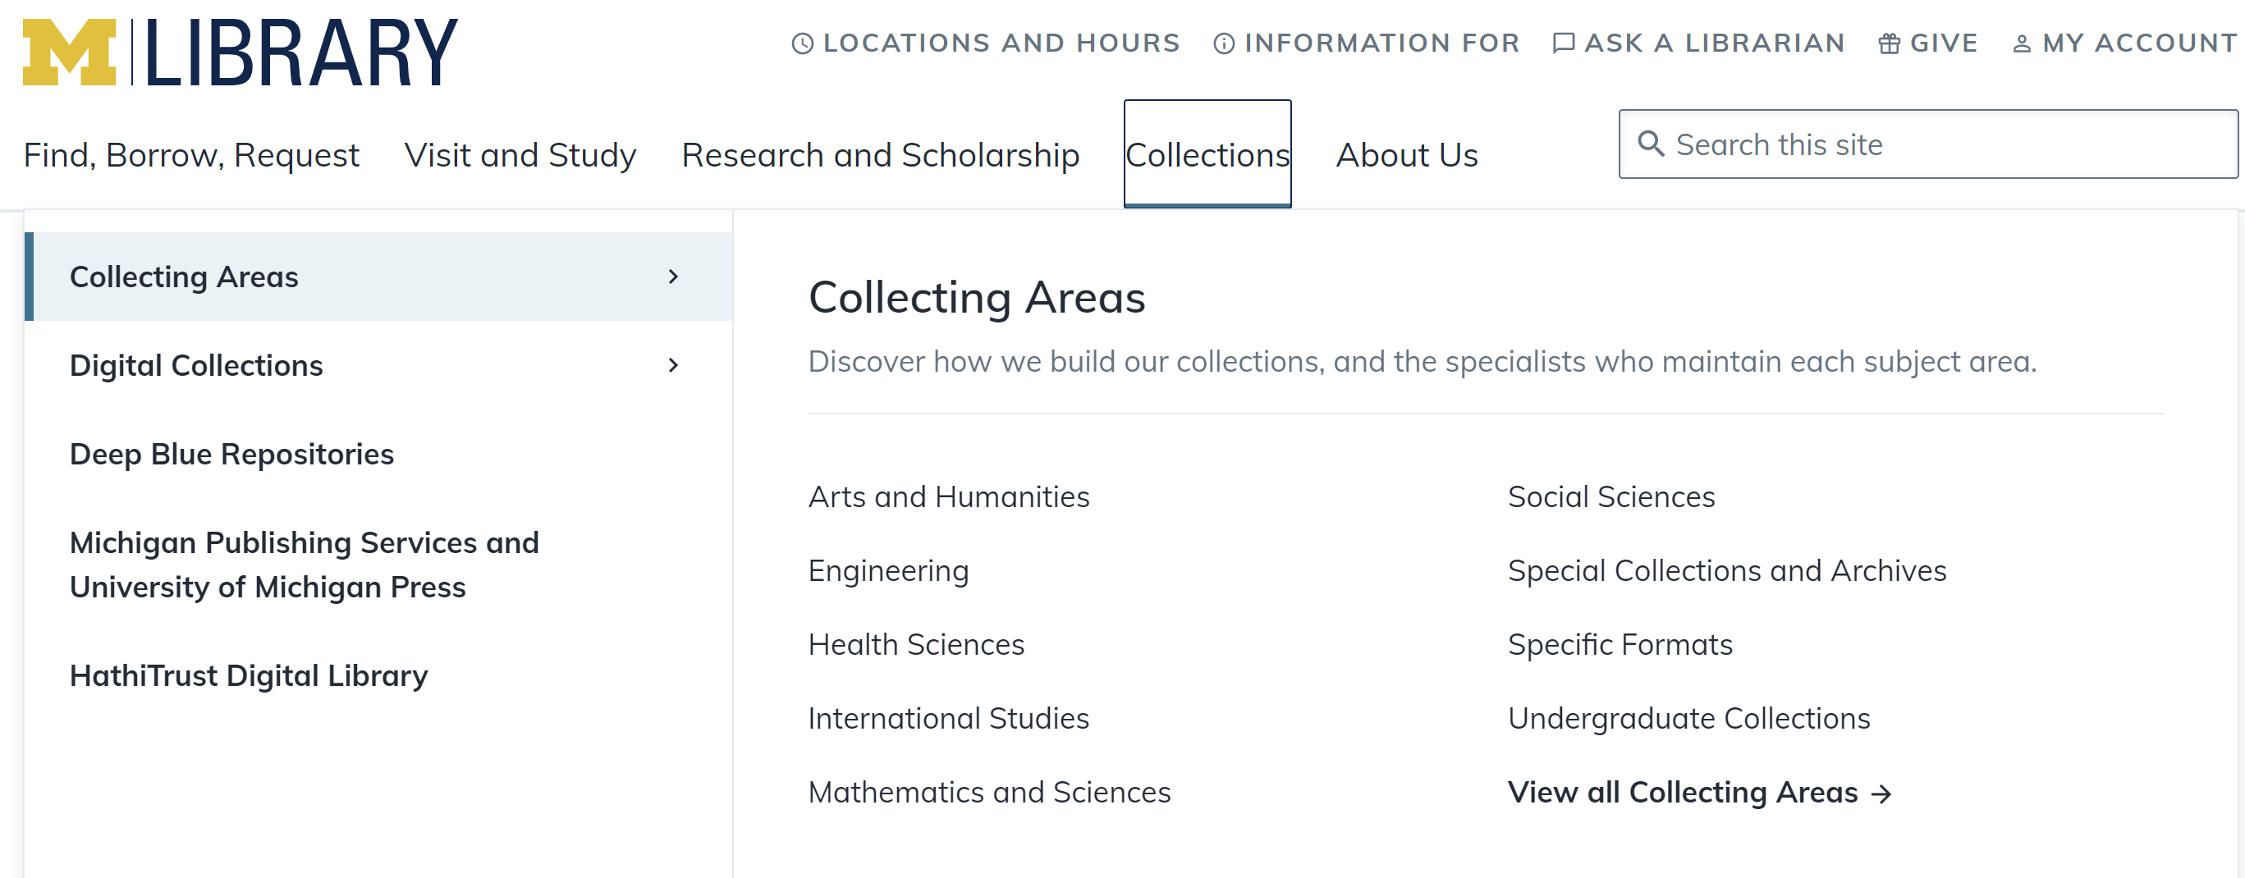

Slide 15
Aligned
Focused on community needs / institutional strategy

Slide 16
Supporting research, learning and engagement
Engagement
Research
Education
Supporting social and civic
engagement
Advancing research productivity
and dissemination
Student success and retention
Exhibitions and events
Promotion of expertise and scholarship
Research data management
Digital scholarship
Text and data analysis services
Reputation
Presence in LMS
Research and computational skills
Instructional design services
Collaboration spaces
Undergraduate research
Collections as a service.

Slide 17
Collection directions

Slide 18
Directions
General emphases
Collective
Specialized
Facilitated
Pluralized
Optimized
Inside-out
Mobilized

Slide 19
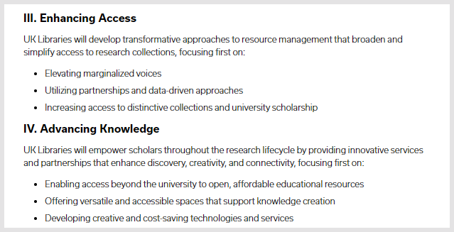

Slide 20
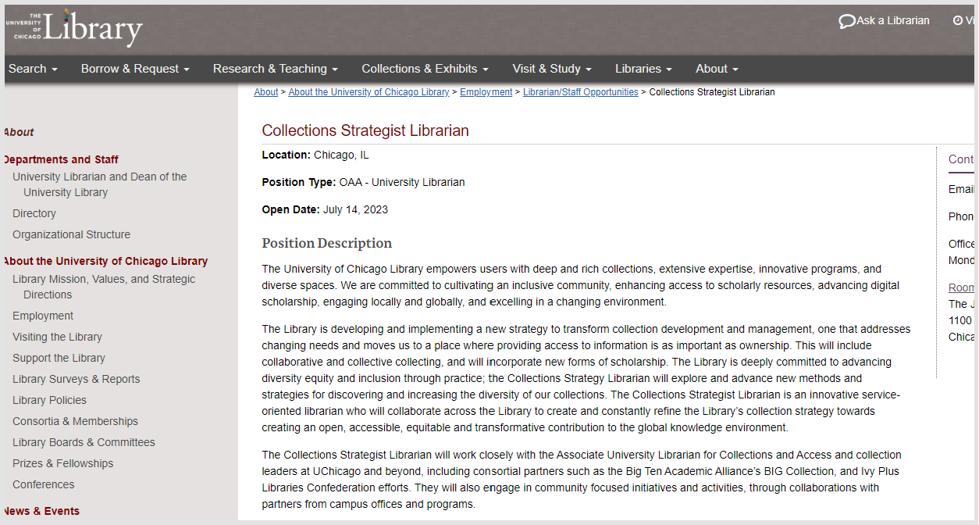
Chicago – history of strong local collections

Slide 21
Collective collection (disproportionate amount of time goes on print?)

Slide 22
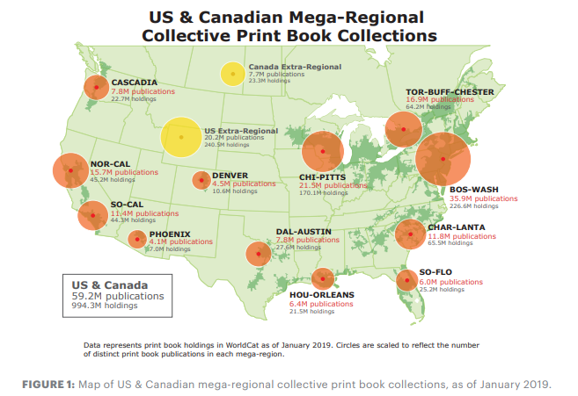
A reservoir not an ocean

Slide 23
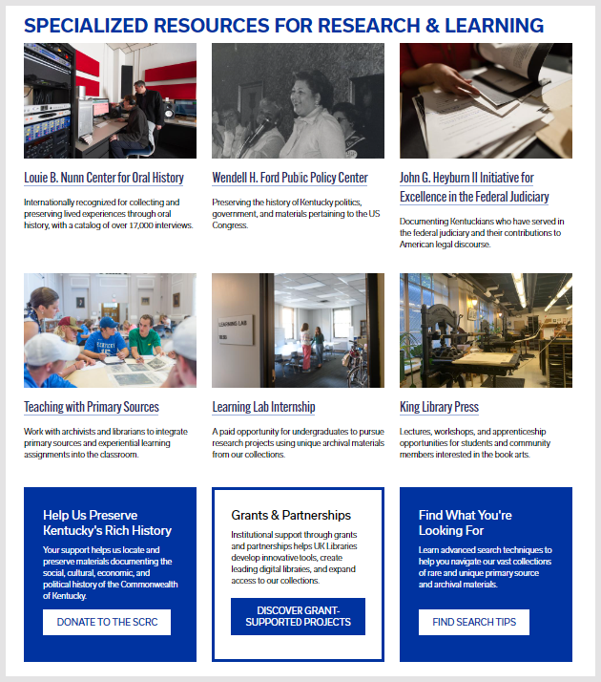
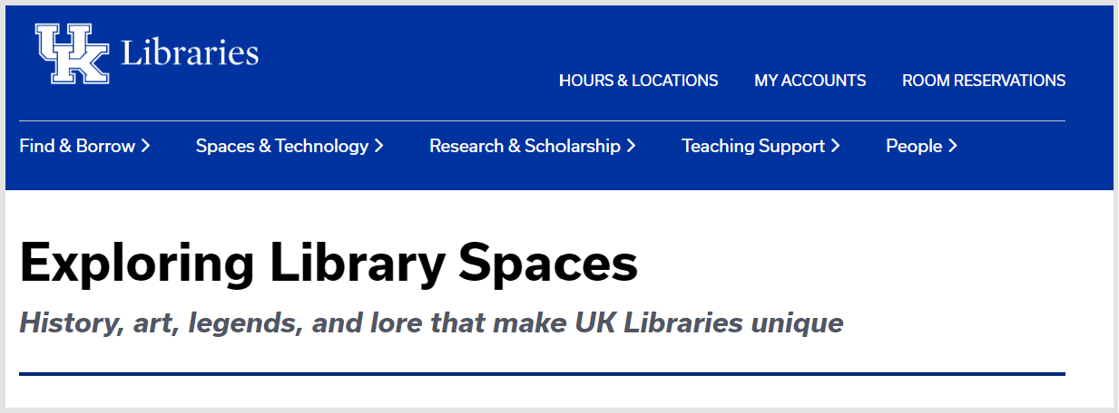
“a former limestone quarry
and mushroom farm”

Slide 24
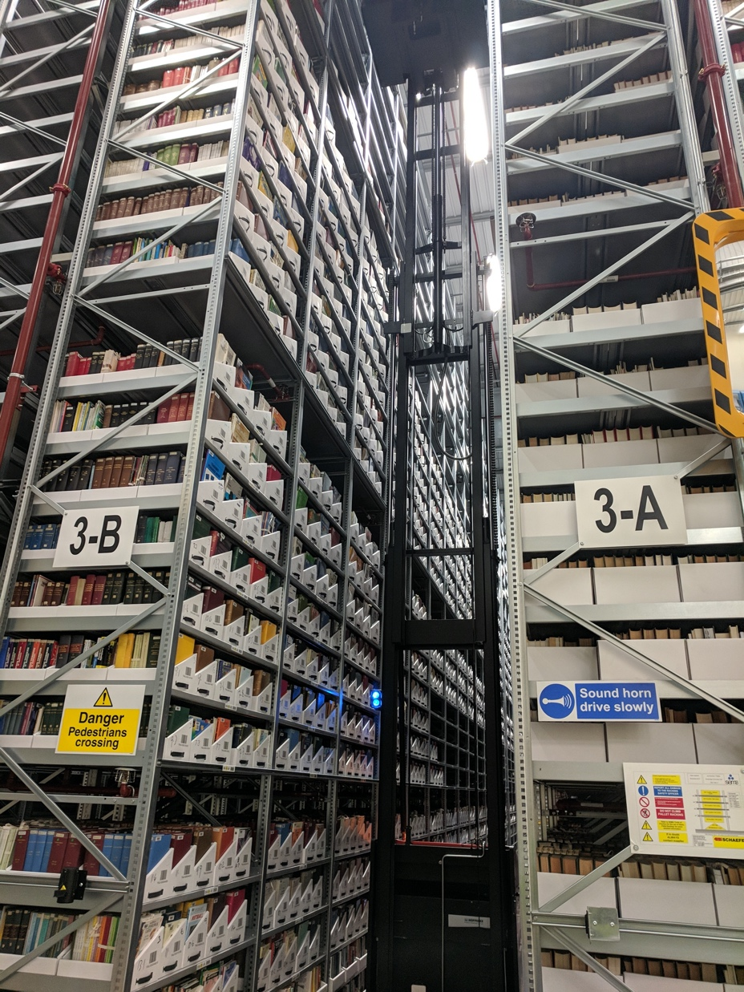
The rise of the
collective collection
Increasingly organize collections at the network or systemwide level.
Recalibration of local provision
Space
Opportunity cost
Broader access
Distribute efficiently
Collectively preserve

Slide 25
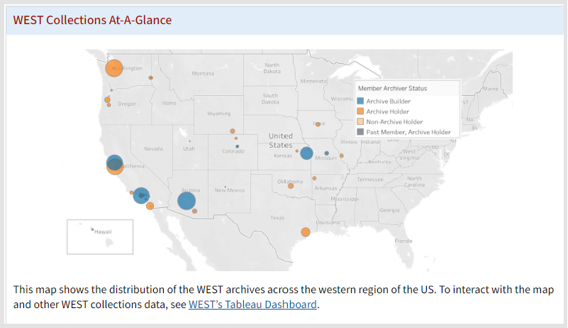
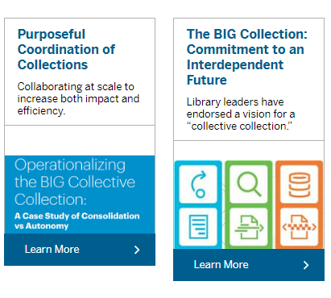
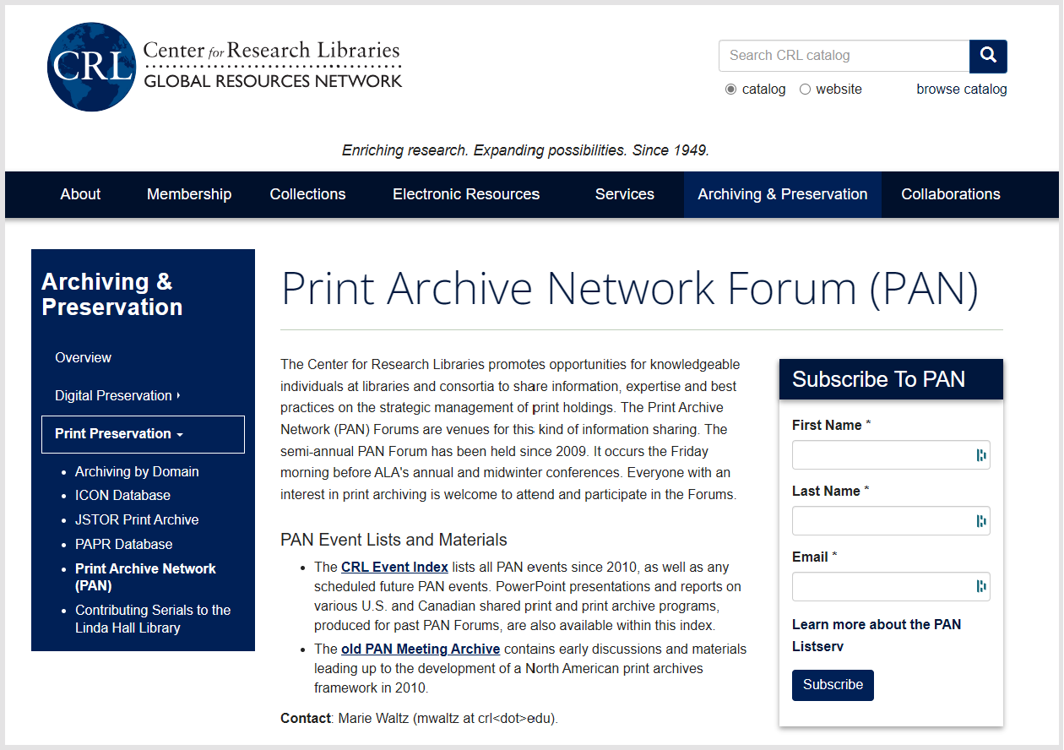
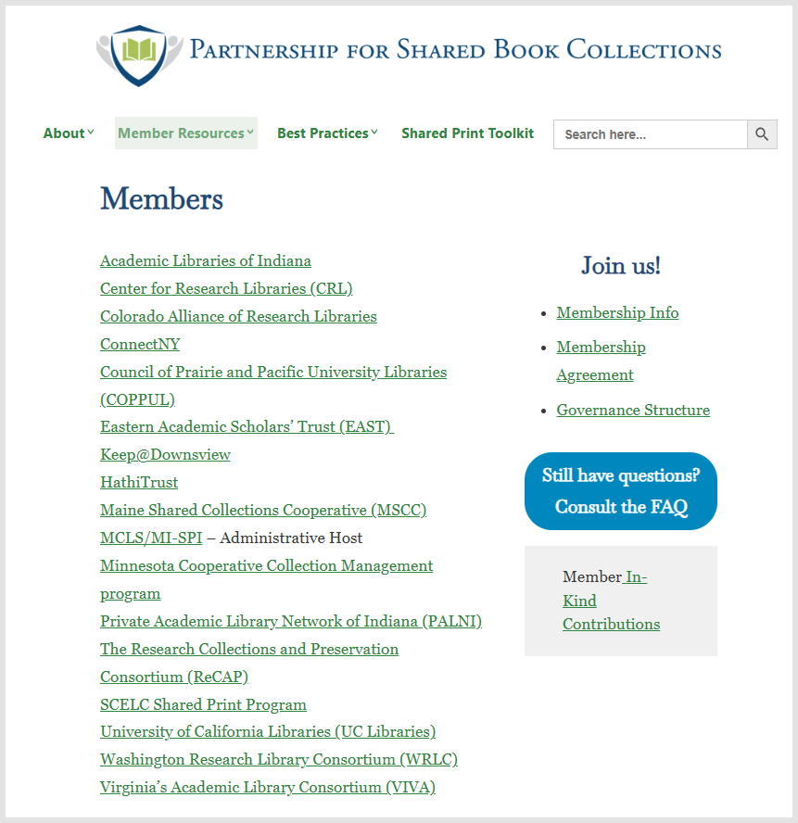

Slide 26
Directions
Operationalize the monograph collective collection?
Some policy questions
Patchwork of cooperative initiatives
Less momentum post-pandemic?
Collective action problem: difficult
Shared print – optimal distribution?
Coordinate digitization plans?
Prospective collection coordination?
Group licenses to permit sharing of ebooks?
Stronger interest in EBA/DDA
What responsibility do libraries collectively take for print scholarly record?
For the (published) digital scholarly record?
Reevaluating rights (controlled digital lending, course materials)
At what level?

Slide 27
The facilitated collection

Slide 28
The ‘external’ collection:
Pointing researchers at Google Scholar;
Including freely available ebooks in the catalog;
Providing access to Open Access and Open Educational resources
Creating resource guides for web resources.
The ‘borrowed’ collection
The shared print collection
The shared digital collection
Shared scholarly outputs
Collective collections
A collections spectrum
The ‘owned’ collection
The ‘licensed’ collection
The ‘demand/data-driven’ collection
The ‘facilitated’ collection

Slide 29
Facilitated: engagement with student and faculty needs
Relational
Network logic: a coordinated mix of local, collaborative and network resources are assembled around user needs.
Move online accelerates need to provide targeted, relevant resources for learners
The ‘external’ collection:
Pointing researchers at Google Scholar;
Including freely available ebooks in the catalog;
Providing access to Open Access and Open Educational resources
Creating resource guides for web resources.
The ‘borrowed’ collection
The shared print collection
The shared digital collection
Shared scholarly outputs
Collective collections
A collections spectrum
The ‘owned’ collection
The ‘licensed’ collection
The ‘demand/data-driven’ collection
The ‘facilitated’ collection

Slide 30
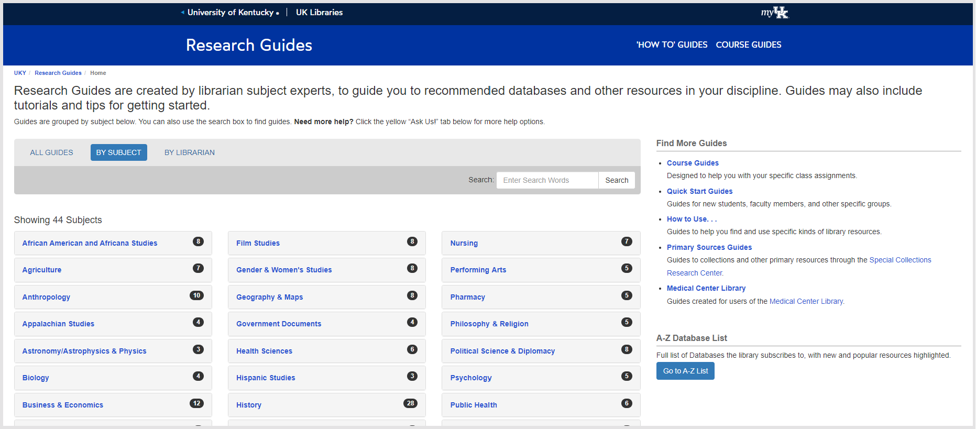

Slide 31
Inside out collections

Slide 32
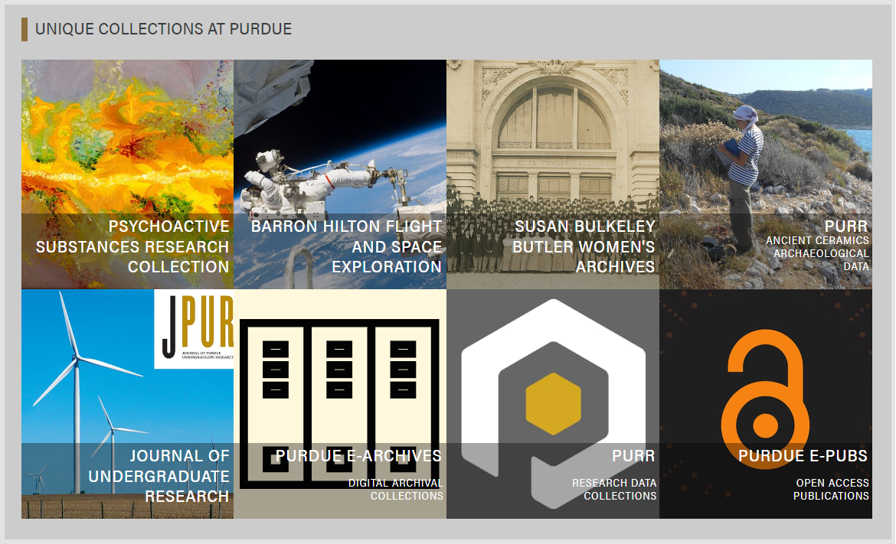
Unique scholarly resources
Archives
Research outputs
Institutional publishing

Slide 33
Creation, management and disclosure:
Vice president for research
R- infra-structure
Medical center
Tech Transfer Office
CIO
News Bureau
Institutional Reporting
Research Data Management
Advancement & corporate relations
Provost
Data Warehouse
RIM/Profiling system
Digital scholarship
LIBRARY
Colleges & depts
Institutional Repository
User education & training
Disciplines & departments
Graduate school
Office of undergraduate research
Researcher
Research manager
Research support
Campus center for teaching & learning

Slide 34
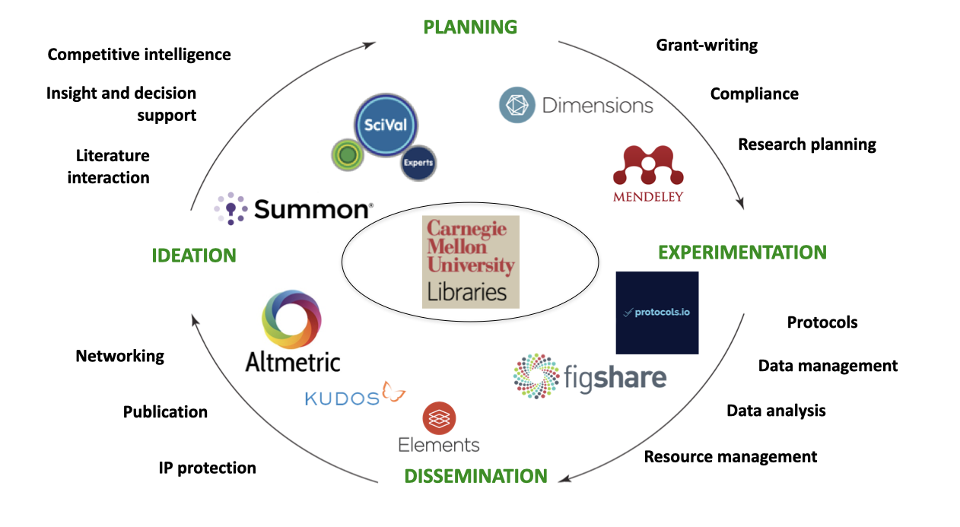

Slide 35
Then:
Institutional repository
Collections view.
Isolated.
Behaviors?
Incentives?
Today:
Set of services around reputation, promotion, scholarly networks.
RDM, RIM, IR, ID, …..
Bibliometrics
Relational view
Close collaboration with campus partners

Slide 36
General emphases
Specialized
Pluralized
Optimized
Mobilized

Slide 37
Specialized

Slide 40
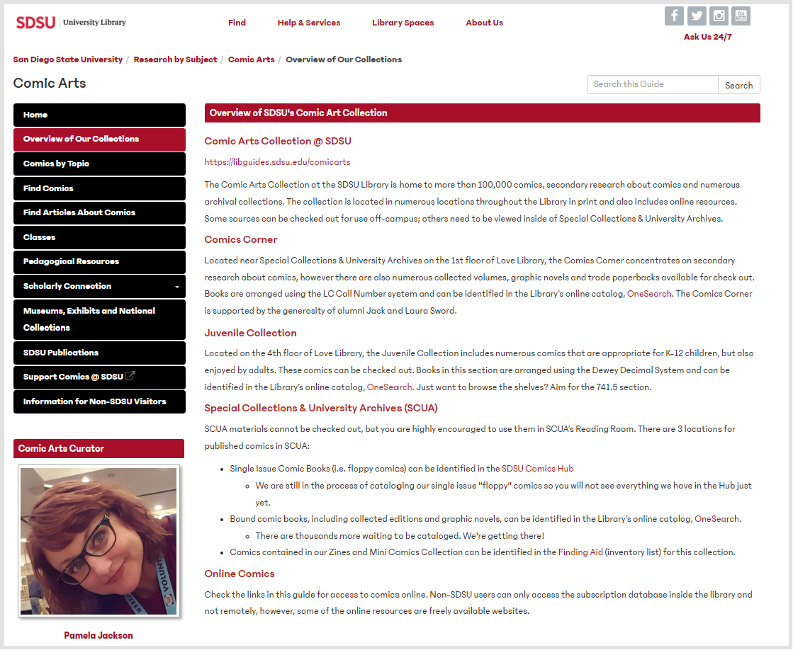

Slide 41
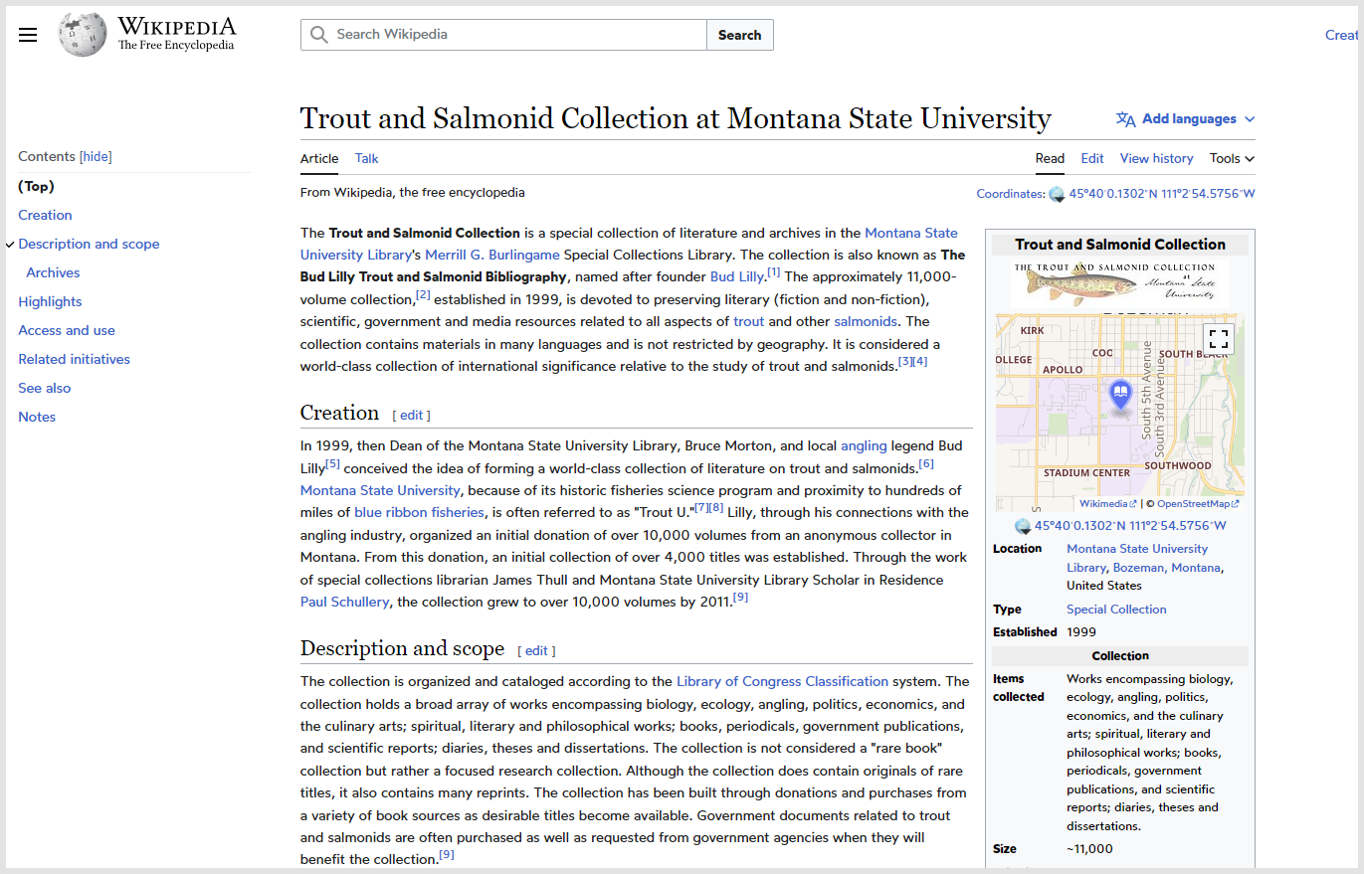
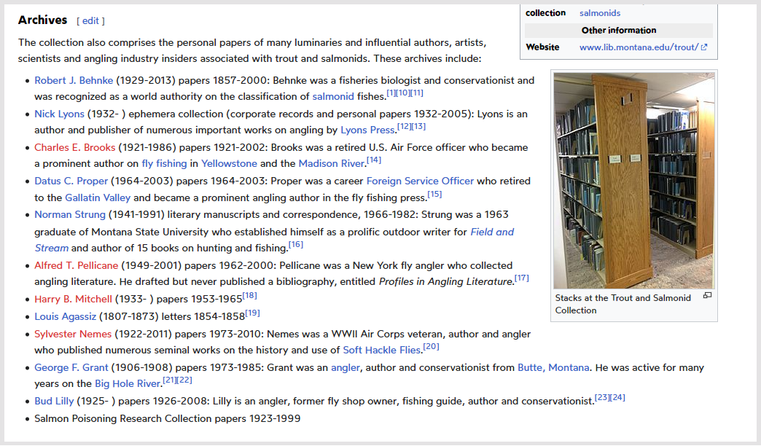
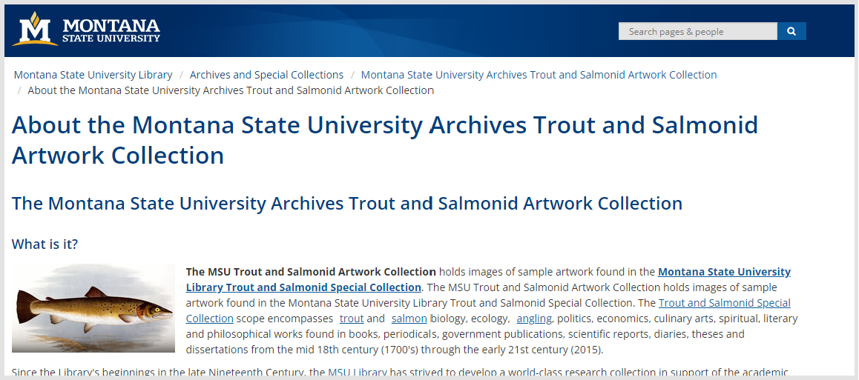

Slide 42
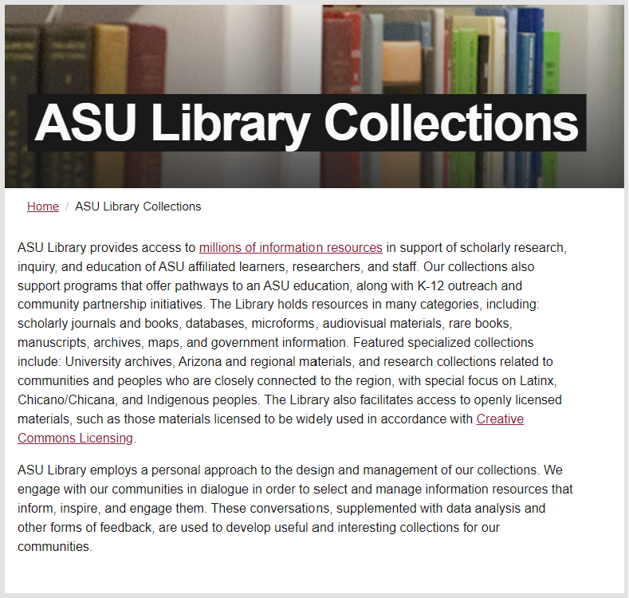
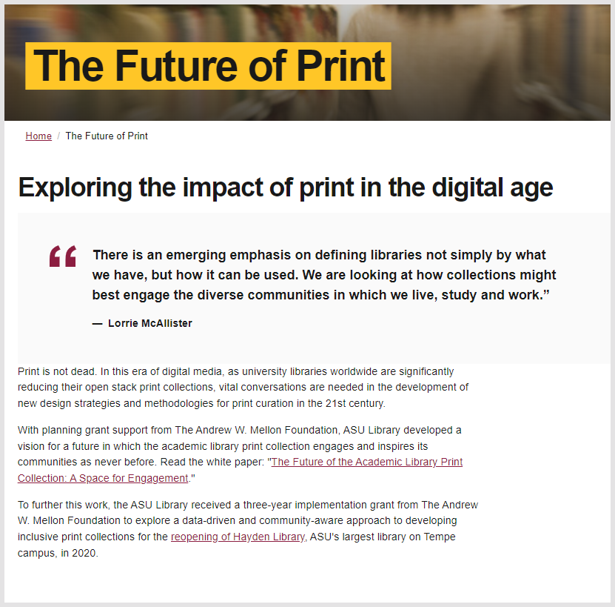

Slide 43
Pluralized

Slide 44
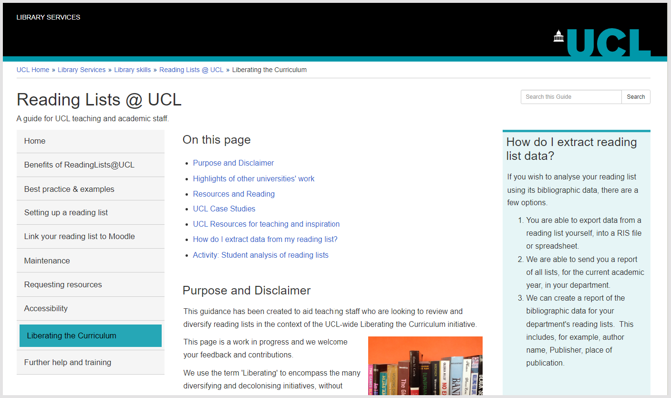
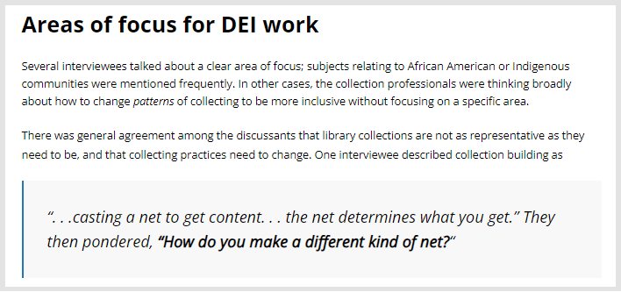
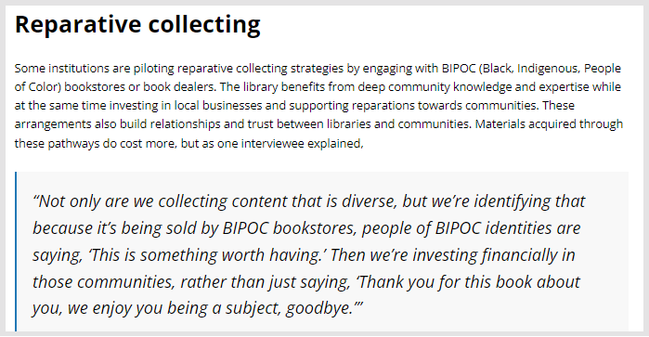
Recognition and restoration of plural
experiences, memories, and voices.

Slide 45
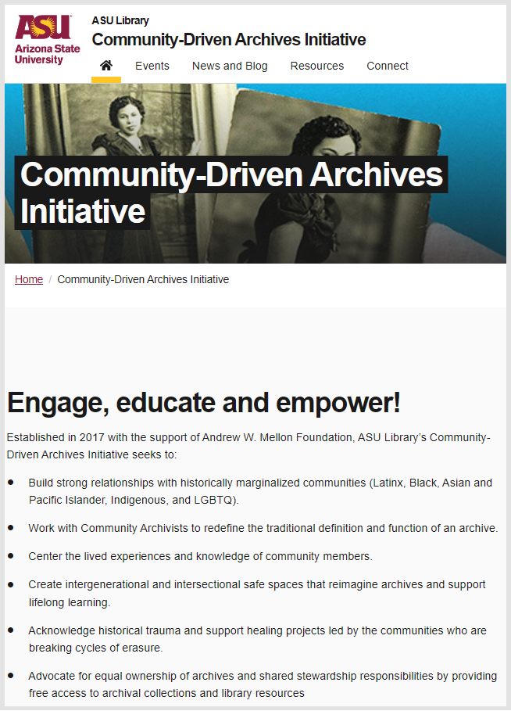
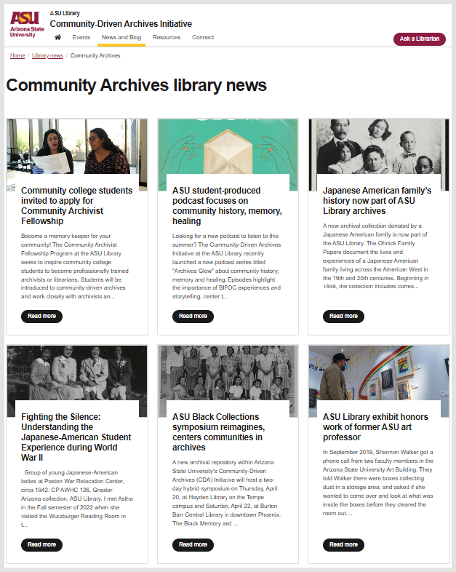

Slide 48
Optimized

Slide 49
More closely matched to feedback, data, courses, …..
Data-driven
Tradeoffs? Optimize for diversity? Open? Price?

Slide 50
Mobilized activate collections in research and learning workflows

Slide 51
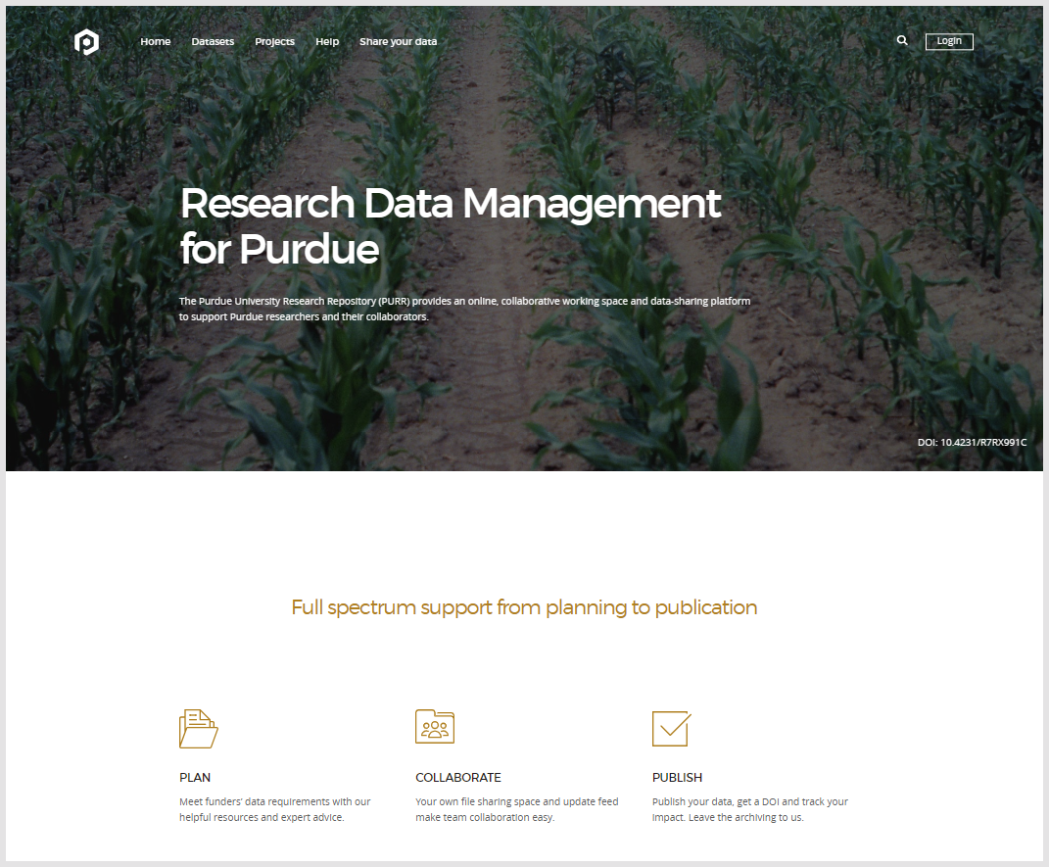
Actively promoted
and connected to
fabric of knowledge

Slide 52
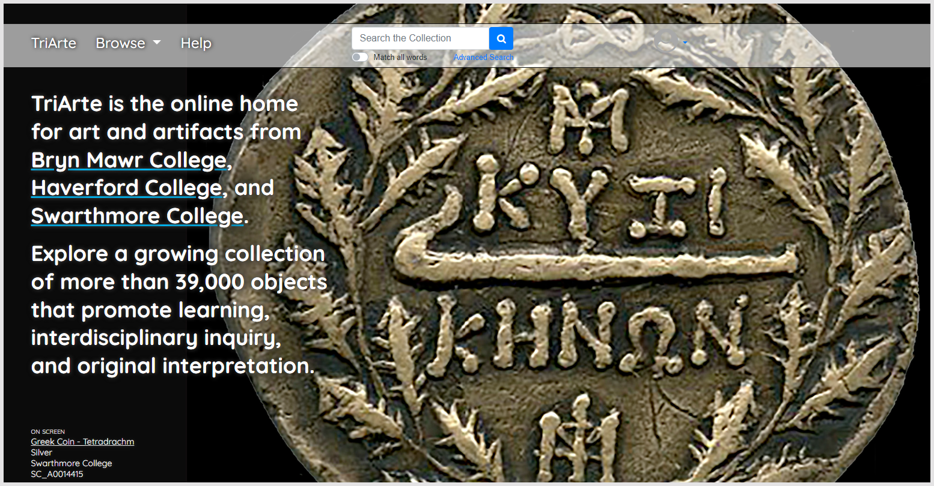
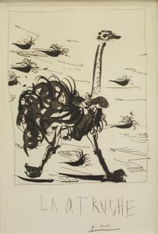

Slide 53
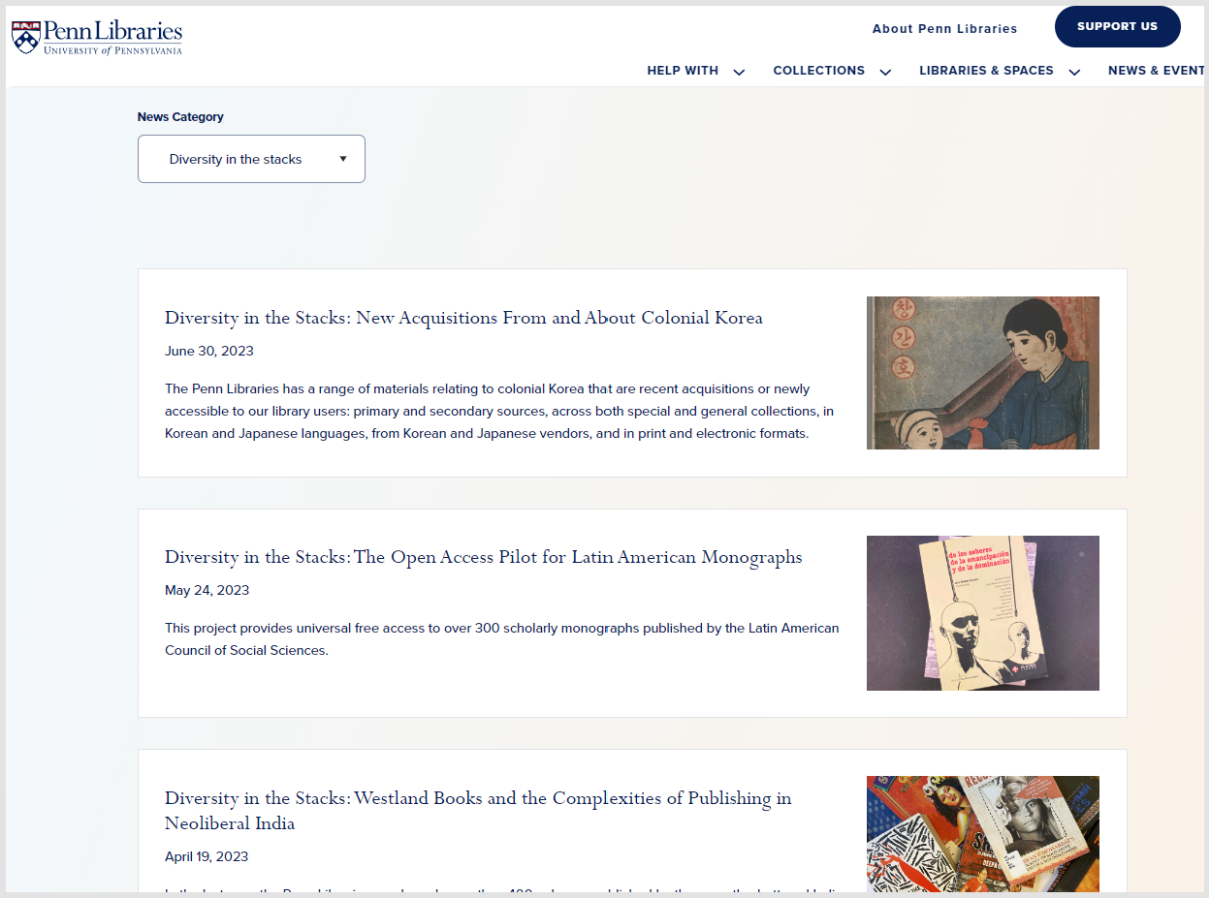

Slide 54
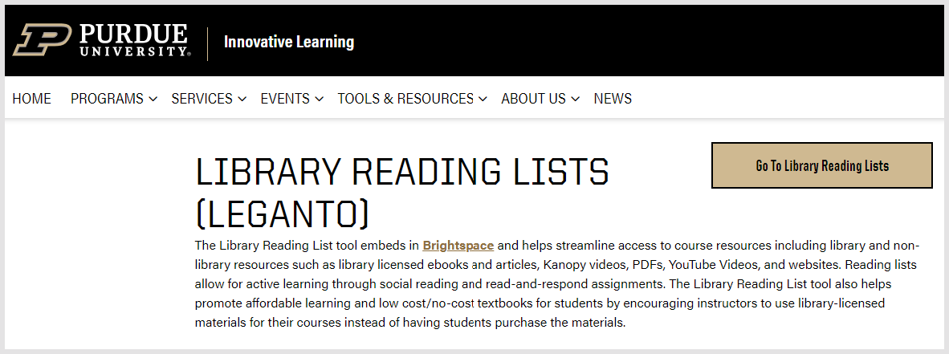
Note: resource/reading list software heavily used in UK and other countries.
Not so much in US.

Slide 55
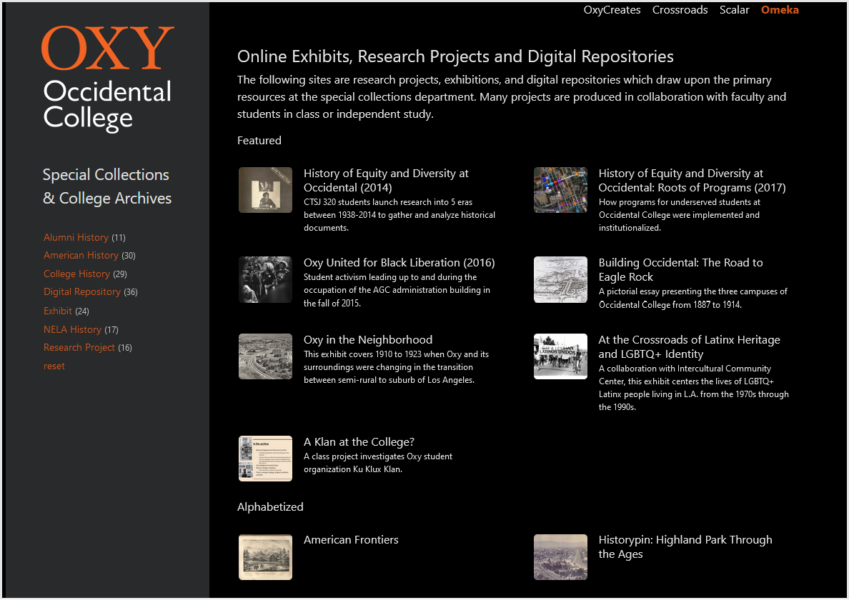
Unique materials with special stories, meanings
Contextualised*
Narrative building *
Story telling * Sensemaking *

Slide 56
A note on open

Slide 57
Pivotal moment in ScholCom .. licensing
Management
3rd front of
open access
Multiple paths to unclear future
Academy outsourced reputation management to increasingly consolidated commercial pub. sector
Publishers diversifying – analytics/workflow.
Multiple competing viewpoints – e.g. rational top down design of system vs market forces vs prestige economy
Institutional, national, international funding/policy agents at play
Pandemic push for open science
Shift to buying publishing services (APCs, …)
Changed patterns of discovery
Compliance management
Future of green?
Scholarly communication service providers (Elsevier, Digital Science/Springer, Clarivate)
Conversational interface to large scholarly corpora?
??

Slide 58
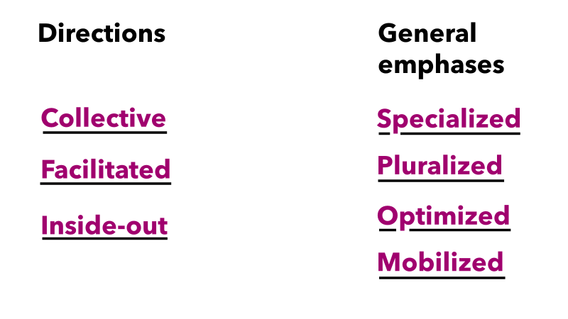
Activate collections in workflows – alert to relational value
Evolving collaborative frameworks for managing and preserving collections
Thank you
Lorcan Dempsey
@LorcanD

