Slide 1
Orbis Cascade Alliance strategic retreat, Ashland, Oregon 13 July 2023 Consortial observations
Lorcan Dempsey
@LorcanD

Slide 2
Claude 2
One of the themes identified …

Slide 3
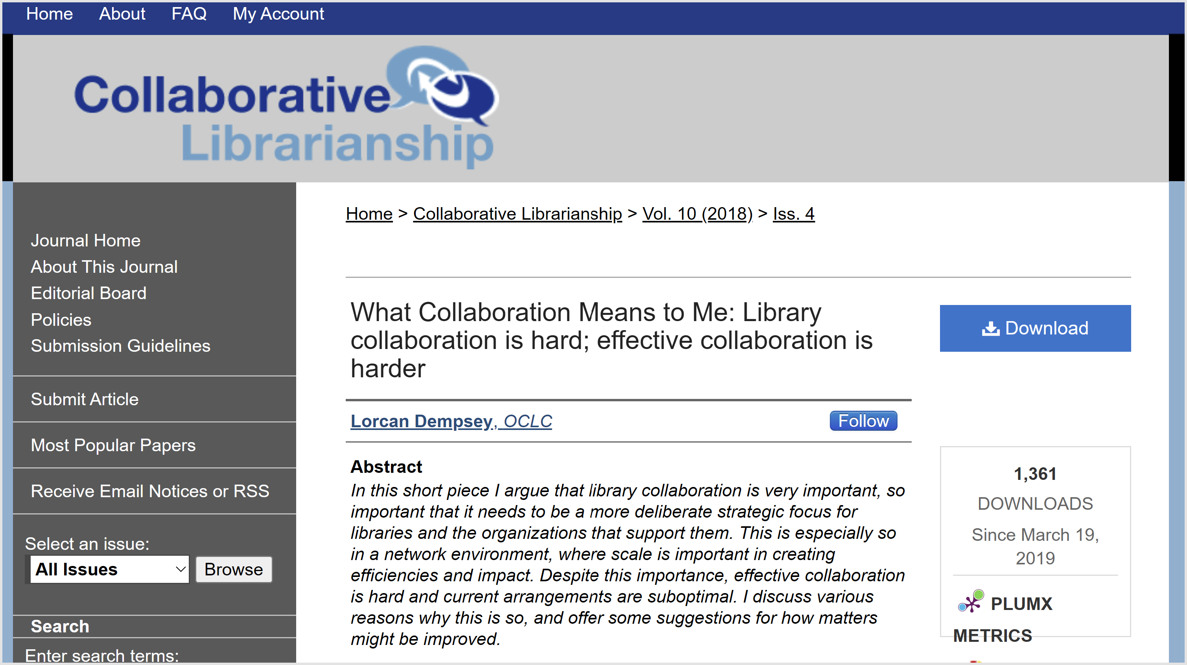
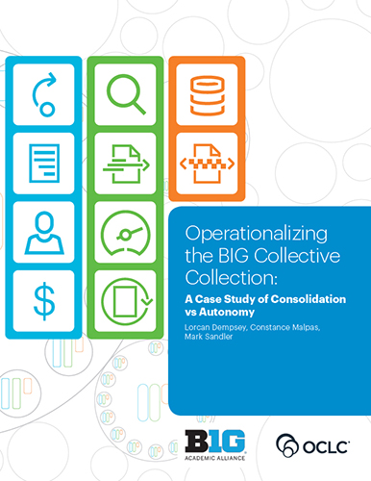
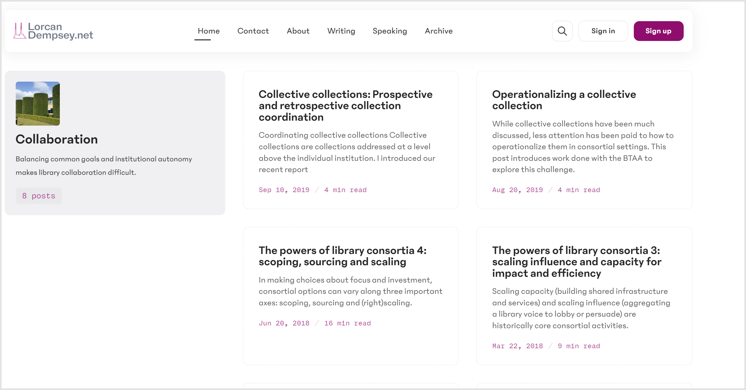

Slide 4
* the relational library * the dynamics of consortia * one collection * scaling capacities * obligatory mention of AI

Slide 5
The relational library

Slide 6
Collections-based library
Services, organization and spaces are configured by management of the collection.
Value and role of library well understood
Optimise fixed capacities
Library develops service according to the
library pattern
Relational library
Services, organization and spaces are configured by changing patterns of research and learning.
Value and role of library continuously and collaboratively re-evaluated
Mobilize capacities around evolving goals
Service collaboratively developed with
campus partners, faculty, students

Slide 7
Collections-based library
Relational library
Space – configured around collections
Collections – (passive) core of service and identity
Expertise – stable (cataloging, reference, access, IT, instruction)
Org chart – well understood; most libraries same or similar
Systems – manage the collection. ILS
Website – collections search box and signposts
Liaison work - emerging
Space – configured around experiences
Collections – Mobilized in workflows, Facilitated, Inside out, collective, distinctive
Expertise – dynamic (mix of domain and relational – core expertise, social skills, research&pedagogy)
Org chart – evolving. Varies across libraries ..
Systems – manage the whole library and its relationships. Repositories, libguides, research&learning workflow, …..
Website – storytelling, narrative and documentary
Liaison – central relational capacity

Slide 8
Consortia
Shared systemwide investment for …
Local efficiencies
Local relational impact

Slide 9
The dynamics of consortia 1, 2, 3

Slide 10
1
Scaling capacity
Scaling learning
Scaling innovation
Scaling influence
the powers of consortia

Slide 11
Scaling learning
Scaling capacity
Scaling innovation
Scaling influence
soft powers: sticky and persistent
pool uncertainty
evidence and arguments
trust facilitates combined action

Slide 12
2
scope

Slide 13
Rightscaling
Some things better done at a higher level?
Digital aggregation for research?
Broad based appeal vs a la carte
Coordination costs?
Some things need to interoperate locally … can this be combined with shared approach?
R-infrastructure: IR/RIM/RDM

Slide 14
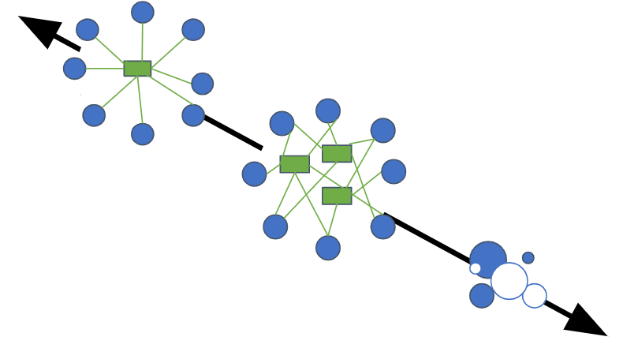
3
Consolidation
Integrated user experience
Ease of management
Reduced coordination costs
** Consortial agency
Local optimization
Close to the user
Control of (local) costs
Pragmatic
** Institutional agency
Cooperation
(autonomy)
Coordination spectrum: tradeoff between *autonomy* and *consolidation*

Slide 15
One collection

Slide 16
Optimize digital resource sharing through strategic use of tools and content
· Considers full range of digital resource sharing options, including, but not limited to: e-book licensing to allow interlibrary loan; controlled digital lending from physical collections; implementation of shared digital resource sharing systems or platforms.
Realize the vision of being one collection in ways that improve service for users and create capacity for members
· Considers potential expansion in collaborative collection activities, shared investment, or cross-institutional use of either physical or digital collections; including, but not limited to shared print initiatives, shared digital collection licensing, and shared collection management and assessment activities.

Slide 17
2. One collection
1. Resource sharing
Difference of degree
Strategic decision
“Interoperability a vote for the status quo” (BTAA library director)

Slide 18
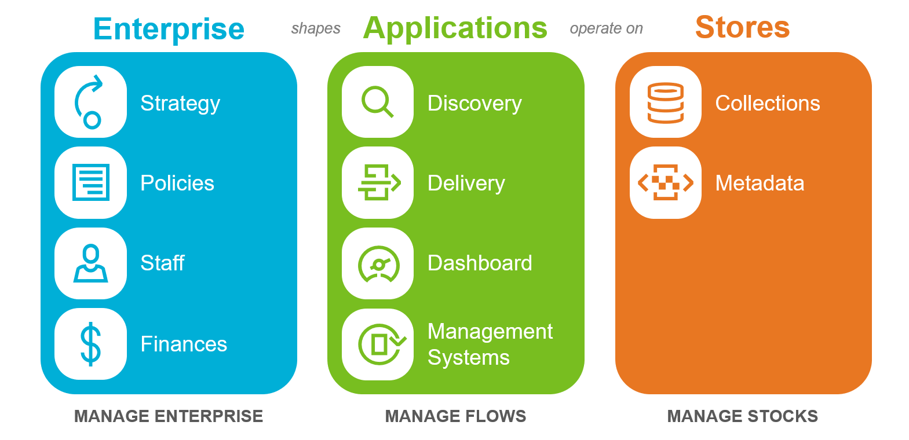
Interoperability
Collective action problem
* Optimize locally
Deal with provost, faculty, …
ALMA a tipping point?
Collections infrastructure mature
What creates other tipping points?
Complex as add resource types
Dashboard … fragmented
Where to manage?
Consolidation of metadata
One collection?

Slide 19
Resource sharing, shared print,
digitization, etc is a form of …
Retrospective collection
coordination
Insert
discussion
about
collaborative
collection
development
Here
(collective action problem)
Prospective collection coordination?
One collection, optimally distributed
Share collecting responsibilities

Slide 20
Conscious coordination
Optimally distributed collections
Explicit commitments
Collective collections
Efficient network fulfilment
Systemwide awareness

Slide 21
One collection – a heavy lift
Build
Commit to …
Optimally distributed collections
Explicit commitments
More strongly coordinate collections for optimal distribution/creation (prospective collection coordination, shared print, digitization)
… real change and resource reallocation. One collection requires one script.
Collective collections
Share
Manage
Efficient network fulfilment
Systemwide awareness
Create stronger systemwide awareness through consolidated metadata management and Dashboard
Improve resource sharing (across networks) and integrate it into the collection dev process

Slide 22
Scaling (collection) capacities (disproportionate amount of time goes on print?)

Slide 23
SpecColls
Research outputs
Learning materials
Stocks
Digitised spec colls
Exhibitions
Images
Finding aids
Preprints
Research data
Expertise prof.
Sw, models, etc
Open journals
Libguides
Course reserves
Resource lists
E-portfolios
OERs
Flows
Repository
Exhibition sw
Circulation (Aeon)
Archives management
Institutional repository
Research data mngmnt
Research info. mngmnt
GIS, etc
Publishing platforms
Libguides
Course reserves
Resource lists
E-portfolios

Slide 24
SpecColls
Research outputs
Learning materials
Does data aggregateion for research make sense?
Good for learning, but at what level?
Fragmented applications environment
Does consortial data aggregation at this level make sense?
Certainly needs to be various network level services (disciplinary, researchgate, etc)
Integration with local campus environments important
Shared creation of libguides? This level?
Interest in OERs
Stocks
Digitised spec colls
Exhibitions
Images
Finding aids
Preprints
Research data
Expertise prof.
Sw, models, etc
Open journals
Libguides
Course reserves
Resource lists
E-portfolios
OERs
Flows
Repository
Exhibition sw
Circulation (Aeon)
Archives management
Institutional repository
Research data mngmnt
Research info. mngmnt
GIS, etc
Publishing platforms
Libguides
Course reserves
Resource lists
E-portfolios

Slide 25
Common exhibition sw/ infrastructure?
Archives infrastructure underdeveloped?
Journal publishing infrastructure?
Support for OERs
Leganto?
Strategic filter:
Shared infrastructure for local relational impact?

Slide 26
Scaling capacities

Slide 27
Dashboard
Expertise
exchange
Innovation & incubation
Analytics –
aggregated and
operationalised
Structure for sharing/
consolidating
scarce expertise
E.g. Slavic cataloging
Scarce technology skills
Project management
UI/UX
Training/awareness
Structured testing, diffusion, scaling:
share learning curve
Map consortial stocks and flows
Track licensing
New modules
Leganto?
AI
Apps, workflows

Slide 28
Consortial experiment

Slide 29
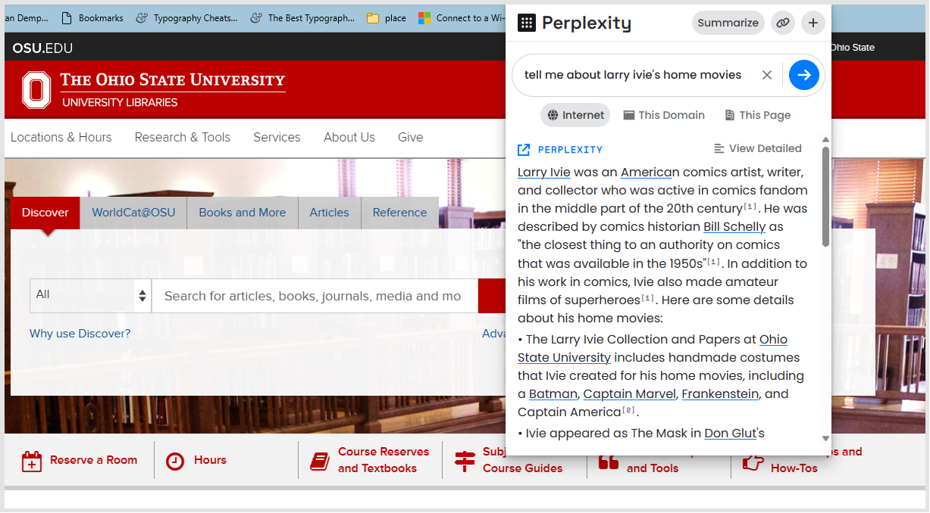
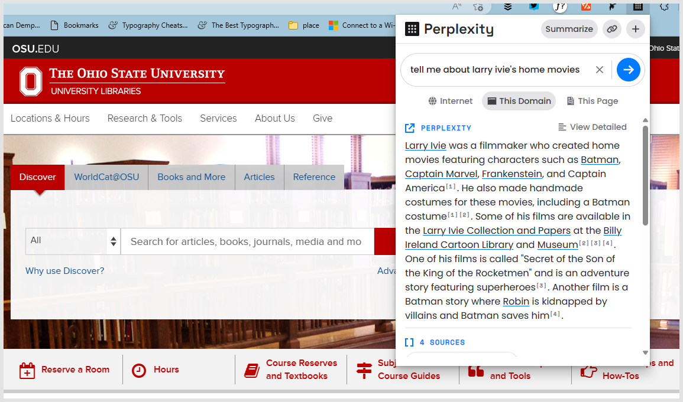

Slide 30
Experiment with context-rich library generated content
Conversational interface (ChUI)
Reasoning capacity of LLM, indexing (embeddings) and search
Experiment with context-rich aggregate corpus
How well does it answer questions?
2 candidates?
Contextualised learning resources with resource guides, reading lists?
Contextualised special collections with exhibitions, finding aids. Finding aids!!

Slide 31
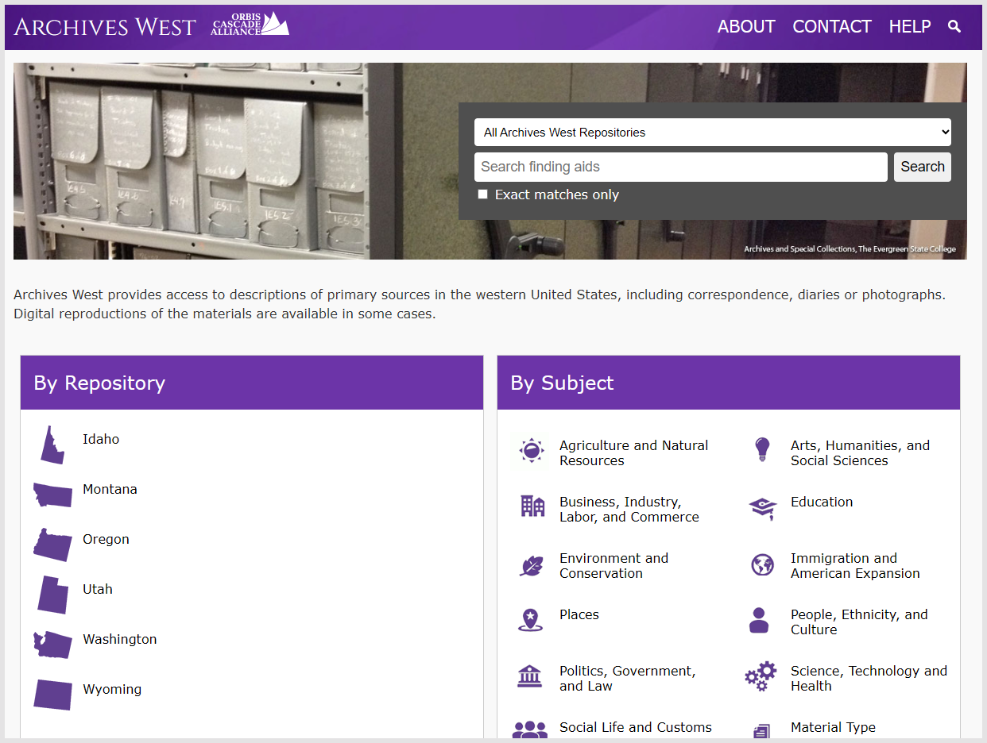
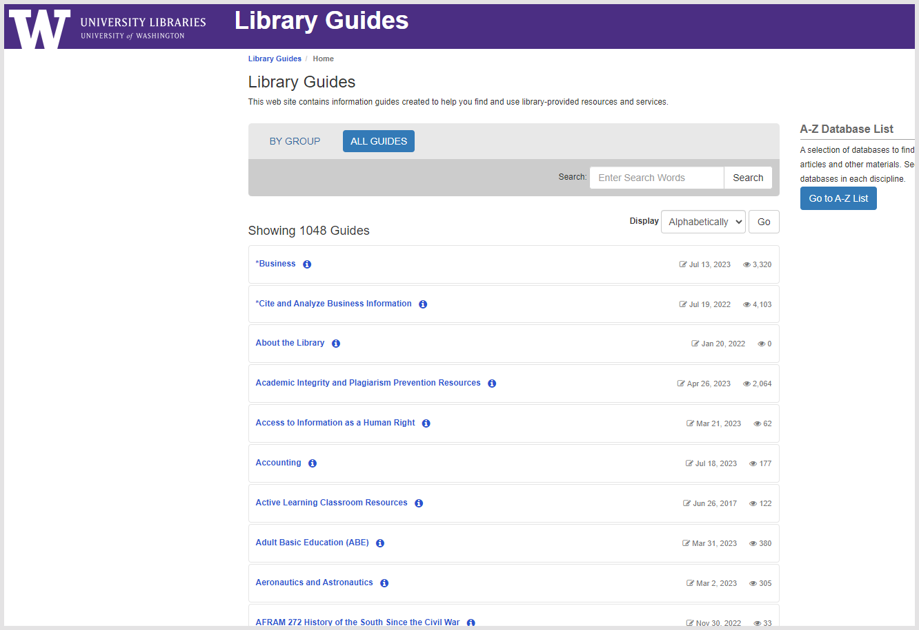
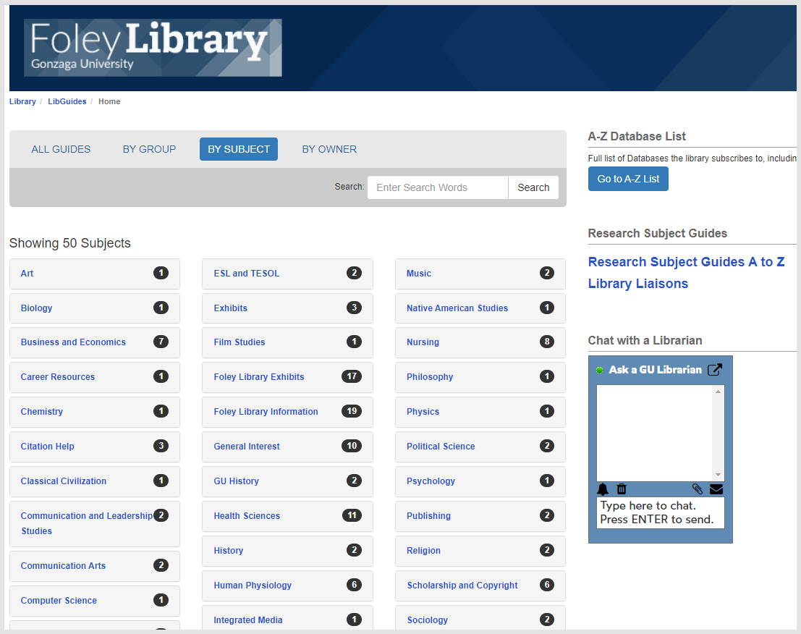
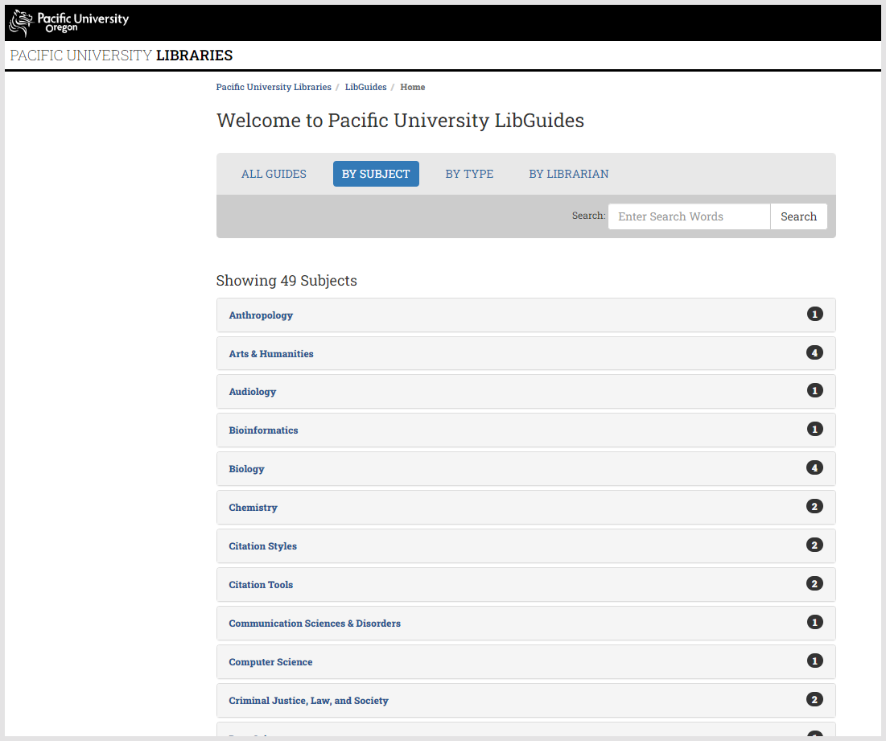
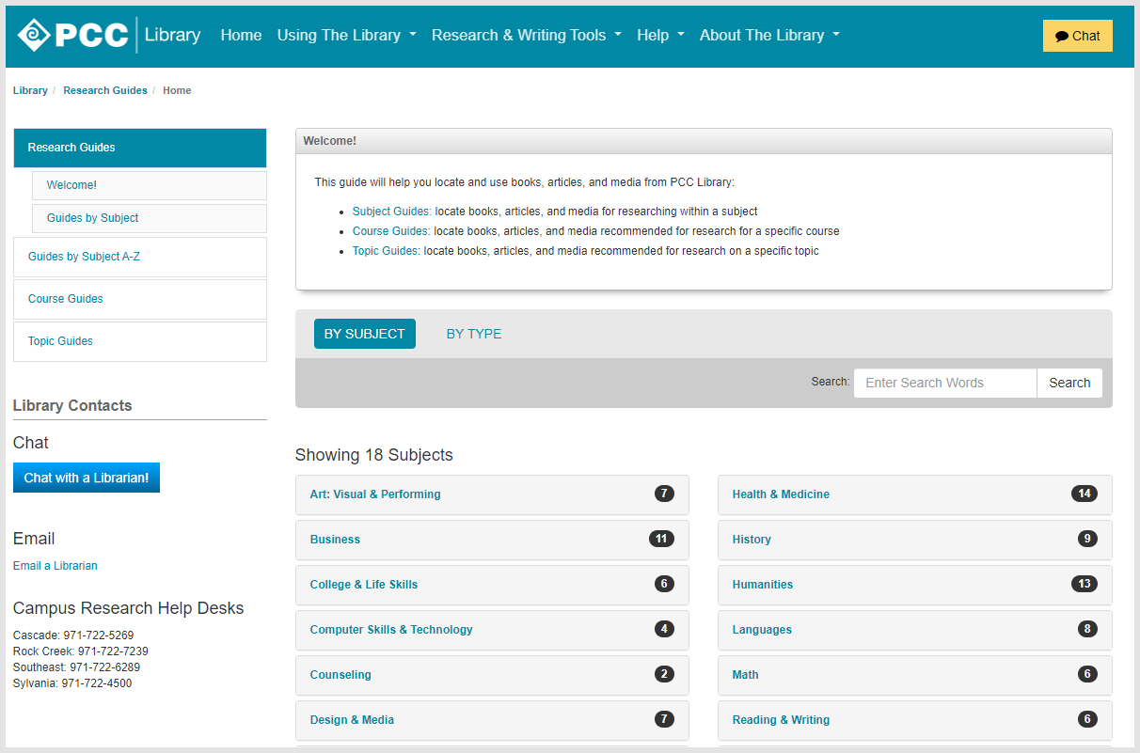
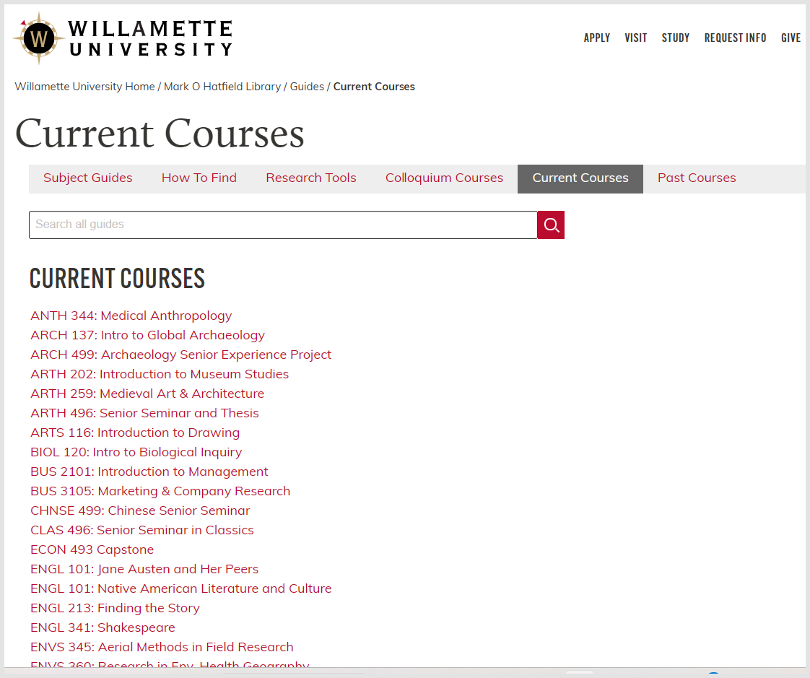
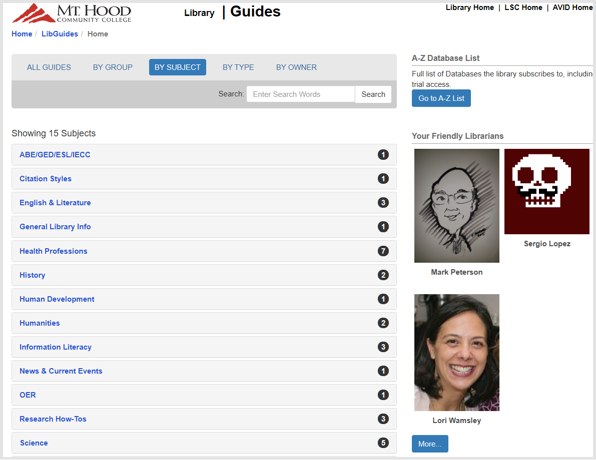

Slide 32
Prospective collection coordination?
Common exhibition sw/ infrastructure?
Archives infrastructure underdeveloped?
Journal publishing infrastructure?
Support for OERs
Leganto?
Dashboard
Expertise exchange/shared working
Innovation incubation
ChUI to aggregate learning or archival resource

