Slide 1
Improving Diversity and Inclusion in the RSE Community
https://doi.org/10.6084/m9.figshare.22214551

Slide 2
Acknowledgement of country
I begin today by acknowledging the Boon Wurrung people, Traditional Custodians of the land on which I work and live today, and pay my respects to their Elders past and present. I extend that respect to Aboriginal and Torres Strait Islander peoples here today.
And since today is about actions, please donate:
The Westerman Jilya Institute for Indigenous Mental Health (link)
Dhadjowa Foundation supporting families affected by a Black death in custody (link)

Slide 3
Table of Contents
This is like an iceberg. It is quite simple but the majority of the information hides below the water:
This will challenge you
Trigger alert for my well being
Motivation for doing this
Discrimination results in a lack of opportunities
Capability Maturity Model for Diversity in Organisations
Pushback
The Intersectionality Spectrum
The Merit Model Percentage
Discourse Analysis and Key Points
How can you help?
Real-life implementations
Acknowledgements

Slide 4
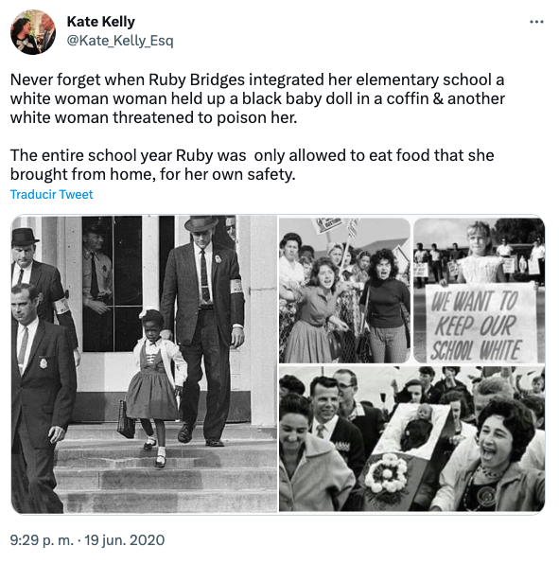
This will challenge you
Feeling uncomfortable is part of change. This presentation allows you an opportunity to change but doesn’t shy away from “uncomfortable truths”.
Ruby Bridges was 6 in 1960 when she went to a previously white school. How did she feel throughout that year?
This is why it is important to centre marginalised perspectives.
Tweet from Kate Kelly that is displayed as an image on this slide

Slide 5
Courage is needed
I need to acknowledge that writing the original document and preparing for this presentation was difficult emotionally.
It will be difficult for me to give this presentation. I will be anxious, especially with any questions at the end.
I need courage to be able to do this.
But you will all need courage to make the changes we need to improve our society. It is not easy. All I can do is to tell you what is really needed for change, to "burst your bubble", so that you can decide if you have the courage to fight, or not.

Slide 6
Why so sensitive?
The sensitive event has to be viewed as part of a cumulative impact
High pressure situations like this are not in isolation for marginalised groups. They are “the straw that broke the camel’s back”. ie. they are cumulative.
“Cumulative exposure to racial discrimination has incremental negative long-term effects on the mental health of ethnic minority people in the United Kingdom.”

Slide 7
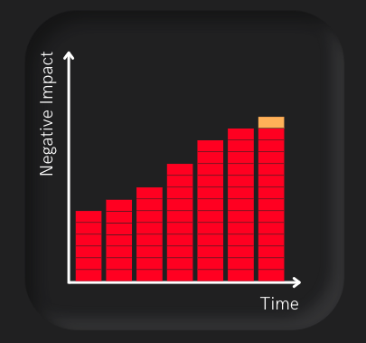
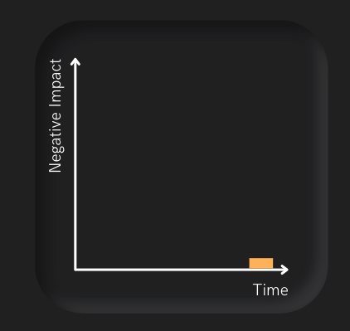
Accumulation of events and trauma
Figure 1 shows how I react to a “minor” event that triggers deep emotional reactions based on previous trauma that accumulates over time.
Figure 2 is how a person with privilege might view the same “minor” event and judge my reaction as an “overreaction”.

Slide 8
Motivation for doing this
The motivation for doing this is to highlight what actually needs to be done. This means having the courage to question your core belief and to take on board uncomfortable truths.
“Thank you for spending the time and mental effort to articulate these uncomfortable truths so clearly in front of an audience that needs to hear it.” - Anonymous
There are two reasons that slow the community to be transformative: a lack of concrete discussion and a lack of person-centered approaches.

Slide 9
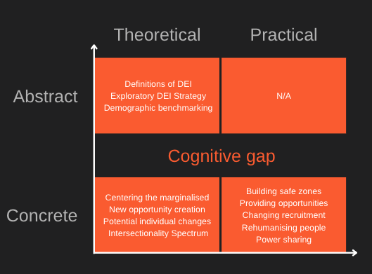
Lack of concrete discussion
There is still systemic imbalance and lack of diversity in the workforce that leads to a lack of opportunity for people from marginalised groups. This needs to be fixed systematically. It is especially true in senior roles.
There is a large conceptual gap between grassroot advocates and typical corporate diversity training. This is mainly due to corporate diversity training being abstract and not concrete.
This was written was a need for a tool to help aid communication at a concrete level.

Slide 10
Lack of person-centered approaches
Many policies and strategies are underpinned with the limiting notion that a person fits in one "box" (see Figure 1). This is why we might have a Disability policy.
People are complex. The only way to truly understand what they need is to ask them, trust the answer, and act (See Figure 2). This is a person-centered approach.

Slide 11
Systemic imbalance
There is an imbalance in the system that is biased against people from marginalised groups.
We cannot fix this imbalance by treating people equally as if they have had the same opportunities, resources and rights.
Systemic racism and U.S. health care,
Systemic racism persists in the sciences,
Systemic racism moderates effects of provider racial biases on adherence to hypertension treatment for African Americans,
Systemic racism is a cause of health disparities."

Slide 12
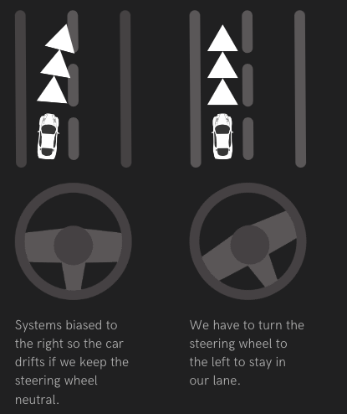
Neutral sides with oppression
“If you are neutral in situations of injustice, you have chosen the side of the oppressor. If an elephant has its foot on the tail of a mouse and you say that you are neutral, the mouse will not appreciate your neutrality.” – Desmond Tutu

Slide 13
Blatant discrimination is not acceptable now
Blatant issues for racism and sexism are well articulated in Australian society. This is because it is easy to spot, even though it is still commonplace in many organisations.
"Why are Asian women's feet so small? So they can stand closer to the sink!" a male employee joked with his Asian colleague, then got angry when she didn't like it.

Slide 14
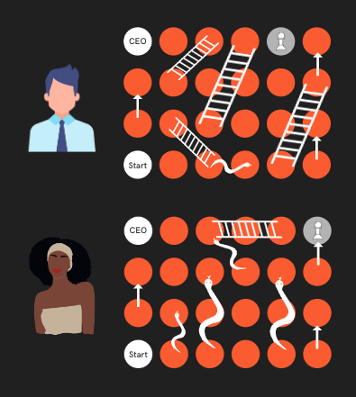
But subtle discrimination is more challenging
Figure 1 shows the idea of cumulative problems using a "Snakes and Ladders" analogy to show the "degree of difficulty" and the lack of opportunities of a person from a marginalised group, that may not be apparent to an outsider.
If you only measure someone's experience and not take into account their "degree of difficulty", you could miss out on talent.

Slide 15
Subtle discrimination can be worse
But more importantly, the results show that across every job and individual outcome, the effects of subtle discrimination were at least as bad as, if not worse than, overt discrimination.
I now define a microaggression as:
A microaggression is a clear sign to a marginalised person that they do not belong in that environment.

Slide 16
Intersectionality increases the degree of difficulty
Intersectionality is belonging to more than one marginalised group. It means that you have more “areas” that can open you up for attack.
Understanding the range of areas and the effects is key to being able to help.
Intersectionality was originally coined by Kimberlé Williams Crenshaw in 1991 in her publication "Mapping the Margins: Intersectionality, Identity Politics, and Violence against Women of Color".

Slide 17
Discrimination results in a lack of opportunities
Here are a few examples of how people are discriminated against.

Slide 18
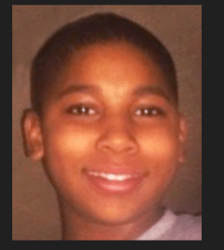
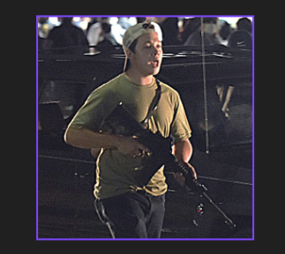
Punished vs Forgiven
Tamir Rice was 12 years old when he was killed by a policeman while holding a replica gun. He did not make any verbal threats nor point the gun towards the officers (Figure 1).
The Illinois teen accused of fatally gunning down two protesters during violent demonstrations sparked by the police shooting of Jacob Blake is fighting extradition to Wisconsin, according to reports (Figure 2).

Slide 19
Stereotyping
Dr Satra Browne is a black American living in Aotearoa New Zealand who shares her story about racism in Aotearoa New Zealand.
White privilege still reigns and people of colour are still the target of racism which shortens our lives. As long as it’s our reality, we have no choice but to talk about it.

Slide 20
Lack of privacy
As part of The Health and Well-Being of Transgender Australians: A National Community Survey; out of 927 responses, 304 or 33% were discriminated against in employment, 26% in accessing health care and 16% in government services.
To learn more you can follow Professor Sandy O'Sullivan from Macquarie Uni.

Slide 21
Low expectations
"You can't study chemistry." That was what a well-meaning teacher told Angela Bijimba, a Malawi refugee, but now she is studying biomedical science and is on her way to becoming a doctor.
PS. Note how the teacher was treated very generously in that statement.

Slide 22
Gaslighting
Gaslighting is a form of psychological manipulation in which a person seeks to sow seeds of doubt in a targeted individual or in members of a targeted group, making them question their own memory, perception, and sanity (Wikipedia).
The story is from Imani Barbarin, someone you can follow and support on Patreon.

Slide 23
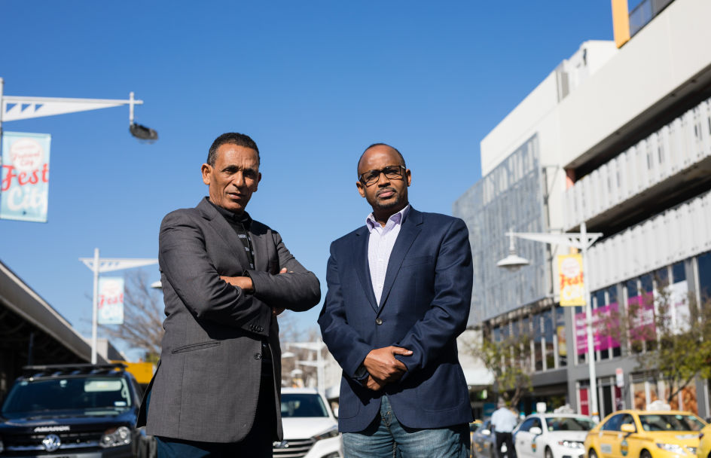
Even looking for housing can affect your work
Hassan, an engineer, applied for a five-bedroom rental property in the same neighbourhood. He was rejected and told the landlord had not liked his application despite earning a good salary.
He said while he was disappointed, he wasn’t surprised by the decision. “It’s very common for people of African background. They always get knocked back.”

Slide 24
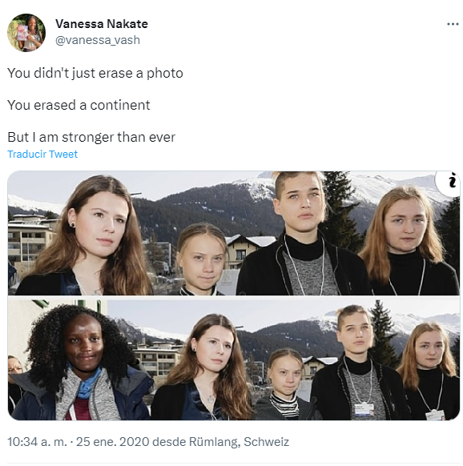
You can even be erased altogether (twice)
Outrage at whites-only image as Ugandan climate activist Vanessa Nakate cropped from photo by Associated Press.
This was at Davos and it also happened in 2021 at COP26.

Slide 25
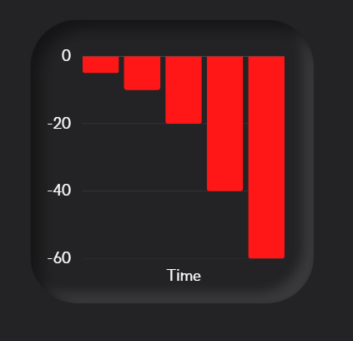
Lack of opportunities over time reduces employability

Slide 26
Video: Are you really hiring on merit?
This is demonstrated in the video "Are you really hiring on merit? A story about hiring senior management with Diversity and Inclusion" (Figure 1).

Slide 27
The key is to give people from marginalised groups more opportunities to make up for the ones they have lost.
Tweet about Marilyn Monroe helping Ella Fitzgerald.

Slide 28
Capability Maturity Model for Diversity in Organisations
There is just one slide for the CMM, but it is quite a complex table that doesn't make sense if we didn't go through all the preamble.

Slide 29
Table showing Capability Maturity Model for Diversity in Organisations
CMM Level | Understanding | Key Question
#1 Systems encouraging lack of diversity | There is no understanding | There are no questions being asked.
#2 Systems neutral that keeps status quo | There is understanding of blatant issues in diversity, but not systemic issues. | How do we stop unconscious bias and only judge on skills and experience?
#3 Individuals actively fighting the status quo | There is understanding of blatant and systemic issues in diversity by individuals. | How do we get privileged people to give people from marginalised groups more opportunities?
#4 Systems improvement in one organisation | There is understanding of blatant and systemic issues across the organisation. | How do we build systems to give people from marginalised groups more opportunities?
#5 Systems improvement across organisations | There is understanding of systemic issues across multiple organisations. | How do we build systems to give people from marginalised groups more opportunities?

Slide 30
Sacrificing privilege will challenge you
To work towards a better community, we need to sacrifice our privilege and comfort. This is mentioned in a 2015 article by Clementine Ford:
Equality comes from people either sacrificing their privilege or having it forcibly taken away from them. It does not come from waiting from the oppressed to rise up and meet it. [...] But if all you can think about when you think about equality is everything you stand to lose, then you're not trying hard enough. And yes, you are part of the problem.

Slide 31
Pushback
As you move into CMM level 3 you can expect to get pushback. This is easily seen in the infamous words of Scott Morrison.
“We want to see women rise. But we don’t want to see women rise only on the basis of others doing worse.” - Scott Morrison International Women's day 2019.
Here are some other forms of pushback.

Slide 32
You are being too loud
People who push back usually make excuses that have been made before in more horrific situations.
"a little too fierce on the slavery question"
"[this] will certainly do harm"
This was the reaction to an anti-slavery speech in 1853 by Frederick Douglass.

Slide 33
Not the right fit
This is a very common phenomenon.
What does the best person look like?
‘It's like looking in a mirror‘.

Slide 34
That doesn't happen anymore
Remember Ruby Bridges? This is what she looks like now in 2020. She even has a website at https://www.rubybridges.com/
Don't let the black and white photos fool you into thinking it was a long time ago. Then remember the murder of George Floyd.

Slide 35
But we already hire on merit
But all of this information about Trump’s lifelong criminal activity has been documented, for years—it just wasn’t brought to the forefront when voters needed to know about it. Sarah Kendzior
Did Donald Trump, Boris Johnson and Scott Morrison get to the top due to merit?

Slide 36
The end of civilization
This anti-suffragette postcard from 1910 shows what the end of the world would look like if women got the vote.
When women vote it won't be lawful for a man to remain single.

Slide 37
There are many more delaying tactics
Some of the others include:
This isn't the right time
There are no quality candidates
I'm already doing X, I can't do Y as well!
We tried before and failed
Good idea, we will get back to you...
But that has never affected me personally
I don't have privilege, I just worked hard
These are all ways to delay the actions needed to change the system.

Slide 38
Intersectionality Spectrum
I created a model to help visualise “degree of difficulty” based off this picture so that it can be taken into account when looking at “merit”.
This sits into the people-centered category, as we are aiming to understand each person we work or interact with.
But the risk is that this will dehumanise and this needs to be kept in mind as we continue.

Slide 39
At a fundamental level, we need to rehumanise the marginalised people that have been dehumanised.

Slide 40
All models are wrong but some are useful. George Box
From the article Box, G. E. P. (1979), "Robustness in the strategy of scientific model building", in Launer, R. L.; Wilkinson, G. N. (eds.), Robustness in Statistics, Academic Press, pp. 201–236, doi:10.1016/B978-0-12-438150-6.50018-2, ISBN 9781483263366.

Slide 41
Intersectionality Spectrum initial figure
Initial intersectionality figure shown in Figure 1.

Slide 42
Intersectionality Spectrum - showing calculation
Degree of Difficulty is 2^number of marginalised groups. Use base 3 for highly marginalised groups. See Figure 1.

Slide 43
Intersectionality Spectrum - Most DEI initiatives target gender equity
Most DEI initiatives target gender equity. See Figure 1.

Slide 44
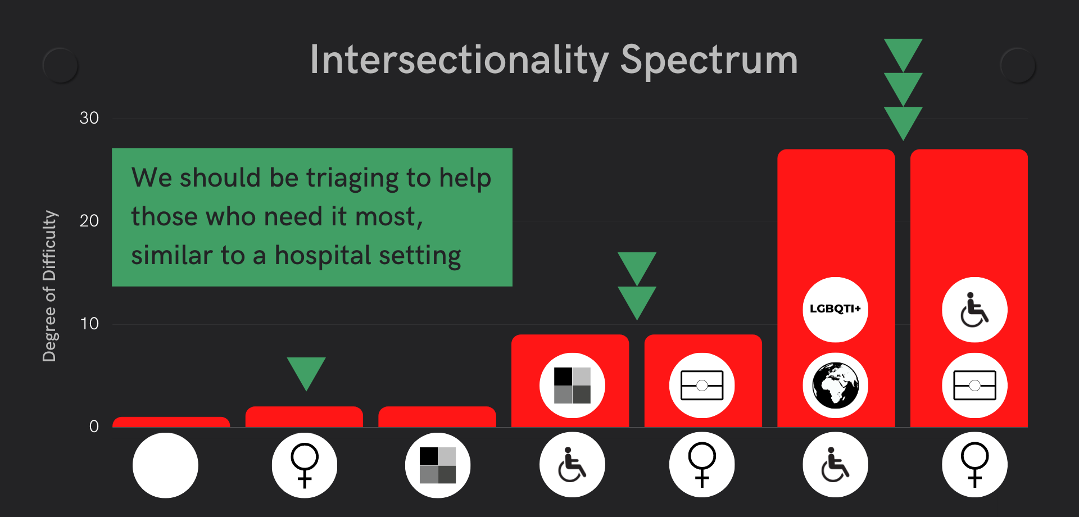
Intersectionality Spectrum and Triaging
We should be triaging to help those who need it most, similar to a hospital setting as in Figure 1.

Slide 45
Merit Model Percentage
Further to the Intersectionality Spectrum and the Degree of Difficulty, I wanted to demonstrate what merit might look like if you took into account opportunities as well.
This is similar to the Achievement Relative to Opportunity that is part of Monash University, but should also take into account opportunities missed before becoming a student or worker.

Slide 46
Nova Peris
The first First Nations person to win an Olympic gold medal.
One of the very first people to represent their country at Olympic level in two distinct sports.
The only Australian athlete to win Olympic gold in one sport and Commonwealth Games gold in another.
Australia's first First Nations woman elected to federal parliament.
https://trove.nla.gov.au/work/8345406?q&versionId=9620252+44665336+260827319

Slide 47
Merit Model for Nova Peris
Her range calculation:
Skills and experience is 3
Opportunities is a range 1 or 2
Degree of Difficulty is 3^2 = 9
Merit Model % range is 1350% to 2700%
To give a benchmark, I could only obtain a maximum of 600% given my Degree of Difficulty of 2^1=2. I would rate myself in the range of 200 to 300%.

Slide 48
From Theory to Implementation
In this section, we will talk about examples of how you can take this framework and apply it into most situations by using discourse analysis.

Slide 49
Discourse Analysis
What makes discourse analysis unique is that it posits that social reality is socially constructed. Discourse analysis goes beyond the literal meaning of words and languages.
Discourse analysis can also tell you a lot about power and power imbalances, including how this is developed and maintained.

Slide 50
Discourse Analysis Points
These discourse analyses points can be used to test if the framework is being implemented in any work, events, or changes you make concerning DEI.
They range from the high level (1st column), to understanding (columns 2 and 3), to outcomes (last column. The examples on the next few pages will show how they can be implemented.

Slide 51
Engenders trust and legitimacy (high level)
You can use this point to ask questions about the event, article, presentation, or action you plan to do and decide if it fits within the framework.
Questions based on a strategy could include:
Does the strategy build trust and shows that we have tried beyond a reasonable doubt?
Does it show that we are committed?
Does it show that we are going to be held accountable?
Does it show the most marginalised people that we understand the challenge?

Slide 52
Humanises policy and strategy (high level)
Questions based on a policy could include:
Does the strategy humanise the most marginalised people it is trying to help?
Does it use a lot of numbers and percentages?
Does it ignore stories and narratives that center marginalised people?
Does it make it sound like people can be changed around like spare parts?
Does it highlight the business case or increased profitability as its key drivers?

Slide 53
Highlights challenges to audience (high level)
Questions based on an event could include:
Does the event highlight that there is a need for people to share their power?
Does it highlight that by staying neutral, you are on the side of the oppressor?
Does it highlight that you will get things wrong and will have to navigate through that?
Does it highlight that this is a continuous improvement challenge, and therefore lifelong learning is involved?

Slide 54
Understands change is uncomfortable
Questions based on a presentation could include:
Does it highlight that there is a need for people to share their power?
Does it highlight that you will get things wrong and will be called out for that?
Does it highlight that it could dampen some of the joys you took for granted?

Slide 55
Understands marginalised people by centering them
Questions based on an event could include:
Are we centering the most marginalised people for this event? If so, how?
Who are the most marginalised people in this context, and are they even in the community?
Do we have anyone with lived experience or do we follow marginalised people on social media to ensure we have more information?

Slide 56
Understands the different "degrees of difficulty"
Questions for training programs could include:
Does this take into account the different discrimination people have faced? If so, how?
Does this take into account the triggers and difficulties people have faced previously?
Does this make assumptions that are from a privileged perspective?

Slide 57
Understands intersectionality as a spectrum
Questions for promotions could include:
Does this take into account the cumulative effects of discrimination across all areas?
Does this take into account the specific context for this environment?
Does it include those people who aren't even in the community due to the effects of cumulative discrimination?

Slide 58
Understands cumulative effects of marginalisation
Questions for recruitment could include:
Does this take into account the cumulative effects of marginalisation ie. Achievement Relative to Opportunity?
Does this decrease the emphasis on years of experience and increase the emphasis on continuous improvement skills?
Does it clearly explain that the recruitment process takes this into account?

Slide 59
Understands merit is often based on opportunity, not ability
Questions for interviews could include:
Do the questions take into account the cumulative effects of marginalisation ie. Achievement Relative to Opportunity?
Does the interview panel have a broad range of diversity across the Intersectionality Spectrum?
Does the interview panel share the questions before the interview?

Slide 60
Provides practical actions as an organisation
Questions for a strategy could include:
Does it clearly identify practical next steps that will focus on the key challenges?
Does It assign responsibility and KPIs that hold people accountable?
Does it make sense and will it make an impact to people who are highly marginalised?

Slide 61
Provides practical actions as an individual
Questions for an action plan could include:
Does it clearly identify practical next steps that will focus on the key challenges?
Is there a way to take responsibility in a way that holds myself accountable to others?
Does it make sense and will it make an impact to people who are highly marginalised?

Slide 62
Recognises the need to share power
Questions for promotions could include:
Does it clearly identify practical ways that executives will share power?
Is there a way to hold people accountable for sharing power?
Does it make sense and will it make an impact to people who are highly marginalised?

Slide 63
How can you help as an individual?

Slide 64
Moving from CMM level 2 to CMM level 3
This is what you need to do to move from CMM Level #2 to CMM Level #3.

Slide 65
Focus on Action
Advocate for people from one or more marginalised groups
Redefine merit

Slide 66
Centre people from marginalised groups
Because people from marginalised groups get erased from the conversation every single day.
Setup your social media to include a core of people from marginalised groups that you wouldn’t normally see.
Proactively find databases of intersectionality marginalised people in your industry to build new relationships.

Slide 67
Step aside for people from marginalised groups
Instead of applying for a choice opportunity for yourself, encourage, mentor and help people from a marginalised group apply.
This is not tokenism if they have the talent and potential and you are willing to share your skills and experience with them.

Slide 68
Encourage (and sponsor) people from marginalised groups
Interview marginalised candidates by default and provide them with constructive feedback.
Go out of your way to engage with, help with introductions, and mentor them. Once you know them better you can sponsor them.
Sponsorship means advocating for people when they are not in the room, eg. suggesting a marginalised colleague or candidate for a job when they aren't in the room when there is talk of a new job opportunity being planned (that they would be great for).
But the best advice is to ask the person themselves what they think they need, see what their strengths are and take that into account when deciding to identify or fight for opportunities for them.
When you see a marginalised person do something well, compliment them. This can help with fighting the effects of gaslighting.
Article called ACTIVATING THE POWER WITHIN: SPONSORSHIP AMONG BLACK WOMEN PROFESSIONALS has an extract in Figure 1

Slide 69
Identify talented people from marginalised groups
Focus less on skills and experience and more on potential and talent as per Future-Proofing your Workforce while Navigating Organisational Change .
Go out of your way to engage with, help with introductions and job opportunities, and mentor.
Especially be proactive in job opportunities!
The more marginalised a candidate, the more the gap between skills and experience should be reduced as a weighting when hiring.
Take into account extenuating circumstances eg. returning from long-term maternity leave when comparing skills tests.

Slide 70
How can you help as an organisation?

Slide 71
Moving from CMM level 3 to CMM level 4
This is what you need to do to move from CMM Level #3 to CMM Level #4.

Slide 72
Recruitment
Focus less on skills and experience and more on potential and talent.
Use Achievement relative to Opportunity to take into account extenuating circumstances eg. returning from long-term maternity leave when comparing skills tests.
Use selection criteria that incentives DEI work eg. Demonstrated ability to champion, identify and mentor diverse candidates for senior management roles.
See "Improving Diversity and Inclusion in Senior Leadership" [1] for 30 tips you can do right now.
Redefine merit by increasing the emphasis on ability and potential while de-emphasising experience, as experience can be correlated with opportunity, not ability.

Slide 73
Events
Choose keynote speakers that are not the same ones "on the circuit", by de-emphasising experience or positional authority and emphasising potential and talent.
Commission an accessibility report and create a sponsorship package that helps to pay for this and implements the suggestions.
Make a commitment to create accessible documentation throughout the conference, including the conference report.
See "Using Intersectionality to underpin a conference" [1] for more.
Center the most marginalised people that find attending events challenging, such as people with low-income, disabilities, or who are intersectionally marginalised.

Slide 74
Mentoring/Training Programs
Choose educators and training co-ordinators that understand DEI and value the lived experience of those who are highly marginalised.
Provide opportunities for educators that are highly marginalised, by de-emphasising experience and emphasising potential and talent.
Budget for the accessibility needs in presentations, documents, and examinations.
See "Documentation from the Mentoring for PoC aiming for Senior Leadership positions program" [1] for more.
Center the most marginalised people that find attending programs challenging, such as people with low-income, disabilities, or who are intersectionally marginalised.

Slide 75
Publishing and Citing
When looking at publishing about the RSE community, identify co-authors that are not the same ones "on the circuit", by de-emphasising experience or positional authority and emphasising potential and talent.
Ensure you cite marginalised people who have shown potential who may not have positional authority or reputation alongside those that do.
Encourage talented, highly marginalised people outside your standard networks by offering support to write papers or work collaboratively regardless of experience or reputation.
Center the most marginalised people that find publishing challenging, such as people with low-income, disabilities, or who are intersectionally marginalised.

Slide 76
Strategy and Policy
Ensure strategy is written with marginalised people as one of the the main audiences.
Ensure the language humanises and is not completely filled with percentages and numbers.
Ensure that the strategy is practical and focuses on individual as well as systemic power sharing.
Make a commitment to accept this will not be easy or comfortable and stay the course.
Recognise that strategy should be updated iteratively as programs develop.
See "Feedback on UKRI EDI Strategy" [1] for more ideas.
Center the most marginalised people that find keeping or finding jobs challenging, such as people with low-income, or those who are intersectionally marginalised.

Slide 77
Handling Criticism of DEI
Continuous improvement is key.
Each individual who is highly marginalised will have different needs and may be critical of the work being done.
This is actually progress. Previously they may have been ignored or had given up.
The focus should be on helping to improve at an person-centered level that is supposed to be standard in a disability setting.
See "Missing narratives in discussions around diversity and inclusion in research software engineering" [1] for more.
Accept that when the most marginalised people find you are willing to listen to them, they will open up. It is not easy to handle if you expect to be above criticism.

Slide 78
Being supported and understood creates inclusive spaces
When I know that I am supported and people understand why I am sensitive, I feel safe. When I feel safe, I am comfortable being myself and am able to share when something is wrong without being worried about losing my job, losing friendships, or damaging my career. To me, that is inclusion. - Rowland Mosbergen

Slide 79
Real-life Implementations
In this section, we will talk about real-life examples of how this has been implemented and the impact made.

Slide 80
Stemformatics
I organically built a very diverse software engineering team that at one point consisted of 4 women (including 3 students and 3 women of colour) and myself.
I mainly used Achievement relative to Opportunity and Continuous Improvement skills to identify talent.
To give you a benchmark, I had a colleague in a similar industry who struggled to find female software engineers.

Slide 81
RSE-AUNZ Community
Setting up a committee for a community that was overwhelmingly (91%) male.
I wrote the CMM to argue we should use a collaborative framework and that people with privilege should step aside.
This convinced a candidate who went from wanting to be the chair to backing a candidate who had a higher “Degree of Difficulty”.
There was pushback even from the ones who would benefit (Token hire).
The end result of this was we selected two very capable co-chairs - both women, with one being a woman of colour.

Slide 82
Melbourne Data Analytics Platform
Setup of a new 8 strong data analytics group at the University of Melbourne
During the initial interviews I recognised there was no cultural diversity in the interview panel.
I reached out to my network of culturally diverse colleagues and they responded.
In many interviews we had one or more culturally diverse interviewers.
The result was that we ended up having 44% of the initial recruitment being culturally diverse and 25% intersectionally diverse.

Slide 83
Mentoring for PoC aiming for Senior Leadership Program
I setup and ran the Mentoring for PoC aiming for Senior Leadership positions program that had an intake in 2020.
The biggest challenge was ensuring the mentors were culturally and intersectionally complementary to not trigger or cause distress to the mentees.
The feedback received was positive. “Thanks a million for your understanding and your support Rowland, I truly appreciate it.”, said one mentee.

Slide 84
Panel for SeptembRSE
In 2021, using the framework, I co-designed a panel “Missing narratives around diversity and inclusion in Research Software Engineering”
This centered intersectionally marginalised people and were offered an honoraria for their efforts.
Yanina Bellini Saibenen, said: “… it makes me wonder what people like me could achieve if we weren’t wasting out time breaking through all these barriers”.

Slide 85
Unconscious Bias Presentation
In 2021 I wrote and delivered a short presentation “Unconscious bias – does it really matter?” that was based on the framework for Open Life Science, a not-for-profit based in the UK.
It made the case for centering the victims, not the people with the bias.
The feedback was extremely positive with the most common feedback highlighting that “this was very powerful”.

Slide 86
International Recruitment
In 2022 I co-designed a recruitment campaign using the framework with Open Life Science and MetaDocencia.
I extended best-practice in DEI by creating a recruitment process that centred the applicants’ perspectives.
This led to over 120 applicants from Europe, Africa, the Americas, and Asia.
MetaDocencia received around 150 applicants in only 2 weeks. Most of the applications received were from people who did not know MetaDocencia before.

Slide 87
Vive la différence -RSE Diversity workshop
In 2022 the framework was presented in a lightning talk at the international 2022 Vive la différence -research software engineers workshop.
This generated enough interest that a public presentation of the full framework was done.
This led to the framework being disseminated via the University of Manchester’s new flagship anti-racism programme and it being used in the School of Engineering there.

Slide 88
Facilitation Session for Not-for-Profit
In 2022 this framework was used to facilitate an exploratory session with a well-known international not-for-profit.
The session was co-designed with MDF, an international consultancy firm based in the Netherlands, for their Global Leadership Forum that consisted of 20+ international leaders from 5 continents.
Matthias Fecht remarked: "Rowland’s participation had a huge impact on our leadership team. I will most certainly not forget the session we had with him. It was really impactful!".

Slide 89
Organising an inclusive international conference
In 2022 as the co-chair of the international Research Software Engineer (RSE) Asia Australia Unconference, this framework was used to underpin this event from the ground up.
Again this extended DEI best-practice by commissioning a high-level accessibility report for the conference, the establishment of an Accessibility Partner, provision of an accessible report, having a participant-centered focus, and an intersectional approach to identifying keynote speakers.
This was considered a success as the community is small, yet 141 participants were registered for the unconference across 6 countries.

Slide 90
Further Feedback
“So much respect to you for undertaking a challenging feat to open up difficult conversations. These conversations are extremely important and it’s a shame they are not a part of occupational health and safety procedures.” – Priyanka Pillai
“As a stupendously privileged white male whose life has essentially gone the easy-route to success, I would like to compliment you on this work. Seriously.” – Sven Dowideit

Slide 91
Find out more
More open and free resources at the Practical Diversity and Inclusion website.

Slide 92
New RSE Leadership Course Pilot
There is a new RSE Leadership Training Program Pilot that provides practical, concrete ways to incorporate intersectionality into the RSE community.

Slide 93
Key Continuous Improvement Skills
The six key continuous improvement skills are:
Collaborative by Default
Adaptability
Learnability
Critical Thinking
Tolerance for Ambiguity
Tolerance for Complexity

Slide 94
Acknowledgements
I would really like to acknowledge the large number of people who helped me directly and indirectly, but in particular Manodeep, Roman, Yo, Michelle, Jeremy, Malvika, and Camille.
I recommend that you follow the following people on twitter as they have all helped me at some point in my journey and still do.
Thank you.

