Slide 1
Supplementary Information
Size matters: physiological sensitivity of the scallop Argopecten purpuratus to local seasonal upwelling conditions
Laura Ramajo^{1,2,3*}, Camila Sola-Hidalgo^{1,4}, María Valladares¹, Orlando Astudillo^{1,2}, and Jorge Inostroza¹
¹Centro de Estudios Avanzados en Zonas Áridas (CEAZA), Coquimbo, Chile
²Departamento de Biología Marina, Facultad de Ciencias del Mar, Universidad Católica del Norte (UCN), Coquimbo, Chile
³Center for Climate and Resilience Research (CR)², Santiago, Chile
⁴ONG Jáukén, Santiago, Chile
* Correspondence:
Laura Ramajo
laura.ramajo@ceaza.cl

Slide 2
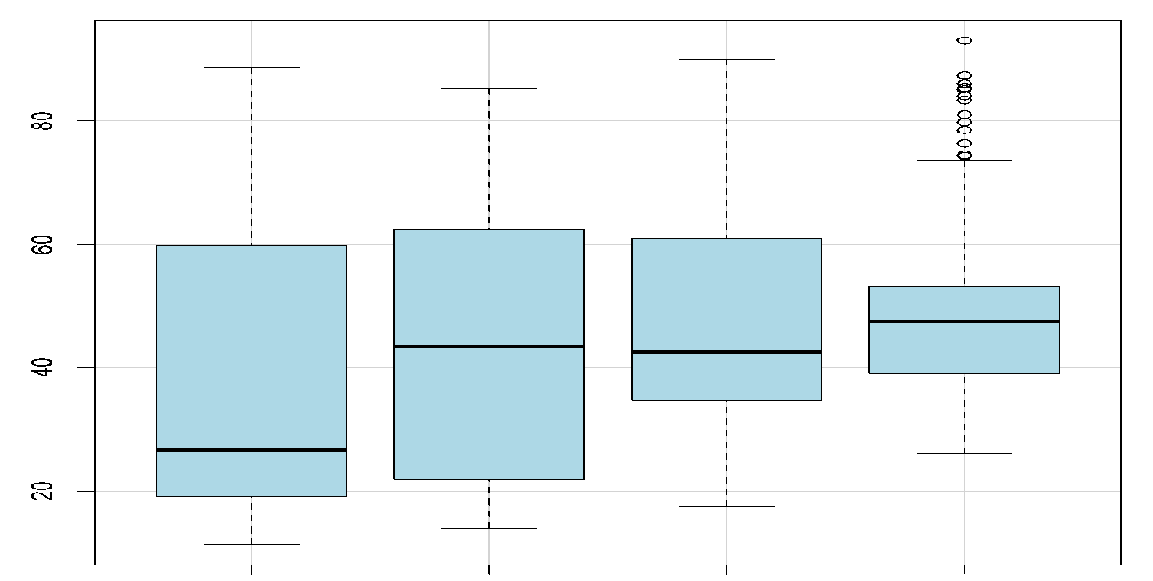
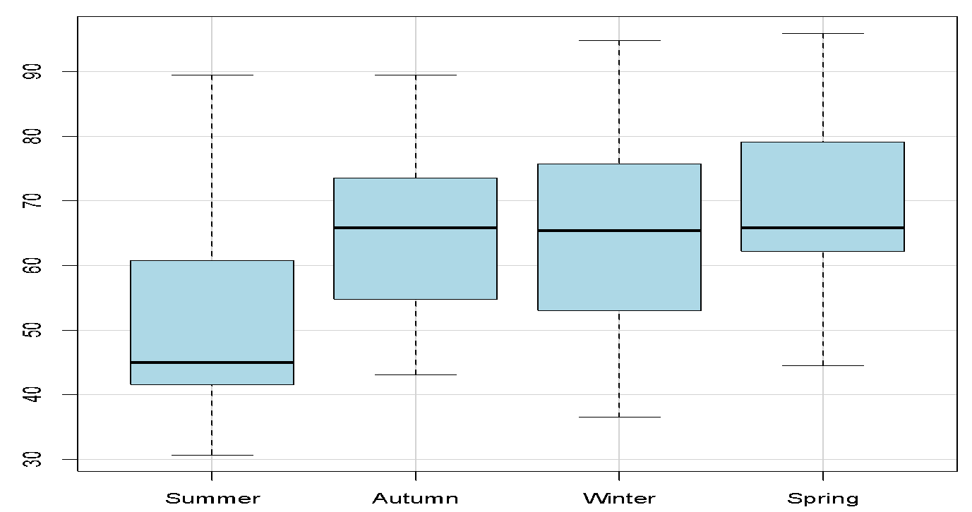
(A)
a
b
80
b
b
60
Initial Shell Length
(mm)
40
20
Kruskal Wallis Test: 𝟀² = 31.87
P-value < 0.001
90
(B)
b
b
90
a
b
80
70
Final Shell Length
(mm)
60
50
40
Kruskal Wallis Test: 𝟀² = 62.68
P-value < 0.001
30
Summer
Autumn
Winter
Spring
Figure S1. Size. Mean initial and final size of scallops A. purpuratus by each seasonal experiment.

Slide 3

0.75
0.50
Decalcification Rates (gCaCO₃ d⁻¹)
0.25
0.00
-0.25
0
20
40
60
80
100
Maximum Initial shell length (mm)
Figure S2. Decalcification rates. Size-related decalcification rates estimations for each seasonal experiment calculated from empty shells. Regression index for all seasons are showed.

Slide 4
Figure S3. Monthly chlorophyll-a. Monthly-averaged Chl-a fields derived from MODIS-Aqua 8-day composites during the year-round experiment.

