Slide 1
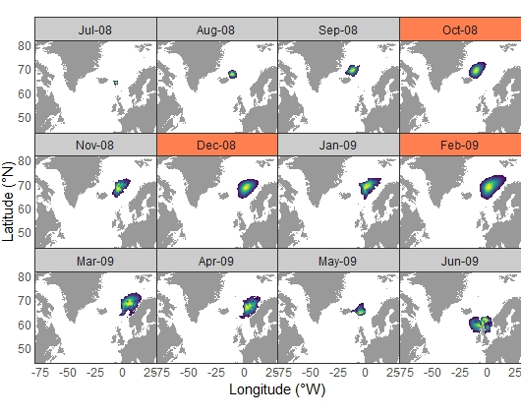
Supplementary Figure S1. Locations inferred from SST at various time points along the migration paths of the 1SW adult salmon. Heatmap area indicates 90% C.I. of the density distribution of locations derived from the hidden Markov movement model. Red coloured maps indicate time steps with no associated data and therefore where probability distributions were not conditional on observations.

Slide 2
Supplementary Figure S2. Locations inferred from SST at each weekly time step along the northward simulated migration path. Contours indicate 10%, 50% and 90% C.I. of the density distribution of locations derived from the hidden Markov movement model. Solid contour lines indicate a time-step with observation data; dotted lines indicate a time-step without observation data. Blue dots show the mean location inferred from the HMM at each previous time-step.

Slide 3
Supplementary Figure S3. Locations inferred from SST at each weekly time step along the westward simulated migration path. Contours indicate 10%, 50% and 90% C.I. of the density distribution of locations derived from the hidden Markov movement model. Solid contour lines indicate a time-step with observation data; dotted lines indicate a time-step without observation data. Blue dots show the mean location inferred from the HMM at each previous time-step.

Slide 4
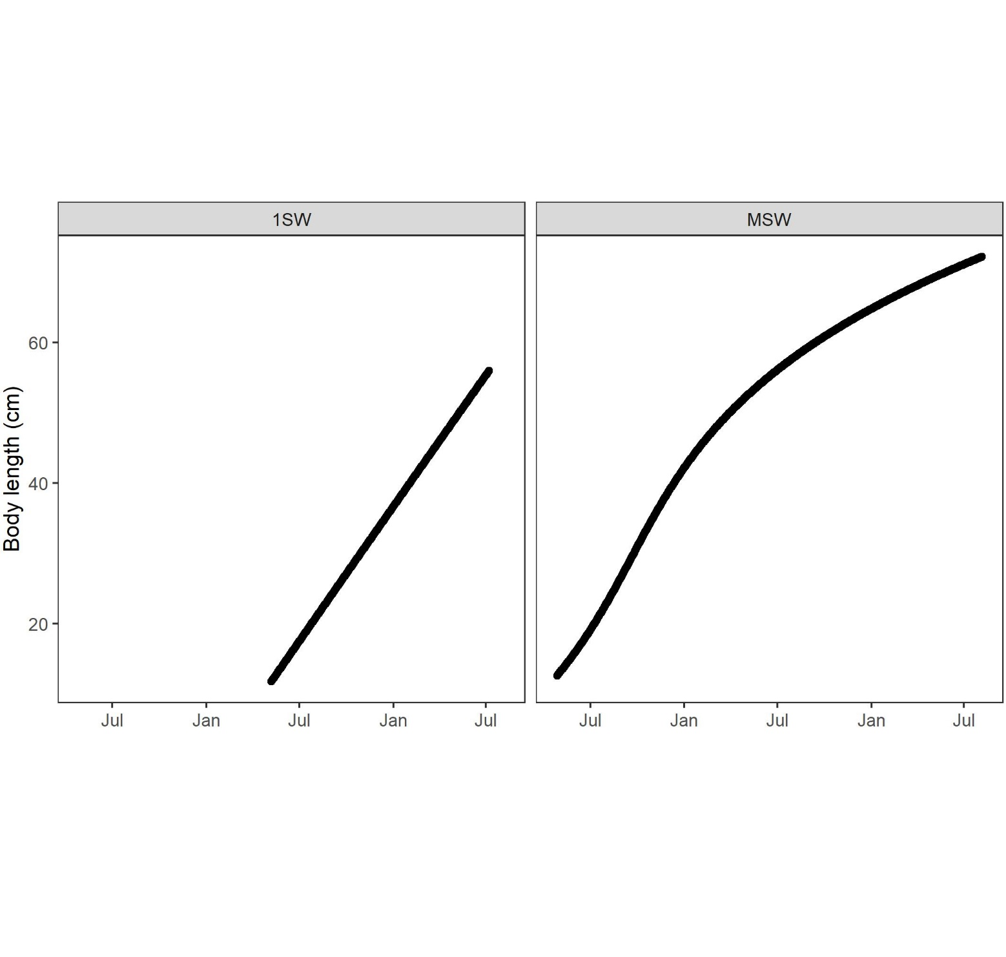
Supplementary Figure S4. Body length values estimated from scale increment analysis throughout the marine migration period for one (A) 1SW and one (B) 2SW wild Atlantic salmon used in the present study.

Slide 5
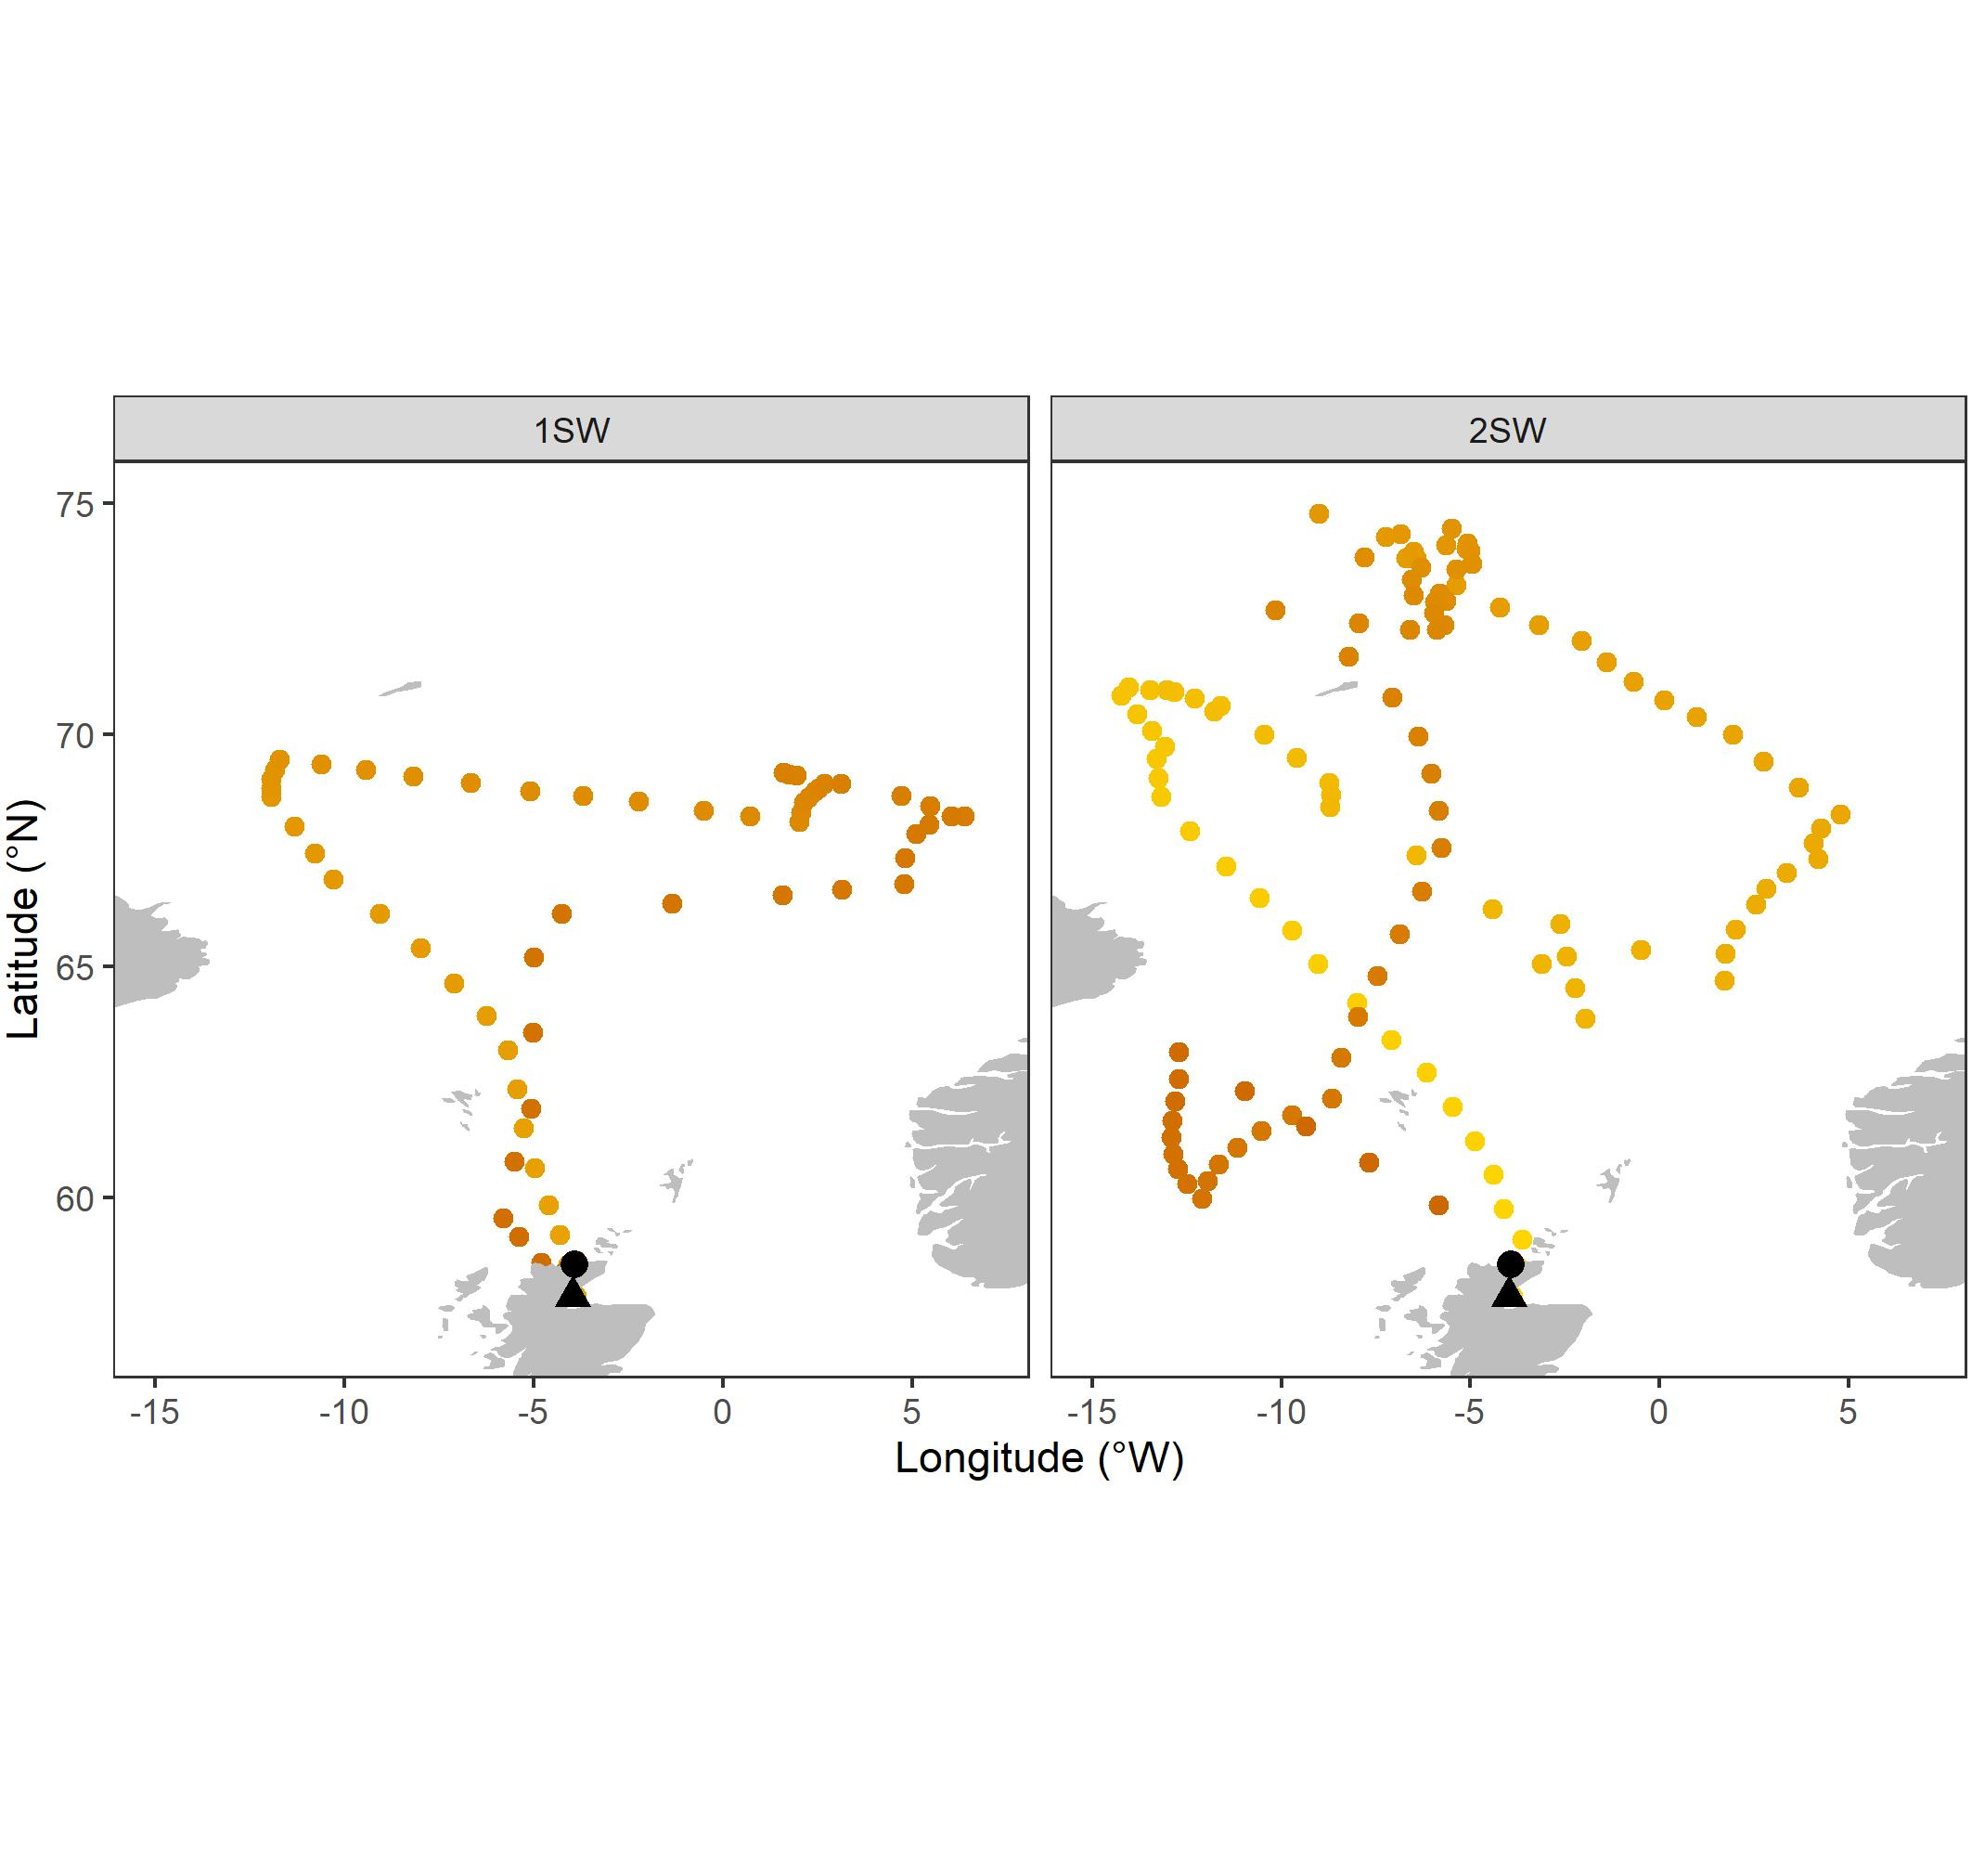
Supplementary Figure S5. Emigration (black triangle) and capture (black circle) locations together with mean locations inferred from the hidden Markov model for one (A) 1SW and one (B) 2SW wild Atlantic salmon used in the present study.

Slide 6
Supplementary Figure S6. Locations inferred from SST at each weekly time step along the wild Atlantic salmon one sea-winter (1SW) migration paths. Contours indicate 10%, 50% and 90% C.I. of the density distribution of locations derived from the hidden Markov movement model. Solid contour lines indicate a time-step with observation data; dotted lines indicate a time-step without observation data. Blue dots show the mean location inferred from the HMM at each previous time-step.

Slide 7
Supplementary Figure S7. Locations inferred from SST at each weekly time step along the wild Atlantic salmon two sea-winter (2SW) migration paths. Contours indicate 10%, 50% and 90% C.I. of the density distribution of locations derived from the hidden Markov movement model. Solid contour lines indicate a time-step with observation data; dotted lines indicate a time-step without observation data. Blue dots show the mean location inferred from the HMM at each previous time-step.

Slide 8
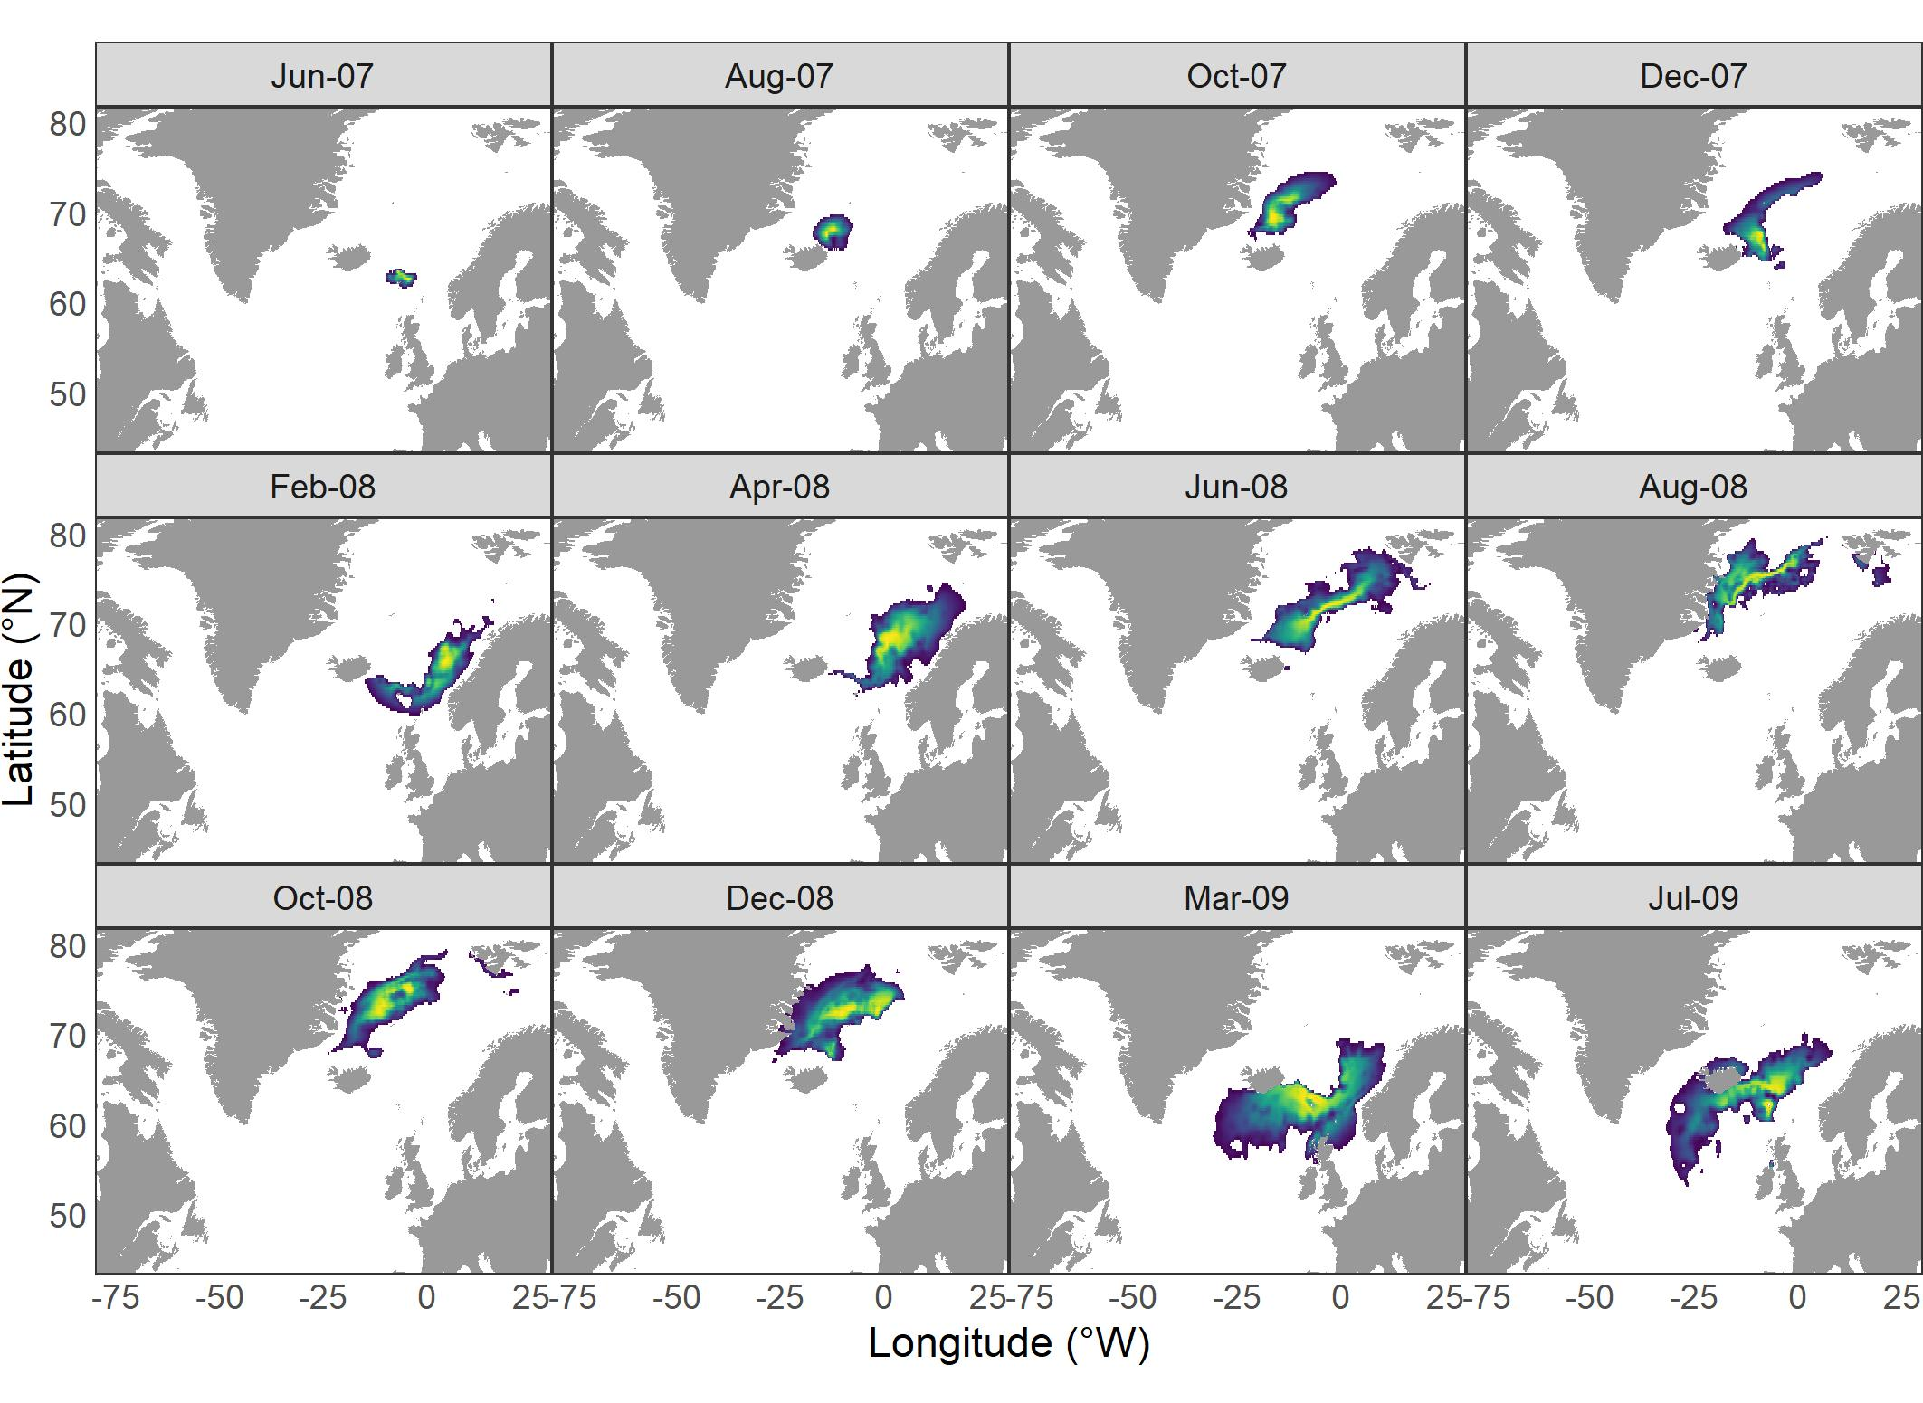
Supplementary Figure S8. Locations inferred from SST at various time points along the migration paths of the 2SW adult salmon. Heatmap area indicates 90% C.I. of the density distribution of locations derived from the hidden Markov movement model. The approximate location of Atlantic salmon post-smolt aggregations inferred from available fisheries and research cruise data (blue; Gilbey et al., 2021), adult captures in commercial fisheries at the Faroes and West Greenland (yellow; Bradbury et al., 2016; Ó Maoiléidigh et al., 2018), and post-spawned adult tracks from Danish & (southern) Norwegian salmon fitted with pop-up satellite archival tags (red; Rikardsen et al., 2021).

