Slide 1
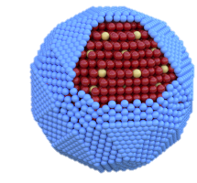
a
b
c
4 nm
10 nm
d
ZCISe-TCA
e
ZCISe-TCA
f
ZCISe
TCA
CB
LUMO
ZCISe
~100s ps
trap
bleach
³TCA*
³TCA*
TET ~14 ns
ZCISe-TCA
Cu*
~1 ps
VB
HOMO
0
0

Slide 2
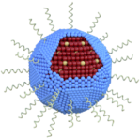
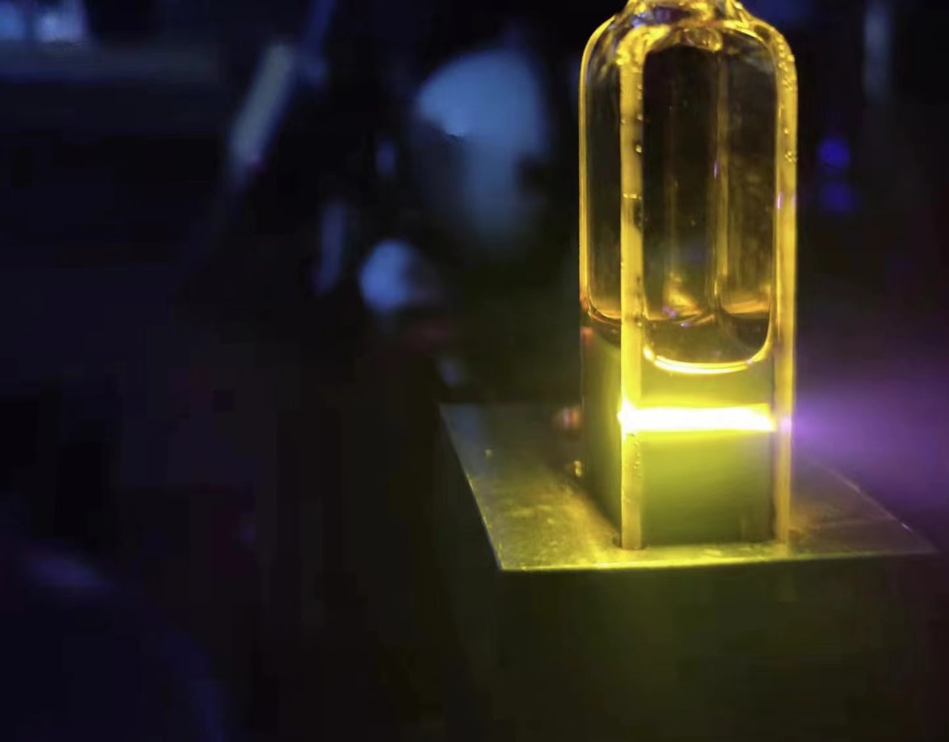
a
b
¹Rub*
808 nm exc.
2.21 eV
TET
TET
TTA
ZCISe*
1.6 eV
³TCA*
³Rub*
³Rub*
1.3 eV
1.14 eV
c
d
Zn-CISe: 16.7±0.2%
Δ_{as} ~0.7 eV
W/cm²
32
Zn_{0.4}-CISe: 7.0±0.1%
0.5
CISe: 4.8±0.2%

Slide 3
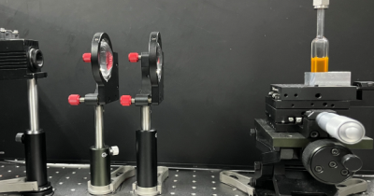
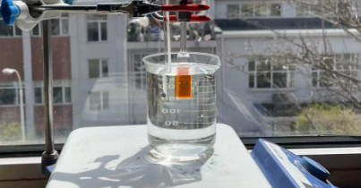
a
b
or
Indoor sunlight
¹Rub*
808 nm NIR laser
Ox.
Red.
Red.
Ox.
c
ZCISe-TCA//Rub
Diludine, DIPEA
Reaction 8 h: >99%
Dark 8 h: 3%
Eosin Y 8 h: >99%
(532 nm laser )
Reaction 1 h: 91%
Eosin Y 1 h : 18%
Rubrene 1 h: 20%
1
DMF/Toluene
2
d
ZCISe-TCA//Rub
Bromoacetonitrile
Reaction 8 h: 89%
Dark 8 h: 4%
Rose B. 8 h: >99%
(532 nm laser )
Reaction 2 h: 95%
Rose B. 2 h : 55%
Rubrene 2 h: 21%
Toluene
3
4
e
ZCISe-TCA//Rub DIPEA
Reaction 8 h: 97%
Dark 8 h: 4%
Reaction 0.5 h: 96%
Toluene
5
1
6

Slide 4
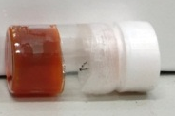

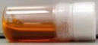
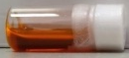
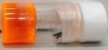
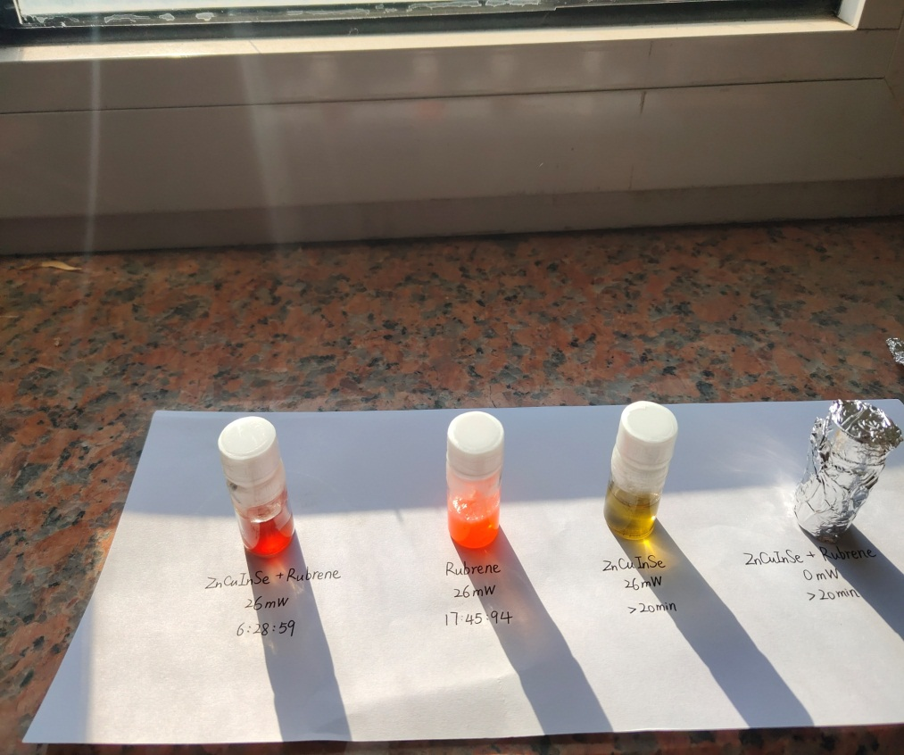
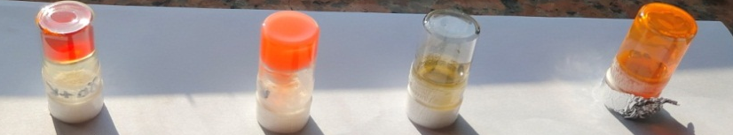
a
ZCISe-TCA//Rub
Iod, NVK, DMF
Polymer
Light
Photosensitizer | Light source | Time | Results
ZCISe-TCA//Rub | 808 nm | 12 min
ZCISe-TCA//Rub | dark | 3 dy
ZCISe//Rub | 808 nm | 2 hr
Rub | 532 nm | 3 min
b
Under indoor sunlight
before
after
ZCISe-TCA//Rub
30 s
Rub
2.5 min
ZCISe
30 min
ZCISe-TCA//Rub
Immediate exposure

Slide 5
 | Varying [ZCISe-TCA] (μmol/L) |  |  |  | Varying [Rub] (mmol/L)
 | 5 | 10 | 20 | 40 | 10 | 16 | 40
Φ'_{UC} (%) | 16.1 | 16.7 | 14.1 | 7.4 | 15.2 | 16.7 | 16.5
I_{th} (W/cm²) | 3.4 | 2.1 | 0.86 | 0.32 | 2.2 | 2.1 | 2.4
Chemical yield (%) | 11 (2 hr) | 19 (2 hr) | 56 (2 hr) | 78 (1 hr) | 23 (2 hr) | 25 (2 hr) | 26 (2 hr)
Absorptance at 808 nm | 0.13 | 0.24 | 0.42 | 0.67 | 0.24 | 0.24 | 0.24

