Slide 1
Single-Molecule Localization Microscopy: Theoretical Basis and Practical Guide
“Widening the Lens” Microscopy Education program Vanderbilt University, Nashville, TN, USA Ulrike Boehm, Ph.D. ulrike.boehm@zeiss.com - @ulrike_boehm Corporate Research & Technology (CRT), Carl Zeiss AG

Slide 2
Diffraction Limited
vs. Diffraction Unlimited
Microtubules, scale bar: 1 um

Slide 3
The Diffraction Limit
Point Spread Function (PSF)
Lateral resolution
$$Δz≥500 \text{nm}$$
$$Δx≈\frac{λ}{2\text{NA}}$$
Abbe Equation
$$α$$
Axial resolution
$$Δz≈\frac{2λn}{{\text{NA}}^{2}}$$
$$Δx≥200 \text{nm}$$
$$λ − \text{wavelength}$$
$$n − \text{refractive} \text{index}$$
$$α − \text{semi} \text{aperture} \text{angle}$$
$$\text{NA}− \text{refractive} \text{index}$$
$$\text{NA}=n \sin{α}$$
Abbe et al. Arch. Mikroskop. (1873)
Notes:
PSF – point spread function

Slide 4
Circumventing the diffraction limit with…
STED
SIM
SMLM
This lecture’s focus
Schermelleh et al. Nature Cell Biology (2019)

Slide 5
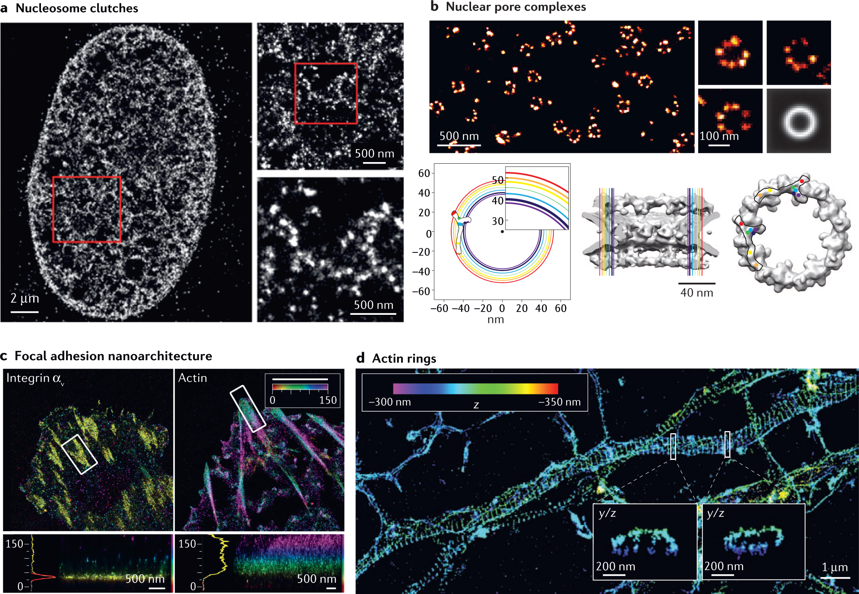
Major discoveries enabled by SMLM
Lelek et al. Nature Reviews Methods Primer (2021)

Slide 6
Major discoveries enabled by SMLM
Lelek et al. Nature Reviews Methods Primer (2021)

Slide 7
Overview
Basic principles 2D SMLM
Hardware for SMLM
Practical considerations: sample preparation, suitable dyes, linkage errors, and buffers
Processing, quantification, and interpretation of SMLM data
3D SMLM
Summary
Extra: New directions in SMLM
Extra: SRM as a multidimensional challenge

Slide 8
Basic principles of 2D SMLM

Slide 9
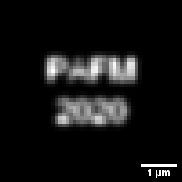
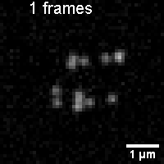
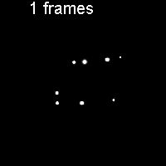
What is Single Molecule Localization Microscopy (SMLM)?
Widefield image
Superresolution image
Sequence of widefield images
Accumulated localizations
Betzig et al. Science (2006), Hess et al. Biophy. J. (2006), Rust et al. Nature Methods (2006)

Slide 10
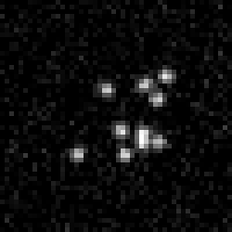
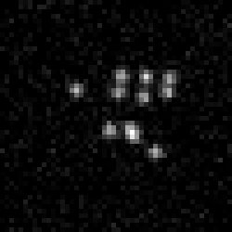
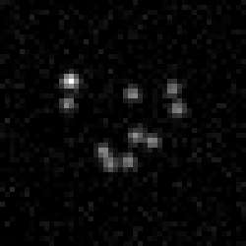
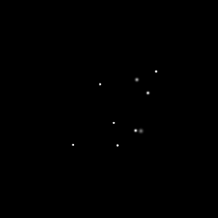
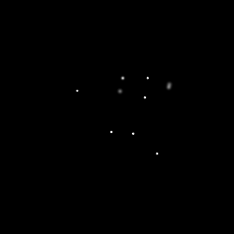
What is Single Molecule Localization Microscopy (SMLM)?
Sample Preparation
Image Acquisition
Widefield image
Image at t₁
Image at t₂
Image at t₃
Processing
Superresolution image
Hardware
Betzig et al. Science (2006), Hess et al. Biophy. J. (2006), Rust et al. Nature Methods (2006)
t₁ < t₂ < t₃

Slide 11
What is Single Molecule Localization Microscopy (SMLM)?
In SMLM small subsets of individual emitters are randomly activated or switched ON/OFF in consecutive acquisitions.
If sparse enough to be identified as single molecule switching events, signals become spatiotemporally separated and are collected over several thousands of camera frames.
Raw data are computationally processed to detect single molecules and determine their center positions with nanometer precision dependent on the number of photons detected per individual emitter.
These are finally assembled through superimposition into a single-plane image.
Betzig et al. Science (2006), Hess et al. Biophy. J. (2006), Rust et al. Nat Methods (2006)

Slide 12
Overview
Basic principles 2D SMLM
Hardware for SMLM
Practical considerations: sample preparation, suitable dyes, and buffers
Processing, quantification, and interpretation of SMLM data
3D SMLM
Summary
Extra: New directions in SMLM
Extra: SRM as a multidimensional challenge

Slide 13
Hardware for SMLM

Slide 14
Hardware for SMLM
Wide-field
TIRF
Java Tutorial: Evanescent Field Penetration Depth
Schermelleh et al. Nature Cell Biology (2019)

Slide 15
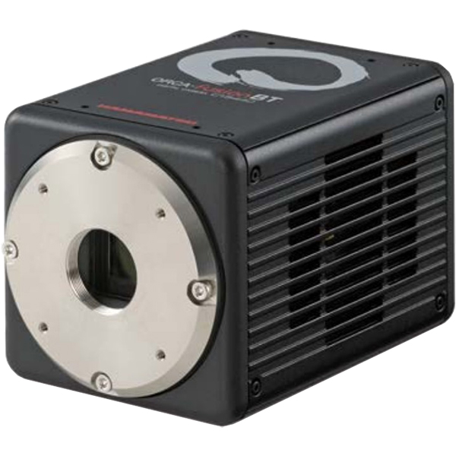
Hardware for SMLM
Wide-field or TIRF with high NA objectives (15k-20k)
High power lasers (~25k)
Sensitive EMCCD (~35k) or sCMOS (~16k) cameras
Additional optics for 3D information
System upgrade: ~$80,000

Slide 16
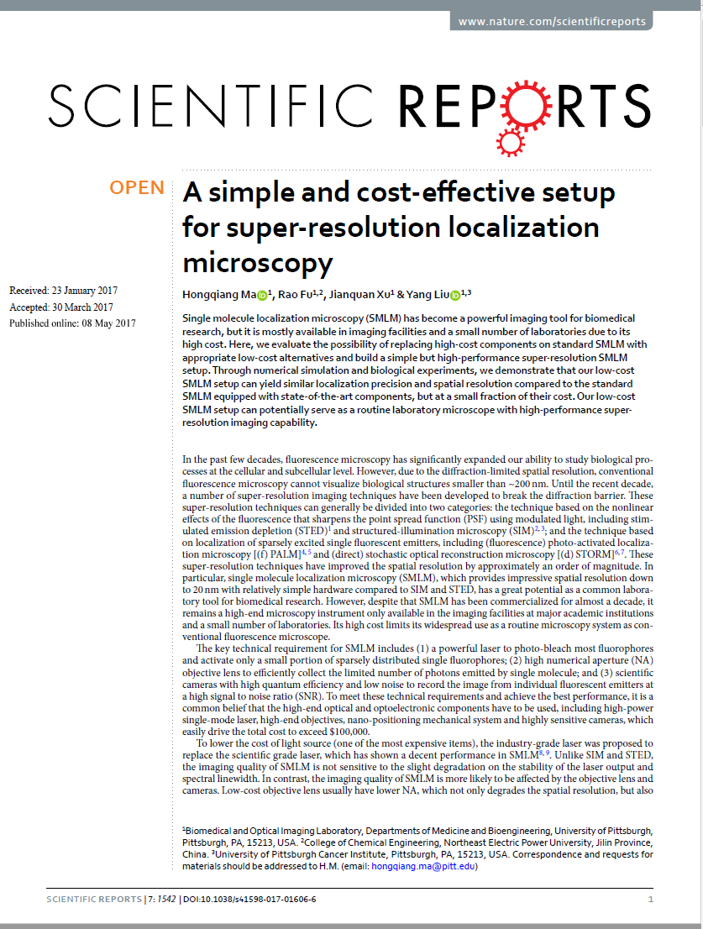
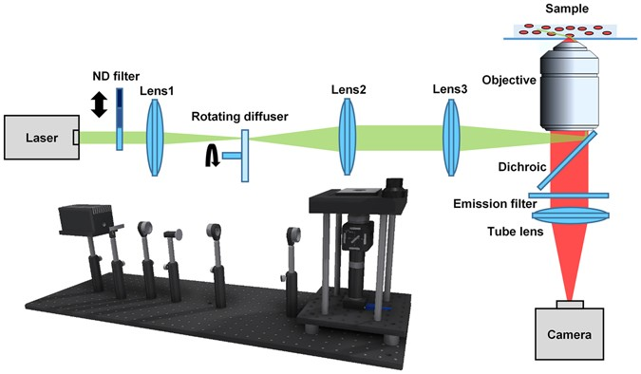
Hardware for SMLM
Total cost: $4,100.00
Ma et al. Scientific Reports (2017)

Slide 17
Overview
Basic principles 2D SMLM
Hardware for SMLM
Practical considerations: sample preparation, suitable dyes, linkage errors, and buffers
Processing, quantification, and interpretation of SMLM data
3D SMLM
Summary
Extra: New directions in SMLM
Extra: SRM as a multidimensional challenge

Slide 18
Practical considerations: sample preparation, suitable dyes, linkage errors, and buffers

Slide 19
Photoswitching – ON/OFF switching

Slide 20
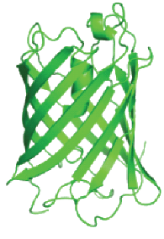
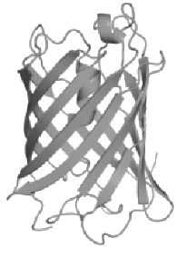
Photoswitching – ON/OFF switching
Electron lifetime: ~ns
Dark state decay rates: ~µs
~ps
ON
Excitation
Fluorescence
ON
OFF
~ps
OFF
Conventional dyes
Typical SMLM dyes
Temporal separation not possible
“Dark” state allows temporal separation for SMLM
Notes:
The off state can be a dark state, a state with a different fluorescent emission etc. – it only needs to be separate from the original state
Dashed line – not necessary reverse

Slide 21
A good SMLM dye has…
Long ON-time to allow the collection of many photons, but not too long such that the data acquisition is slowed down.
Complete dark OFF-state that is long enough to prevent too many fluorophores from being ON simultaneously.
High absorption coefficient and quantum yield to produce bright events.
Exceptional resistance to bleaching since tens of thousands of images are collected at high laser power.
Bleaching, brightness, ON-time, and ON/OFF duty cycle are all strongly affected by laser power and buffer composition.
Nahidiazar et al. PLOS ONE (2016)

Slide 22
Photoswitchable Fluorescent Proteins
Photoactivation by decarboxylation (PA-GFP, PA-mKate, PA-mCherry)
Photoswitching by beta-elimination (Dendra, mEos, mClavGR2, mIrisFP, mMaple)
Jradi et al. ACS Chem. Biol. (2019)

Slide 23
Photoswitchable Fluorescent Proteins
Photoconversion by cis-trans isomerization (Dronpa)
Photoconversion by hydration/dehydration (Dreiklang)
Jradi et al. ACS Chem. Biol. (2019)

Slide 24
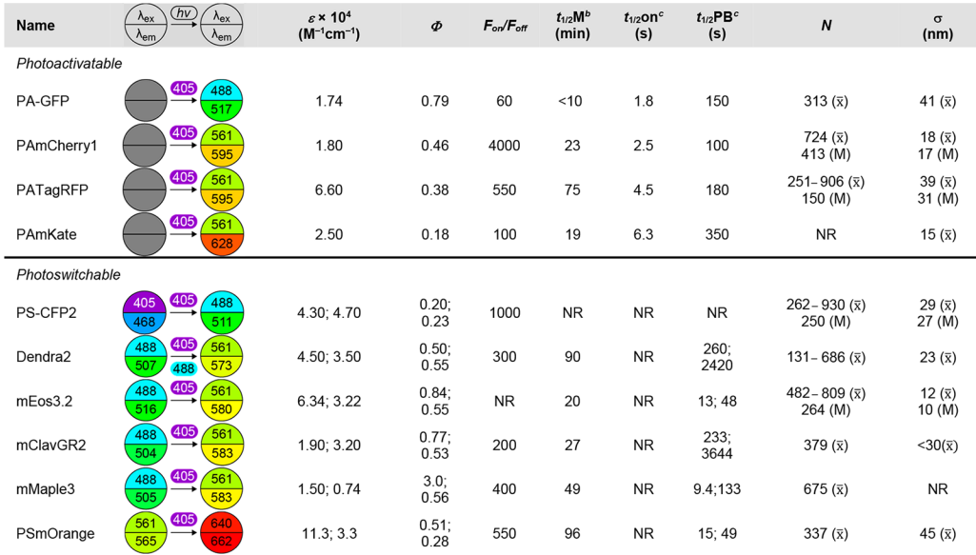
Photoswitchable Fluorescent Proteins
Jradi et al. ACS Chem. Biol. (2019)
Notes:
As with all fluorescence microscopy, the photophysical properties of the fluorophore labels are crucial for SMLM. These are summarized in Tables 1 and 2 and include the laser excitation wavelength (λ_{ex}), the fluorescence emission maximum (λ_{em}), the extinction coefficient at λ_{max} (ε), and the fluorescence quantum yield (Φ). Properties specific to fluorophores activated with light include: the fluorescence contrast upon photoactivation (F_{on}/F_{off}), the turn-on (t_{1/2}on) halftime, the photobleaching halftime (t_{1/2}PB), and the photon yield of individual fluorophores before bleaching (N). The maturation halftime (t_{1/2}M) is an important consideration for fluorescent proteins. For caged dyes, a critical factor is the photoactivation quantum yield (Φ_{PA}).

Slide 25
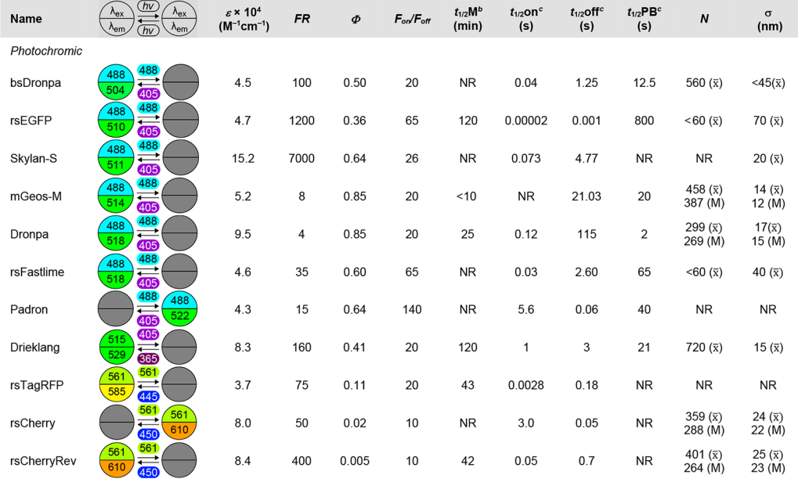
Jradi et al. ACS Chem. Biol. (2019)

Slide 26
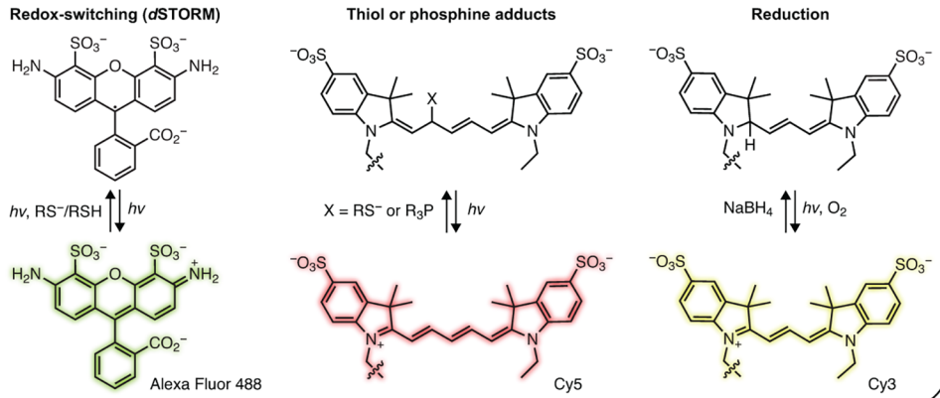
Photoswitchable Dyes
Conventional fluorophores (Alexa Fluor 488, Cy5, Cy3)
Jradi et al. ACS Chem. Biol. (2019)

Slide 27
Photoswitchable Dyes
Spontaneously blinking (HM-SiR)
Photochromic rhodamines
Jradi et al. ACS Chem. Biol. (2019)

Slide 28
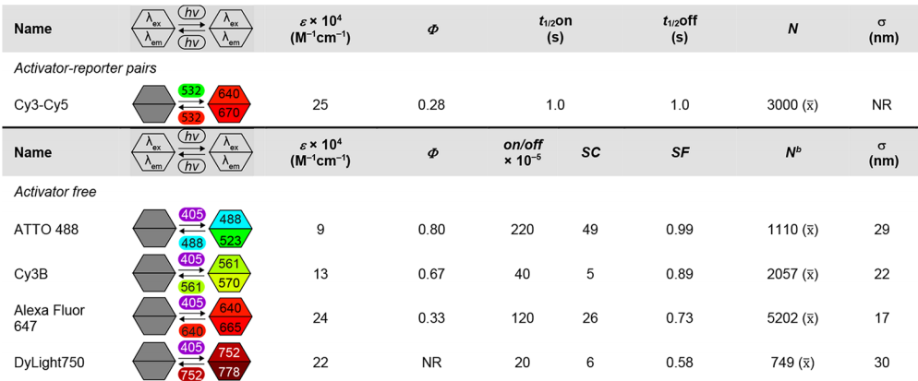
Photoswitchable Dyes
Jradi et al. ACS Chem. Biol. (2019)
Notes:
As with all fluorescence microscopy, the photophysical properties of the fluorophore labels are crucial for SMLM. These are summarized in Tables 1 and 2 and include the laser excitation wavelength (λ_{ex}), the fluorescence emission maximum (λ_{em}), the extinction coefficient at λ_{max} (ε), and the fluorescence quantum yield (Φ). Properties specific to fluorophores activated with light include: the fluorescence contrast upon photoactivation (F_{on}/F_{off}), the turn-on (t_{1/2}on) halftime, the photobleaching halftime (t_{1/2}PB), and the photon yield of individual fluorophores before bleaching (N). The maturation halftime (t_{1/2}M) is an important consideration for fluorescent proteins. For caged dyes, a critical factor is the photoactivation quantum yield (Φ_{PA}).

Slide 29
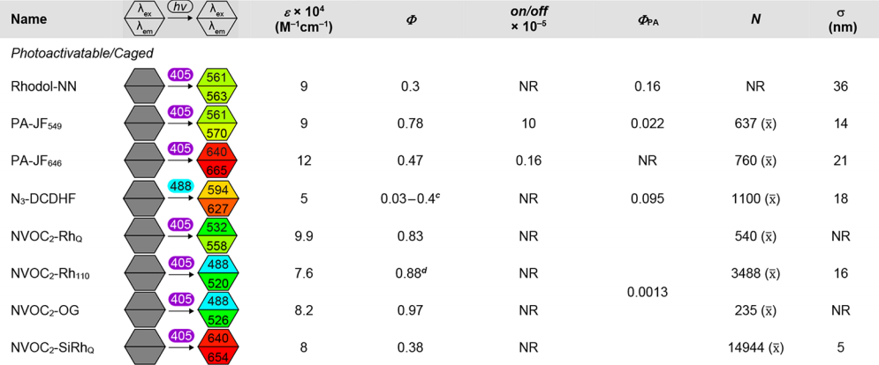
Jradi et al. ACS Chem. Biol. (2019)

Slide 30
Current Approaches in SMLM
They differ primarily in how ON/OFF switching is achieved:
(f)PALM – photoactivation
STORM – photoswitching of activator and reporter dye-pair
dSTORM – conventional fluorescent probes in the presence of thiols transfer dyes to a long-lived OFF state
(f)BALM – binding and fluorescence activation of specific dyes
DNA-PAINT/Exchange-PAINT – transient oligonucleotide hybridization
Betzig et al. Science (2006), Hess et al. Biophy. J. (2006), Rust et al. Nature Methods. (2006), Heilemann et al. Angew Chem Int Ed Engl. (2008), Schoen et al. Nano Lett. (2011), Szczurek et al. Nucleic Acids Res. (2017), Jungmann et al. Nano Lett. (2010), Jungmann et al. Nat. Methods (2010), Jungmann et al. Nat. Methods (2014)

Slide 31
Linkage errors of various fluorescent labelling approaches
!!!
Lelek et al. Nature Reviews Methods Primer (2021)
Notes:
immunolabelling with primary (1st) and secondary (2nd) antibodies (yellow); labelling with a small camelid antibody (nanobody, light green), often in combination with green fluorescent protein (dark green), as shown, or when available directly binding to the protein of interest (not shown); labelling with a protein tag or genetically encoded protein, such as Eos (orange); direct labelling with a dye-conjugated ligand (such as the microtubule-binding compound docetaxel in this example); and incorporation of unnatural amino acids such as TCO*-lysine through genetic code expansion, which enables rapid labelling using functionalized synthetic dyes.

Slide 32
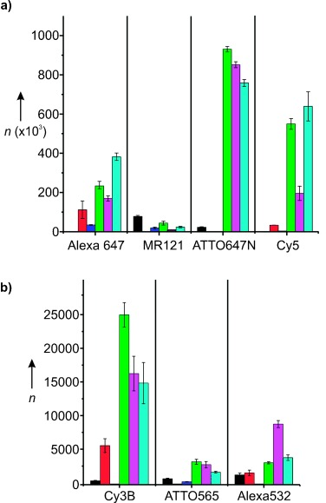
Buffers in SMLM
Different dyes blink optimally in different imaging buffers. Therefore, the acquisition of good quality 2- and 3-color images can be challenging.
Average photon counts per molecule in different buffers
Vogelsang et al. Angew Chem Int Ed Engl. (2008)
Notes:
Figure: Average photon counts per molecule a) for the red fluorophores Alexa647, MR121, ATTO647N, and Cy5, and b) for the green/yellow fluorophores Cy3B, ATTO565, and Alexa532 were obtained from at least three photobleaching movies using objective‐type total internal reflection microscopy. Measurements were carried out in PBS (black bars), oxygen‐depleted PBS with 1 mM AA (red), with 1 mM MV (blue), with ROXS (1 mM AA plus 1 mM MV (green), or 2 mM TX plus 1 mM MV (cyan), or 2 mM TX (magenta)).

Slide 33
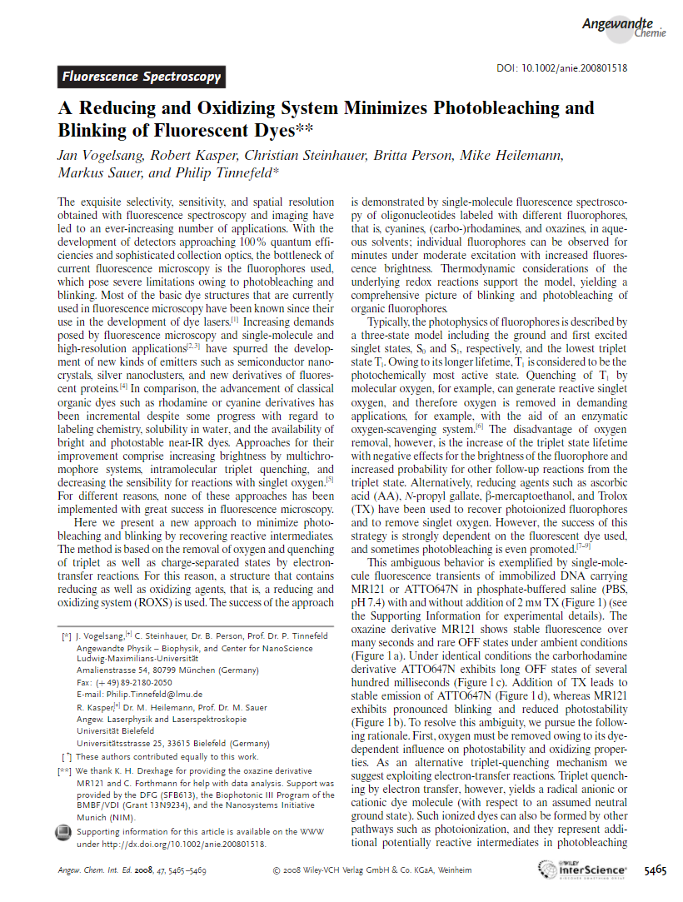
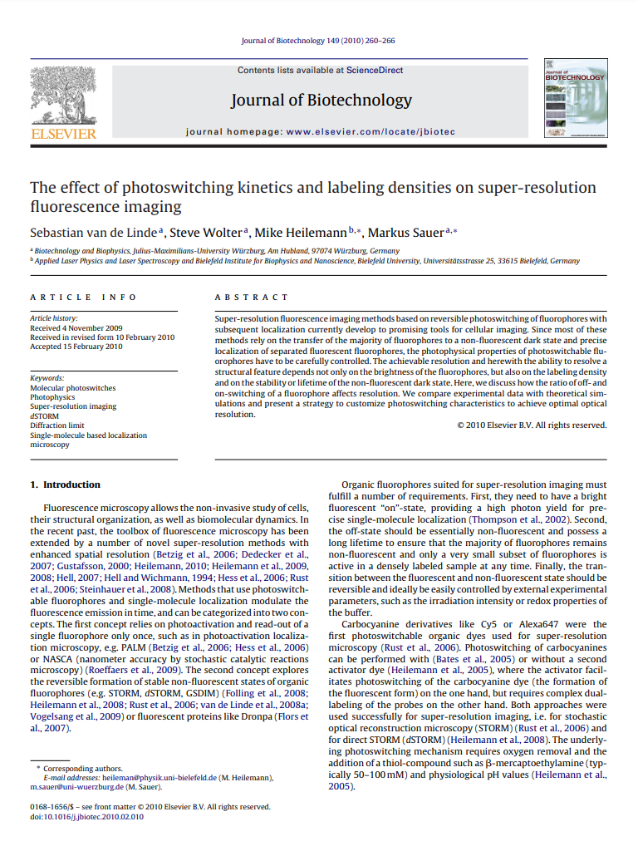
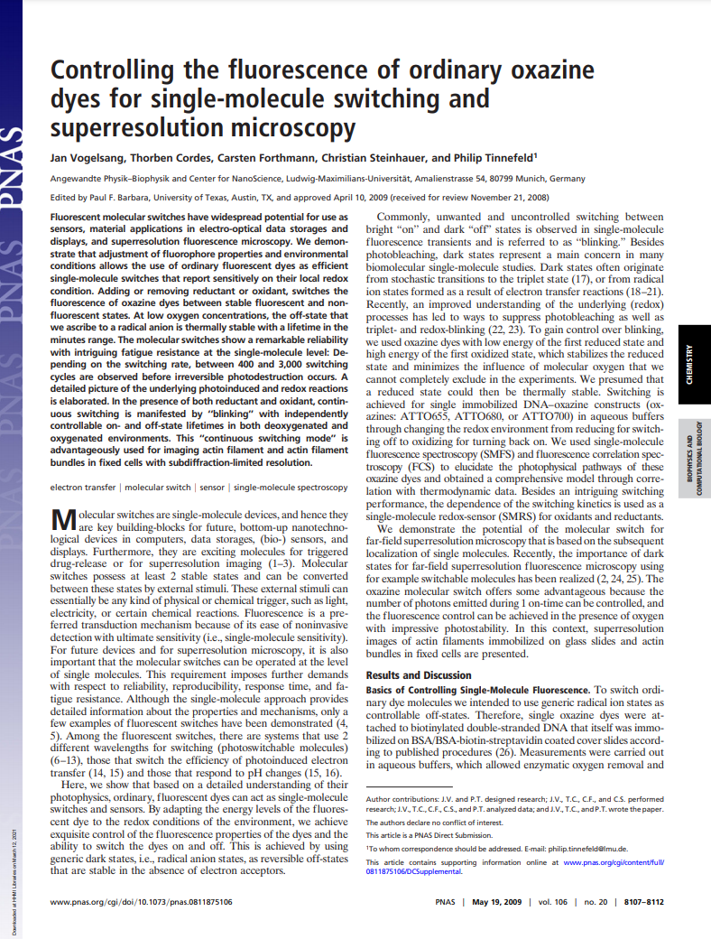
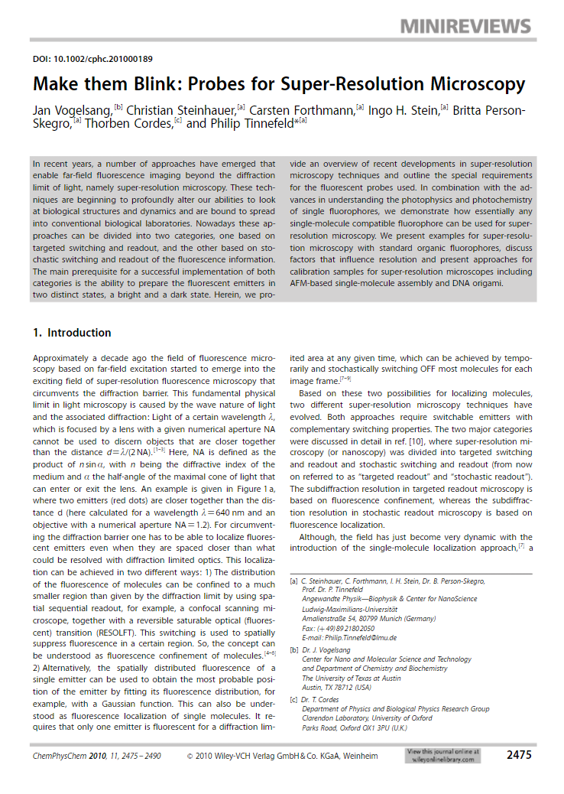
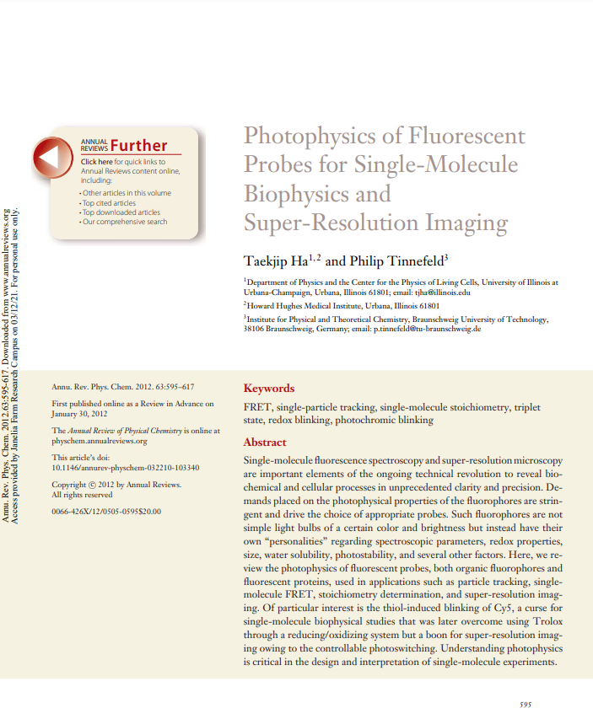
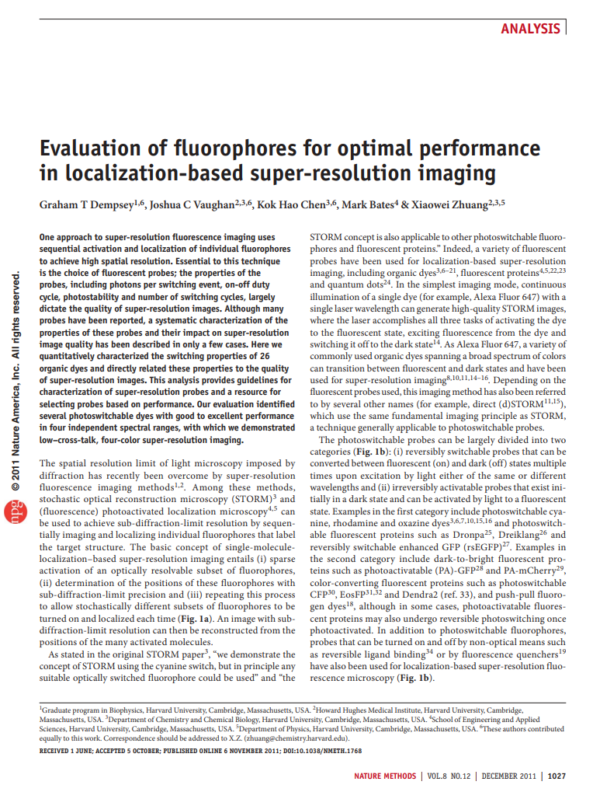
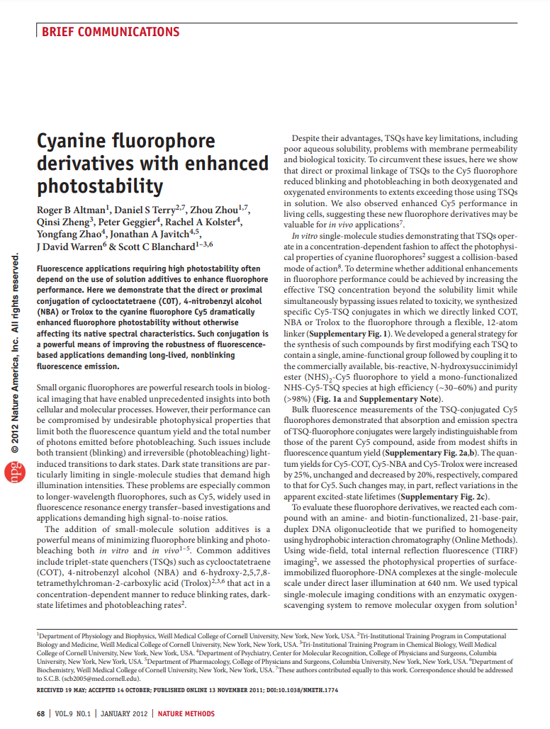
Buffers in SMLM
Advice: Once you have picked a dye for your SMLM experiment depending on your microscope (available lasers) and biological constraints, make yourself familiar with which buffers are most suitable and test & optimize them.

Slide 34
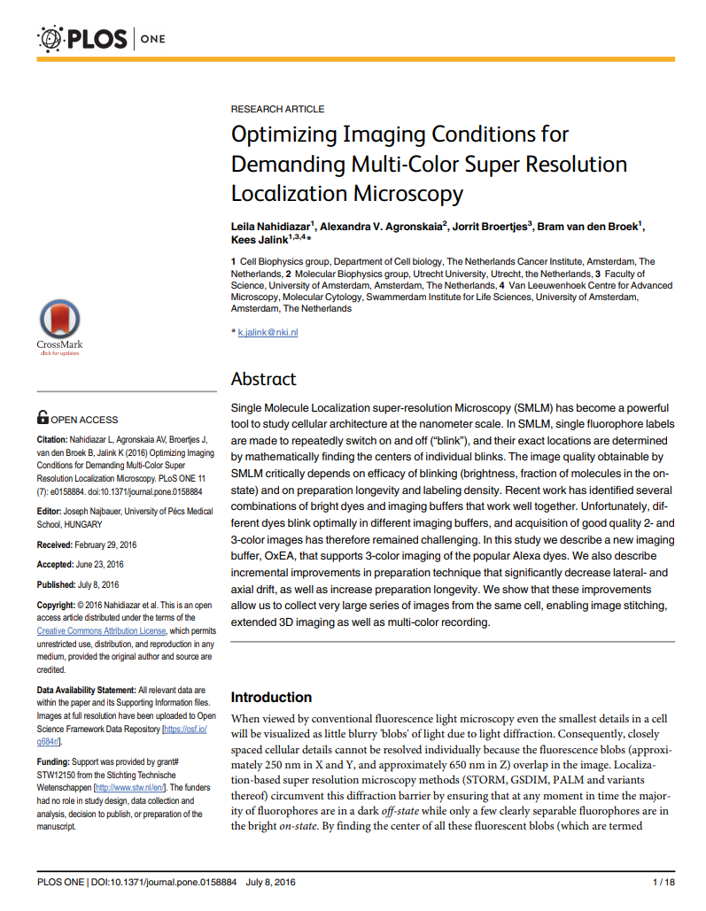
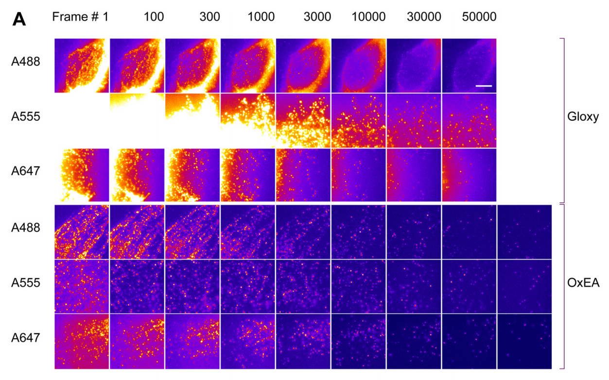
Buffers in SMLM
Nahidiazar et al. PLOS ONE (2016)
Notes:
RF EC24 endothelial cells were labeled for vimentin using a mouse monoclonal antibody (Ab) and secondary Ab labeled with Alexa dyes.

Slide 35
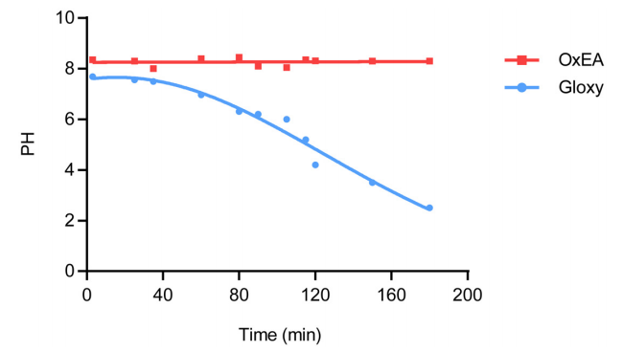
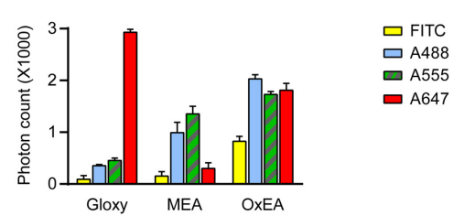
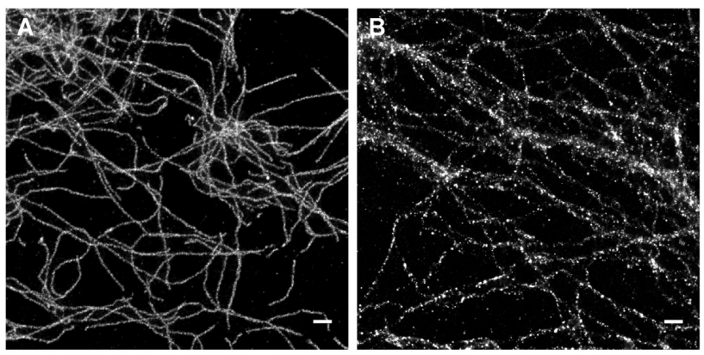
Buffers in SMLM
Comparison of image quality in ageing Gloxy buffer (B) to that in OxEA buffer (A).
Advice: Always prepare your imaging buffer right before experiments &
adjust your imaging buffer choice for multicolor experiments.
Nahidiazar et al. PLOS ONE (2016)

Slide 36
Overview
Basic principles 2D SMLM
Hardware for SMLM
Practical considerations: sample preparation, suitable dyes, linkage errors, and buffers
Processing, quantification, and interpretation of SMLM data
3D SMLM
Summary
Extra: New directions in SMLM
Extra: SRM as a multidimensional challenge

Slide 37
Processing, quantification, and interpretation of SMLM data

Slide 38
How large is an SMLM dataset?
50,000 frames taken with a 16-bit camera (1024 x 1024 pixel) lead to…
Total number of pixel on the detector:
1024 x 1024 = 1,048,576 pixel
Total bits:
1,048,576 x 16 bits = 16,777,216 bits
Conversion into bytes:
16,777,216 bits / 8 = 2,097,152 bytes ~ 2 MB (one frame)
Upscaled to 50,000 frames:
2 MB x 50,000 ~ 100 GB
That is a lot of data that needs to be handled…

Slide 39
From raw SMLM data to reconstructed super-resolved image
Image Acquisition
Widefield image
Image at t₁
Image at t₂
Image at t₃
Render SMLM image
Superresolution image
Detection and localization
Betzig et al. Science (2006), Hess et al. Biophy. J. (2006), Rust et al. Nat Methods (2006)
t₁ < t₂ < t₃

Slide 40
Detection
Approximate molecule location = Detection
Detection

Slide 41
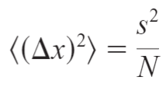
Detection and localization
$$Δx≈\frac{λ}{2\text{NA}}$$
Abbe Equation
vs.
Approximate molecule location = Detection
Accurate determination of the molecule center = Localization
Localization
Thompson et al. Biophysical Journal (2002)

Slide 42
Error in localization – Equations
$$∆x$$
Error in localization
s Standard deviation of the PSF
N Number of photons collected
The modified equation to account for photon-counting noise, pixelation noise and background noise:
a Size of the pixel
b Background noise
Thompson et al. Biophysical Journal (2002)

Slide 43
Detection and localization
Approximate molecule location = Detection
Accurate determination of the molecule center = Localization
New images with localizations?
Result: List of localizations (x,y coordinates, localization errors / uncertainties & add. parameters)
No, but a list of localizations!

Slide 44
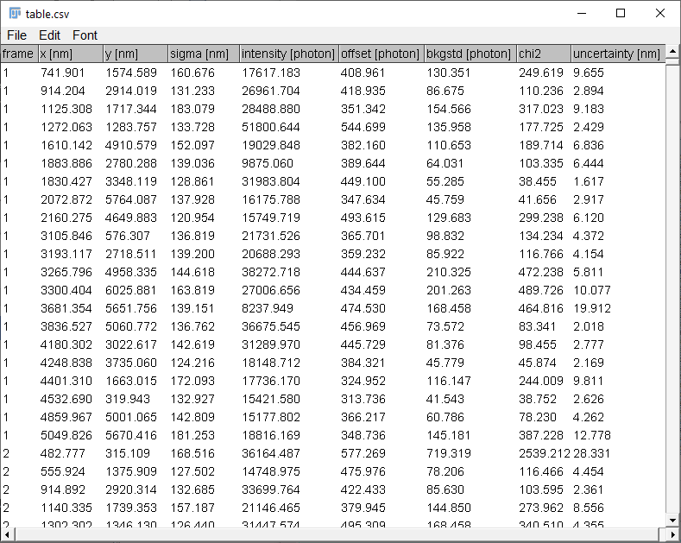
Pixel data vs. point clouds
In contrast to standard microscopy imaging that produces 2D pixel or 3D voxel grid data, SMLM generates big data of 2D or 3D point clouds with millions of localizations and associated uncertainties.
Therefore, processing, quantification, analysis and interpretation of SMLM must be approaches differently.
To this day, the SMLM data quantification and interpretation methods have yet to keep pace with the rapid advancement of SMLM imaging.
Khater et al. Biophysical Journal (2002)

Slide 45
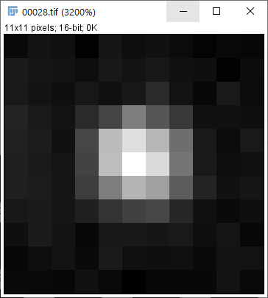
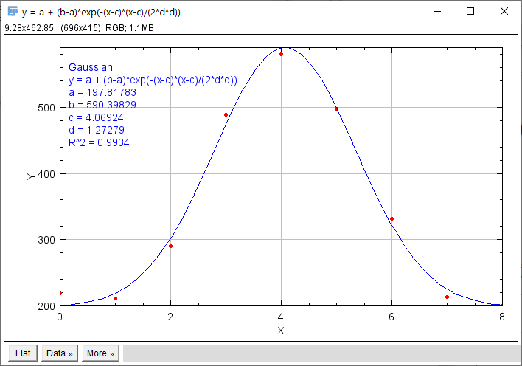
List of localizations
x,y – central coordinate
sigma - Gaussian width
Gaussian amplitude / offset
χ2 – goodness-of-fit
Uncertainty
New images with localizations?

Slide 46
Sequence of SMLM processing and analysis steps
(1) Detection & localization
(2) Sieving / Filtering
Raw camera image (typ. 128x128x10,000)
List of localizations (typ. 200,000)
List of localizations (typ. 100,000)
(5) Quantification
(3) De-drifting and Grouping
Size (nm), Clusters, Stoichiometry
Super-resolved image (typ. 1028x1028)
List of localizations (typ. 80,000)
(4) Rendering

Slide 47
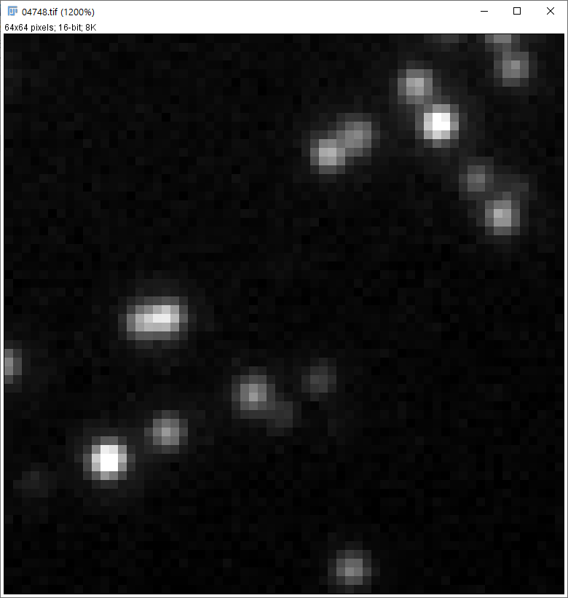
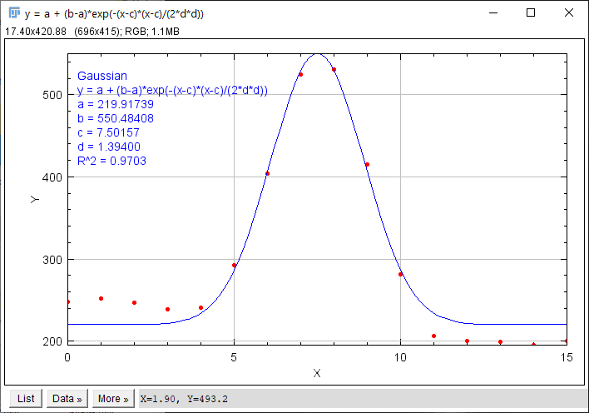
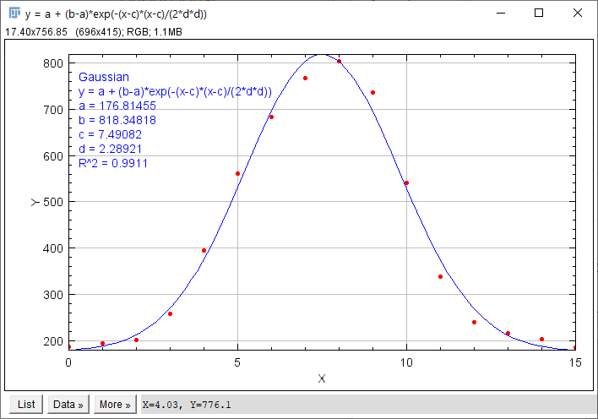
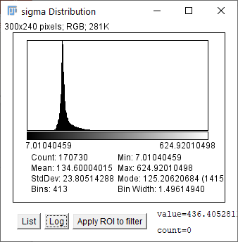
High-density data / multiple emitters
A
B
B
A
Choosing a suitable multi-emitter fitting method/algorithm can help to deal with high-density data.
Alternatively, you can filter/sieve your data to handle invalid localizations.
Advice: Choose suitable filtering parameters with the histogram of the respective fitting parameter.

Slide 48
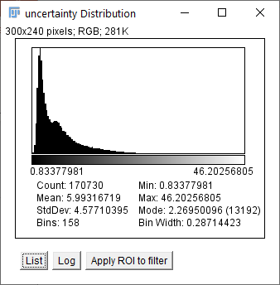
SMLM’s resolution
So, when you filter/sieve out high uncertainties, you can reach insanely high resolutions, right?
No, not really!
5.5
5.5
11.1
8.5
4.5
8.5
4.5
5.5
5.5
10.3
15.8
7.5
7.5
12.2
12.1
17.4
5.3
5.3
15.4
17.4
13.3
25.5
20.7
4.0
6.5
4.0
6.5
11.7
2.8
2.8
10.7
Uncertainty < 25 nm
Uncertainty < 10nm
You can filter high uncertainties, but at a certain point you’ll lose the structure’s integrity. The measure of resolution would be meaningless.

Slide 49
Drift-correction
4 min movie
0.5 µm
uncorrected
corrected
Drift becomes a limiting factor in achieving high resolution. Fortunately, it can be corrected for by fiducial-based or image-based (cross-correlation) strategies.

Slide 50
Grouping / Blink-correction
According to time
According to space
Grouping time t_{g}
Grouping radius r_{g}
Intensity [AU]
“Grouped” molecules
Frames
Individual molecules
Grouped photon-averaged position
Notes:
All localizations within a given region of space limited by grouping radius r_g and time limited by a grouping time t_g are considered to originate from the same molecule and their positions are averaged into a new grouped photon-weighted average molecular localization.

Slide 51
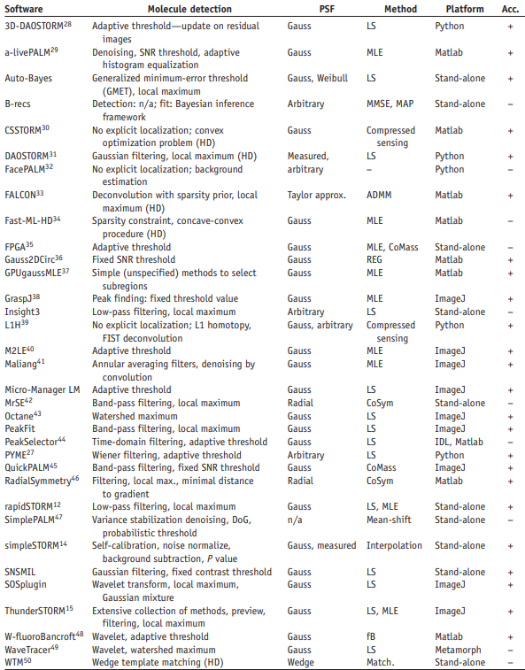
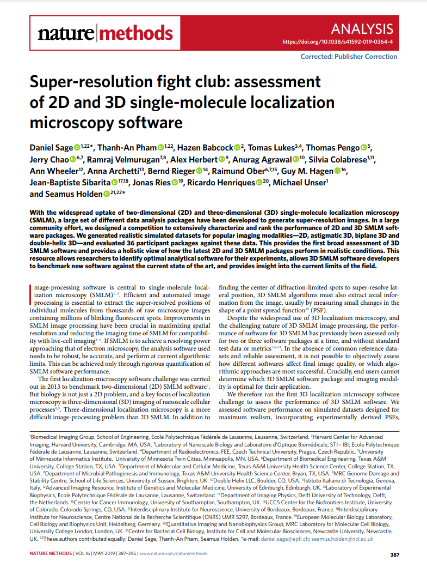
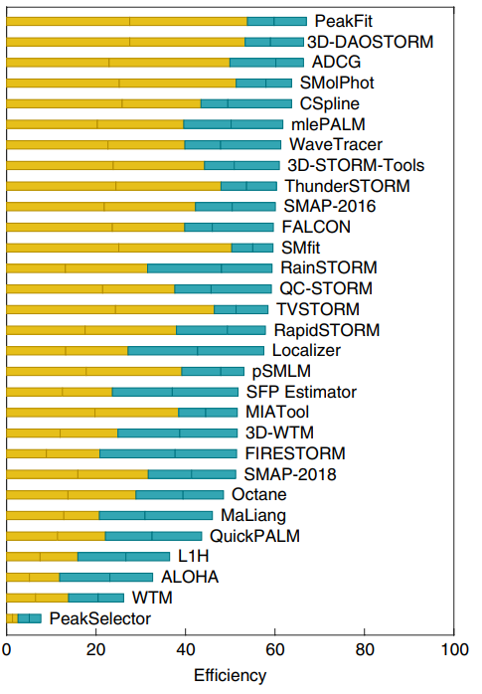
Software for SMLM
Sage et al. Nature Methods (2019), Sage et al. Nature Methods (2015)

Slide 52
Sequence of SMLM processing and analysis steps
(1) Detection & localization
(2) Sieving / Filtering
Raw camera image (typ. 128x128x10.000)
List of localizations (typ. 200.000)
List of localizations (typ. 100.000)
(5) Quantification
(3) De-drifting and Grouping
Size (nm), Clusters, Stoichiometry
With ThunderSTORM you can…
Super-resolved image (typ. 1028x1028)
List of localizations (typ. 80.000)
(4) Rendering
Ovesny et al. Bioinformatics (2014)

Slide 53
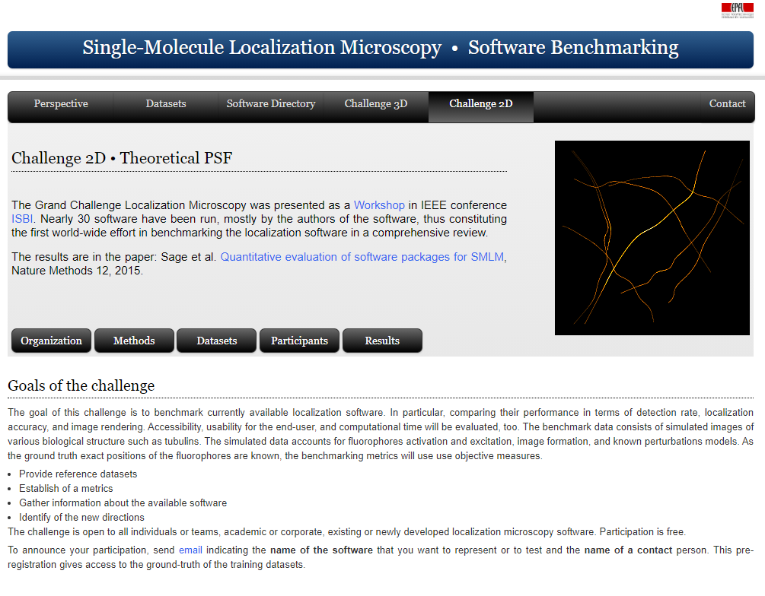
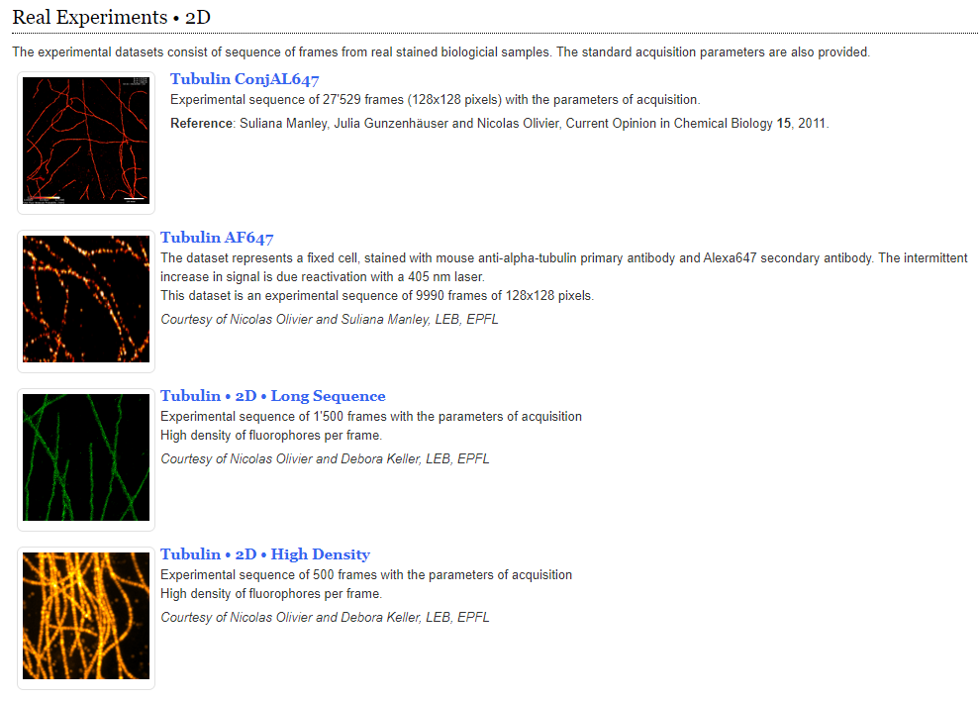
Feel free to test it…
Use the Fiji plugin ThunderSTORM to analysis the Tubulin 2D Long Sequence Dataset
Software: Fiji plugin ThunderSTORM Plugin can be downloaded here: https://github.com/zitmen/thunderstorm/releases/tag/v1.3 and will be located here: Plugins > ThunderSTORM Online manual: https://github.com/zitmen/thunderstorm/wiki/Tutorials
Dataset: Tubulin 2D Long Sequence http://bigwww.epfl.ch/smlm/datasets/index.html?p=../challenge2013/datasets/Real_Long_Sequence
Ovesny et al. Bioinformatics (2014)

Slide 54
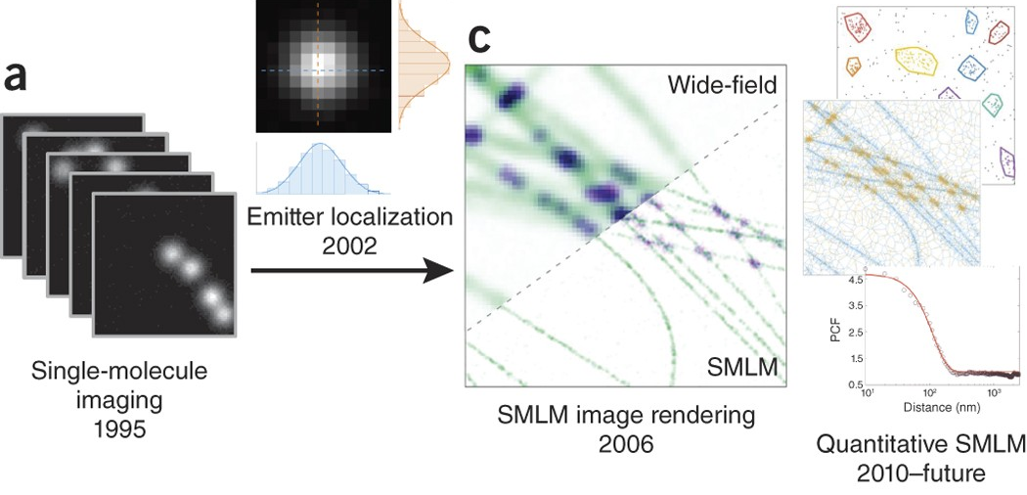
Timeline of SMLM developments
Nicovich et al. Nature Protocols (2017)

Slide 55
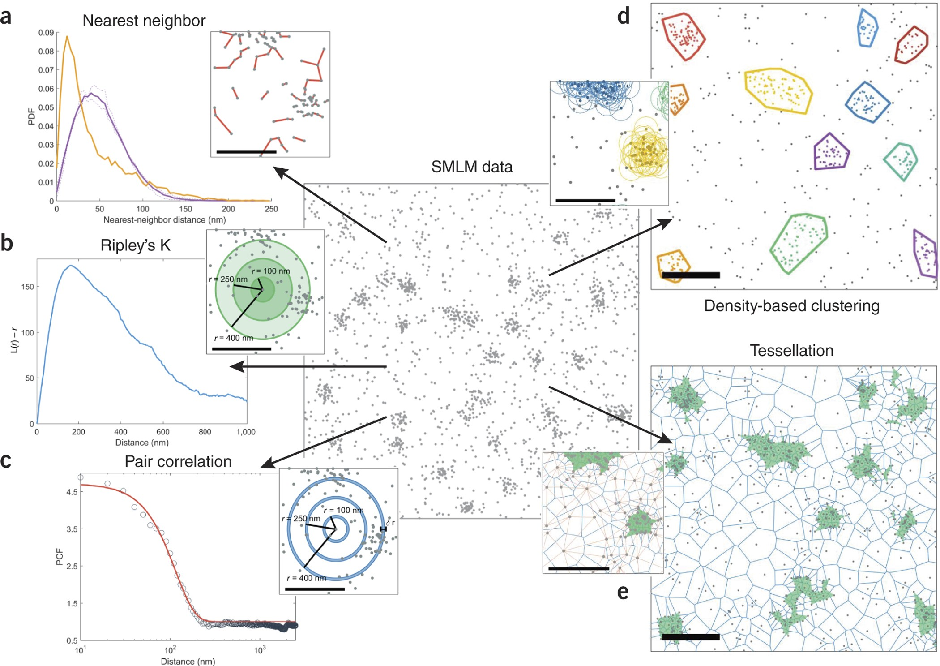
Spatial analysis approaches
Nicovich et al. Nature Protocols (2017)

Slide 56
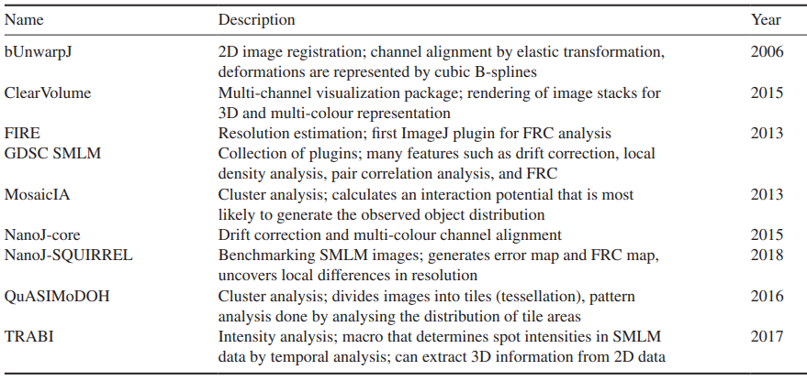
Fiji plugins for SMLM post-processing
Van der Linde et al. Journal of Physics D: Applied Physics (2019)

Slide 57
Overview
Basic principles 2D SMLM
Hardware for SMLM
Practical considerations: sample preparation, suitable dyes, linkage errors, and buffers
Processing, quantification, and interpretation of SMLM data
3D SMLM
Summary
Extra: New directions in SMLM
Extra: SRM as a multidimensional challenge

Slide 58
3D SMLM

Slide 59
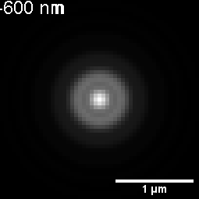
Can we localize SM in the axial direction?
A microscope’s PSF is symmetric in the axial direction, which complicates single molecules' localization along the axial axes.
$$α$$
Simulated PSF
-200 nm
0 nm
+200 nm

Slide 60
Decoding the axial information
Breaking the symmetry of the PSF enables us to decode axial information.
Astigmatism
Biplane
Double-helix
Cylindrical lens in detection path
Emitted light detected onto two cameras (or two halves of one camera) defocused relative to one another
Spatial light modulator / phase mask in detection path
Huang et al. Science (2008), Juette et al. Nature Methods (2008), Pavani et al. Optics Express (2008)

Slide 61
Decoding the axial information
Lelek et al. Nature Reviews Methods Primer (2021)

Slide 62
Decoding the axial information
Breaking the symmetry of the PSF enables us to decode axial information.
Resolution: 10-20 nm in all three dimensions
iPALM
Shtengel et al. PNAS (2009)

Slide 63
Overview
Basic principles 2D SMLM
Hardware for SMLM
Practical considerations: sample preparation, suitable dyes, linkage errors, and buffers
Processing, quantification, and interpretation of SMLM data
3D SMLM
Summary
Extra: New directions in SMLM
Extra: SRM as a multidimensional challenge

Slide 64
Summary

Slide 65
Let’s wrap it up…
Merits
Very high resolution
Single molecule detection
Relative simple microscope setup
Can be combined with TIRF and inclined illumination (HILO)
Quantification of protein numbers
Upgrade solution for exciting setups to enable extended 3D localization using PSF engineering (e.g., Double Helix)
Image: Xu et al. Nature Methods (2012)

Slide 66
Let’s wrap it up…
Disadvantages
Special buffers/probes required
Not for thick samples (< 10 um)
Slow acquisition
Limited 3D (no sectioning)
Advanced post-processing needed
Prone to reconstruction artifacts
Structural resolution labeling density-dependent
Image: Xu et al. Science (2013)

Slide 67
Overview
Basic principles 2D SMLM
Hardware for SMLM
Practical considerations: sample preparation, suitable dyes, linkage errors, and buffers
Processing, quantification, and interpretation of SMLM data
3D SMLM
Summary
Extra: New directions in SMLM
Extra: SRM as a multidimensional challenge

Slide 68
Thank you! Questions?
Ulrike Boehm, Ph.D.
ulrike.boehm@zeiss.com
Twitter: @ulrike_boehm
Opt to Work at ZEISS Job openings and applications
https://www.zeiss.com/corporate/int/careers/job-openings-and-applications.html
Photo: Martin Duckek

Slide 69
New dimensions in SMLM

Slide 70
MINFLUX emitter localization concept
Lelek et al. Nature Reviews Methods Primer (2021)
Notes:
a | MINFLUX excitation concept for precisely probing emitter positions using minimal photon fluxes. A doughnut-shaped excitation beam (green) is moved sequentially to four probing positions r₀, r₁, r₂ and r₃ (coloured circles; probing range L) in the vicinity of a single fluorophore (orange star). If the doughnut centre coincides perfectly with the fluorophore position, no photons are emitted. The position of the fluorophore can be calculated with very high precision from the fluorescence photon counts (shown below). b | Example nuclear pore complexes imaged by MINFLUX.

Slide 71
Expansion SMLM
Lelek et al. Nature Reviews Methods Primer (2021)
Notes:
c | In expansion microscopy, samples are embedded in a gel that expands upon hydration. Immunolabelling of epitopes can be performed before or after gelation and expansion using linkers that bind to the gel and to a fluorescent dye. Full or partial protein digestion is commonly used to enable isotropic expansion. In order to enable direct stochastic optical reconstruction microscopy (dSTORM) imaging in photoswitching buffer, the sample is re-embedded in an uncharged polyacrylamide gel after expansion. d | Left: 3D post-labelling expansion dSTORM image of a 3.2× expanded and re-embedded sample showing 9-fold symmetry of the procentriole. Scale bar: 500 nm. Right: 3.1-fold expanded and re-embedded tubulin filaments, with magnified view of highlighted region. An xz side-view cross-section of a tubulin filament (bottom right) shows its hollow structure. Scale bars: 500 nm (vertical rectangle), 200 nm (small square).

Slide 72
Deep learning-accelerated SMLM
Lelek et al. Nature Reviews Methods Primer (2021)

Slide 73
SRM as a multidimensional challenge

Slide 74
Inherent trade-offs in SRM
Schermelleh et al. Nature Cell Biology (2019)

Slide 75
Decision tree for selecting SRM techniques
Schermelleh et al. Nature Cell Biology (2019)

Slide 76
Appendix

Slide 77
Switching buffers
Turkowyd et al. Anal. Bioanal. Chem. (2016)

Slide 78
Switching buffers
Turkowyd et al. Anal. Bioanal. Chem. (2016)

Slide 79
Multicolor SMLM
Turkowyd et al. Anal. Bioanal. Chem. (2016)

Slide 80
Turkowyd et al. Anal. Bioanal. Chem. (2016)

