Slide 1
LATN Fellowship Exploring Inclusive Solutions in OER
Ash Barber – UniSA Library

Slide 2
Acknowledgement of Country
I respectfully acknowledge the Kaurna People as the Traditional Custodians of the unceded lands where I live and work and I extend that respect to all First Nations Peoples and acknowledge their deep and spiritual relationship to Country.

Slide 3
Why this project?
OER flourishing in Australia
CAUL Pressbooks publishing pilot
Heightened awareness of traditional textbook issues
Lambert & Fadel (2022) Open textbooks and social justice: A national scoping study
Need for central hub of IDEA guidance for Australia
(and why now?)

Slide 4
Adelaide

Slide 5
Leg 1
Los Angeles & Santa Clarita
James Glapa-Grossklag
Dean: Educational Technology, Learning Resources & Distance Education
OER Fellow, Michelson 20MM Foundation
Co-Director: Open for Anti-Racism (OFAR) Program
Los Angeles
Adelaide

Slide 6
Leg 2
Vancouver
Amanda Coolidge
Executive Director, BCcampus
Clint Lalonde
Director: Open Education, BCcampus
Carolee Clyne
Learning Strategy Consultant, Universal Design for Learning (UDL)
Vancouver
Los Angeles
Adelaide

Slide 7
Leg 3
Minneapolis
Dave Ernst
Founder & Executive Director, Open Education Network
Barb Thees
Director: Community Engagement, Open Education Network
Al Kuslikis
Sr. Associate: Strategic Initiatives, AIHEC
Vancouver
Los Angeles
Minneapolis
Adelaide

Slide 8
Home
Adelaide
Vancouver
Los Angeles
Minneapolis
Los Angeles (again)
Adelaide

Slide 9
Home
Adelaide
Vancouver
+ 2.5 weeks
+ 21 meetings
+ 46 people
+ 33,000 kms
Los Angeles
Minneapolis
Los Angeles (again)
Adelaide – Back home!

Slide 10
Home
Adelaide
Vancouver
+ 2.5 weeks
+ 21 meetings
+ 46 people
+ 33,000 kms
Los Angeles
Minneapolis
Los Angeles (again)
= Giant Spreadsheet
Adelaide – Back home!

Slide 11
Key Insights
Dedicated OER role
BranchED Equity Rubric
BCcampus Indigenization Guides
UDL Guidelines
Little wins
Australian resources
(so far)

Slide 12
Key Insights
Dedicated OER role
BranchED Equity Rubric
BCcampus Indigenization Guides
UDL Guidelines
Little wins
Australian resources
(so far)

Slide 13
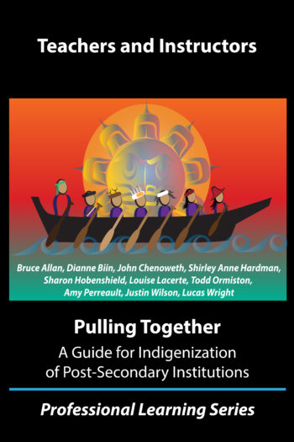
Key Insights
Dedicated OER role
BranchED Equity Rubric
BCcampus Indigenization Guides
UDL Guidelines
Little wins
Australian resources
(so far)

Slide 14
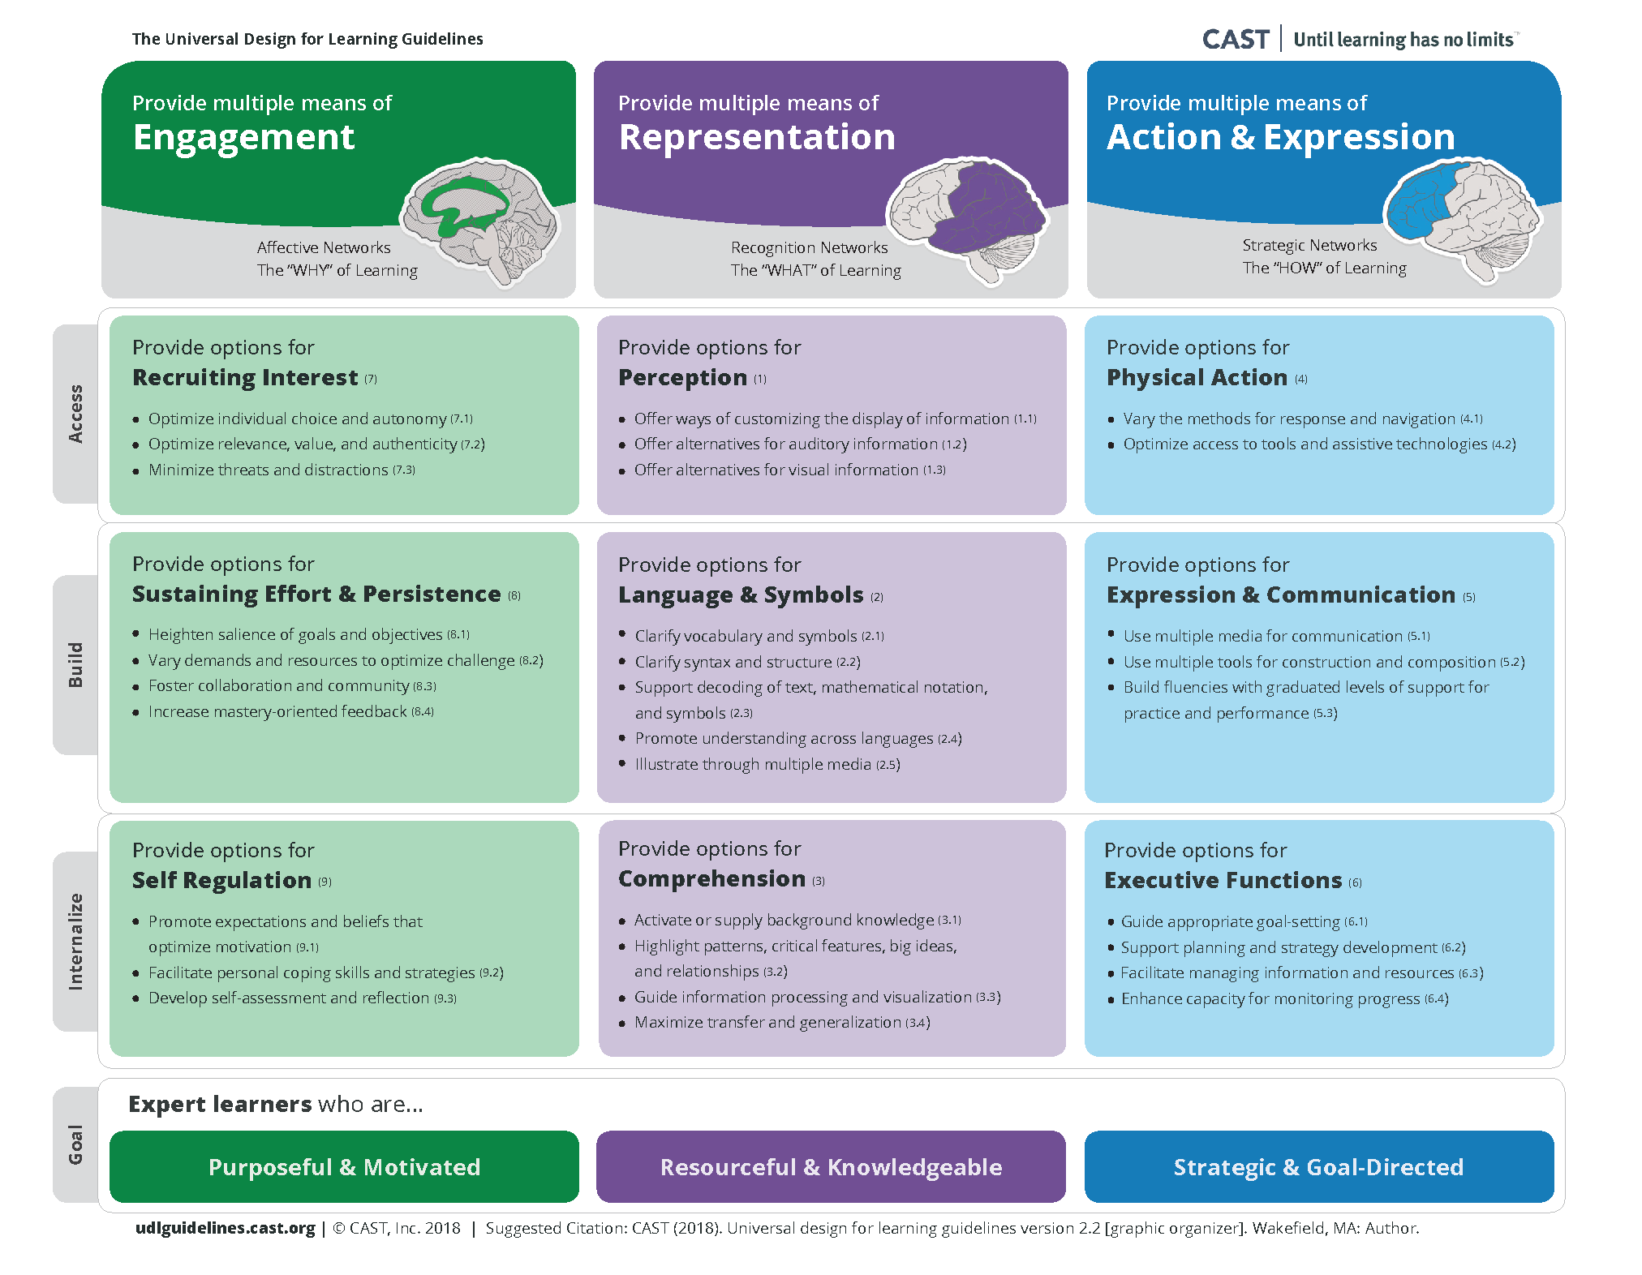
Key Insights
Dedicated OER role
BranchED Equity Rubric
BCcampus Indigenization Guides
UDL Guidelines
Little wins
Australian resources
(so far)

Slide 15
Key Insights
Dedicated OER role
BranchED Equity Rubric
BCcampus Indigenization Guides
UDL Guidelines
Little wins
Australian resources
(so far)

Slide 16
EmpoweredOER.wordpress.com
Ashleigh.Barber@unisa.edu.au
@AshTheLibrarian #EmpoweredOER

Slide 17
EmpoweredOER.wordpress.com
Ashleigh.Barber@unisa.edu.au
@AshTheLibrarian #EmpoweredOER

