Slide 1
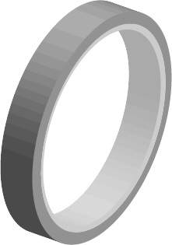
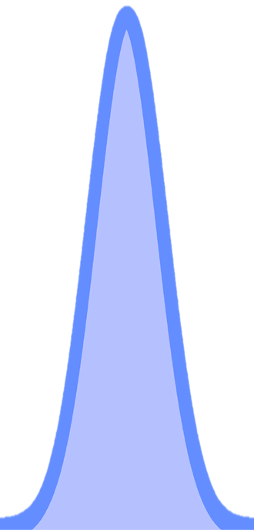
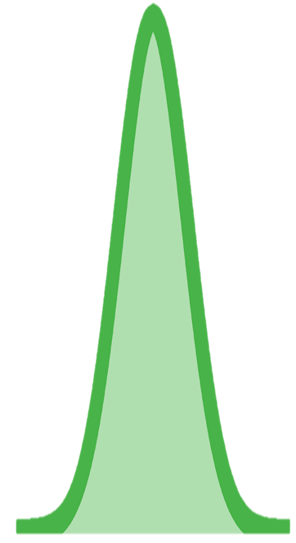
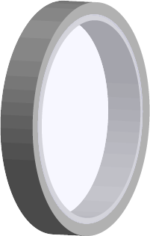
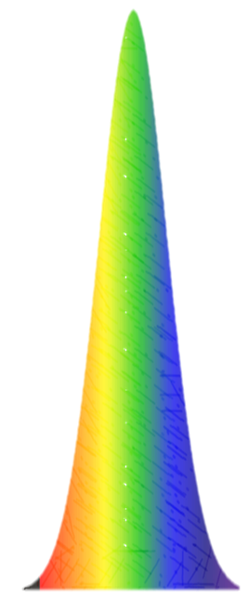
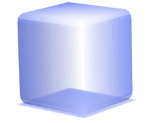
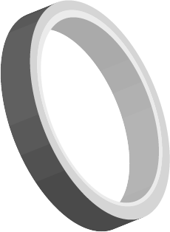
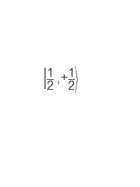

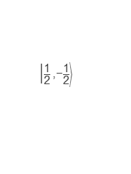
a
b
$$\left|\frac{\text{1}}{\text{2}}\right.\left.\text{,}\left.\text{+}\frac{\text{1}}{\text{2}}\right\rangle \right.$$
$$\left|\frac{\text{1}}{\text{2}}\right.\left.\text{,}\left.\text{−}\frac{\text{1}}{\text{2}}\right\rangle \right.$$
CBM
σ⁺
σ⁻
VBM
$$\left|\frac{\text{1}}{\text{2}}\right.\left.\text{,}\left.\text{−}\frac{\text{1}}{\text{2}}\right\rangle \right.$$
$$\left|\frac{\text{1}}{\text{2}}\right.\left.\text{,}\left.\text{+}\frac{\text{1}}{\text{2}}\right\rangle \right.$$
c
Laser
OPA
Chopper
Pump
$$\overset{⃑}{Bz}$$
Det.
Tip
BBO
Probe
Delay Line
BBO
t_{probe}
t_{tip}
QWP
Sample
298 K
Sapphire
d
$$\overset{⃑}{Bz}$$
Spin precession:
Optical Stark effect:
$$\overset{⃑}{Bz}$$
Coherent manipulation:

Slide 2
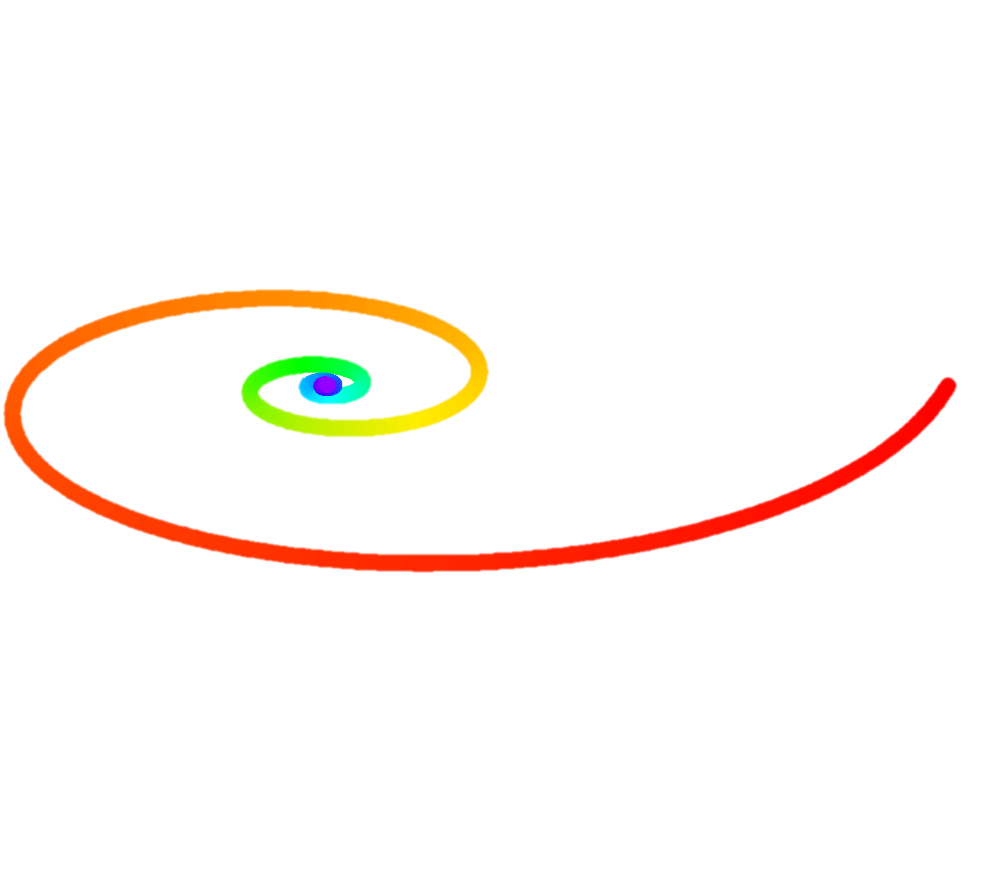

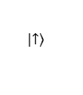

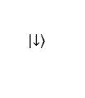





a
c
Co-polar.
0.65 T
Counter-polar.
0.65 T
σ⁺
σ⁻
$$\frac{\left|\left.↑\right\rangle \right.+\left|\left.↓\right\rangle \right. }{\sqrt{2}}$$
$$\frac{\left|\left.↑\right\rangle \right.−\left|\left.↓\right\rangle \right. }{\sqrt{2}}$$
$$\overset{⃑}{B_{z}}$$
b
d
Hole-spin Bloch sphere
$$\left|\left.↑\right\rangle \right.$$
$$\overset{⃑}{B_{z}}$$
$$\frac{\left|\left.↑\right\rangle \right.−\left|\left.↓\right\rangle \right. }{\sqrt{2}}$$
$$\frac{\left|\left.↑\right\rangle \right.+\left|\left.↓\right\rangle \right. }{\sqrt{2}}$$
$$z$$
$$\left|\left.↓\right\rangle \right.$$
$$y$$
laser
$$x$$
Notes:
485.6 nm拟合参数：
0T 单指数：40.66ps
0.65T T2*=44.31 ps 周期=63.66ps

Slide 3
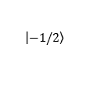


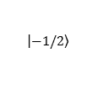

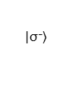
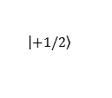


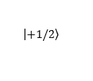


a
b
$$\left|\left.+1/2\right\rangle \right.$$
$$\left|\left.−1/2\right\rangle \right.$$
Co-polar.
Counter-polar.
$$∆$$
$$E_{g}+δOSE$$
Tip
Probe
$$E_{g}$$
σ⁺
σ⁺
σ⁻
$$\left|\left.−1/2\right\rangle \right.$$
$$\left|\left.+1/2\right\rangle \right.$$
c
d
e
Exciton Bloch sphere
Hole-spin Bloch sphere
$$\overset{⃑}{B_{eff}}$$
$$\overset{⃑}{B_{eff}}$$
$$\left|\left.\text{σ}\text{−}\right\rangle \right.$$
$$\left|\left.\text{σ}\text{+} \right\rangle \right.$$
$$\left|\left.↓\right\rangle \right.$$
$$\left|\left.↑\right\rangle \right.$$
$$z$$
$$y$$
laser
$$x$$

Slide 4
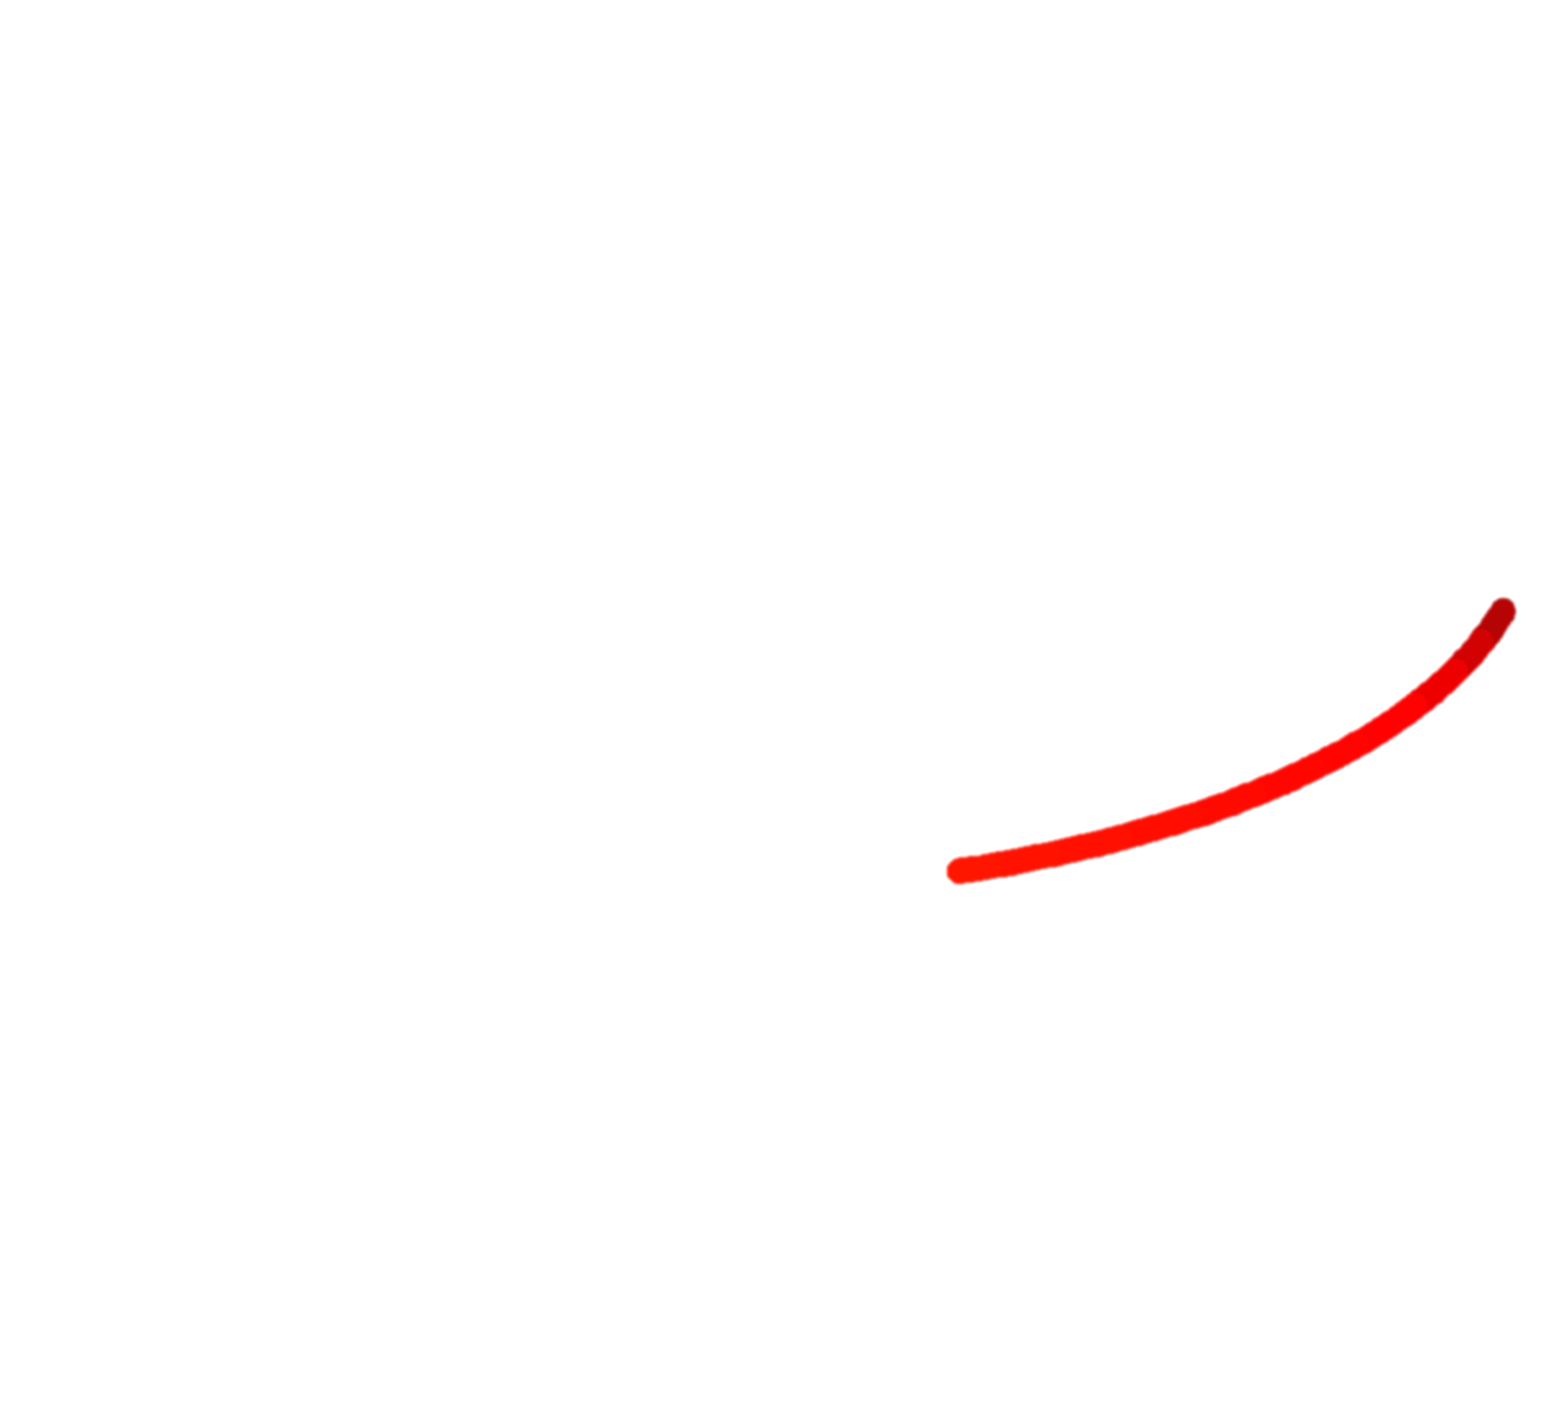
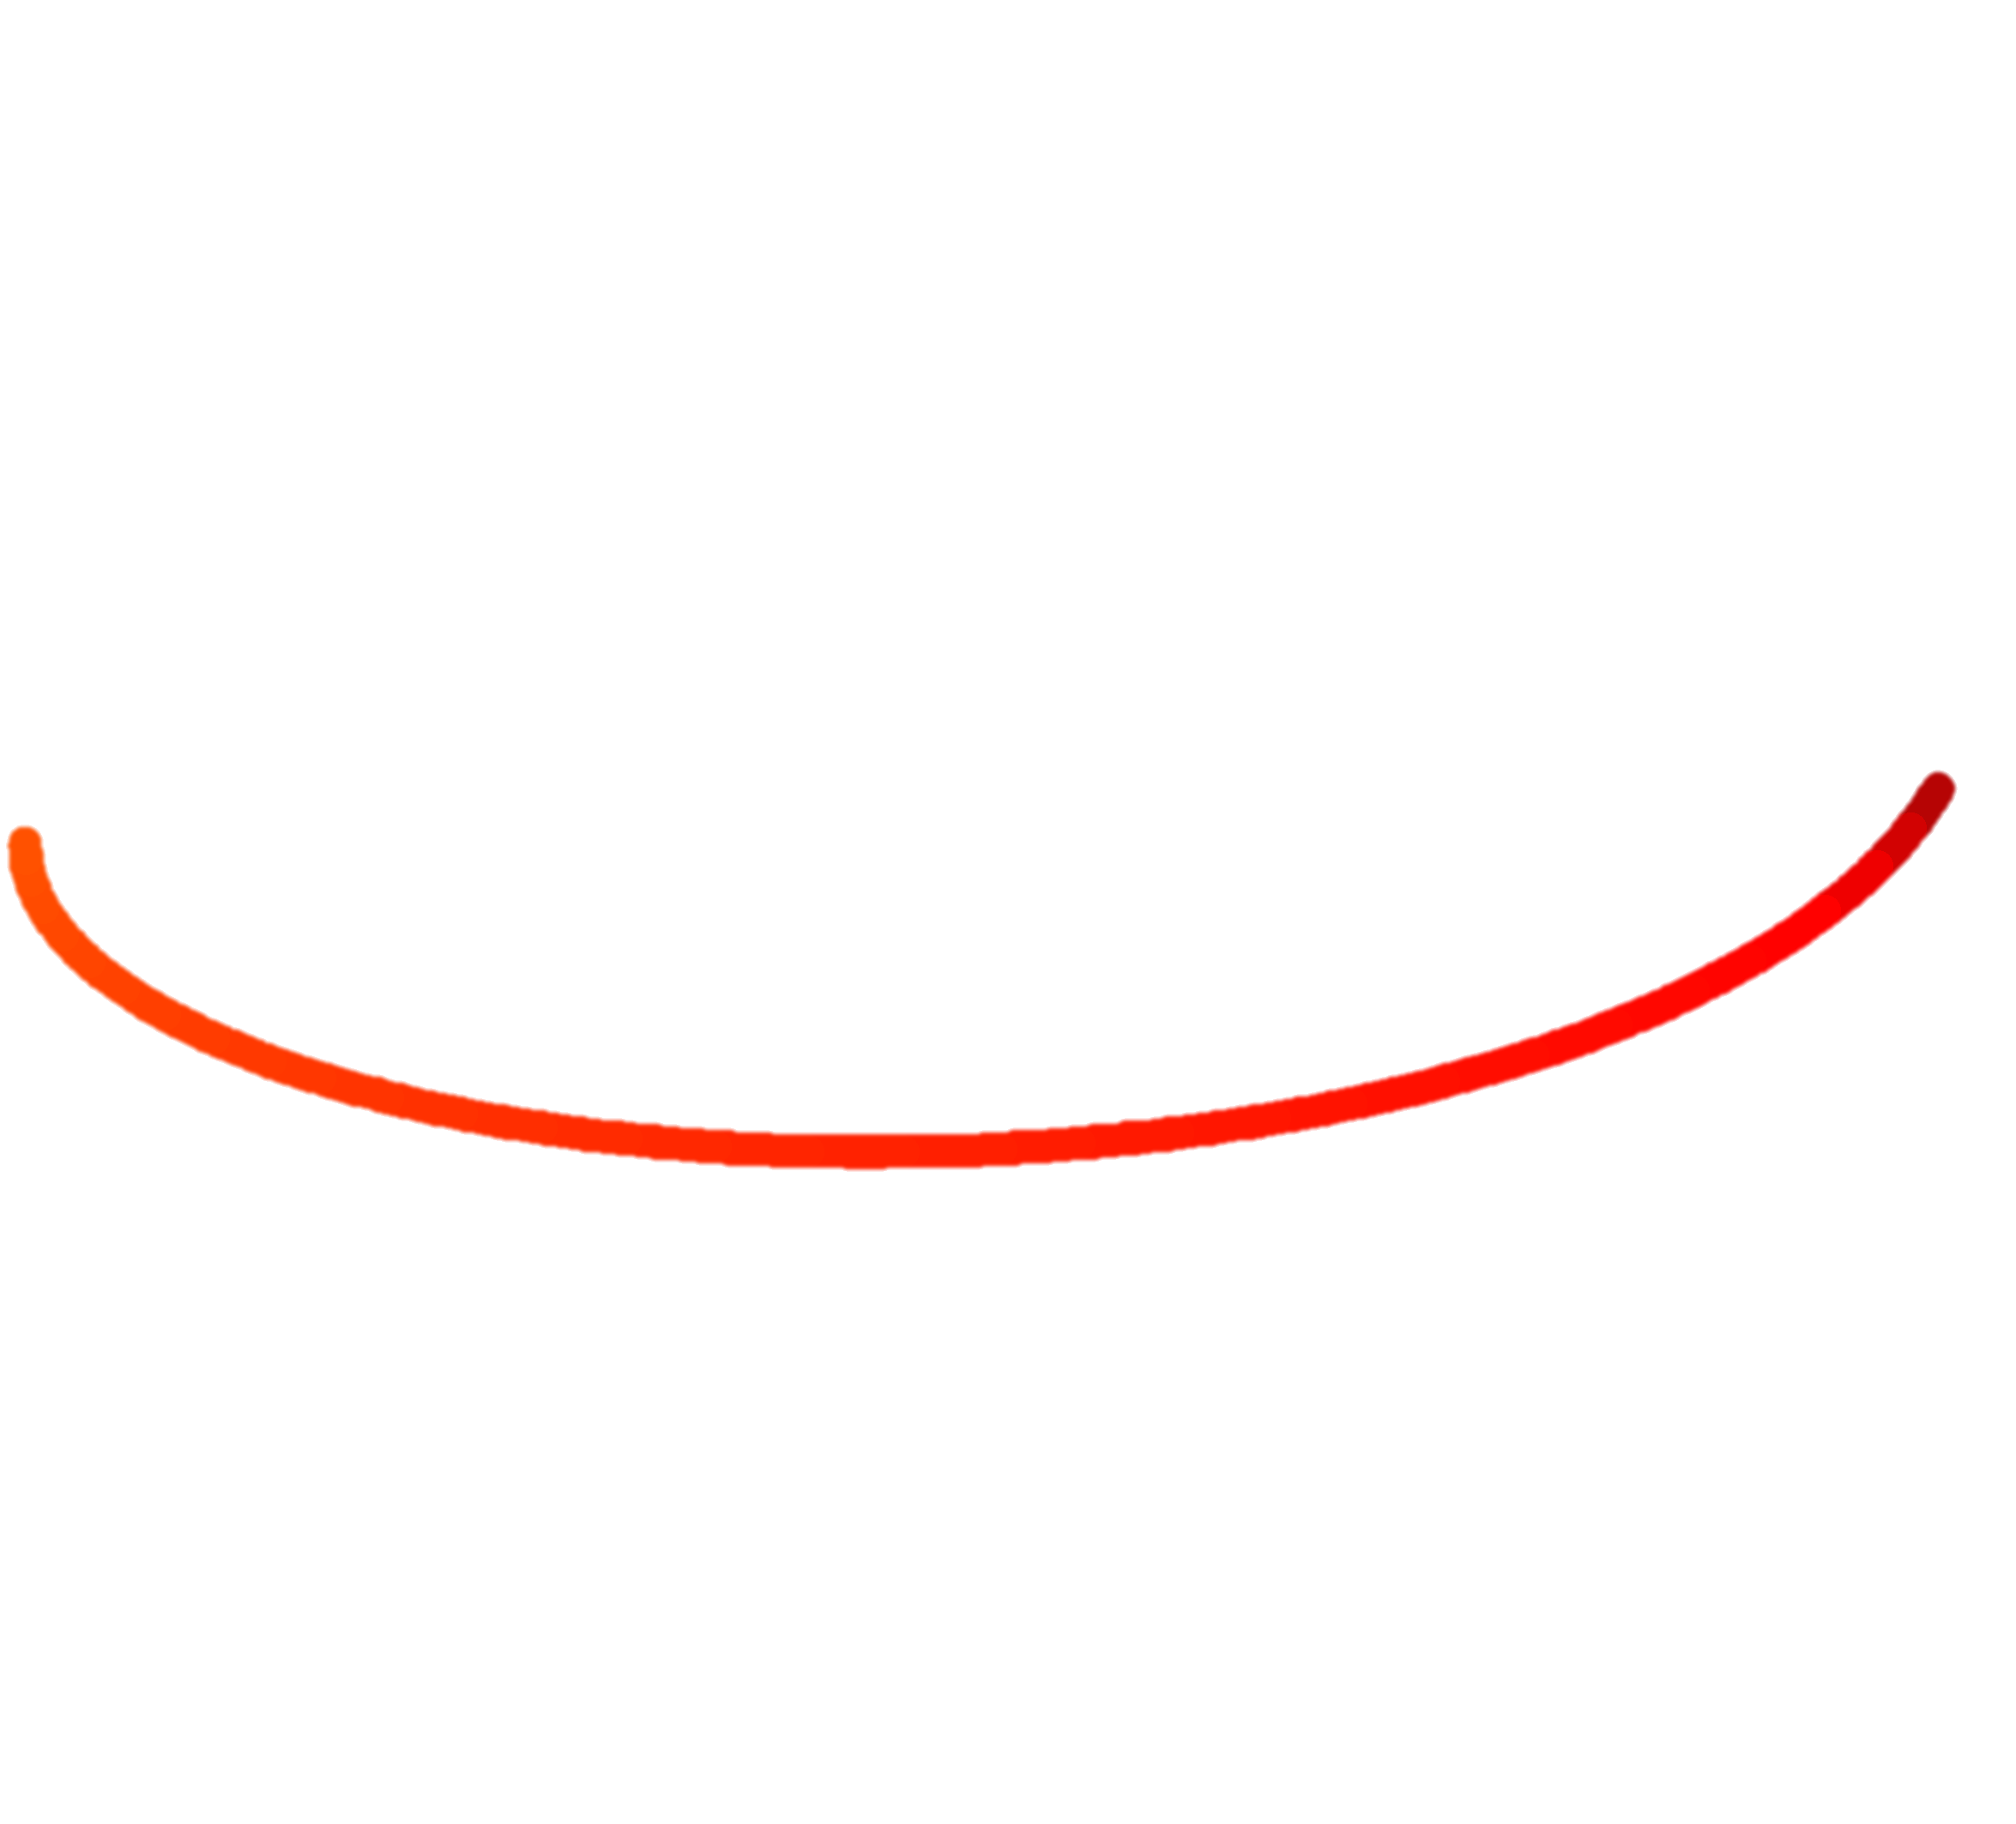
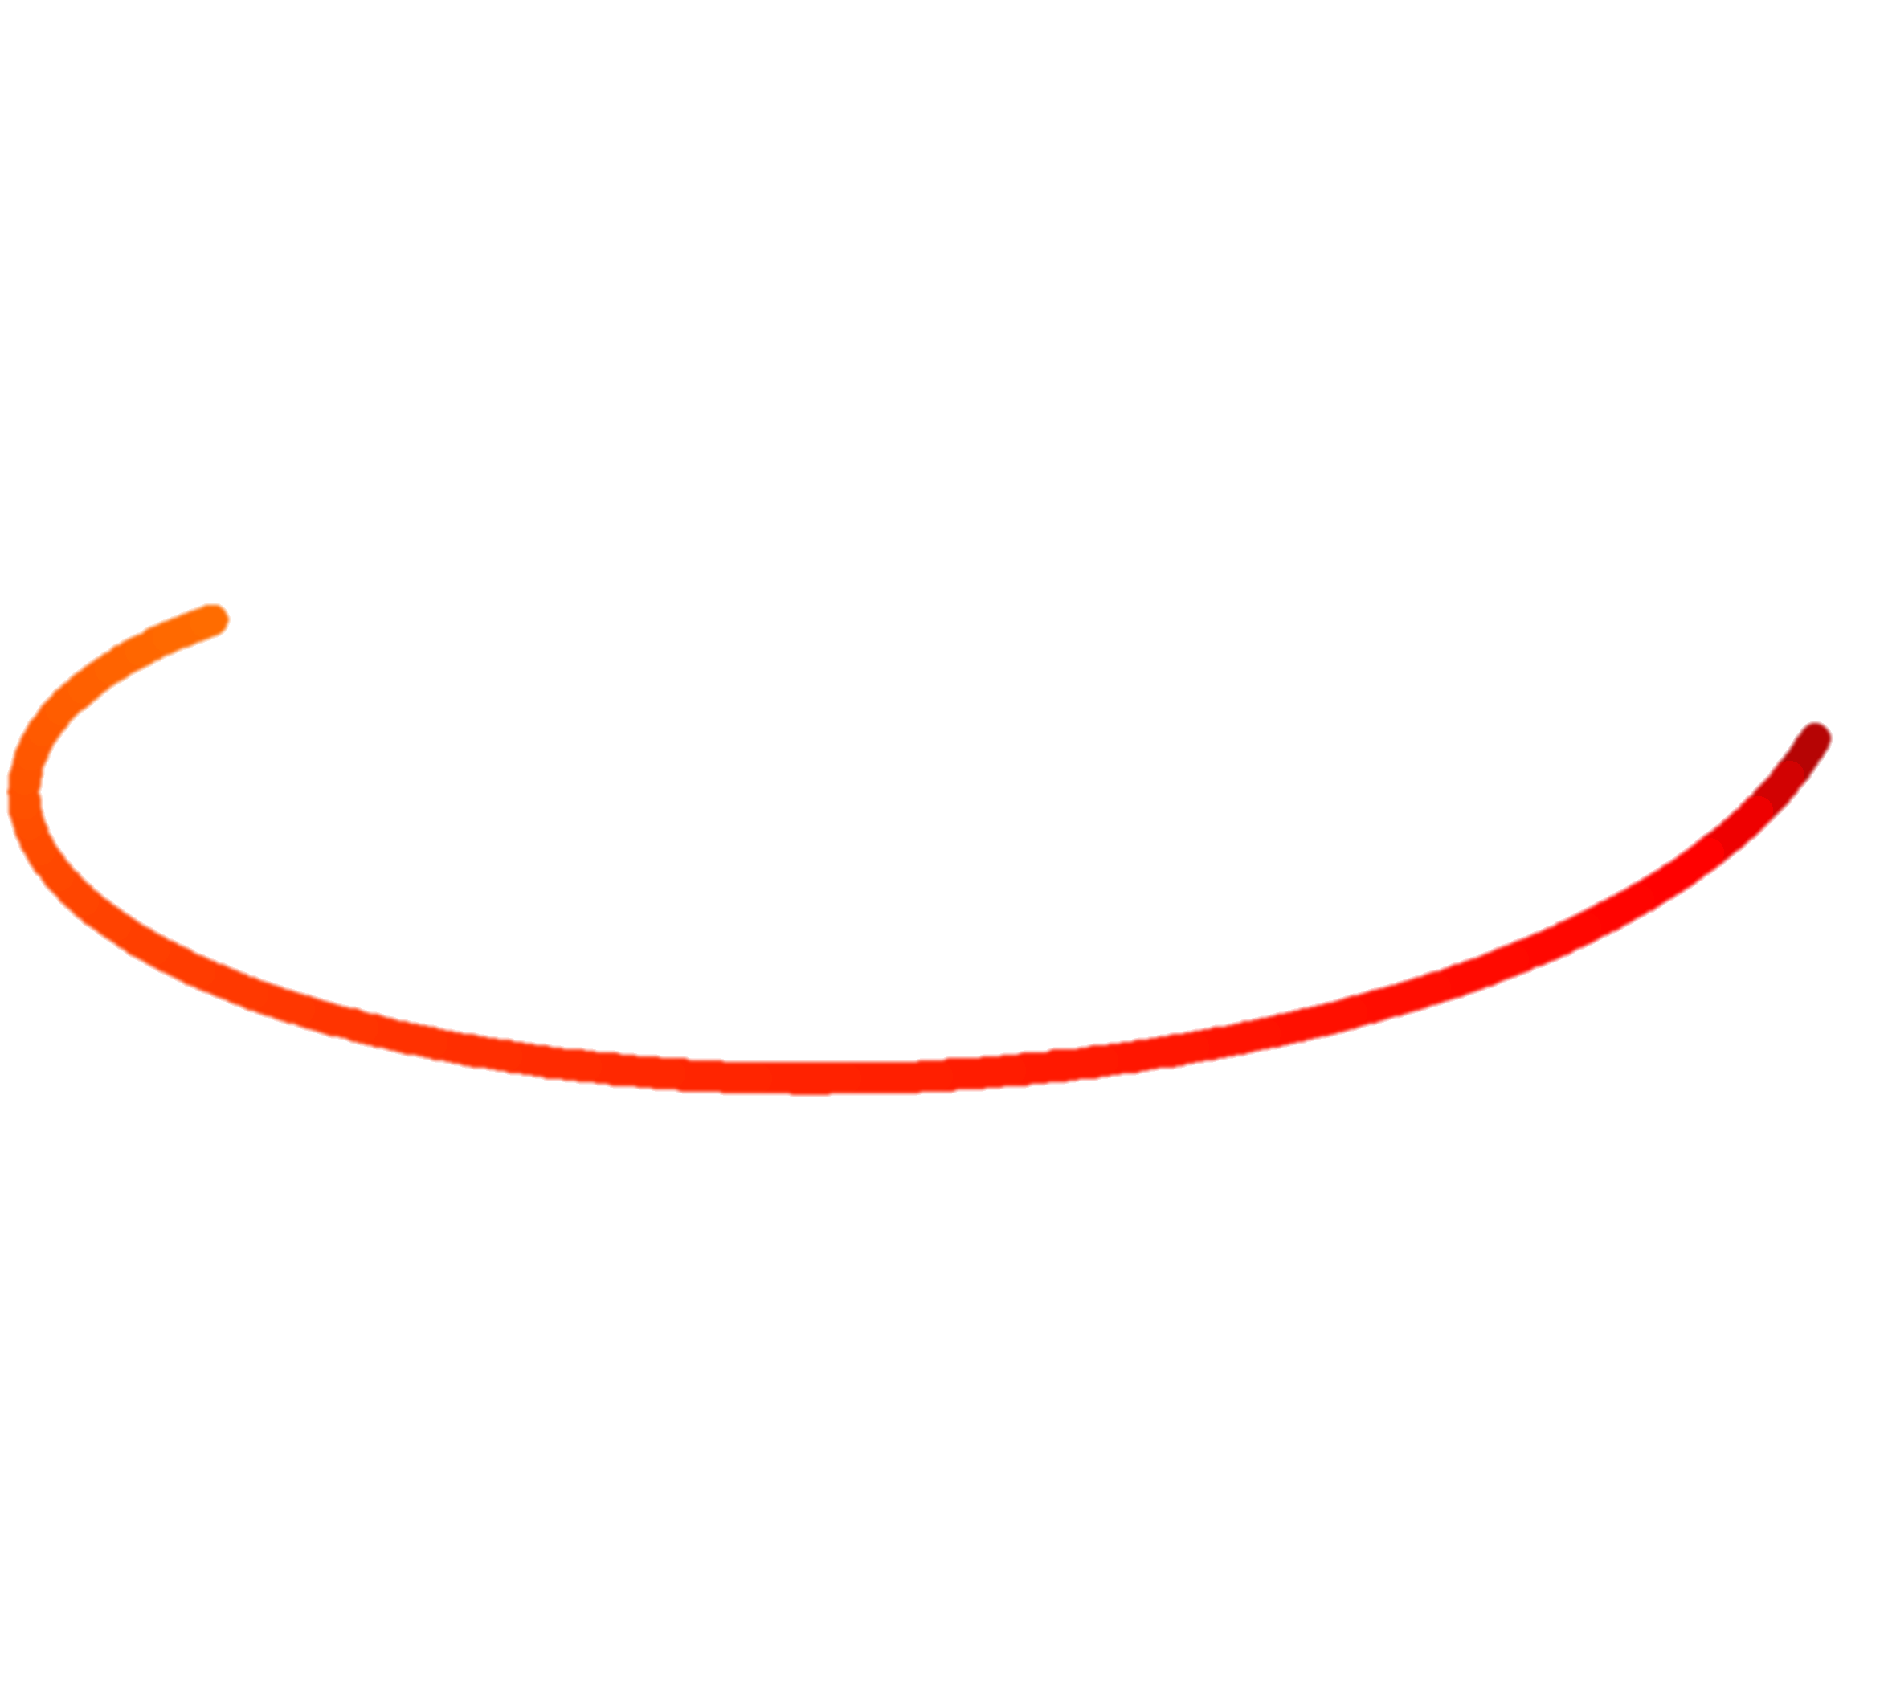



a
b
Hole-spin Bloch sphere
laser
$$θtip=114°$$
$$\overset{⃑}{B_{eff}}$$
$$\overset{⃑}{Bz}$$
$$z$$
$$y$$
$$0°$$
$$x$$
$$\overset{⃑}{B_{eff}}$$
$$112°$$
$$θ$$
$$\overset{⃑}{B_{eff}}$$
c
d

