Slide 1
Establishing a brand online
Workshop, September 26 & 27, 2022 Harnack-Haus, Berlin, Germany Ulrike Boehm, Ph.D. ulrike.boehm@zeiss.com - @ulrike_boehm Corporate Research & Technology (CRT), Carl Zeiss AG
Notes:
Hello Max Planck Alumni and Early Career Researchers. My name is Ulrike Boehm. I am a physicist and Max Planck alumna who did her Master‘s at the MPI of Biochemistry and her Ph.D. at the MPI for Biophysical Chemistry and now works in corporate research with ZEISS. In this focus talk, I will highlight the importance of personal branding for your career and how to go about it. So let‘s start…

Slide 2
What is a brand?
Your personal brand refers to how you present yourself, your skills, your experience, and your career goals to other professionals, including future employers.
A company brand refers to how a company presents itself, its skills, and its products/services to customers.
Notes:
When we think about brands, we usually have the logos of big companies in mind - like it’s displayed here - But you can also highlight your skills and experiences to your future employer like a company presents its services and products to customers. This type of branding is also referred to as personal branding and it is even more important in our modern digitalized world than ever.

Slide 3
“Personal branding is about managing your name – even if you don’t own a business – in a world of misinformation, disinformation, and semi-permanent Google records. Going on a date? Chances are that your “blind” date has Googled your name. Going to a job interview? Ditto.”
- Tim Ferriss
Notes:
Tim Ferriss described it as follows…

Slide 4
Overview
Survey
Why do you need a brand online?
How do you establish your personal brand online?
What are the next steps?
Survey

Slide 5
Survey

Slide 6
Why could a brand online be helpful?
On a scale from 1-10: How comfortable do you feel showcasing yourself and your work online?
Which tools & platforms are you currently using?
What were the benefits so far for you?

Slide 7
Why do we need a brand online?
Notes:
So, but what are the exact benefits of a personal brand or even an online one?

Slide 8
Builds Your Credibility
Job Hunting
Forms Vital Relationships / Networking
Collaborations
Free Advertising
…
Establish Yourself as an Expert
Notes:
The four most significant benefits of establishing a personal brand online are the following: First, personal branding helps build your credibility because you actively show people that you have the expertise they are looking for. 2. Then, by putting yourself out there, you also have better chances to build relationships and networks within and outside your field of expertise (you are findable). 3. Furthermore, by having a brand online, you get free advertising for your skills and service, and lastly, you establish yourself as an expert without having sponsors or supporters of any kind.
All these benefits help you in the end with your job hunt, finding collaborations, and in general, will be a key to your career success.

Slide 9
The way a typical employer prefers to fill a vacancy
Employers’ main value/concern is risk
From Within
Using Proof
Using a Best Friend or Business Colleagues
Using an Agency, They Trust
Using an Ad, They Have Placed
Job hunters’ main value/concern is time
Using a Resume
The way a typical job hunter prefers to fill a vacancy
Notes:
Let’s have a closer looks at why a personal brand is so crucial for job hunting…

Slide 10
Many, if not most employers hunt for job hunters in the exact opposite way from how most job hunters hunt for them.
You can increase your job perspectives if you decrease the risk for your future employer, e.g., by having a strong personal brand.
Notes:
To summarize…

Slide 11
The way a typical employer prefers to fill a vacancy
Employers’ main value/concern is risk
From Within
Having a strong personal brand online!!!
Using Proof
Using a Best Friend or Business Colleagues
Using an Agency, They Trust
Using an Ad, They Have Placed
Job hunters’ main value/concern is time
Using a Resume
The way a typical job hunter prefers to fill a vacancy
Notes:
Let’s have a closer looks at why a personal brand is so crucial for job hunting…

Slide 12
How do establish your personal brand online?
Notes:
So now that we know why we need a brand online let’s learn how to go about it…

Slide 13
Show your work!!!
Notes:
And you may not believe it, but it actually is pretty simple because you only need to remember that building a brand online is about showing your work…

Slide 14
…fortunately, there are plenty of digital tools and platforms available that you can use…
ORCiD
LinkedIn
Own institute website
Google Scholar
Xing
Twitter
Own personal website
Notes:
Fortunately, there are plenty of digital tools and platforms available that you can use that help you to do precisely that… Starting by using platforms like ORCiD and Google Scholar, which are intensely used within the academic square, to social media platforms like LinkedIn and Twitter. But, of course, you can even build your own website to show your work in more depth…

Slide 15
Available digital tools and platforms
Notes:
In the following, I will show you a few examples of how people use these platforms and automatically build their personal brand at the same time…

Slide 16
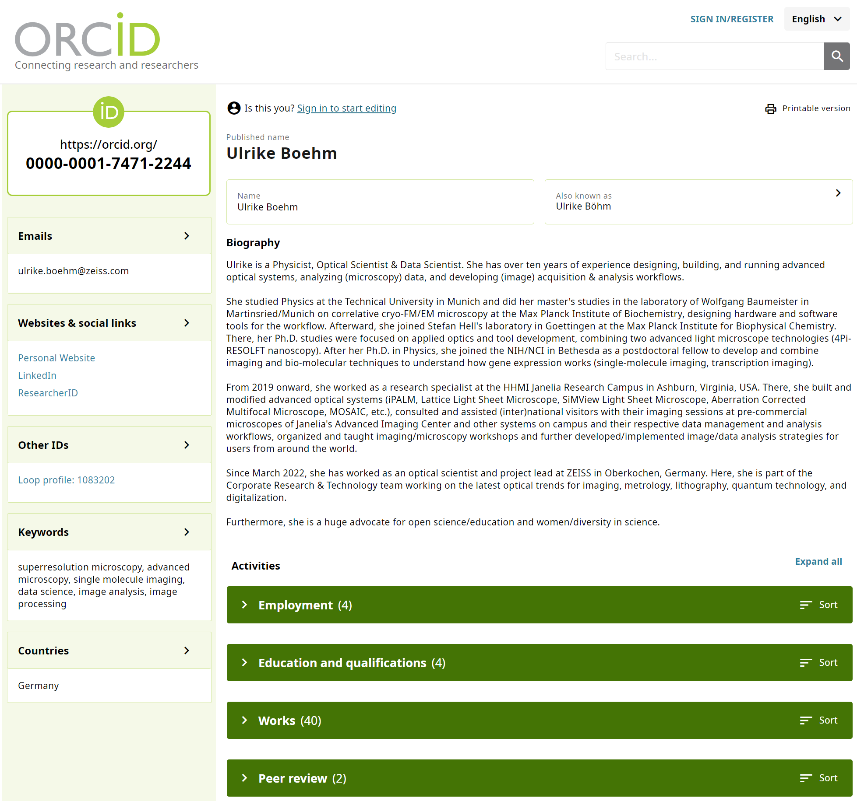
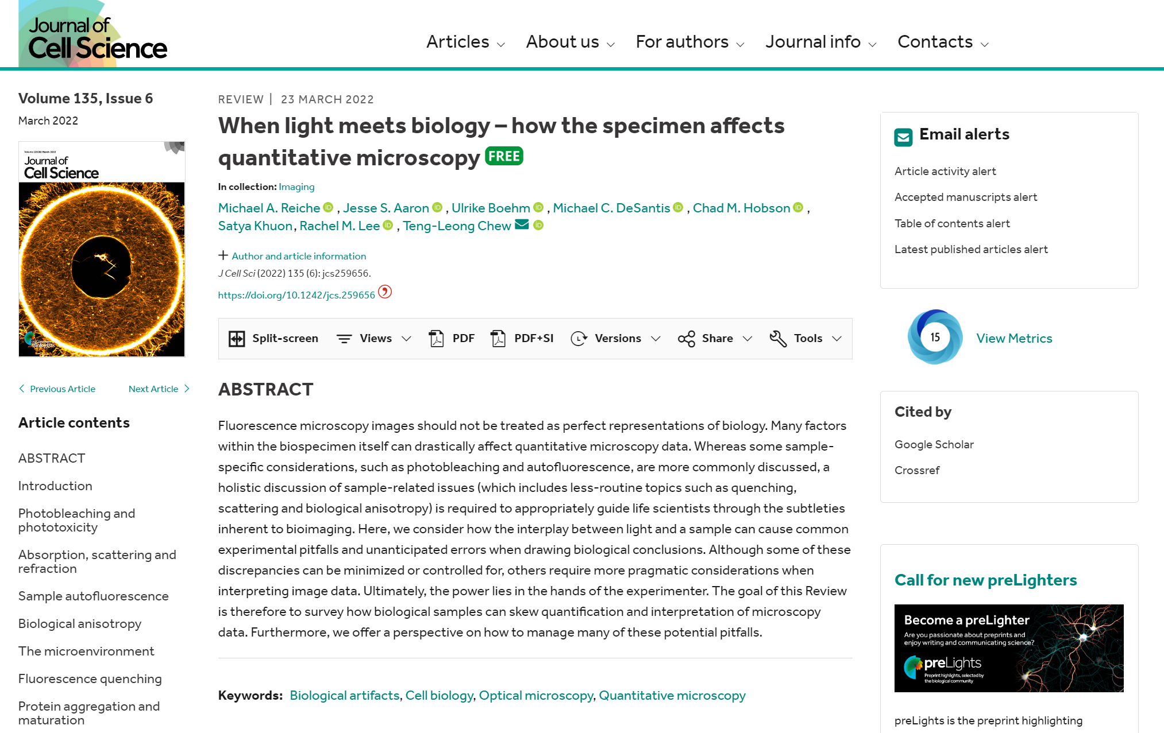
ORCiD
Notes:
Let’s start with ORCiD: If researchers register on this platform, they can create their own personal profile page similar to profiles on other social media platforms, but in addition, they receive a unique ID that can be attached to every paper they publish. In the end, all papers that are marked with that ID will be automatically posted on their ORCiD profile page. Therefore, other scientists can quickly navigate from your published paper to your overall scientific output. And how cool is that!

Slide 17
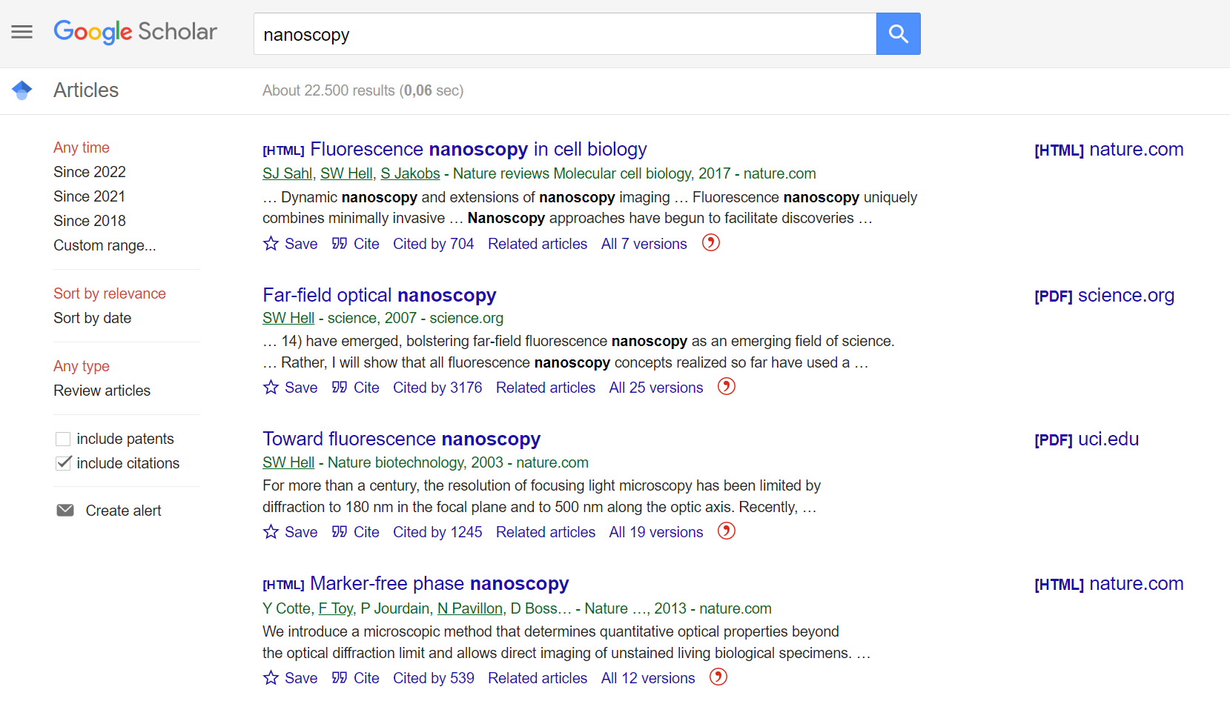
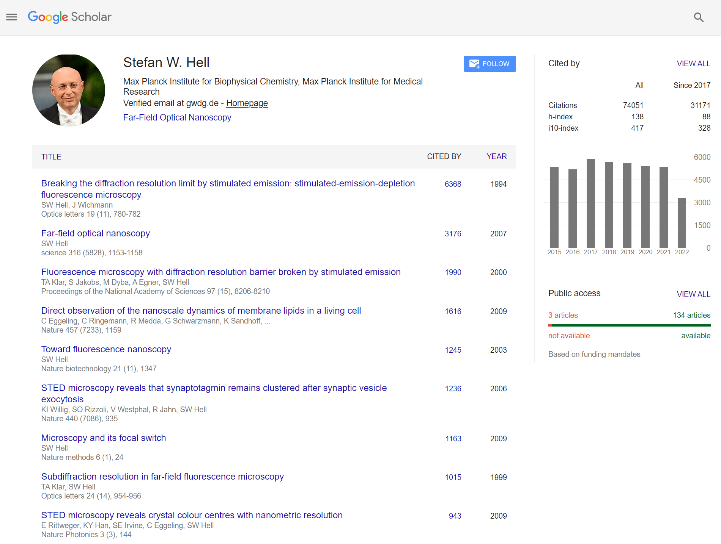
Google Scholar
Notes:
Google offers a similar service with Google Scholar. Google Scholar is not only a freely accessible web search engine that indexes the full text or metadata of scholarly literature, but it also lets you create your own personal profile which will highlight your scientific output and its significance.

Slide 18
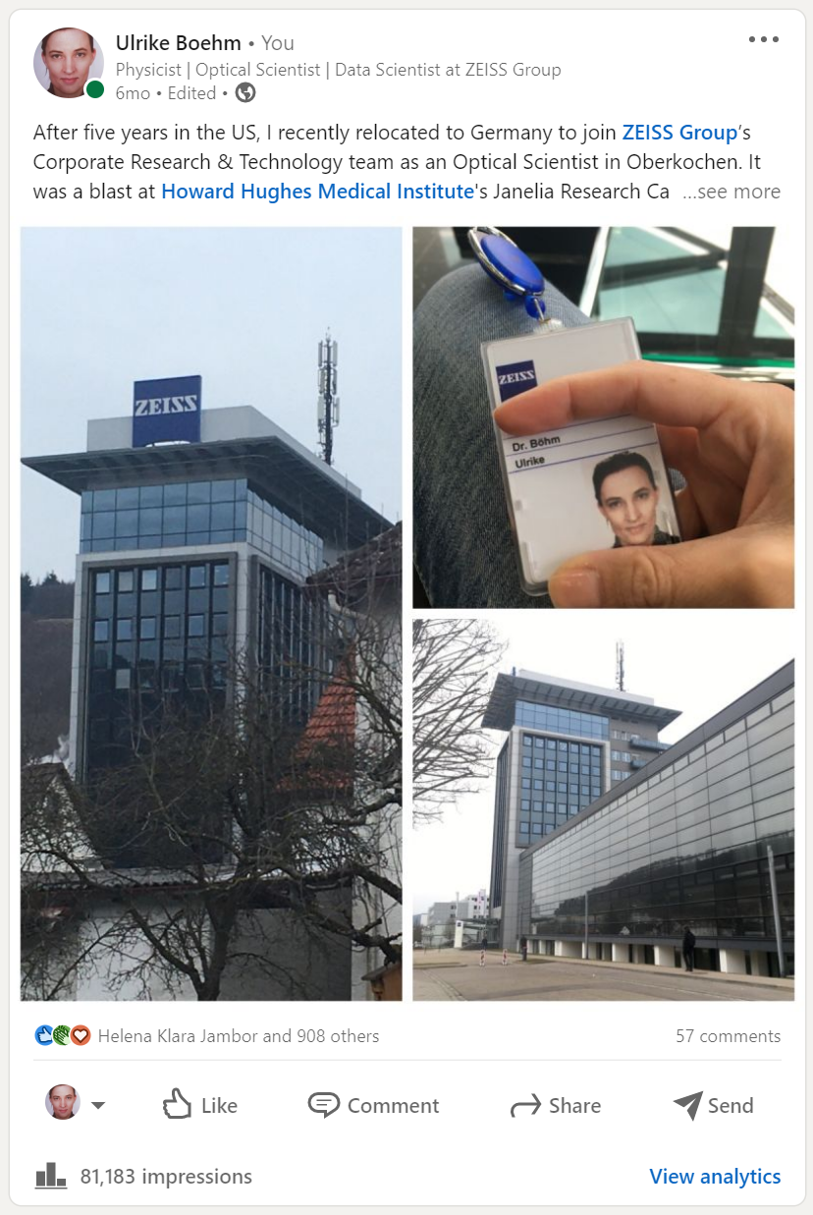
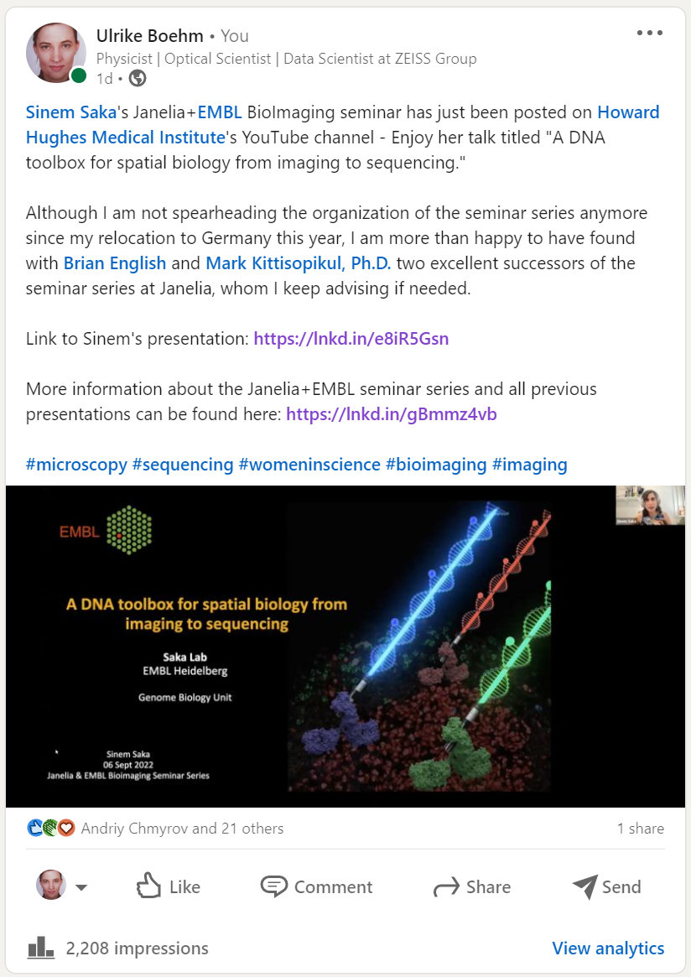
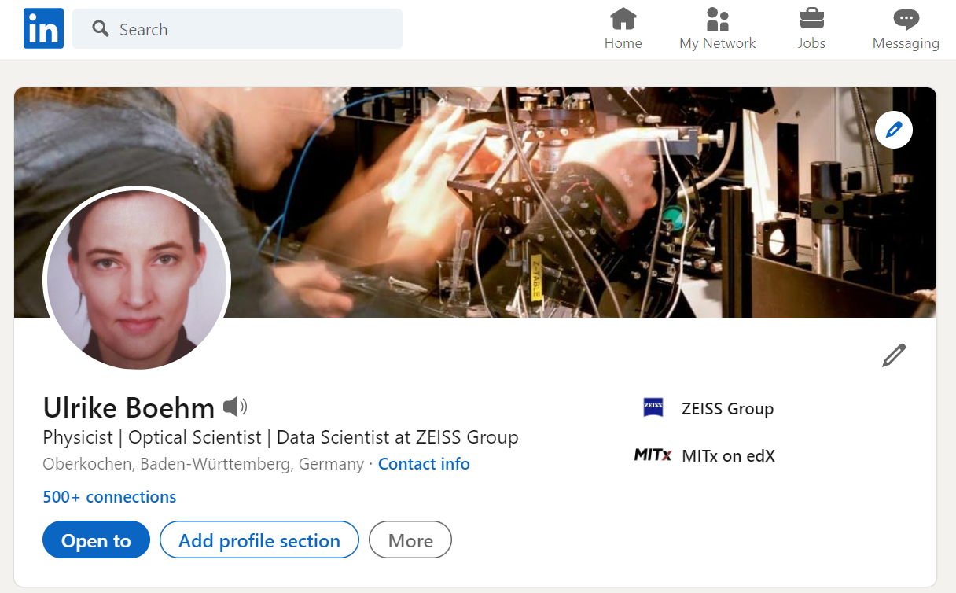
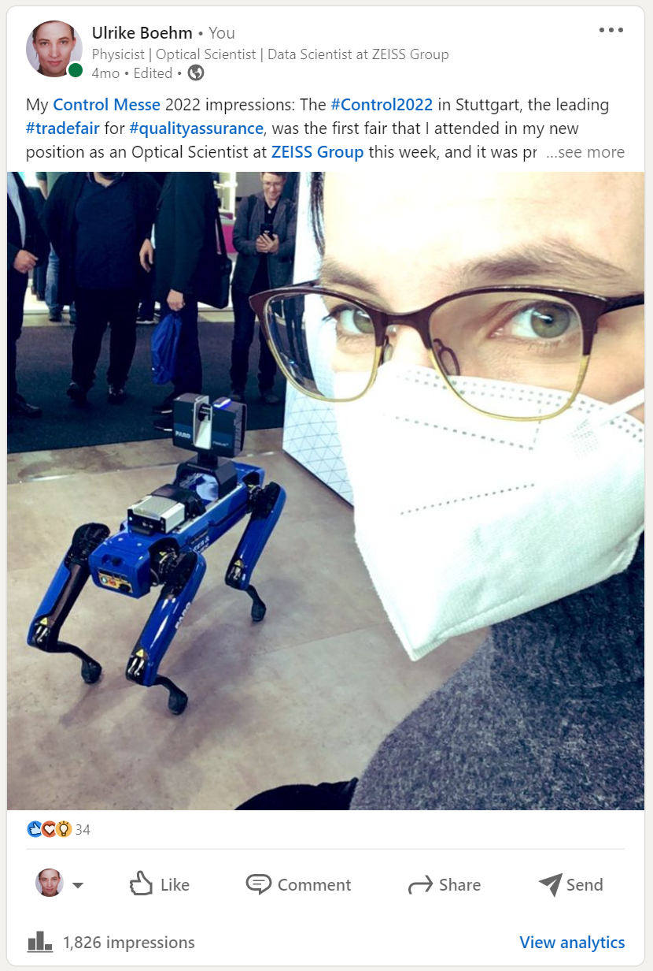
LinkedIn
Notes:
The social media platform LinkedIn is a platform for professional networking and career development and allows job seekers to post their CVs and employers to post jobs. I frequently use the feature to post “posts” and “articles” about my professional life here as well, e.g., when I joined ZEISS, when I went to a trade fair or conference in my field, or about other professional activities. These stories should always be informative and of use to your network. So don’t brag and please do not post photos of your lunch.

Slide 19
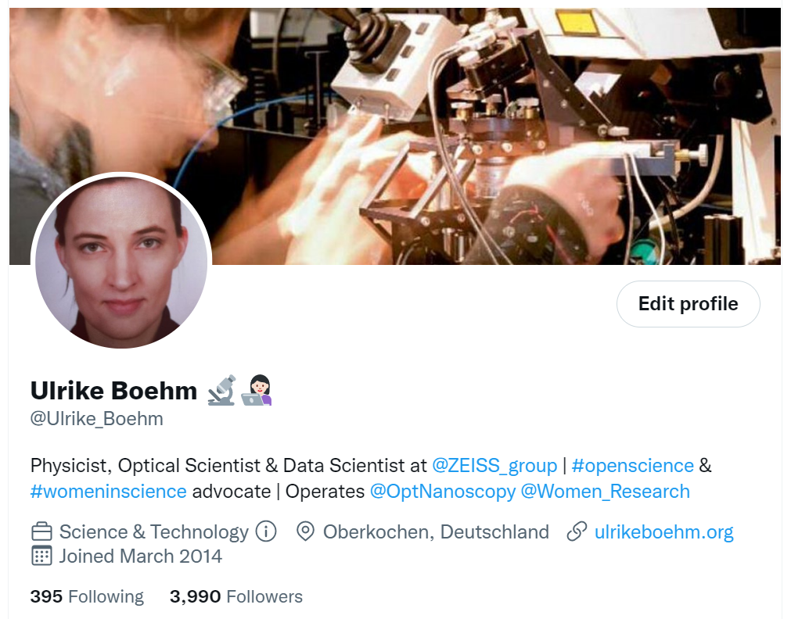
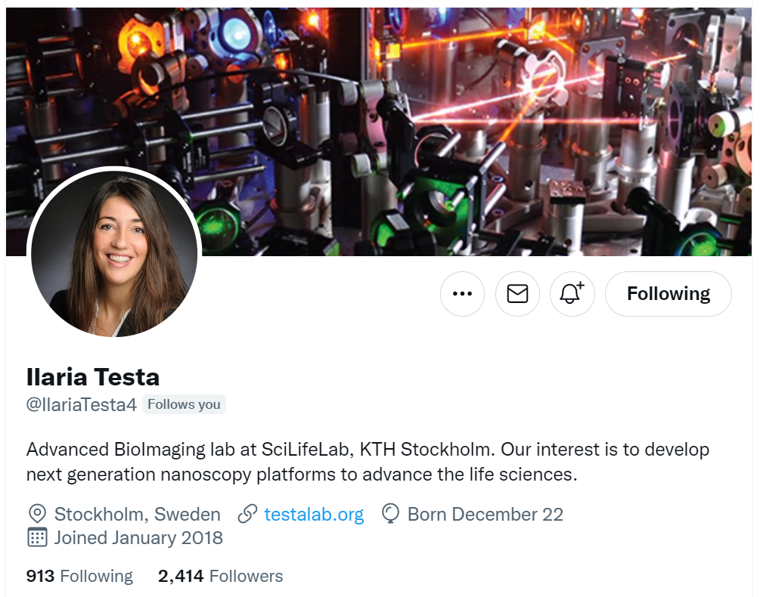
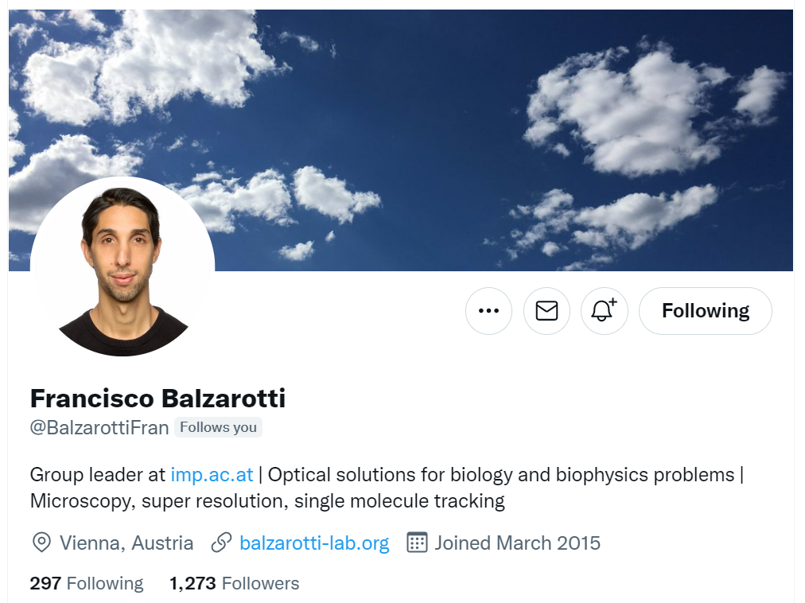
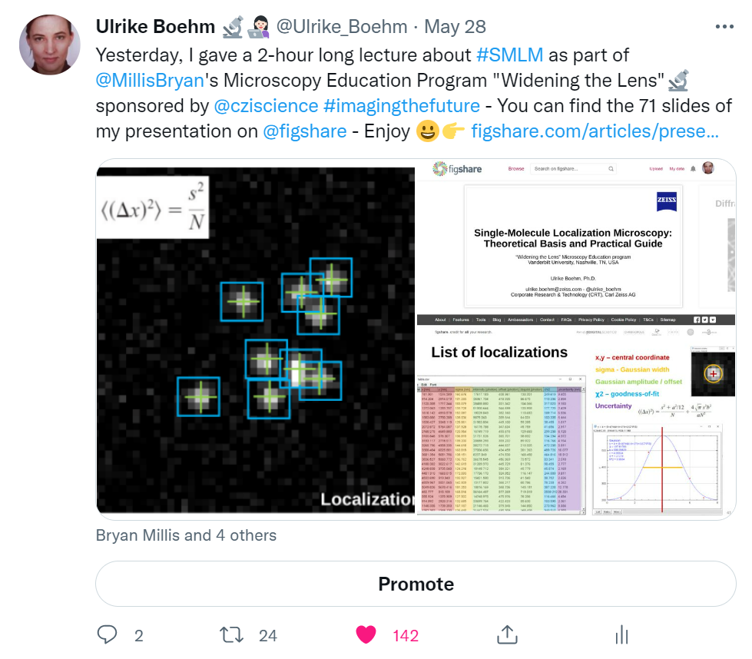
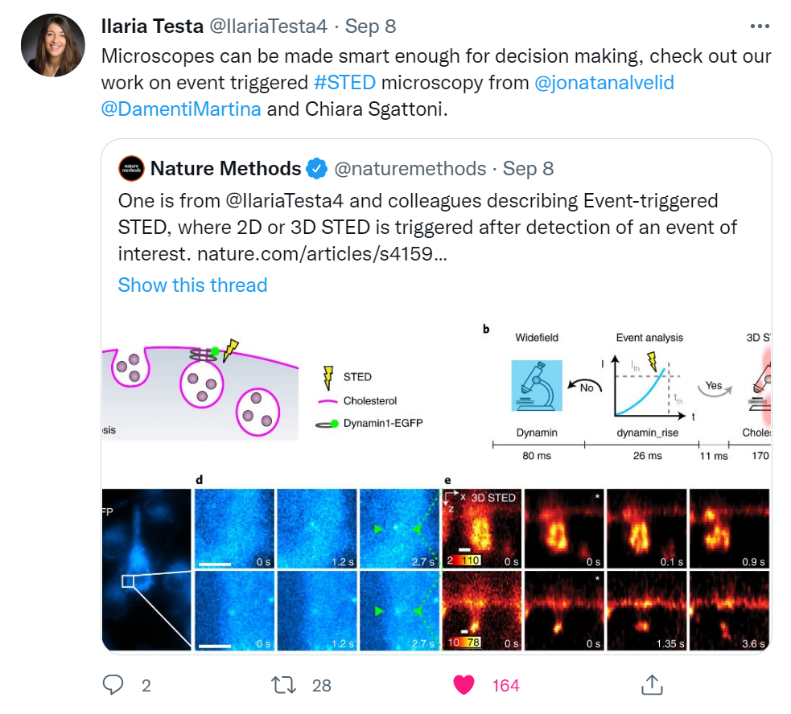
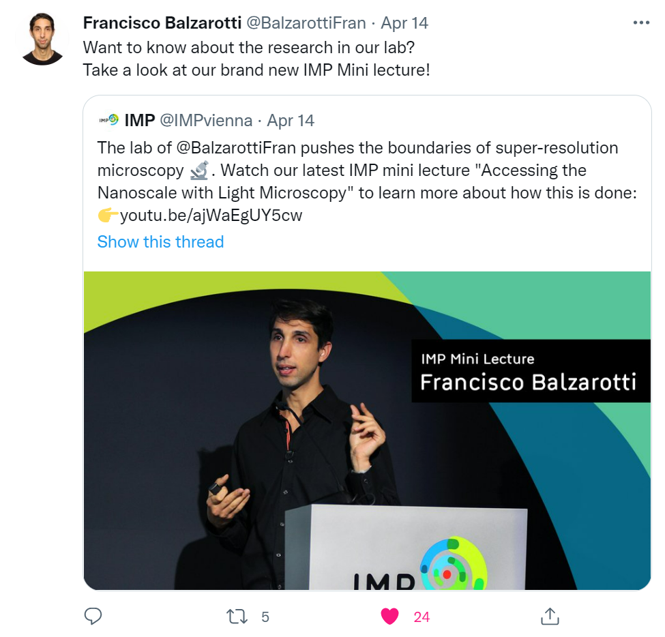
Twitter
Notes:
Twitter is another handy social media platform whose main features are posts, also called tweets. Posting on a regular base 2-3 per month helps you build your personal brand. Here, for example, I posted a tweet about where to find the slides of a lecture I gave, Ilaria posted a tweet about a recent paper from her lab and Francisco highlights his institute’s lecture series to which he also contributed.

Slide 20
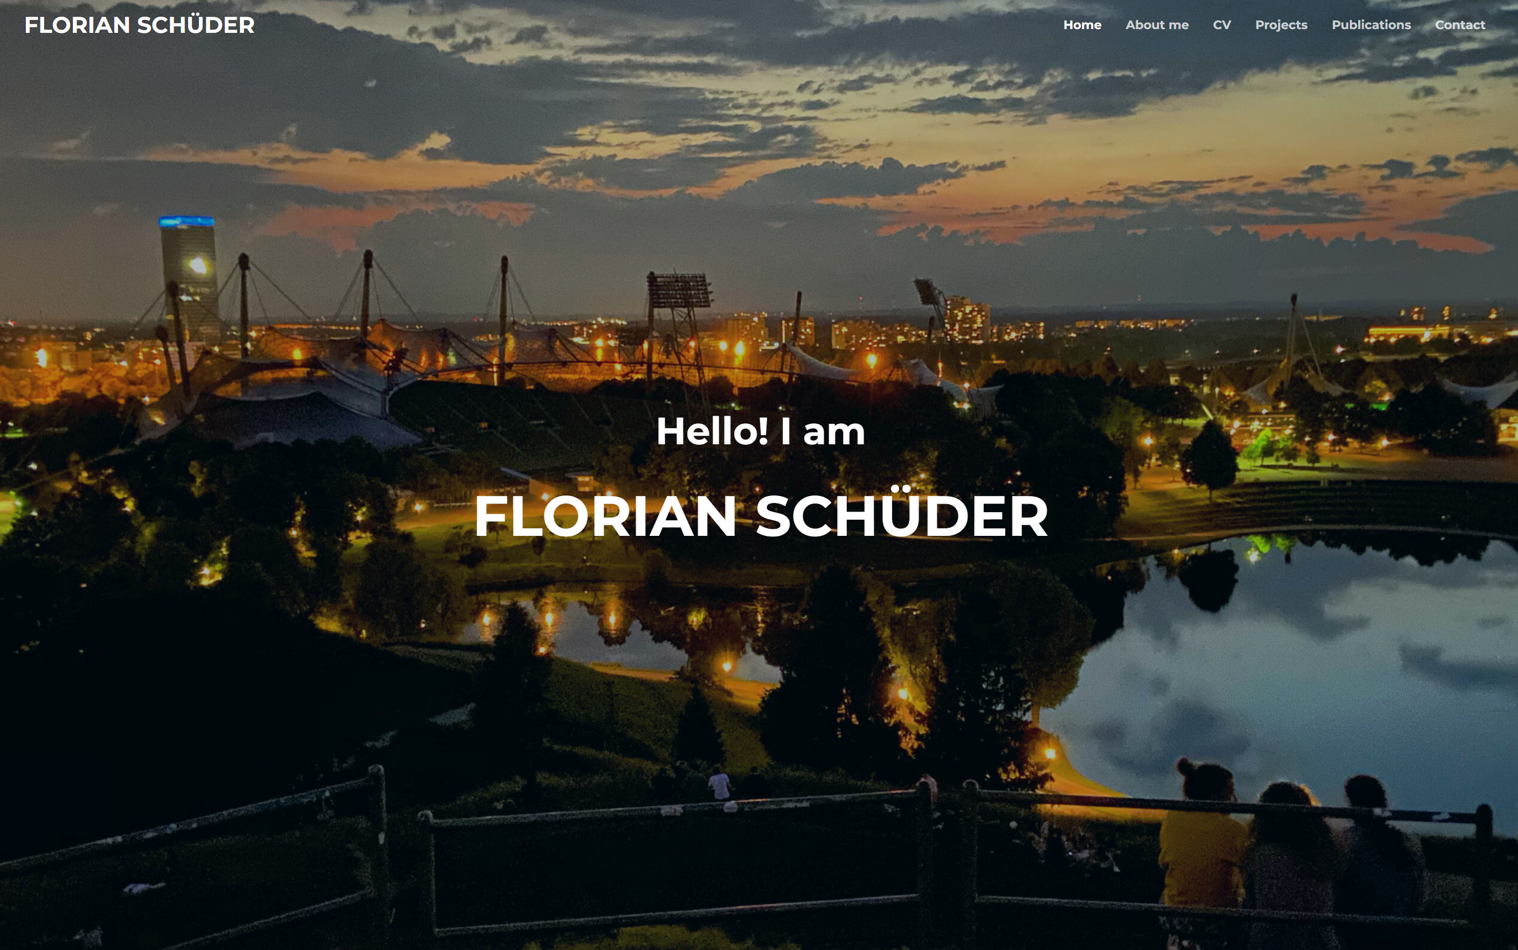
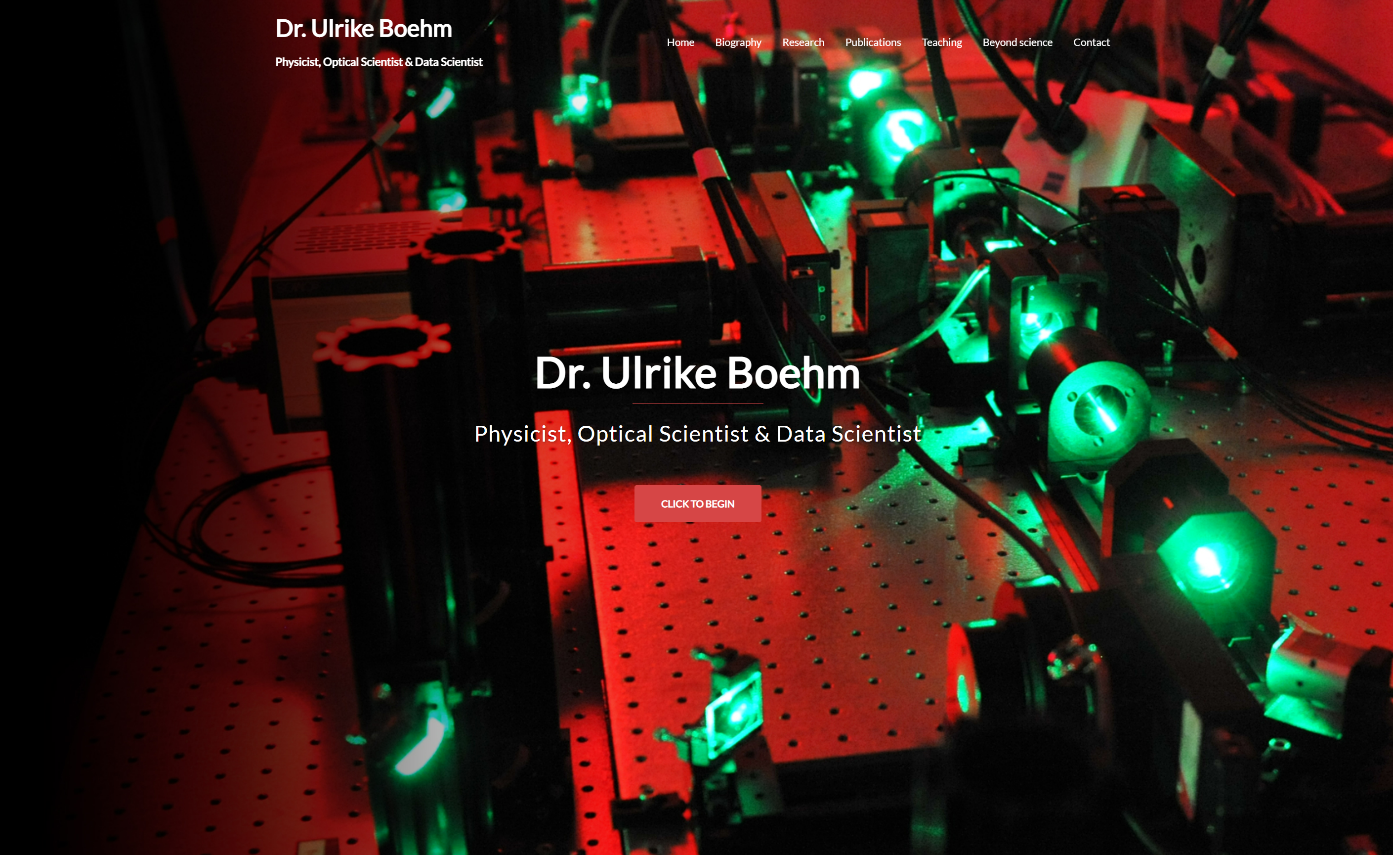
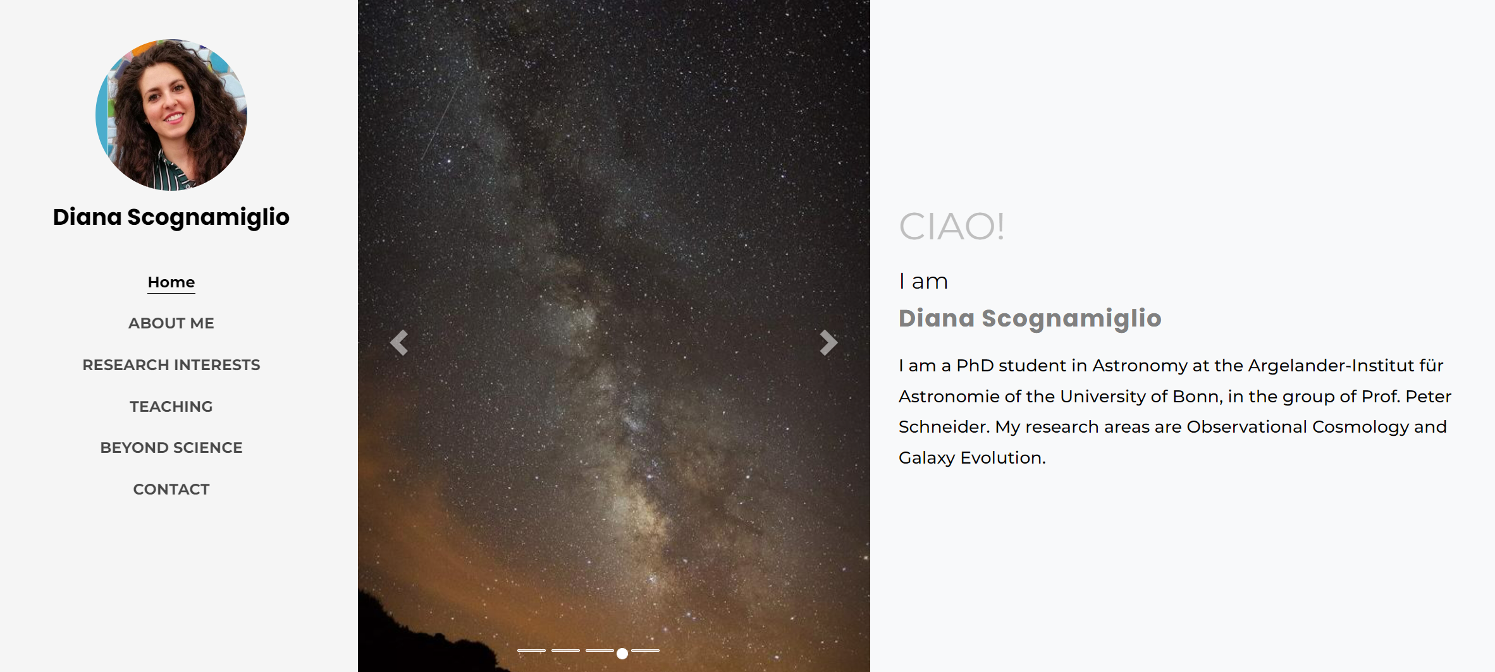
Own personal website
https://schueder.uber.space/
http://ulrikeboehm.org/
https://diana-sco.github.io/index.html
Notes:
But, of course, you can also build your own platform in the form of a personal website to show your work. Here, different backends come with a different prize tag, e.g., creating a website on Squarespace or Strato will cost a few bucks per month, whereas a website on GitHub would be for free, but more time-consuming to make. Feel free to check out the three examples later.

Slide 21
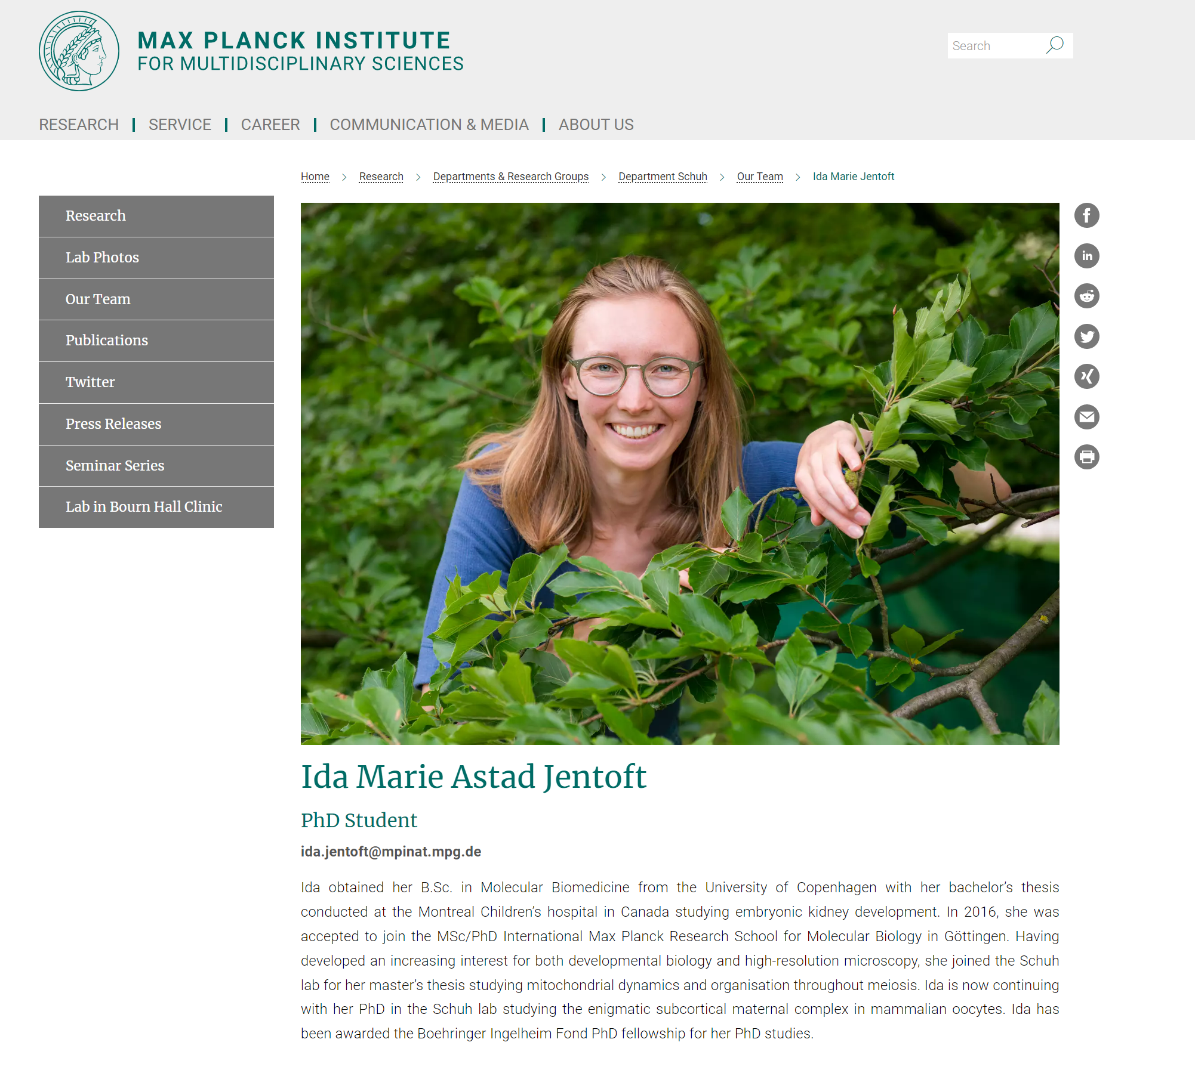
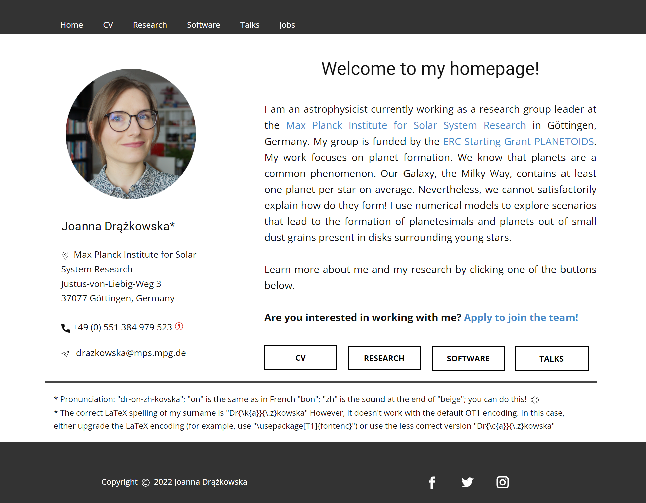
Own institute website
https://www2.mps.mpg.de/homes/drazkowska/
https://www.mpinat.mpg.de/638803/Ida-Marie-Jentoft-short-bio
Notes:
A fast and free way to your own website or at least to free web space for a website is also provided by most Max Planck Institute. Just approach your IT department.

Slide 22
7 ways to share your work and get discovered…
You don’t have to be a genius
Tell good stories
Think process, not product
Teach what you know
Share something small regularly
Don’t turn into human spam
Open up your cabinet of curiosities

Slide 23
How present are you currently online?
Go ahead and Google yourself…

Slide 24
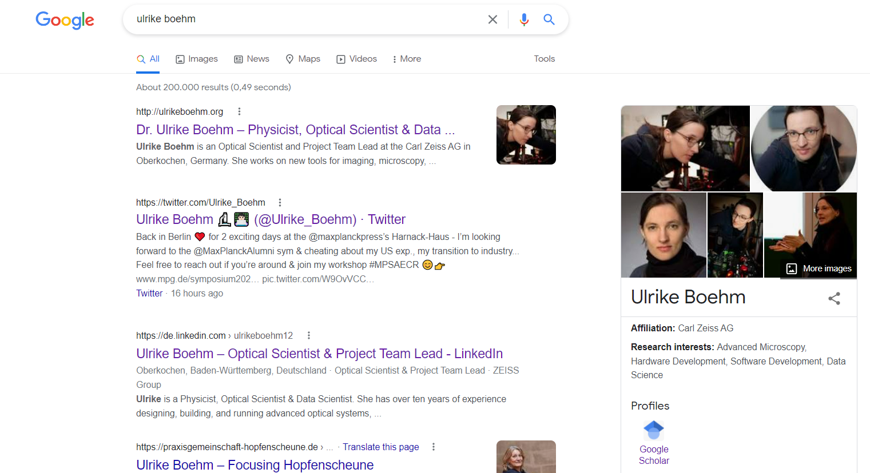

Slide 25
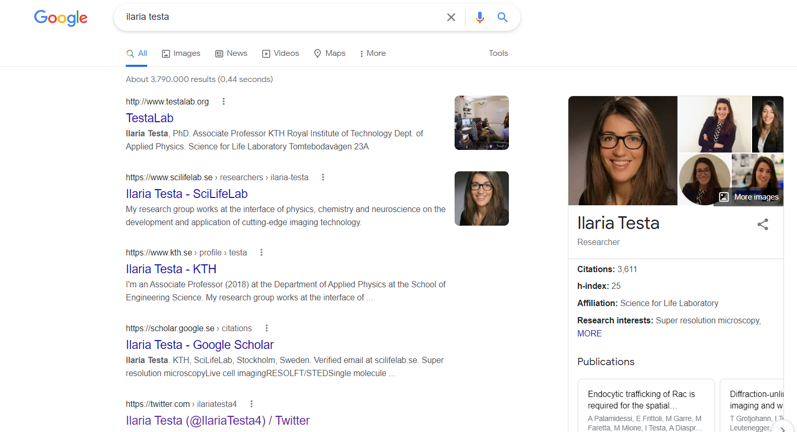

Slide 26
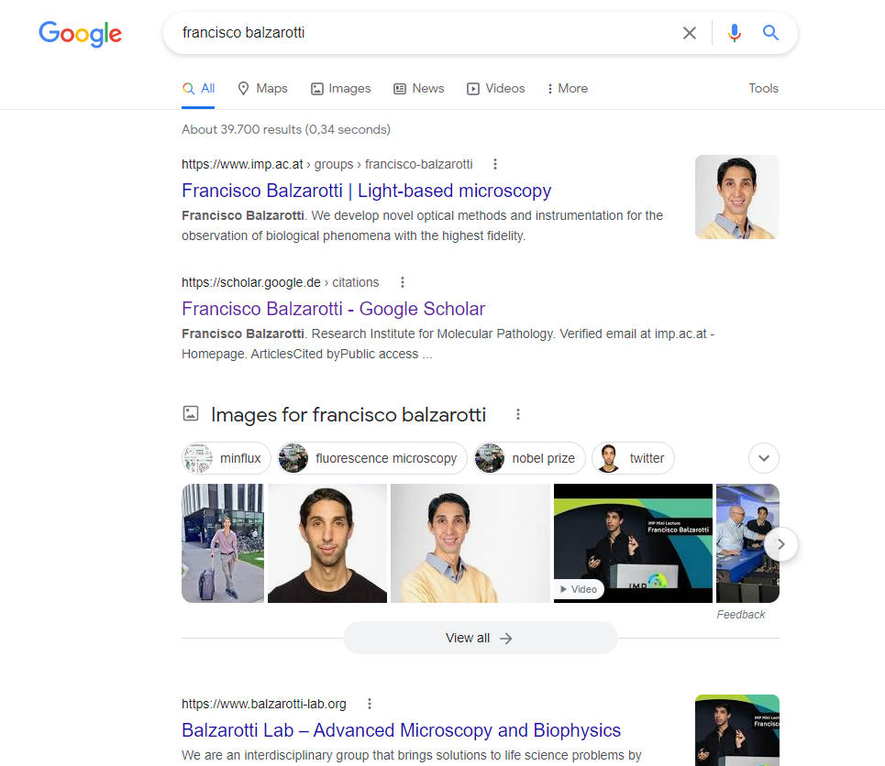

Slide 27
Survey

Slide 28
On a scale from 1-10: How comfortable do you feel showcasing yourself and your work online?
Were you able to identify more benefits?
Which tools & platforms would you start to use more after this workshop?

Slide 29
Take home message
Notes:
So let’s summarize…

Slide 30
No matter how talented you are, it doesn’t matter unless department heads / managers can see those talents and think of you as an invaluable (future) employee.
With the internet and social media, the ability to brand and promote yourself effectively has become absolutely essential but, fortunately, also straightforward.
The subtle and amazingly effective art of personal branding / self-promotion can be the razor-thin difference between success and failure.
So, what now?
Make use of these tools/platforms & show your work to build your personal brand to land your dream job. Best of luck!

Slide 31
HOMEWORK
Write a tweet on Twitter or a post on LinkedIn about this event!
1) Which takeaway is useful for you and would be useful for your network?
2) Craft a compelling message about this learning.
3) Add a suitable photo or video to the message.
4) Tag your affiliations (e.g., @maxplanckpress) and people connect to the message.
5) Add suitable hashtags (e.g., #MPSAECR).
6) Make it public ☺

Slide 32
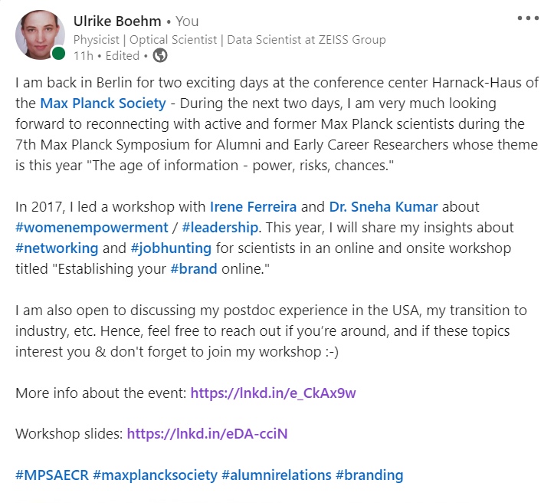
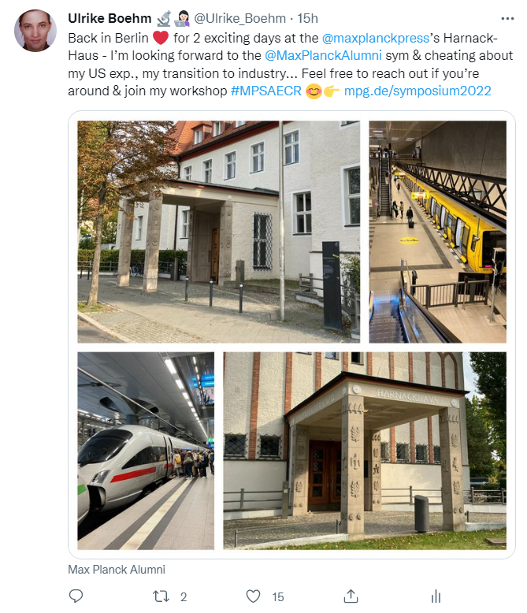
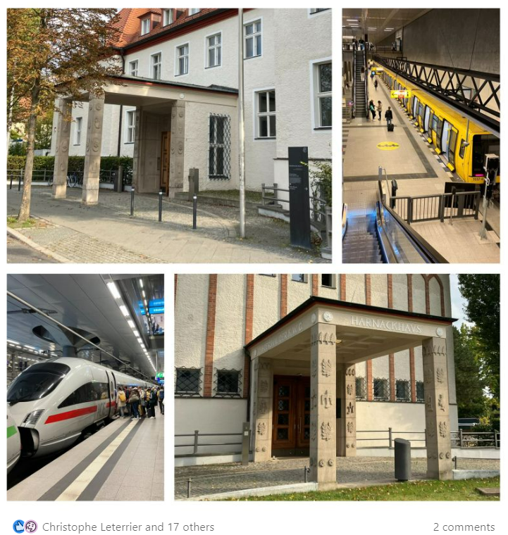
EXAMPLES
Write a tweet on Twitter or a post on LinkedIn about this event!

Slide 33
Thank you! Questions?
Ulrike Boehm, Ph.D. ulrike.boehm@zeiss.com Twitter: @ulrike_boehm
Opt to Work at ZEISS Job openings and applications
https://www.zeiss.com/corporate/int/careers/job-openings-and-applications.html
Photo: Martin Duckek
Notes:
Thank you again for your attention. Please feel free to reach out in case of questions, and enjoy the rest of the symposium. Also, don‘t forget to check out the ZEISS job portal. We always search for talented scientists from all fields. Bye!

Slide 34
References

Slide 35
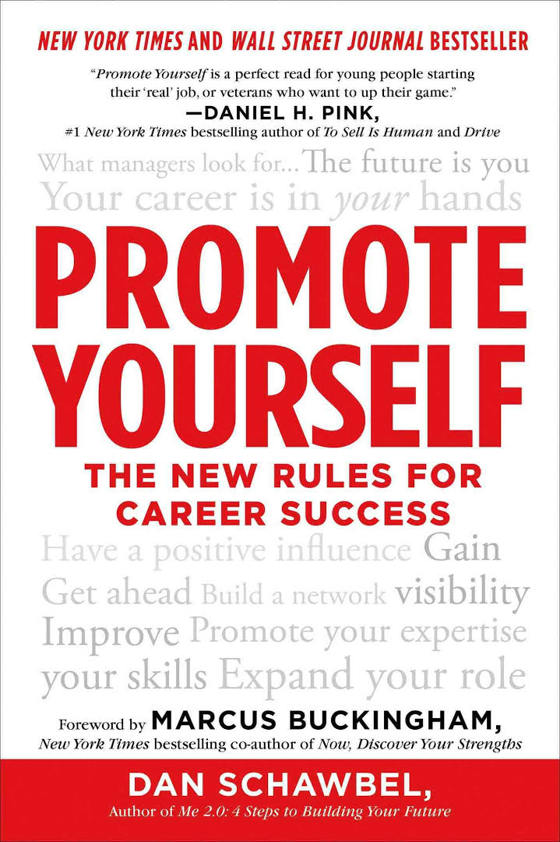
“Promote Yourself: The New Rules For Career Success” by Dan Schawbel
“Show Your Work! 10 Ways To Share Your Creativity And Get Discovered” by Austin Kleon
“What color is your parachute?” by Richard N. Bolles
…and a ton of online tutorials!

