Slide 1
Selecting bioactive-like conformations of small molecules using atomistic neural networks
Benoit Baillif
16th June 2022
International Conference on Chemical Structures (ICCS) 2022

Slide 2
Outline
Introduction
Methods:
Model
Dataset
Evaluation: metrics and baselines
Results:
Ranking and selecting conformations
Application to rigid-ligand docking
Conclusion
2

Slide 3
Introduction
3

Slide 4
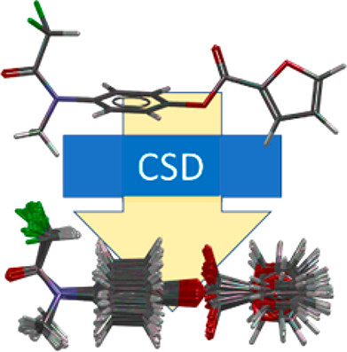
Context: Finding bioactive conformations
Importance in virtual screening: docking or pharmacophore searching
Conformer generators can generate plausible conformations:
The CCDC generator retrieves a bioactive-like conformation (ARMSD < 1 Å) for 90% of the molecules in the Platinum dataset (among 250 generated conformations)
Only 70 % are retrieved in the top 10 conformations, 40% retrieved taking the top 1
ARMSD = Atomic Root-Mean-Square Deviation
Friedrich, Nils-Ole, et al. "High-quality dataset of protein-bound ligand conformations and its application to benchmarking conformer ensemble generators." Journal of Chemical Information and Modeling 57.3 (2017): 529-539.
Cole, Jason C., et al. "Knowledge-based conformer generation using the Cambridge structural database." Journal of Chemical Information and Modeling 58.3 (2018): 615-629.
4

Slide 5
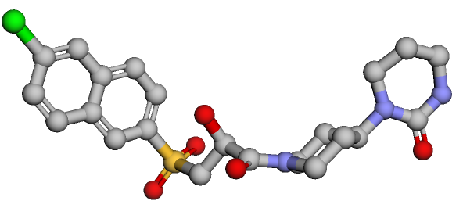
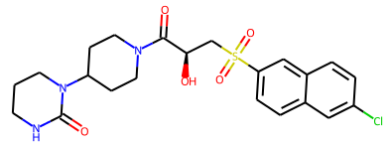
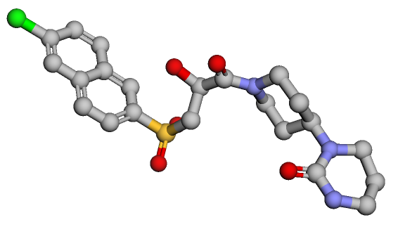
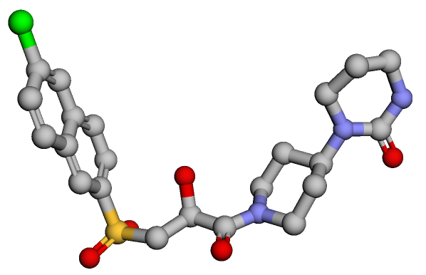
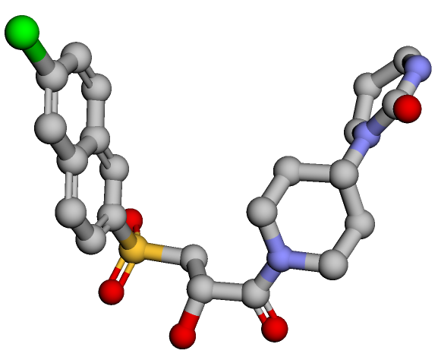
Aim: Identify bioactive-like conformations of small molecules
ARMSD = 1.27
Generator
ARMSD = 3.05
Bioactive conformation
Model
ARMSD = 0.67
ARMSD = Atomic Root-Mean-Square Deviation
5

Slide 6
Methods
6

Slide 7
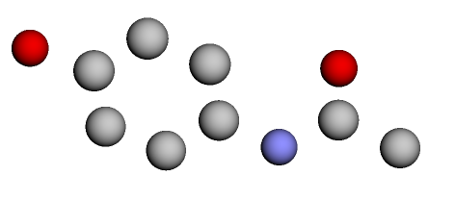
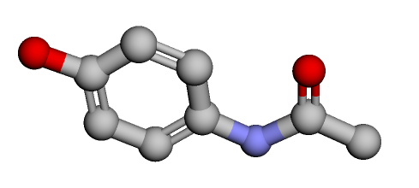
SchNet atomistic neural network
Neighborhood convolution
= interaction block
Atomic positions
Interatomic distance embeddings
Raw embedding
Interaction blocks
Processed atom embeddings (single value)
Single value output for conformation
Atomic numbers
Raw atom embeddings
Sum
Schütt, K. T.; Sauceda, H. E.; Kindermans, P.-J.; Tkatchenko, A.; Müller, K.-R. SchNet – A Deep Learning Architecture for Molecules and Materials. J. Chem. Phys. 2018, 148 (24), 241722. https://doi.org/10.1063/1.5019779.
7

Slide 8
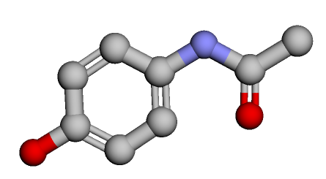
The BioSchNet model is trained to predict the ARMSD
Sum
Predicted ARMSD to bioactive
Atom contributions
SchNet
LeakyReLU
Loss function:
Root-Mean-Square Error (RMSE)
Input conformation
BioSchNet
Real ARMSD to bioactive
8

Slide 9
Bioactive conformations were extracted from PDBbind
PDBbind + generated conformations
952,880 conformations
including 15,296 bioactive
PDBbind v2020
General + Refined
14,385 ligands
17,324 complexes
PDBbind dataset
12,592 ligands
15,296 complexes
RDKit parsed
Generate up to 100 conformers with the CCDC generator
Remove molecules with more than 50 heavy atoms​
Compute ARMSD for each conformation
Liu, Z. et al. PDB-wide collection of binding data: current status of the PDBbind database. Bioinformatics 31, 405–412 (2015).
9

Slide 10
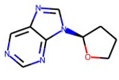
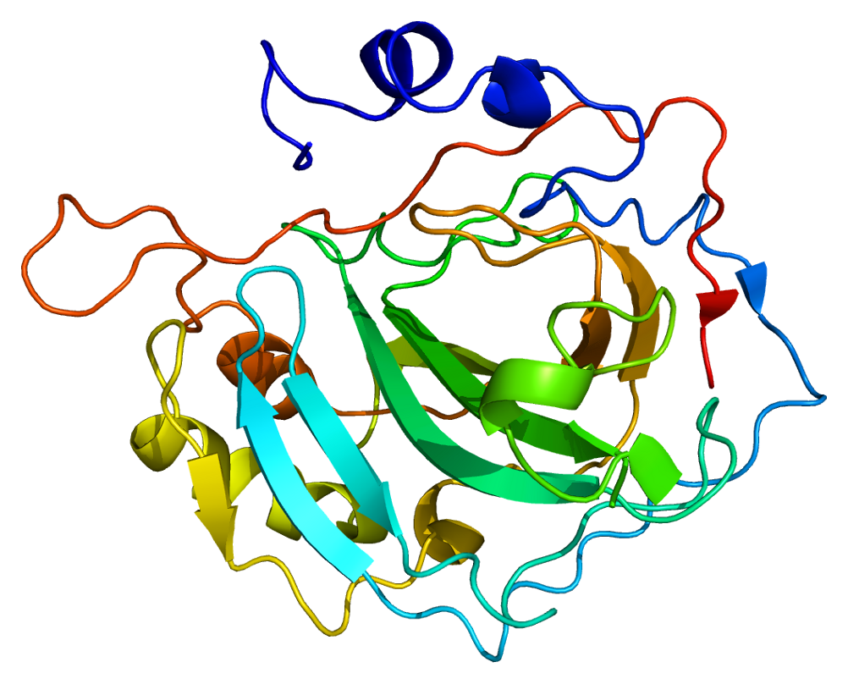
Three different splitting strategies were tested
Train
(80%)
Validation
(10%)
Test
(10%)
PDBbind + conformers
Shuffle order 5 times (bootstrapping)
Random split
Scaffold split
Protein split
Random shuffling of the unique ligands
Train and test sets will have different molecules
Cluster ligands by Bemis-Murcko scaffold
Train and test molecules will have different scaffolds
Cluster proteins by Needleman-Wunsch sequence identity (intra-cluster similarity > 80%)
Train and test molecules bind different proteins
10

Slide 11
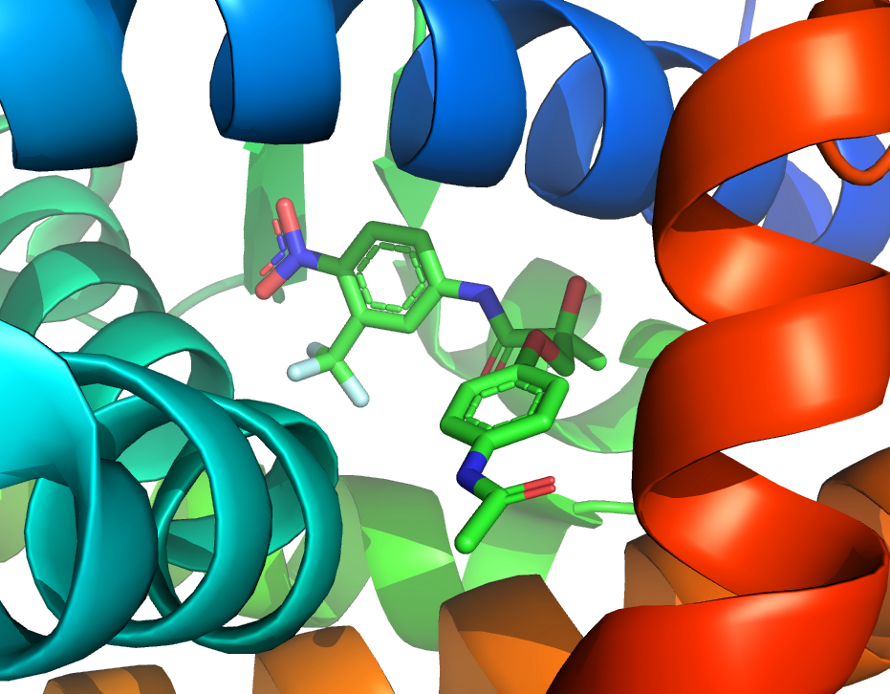
Short-listing input conformations for rigid-ligand docking
CCDC Gold with PLP scoring function:
10 poses per conformations (keep best)
No torsional search
+
Generate conformations
2.2
Predict ARMSD
Rank by ARMSD
Select fraction f
0.5
0.5
0.5
...
...
...
2.2
f ∈ [0;1]
...
11

Slide 12
Evaluation metrics for the ARMSD regression and conformation ranking
Mean Root-Mean-Square Error (RMSE)
R²
Enrichment factor (EF) of bioactive-like conformations at different fractions
2.2
f = 0.10
Bioactive-like ?
Predict ARMSD
Rank by ARMSD
0.5
...
0.5
...
2.2
...
12

Slide 13
Evaluating the rigid-ligand docking with short-listing in virtual screening
DUD-E virtual screening : retrieve active compounds among decoys
Select fraction f
Dock
0.5
Rank molecules by PLP score of best pose
0.5
...
...
...
2.2
f ∈ [0;1]
Assess enrichment of actives using the BEDROC (∈ [0;1], close to EF_{8%})
13

Slide 14
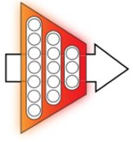
Performance baselines
ARMSD prediction baseline: Molsize model:
Predicting a molecule average ARMSD using only 2D descriptors
Molsize
#HeavyAtoms
#RotBonds
Predicted ARMSD to bioactive
Conformation ranking baselines:
Random shuffling of conformations
Ascending UFF energy
CCDC conformer generator order
14

Slide 15
Results
15

Slide 16
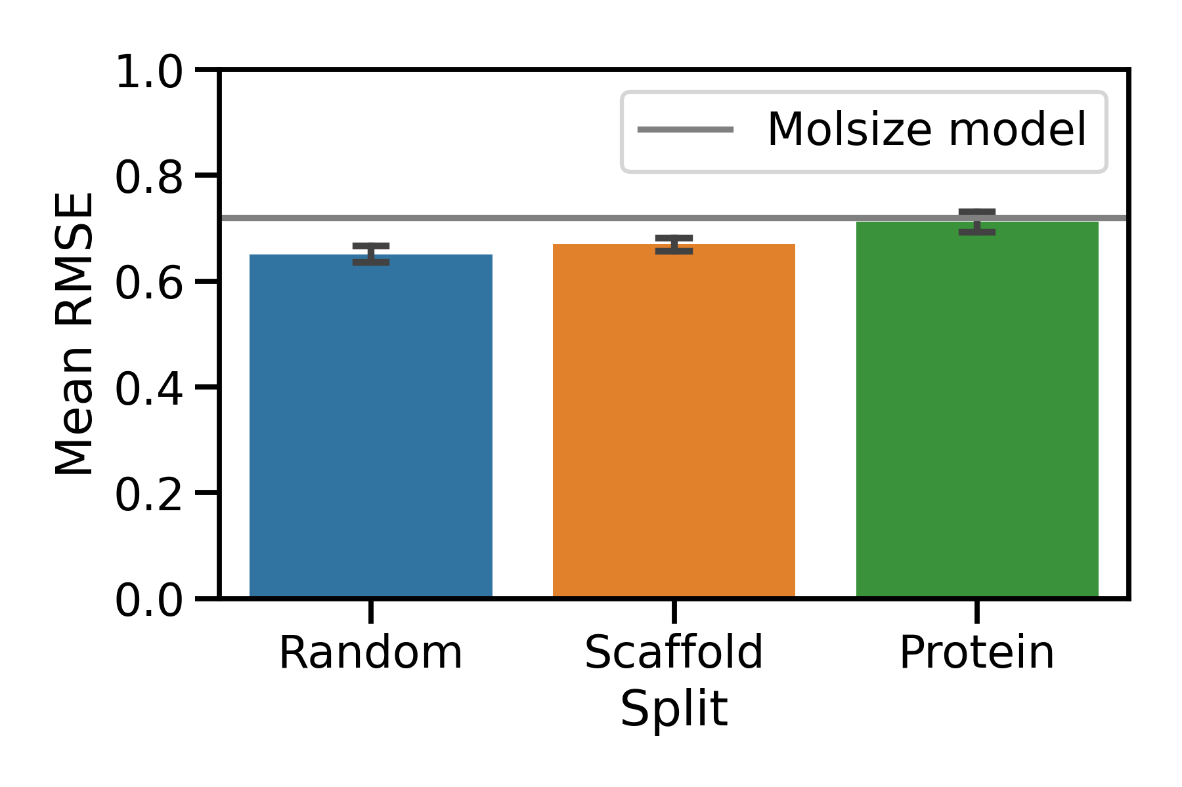
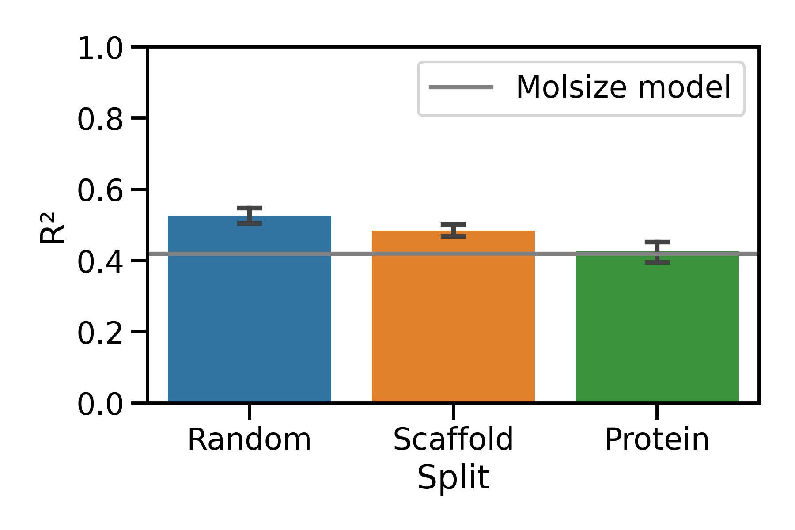
The different splits have variable ARMSD prediction performances
16

Slide 17
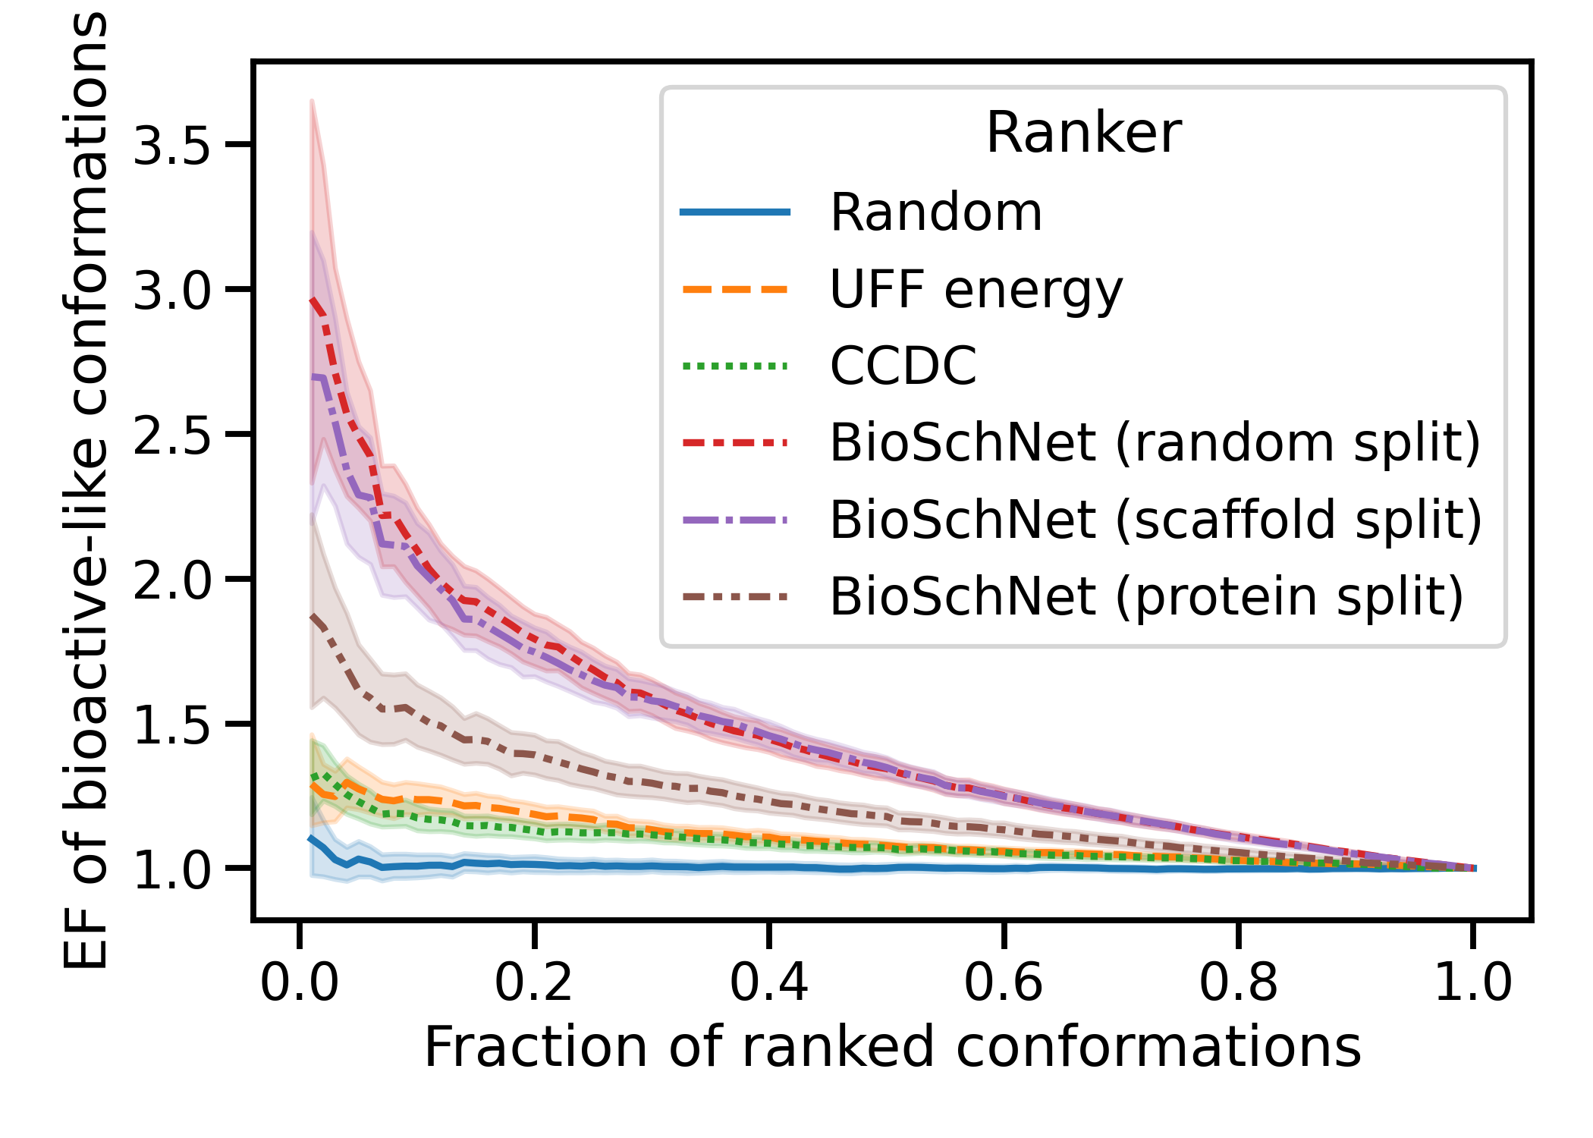
BioSchNet ranking retrieves bioactive-like conformations in early ranks
17

Slide 18
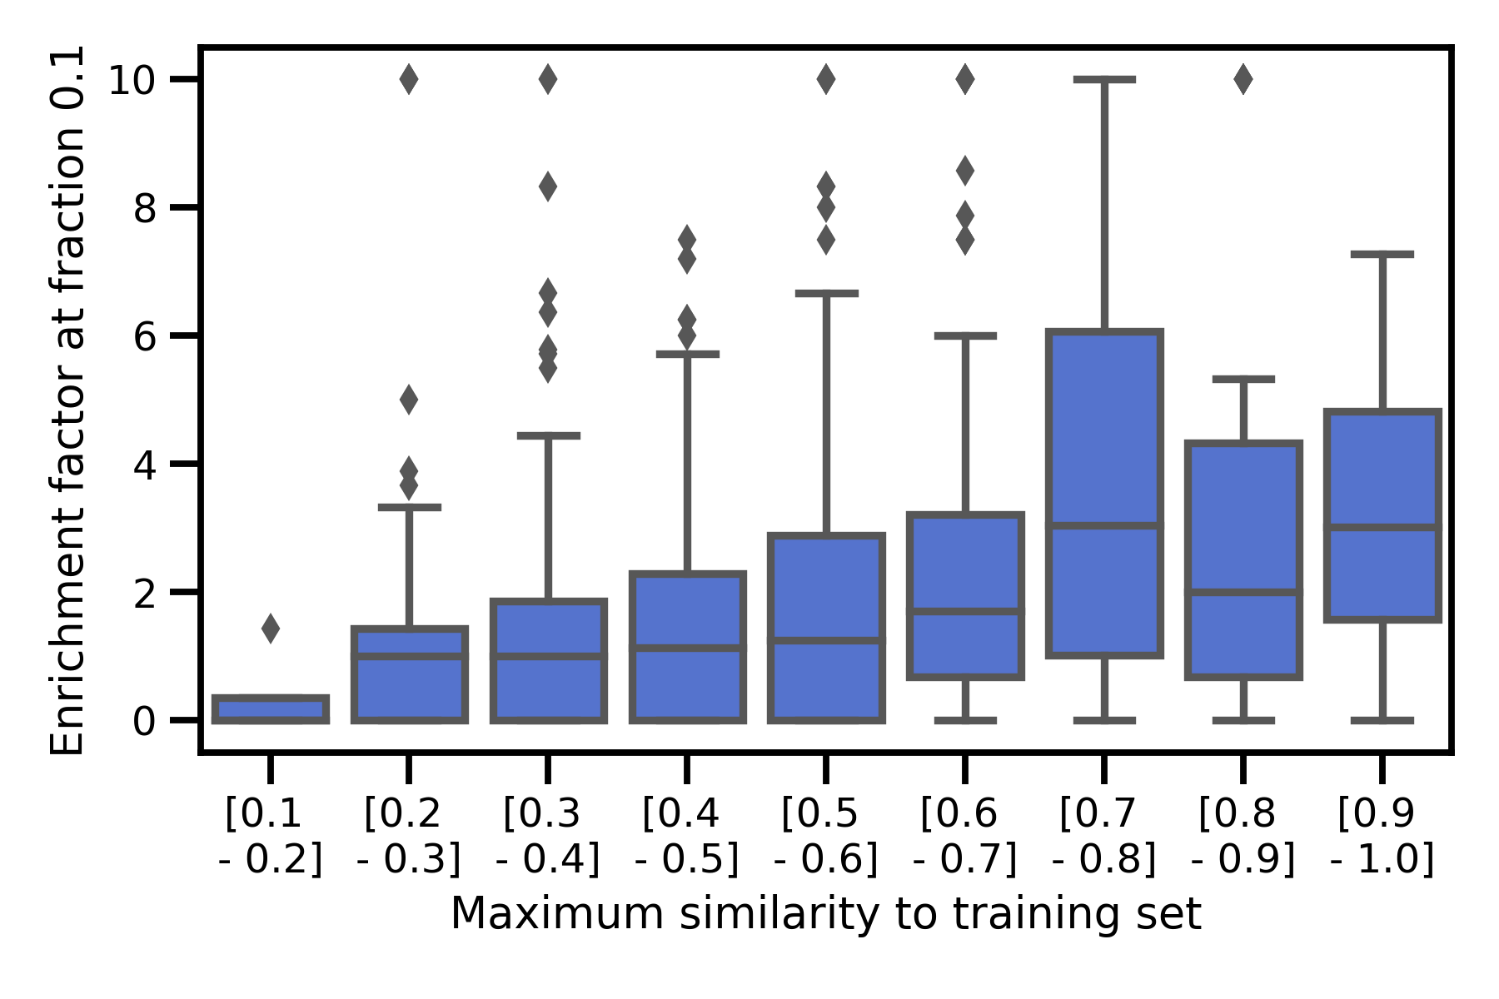
Ranking performance is correlated with molecule similarity to training set
18

Slide 19
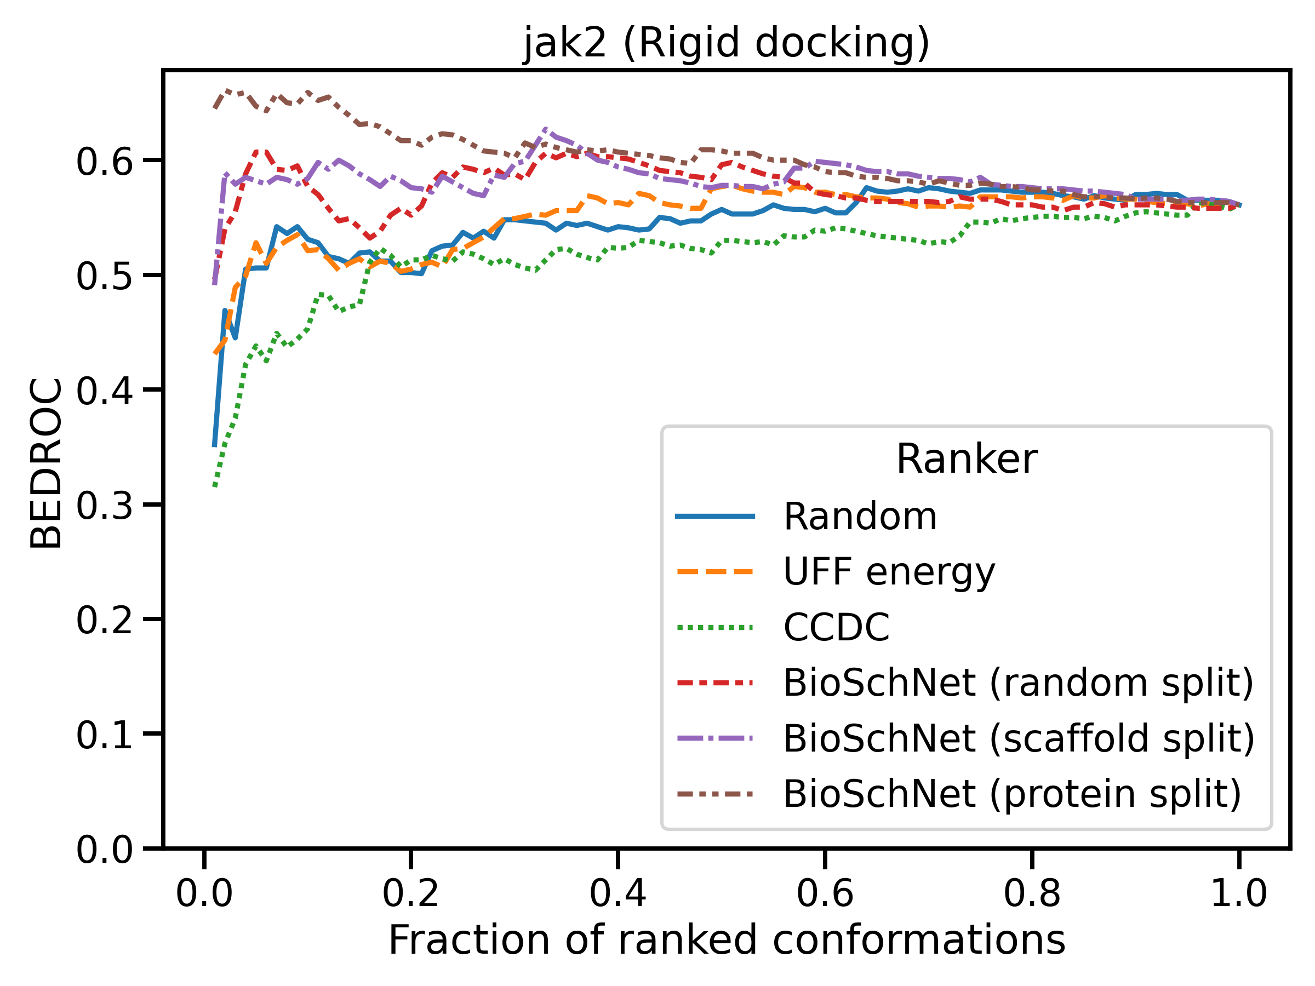
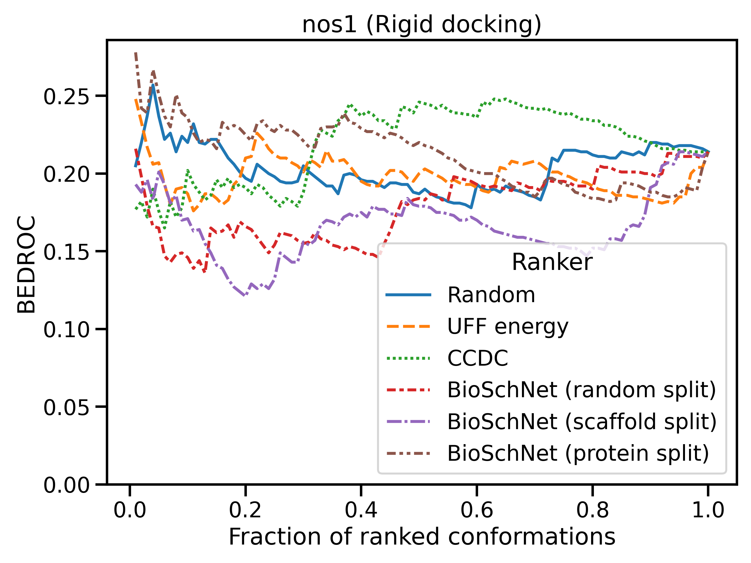
BioSchNet can accelerate virtual screening on targets seen in training
jak2 (in PDBBind)
nos1 (not in PDBBind)
19

Slide 20
Conclusion
20

Slide 21
BioSchNet can help accelerate bioactive conformation identification
Training the BioSchNet model on PDBbind target-bound ligand conformations and generated conformations allowed us to :
Predict for input conformations their ARMSD to their closest known bioactive conformation
Rank generated conformations with an early enrichment of bioactive-like conformations
Short-list input conformations for virtual screening using rigid-ligand docking
Main limitation: BioSchNet has limited applicability for molecules dissimilar from training or binding proteins whose ligands were not in the training set
21

Slide 22
Acknowledgements
Bender group members
Andreas Bender
Jason Cole
Ilenia Giangreco
Patrick McCabe
22

Slide 23
Extra slides
23

Slide 24
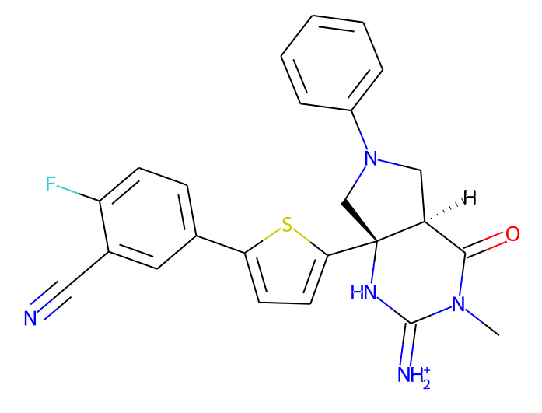
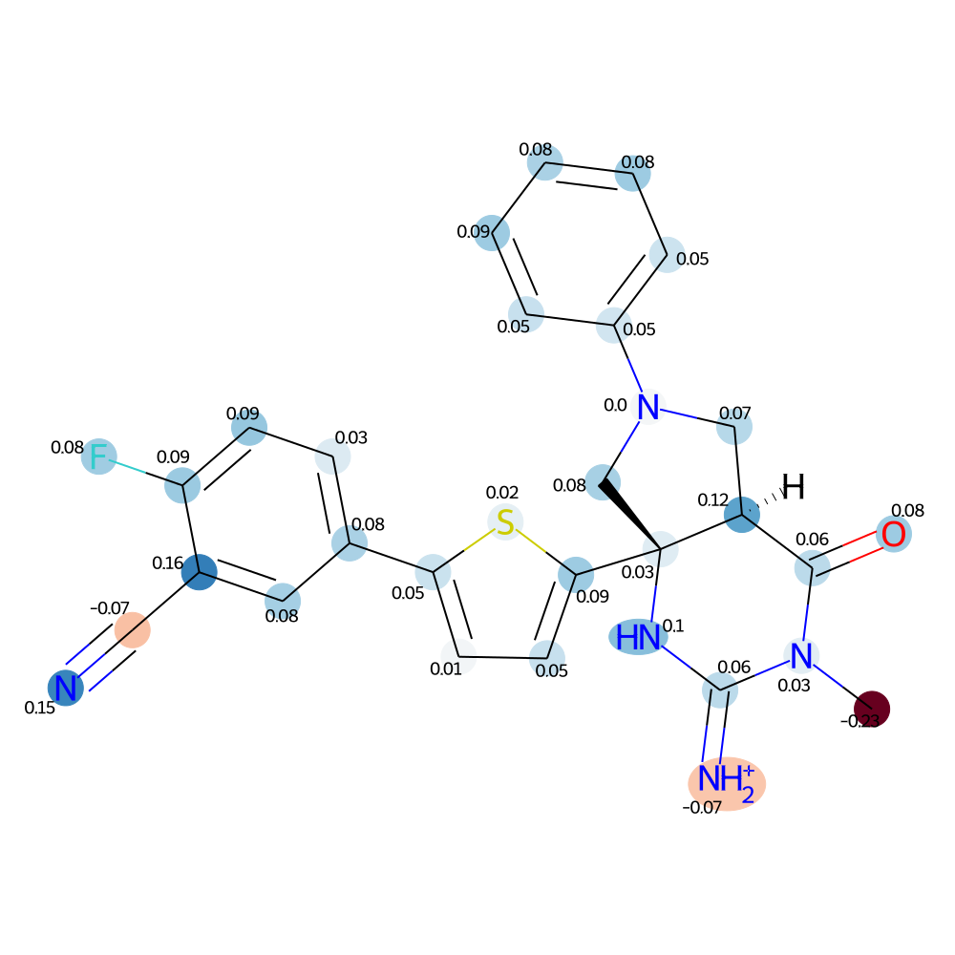
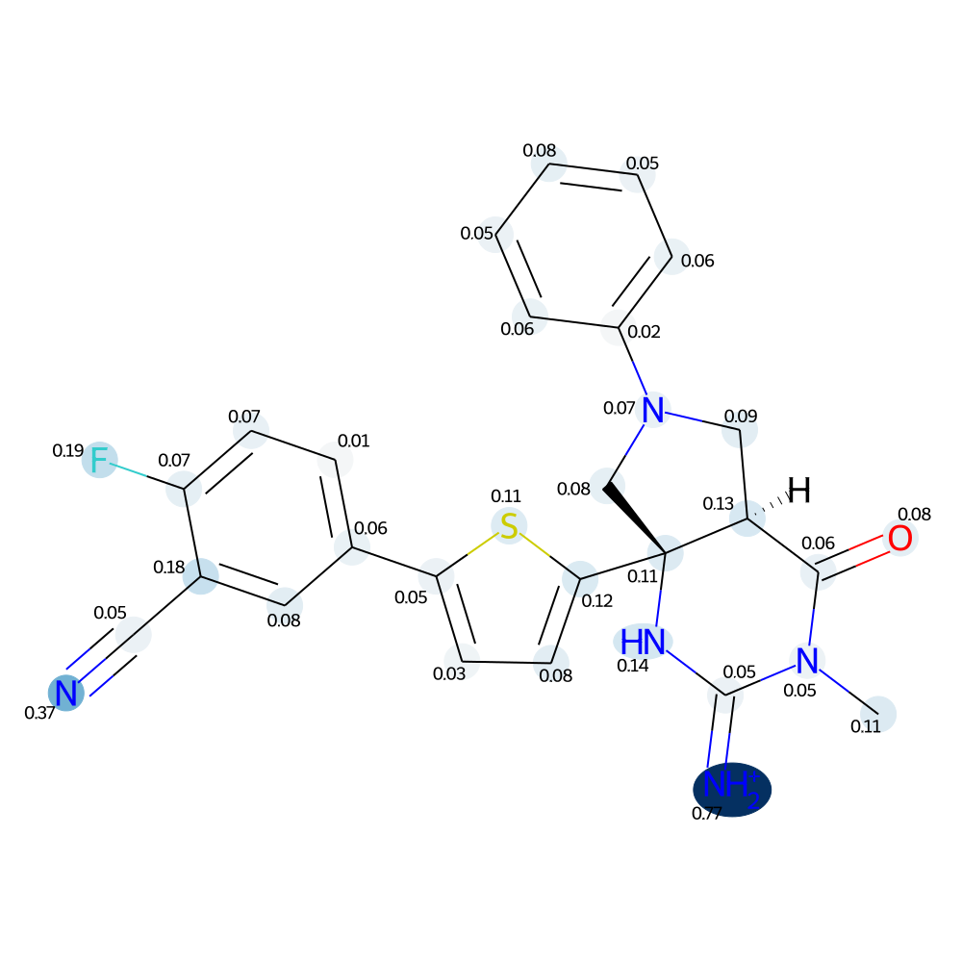
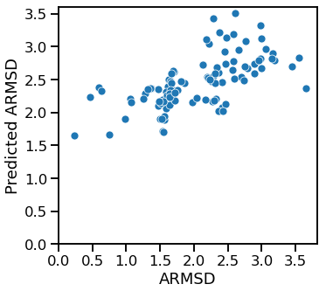
Insights to model interpretability
Negative contribution
Positive contribution
24

Slide 25
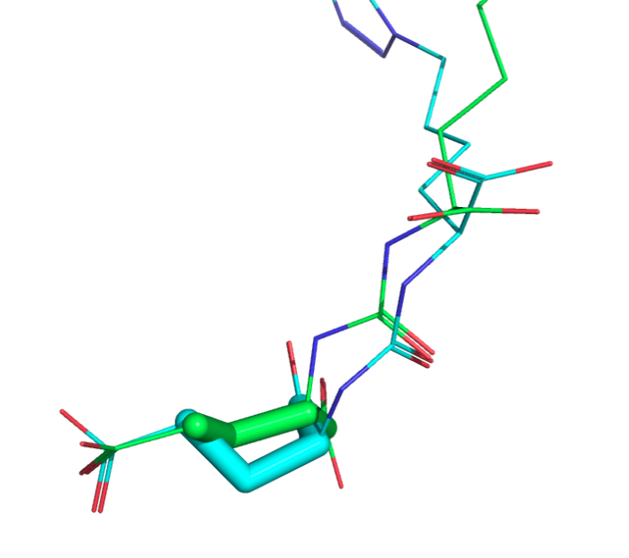
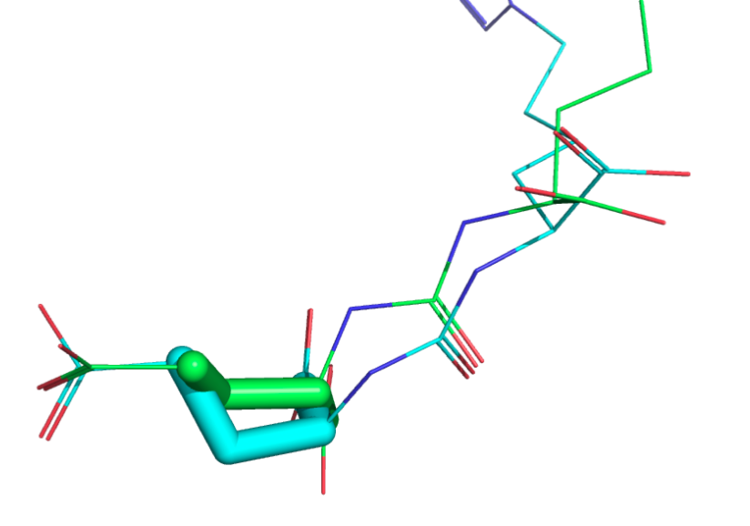
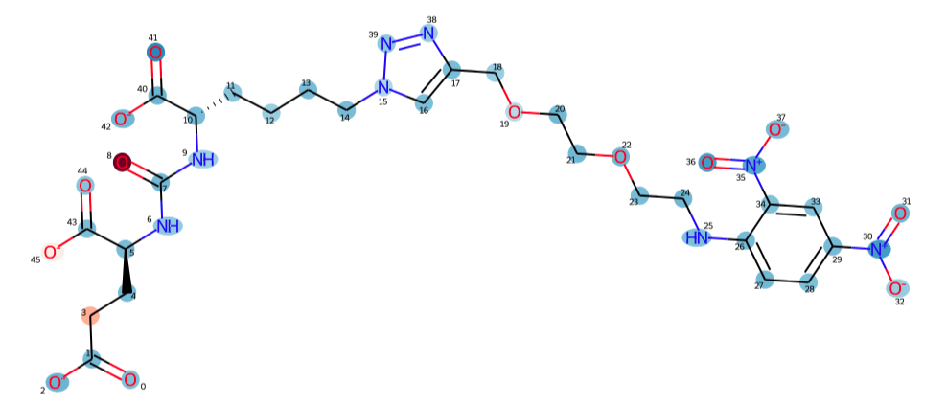
The most similar molecule in the training set show a similar pattern
Test molecule
Conformation:
Bioactive: torsion = 60°
Generated: torsion = 180°
Atomic contribution:
Low value (min = -1)
High value (max = 0.05)
Same substructure
Closest train molecule
(Tanimoto similarity = 0.54)
25

Slide 26
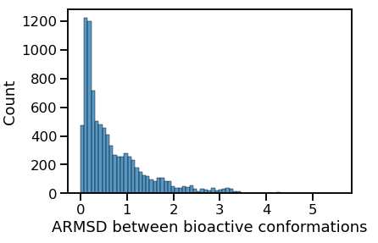
Bioactive conformation diversity
75%
25%

Slide 27
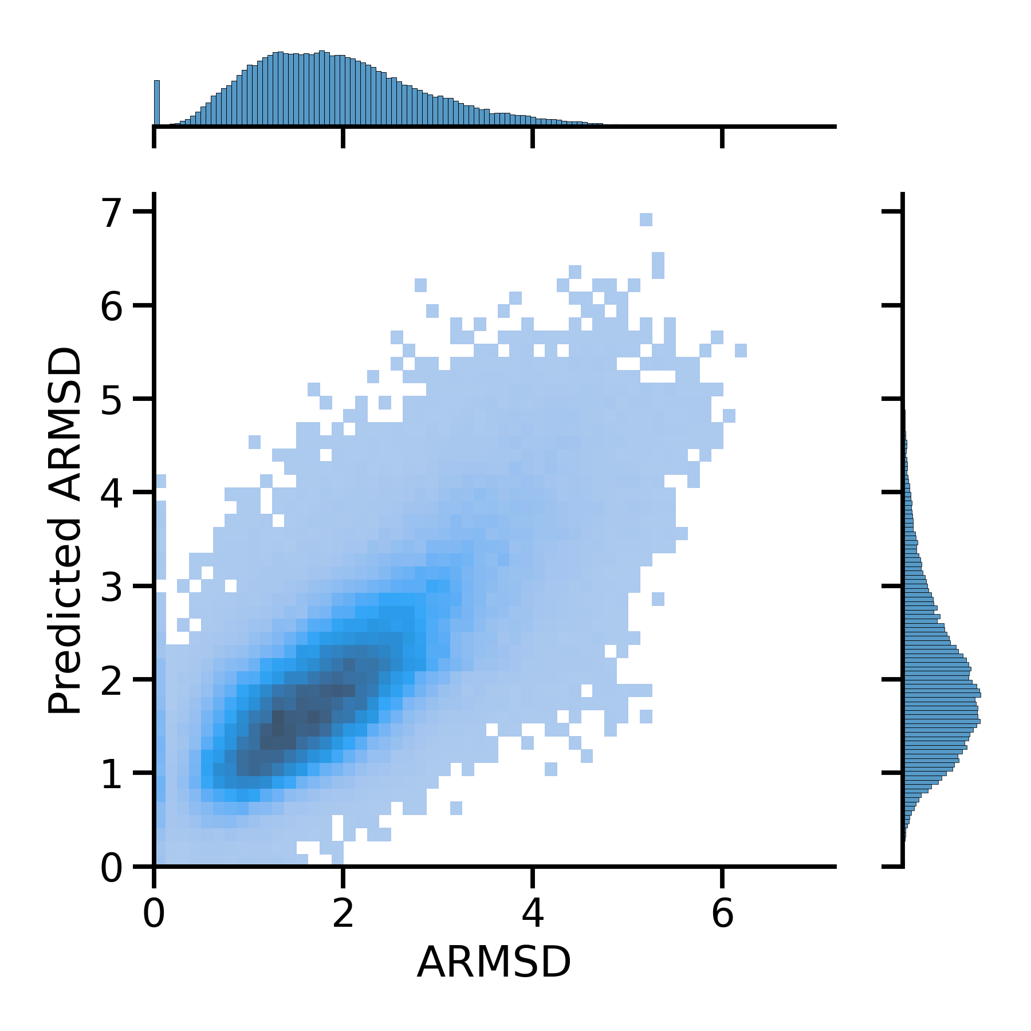
ARMSD regression performance on the random split is satisfactory
Baseline Molsize model:
R2 = 0.43
Mean RMSE = 0.72
R² = 0.53 ± 0.03
Mean RMSE = 0.65 ± 0.02
27

Slide 28
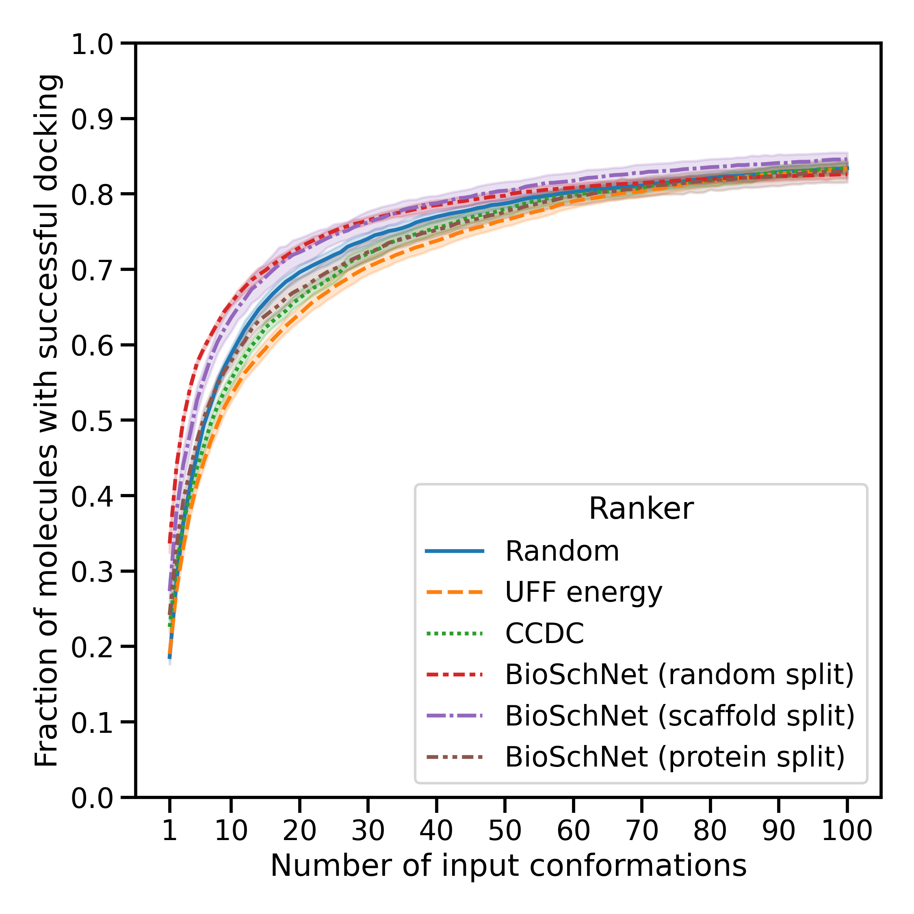
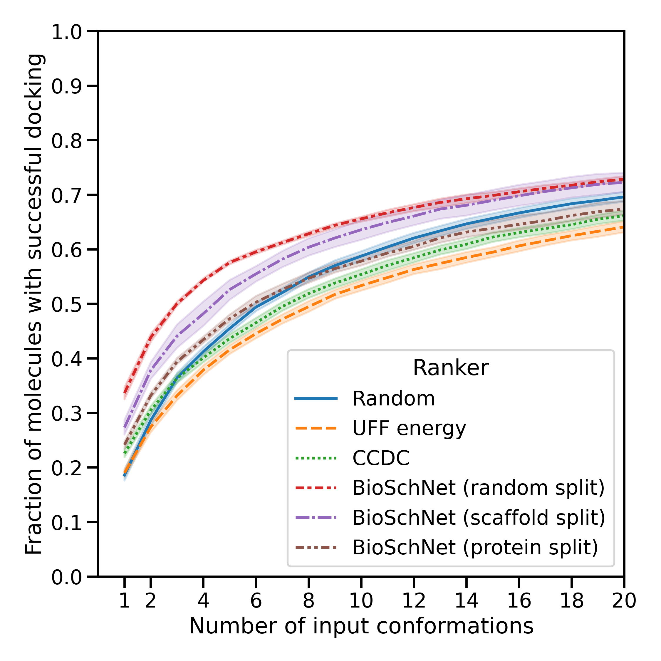
BioSchNet retrieves a higher rate of successful docking using a limited number of input conformations
28

Slide 29
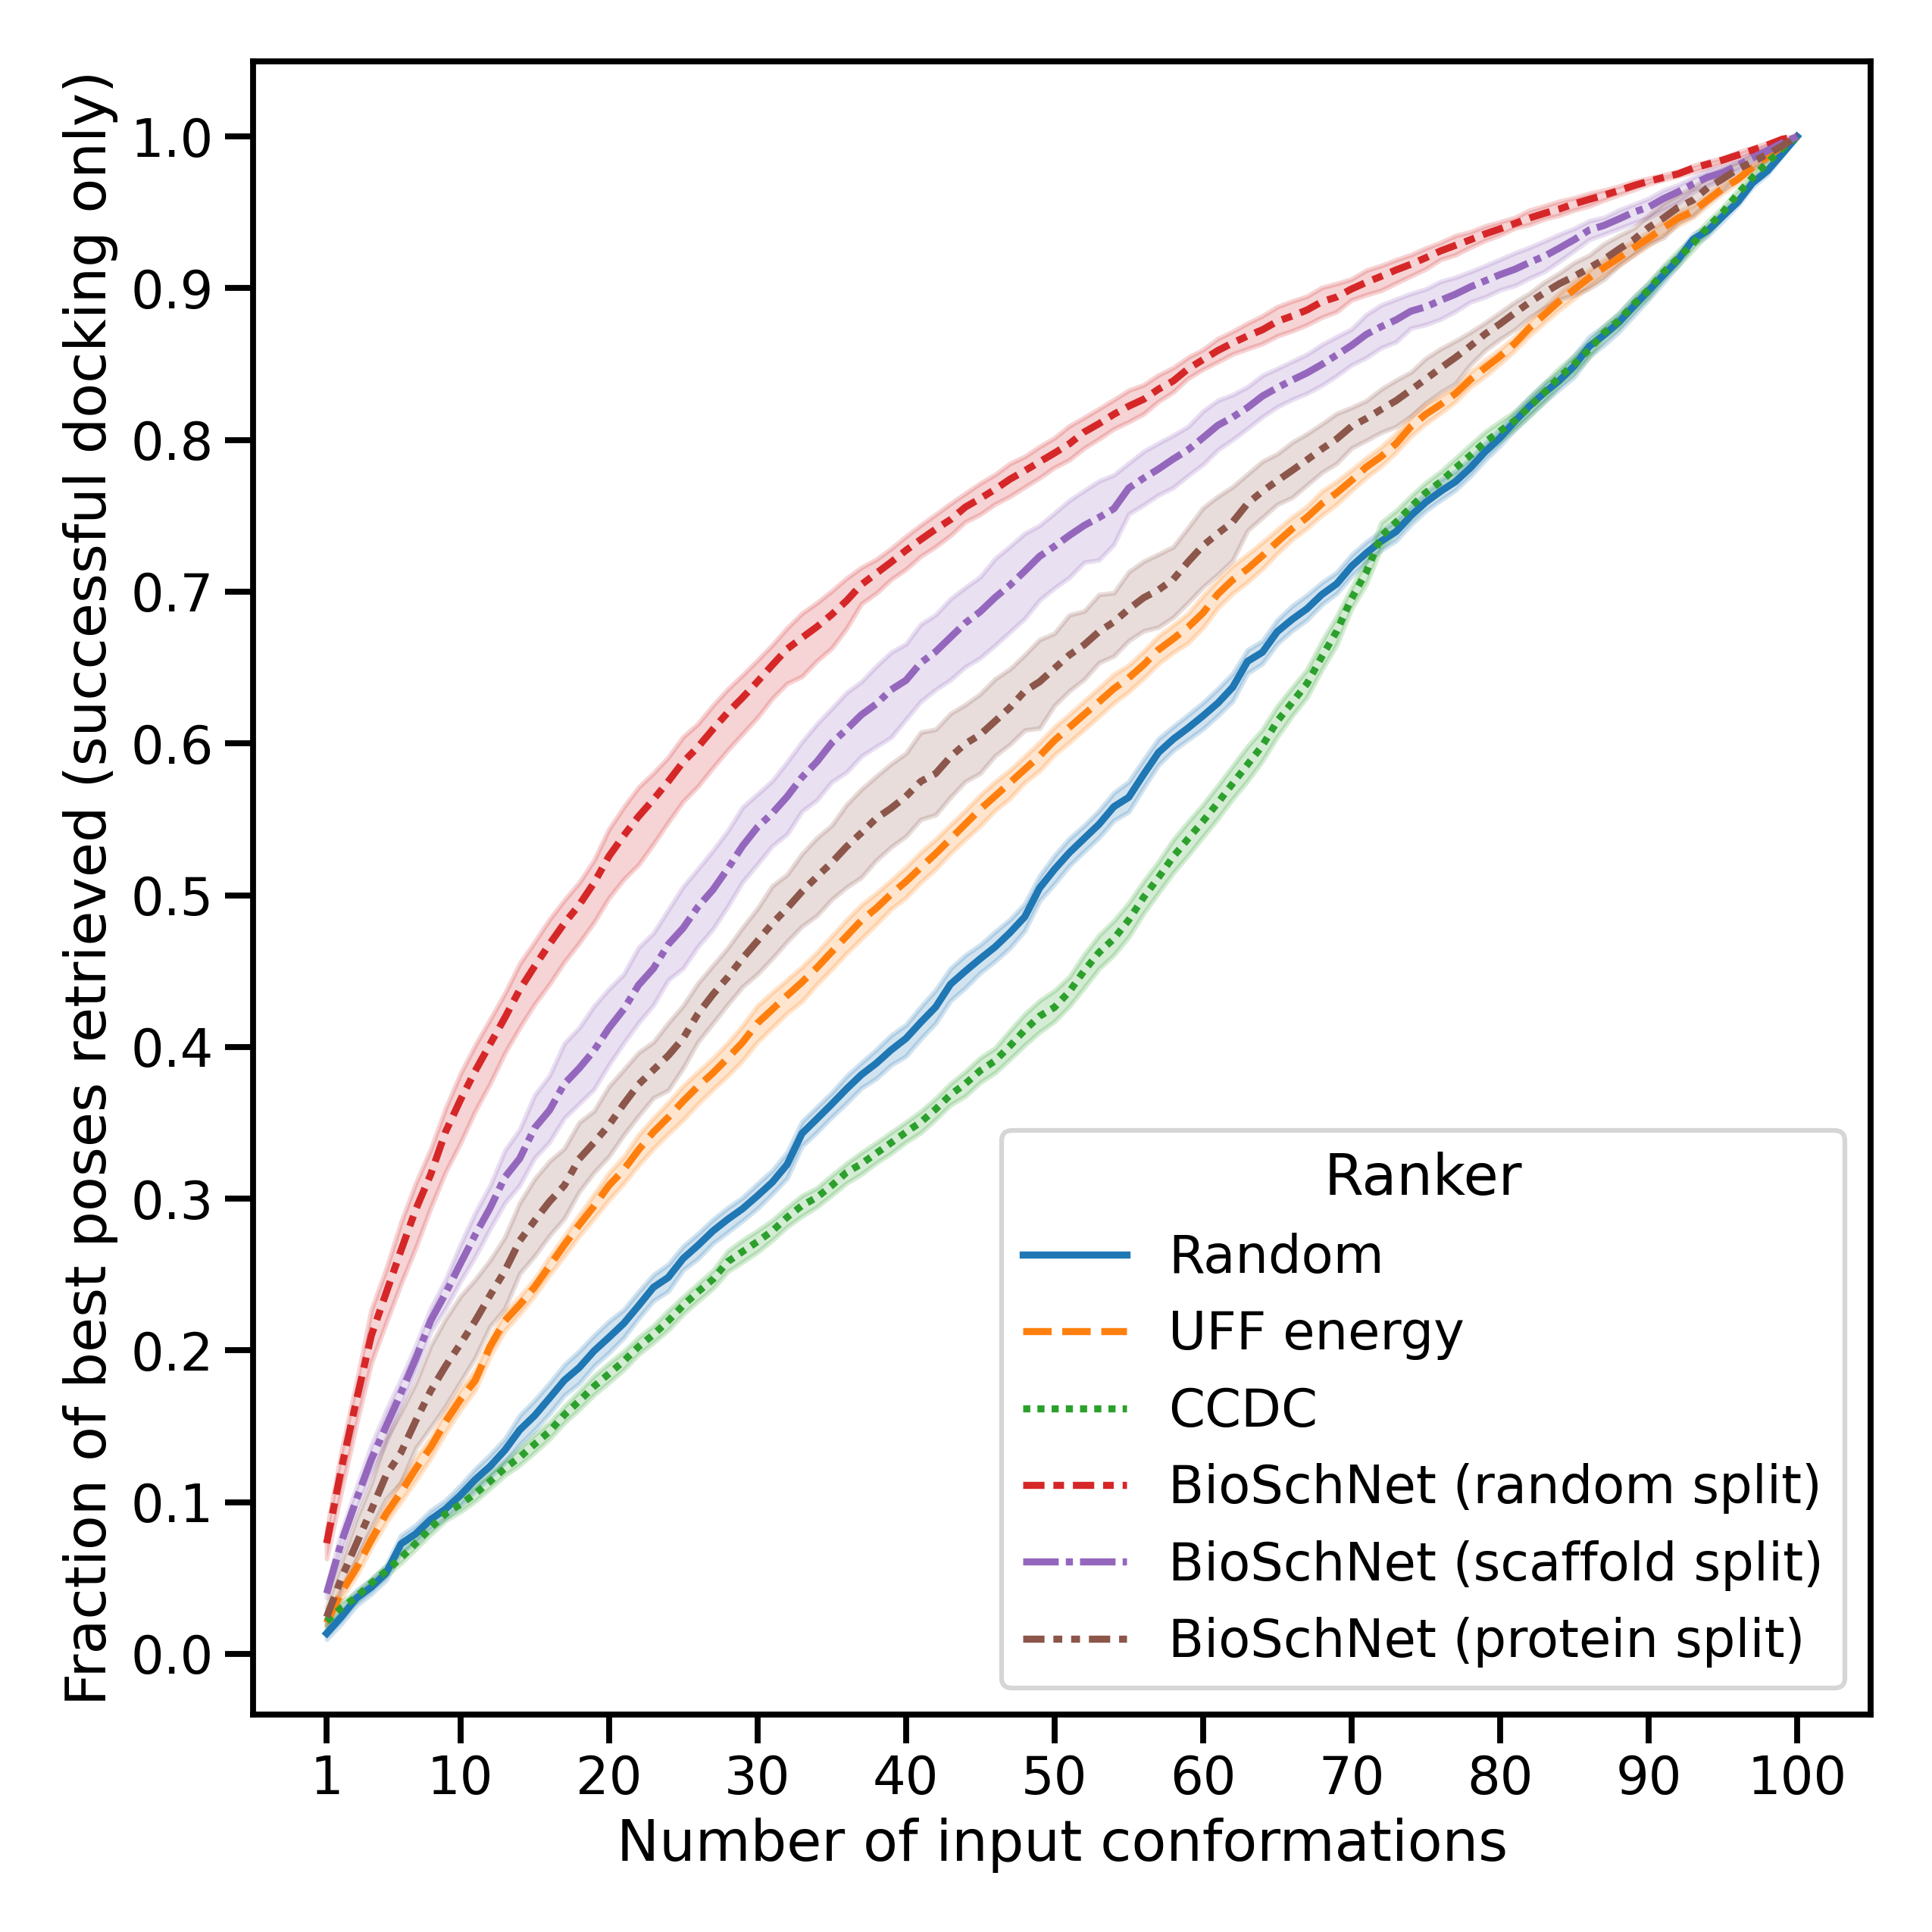
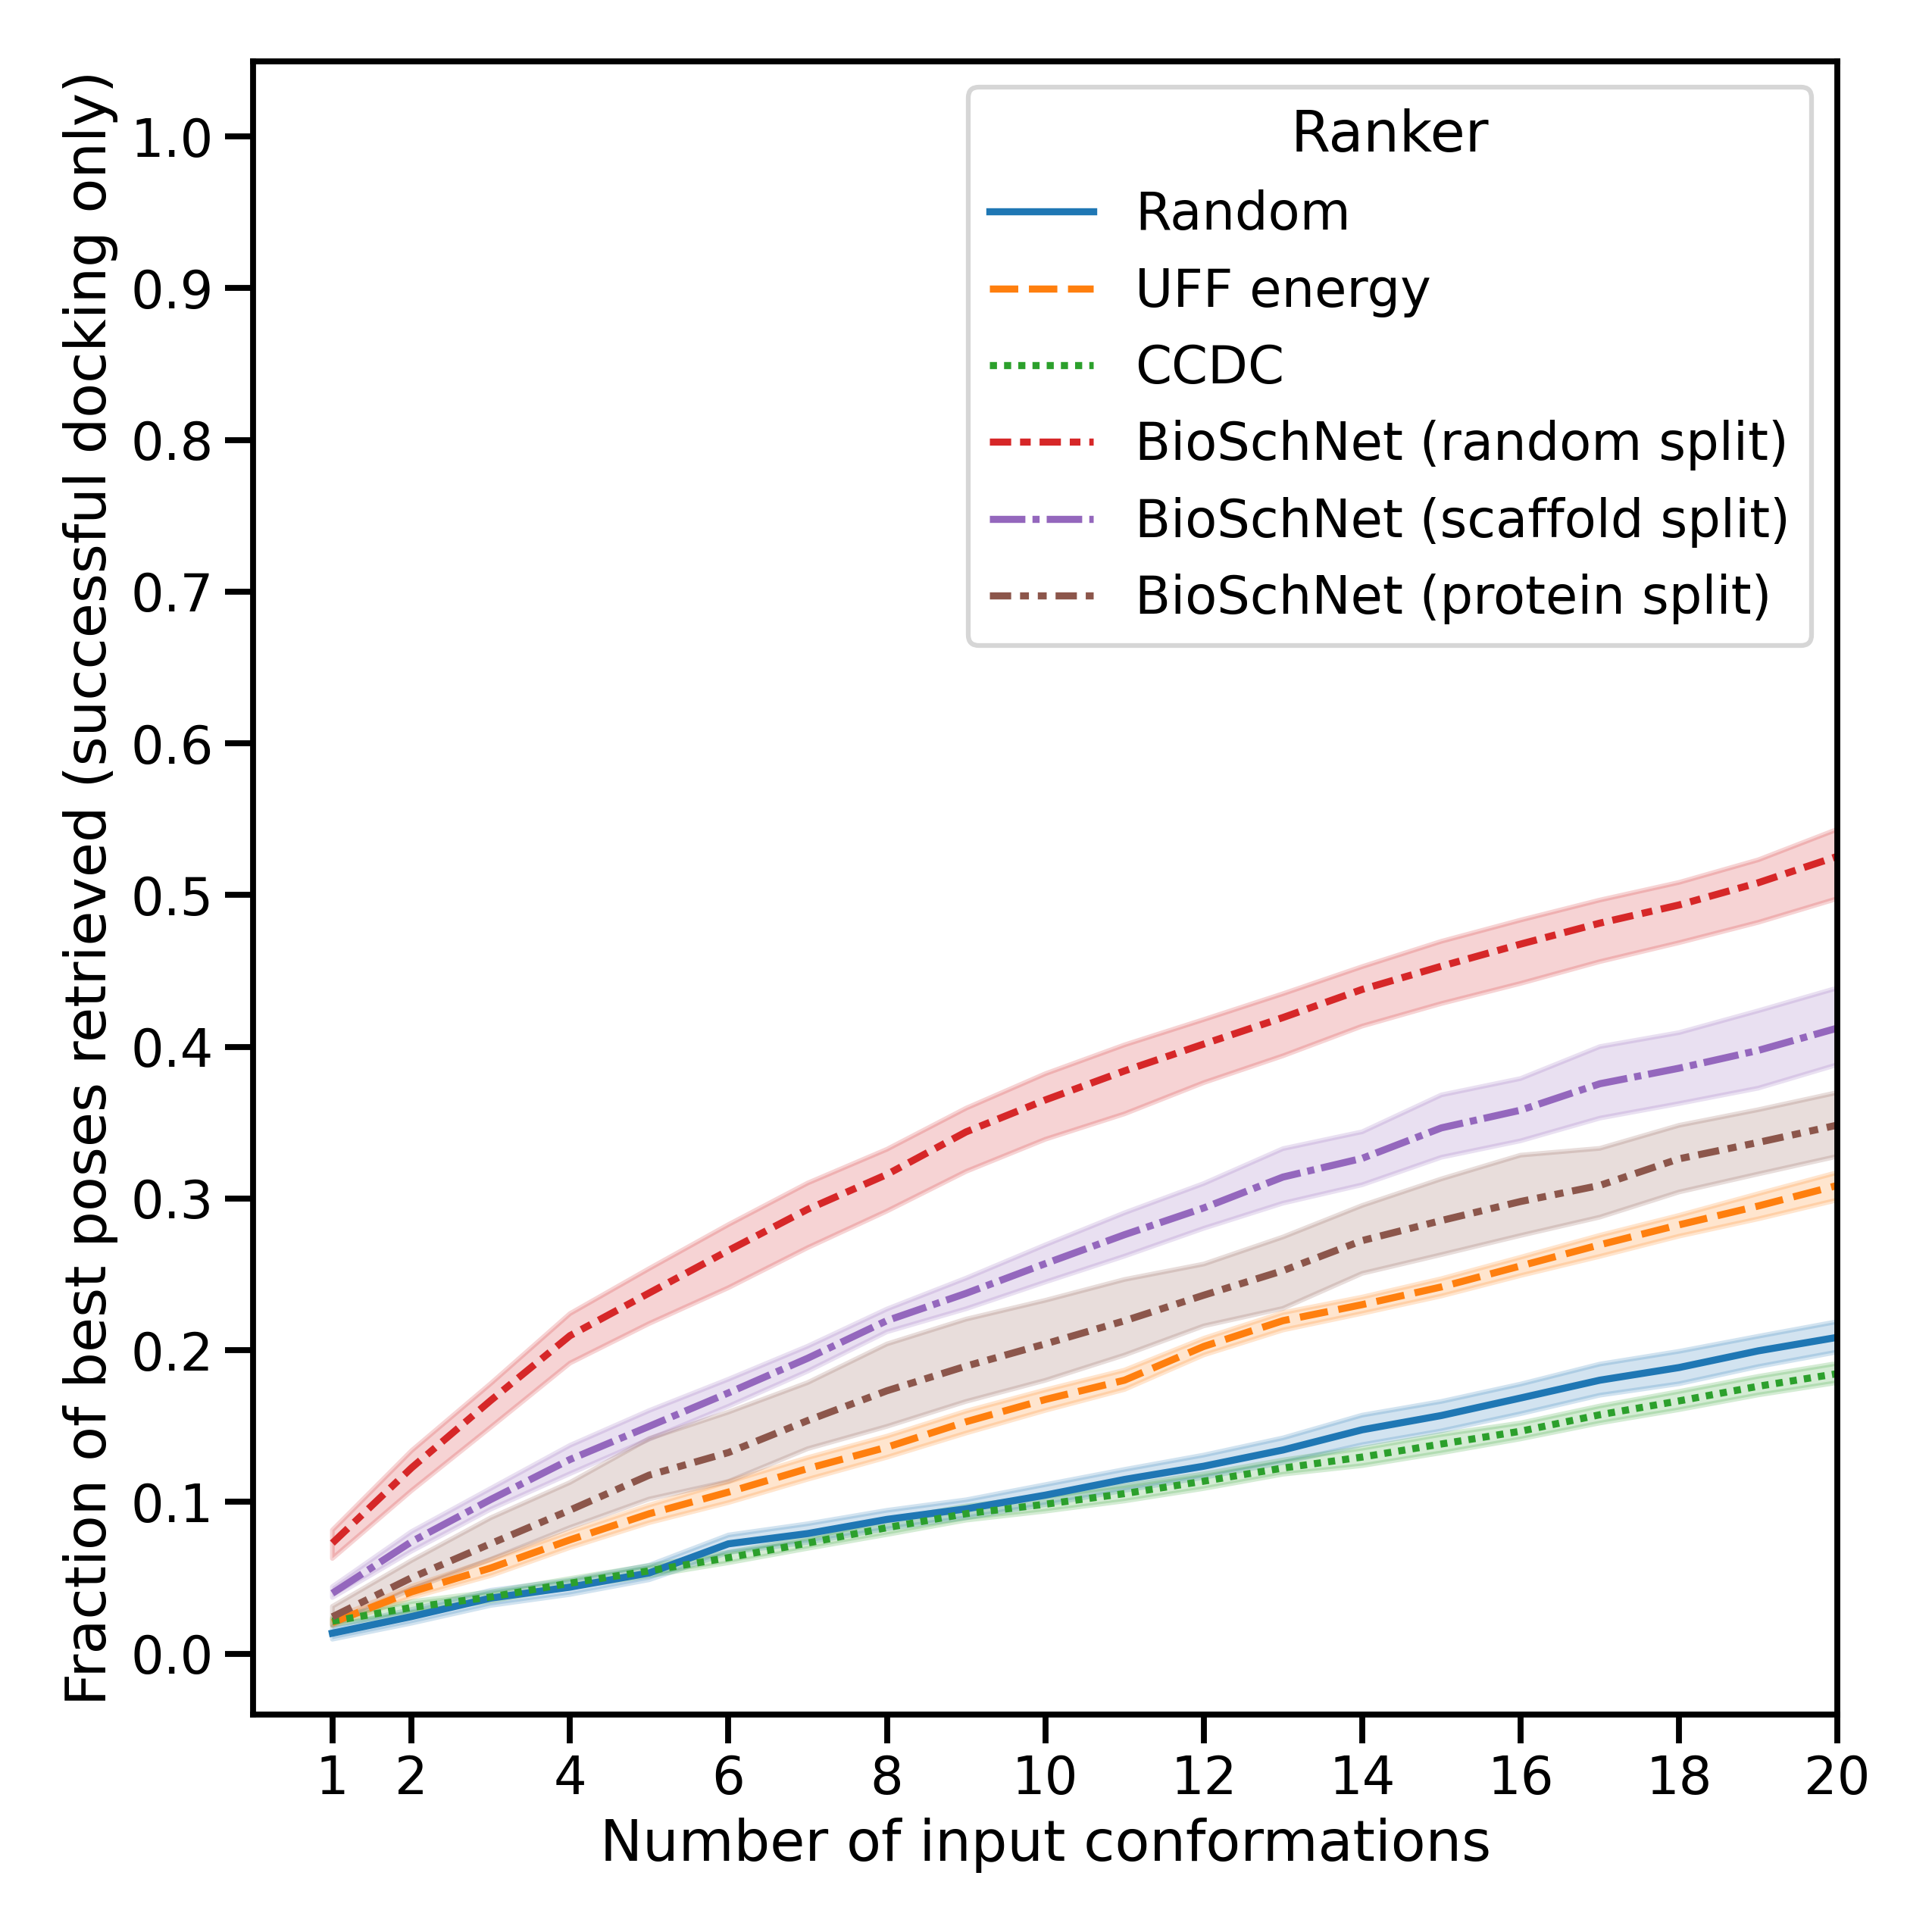
BioSchNet retrieves best poses at earlier ranks
29

Slide 30
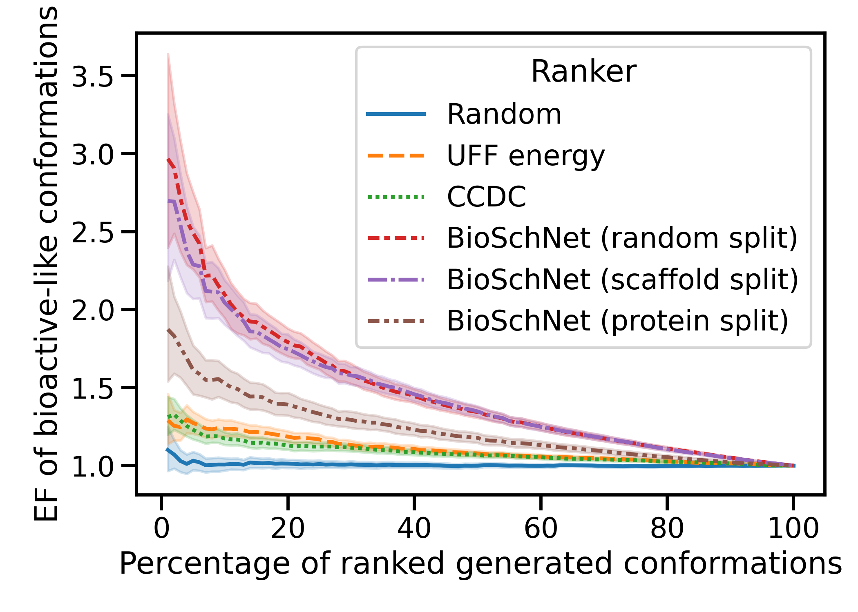
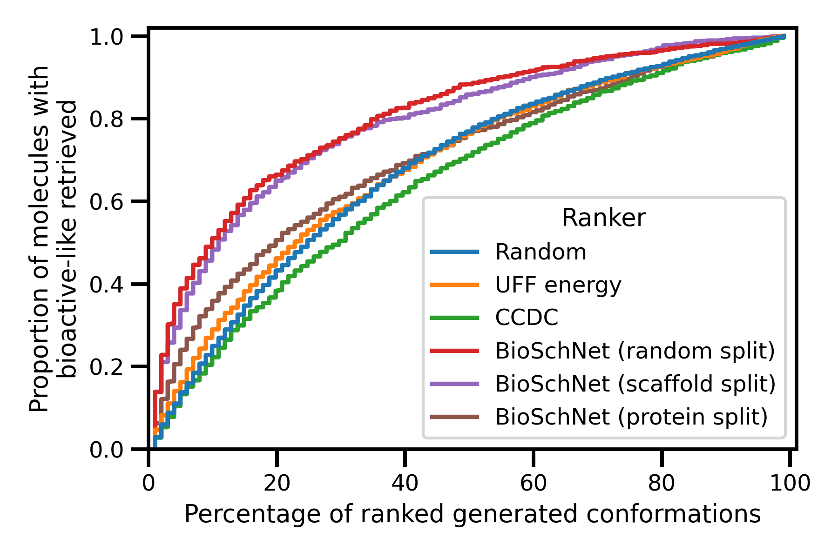
BioSchNet ranking retrieves bioactive-like conformations in early ranks
On molecules having 5% or less bioactive-like generated conformations
Median
Ranked first
30

Slide 31
BioSchNet surprisingly ranks bioactive conformations first for highly flexible molecules
Pearson coefficient = -0.202
31

Slide 32
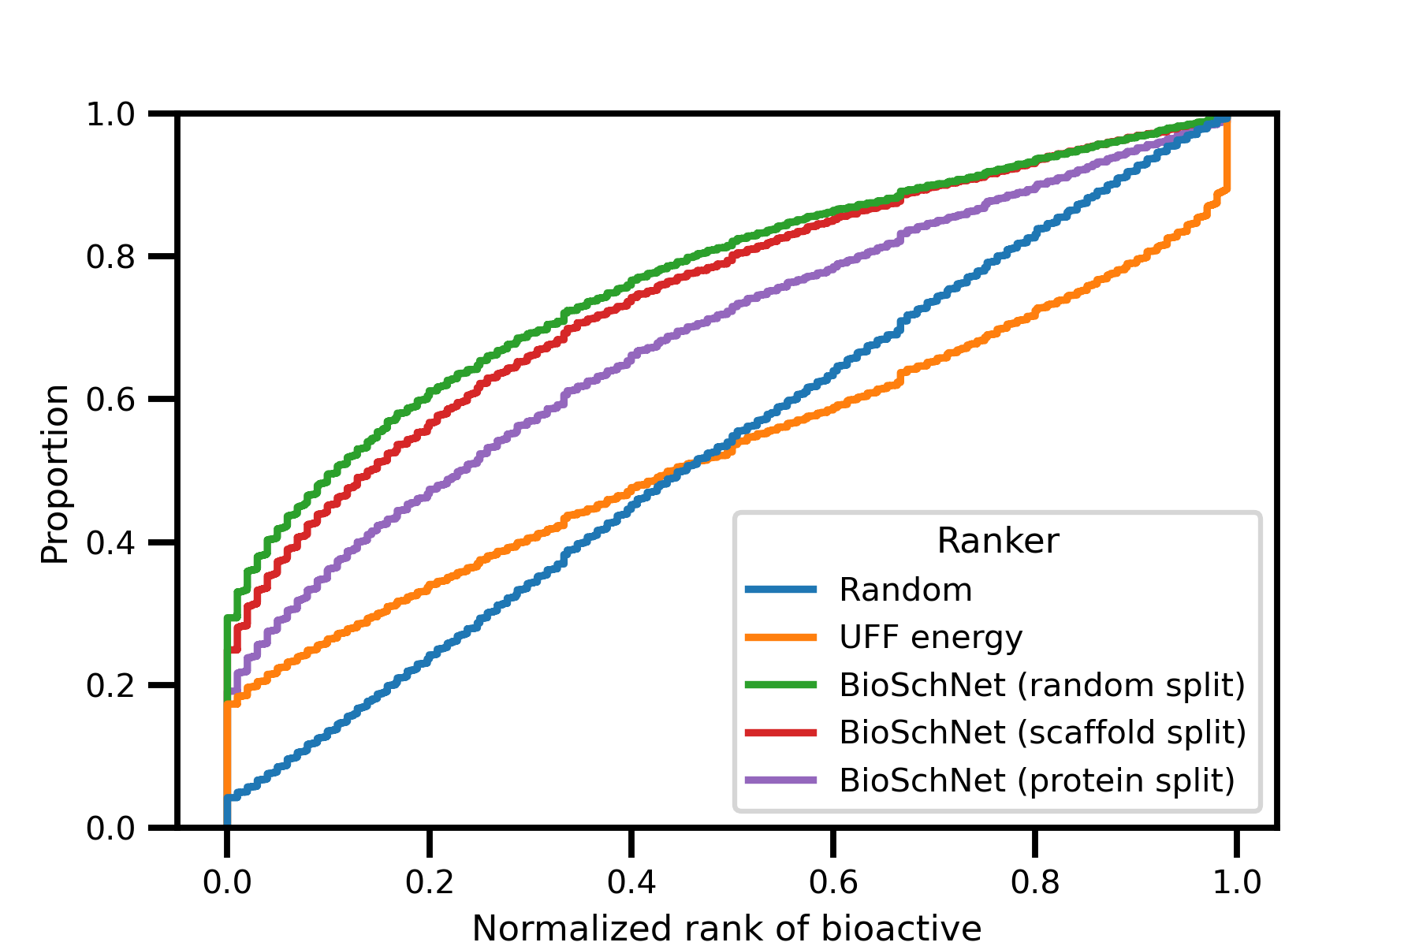
BioSchNet ranking retrieves bioactive conformations in early ranks
Median
Ranked first
32
Notes:
Best baseline is the UFF energy with 18% bioactive conformations ranked first and a median normalized rank of 0.43

Slide 33
Perspectives
Docking
Pre-processing
Can a subset of topN conformation ranked by the model give better results (wrt time, docking power or virtual screening) at rigid-ligand docking?
Post-processing
Can a subset of topN poses ranked by the model give poses closer to the real pose ? (Docking power)
Is the top docking score from this subset able to give better results for virtual screening ?
Custom scoring function
Pharmacophore searching
Among a set of generated conformations, are the topN conformations ranked by the model more likely to find the bioactive pharmacophore (for a given molecule, or a given structure/target-based pharmacophore)?
Conformation generation
Can we use the model to bias the generation of conformation toward bioactive conformations ?

