Slide 1
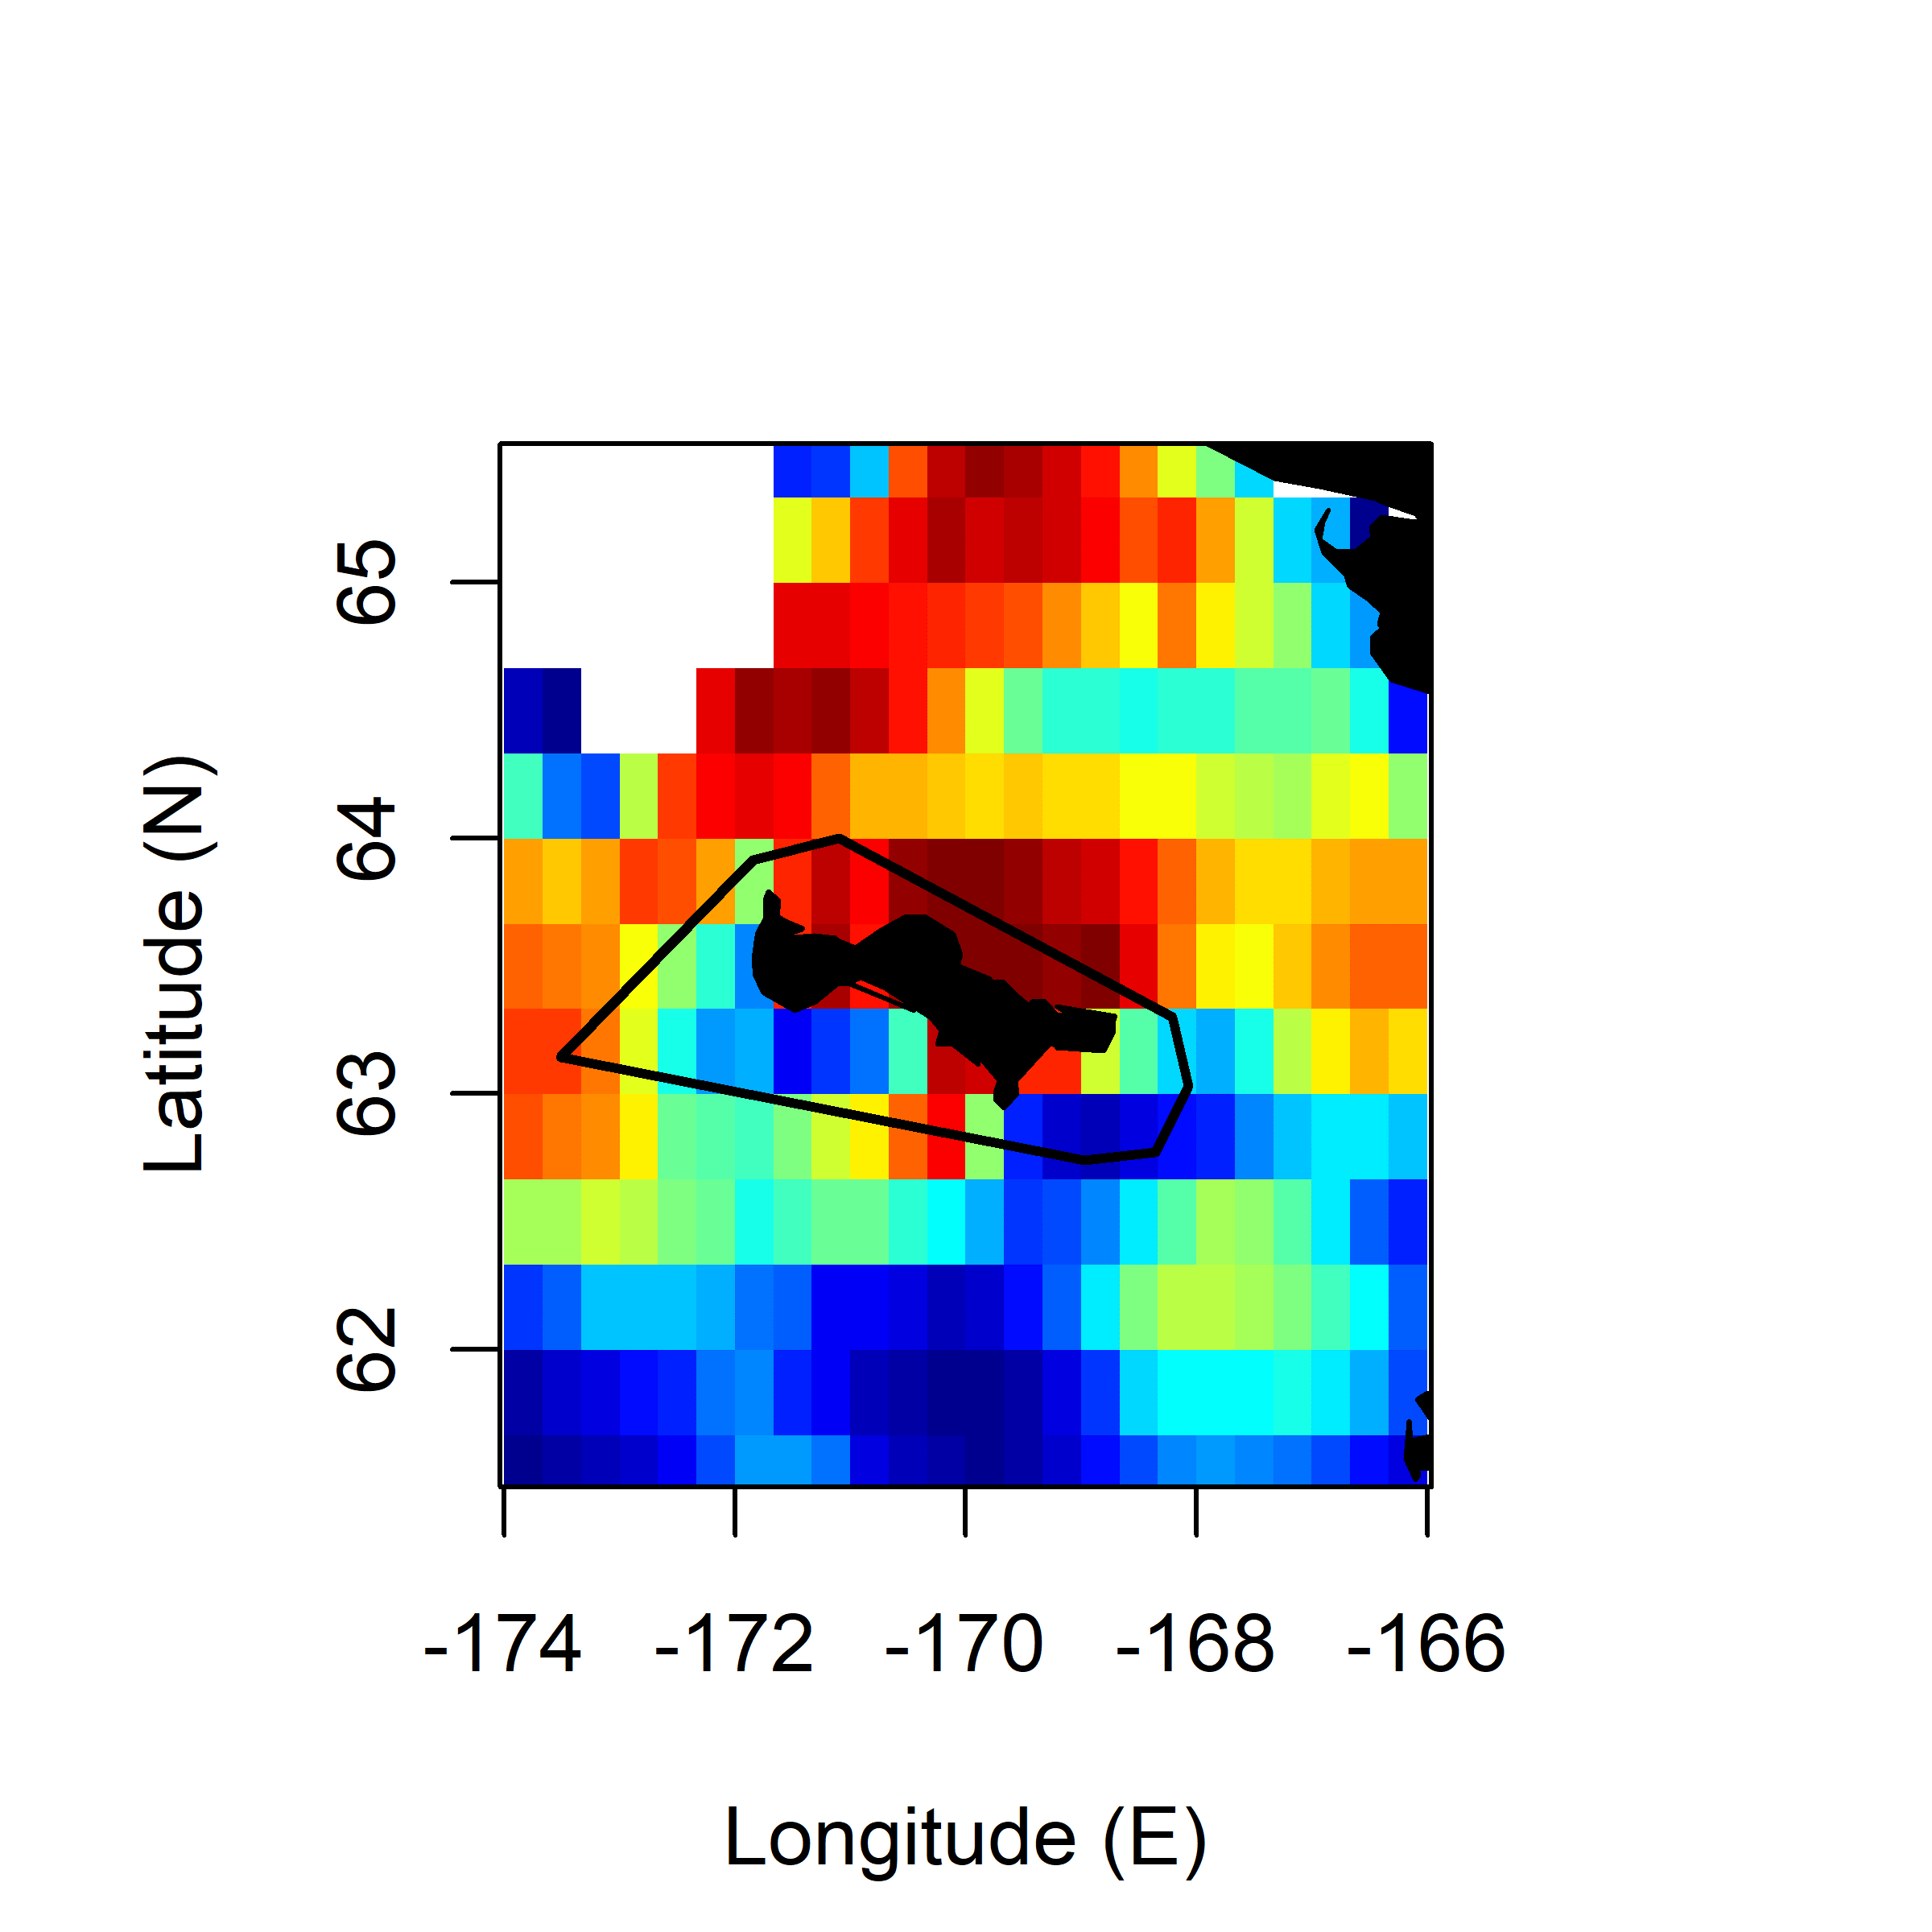
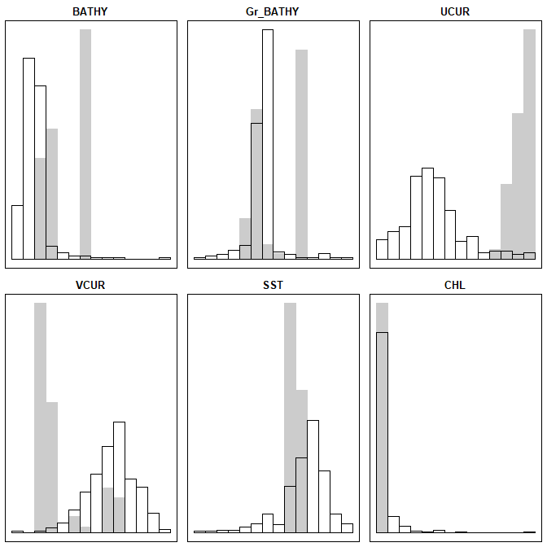
COMU 2016 Chick-R.
Comp.1 (97.61%) Comp.2 (2.36%)
BATHY -0.016243427 0.268227378
GrBATHY -0.163018589 0.005652004
U-CUR -0.958976436 0.139024251
V-CUR 0.005562146 0.118520714
SST 0.484302660 0.135528185
CHL -0.039752306 0.984020170

Slide 2
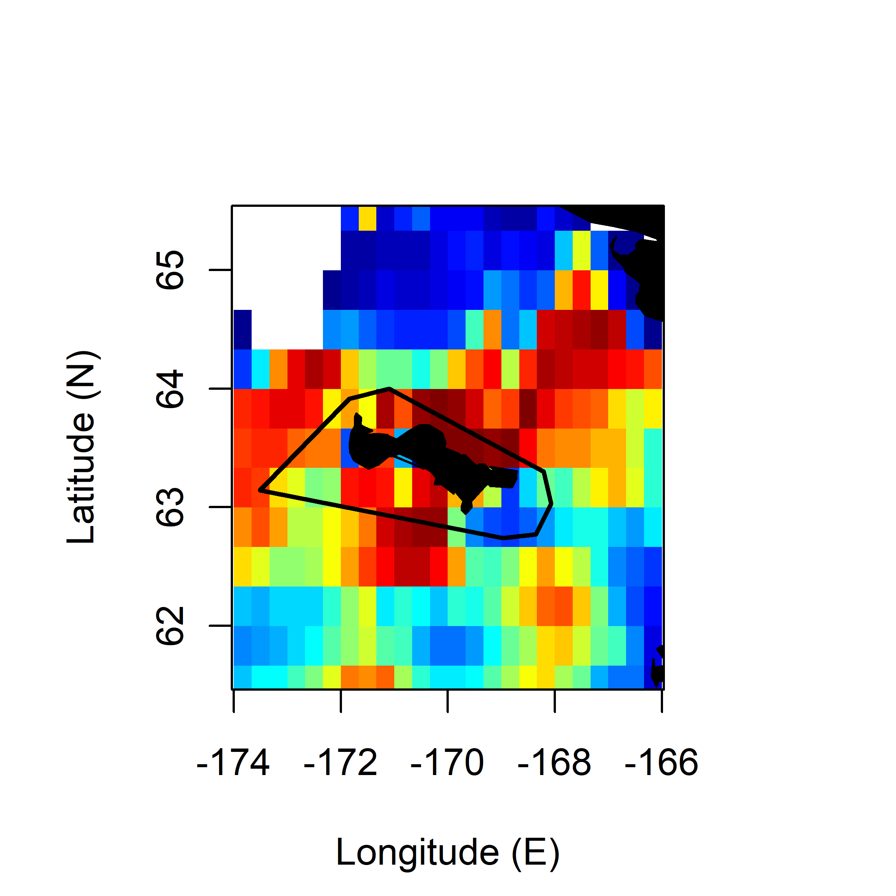
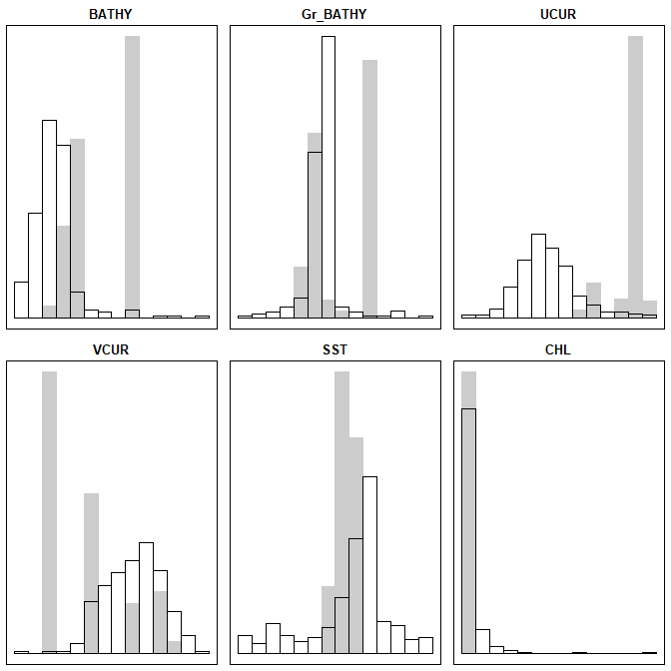
COMU 2017 Chick-R.
Comp.1 (86.11%) Comp.2 (11.73%)
BATHY -0.4494882 0.4493032
GrBATHY -0.1725243 -0.1025402
U-CUR -0.1984549 -0.2176442
V-CUR -0.1782917 0.3173974
SST 0.3053248 0.8089526
CHL -0.9519284 0.2679899

Slide 3
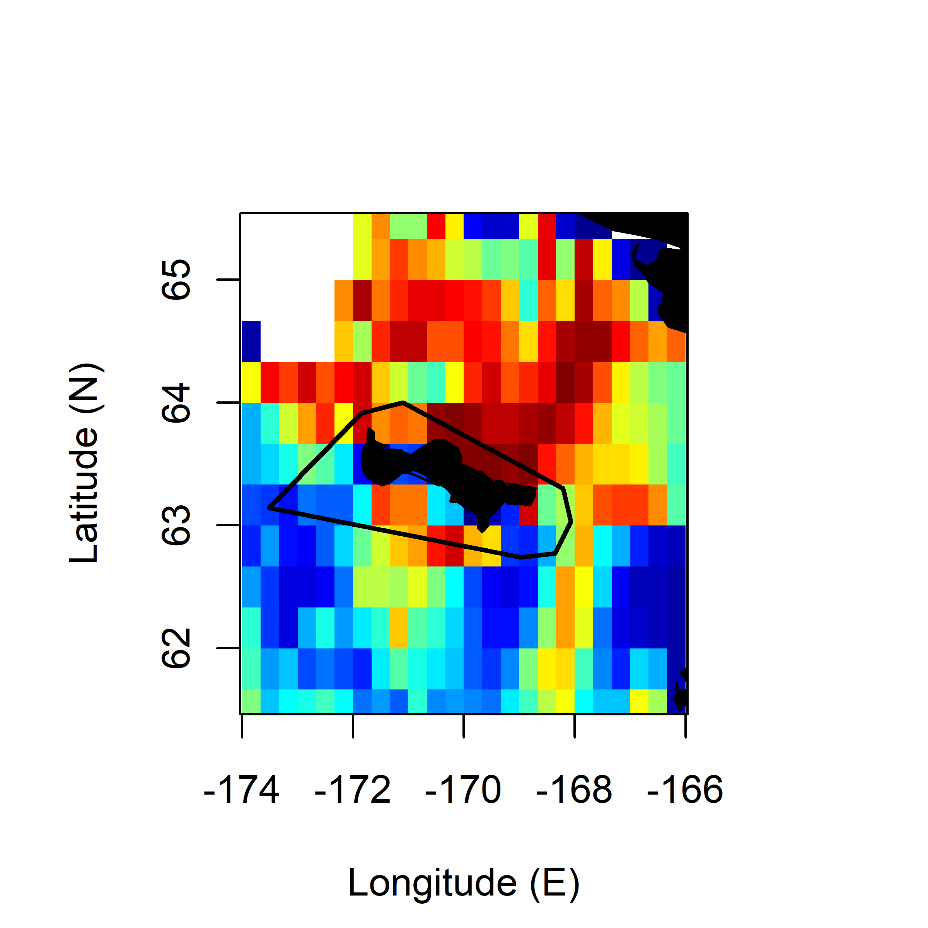
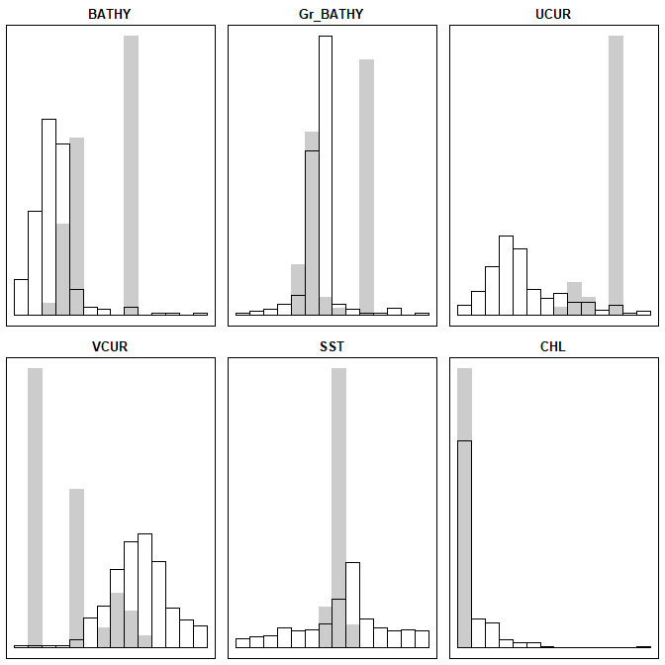
COMU 2019 Incub.
Comp.1 (88.41%) Comp.2 (10.42%)
BATHY 0.63039732 -0.23636157
GrBATHY 0.11419946 0.07593436
U-CUR 0.16187700 -0.54061804
V-CUR 0.21741170 -0.22118339
SST -0.03558849 0.47773741
CHL 0.90992509 0.40190794

Slide 4
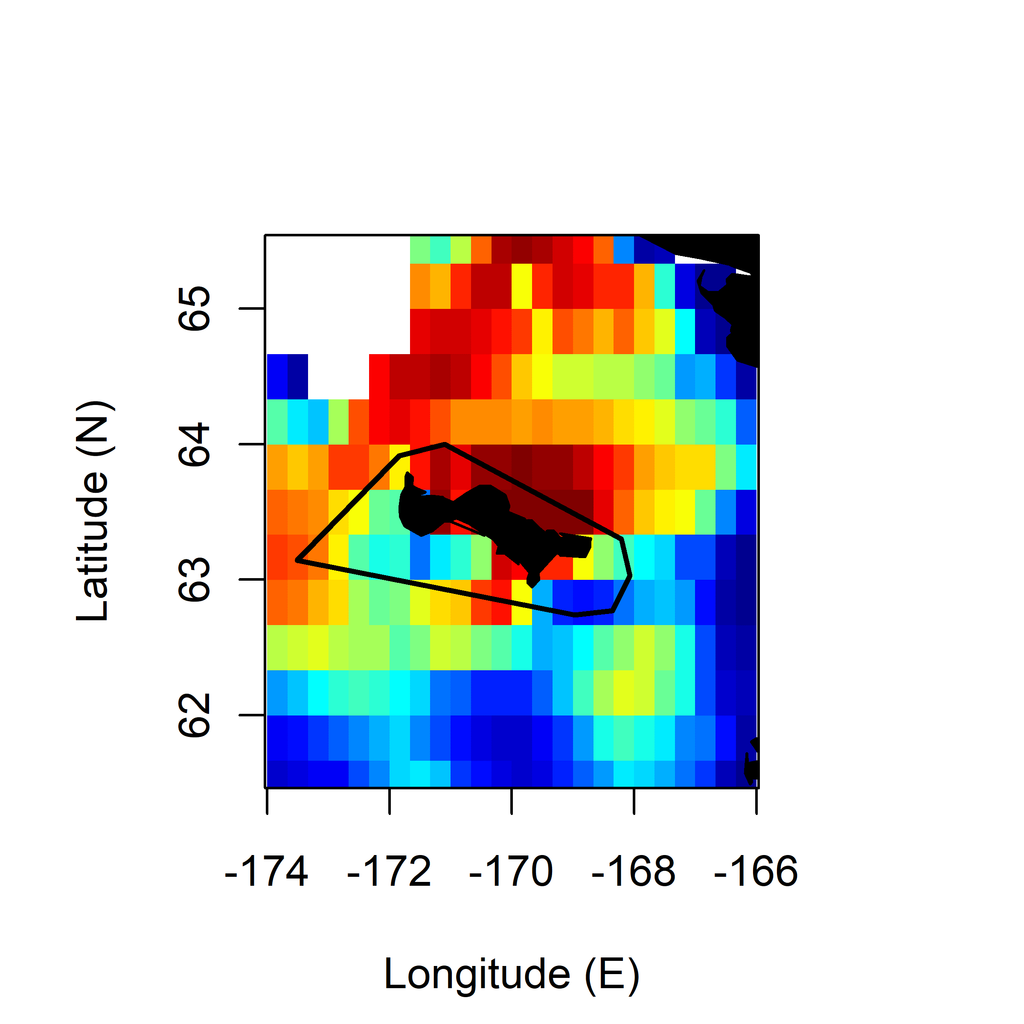
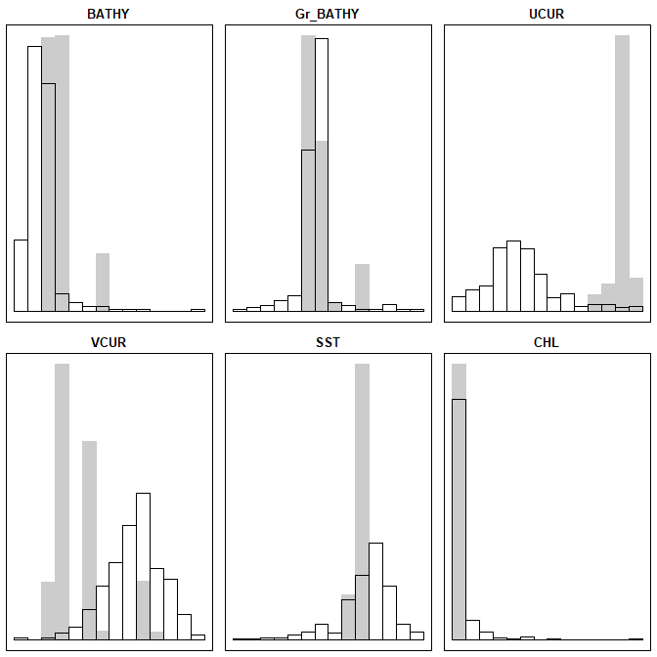
TBMU 2016 Chick-R.
Comp.1 (84.27%) Comp.2 (15.45%)
BATHY 0.1579547 -0.21353056
GrBATHY -0.1248962 -0.03669995
U-CUR -0.6517447 -0.29783364
V-CUR 0.0764515 -0.09308802
SST 0.5809581 -0.08460694
CHL 0.7256934 -0.93596165

Slide 5
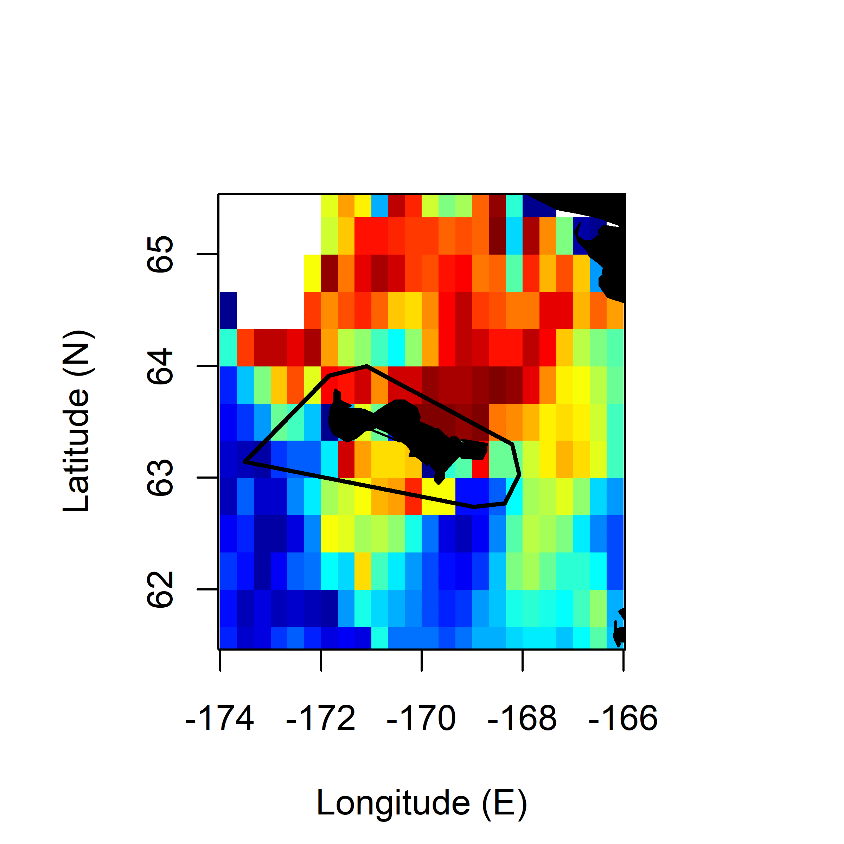
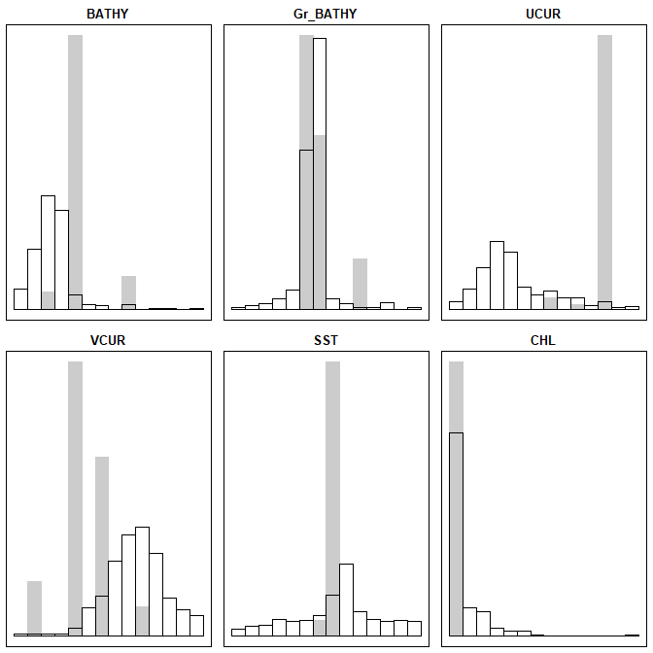
TBMU 2019 Incub.
Comp.1 (80.54%) Comp.2 (17.94%)
BATHY 0.652931357 -0.393729724
GrBATHY 0.004685628 -0.191106163
U-CUR 0.331991368 -0.001637168
V-CUR 0.352544000 -0.017920747
SST -0.343185534 -0.241200987
CHL 0.493493839 -0.970000474

Slide 6
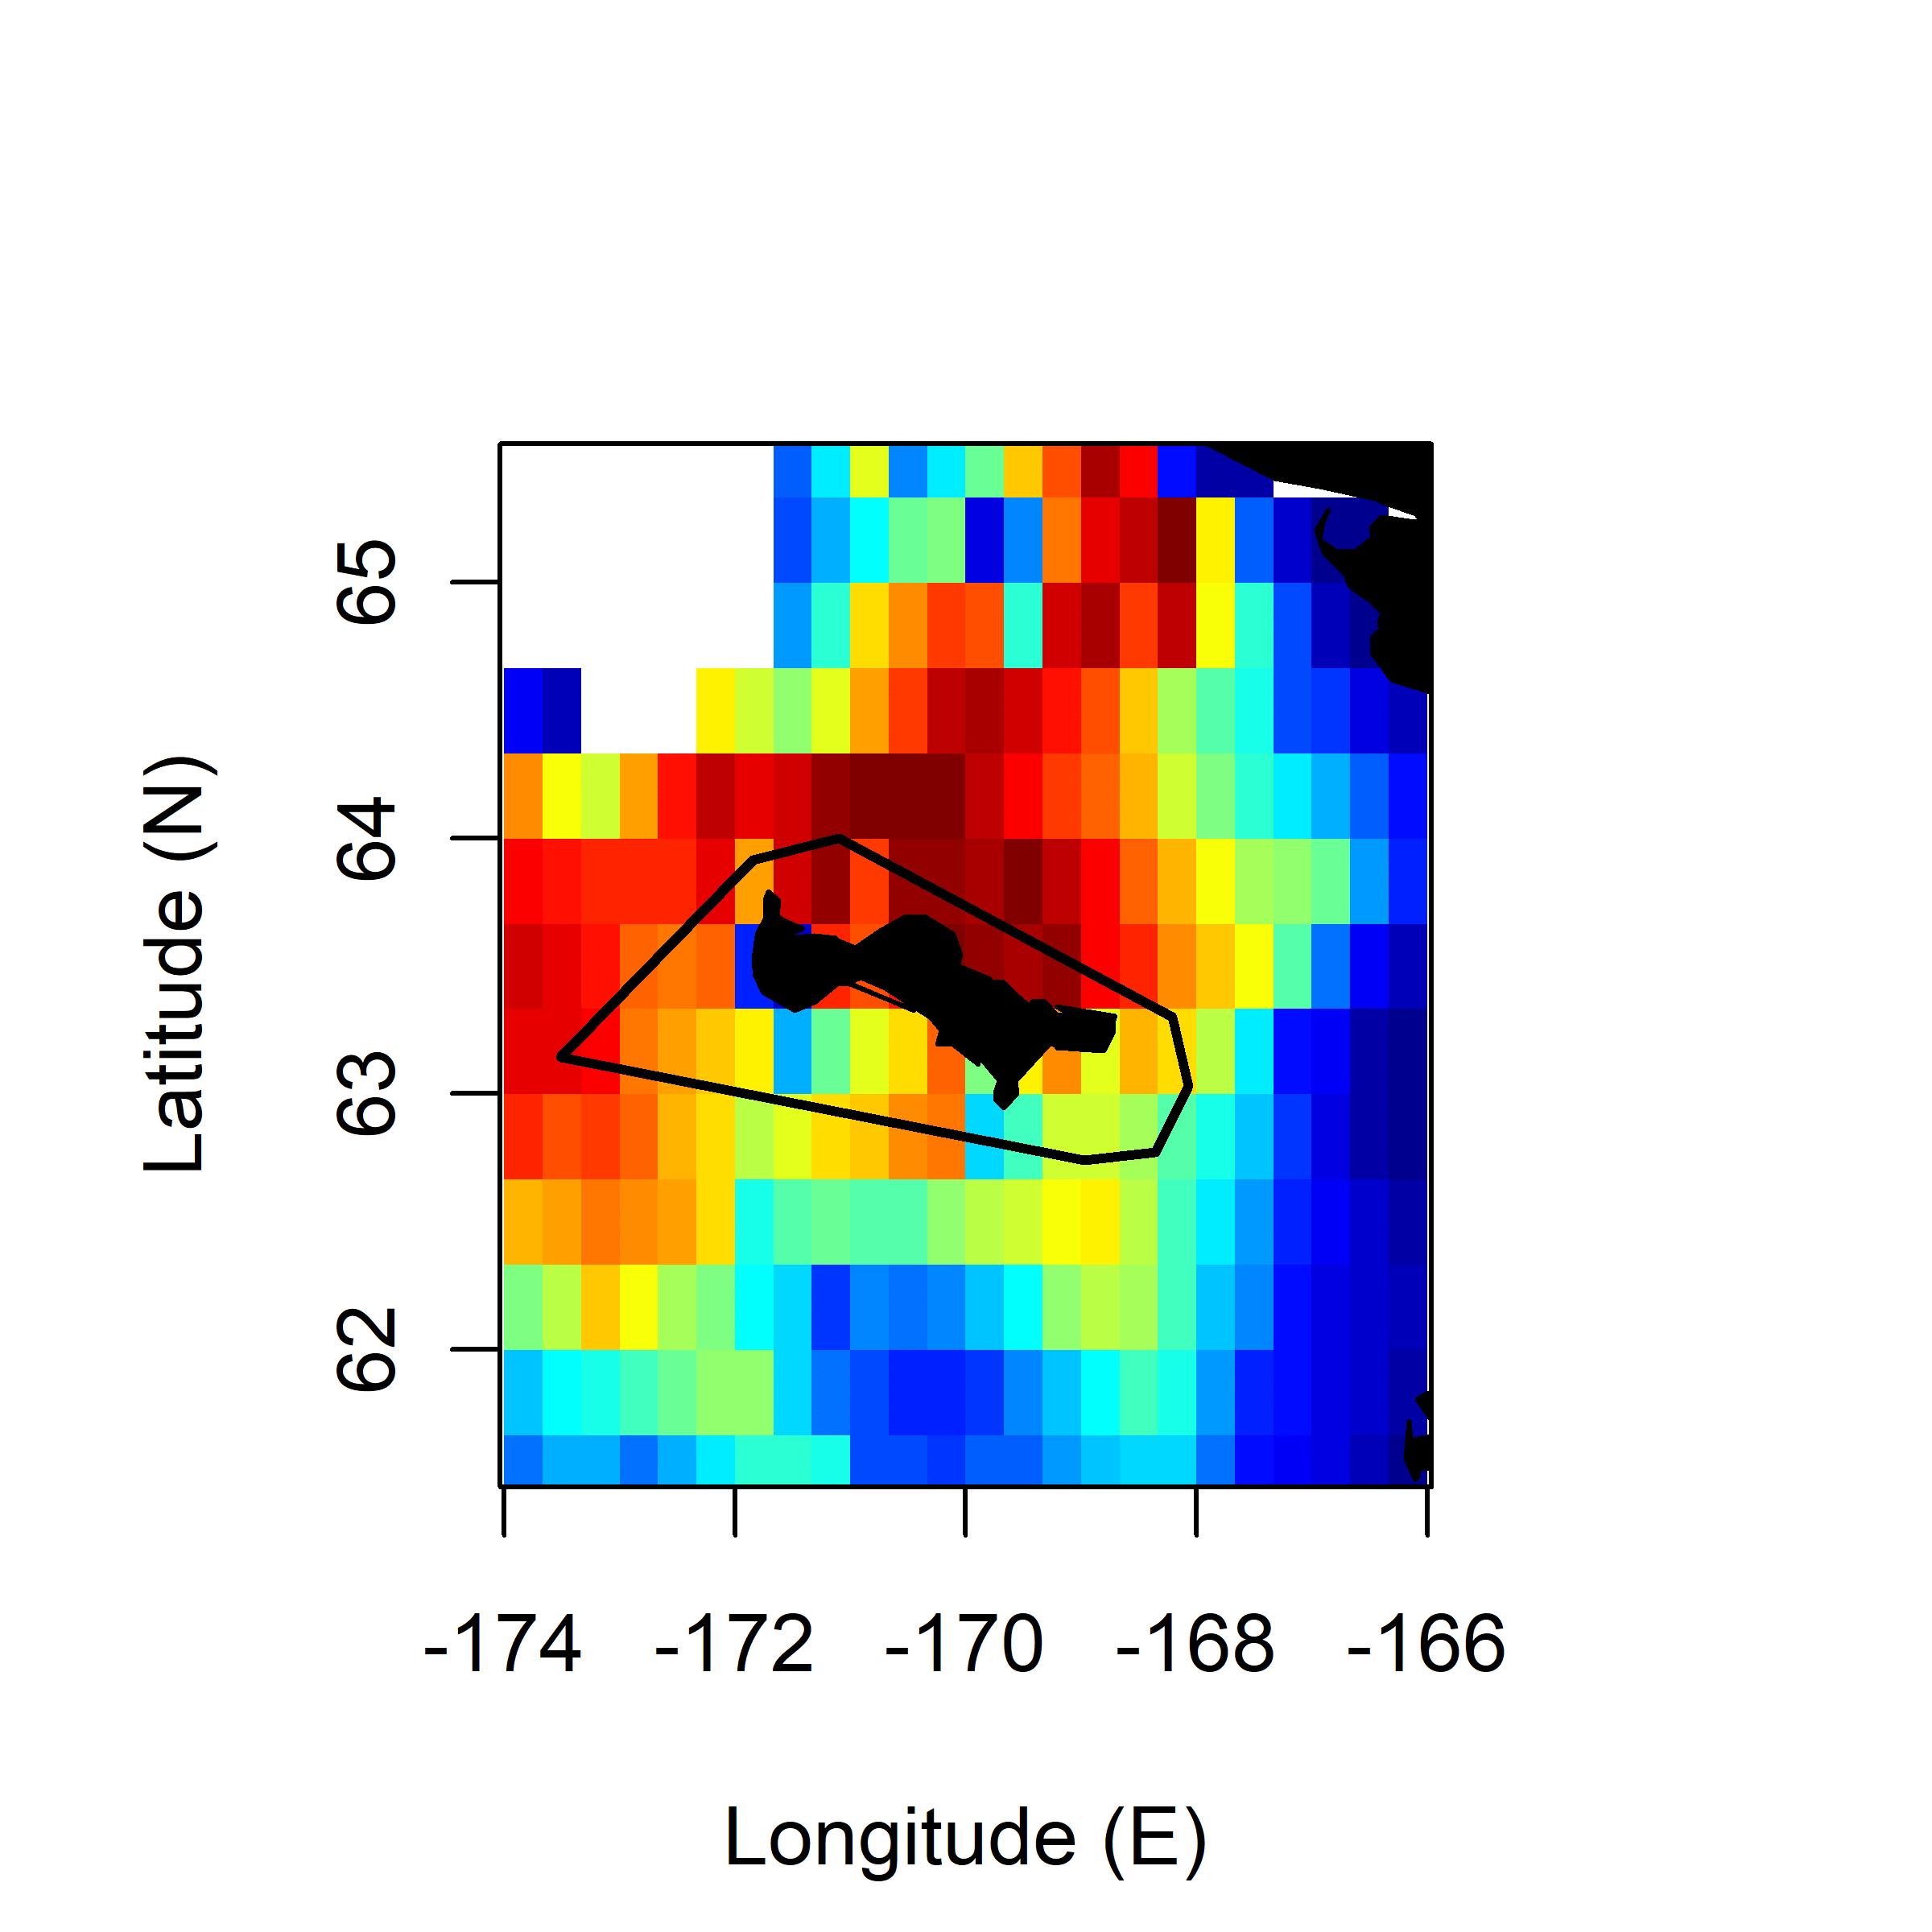
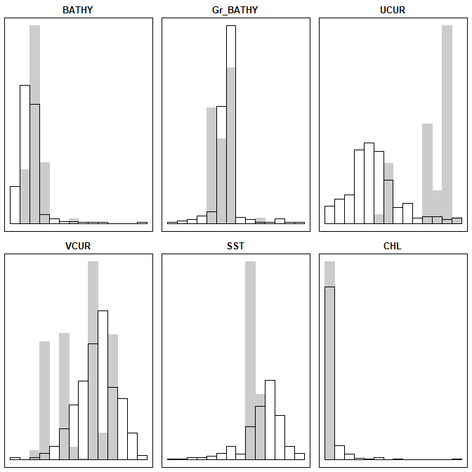
CRAU 2016 Incub.
Comp.1 (73.64%) Comp.2 (25.70%)
BATHY 0.30772095 -0.09336980
GrBATHY -0.06354386 -0.06241628
U-CUR -0.21847927 -0.46886222
V-CUR 0.17647149 0.04379591
SST 0.53002425 0.53029195
CHL 0.93564043 -0.61869100

Slide 7
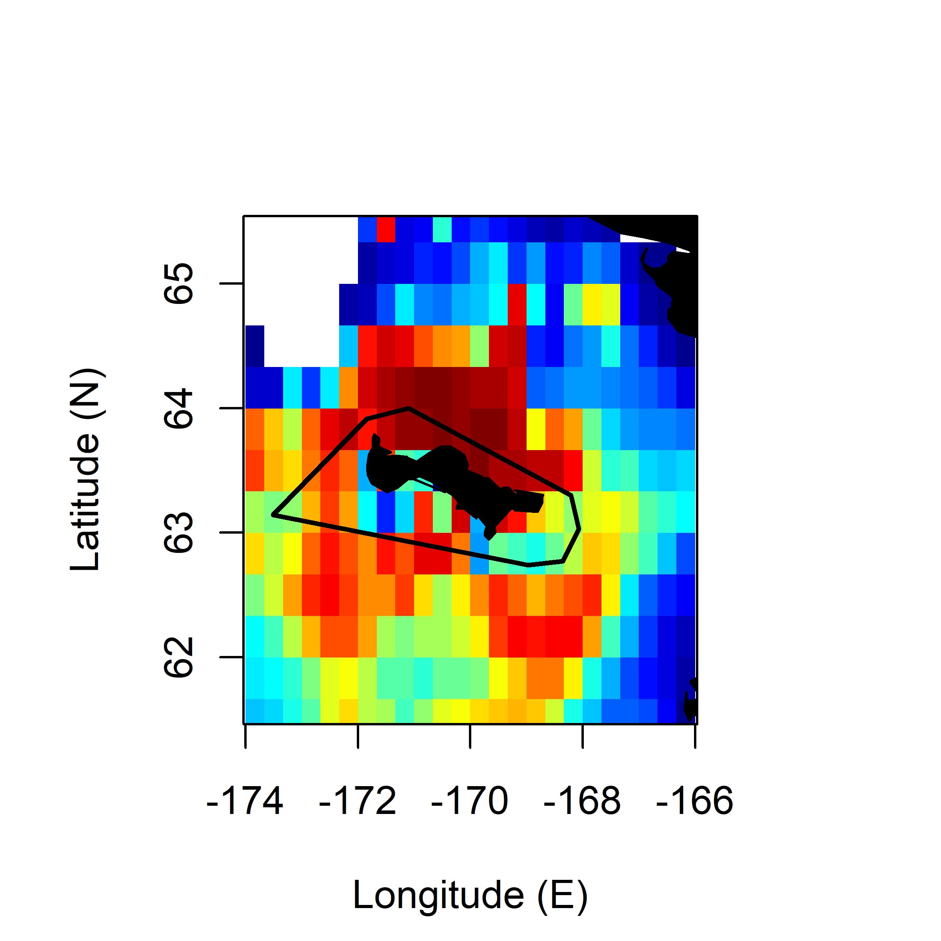
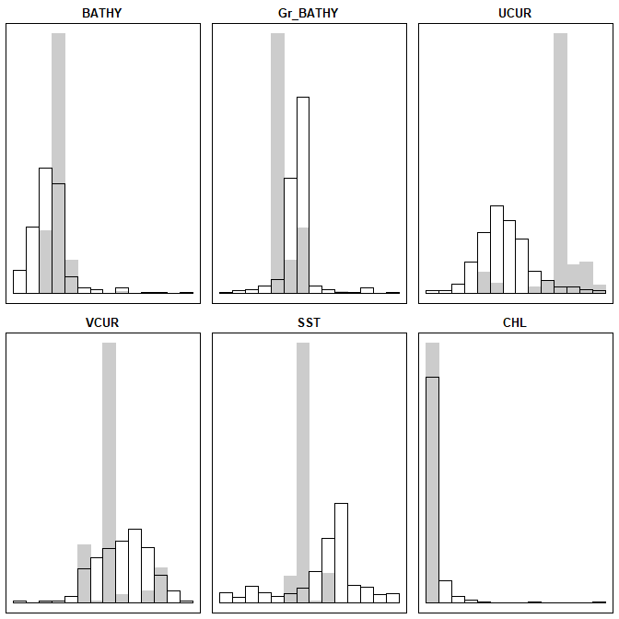
CRAU 2017 Chick-R.
Comp.1 (92.62%) Comp.2 (6.57%)
BATHY 0.46588647 -0.18682677
GrBATHY 0.10409255 -0.18330422
U-CUR -0.01145722 -0.37739778
V-CUR 0.19556639 0.06208122
SST 0.07967012 0.90531076
CHL 0.98387802 -0.40455977

