Slide 1
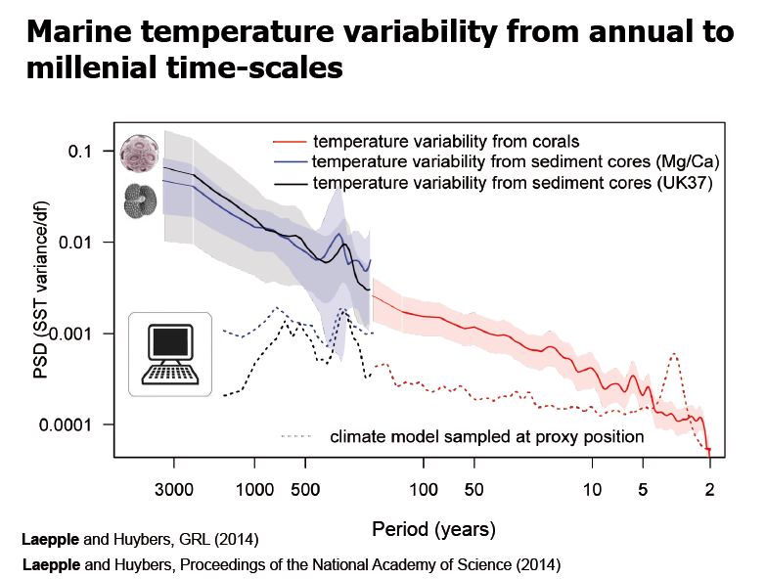
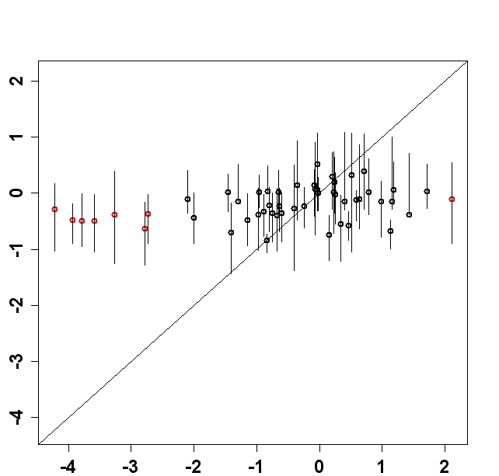
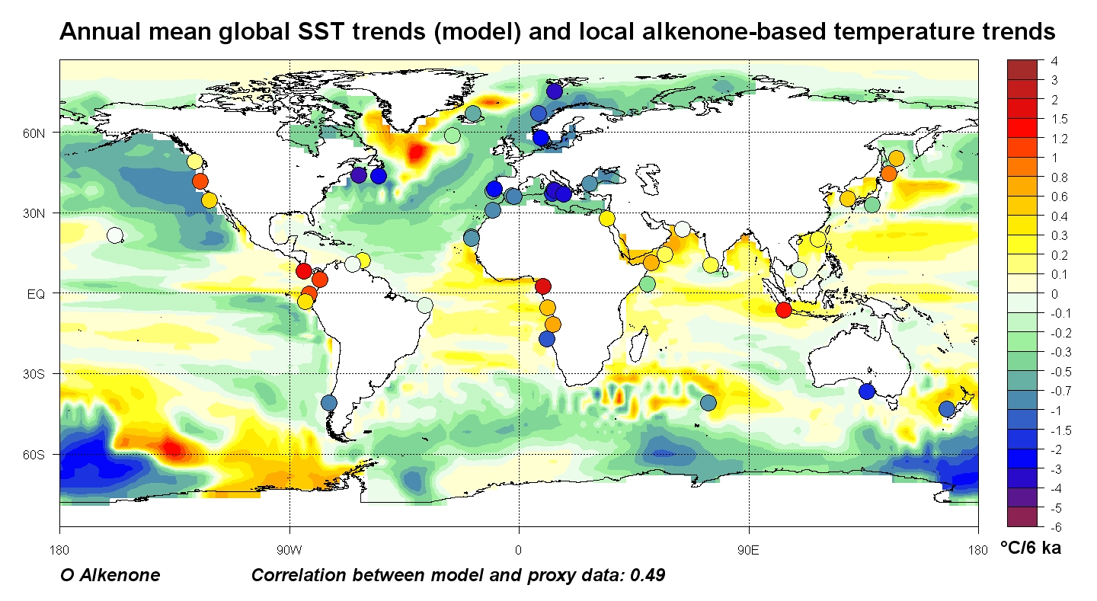
Marine temperature trends (last 6000 years)
Annual mean sea surface temperature trends
Response too low
Alkenone-based temperature trends
Lohmann et al., 2013
Notes:
Plot the reconstructed

Slide 2
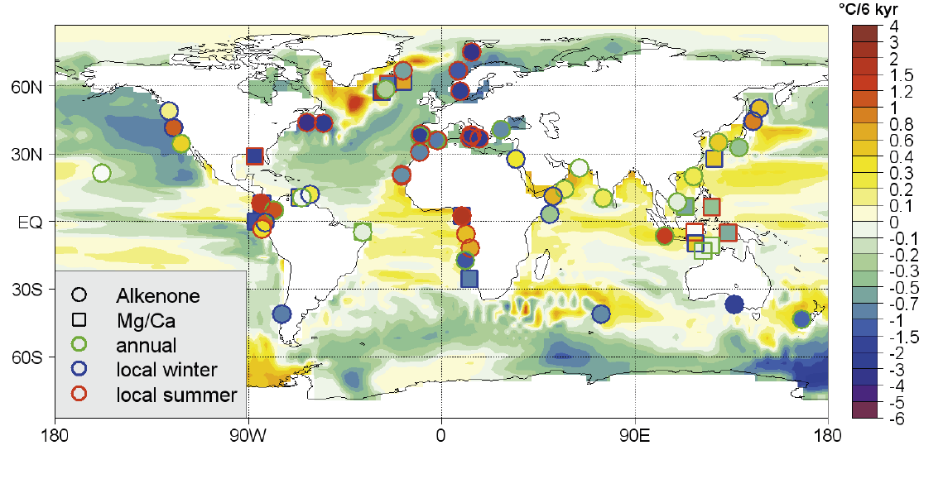
Marine temperature trends (last 6000 years)
Annual mean sea surface temperature trends
Seasonality of the recorder systems
Lohmann et al., 2013

Slide 3
Marine temperature variability
6
Power spectrum
Current climate models seem to underestimate long-term variability
Laepple and Huybers, 2014
Notes:
Taking basically the same data, we analyzed the spectrum

Slide 4
Climate variability and sensitivity are related
Stochastic climate model (Hasselmann, 1976)
Noise
Forcing
Damping too high
Power spectrum: Holocene variability
Holocene trends
Variance too low
Response too low
Forcing
(Fluctuation Dissipation Theorem)
Lohmann, 2018
Notes:
The damping lambda is too high

Slide 5
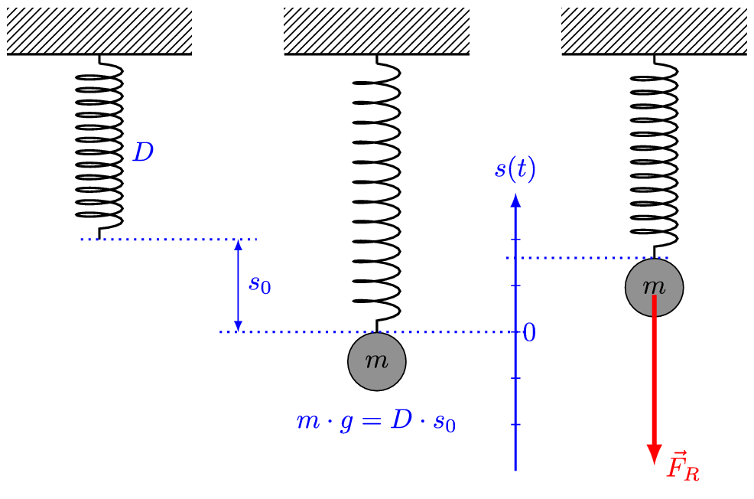
Climate variability and sensitivity are related
Response
Variation
Damping D
D = spring constant
s = deflection
Hookes Law: F = -D s
(Fluctuation Dissipation Theorem)
And1mu, CC BY-SA 4.0, https://commons.wikimedia.org/w/index.php?curid=47864359

