Slide 1
Figure S1. Overlap extension PCR for mutant allele construction and cloning strategy.
1 32
444 462
wzx
ATG
wzx_R2
wzx_F3
TAG
wzx_R4
wzx_F1
PCR F1R2
PCR F3R4
ATG
TAG
PCR F1R4 (overlapping PCR)
ATG
TAG
=
Δwzx allele (Δ33-443)
1 32 444 462
TA cloning (pCR2.1 TOPO plasmid)
Km^{R}
Km^{R}
Subcloning
(BamHI-XbaI double-digested pJQK plasmid )
pJQwzx
Amp^{R}
pCRwzx
sacBR
BamHI
XbaI

Slide 2
Km^{R}
Suicide vector
pJQwzx
sacBR
Δwzx
Figure S2. Schematic representation for allelic exchange. A suicide vector containing the truncated gene or mutant allele (wzx in the example) is introduced by mating into P. salmonis. After a second recombination, the interchange will yield two type of cells: wild-type revertant or mutant. It is possible to distinguish both genotypes by colony PCR using F1R4 primers. Km (kanamycin), sacB (levansucrase gene), Px (polymyxin) and Sac (sucrose). ^{R} or ^{S} indicates the phenotype (resistant or susceptible).
P. salmonis chromosome
wzx (wild type)
Px^{R}, Km^{S}, Sac^{R}
Δwzx
Km^{R} sacBR
wzx
1st crossover
Px^{R}, Km^{R}, Sac^{S}
2nd crossover
Km^{R}
A
B
Km^{R}
sacBR
A
sacBR
B
+
WT (revertant)
Mutant
+
Px^{R}, Km^{S}, Sac^{R}
Px^{R}, Km^{S}, Sac^{R}

Slide 3
Figure S3. 8.5 kb capsular polysaccharide biosynthesis gene cluster. Gene functions to be found in Table S1.

Slide 4
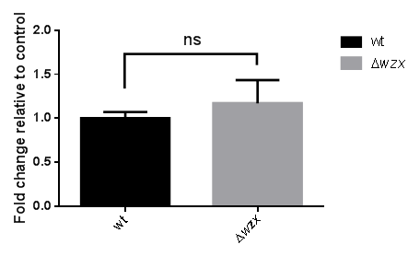
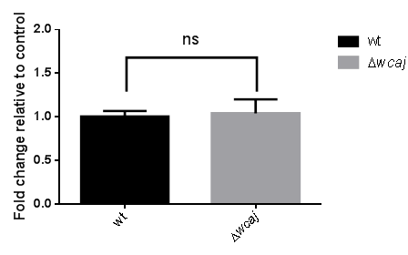
A
B
Figure S4. Gene expression of downstream genes. Plots show the relative transcript levels of polar effect reporter genes. (A) KW_2966. (B) KW_2958. Position of ORFs can be seen in Figure 1. RNA was extracted from wild-type and mutant strains (Δwzx, ΔwcaJ) cultured in PSB. RT-PCR rounds were accomplished with primers pairs 2958 and 2966 (Table 3). P. salmonis rpoD gene was used as single reference gene. ns, no significant difference (p > 0.05).

Slide 5
Table S1. Description of the gene products found in the capsular polysaccharide biosynthesis gene cluster detected in P. salmonis PM15972A1 genome.
ORF | Gene | Predicted function
KW89_2614 | - | Capsule polysaccharide biosynthesis family protein. Beta-3-deoxy-D-manno-oct-2-ulosonic acid (Kdo)-transferase KpsC
KW89_2615 | neuB | Pseudaminic acid synthase
KW89_2616 | - | Acetyltransferase domain protein. UDP-2,4-diacetamido-2,4,6-trideoxy-beta-L-altropyranose hydrolase (SpsG superfamily)
KW89_2617 | - | Pseudaminic acid CMP transferase
KW89_2618 | pseC or wecE | Spore coat protein. UDP-4-amino-4,6-dideoxy-N-acetyl-beta-L-altrosamine transaminase.
KW89_2619 | pseB | UDP-N-acetylglucosamine 4,6-dehydratase (inverting)
KW89_2620 | - | Capsule polysaccharide biosynthesis family protein. Beta-3-deoxy-D-manno-oct-2-ulosonic acid (Kdo)-transferase KpsC

Slide 6
Figure S5. Growth kinetics in liquid medium. Both P. salmonis mutants and the wild-type strain show similar growth behavior when incubated at 18°C in PSB.

Slide 7
A
B
**
*
C
D
*
Figure S6. Gene expression of elf1α normalizer gene across samples. Plots show Ct values of elf1α for in vitro (A, B) and in vivo (C, D) samples. Groups were analyzed with Kruskal-Wallis test, and if significant, the difference was indicated with an asterisk (*, p < 0.05 and **, p < 0.01). Primer efficiency for elf1α, il1ß, ifnγ and tnfα were 96.8, 101.3, 97.7 and 100.6 %, respectively.

Slide 8
1 2
Figure S7. LPS analysis. Comparison between silver-stained SDS-PAGE of Westphal phenol-extracted LPS samples from Brucella abortus 2308 (lane 1) and Piscirickettsia salmonis PM15972 strain (lane 2). Brucella LPS was kindly provided by Dr Conde-Alvarez, University of Navarra, Spain.
10 kDa

