Slide 1
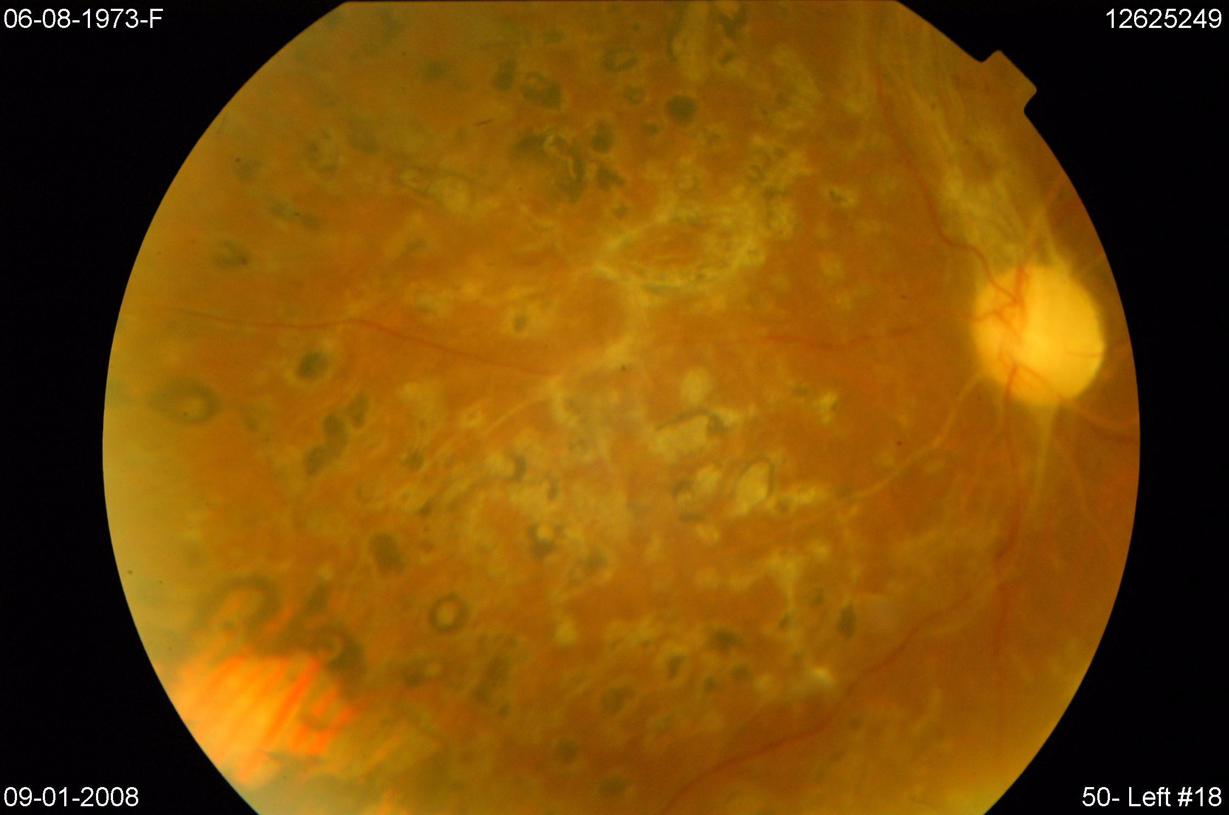
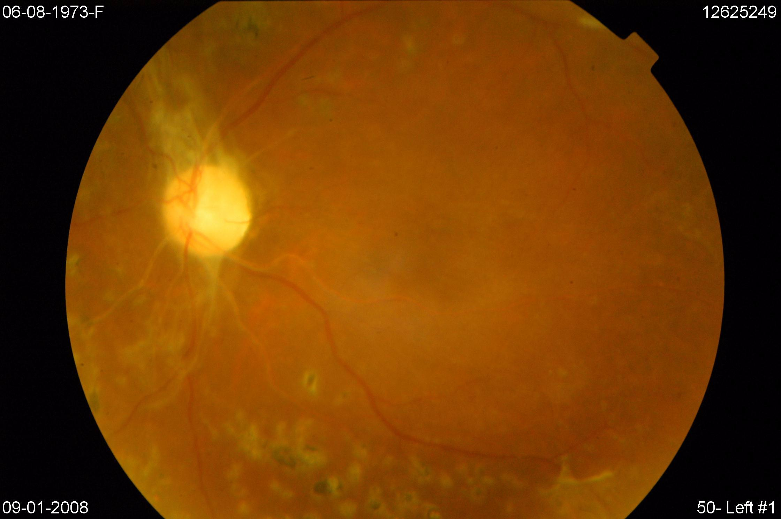
Additional file 1: Figure S1A. The eye fundi pictures of Acromegaly-04

Slide 2
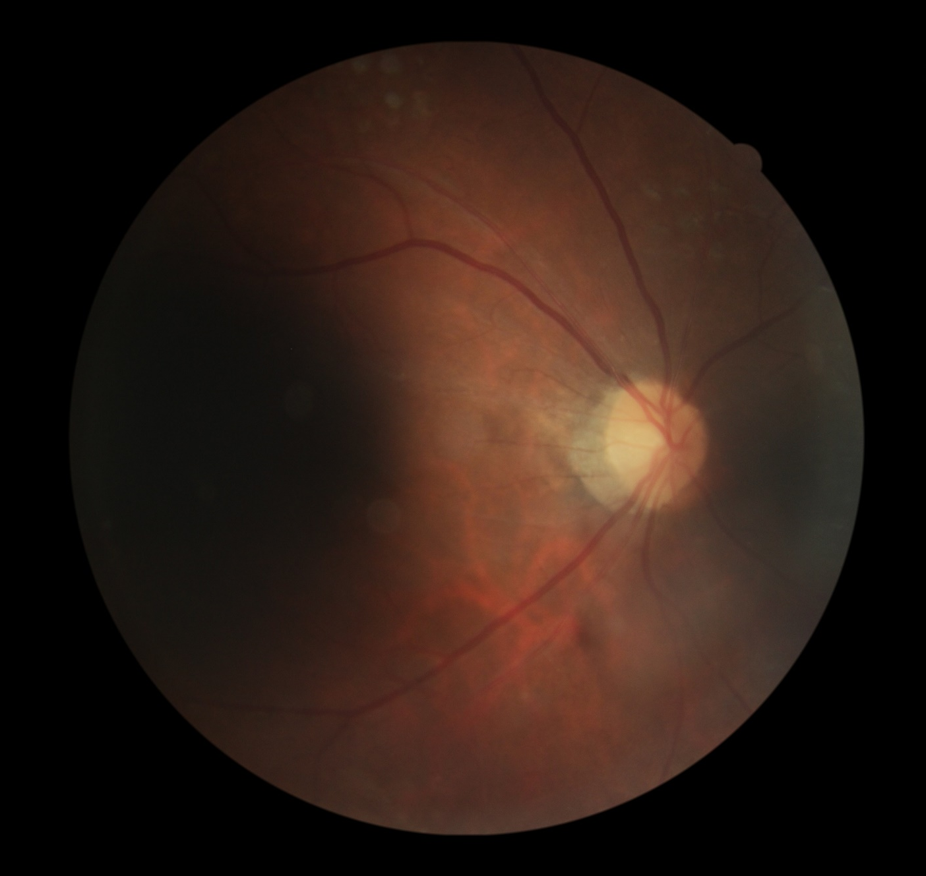
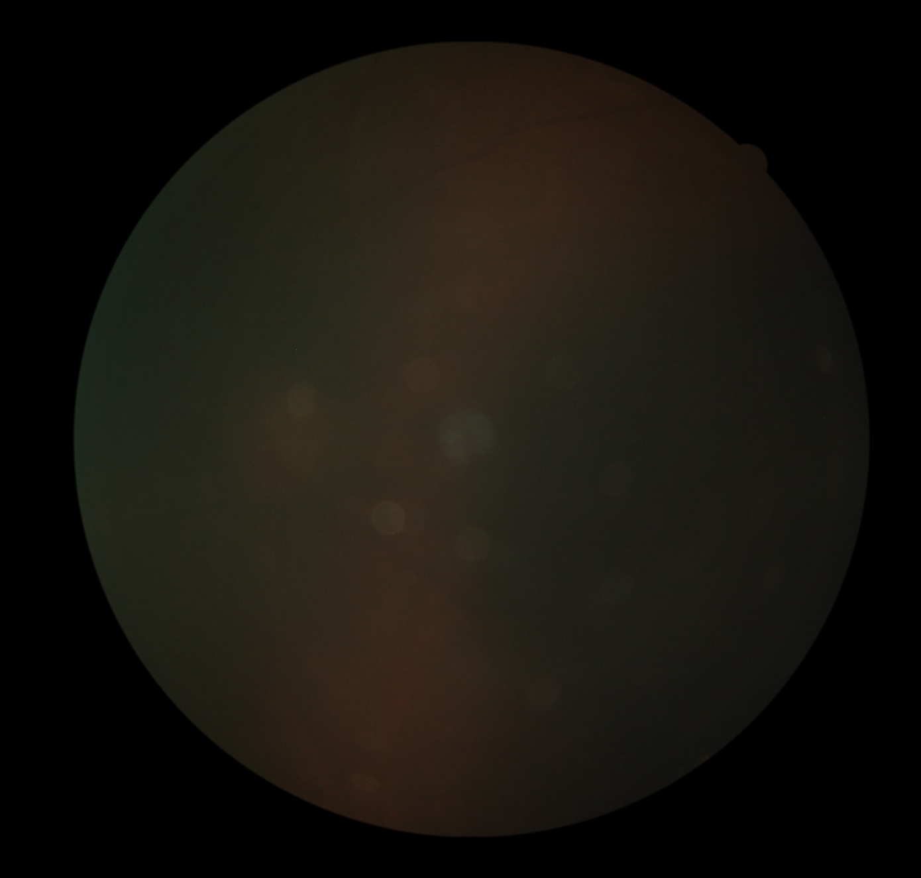
Additional file 1: Figure S1B. The eye fundi pictures of Acromegaly-52

Slide 3
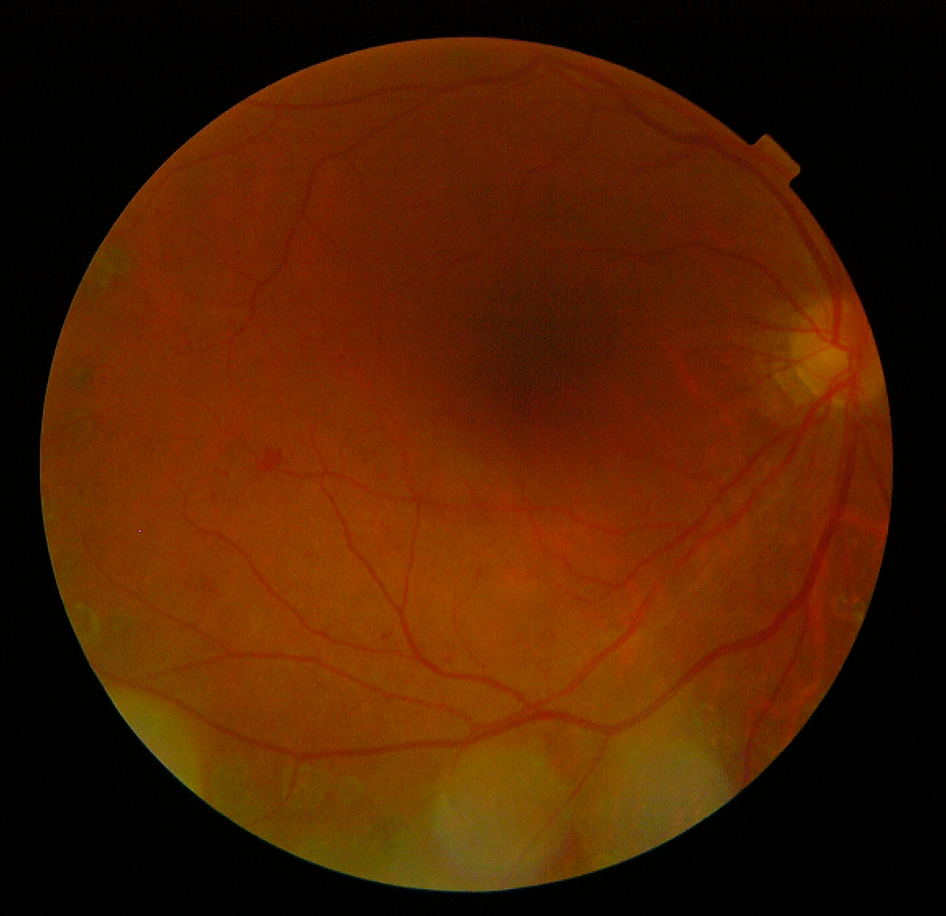
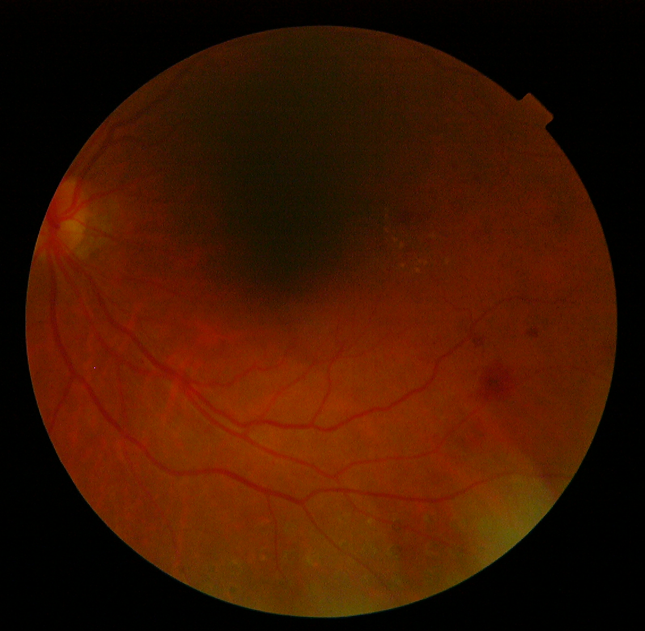
Additional file 1: Figure S1C. The eye fundi pictures of Acromegaly-54

Slide 4
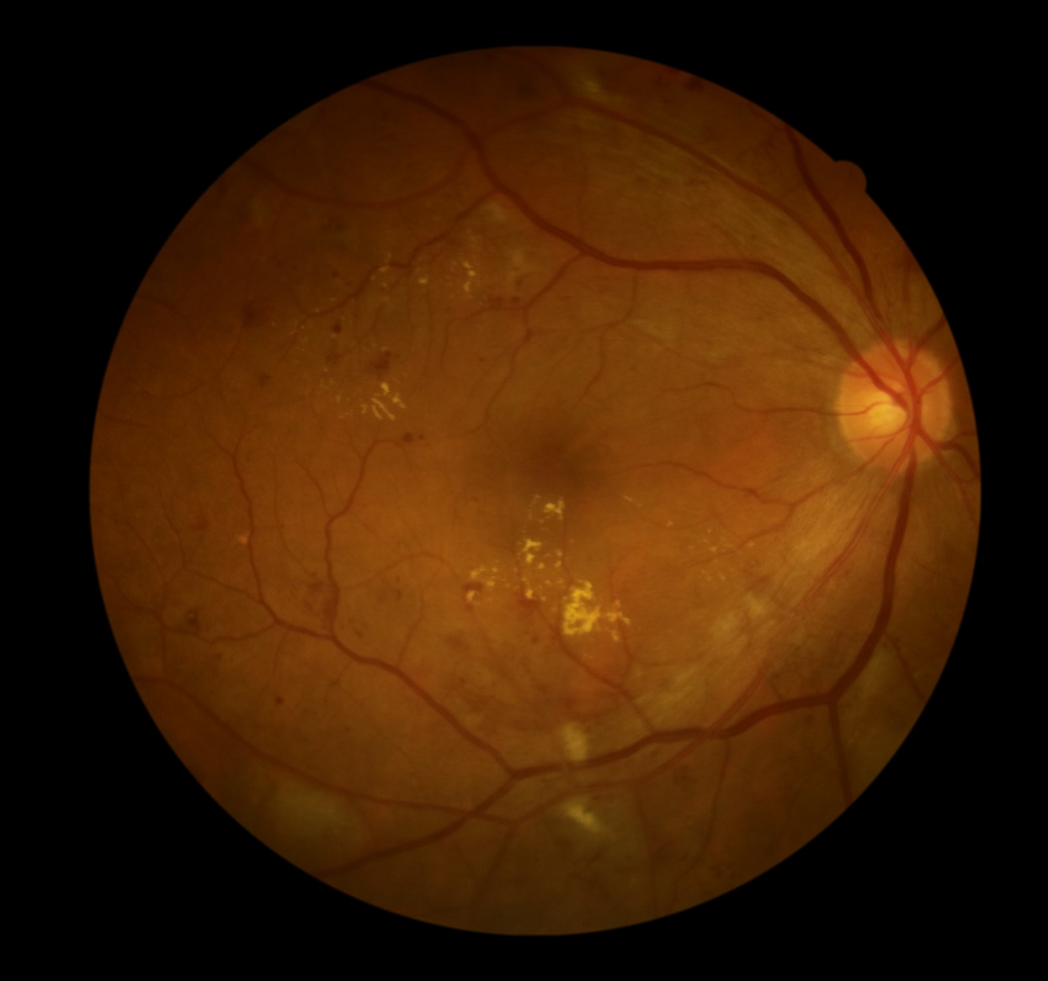
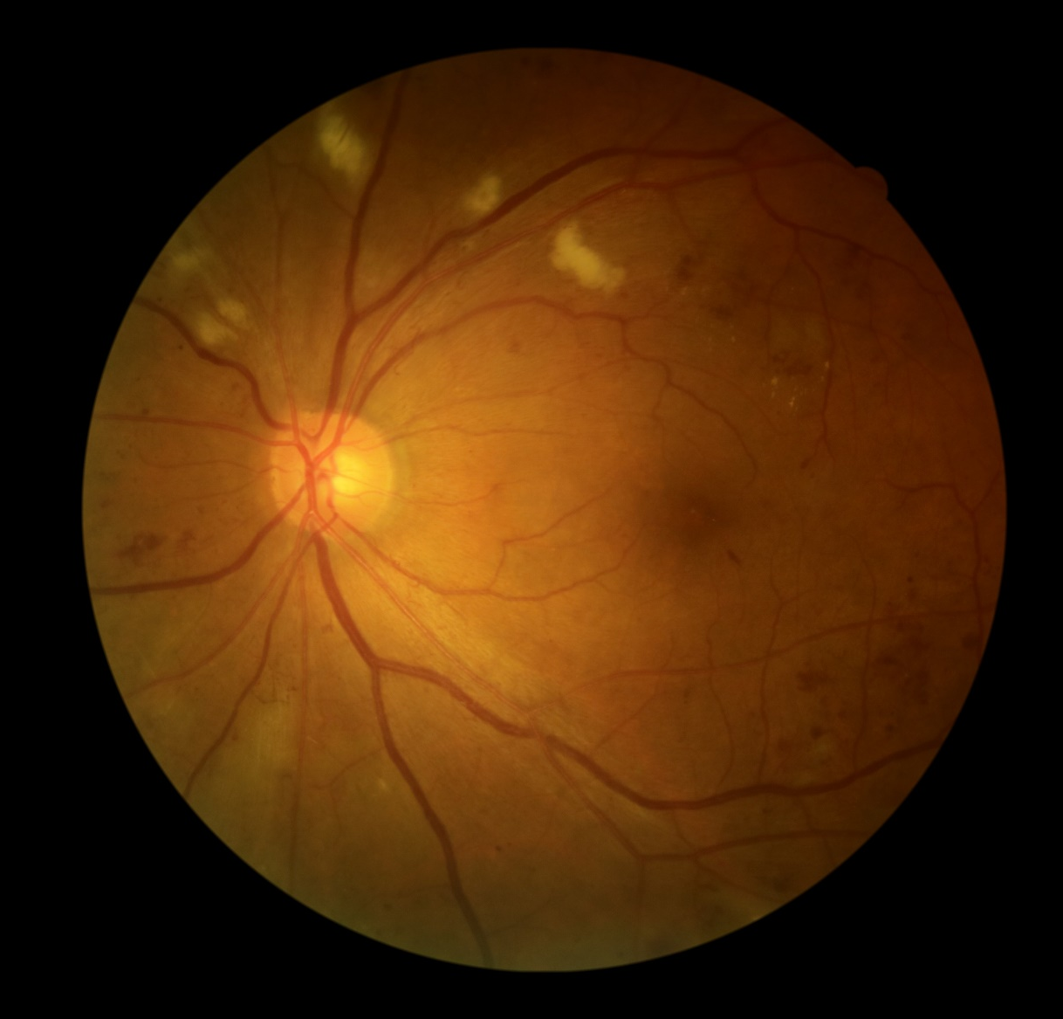
Additional file 1: Figure S1D. The eye fundi pictures of Impaired fasting glucose-307

Slide 5
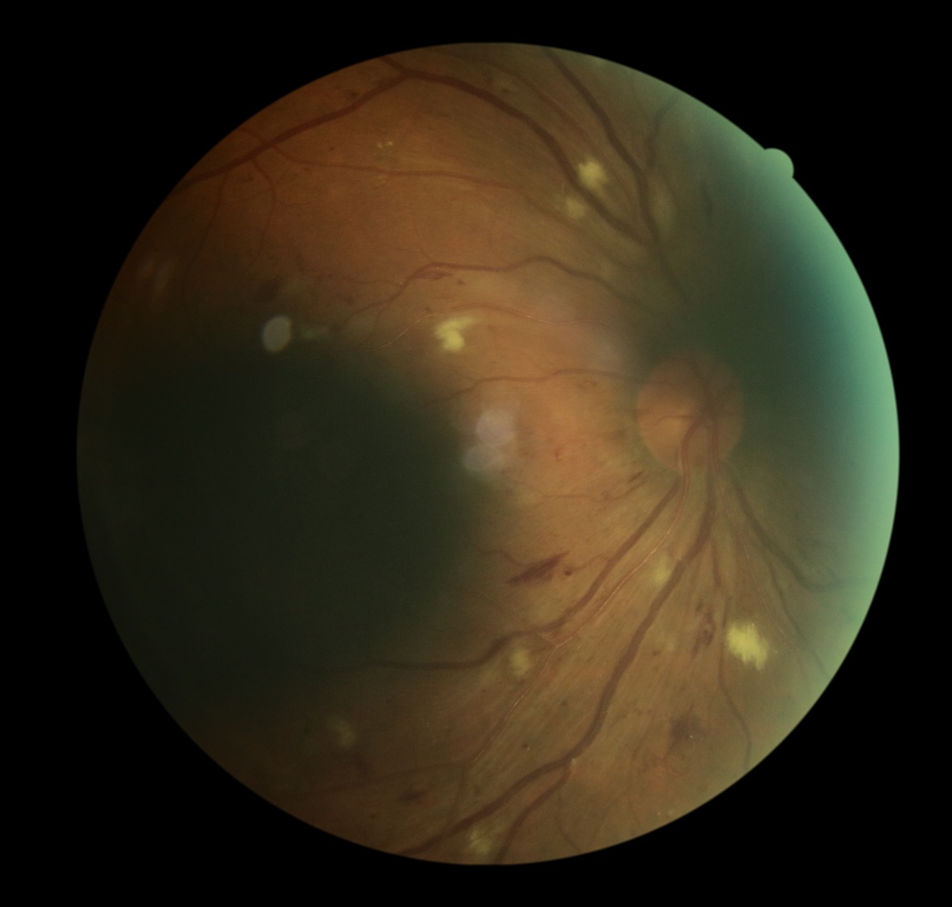
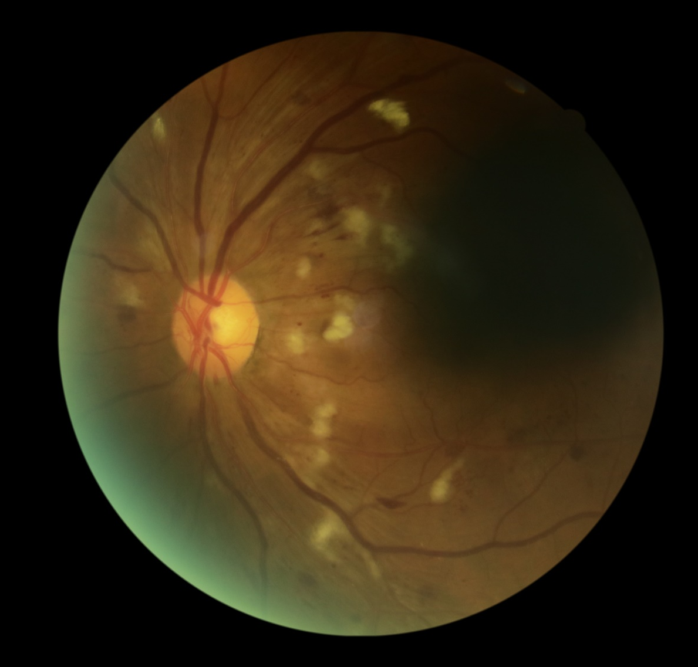
Additional file 1: Figure S1E. The eye fundi pictures of Impaired fasting glucose-428

