Slide 1
Food waste
Eva Jenkins
Prof Linda Brennan & Dr Tracy McCaffrey
RMIT University & Monash University

Slide 2
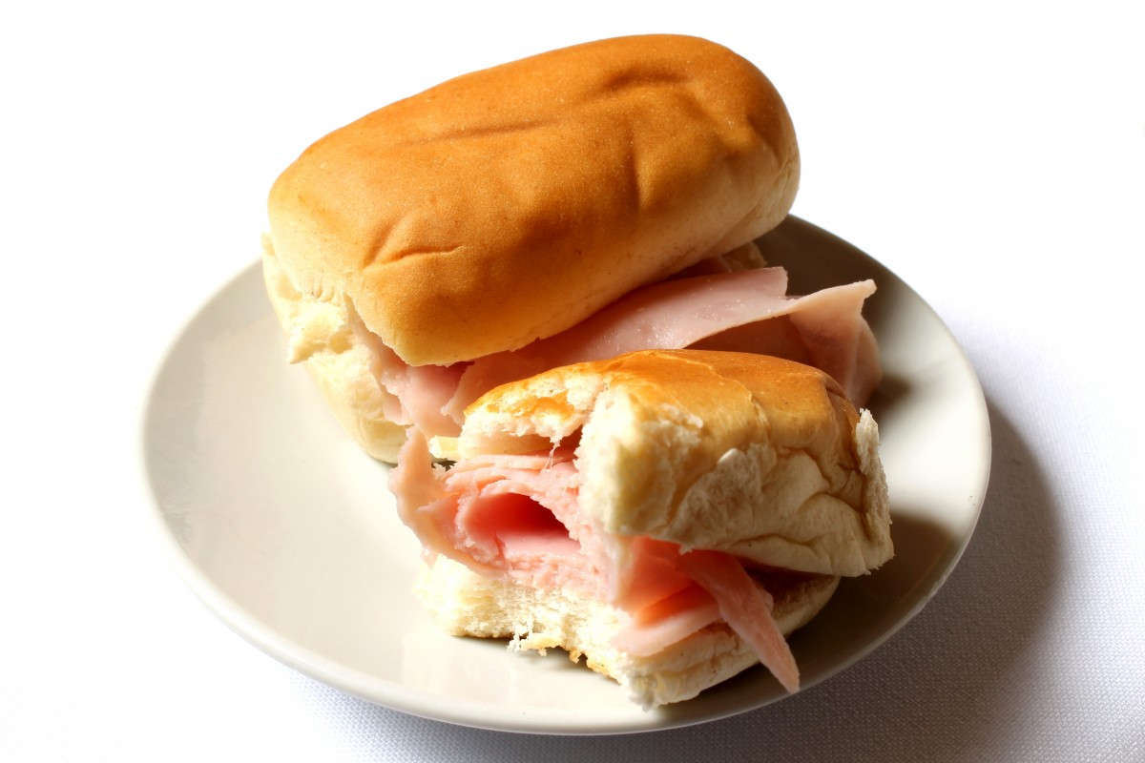
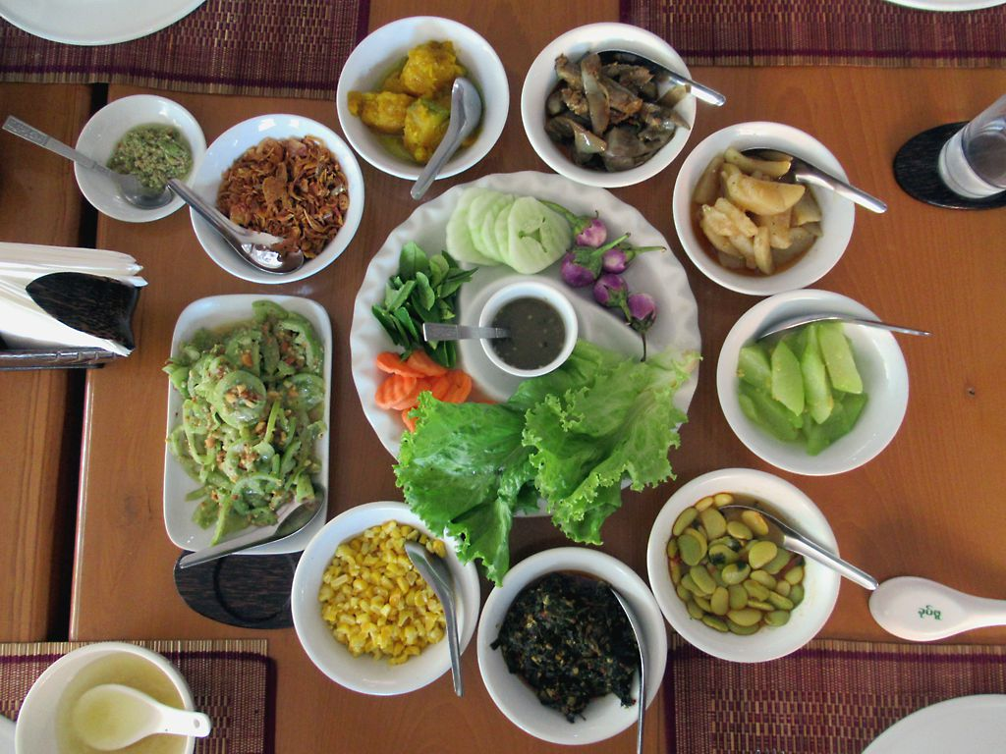
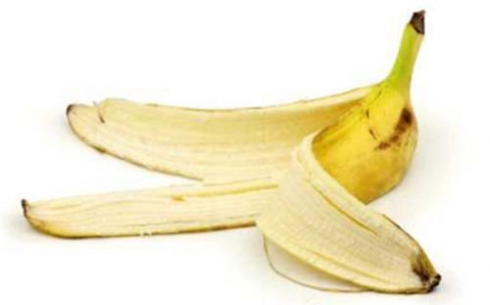
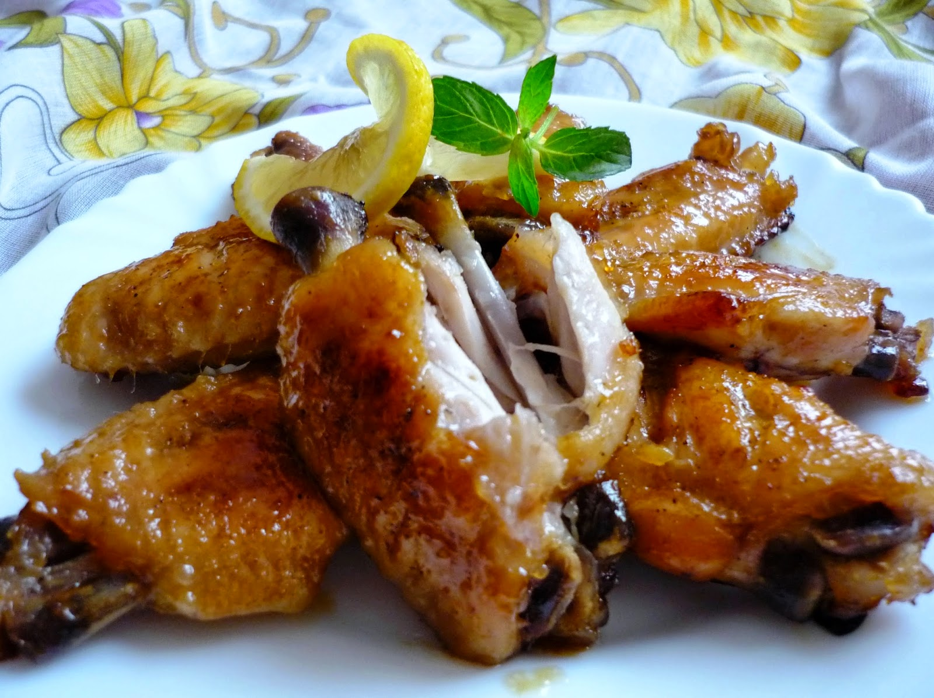
What is food waste?
“Food that is good quality and fit for human consumption, but gets discarded”
Avoidable
Unavoidable
Gustavsson J. Global food losses and food waste: extent, causes and prevention. 2011; Available from: http://www.fao.org/3/mb060e/mb060e.pdf
Notes:
Food waste refers to food that is good quality and fit for human consumption but gets discarded - you have fresh food in your house, but you might throw it away because you don’t want to eat it anymore.
There are two main types of waste: avoidable food waste is food such as leftovers that you might throw away because you didn’t eat or you forgot about. Unavoidable food waste which is things like bananas or bones that you actually can’t consume.

Slide 3
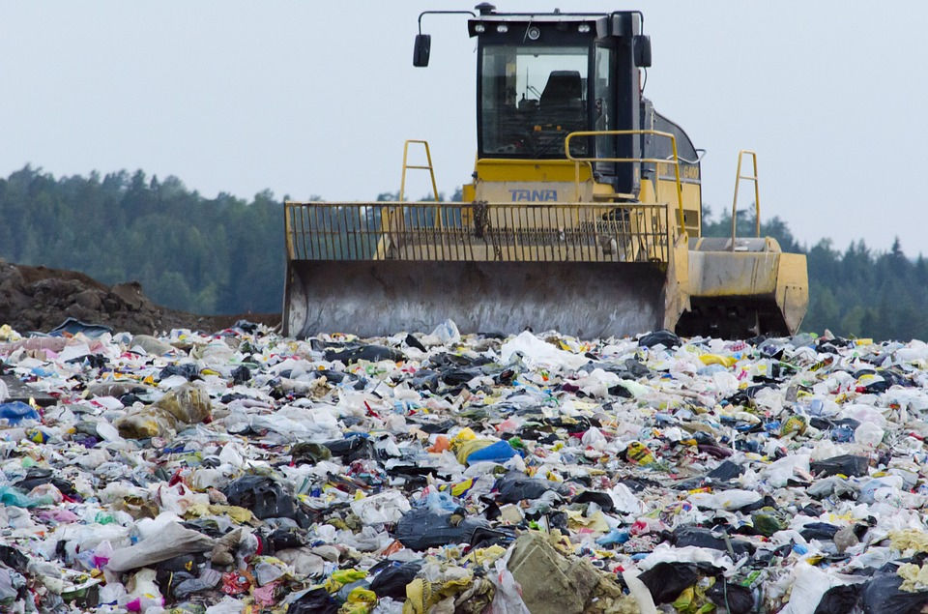
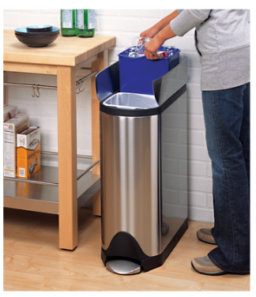
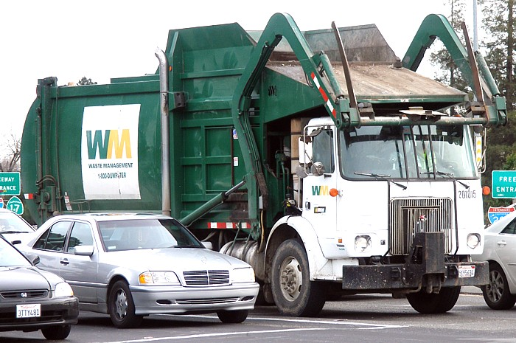
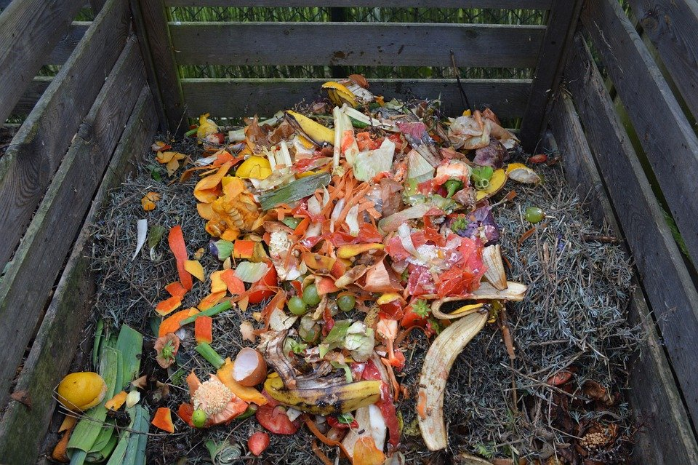
Where does food waste go?
Landfill
Compost
Depending where you live
Notes:
When you throw food into the bin at home, it gets picked up by the garbage truck and taken to landfill, where it cannot break down efficiently because there is no oxygen – and this causes greenhouse gases.
In some local areas you can put your food waste into the green bin, and they have composting facilities, which means it isn’t going to landfill. For example, the city of knox does not permit food waste to go into garden bins. But other councils such as the city of Monash, Greater Dandgenong, Cardinia and Booroondara allows you to put food waste into the garden bin and therefore divert it from landfill. So it depends where you live. If your council does not collect food waste, you can get a compost bin at home or a bokashi bin – which Is an alternative for people who live in apartments.

Slide 4
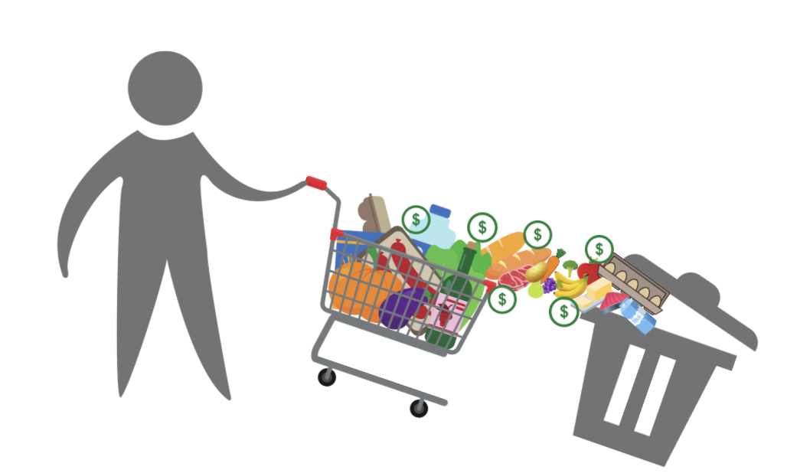
How much food is wasted?
1/3 of all food produced is wasted
Gustavsson J. Global food losses and food waste: extent, causes and prevention. 2011; Available from: http://www.fao.org/3/mb060e/mb060e.pdf
Notes:
So if we imagine that this chart is the all the food produced in the world, 1/3 of the total food produced is wasted. This can be through different parts of the supply chain like farming, however a lot of it is also from regular people like us throwing food away after we have bought it. So imagine you are going food shopping with your family, and you have filled up your trolley. But just after you have paid for it, 1/3 of it goes into the bin.

Slide 5
Why should we care?
Climate change
Money!!
Food waste cannot break down properly when in landfill Instead it produces greenhouse gases
Carbon dioxide
Methane
Greenhouse gases contribute to global warming and climate change
Gustavsson J. Global food losses and food waste: extent, causes and prevention. 2011; Available from: http://www.fao.org/3/mb060e/mb060e.pdf
Notes:
When food is in landfill, it can’t break down properly as it would if it was in a compost bin. It produces methane which is a damaging greenhouse gas. Greenhouse gases act as insulation over the earth and trap the heat, contributing to global warming and climate change which affects our natural ecosystems, our access to food, and our health.
The cost of food waste is also huge. This involves personal costs because you are buying food and throwing it out, and broader costs that affect the whole economy.

Slide 6
How can we start to reduce food waste?
Practical tips
Eat your leftovers or re-purpose them! This is what you will be learning about this term!
Use the freezer for leftovers if you can’t eat it on time
Understand expiry dates
Use-by: must eat before this date
Best before: still safe to eat but may not be at its best quality
Share what you know with others – talk to your family, use social media
Notes:
Leftovers are a major problem for food waste because a lot of people don’t want to eat yesterday’s food. If you have specific leftover ingredients you can create new recipes that make it more exciting to eat them. If you cannot eat the leftovers, the freezer is your best friend.
We also need to understand expiry dates to make sure we aren’t throwing out foods that are safe to consume. So a use by date refers to the date that you MUST eat the food by. However the best before indicates it is still safe to eat but might not be at its best quality – whether that is a change in texture or flavour - it can differ between different types of food
Another way to reduce food waste is to share what you know with people around you. Share your knowledge and tips with your family at home and get everyone involved to try and reduce your whole household’s food waste. Your family might not be aware of the effects on the environment when they throw out food, so start a discussion with them.
You can also share what you are leanring over social media platforms if that is something you use, and you might inspire some of your friends.

