Slide 1
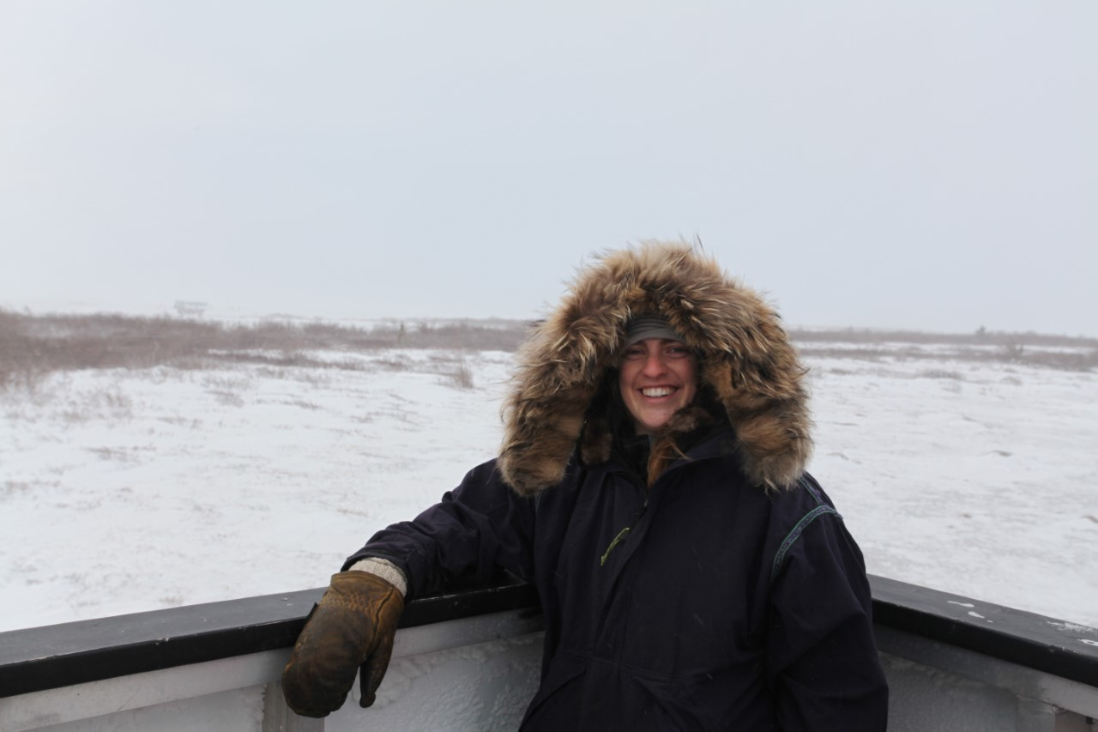
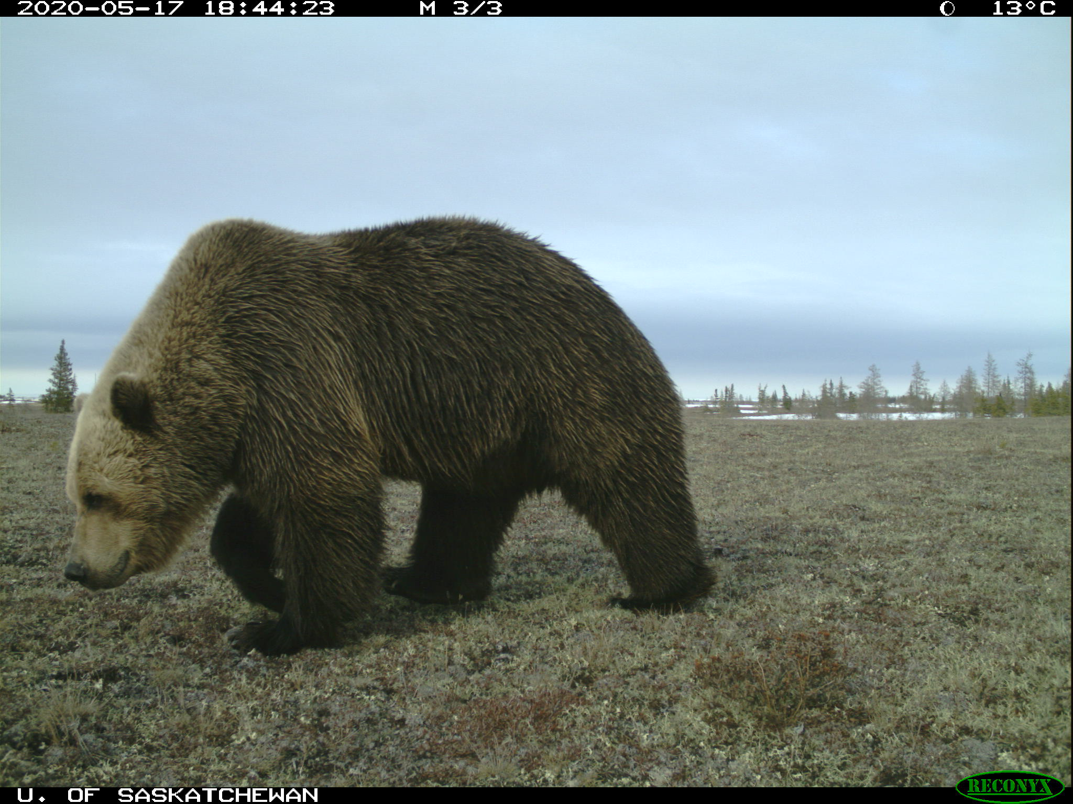
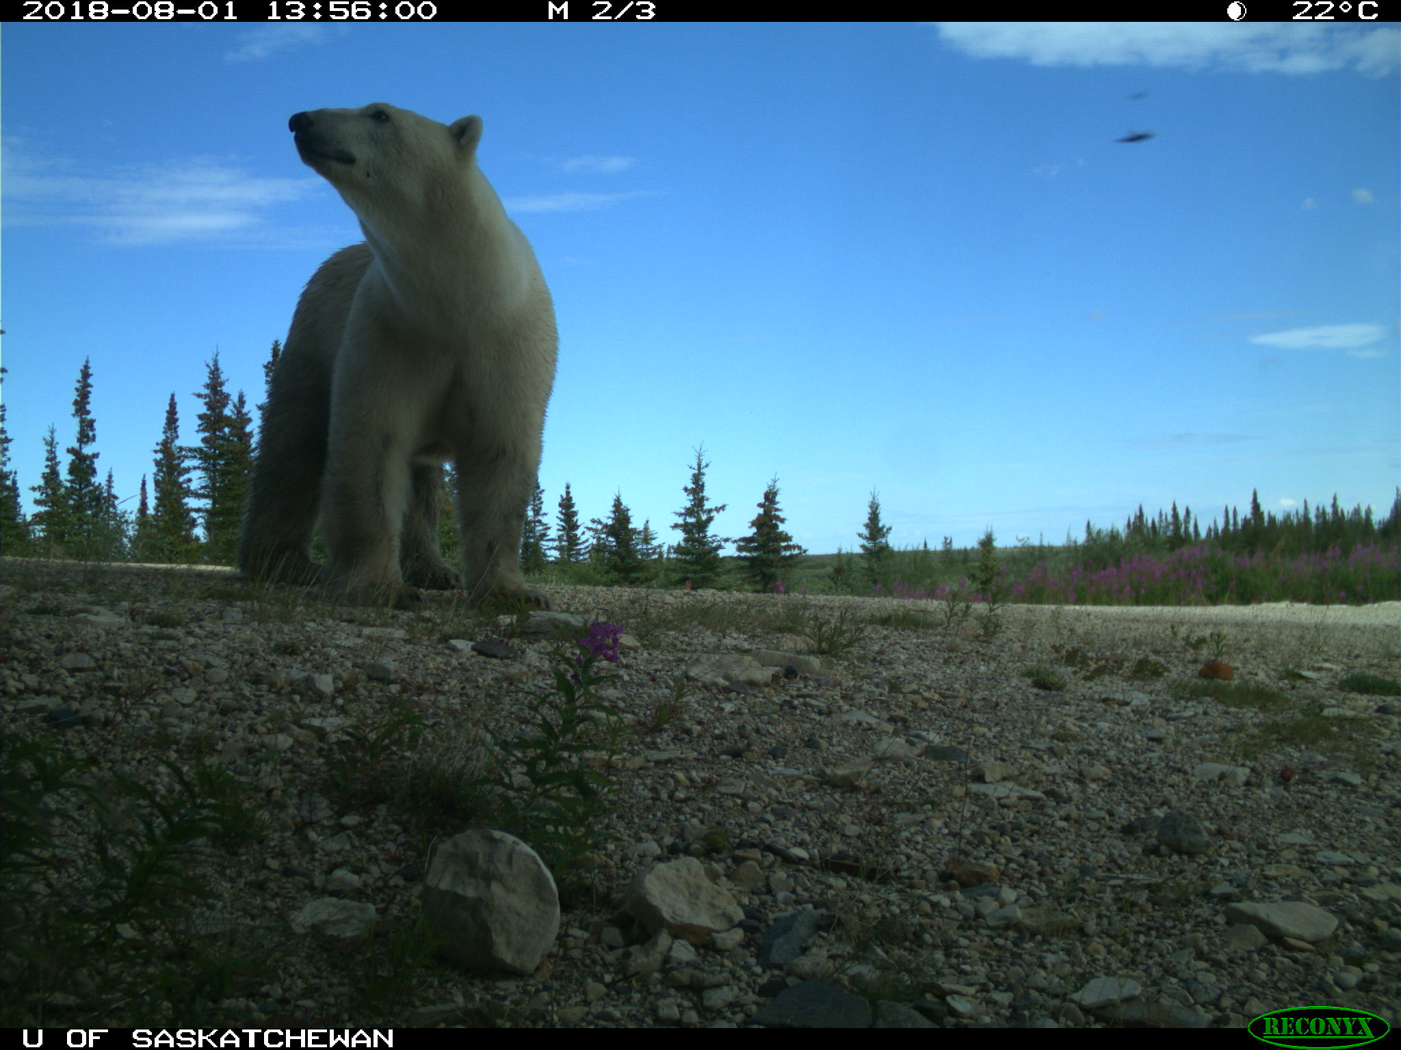
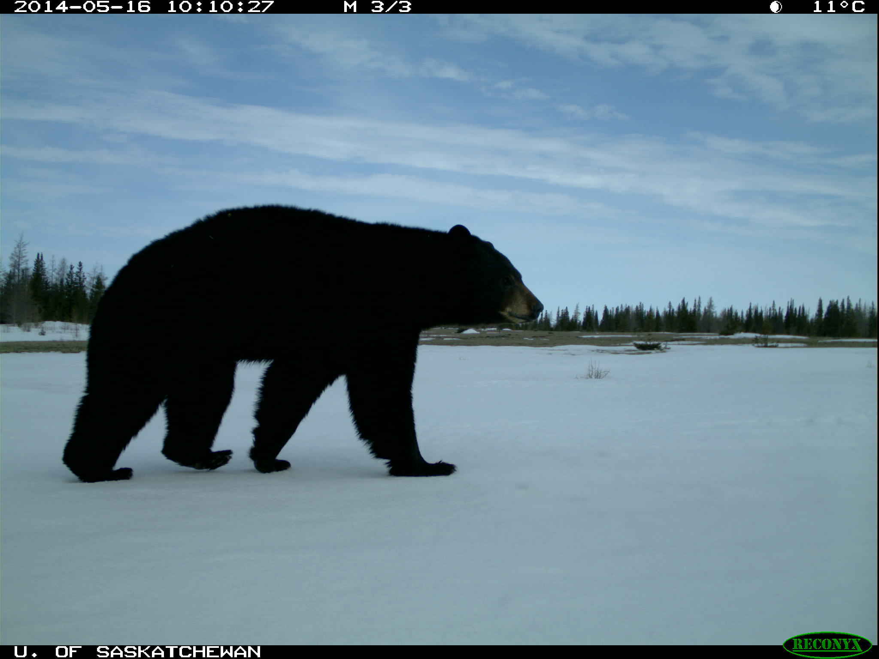
Defence Against the Three Bears: Local Innovations for Protection of Life and Property on Western Hudson Bay
Strategies to protect life and property need to be species-specific
PRESENTER
Kathryn Manning
Katie.manning@usask.ca
Background
Grizzly Bear
Damage > frequency
“Rip, claw, pull and peel”
Multiple defence layers
Remove oneself and remain unknown
Behaviour is erratic and “consistently mean ”
Churchill, Manitoba is home to all three bear species; black bears, polar bears, and a ”new” barren-land grizzly bear population and are making their presence known through sightings and destruction of property. Locals are aware of their knowledge gaps and interested in identifying pre-emptive solutions to future human-bear conflict.
Polar Bear
Frequency > damage
“Pushes and pounds”
1-2 defence layers
Make your presence known
Behaviour is more predictable
Methods
Phase 1: Semi-structured interviews
EXPERIMENT GROUP
Local and Traditional knowledge holders conducted remotely (summer 2020)
Remote cameras
Deployed by community members in town and on the land (2011-present dataset)
Types of Defence Layers
Nail boards
Fences (electrified or not)
Javex poured outside of buildings
Mothballs placed around outside of cabin
Cayenne pepper sprinkled at doors and on windowsills
Trip wires connected to bear bangers
Phase 2 (Winter 2021) : Coproduction workshop or Q-sort (COVID dependent)
Goals:
Create community-generated hypothesis on knowledge overlap between bear species
Identify knowledge gaps for grizzly bear management
Identify acceptable future bear management strategies
The Push vs. Pull
Black Bear
Minimal and infrequent damage
Garbage is #1 attractant
Bears are scared away easily
Locals are innovating and learning to adapt to the presence of grizzlies. Cabins on the land are sources of food, places for traditional activities and recreation, and are large investments (professionally and personally). Documenting social innovations is an opportunity for sharing, learning, tips and tricks in Churchill and with other communities.
This study offers the chance for local and Indigenous perspective and knowledge, historically excluded from bear conservation efforts, to be considered simultaneously with natural science data to develop a new national grizzly bear management plan.
Churchill, MB
Acknowledgements
Authors:
Kathryn Manning (U. of Saskatchewan),
Erica Gillis (Churchill Northern Studies Centre),
Douglas Clark (U. of Saskatchewan).

