Slide 1
Managing your Workload
Dr Nathalie Sheridan (Tasler)

Slide 2
Tempora Mutantur
1st Year
2nd Year
3rd Year
Write Up
3 years 10 months

Slide 3
Three Stages of PhD according to MIT
Entry Stage
Engagement Stage
Exit Stage
The Haze
Get into Gear
Slump/Final Spurt
Notes:
1: the haze … who am I and if yes how many?
2: Get into Gear … collecting your data
3. Overcoming the slump & the final spurt

Slide 4
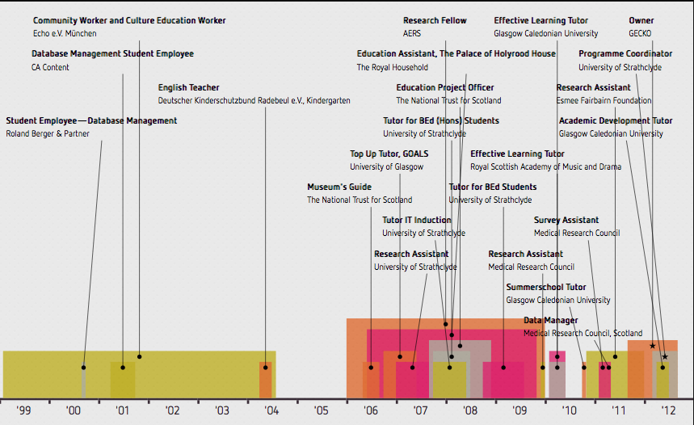
Plan
Member Departmental Research Committee
Member Executive Board Scottish Educational Research Association
Member of Strathclyde Migration Research Group
Volunteer Local Church
Notes:
Plan
Gantt Chart, To Do list
Rough estimates for key deadlines …

Slide 5
Learn the Magic Word!
NO

Slide 6
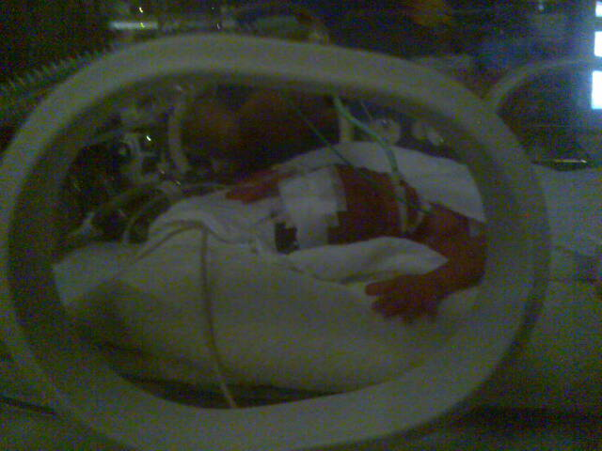
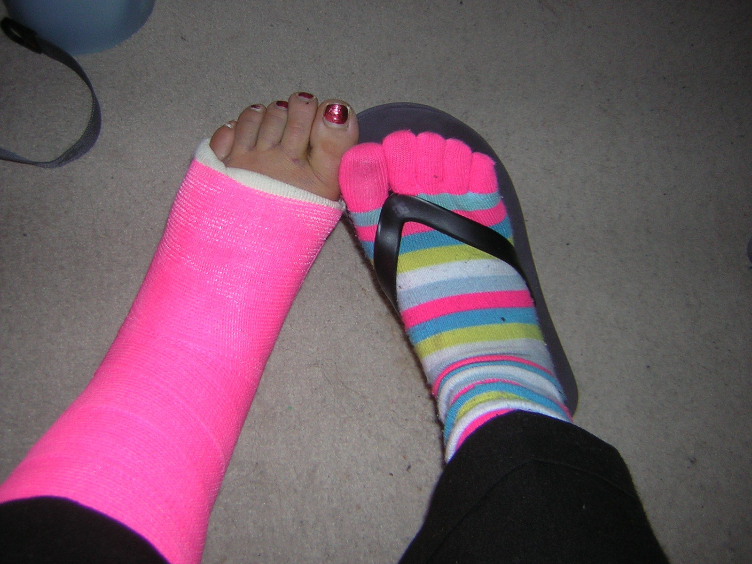
And then life happens!
Niece living with you for the summer
Because nephew made an early appearance
Car Crash
Death Toll
2 Grand Parents
1 Biological Father
2 Family Friends

Slide 7
Balancing Expectations
Strategies for Work
Strategies for Life
Notes:
Make Blog Post about Strategies so easier links
What were the expectations for the PhD and the progress how and why did it change?

Slide 8
It’s all about strategy
Interesting
Thinking
Mornings/Evenings
Focussed
Productive
Mornings/Evenings
Busy
Boring
After Lunch/Early Afternoon
Quiet vs Noisy
Alone Time vs Team-Up

Slide 9
And don’t forget the coffee
… or tea (if you must)
But I DON’T feel stressed.
Embrace Procrastination!

Slide 10
The Final Spurt
In a PhD the final spurt is not a spurt—it is sustained effort
You cannot hold your breath for a year
Look for exit strategies
Scenario Technique

Slide 11
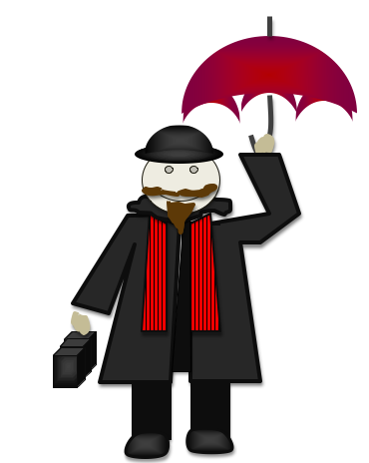
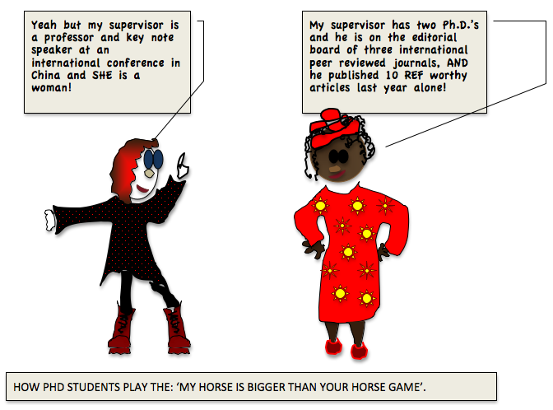
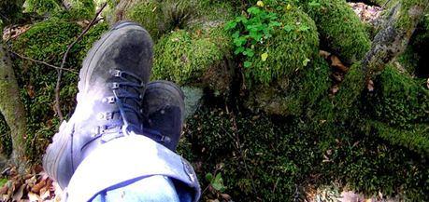
One more—Celebrating Life

