Slide 1
Knowledge Graph Publication and Browsing Using Neo4J
Ghislain Atemezing, Anh Huynh
@gatemezing
SCG Workshop 2021 @SEMANTiCS– Amsterdam – September 6th, 2021
Notes:
Hello everyone!
Thank you for joining this session.
I am Ghislain Atemezing from Mondeca. Very happy to be here today!
The topic of my presentation (a joint work with my colleague Anh Huynh) is “Knowledge Graph Publication and Browsing using Neo4J”.

Slide 2
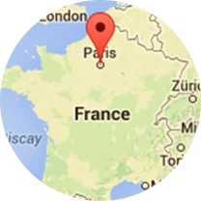
About Mondeca
Software for taxonomy management, content analytics, knowledge discovery
+20 years experience
Agile, flat structure focused on software development
Based in Paris / France
A strong foothold in Europe and in North America
16
Staff
21
years
1999
SCG Workshop 2021 @SEMANTiCS– Amsterdam – September 6th, 2021

Slide 3
Key references
International Olympic Committee
Uppsala University Hospital
SCG Workshop 2021 @SEMANTiCS– Amsterdam – September 6th, 2021
Notes:
Mondeca’s customers are mainly in the US: - traditional news media; Health domain; public sector and big corporates. They all have in common that they use semantic technologies to create business values in their domain.

Slide 4
Agenda
Motivation
Our proposal
Mondeca Mappings RDF → PG
Implementation & Evaluation
KBrowser tool
Application Use cases
Limitations
Conclusions
SCG Workshop 2021 @SEMANTiCS– Amsterdam – September 6th, 2021

Slide 5
Motivation RDF vs Property Graph (PG)
No properties on edge
Formal semantics for inference
Built on W3C standards process
Multiple serialization format
Schema languages (RDFS, OWL)
Great for Linked (open) Data with no central control
Great for Knowledge Graphs (KG) creation and publication
Key-value pairs for nodes and edges
No formal model representation
Different vendors
Cypher, PGQL, Gcore, GQL (standard to come)
No schema language
Great for graph analytics and path search
Great for using ML libraries and graph traversal language (Gremlin)
SCG Workshop 2021 @SEMANTiCS– Amsterdam – September 6th, 2021

Slide 6
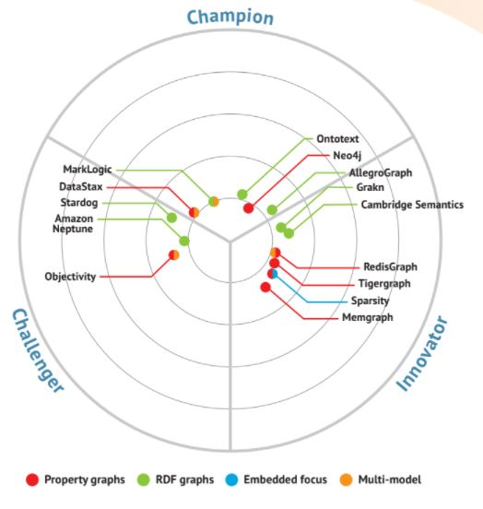
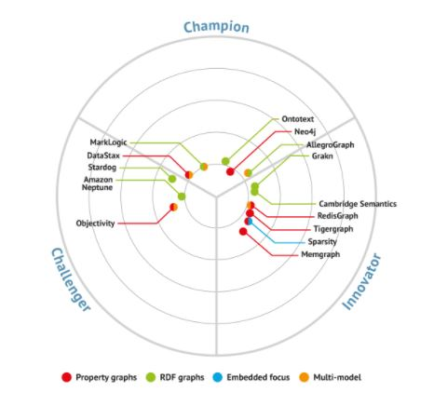
Graph Database Market Update 2020 - 2021
Neo4J is the leader for PG database
Ontotext GraphDB is the champion for RDF database
Bloor Research - https://www.bloorresearch.com/technology/graph-databases/#vendorlandscape
SCG Workshop 2021 @SEMANTiCS– Amsterdam – September 6th, 2021

Slide 7
How to use a PG database (aka Neo4J) to publish and visualize Knowledge Graphs on the Web?
Our main business use case
SCG Workshop 2021 @SEMANTiCS– Amsterdam – September 6th, 2021

Slide 8
Our contributions
Mondeca Mappings RDF→PG (Neo4J)
Implementation & Evaluation
KBrowser tool
Application Use cases
SCG Workshop 2021 @SEMANTiCS– Amsterdam – September 6th, 2021

Slide 9
Mappings RDF → PG: Node creation
Rule 1:
Subjects of triples are mapped to nodes in Neo4j. A node in Neo4j representing an RDF resource will be labeled :Resource and have a property uri with the resource’s URI.
(S, P, O) => (:Resource{value: S, kind:uri| bnode})
&&
(:Resource{value:O, kind :uri| bnode})
dbr:Mondeca rdf:type dbo:Organisation.
SCG Workshop 2021 @SEMANTiCS– Amsterdam – September 6th, 2021

Slide 10
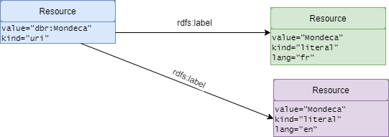
Mappings RDF → PG: Datatypes and multilingual information
Rule 2:
Predicates of triples are mapped to relationships in Neo4j if the object of the triple is a literal.
(S, P, O) && isLiteral(O) =>
(: Resource{value:S, kind:uri}) −[:P] −> (:Resource{value: O, kind:literal})
dbr:Mondeca rdfs:label "Mondeca"@fr , "Mondeca"@en.
SCG Workshop 2021 @SEMANTiCS– Amsterdam – September 6th, 2021

Slide 11
Mappings RDF → PG
Rule 3:
Predicates of triples are mapped to relationships in Neo4J if the object of the triple is a resource.
(S, P, O)&&!isLiteral(O) =>
(:Resource{value: S, kind:uri)− [:P]− > (:Resource{value :O, kind :uri})
dbr:Mondeca rdf:type dbo:Organisation.
SCG Workshop 2021 @SEMANTiCS– Amsterdam – September 6th, 2021

Slide 12
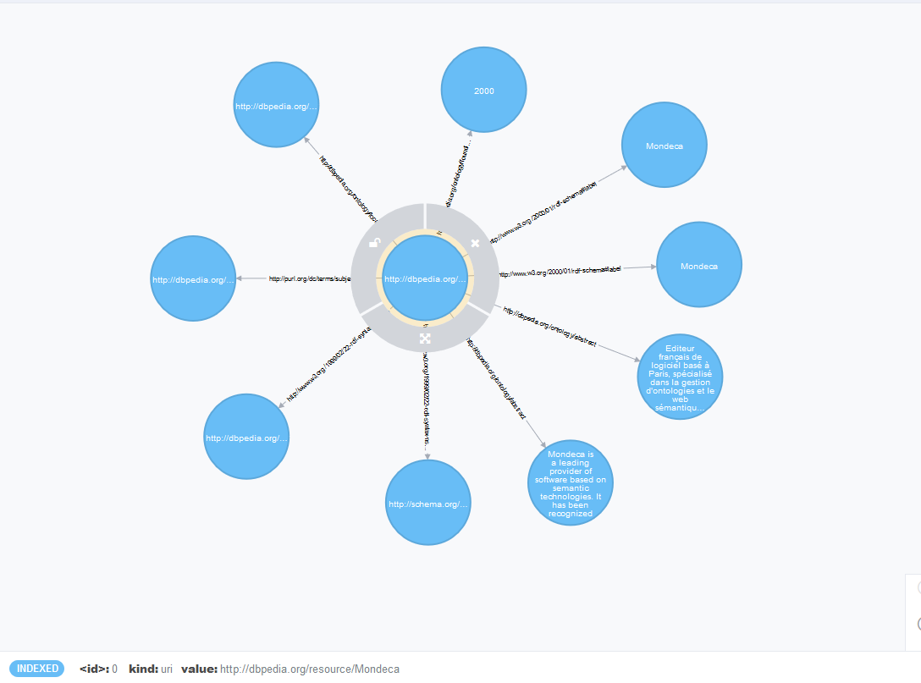
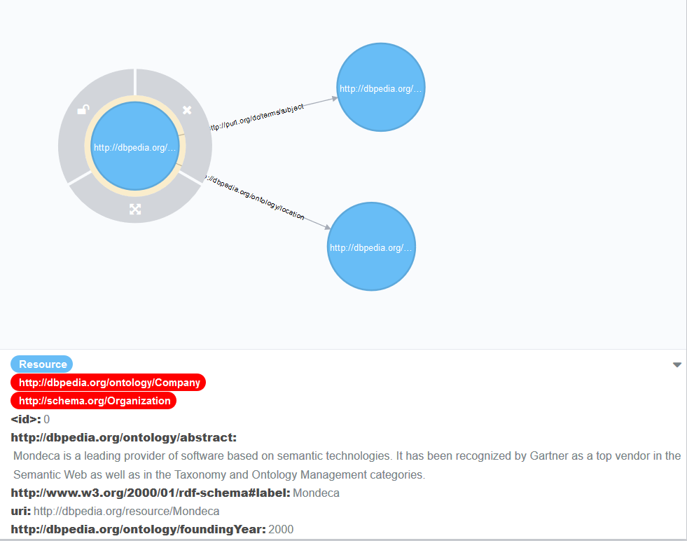
Mappings sample visual result
SCG Workshop 2021 @SEMANTiCS– Amsterdam – September 6th, 2021
Notes:
The implementation is inspired by the approach used by the Neo4J Labs. In this picture, we can see a visual representation of our implementation (left) and the one from Neo4J Labs plugin (right).

Slide 13
Experiment set up: Loading time performance
Neo4J 3.5.6 community edition memory heap size of 8GB and page cache memory of 1GB
Creation of 5 indexes p, c, cp, kind and value
Call the procedure with three parameters: the file, the serialization, and the number of triples per transaction set to 50K triples
Datasets: one vocabulary and random datasets from DBpedia dumps from 2015 [1]
Dataset | NbTriples
schema.org | 15,400
DBpedia citations links EN | 880,250
DBpedia category labels EN | 1,321,139
DBpedia instance types EN | 5,067,876
DBpedia person data EN | 8,422,913
DBpedia out degree EN | 11,998,171
[1] http://downloads.dbpedia.org/2015-10/core-i18n/en/
SCG Workshop 2021 @SEMANTiCS– Amsterdam – September 6th, 2021
Notes:
Datasets: schema.org (latest version), and sample datasets from DBpedia 2015 assets, available at Index of /2015-10/core-i18n/en/ (dbpedia.org)

Slide 14
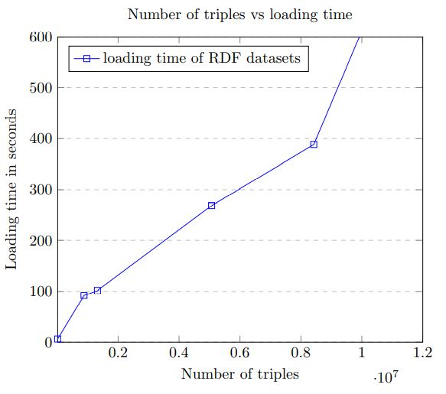
Loading time : Results
6s for loading schema.org
Less than 2 minutes for loading 1.5Mio triples
Around 4 minutes for loading 5Mio triples
Around 15 minutes for 11Mio triples

Slide 15
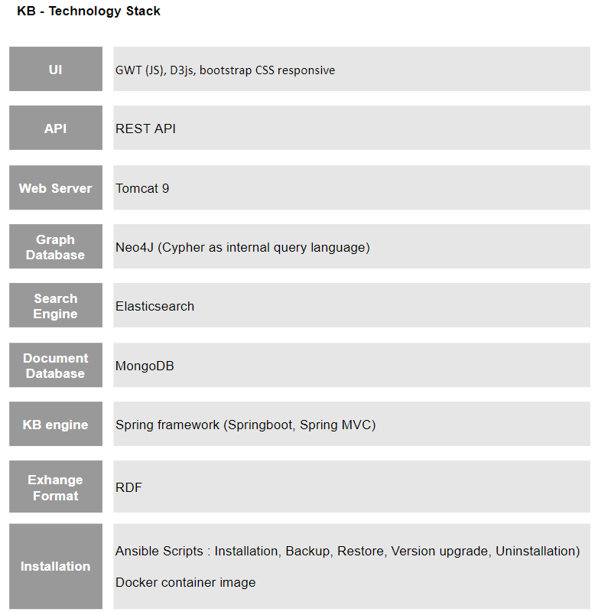
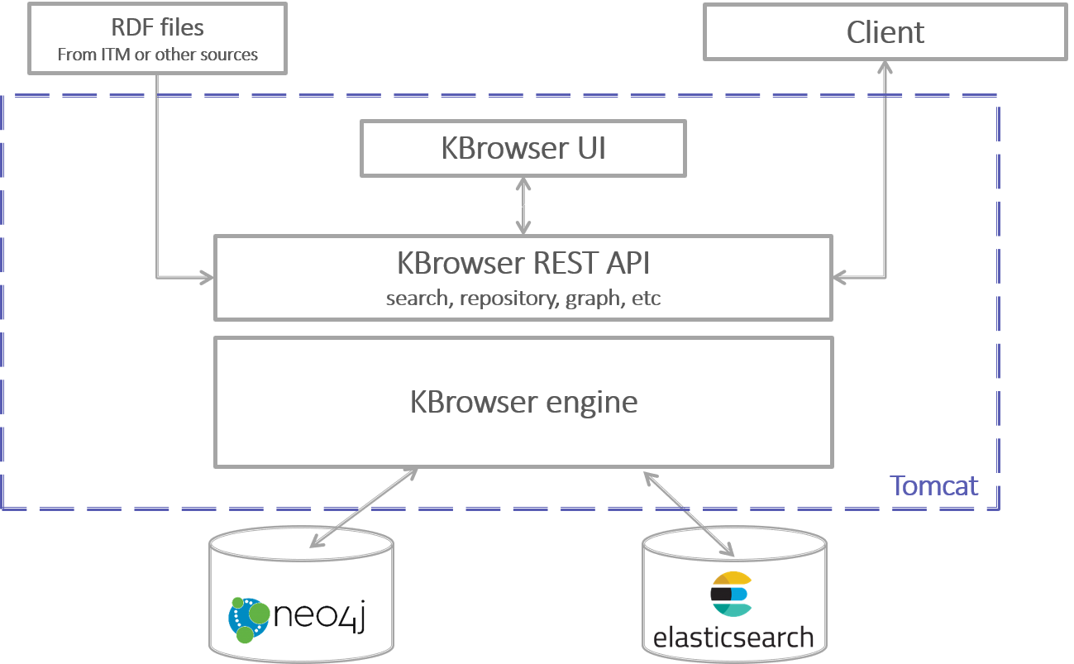
KBrowser Architecture overview
SCG Workshop 2021 @SEMANTiCS– Amsterdam – September 6th, 2021

Slide 16
KBrowser Applications: TerMef and French Bioloinc Portal
Live deployments of KBrowser
Easy publication of terminologies for both domains (Finance and Health)
Datasets represent around 500K triples
Search interface and graph views of relationships (Molecular visualization)
KBrowser runs on a minimal RAM ( 2GB)
TerMef: https://terminologie.finances.gouv.fr/
BIOLOINC: https://bioloinc.fr/
SCG Workshop 2021 @SEMANTiCS– Amsterdam – September 6th, 2021

Slide 17
Limitations
Benchmark our proposal with existing solutions (NSMNTX, Angles et. al, 2020)
Check memory evolution with billions of triples
Integrate named graphs in the proposal
Target other graphs databases (ArangoDB, JanusGraph)
We do not provide mappings from PG → RDF data models (not a business use case)
Study the impact of the new RDF-star CG proposal
SCG Workshop 2021 @SEMANTiCS– Amsterdam – September 6th, 2021
Notes:
- NSMNTX is Jesus Barrasa work available in the recent Neo4J Lab plugin
Angles et. al, 2020: “Mapping RDF Databases to Property Graph Databases”.
- All the above limitations can be part of our future works.

Slide 18
Conclusions
We have proposed a generic mappings from RDF2PG data model for Neo4J
We have implemented the procedure to load RDF datasets using Neo4J
The loading time is promising in an 8G RAM machine
We use the mappings to showcase KBrowser, a tool to publish and visualize KGs using Neo4J
KBrowser is featured in two portals showcasing the validity and usability of our approach
SCG Workshop 2021 @SEMANTiCS– Amsterdam – September 6th, 2021

Slide 19
Thank you for your attention!
Q/A session
SCG Workshop 2021 @SEMANTiCS– Amsterdam – September 6th, 2021
Notes:
Thank you for your attention. Happy to answer to your questions!!

Slide 20
Knowledge Graph Publication and Browsing Using Neo4J
Ghislain Atemezing, Anh Huynh
@gatemezing
SCG Workshop 2021 @SEMANTiCS– Amsterdam – September 6th, 2021
Notes:
Hello everyone!
Thank you for joining this session.
I am Ghislain Atemezing from Mondeca. Very happy to be here today!
The topic of my presentation (a joint work with my colleague Anh Huynh) is “Knowledge Graph Publication and Browsing using Neo4J”.

Slide 21
Next steps
Investigate the changes to this mappings with the new RDF-star compliant datasets
Make a rigorous comparison with other works in the literature tackling this same problem space.
Deeper evaluation of the memory usage when loading billions of triples
Extend the approach to others NoSQL graph databases (e.g., JanusGraph, ArangoDB)
SCG Workshop 2021 @SEMANTiCS– Amsterdam – September 6th, 2021

Slide 22
Gadgets, stock, basics
Base font: Open Sans
Icons: FontAwesome

