Slide 1
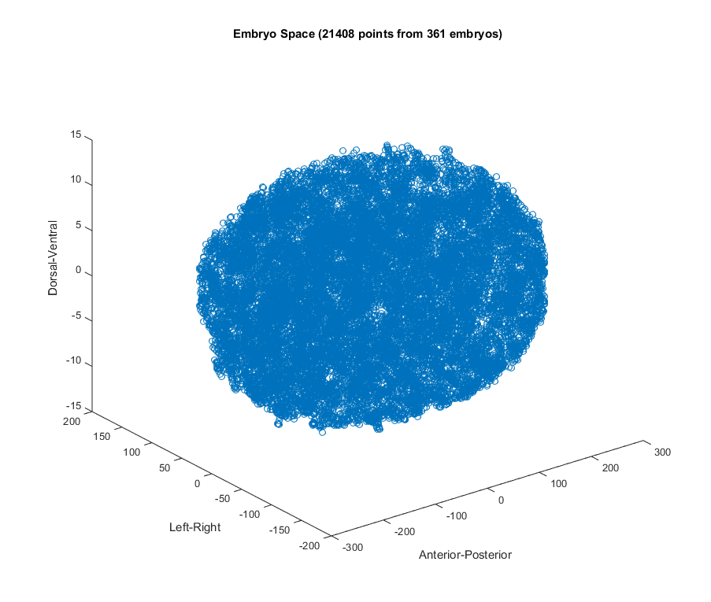
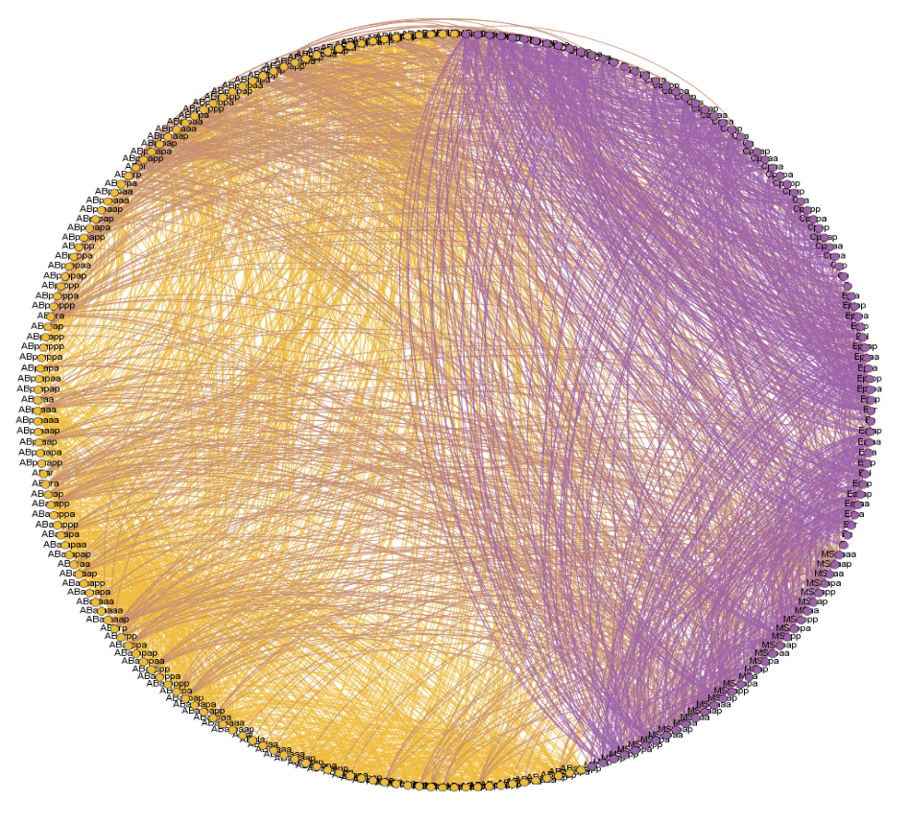
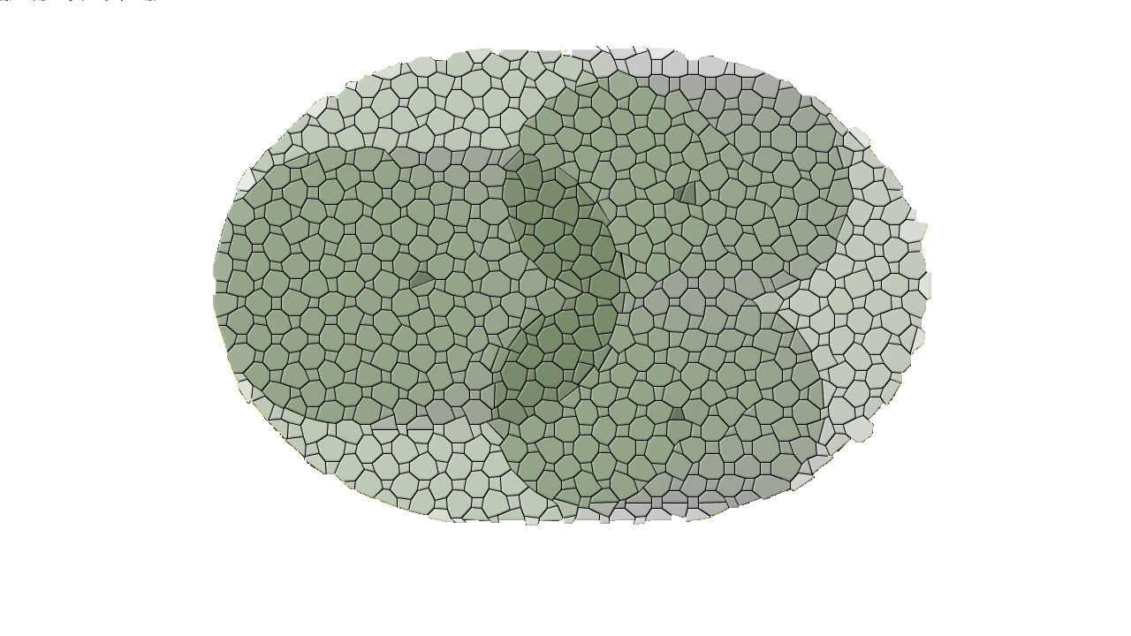
Generative Divergent Integration as a Theory of the Emergent Connectome
Big Data Neuroscience Workshop,
Beckman Institute, UIUC
Bradly Alicea
@balicea1

Slide 2
Embryo Networks
x,y,z,t,θ
3-D space
time and context
x,y,z,t,θ
See our Jupyter Notebook for
more information
https://devoworm.github.io/

Slide 3
5-dimensional Data Structure
x, y, z, t, i
z
t
0
1
00
01
10
11
y
i
x
A spatially-independent parameter space ordered
by A-P axial order (i) and lineage time (t,i)
A generalized parameter space based on
observations across C. elegans embryos (x,y,z)

Slide 4
Cell Division
Graph diameter expands (growth in number of nodes)
Local connectivity increases (nodal density)
Global modularity increases (differentiation events, bifurcation)
Bipartite Structure (Bifurcation)
Initial Condition
Expansion of Structure

Slide 5
Cell Division
Bifurcation: single network to bipartite.
how many parts does the network fragment into over time?
Bipartite Structure (Bifurcation)

Slide 6
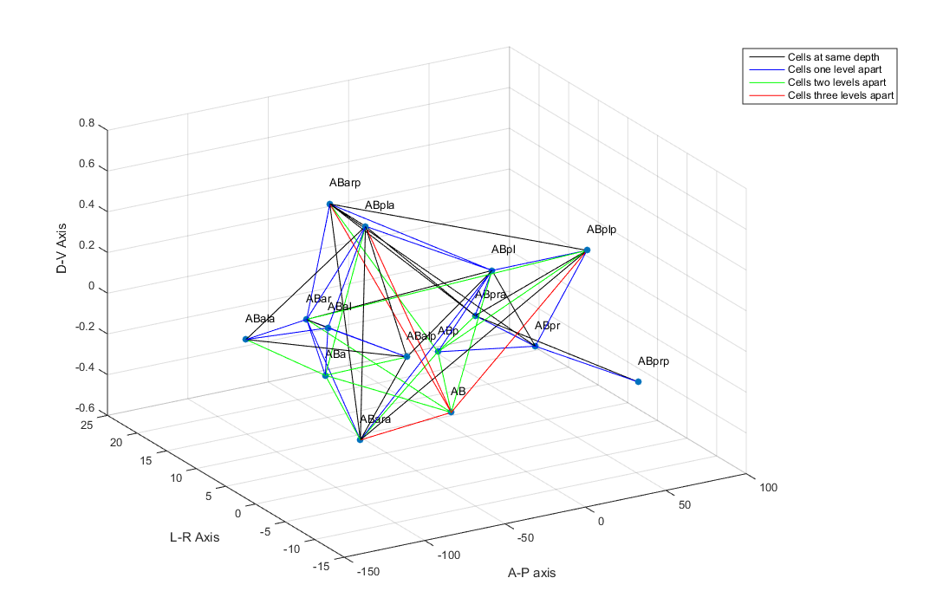
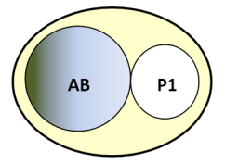
Spatial Connectivity (Interactome)
P1
subtree
AB
subtree

Slide 7
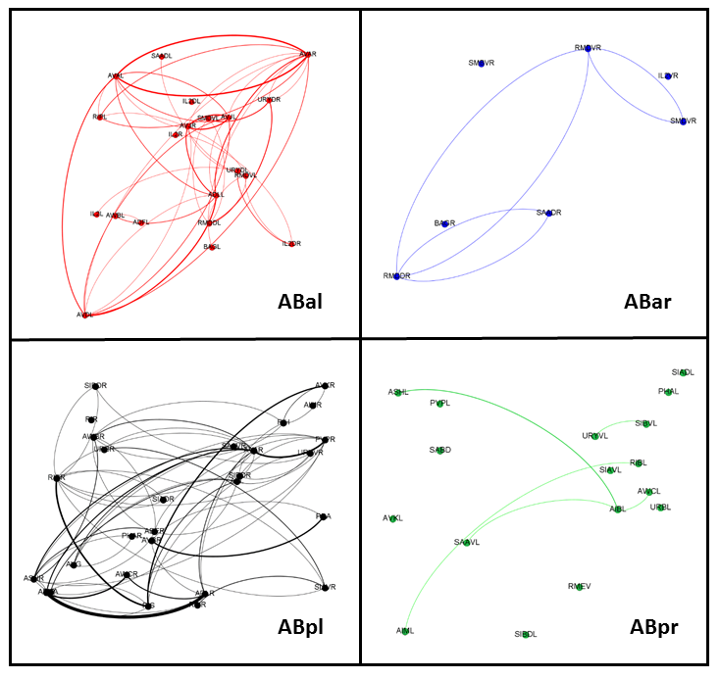
Spatial Connectivity (developmental lineages leading to Connectome)

Slide 8
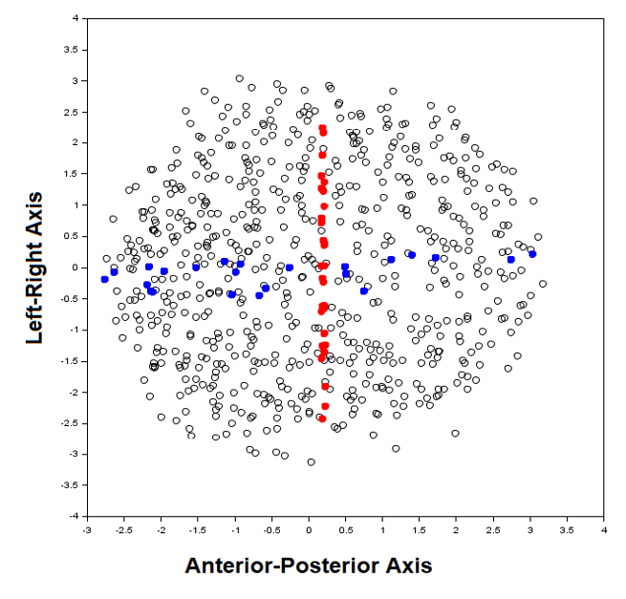
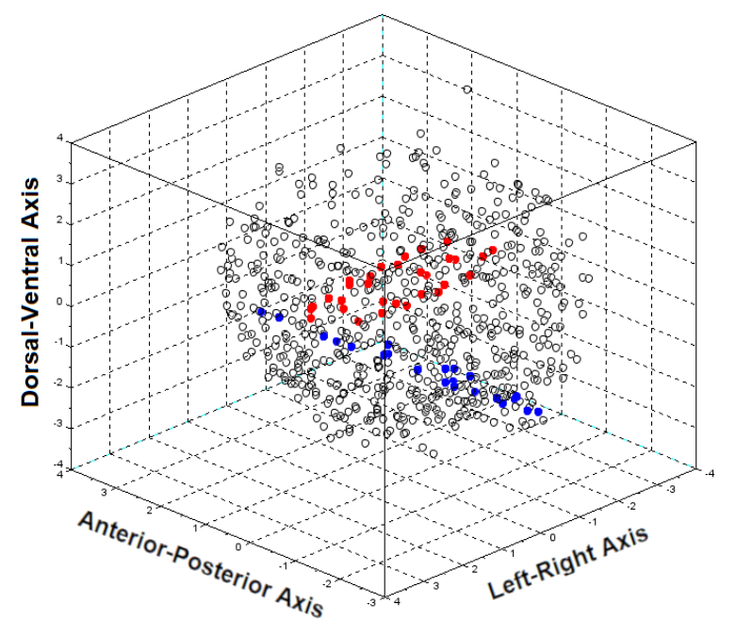
Where connectome neurons emerge in the embryo
z
y
x

Slide 9
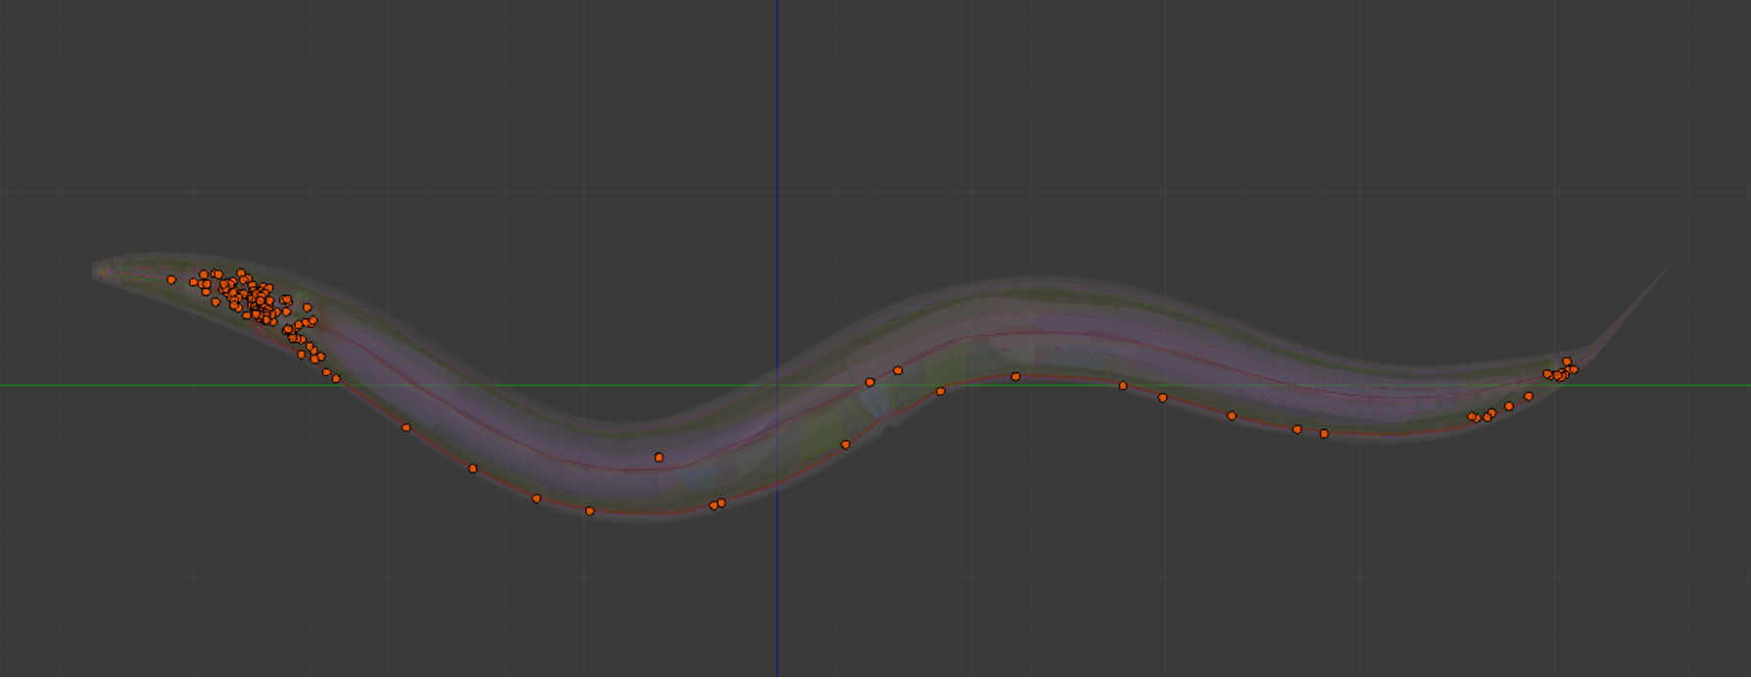

Slide 10
Generative Divergent Integration
8-cell example
24-cell example
Embryo network only. Connections between nodes:
For all developmental cells (blue), < distance t (threshold) between cell centroids.
Sparse connectivity due to larger cell size.
Embryo and Neuronal network. Connections between nodes:
For all developmental cells (blue), < distance t (threshold) between cell centroids.
All neurons (green) that share gap junctions.

Slide 11
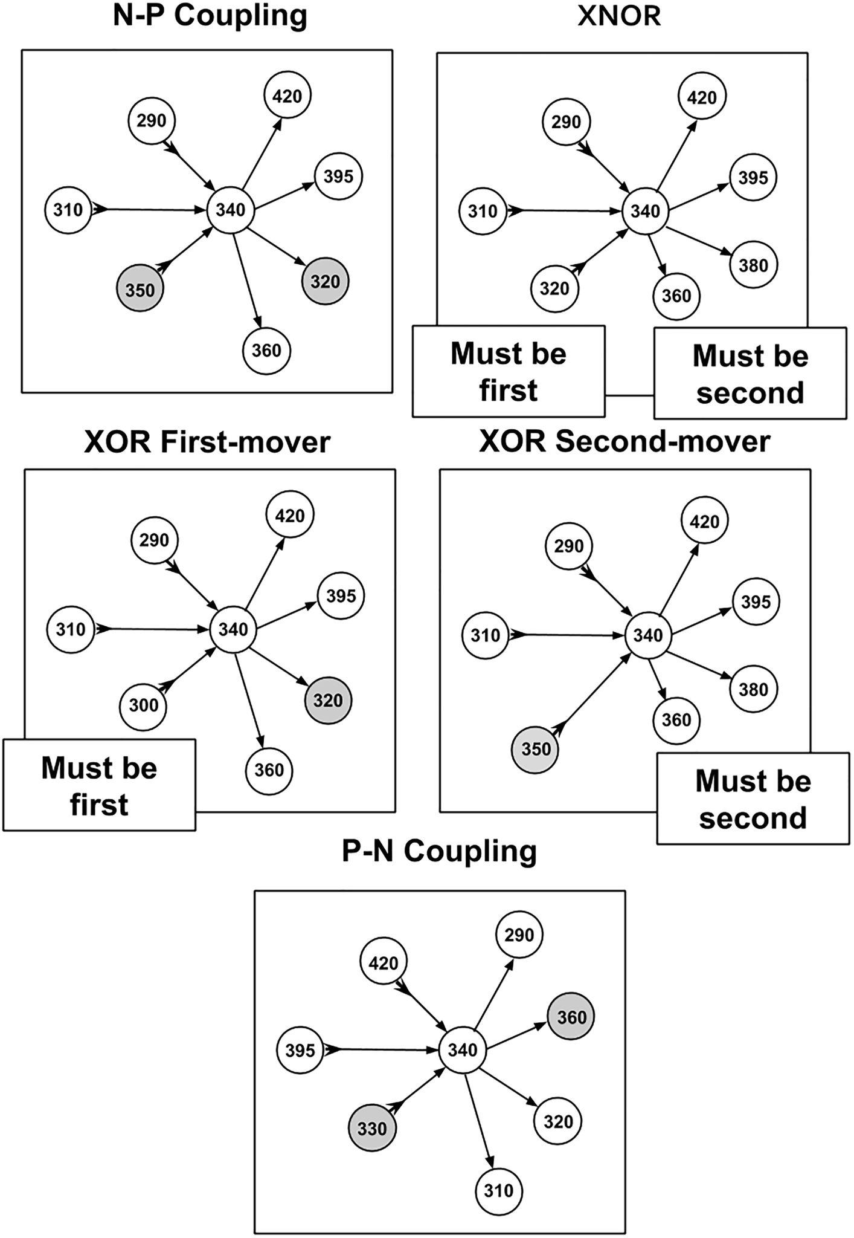
First-player Dynamics in Connectome Formation
Analysis of developmental synaptic connectivity data in C. elegans. Define connectogenetic strategies.
potential pre- and post-synaptic relationships.
yield various strategies for establishing connections.
Alicea, Frontiers in Cellular Neuroscience, 14, 524791. (2020).

Slide 12
Density-Bifurcation Model
The process of increasing connectivity in development is as follows:
cells divide and migrate, connectivity increases.
cell migration enriches local communities and cliques.
function of cells diverges (differentiation), two interconnected networks emerge.
interconnected networks provide weak ties (functional interdependencies) between emerging tissues.

Slide 13
CONNECTOME
Divergent Integration As Hyper-lineage Tree
A Hypergraph of Embryogenesis and Connectogenesis
48
190
228
26
24
24
TIME
194
EMBRYO
NETWORK
50
12
48
GERM
LINE
LEFT: C. elegans-like connectome (deterministic lineage tree, bilateral symmetry).
3
6
32-cell embryo
28
4
14
2
8-cell embryo
Stem (developmental) cells can move across subgraphs (ovals, n = size of network), but terminally differentiated cells cannot.
7
1
4
2
1

Slide 14
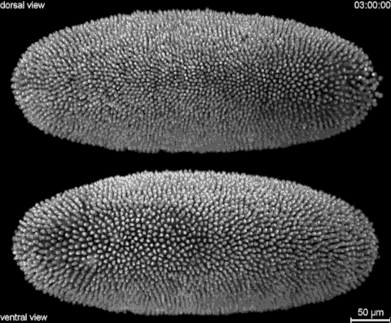
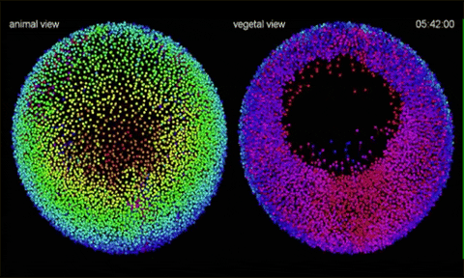
Future directions: capturing embryo dynamics
time-series of static embryo networks with spatially-localized differentiation.
COURTESY: https://txchnologist.com/post/ 109306942500/watching-embryos-develop-from- earliest-moments
COURTESY: https://giphy.com/gifs/BAccmmPOGIAQo

Slide 15
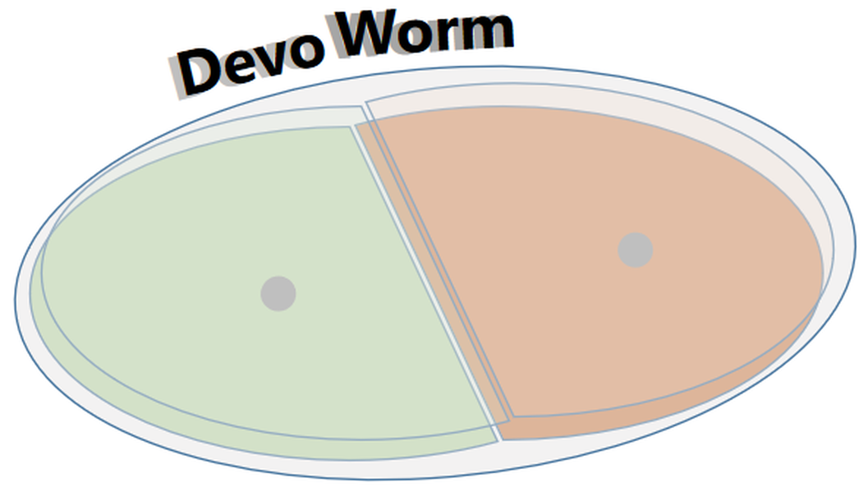
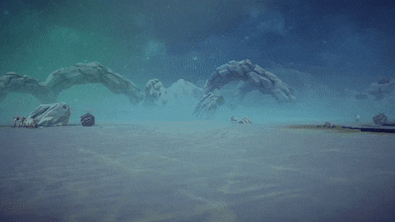
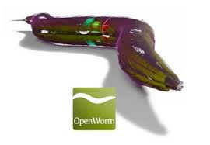
Thanks for Your Attention
http://devoworm.weebly.com
COURTESY: gfycat user orneryangelicgaur

