Slide 1
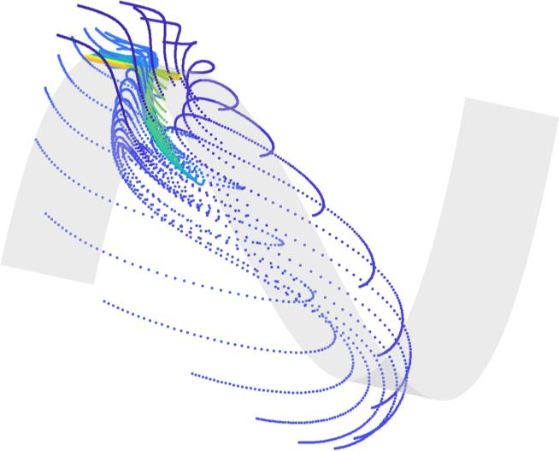
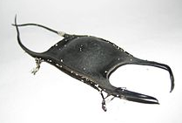
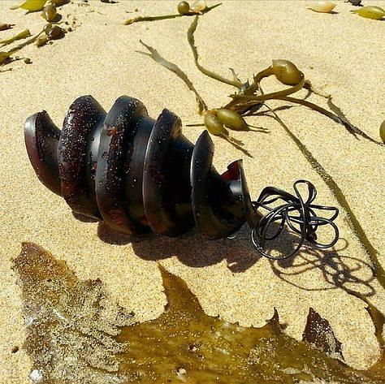
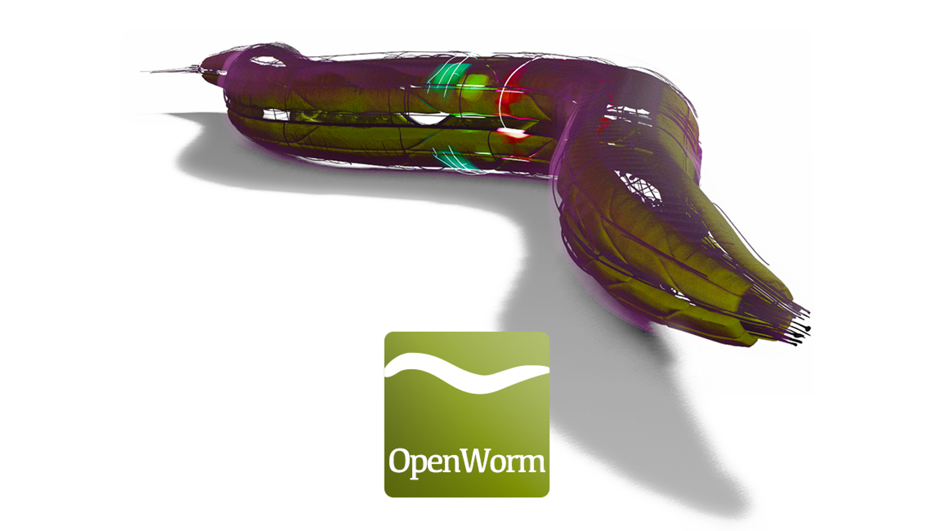
Game Theory of Developmental Processes
Dynamics Days XL (2021)
2, 0
1, 0
0, 1
-1, -1
2-player egg purse shape game
(a hypothetical example)
Bradly Alicea
CS06: Games, Development,
and Pattern Formation
@balicea1

Slide 2
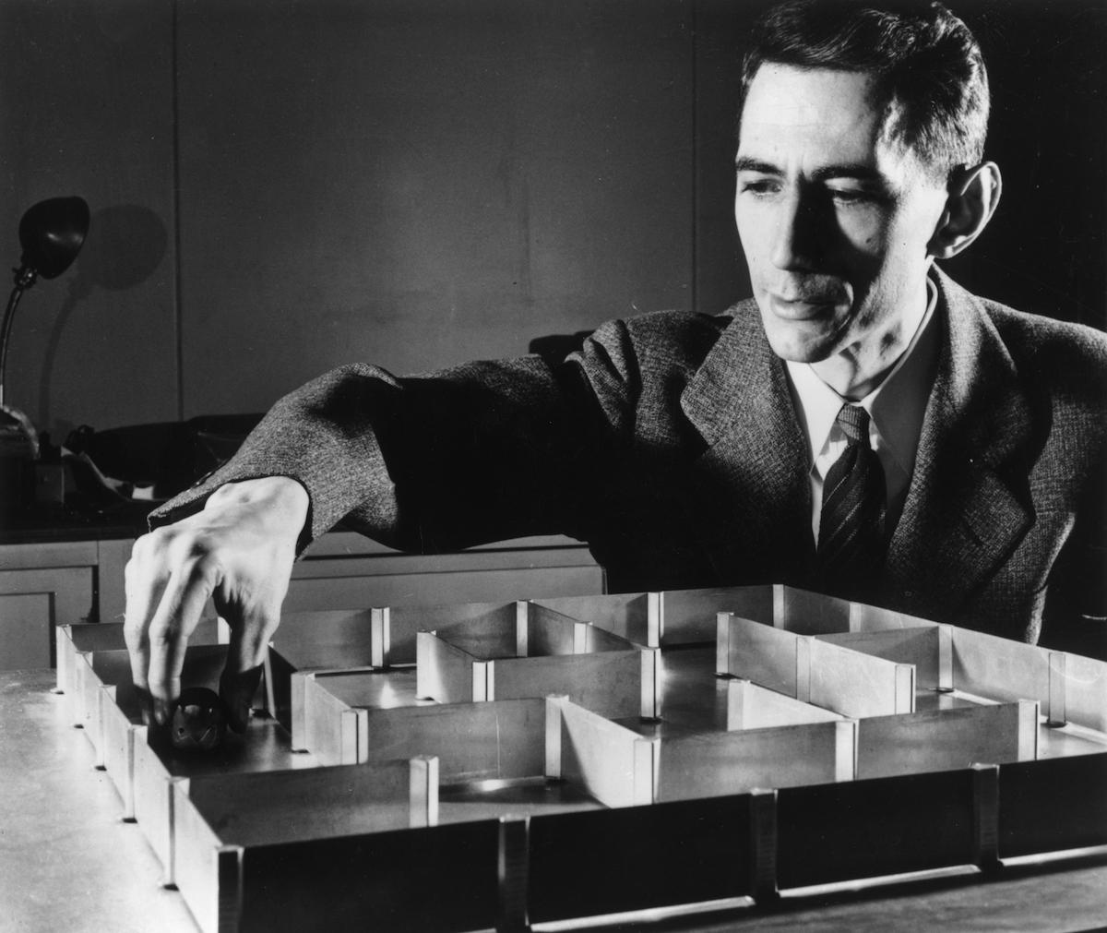
Variation, Morphogenesis, and Learning/Adaptation

Slide 3
Developmental Agents
General Case
Agents (taking the form of cells, morphogenesis, gene products) emit states. A developmental game is the strategic interactions of these states.

Slide 4
Developmental Agents
General Case
Agents (taking the form of cells, morphogenesis, gene products) emit states. A developmental game is the strategic interactions of these states.

Slide 5
Developmental Agents
General Case
Agents (taking the form of cells, morphogenesis, gene products) emit states. A developmental game is the interactions of these states.
Ontogenetic Agents
Specific Case
Does not use cognition to execute behaviors -- instead intentional strategies are related to transformational processes (movement, differentiation, growth, and regulation).

Slide 6
Coordination Between Ontogenetic Agents
Coordination can result from collective behavior over time, or perfect coordination can be assumed a priori.

Slide 7
Developmental Tradeoffs
Model the internal state of an ontogenetic agent.
agent needs to maximally conserve energy, invest in one set of strategies over another.
Energetic scarcity can lead to pure strategy suite (only a single strategy employed).
Can also change the composition of different agents (heterogeneity).
ontogenetic agents with more available energy have greater degree of complexity, with capacity for a greater number of strategies.

Slide 8
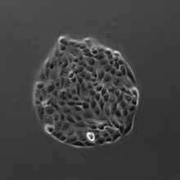
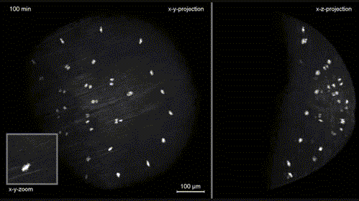
Biological Intentionality
Rather than assume goal-directed behavior among the ontogenetic agents, bio-intentionality is a means to achieve some functional imperative or to improve individual fitness.
examples include phenotypic plasticity, cell migration, and excitation/inhibition circuits.

Slide 9
0-player Games
Stack Exchange: How to generate nD point processes
https://stats.stackexchange.com/questions/16282/how-to-generate-nd-point-process
Example: Conway’s Game of Life (GoL).
Cells operate as a point process that emit a state of “dead” or “alive”.
have only an indirect influence on spatial dimensionality, lifelike attributes captured in these dimensions.

Slide 10
0-player Games
Example: Conway’s Game of Life (GoL).
Cells operate as a point process that emit a state of “dead” or “alive”.
have only an indirect influence on spatial dimensionality, lifelike attributes captured in these dimensions.
Application to Development
Turing morphogenesis (reaction-diffusion), where particles compose a population of 0-dimensional agents, and morphogens act indirectly to transform population into a spatial pattern.
equilibrium is reached when a stable morphogenetic pattern is achieved.

Slide 11
0-player game Payoff Matrix
With this payoff structure, cell will tend to stay “alive”.
Payoff to stay alive increases when particle is part of a pattern.
Alive | Dead
0.8 | 0.2
Asymmetric payoff is determined by information (local biochemistry, global fitness).

Slide 12
0-player game Payoff Matrix
With this payoff structure, cell will tend to stay “alive”.
Payoff to stay alive increases when particle is part of a pattern.
Alive | Dead
0.8 | 0.2
With this payoff structure, cell will vacillate between “dead” and “alive” (equiprobable).
Alive | Dead
0.5 | 0.5

Slide 13
1-player Games
Example: Game Against Nature.
An ontogenetic agent will play an intentional strategy against a quasi-random natural process (e.g. weather, entropy).
payoff structure will be solely dependent upon a process-driven objective (e.g. increase in fitness, maximization of error correction).
Application to Development
generic developmental processes as a game of developmental Minesweeper.

Slide 14
Game Against Nature
Single rational player plays a pure or mixed against nature (random, mixed strategy). Strategy: carry an umbrella (U) or not (N).
Random generator of discrete states.
Forecast is imperfect information,
informs deployed strategy by other opponent.
Observer Strategy | U | N | N | U | U | U | N
Payoff | 0 | 1 | -1 | 1 | 1 | 0 | 1

Slide 15
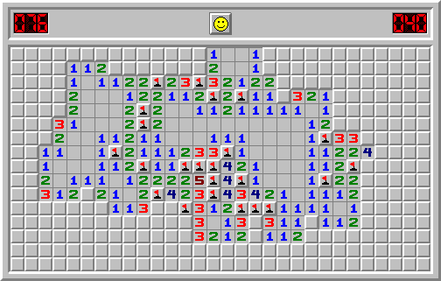
Developmental Minesweeper
Minesweeper as a game between nature and a single ontogenetic agent:
Mines: lethal mutations.
nature places lethal mutations in a 2-D genome, ontogenetic agent is blind to these locations.
Null Squares: degrees of freedom.
We can also add in other information to be uncovered, ontogenetic agent is also blind to these features.

Slide 16
2-player Games
Example: Naughts and Crosses (Tic-Tac-Toe)
O
O
O
O
O
O
O
O
O
First-mover advantage:
Timing of cell division and differentiation: first cells/cell lineages to differentiate determines subsequent activities in the embryo.
(biological) Stackleberg equilibrium: optimal play + first-mover advantage = no clear winner. No one cell lineage or type dominates.

Slide 17
First Move
Second Move
Third Move
Fourth Move
O
O
O
O
O
X
O
X
X
X
X
O
X
X
X
O
O
O
X
O
X
O
X
X
O
Fifth Move
Sixth Move
Seventh Move
Eighth Move
O
O
O
X
O
O
X
O
O
X
X
O
X
X
O
X
X
O
X
X
X
O
X
X
O
X
X
O
X
X
O
Stone et.al, Biosystems, 173, 73-82 (2018).

Slide 18
First Move
Second Move
Third Move
Fourth Move
1,1
1,1
1,1,1
1
1,2
1,2
1,1,2
1,2
2
2
2,2
2,2
2,1
2,1
Fifth Move
Sixth Move
Seventh Move
Eighth Move
1,1,1
1,1,1
1,1,1
1,1,1,1
1,1,1,2
1,1,2
1,2,2
1,1,2
1,2,2
1,1,2
1,2,2
1,1,2
1,2,2
2,2
1, 2, 1
1,2,1
2,2,1
2,2,2
1,2,1
2,2,1
2,2,2
1,2,1
2,2
2,1
2,1,1
2,1,1
2,1,1
2,1,2
2,1,2
2,1,2

Slide 19
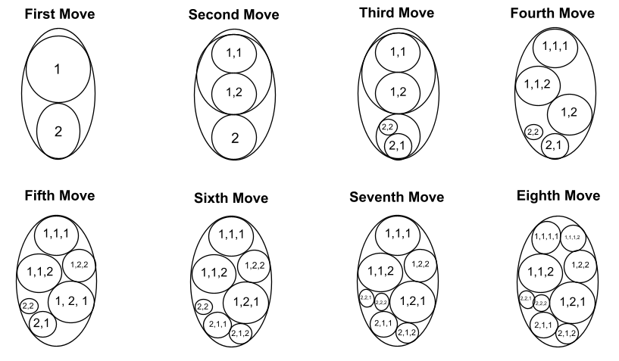
Embryo can also be analyzed as a first-mover (Stackleberg) game:
advantages are in terms of size, for differentiated tissues it could be in terms of function, structure.
Sublineage 1 and 2 are established, 1 has a size/position advantage.
Second move: sublineage 1 mother divides before 2, advantage (leader).
Third move: sublineage 2 mother divides (folllower).
Fourth move: another division event in sublineage 1, further advantage for 1.
Stone et.al BioSystems, 173, 73-82 (2018)

Slide 20
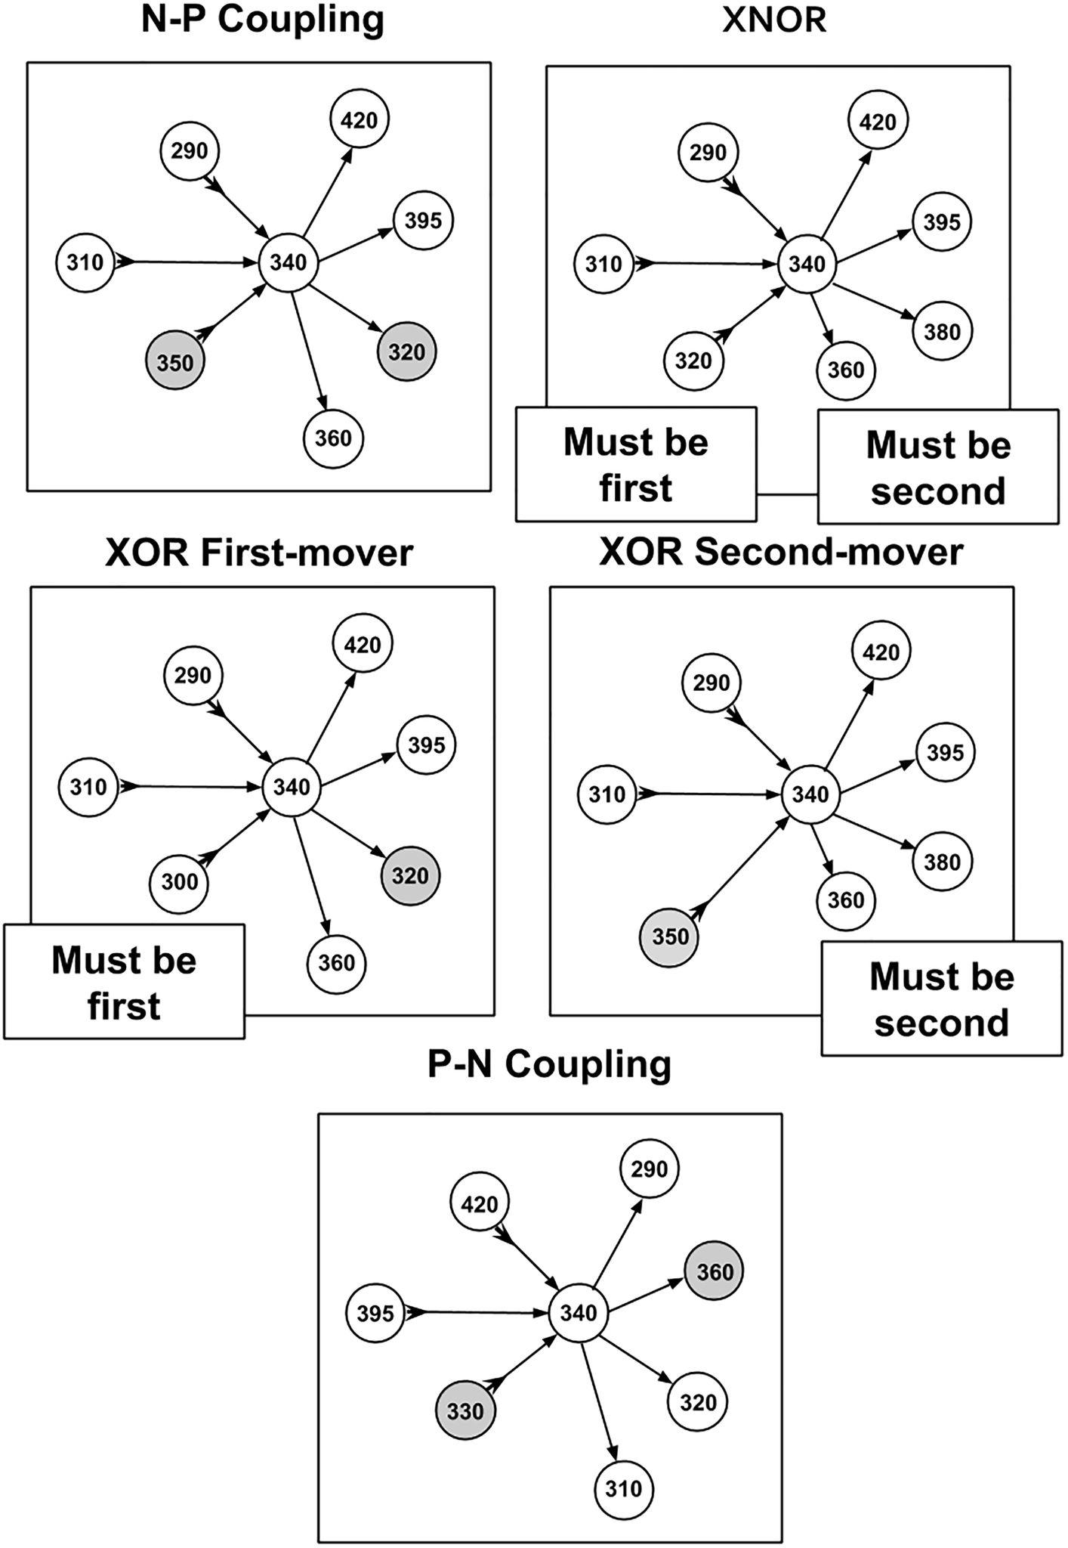
First-player Dynamics in Connectome Formation
Analyze synaptic connectivity data in C. elegans using first-mover model (Stackleberg competition)
potential pre- and post-synaptic relationships.
yield various strategies for establishing connections.
Alicea, Frontiers in Cellular Neuroscience, 14, 524791. (2020).

Slide 21
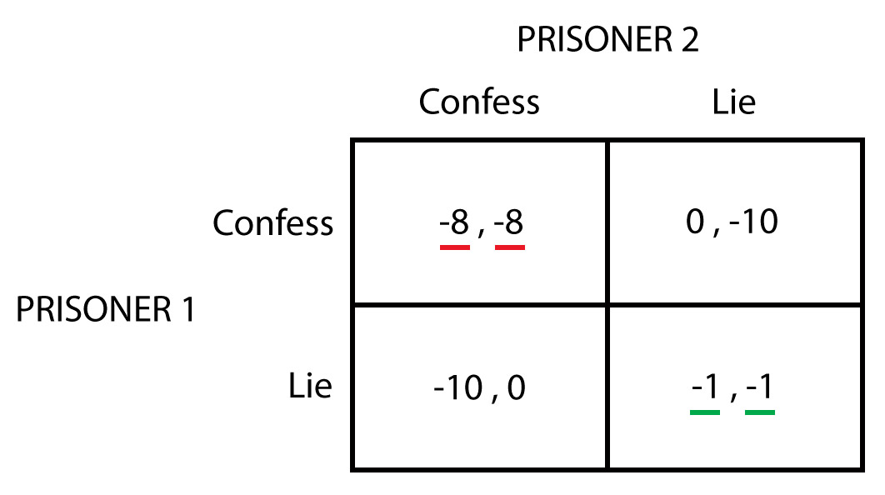
2-player Games
Example: Prisoner’s Dilemma (PD) and Iterated PD
Individual vs. group incentives:
defect to seek maximization of individual payoff (but often suboptimal), cooperate to maximize pairwise (or group) payoff.
in Iterated PD case, game is played repeatedly (dynamically).
Application to development:
A pair of ontogenetic agents with complementary mechanisms (pattern recognition, pattern formation).

Slide 22
EMITTER
OBSERVER
Produces pattern
(morphogenesis)
Reconstructs pattern
(perception)
What is the relationship between morphogenesis and perception?
Using this model, we can treat this as either a predator-prey relationship, or a competitive/cooperative game.
pareidolia (perception/morphogenetic coevolution), camouflage (matching pursuit game).
predator hunts prey (prey must conceal itself), or prey is dangerous to predator (kills with venom).

Slide 23
?
!
Pursuit-evation game (distinct from a PD game) when observer tries to identify partial phenotypes, while the emitter tries to conceal its phenotype as a coherent pattern.

Slide 24
Interesting connections between the pursuit- evasion utility function (iterative payoffs) and Reinforcement Learning.

Slide 25
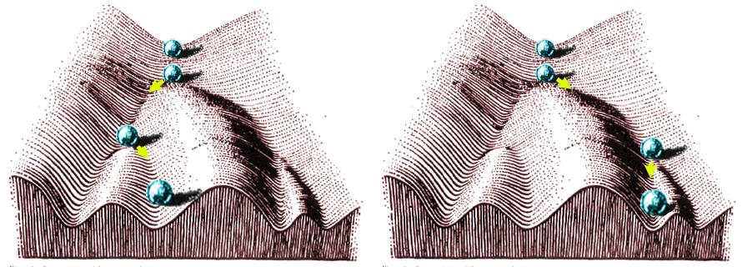
Evolutionary Stable States: given perturbations, a set of strategies can be found that return system to initial state and resist invasion by mutant strategies.
Developmental Stable States (DSS)
Developmental Stable States might work in a similar manner, and mimic the canalization of development proposed by Waddington.

Slide 26
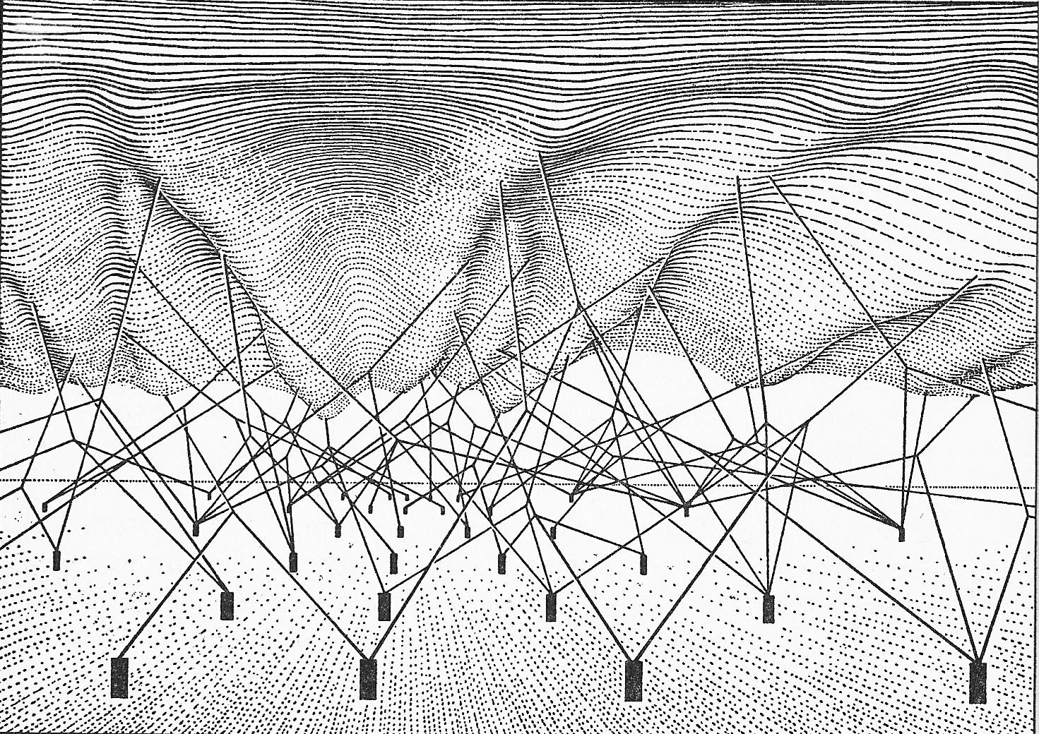
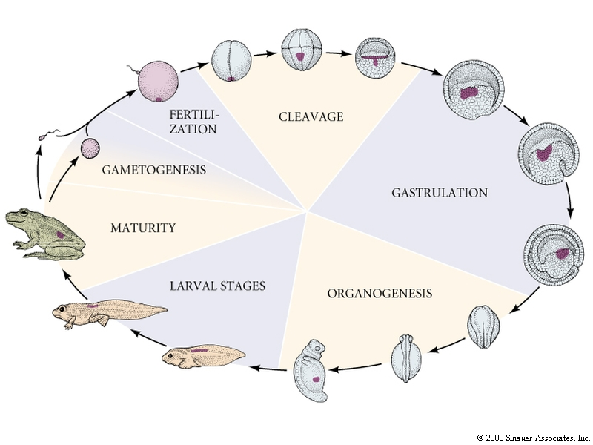
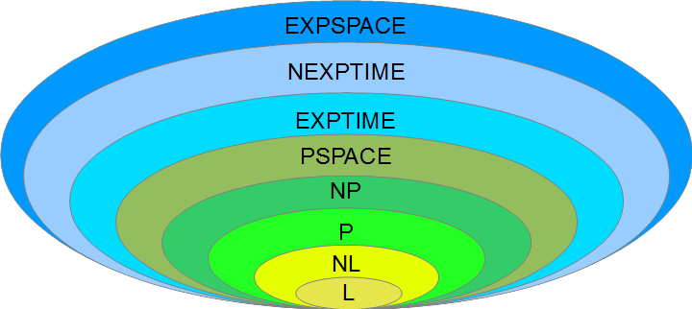
A route to understanding combinatorial complexity
Epigenetic Landscape

Slide 27
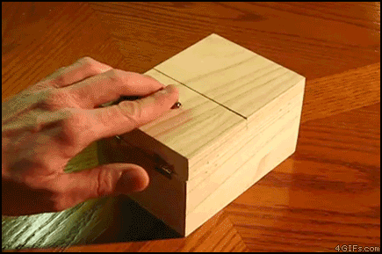
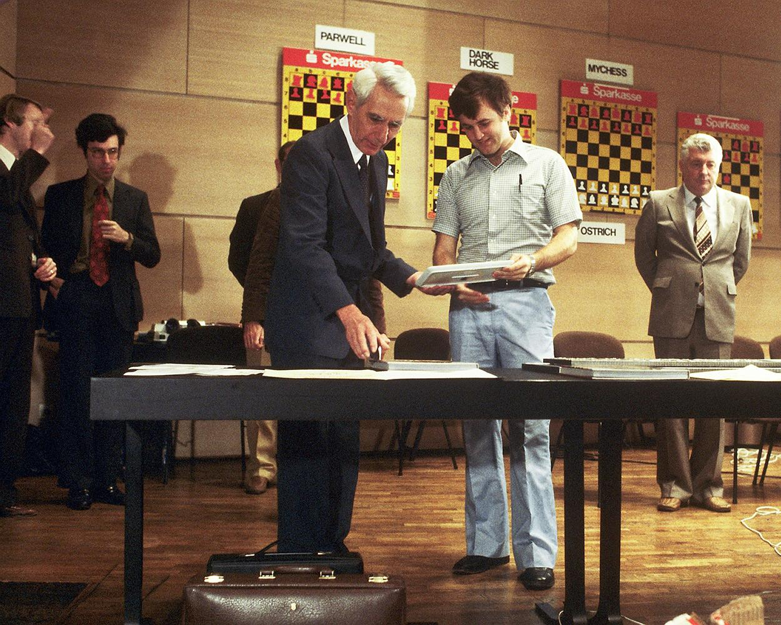
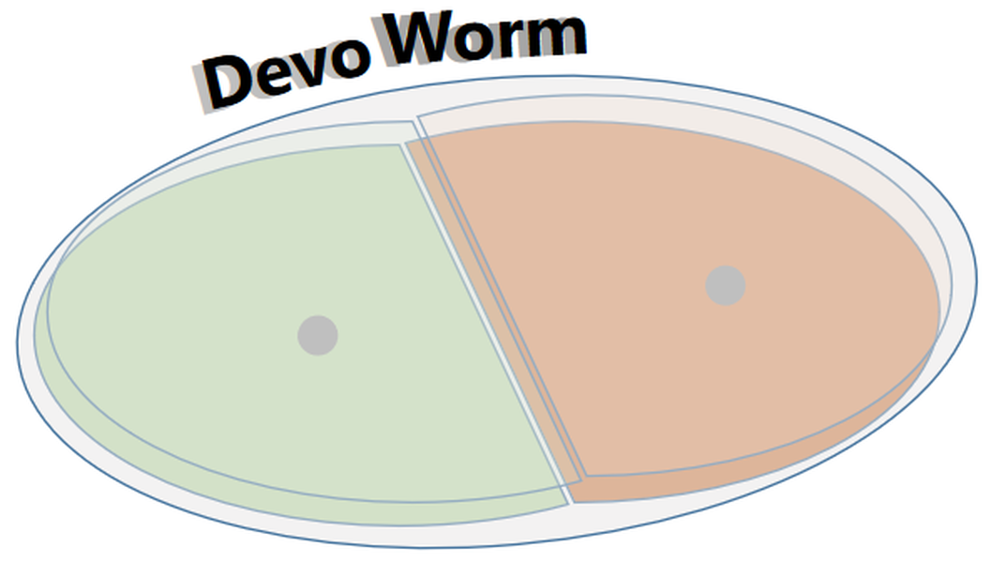
Thanks for your Attention!
Join us!
devoworm.weebly.com

