Slide 1




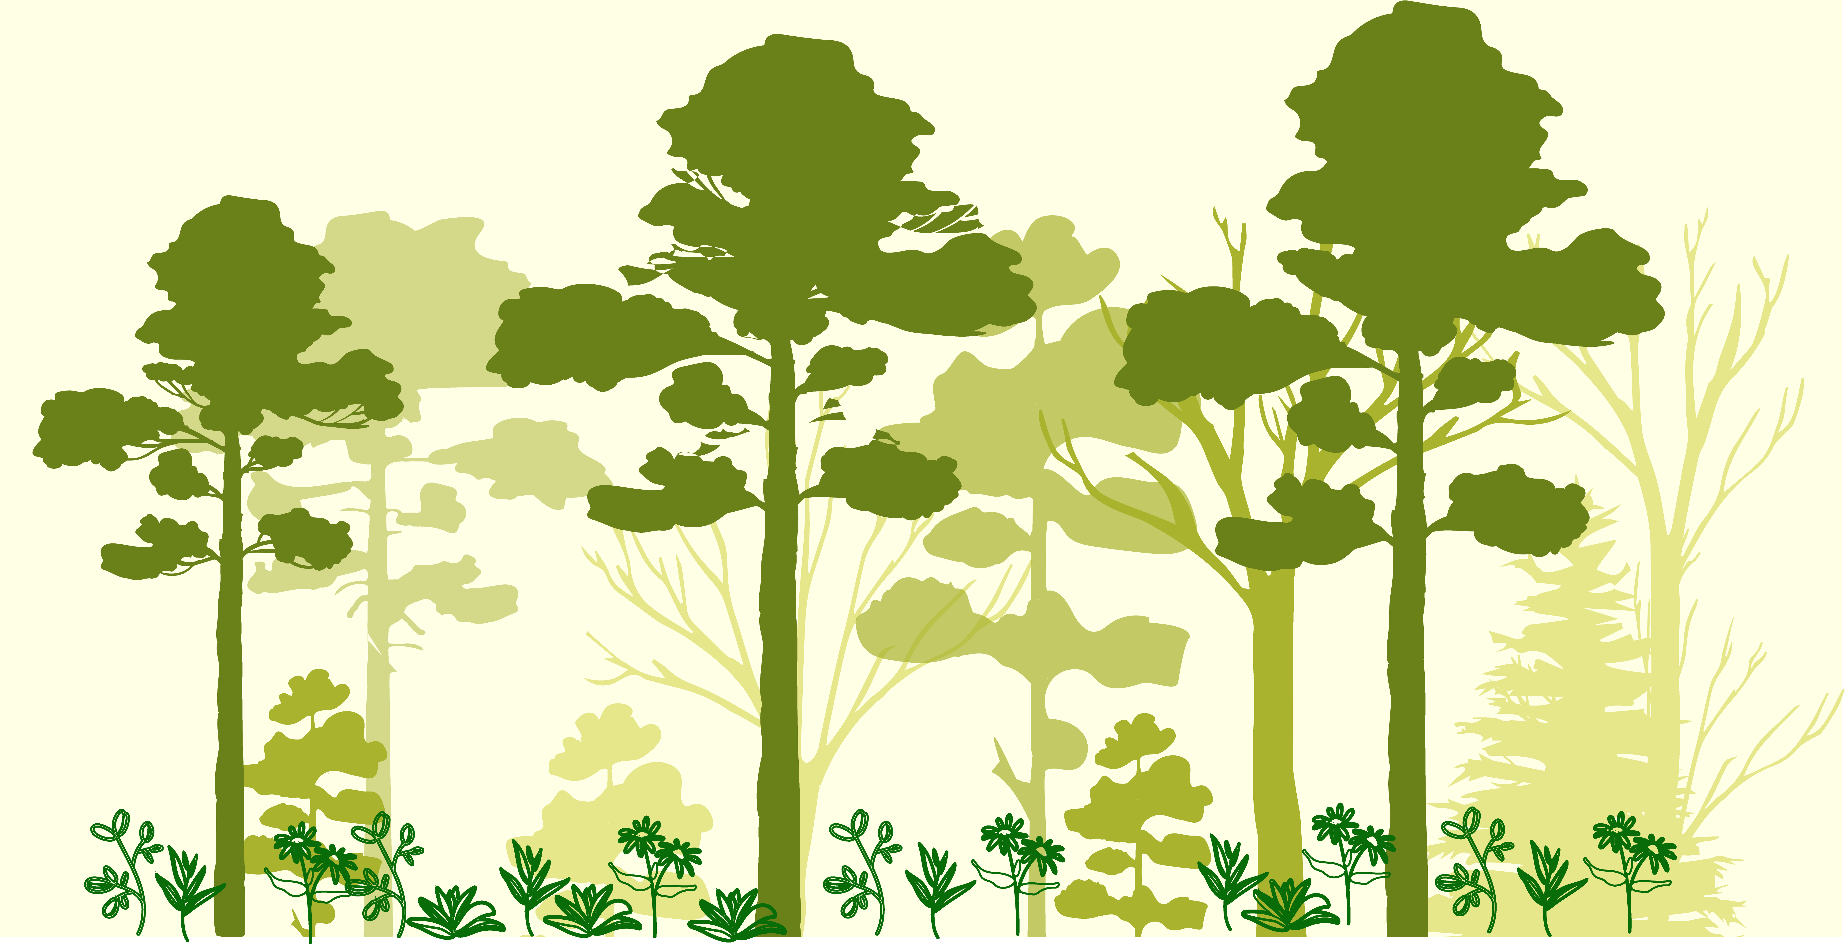
Jonathan Lenoir (CR1)
https://jonathanlenoir.wordpress.com/
@EkoLogIt
Ecologie et Dynamique
des Systèmes Anthropisés
UMR 7058 CNRS-UPJV
www.u-picardie.fr/edysan
The climatic debt is growing in the understory of temperate forests: Stand characteristics matter
Webinar Department of Ecology, Environment & Plant Sciences (DEEP) – Stockholm University – 15/04/2021

Slide 2
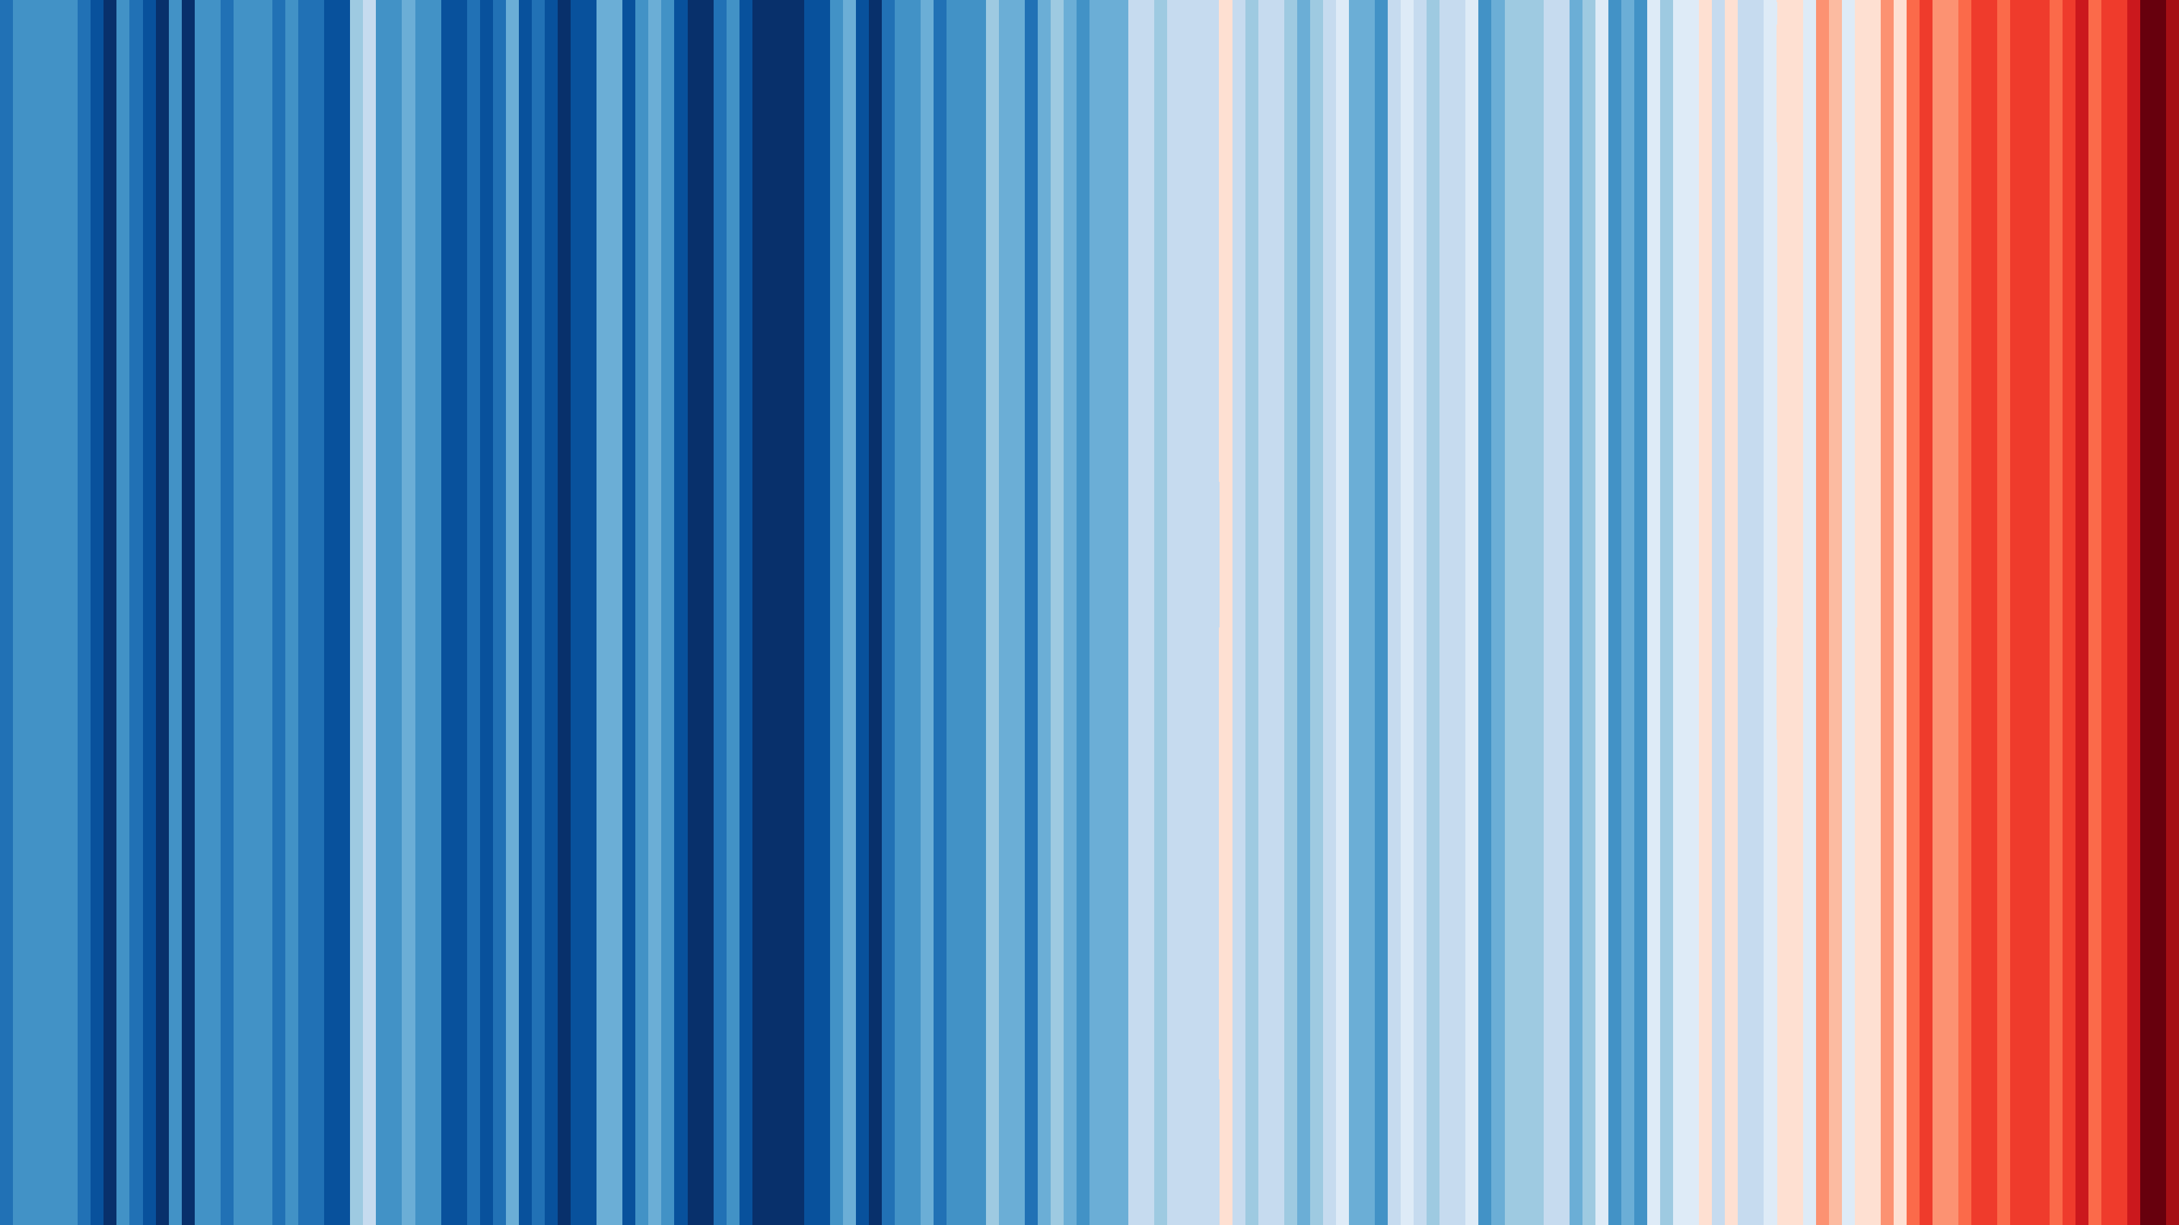
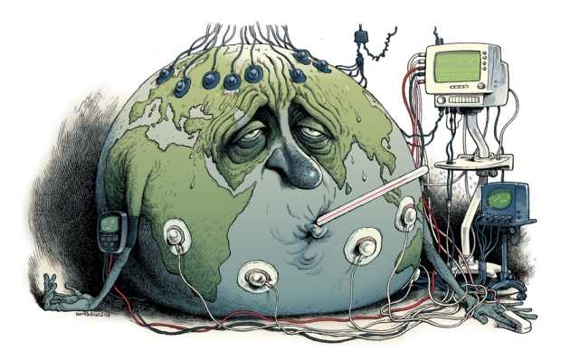
Context: Planet Earth has a fever!
Global mean annual T°C deviations from the 1961-1990 T°C average
1850
2017
Red and blue stripes depict positive and negative anomalies
Ed Hawkins – Stripes | David Parkins – Earth Fever Illustration

Slide 3
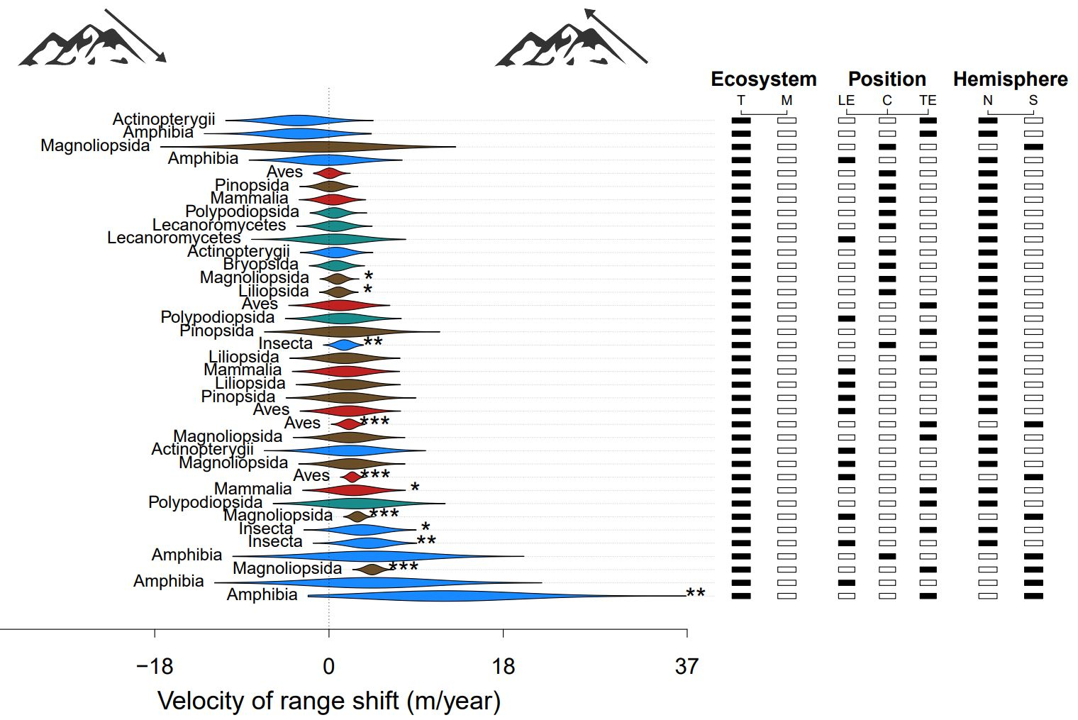
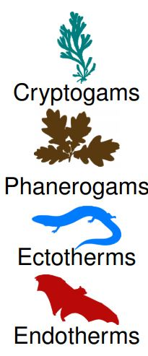
Context: And biodiversity is redistributing!
Terrestrial species are chiefly shifting upslope in mountains
1850
2017
But not fast enough to track the shifting isotherms (lag dynamics)
Lenoir et al. (2020) – Nature Ecology & Evolution

Slide 4
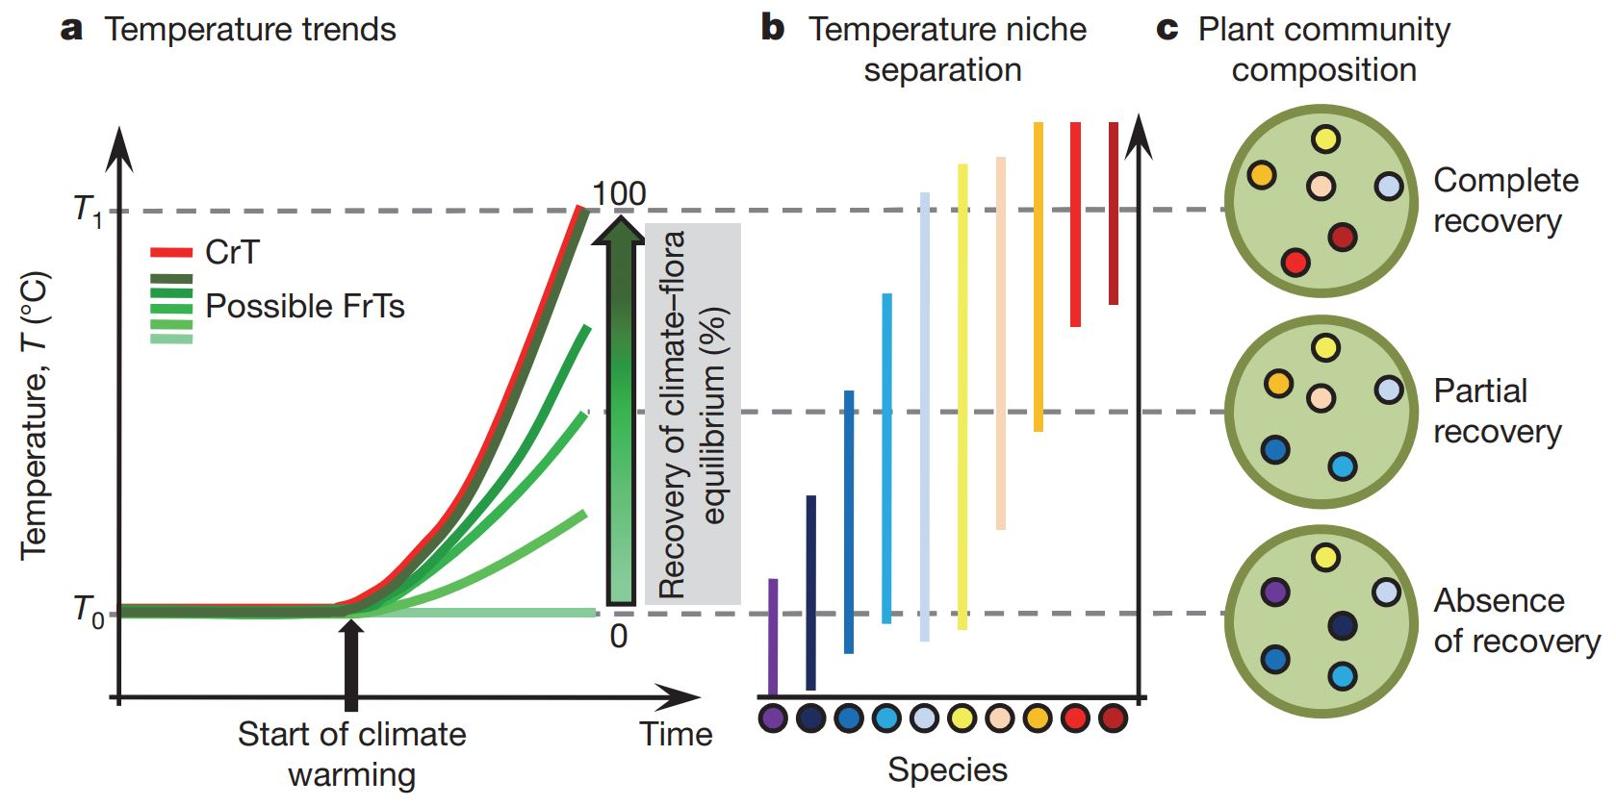
Context: While communities are reshuffled!
Communities gain/loose warm/cold-adapted species over time
1850
2017
This process is coined community thermophilization
Bertrand et al. (2011) – Nature | Gottfried et al. (2012) – Nature Climate Change

Slide 5
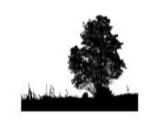

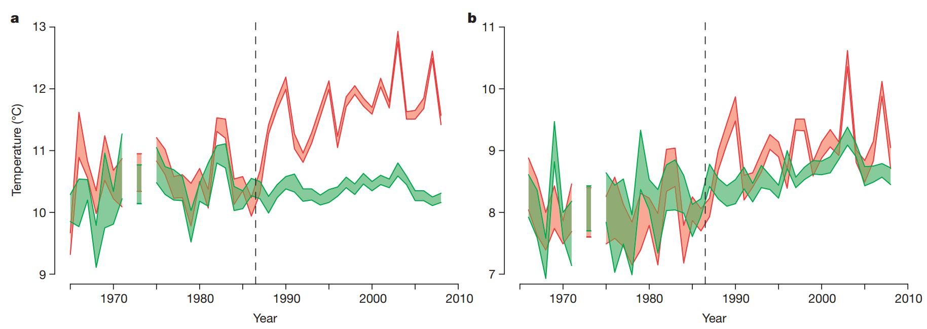
Context: Community thermophilization over time?
Are communities synchronously following macroclimate warming?
1850
Thermophilization of forest plant communities lags behind
2017
Blonder et al. (2017) – Ecology Letters | Bertrand et al. (2011) – Nature

Slide 6
Question: Has the macroclimatic debt grown?
Good & long-term time series of community composition changes are needed to understand the lagging dynamics in forest systems
Several studies assessing the macroclimatic debt of understory plant communities in forests relied on non-permanent plots
The few studies relying on true permanent plots where limited in the number of re-surveys with usually one re-survey (t1 – t2)
2017
The main determinants of the macroclimatic debt are poorly understood due to a lack of long-term biodiversity time series
Richard et al. (Accepted) – Global Ecology & Biogeography

Slide 7
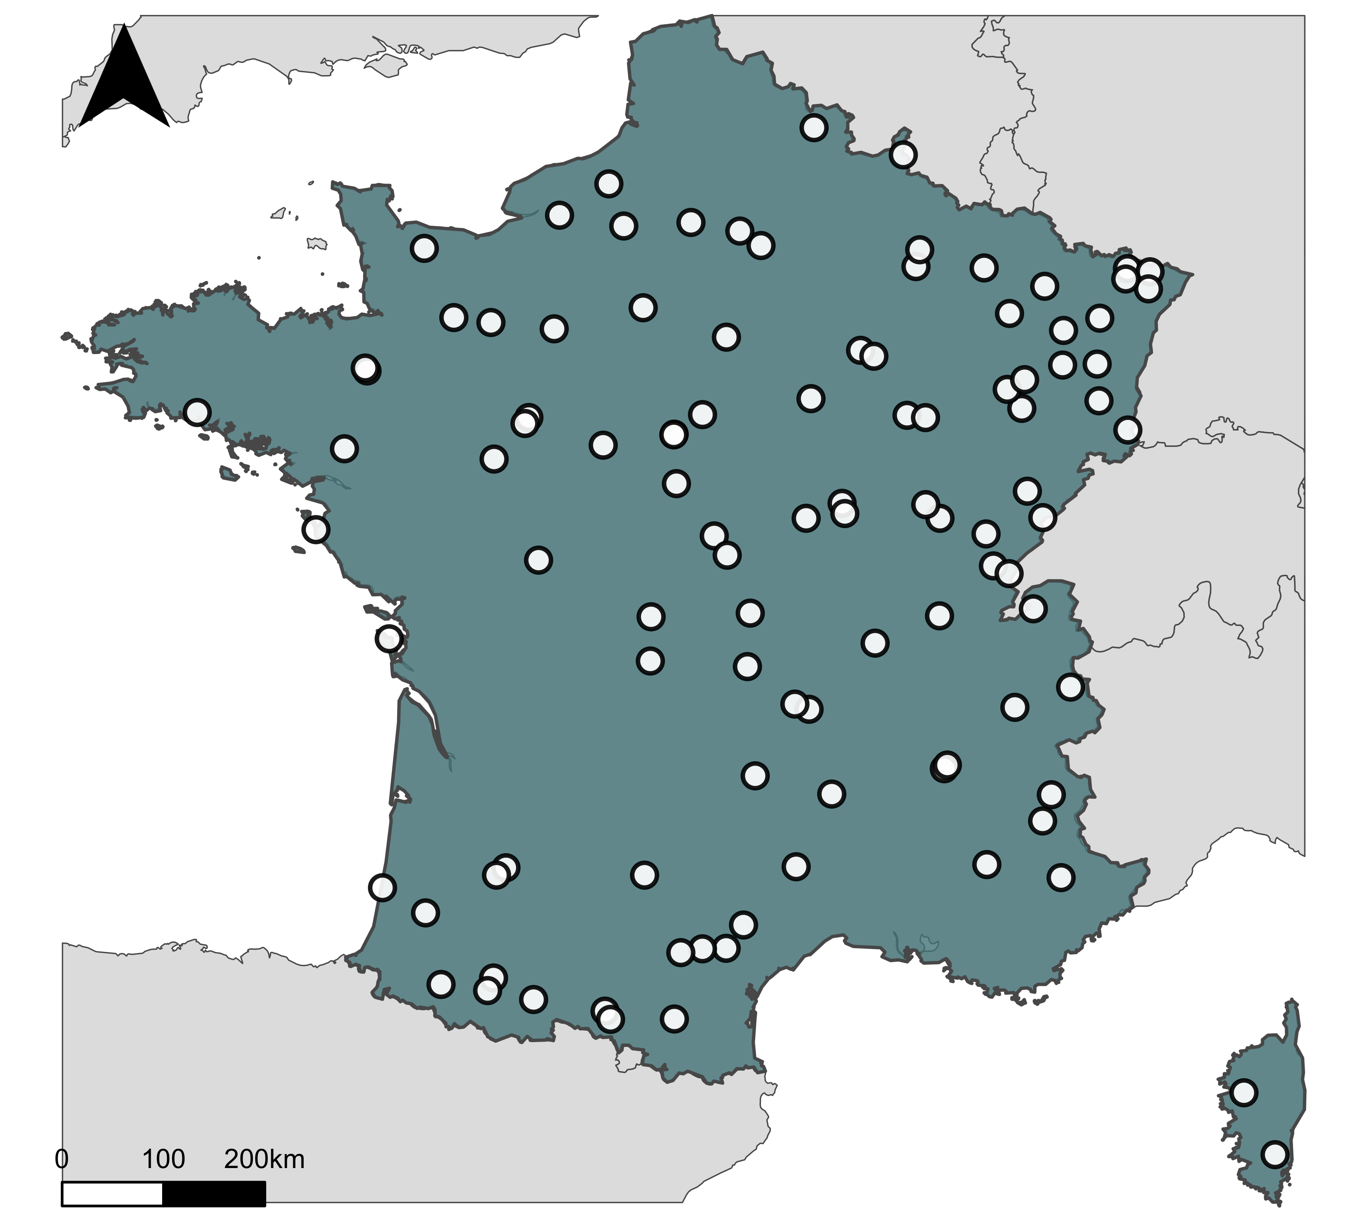
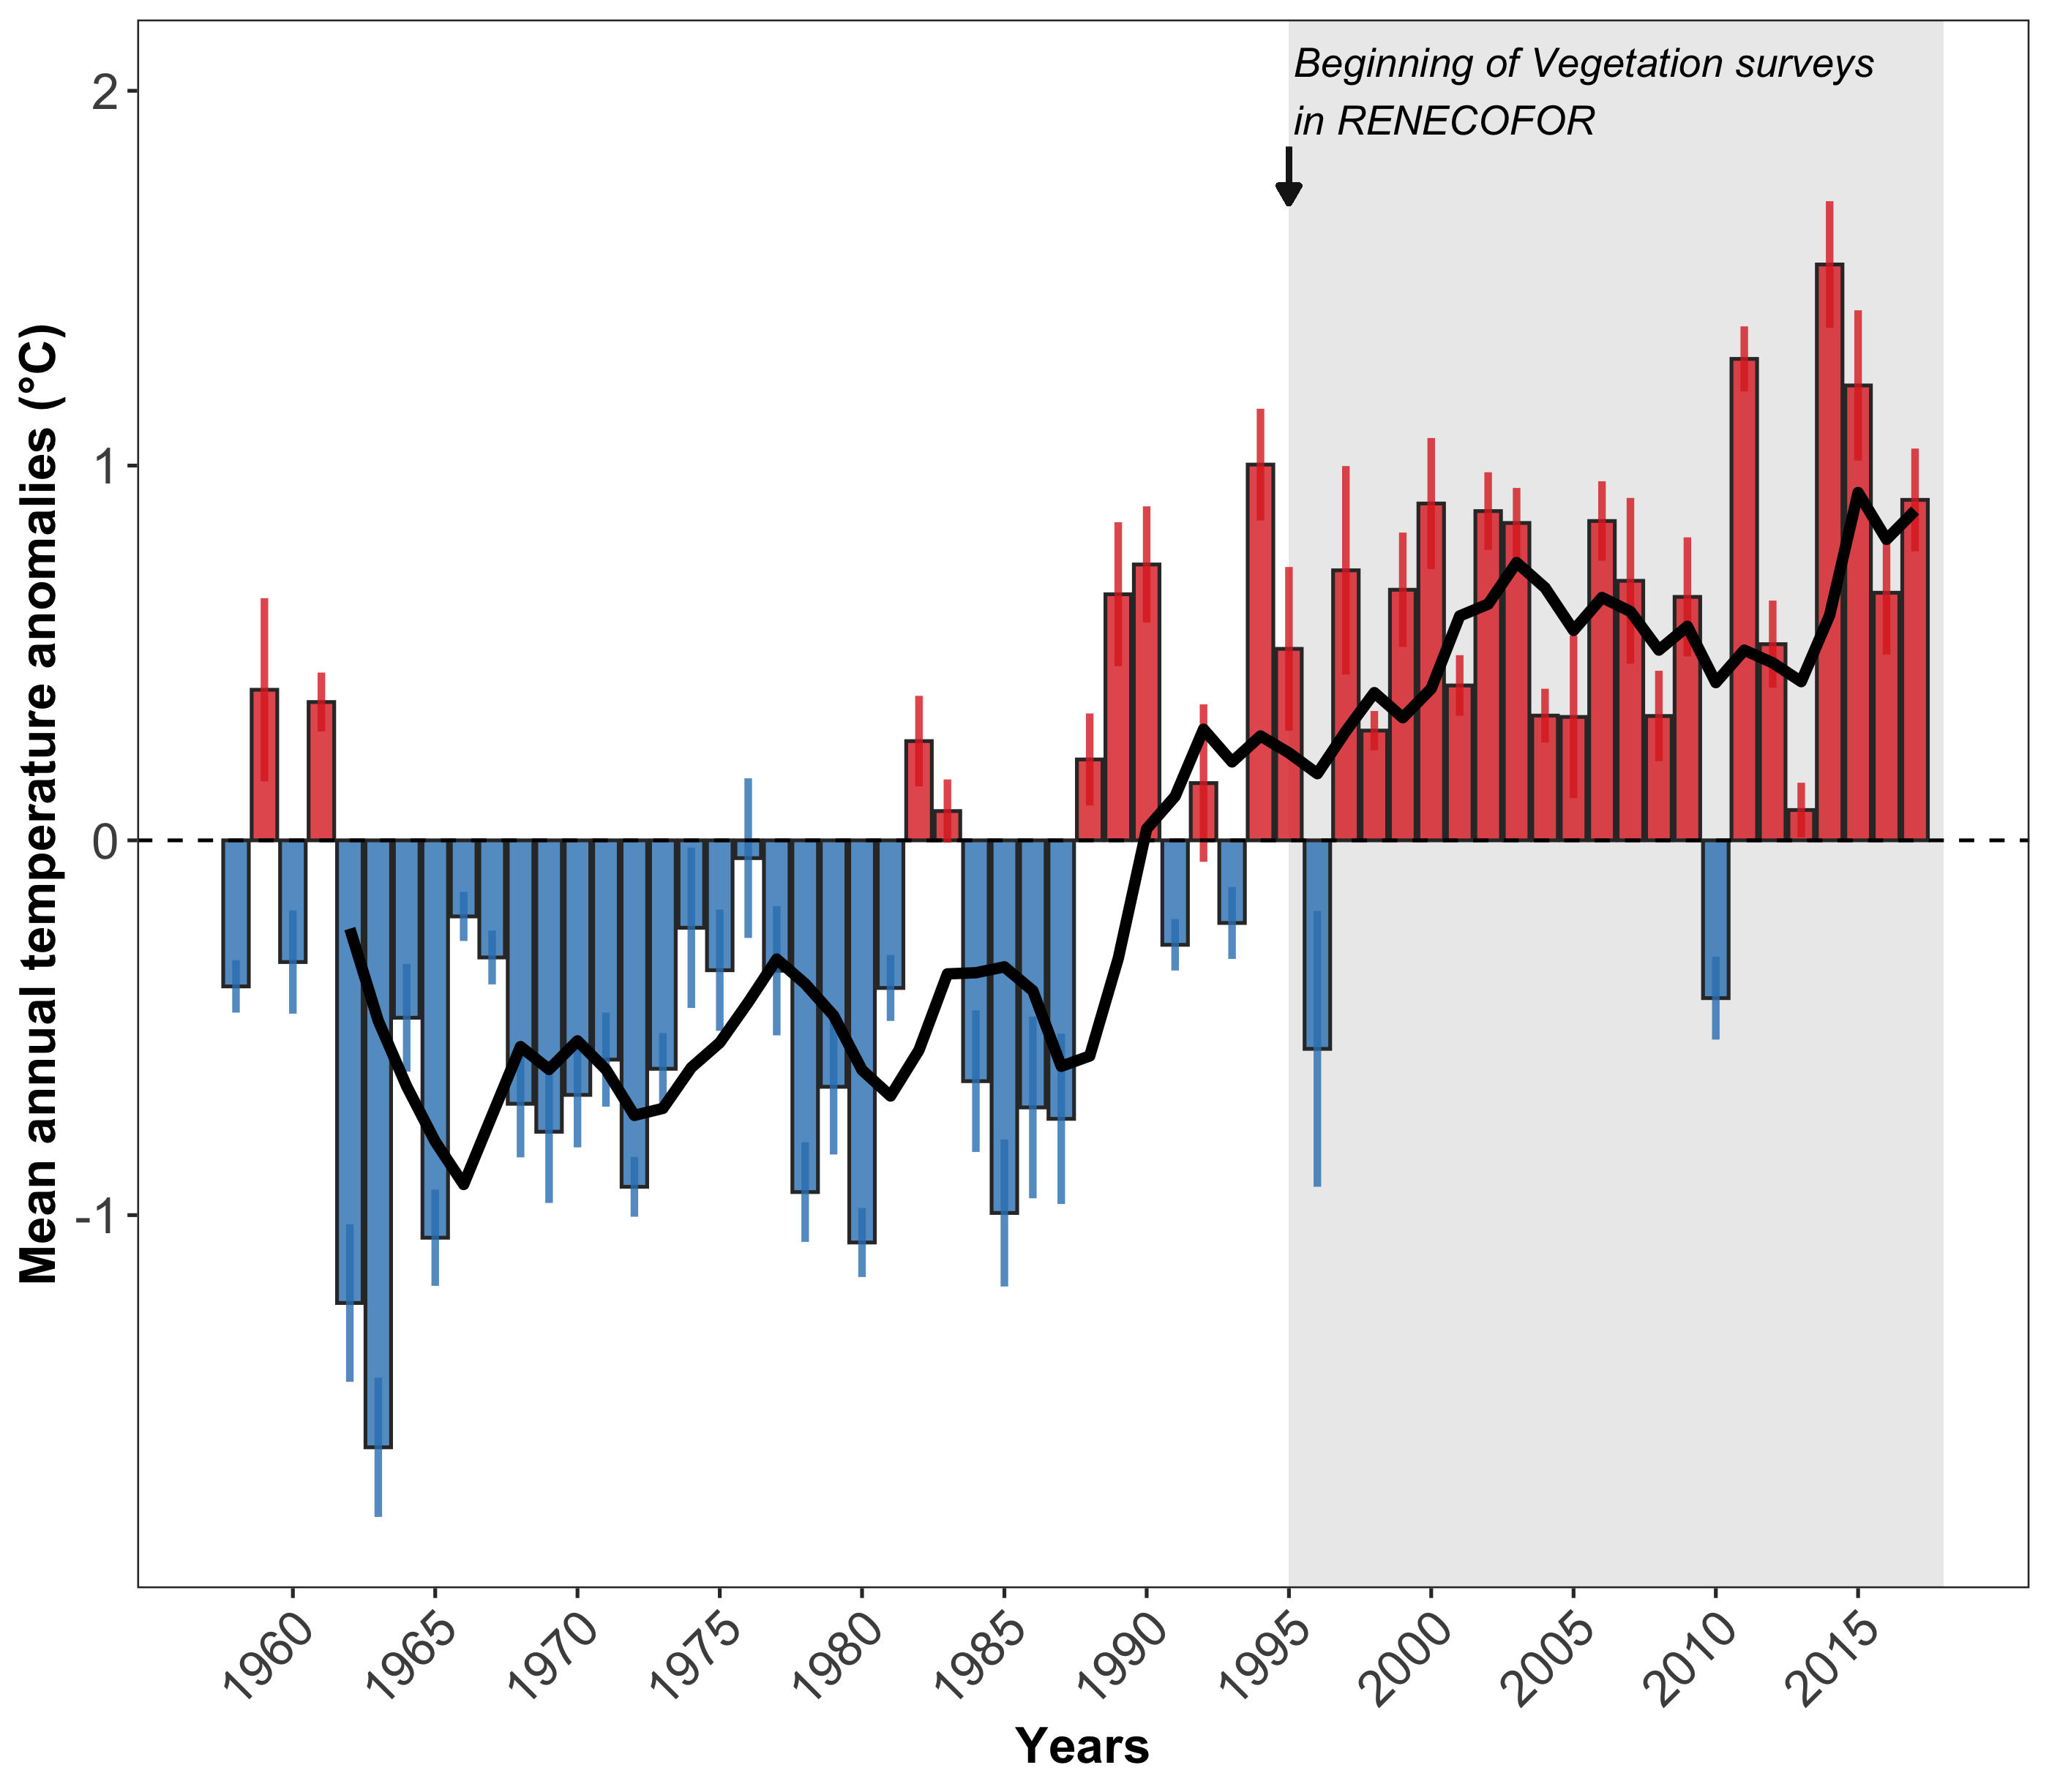

Materials: The RENECOFOR network
Long-term monitoring network such as the ICP Forest (& the French part called RENECOFOR) gives opportunities for assessing long-term plant community changes in the context of climate warning
2017
RENECOFOR sites are monitored, at least, every 5 years since 1995
Manuel Nicolas – ONF | Richard et al. (Accepted) – Global Ecology & Biogeography

Slide 8
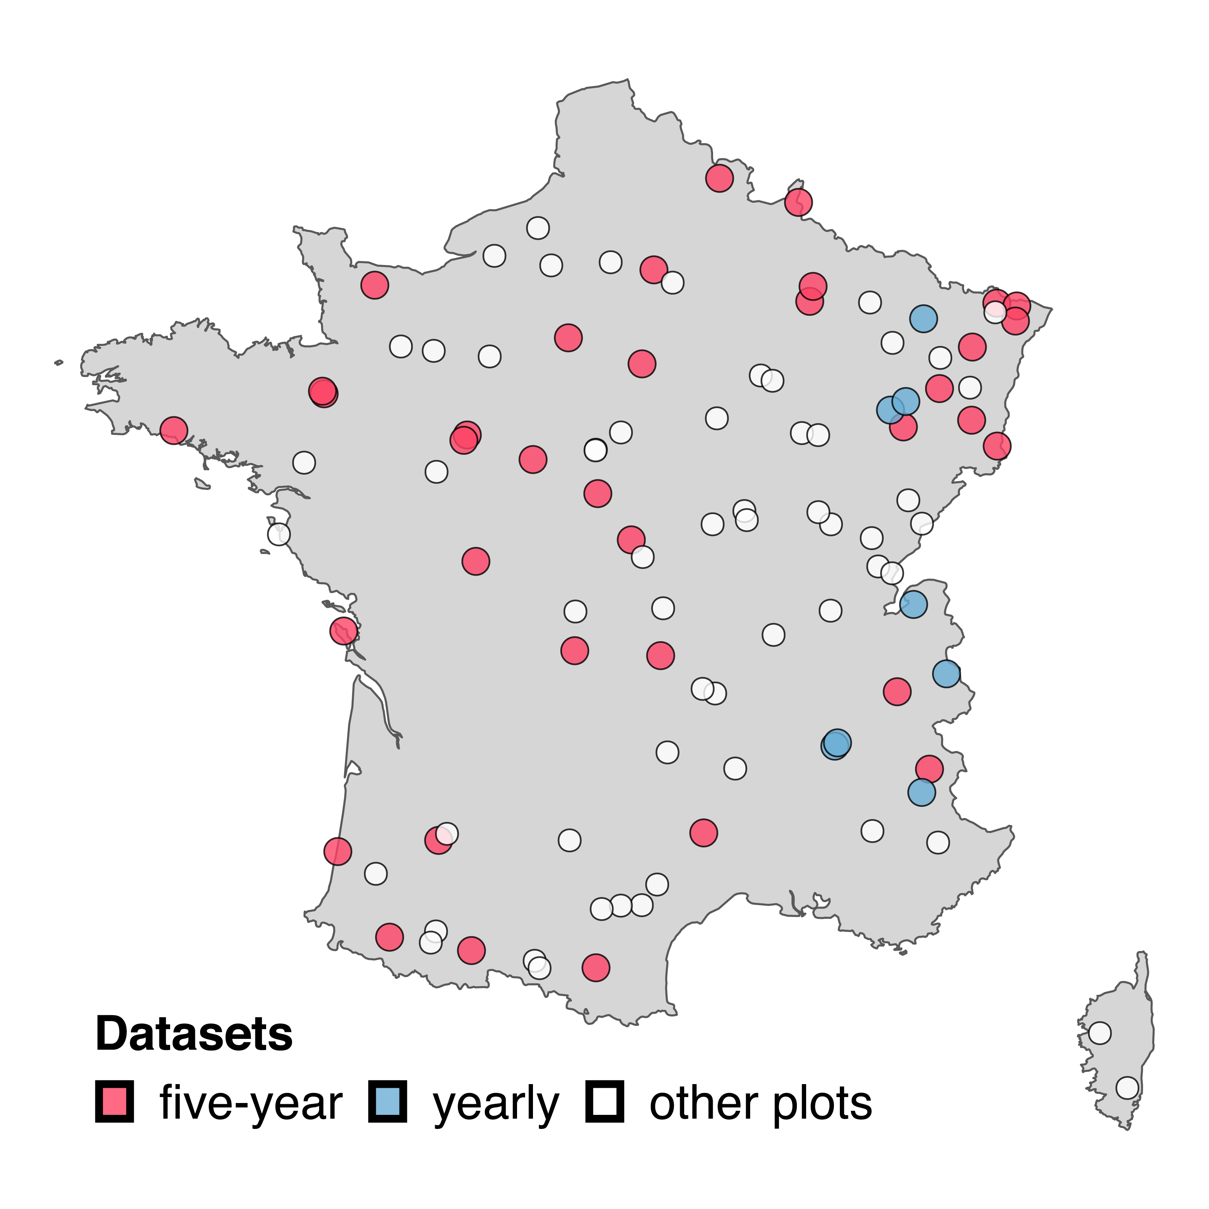
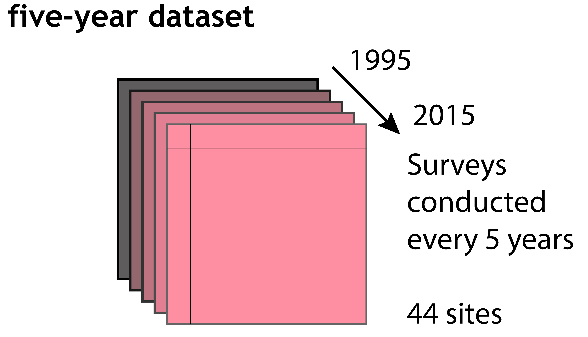
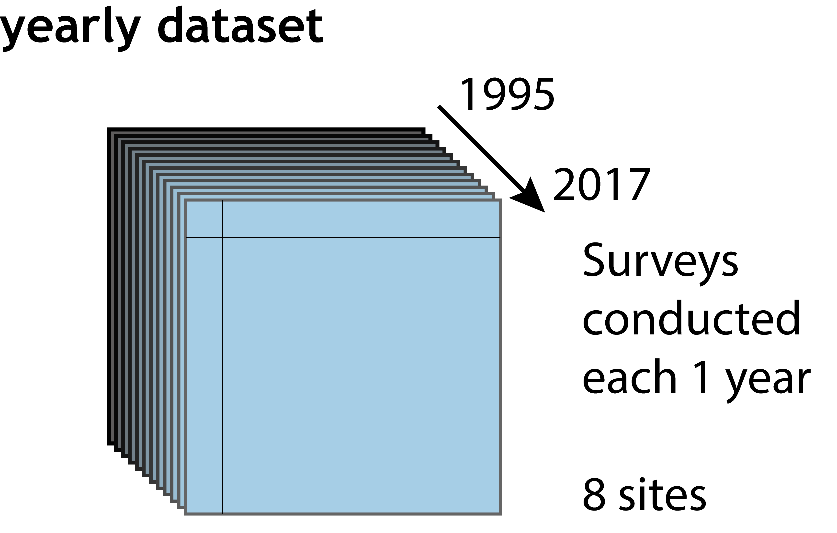
Materials: Data selection
A total of 102 sites from which we removed incomplete time series
Each sites contains 8 permanent vegetation plots of 100 m² each, of which 4 are inside the fenced area vs. 4 outside it (no pooling here)
Richard et al. (Accepted) – Global Ecology & Biogeography

Slide 9
Materials: High-resolution time series
Focus on the 8 sites with a high temporal resolution (yearly dataset)
Multiple surveys (e.g. spring + summer) were pooled together
Richard et al. (Accepted) – Global Ecology & Biogeography

Slide 10
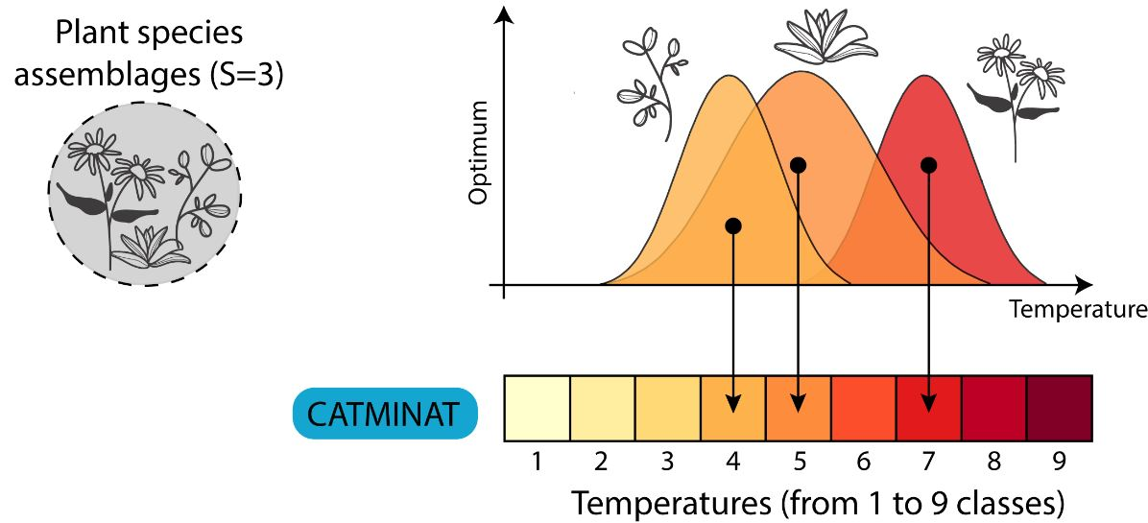
Methods: The community temperature index (CTI)
We used plant indicator values (IVs) ranging from 1 to 9 (similar to Ellenberg IVs) from the CATMINAT database to compute CTI values
Ellenberg (1974) – Scripta Geobotanica | Philippe Julve – CATMINAT

Slide 11
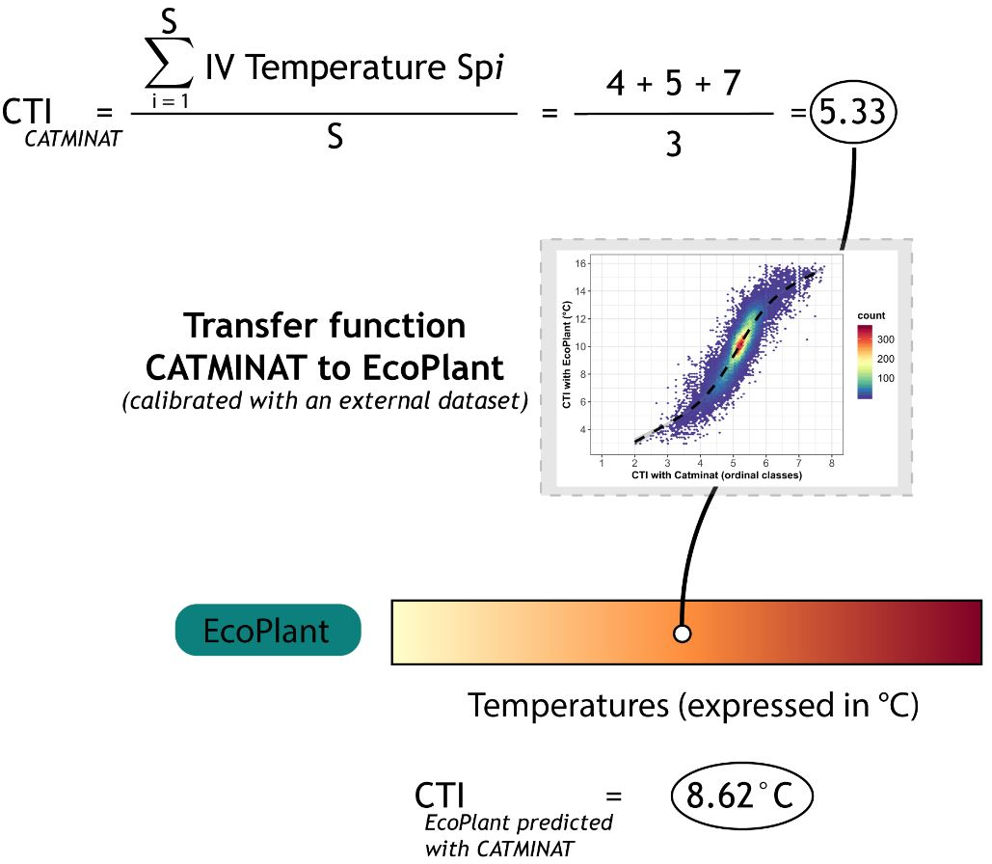
Methods: Converting CTI values in °C
We used another database of plant IVs (Gégout 2007), covering less species but expressed in °C, to build a transfer function
Gégout (2007) – HDR | Richard et al. (Accepted) – Global Ecology & Biogeography

Slide 12
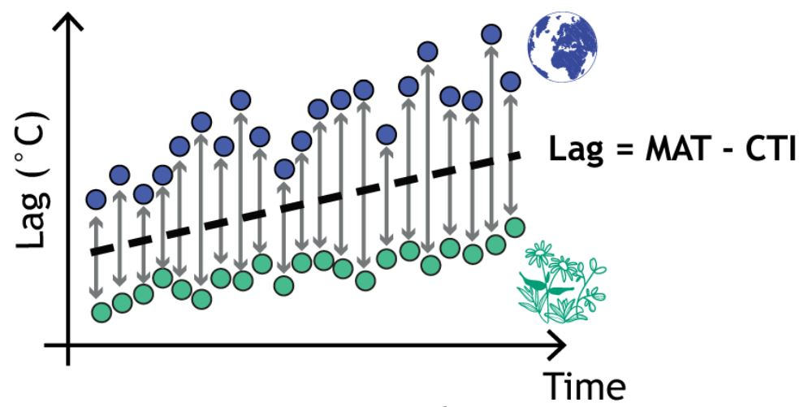
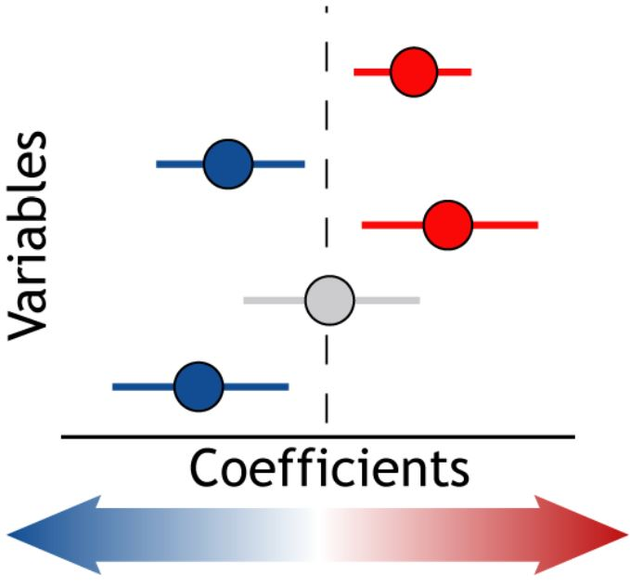
Methods: Analysing the lag over time
Computing the difference between macroclimatic temperatures (MAT) (°C) & CTI values (°C) over time: Lag = MAT – CTI
Analysing the temporal dynamic of the lag (aka the macroclimatic debt) to test for accumulation effect while accounting for other potential determinants related to local conditions in the forest understory (e.g. stand structure)
Richard et al. (Accepted) – Global Ecology & Biogeography

Slide 13
Methods: The main determinants of the lag
In addition to testing the effect of time (year) on the lag, we tested baseline conditions, stand characteristics & forest disturbances
Baseline T°C (mean conditions during 1960-1990 & prior to 1995)
Stand type (deciduous vs. coniferous)
Stand basal area
Stand age
Anteriority of the last disturbance event
Sum of anthropogenic disturbances prior to the survey year
Herbivory effect (inside vs. outside the fenced area)
Richard et al. (Accepted) – Global Ecology & Biogeography

Slide 14
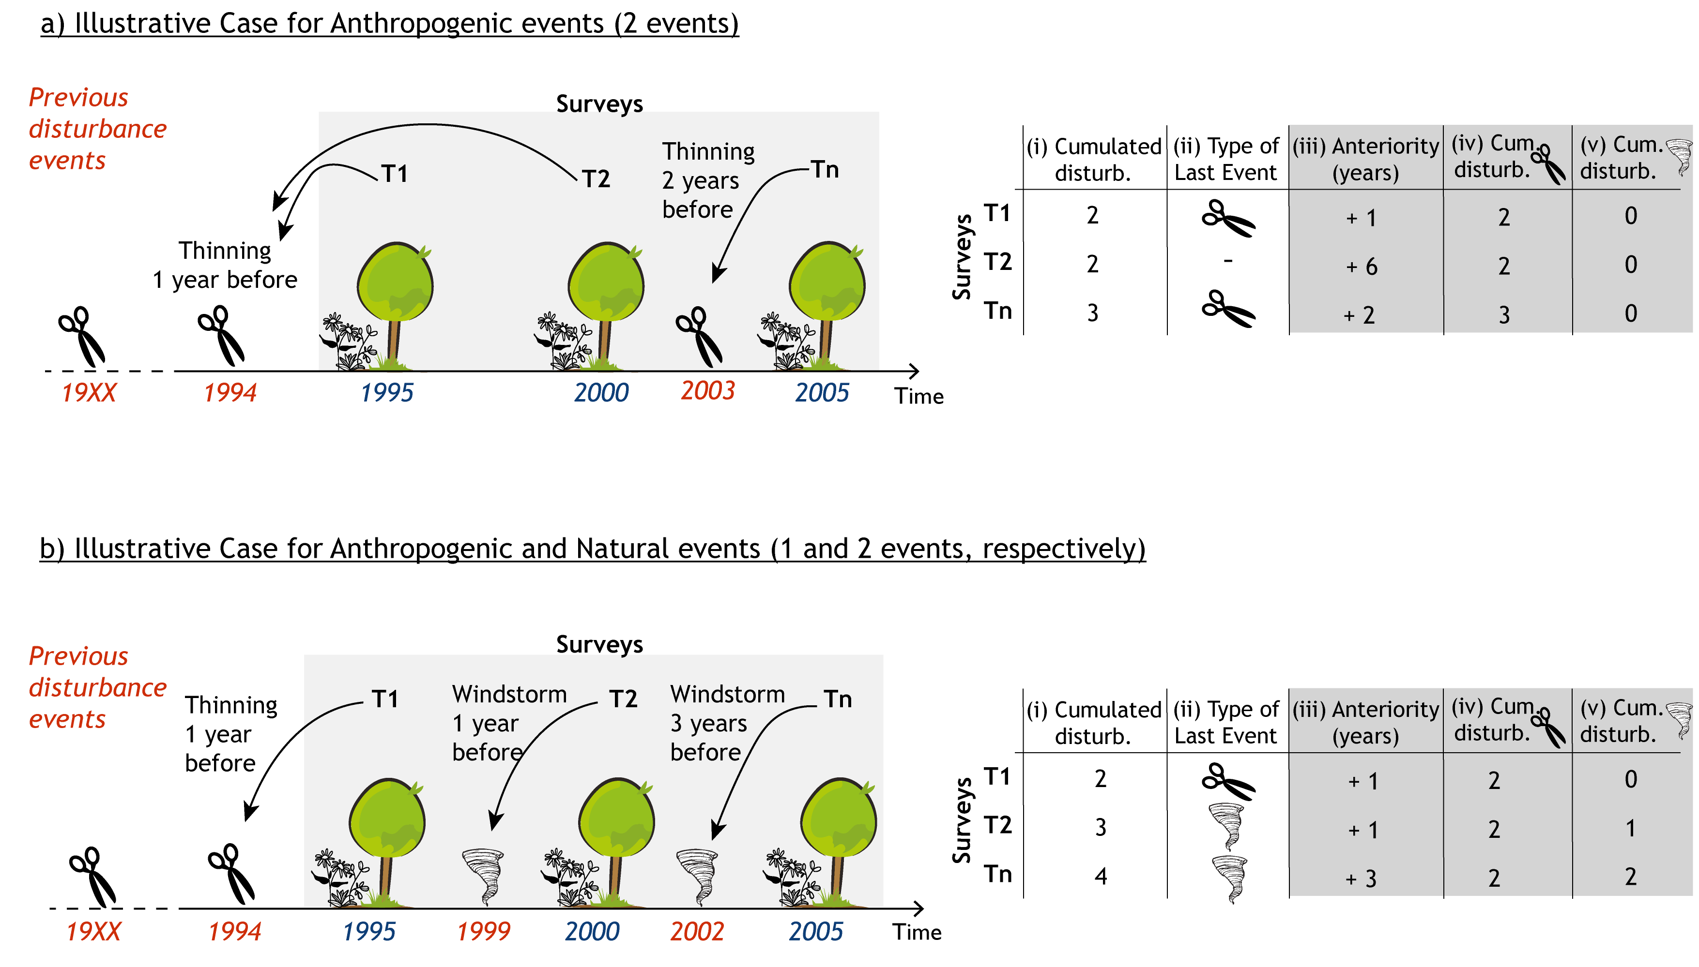
Methods: Assessing forest disturbances
Richard et al. (Accepted) – Global Ecology & Biogeography

Slide 15
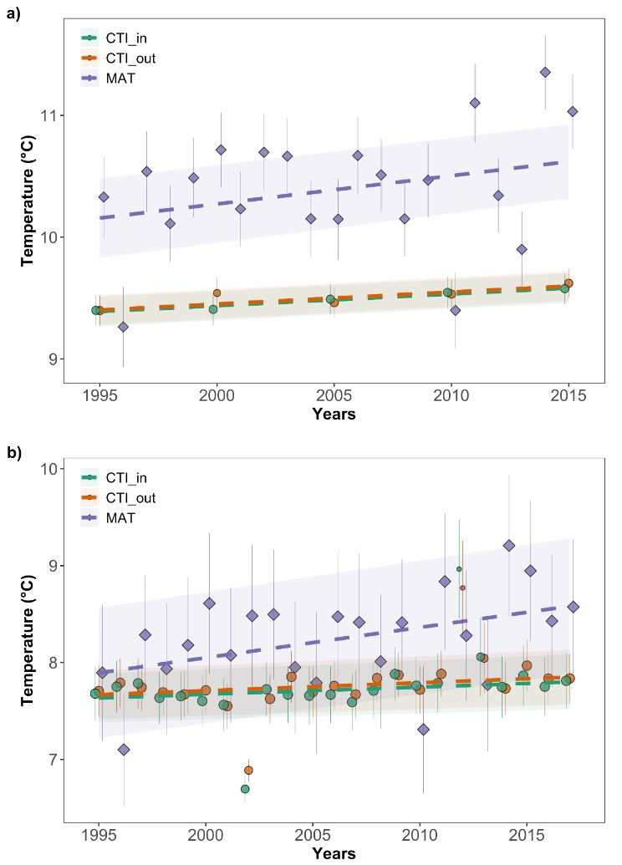
Results: A growing debt!
As expected, the lag in the forest understory is growing over time!
Richard et al. (Accepted) – Global Ecology & Biogeography

Slide 16
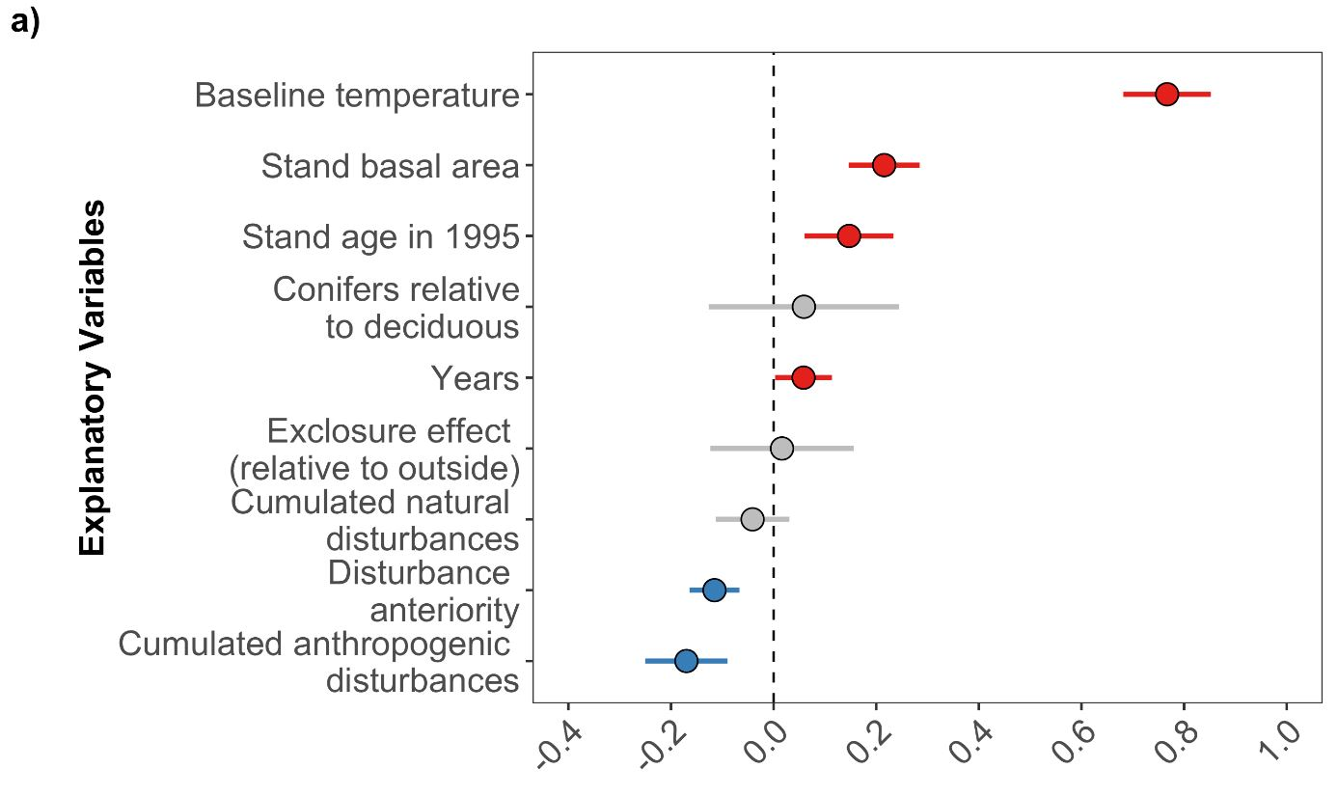
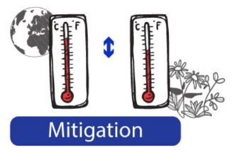
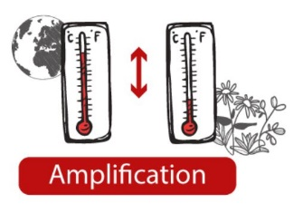
Results: Amplifying & mitigating effects
The main determinants of the lag in the forest understory (5-yr set)
Richard et al. (Accepted) – Global Ecology & Biogeography

Slide 17
Results: Baseline conditions matter
The lag decreases towards colder baseline conditions (cf. highlands)
Richard et al. (Accepted) – Global Ecology & Biogeography

Slide 18
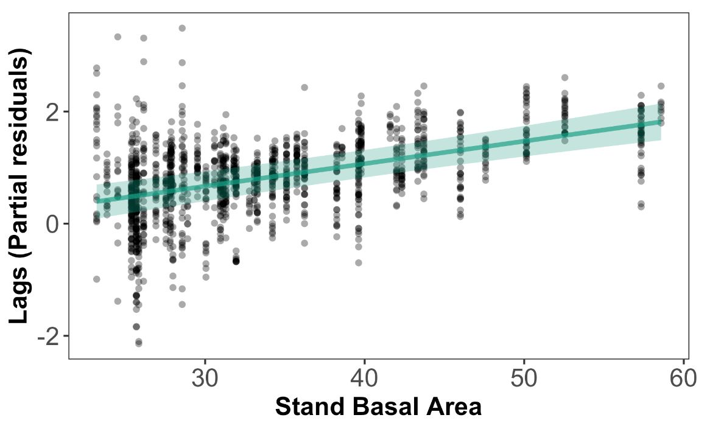
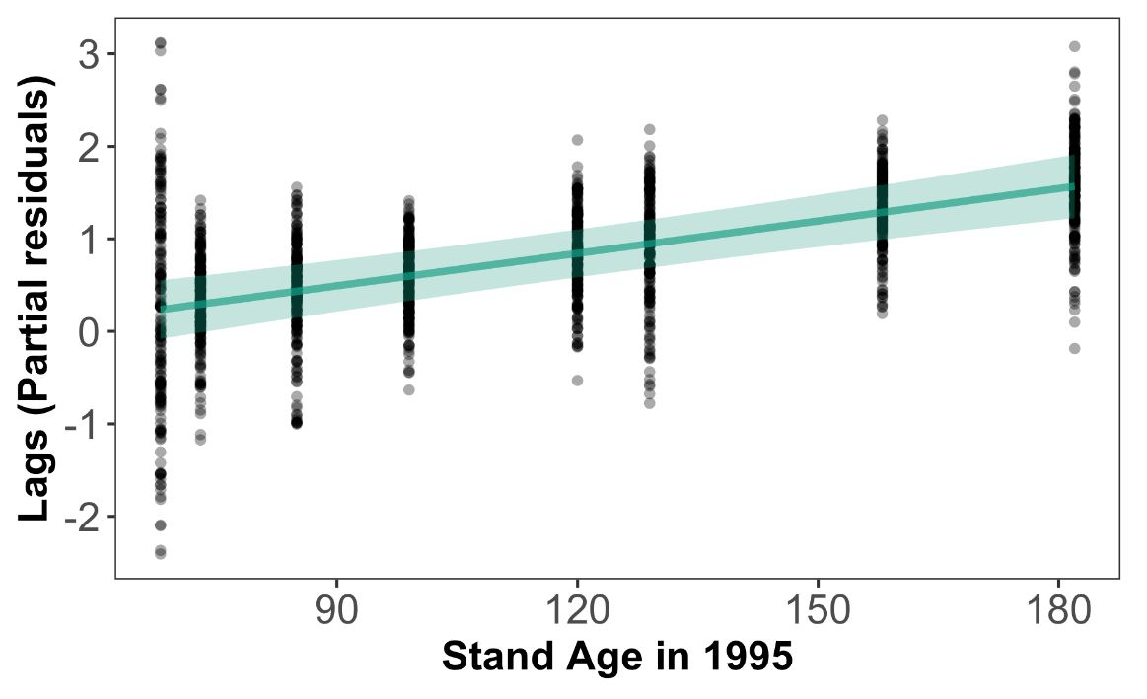
Results: Stand characteristics matter
The lag is greater in denser and older stands (buffering effect)
Richard et al. (Accepted) – Global Ecology & Biogeography

Slide 19
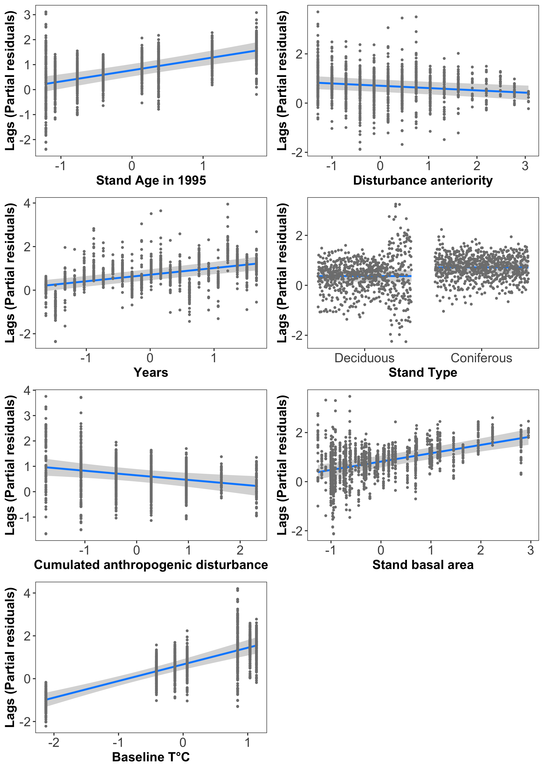
Results: Forest disturbances matter
Disturbances allow to recouple plant communities to macroclimate
old
recent
---
+++
Richard et al. (Accepted) – Global Ecology & Biogeography

Slide 20
Take home message: Local factors matter!
Long-term biodiversity monitoring allows to produce high-quality time series of thermophilization processes & lagging dynamics
The macroclimatic debt (or lag) of understory plant communities in temperate forests grows over time
Baseline macroclimatic conditions is a key driver but it could hide a regional species pool effects (missing IVs for southern colonizers)
Local stand conditions are key to increase the buffering capacity of the upper canopy layer so that understory plants can resist/persist
Local disturbances (chiefly anthropogenic ones) & gap dynamics in the upper canopy layer can suddenly recouple the herbaceous layer with macroclimate → The macroclimatic debt is paid off
Richard et al. (Accepted) – Global Ecology & Biogeography

Slide 21
Jonathan Lenoir (CR1)
https://jonathanlenoir.wordpress.com/
@EkoLogIt
Ecologie et Dynamique
des Systèmes Anthropisés
UMR 7058 CNRS-UPJV
www.u-picardie.fr/edysan
Thank you for your attention
Do you have any questions?
Webinar Department of Ecology, Environment & Plant Sciences (DEEP) – Stockholm University – 15/04/2021

