Slide 1
A full text collection of COVID-19 preprints in Europe PMC using JATS XML
Audrey Hamelers
Michael Parkin
Literature Services, EMBL-EBI
Notes:
Thank you very much for the introduction. It’s my pleasure to talk to you about a project that’s been an unexpected but significant focus of our team over the last year where we’ve been working to create a full-text collection of preprints relevant to COVID-19 tagged in JATS.

Slide 2
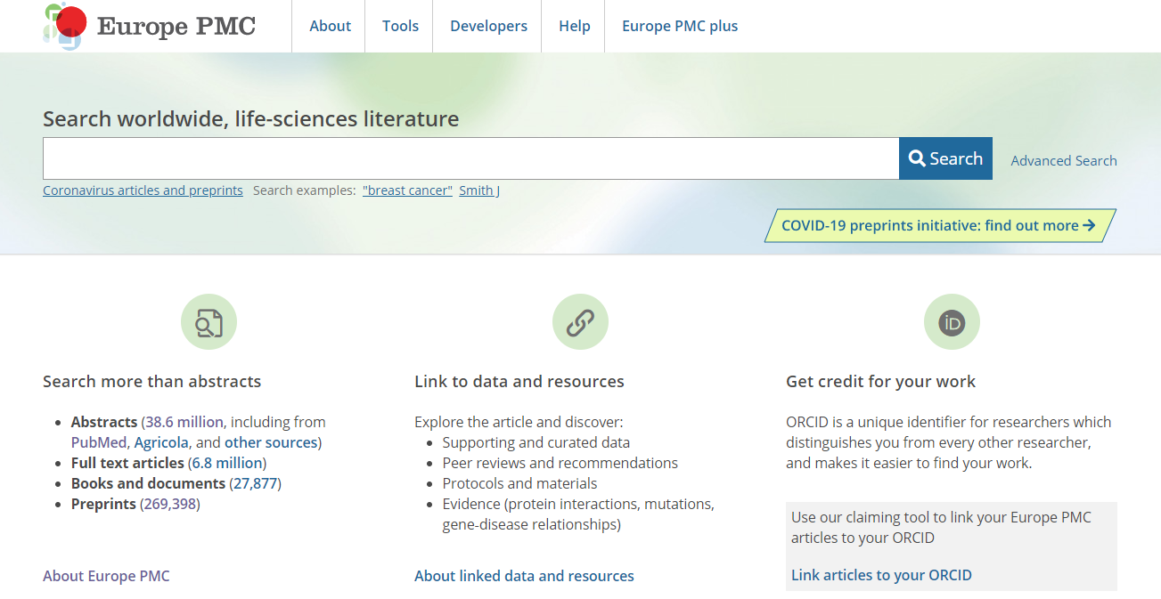
What is Europe PMC?
Free digital archive of biomedical and life science research publications
Notes:
So at the EBI both myself and Audrey work on Europe PMC, and as a quick introduction for those who aren’t familiar, Europe PMC is an open archive of biomedical and life sciences research publications. We’re a member of PubMed Central International, which means that PMC shares with us their full-text articles, which are either tagged in JATS, or the NLM DTDs for older content. The majority of these XMLs and the associated figures and supplementary files are supplied to PMC by publishers, but there’s a smaller but appreciable set of manuscripts that are deposited by authors via either the NIH’s manuscript submission system, or an analogous submission system that we run called “Europe PMC plus”.

Slide 3
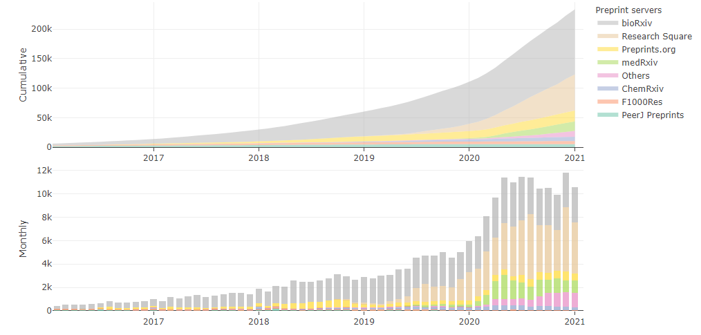
Preprints in the life sciences
Interactive version: https://europepmc.org/Preprints#about-including-preprints
Notes:
In addition to the full-text content from PMC, we also include journal abstracts from PubMed, and since 2018 we’ve also been including preprint abstracts alongside the peer-reviewed literature. For anyone not familiar with preprints, they are academic manuscripts that are uploaded to a public server before they undergo peer review in a journal. One of the interesting aspects relevant to this talk is that preprints allow scientific results to be shared far more rapidly than journal publication because there isn’t a formal peer review process taking place.
We currently index around 270,000 preprint abstracts using metadata supplied by the server to Crossref when the server registers a DOI for the preprint. In total we index 18 preprint servers, and just under half of the abstracts are from a preprint server called ‘bioRxiv’, where the preprints are generally uploaded by authors, with the second largest being ‘Research Square’ where preprints are predominantly uploaded by a publisher.

Slide 4
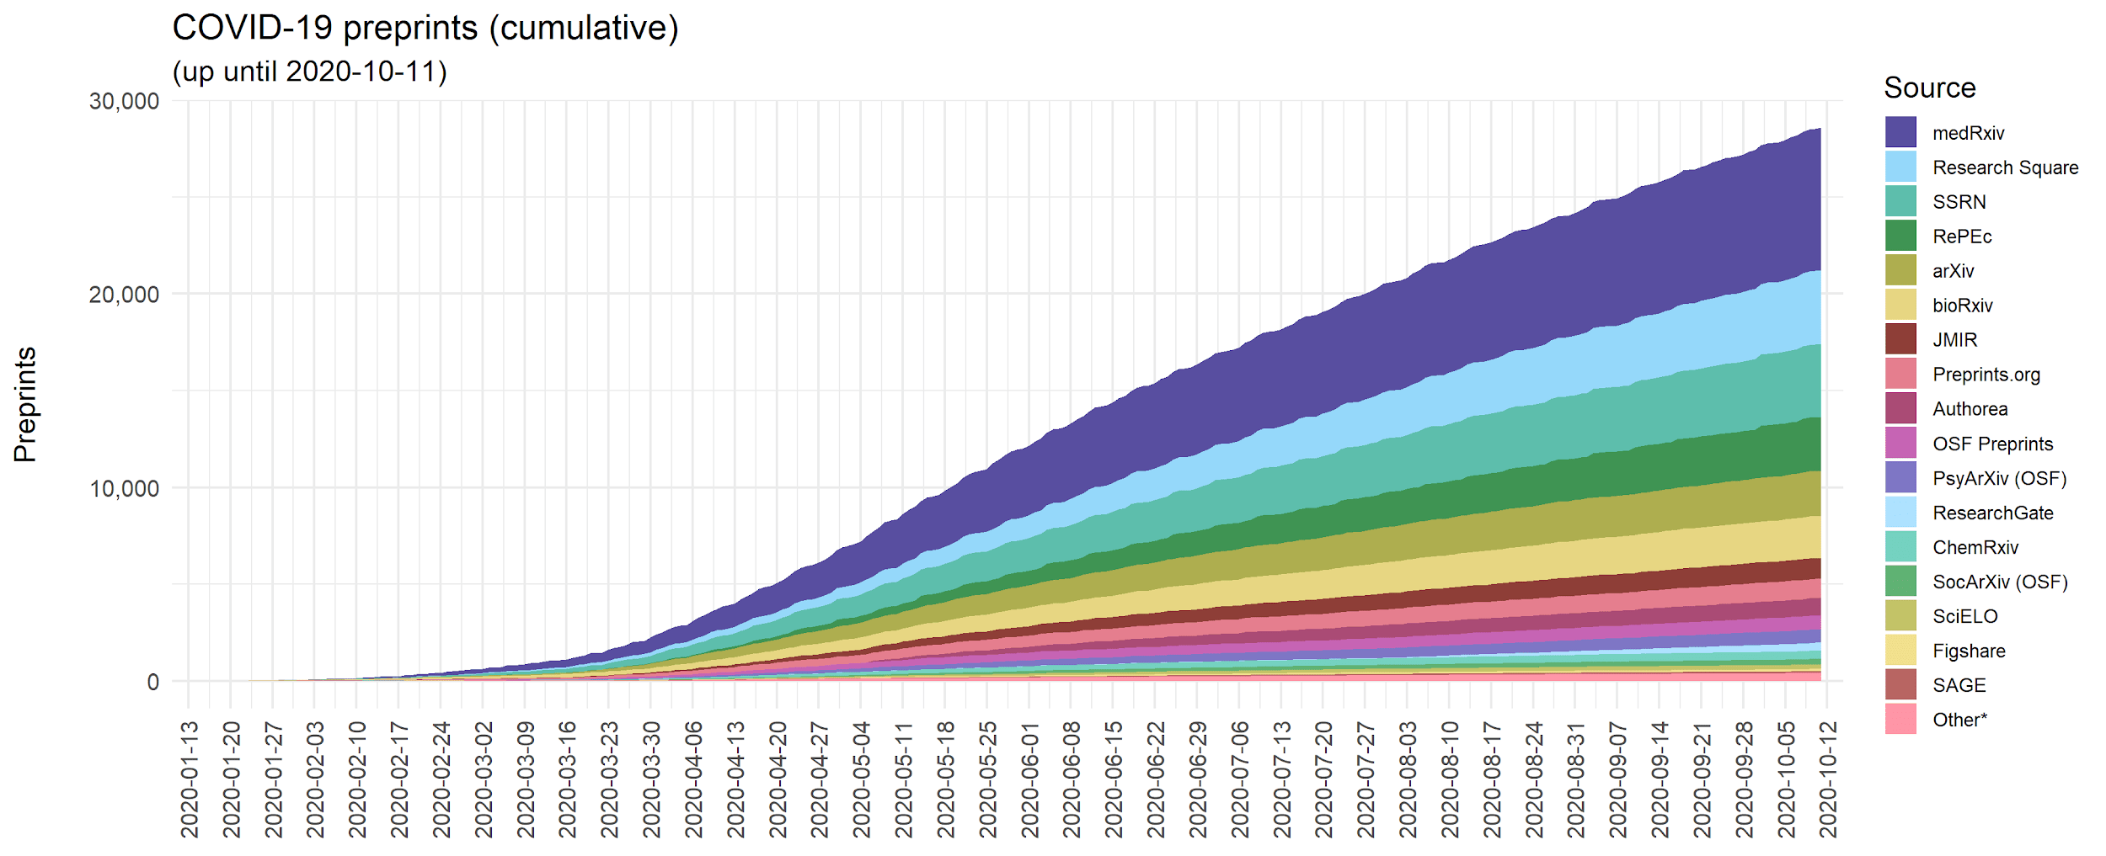
COVID-19 preprints
Fraser, Nicholas; Kramer, Bianca (2020): covid19_preprints. figshare. Software. https://doi.org/10.6084/m9.figshare.12033672.v35
Notes:
In the context of the pandemic we still find ourselves in, preprints have played a significant role in making research results available quickly. This graph looks at COVID-19 preprint publication over time and there are two things to draw your attention to:
i) Firstly, we start to see a significant number of COVID-19 preprints being published from late-March; which is, considering the timescale of the pandemic, is quite a short lag time.
ii) Secondly, this is quite a colourful graph, which reflects that preprints are published on a wide range of servers.

Slide 5
COVID-19 preprints project
Notes:
In March 2020, more than 50 publishers agreed to make all their COVID-19 full-text content freely available and accessible through PubMed Central. We really wanted to do whatever we could to help, and so as a complementary effort, in the Spring we proposed a project to convert COVID-19 preprints from a range of servers into JATS XML which happily received grant funding from Wellcome, the Medical Research Council here in the UK and the Swiss National Science Foundation. The bulk of this grant was to cover the XML conversion and QA costs. Given the growth in COVID-19 preprints we were seeing it was obvious that we needed a system that could handle processing these XMLs at scale.

Slide 6
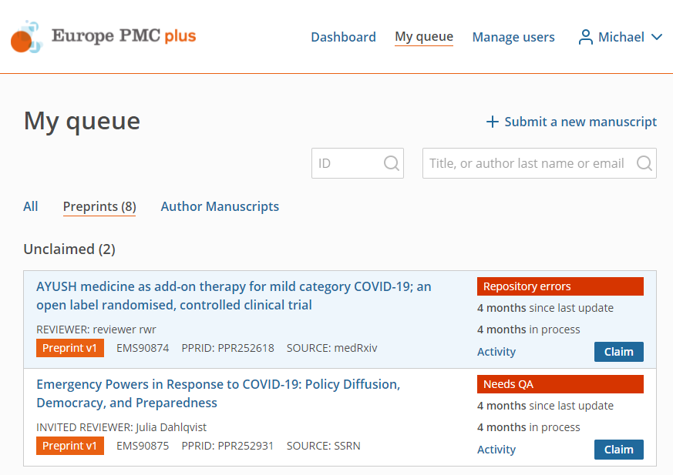
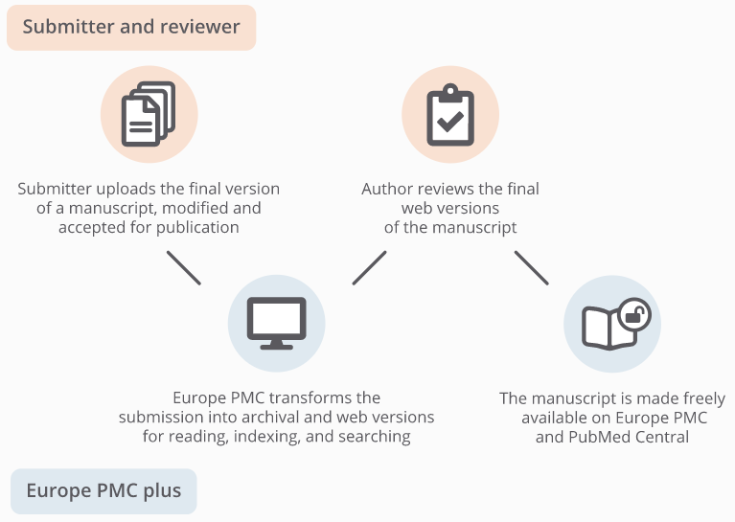
Europe PMC plus
1
3
2
4
PubSweet: https://coko.foundation/product-suite/
Notes:
So as I mentioned, we run a manuscript submission system called Europe PMC plus. This system is used by authors to upload their journal articles for inclusion in PMC in cases where the article isn’t supplied to PMC directly by the publisher. This is either to do with the article’s license, or simply that the publisher doesn’t have an agreement in place to send content to PMC.
Plus is a piece of open source software we’ve developed based on the PubSweet framework from the Coko Foundation and is essentially a combined submission and production system which consists of four main steps as you can see in the right-hand figure:
1. A submission wizard where an author uploads manuscript files (or a bulk workflow via FTP where manuscript packages and metadata XML file can be uploaded)
2. Mechanisms to send and receive file packages to and from an external XML tagging and Quality Assurance vendors
3. HTML rendering of the XML and in-browser annotation of the tagged files allowing the author to request any changes
4. Mechanisms to send the approved files with some associated metadata to the NCBI for inclusion in PMC and Europe PMC

Slide 7
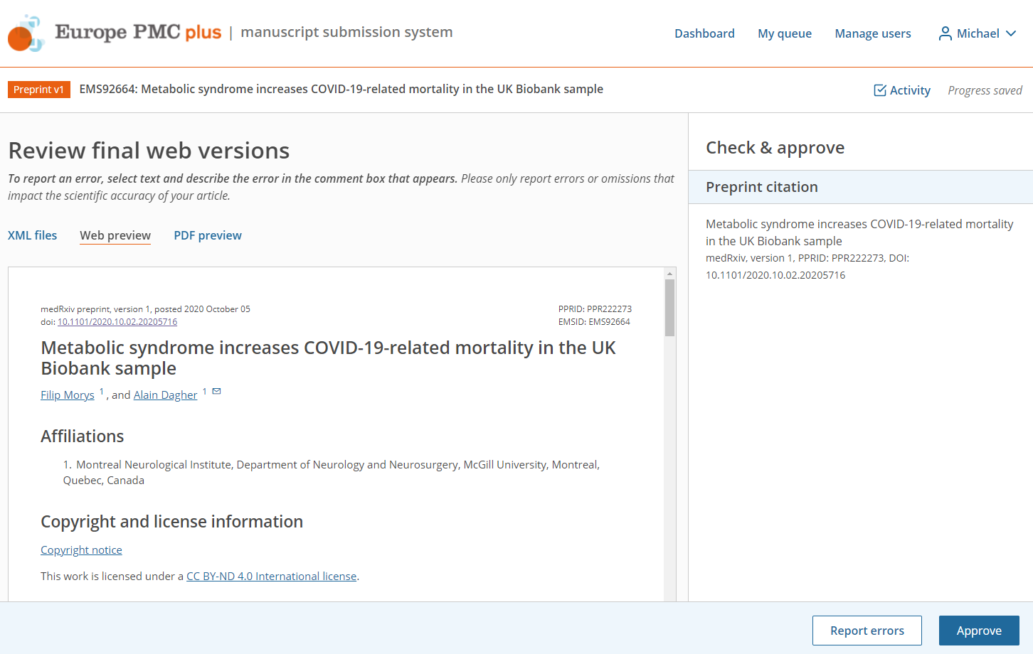
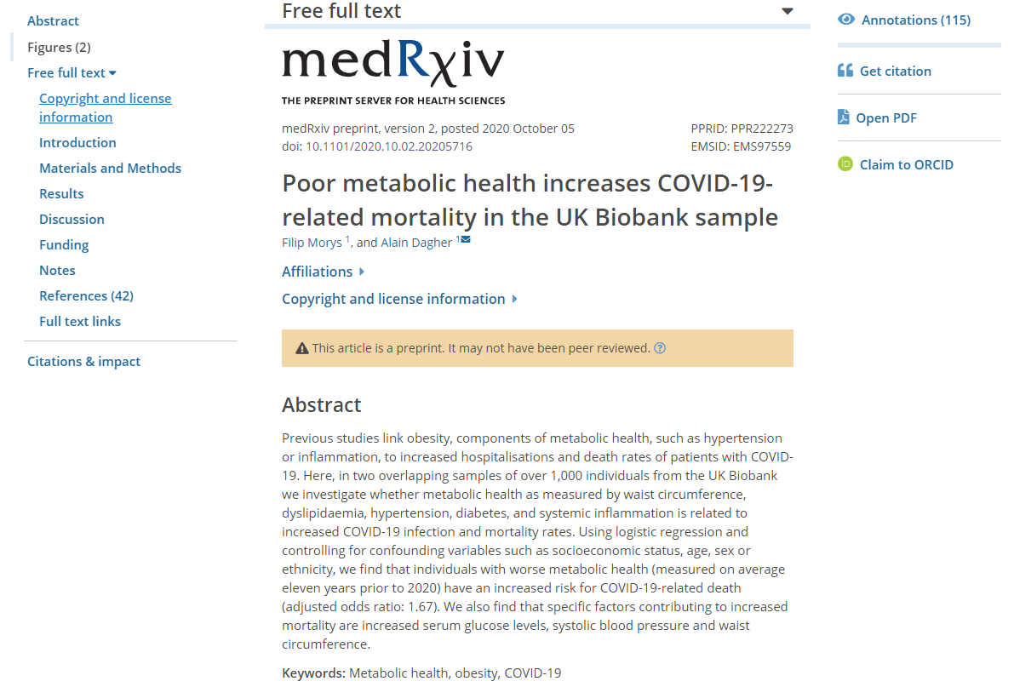
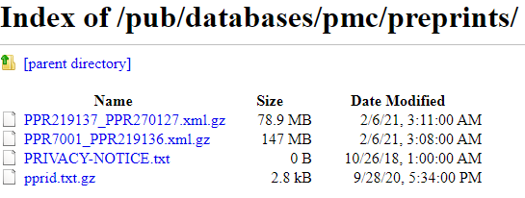
Proposed workflow
Notes:
Rather than building a new system from scratch, since we wanted authors to have the opportunity to review their preprints that were tagged, we decided to repurpose our existing ‘plus’ system to handle the workflow for COVID-19 preprints. I’ll explain a little here about the workflow: we identify either brand new or new versions of COVID-19 preprints from several servers each day. We either search Europe PMC itself for COVID-19 preprints with a comprehensive search query, or we use a curated list provided by the server themselves. We then use some scripts to download the preprint PDF, any supplementary files and fetch some metadata including the license and the corresponding author’s email address.
-CLICK-
The files and information are sent to plus using the bulk FTP upload route and then on to our XML tagging vendor. They then return a package containing an XML in JATS version 1.2 and any associated files which are then undergo QA by another external team. At this point we index the XML in Europe PMC, which makes the full-text searchable by anyone running for example a keyword search, but it’s not displayed for reading or available to download at this point. After QA, the corresponding author is invited to review the HTML rendering and suggest any corrections.
-CLICK-
If the preprint doesn’t have a CC license, the author is invited to add an open access license allowing us to include the preprint in our open access subset for re-use.
-CLICK-
Once approved, the full-text becomes available to read in Europe PMC
-CLICK-
and we make these XMLs available for download individually as well as in bulk via our FTP site.

Slide 8
Adapting ‘plus’ for preprints
Key developments:
Article type @article-type
Versioning <article-version>
Licensing <ali:license_ref>
Withdrawals and removals @article-type
Notes:
That workflow was very top-level and it hides a lot of complexity. Getting this working was a significant effort across the team, all the way from User Experience to building a brand new back-end database to store the XMLs and associated files. I’m just going to focus though on the main technical changes we made specifically to handle preprint XMLs. These relate to article type, versioning, licensing and finally removals and withdrawals. I’ll go through each of these in turn.

Slide 9
1. Article type
Distinguish (internally) between author manuscripts and preprints
Make clear to anyone (externally) downloading XML
Use the @article-type attribute:
<article article-type="preprint">
Notes:
The first is rather straightforward. Since preprint articles are for the most part the same as journal articles, and preprint servers are even included in the NLM catalog and have title abbreviations like journals do, we needed a way to distinguish in our own systems between these preprints and the author manuscripts that are processed in ‘plus’. We also want to make it clear to anyone downloading the XMLs that these are obviously preprints. So we opted for using the article-type=”preprint” attribute, as opposed to “research-article” which is generally used for our author manuscripts.

Slide 10
2. Versioning
Servers allow multiple versions of a preprint
Very important for us to capture all versions, in case there are significant scientific changes between versions
Capture separate XMLs for each version
Make use of within the system to ensure versions are processed in sequence, also let authors pre-approve future versions to reduce workload
Use the <article-version> element:
<article-version article-version-type="publisher-id">2</article-version>
Notes:
Versioning XMLs is one of the more complicated aspects of dealing with preprints, as servers allow authors to upload subsequent versions of their preprint, which can have any number of changes to the text, figures, supplementary and so on. As a result, there can be significant scientific changes between versions, and so we realised it was very important for us to keep up to date and capture each version as a separate XML. If anything this is extra important when dealing with COVID-19 preprints.
We internally track versions entering the plus system to ensure we process versions in the right order (we might get several versions of the same preprint in the course of a few days which isn’t long enough for our vendors to tag everything), and we allow authors to pre-approve future versions of their preprint to reduce the burden on them if they so choose.
Here we make use of the “article-version” element, and fortunately ever server so far has made use of integer versions: 1, 2, 3, 4 - we’ve not yet seen “version 3c.2” for example, which might require a bit more thought on our part.

Slide 11
3. Licensing
Preprints can be published with a variety of license types that need to be captured in the XML
License is read by ‘plus’ and determines subsequent workflow (auto-release after two weeks)
Also determines textmining permissions
Use the <ali:license_ref> element:
<license>
<ali:license_ref xmlns:ali="http://www.niso.org/schemas/ali/1.0/">https://europepmc.org/downloads/openaccess</ali:license_ref>
<license-p>This preprint is made available...</license-p>
</license>
Notes:
Just like journal articles, preprints can be published to a server under a variety of licenses. Often these are one of the various flavours of the Creative Commons license, but sometimes there are some server-specific licenses. As with versioning, this is something that’s absolutely critical for us to capture in the XML. And just like versioning, licensing can get very complicated, especially with regards to subsequent workflow within the ‘plus’ system itself. The main development we made here was to automatically release CC-licensed preprints to Europe PMC without author approval after a two week period.
As I’ll talk about briefly later on, the license type also affects what we can and can’t do when it comes to textmining the XMLs that we’ve generated.
We make use of the ‘Access License and Indicators’ element for the license, and this particular example is for the Europe PMC open access subset I mentioned earlier. I’ve just included the start of the text.

Slide 12
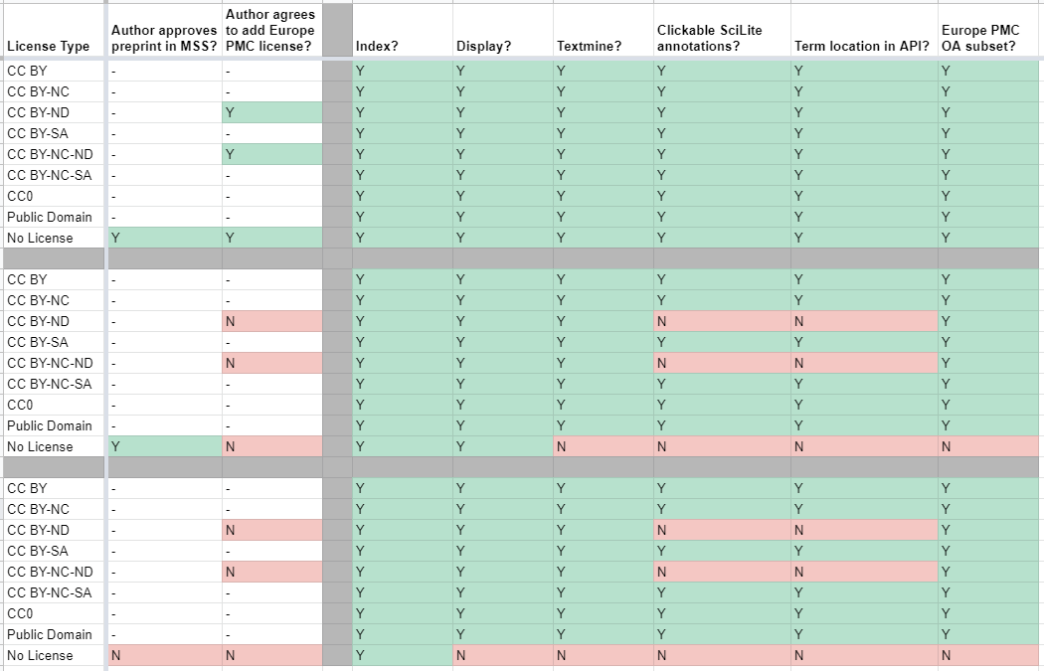
3. Licensing
Notes:
I’ll spare you by not going into any great detail here and leave it for the Q&A if people are interested, but this is just to give you an idea about some of the downstream processes that either are or aren’t allowed depending on the license type and actions the author may or may not take.

Slide 13
4. Withdrawals and removals
ASAPbio recommends two distinct categories:
Withdrawal – full-text for previous version(s) still available
Removal – all full-text content removed
ASAPbio recommendations: https://osf.io/8dn4w/
Notes:
The final development was one we didn’t anticipate, and this functionality was added in during the project. What we found was that we were coming across later versions of a preprint that were very short articles, often just a single-page PDF file, which rather than containing a full research article, consisted of just a single paragraph explaining that the preprint had been ‘suppressed’ for want of a better word. Now I’m going to specifically avoid talking about publication ethics here, that’s not my area of expertise, but suffice it to say there are many reasons why a preprint might be ‘suppressed’.
We’re fortunate working in the life sciences that there’s an organisation called ASAPbio who are a non-profit that, among other things, do a lot of work with the preprint community to provide guidance and recommendations. They suggest two distinct categories of ‘suppression’:
Withdrawal - when the full-text content for previous versions is still available
Removal - when all full-text content is removed
Here are two real examples of this. Sometimes there’s quite a thorough explanation for why a preprint was suppressed, and sometimes not.
So far we’ve seen 32 examples of this: 31 withdrawals and 1 removal.

Slide 14
4. Withdrawals and removals
Capture as a separate XML and display in Europe PMC
Make clear to anyone (externally) downloading XML
Plus flags to Helpdesk staff cases of a single <p> element
Use the @article-type attribute:
<article article-type="preprint-withdrawal">
<article article-type="preprint-removal">
Notes:
As an archive, our job is to ensure that our information is up-to-date, and accurately reflects the scientific record. So we definitely wanted to tag these suppression full-texts; the alternative being to leave the previous version in full on Europe PMC which clearly wasn’t appropriate. So we needed a method to capture this ‘suppression’ information in the XML not only for our own systems, but for the benefit of anyone accessing the XML in the future.
What we’ve implemented in plus is an automated check for XMLs which only have a single paragraph element which raises an alert to our Helpdesk staff. At the moment there’s no obvious way of determining whether a preprint has been withdrawn or removed in its entirety without visiting the preprint server itself. So this is for now a bit of manual effort. Basically when the XML is returned by the vendor, our Helpdesk staff update the XML with one of the two new article types as you can see here.

Slide 15
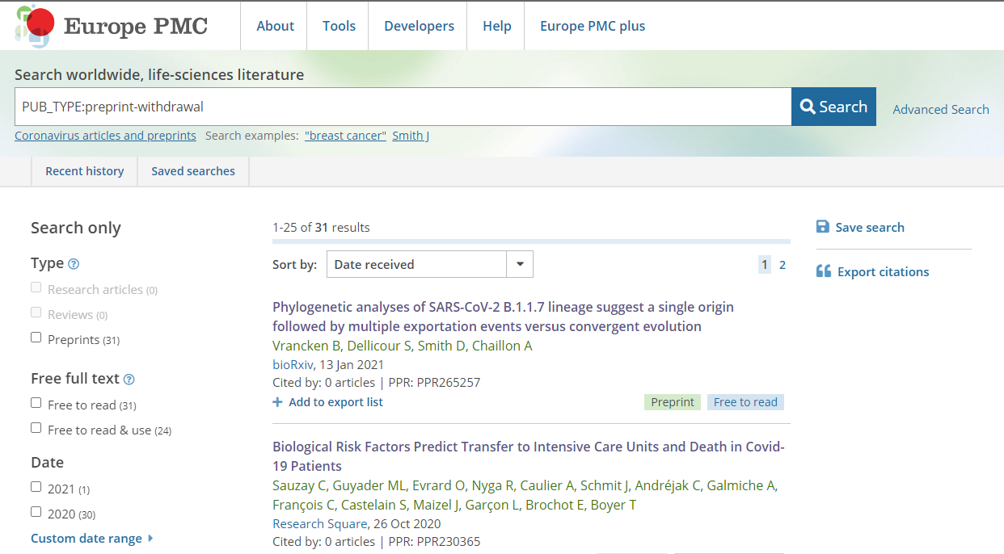
4. Withdrawals and removals
Search link: PUB_TYPE:preprint-withdrawal
Notes:
When we index full-text XMLs we read that article-type into our systems, so what you can now do is a simple search in Europe PMC, in this example shown to find the 31 withdrawn preprints. You can do a very similar search to find the one removed preprint.

Slide 16
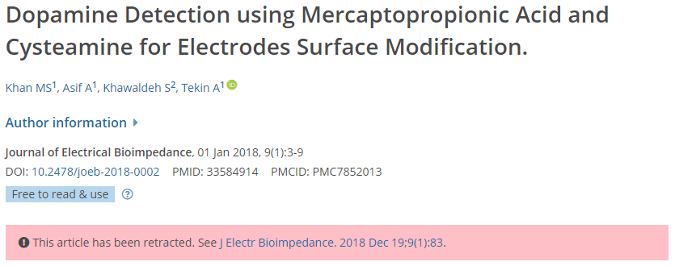
4. Withdrawals and removals
Would like to extend to all our preprint content
Parsing text from the <p> to determine suppression is very challenging
Metadata (generally) not readily available
Notes:
Of course for now this functionality only applies to the COVID-19 full text set, but we’d like to extend this to all preprint abstracts. However this relies on the withdrawal or removal information being accessible and ideally machine-readable, as parsing abstracts for words like ‘withdrawal’ and ‘removal’ simply isn’t accurate enough. It needs a human to take a look. The language used for withdrawals, often because of the explanations that are, isn’t standardised at all.
Some preprint servers, such as bioRxiv and medRxiv do have this information available via their own APIs, so we could consider making use of this, but in our ideal world we’d like this for all servers in a single location (i.e. Crossref metadata). What we’re now looking to do is add a banner similar to what we have for journal article retractions to make it extra clear for readers, and add this banner to any previous versions of a withdrawn preprint that a reader might stumble across.
Preprints often result in journal publications, and we link these together in Europe PMC. So the next level is thinking is about whether we should label journal articles which arose from a preprint that’s now withdrawn or removed, but we’re not there yet.

Slide 17
Response from authors
Our initial concerns before starting:
Engagement from preprint authors
Scale (x15)
Most common emails:
Please can you use the latest version?
Occasional confusion about how we obtained the preprint
Nice rendering
Notes:
We were a little nervous when beginning this project about the response from preprint authors. In part about how whether this project would be received positively or negatively, but also we were concerned about the sheer scale. Our Helpdesk staff process about 250 author manuscripts per month. In order to handle the backlog of COVID-19 preprints when we started this in July 2020, we started processing roughly that volume of preprints every two days.
In general things went better than we expected. By far the most common email was authors asking us to process their latest version. We’ve been extremely glad we spent the time ensuring our version handling was comprehensive, as authors are very keen to ensure we’re displaying the latest version on Europe PMC.
Occasionally there’s some confusion about how Europe PMC came to have the preprint. This is almost always from preprint servers where the preprint submission is actually part of a journal submission process - there’s a check box of some description during submission to a journal that lets you publish your submission as a preprint before peer review begins. In these cases we directed the author back to the server itself to clear up the confusion.
And finally there were a few nice comments about the XML to HTML rendering, which I know Audrey has spent a lot of time getting right.

Slide 18
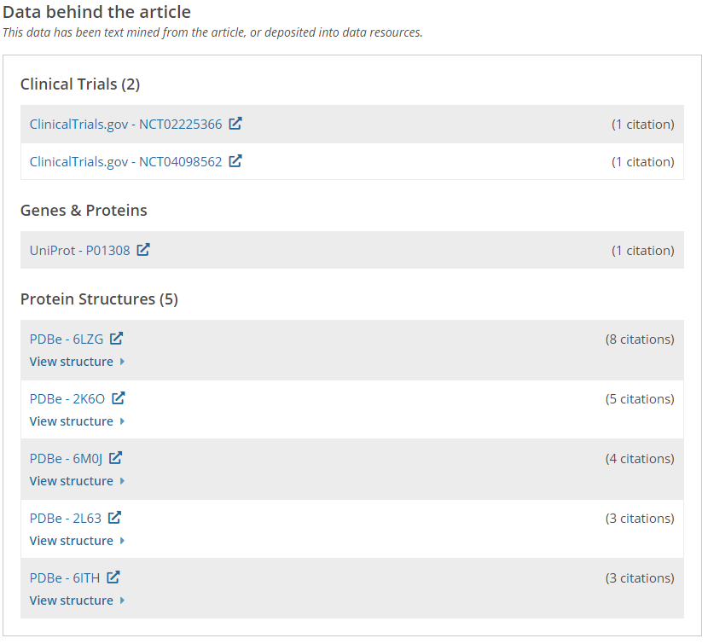
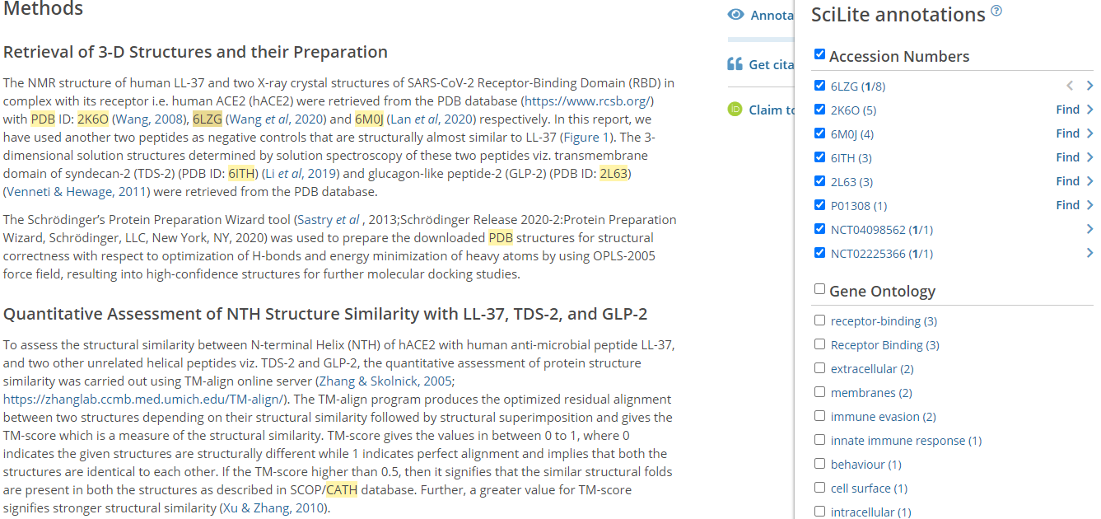
Textmining JATS XML
Data: https://europepmc.org/article/PPR/PPR211829#data
Funding: https://europepmc.org/article/PPR/PPR263456#funding
Notes:
So now we have all this XML, so what? One of the key benefits for us of using JATS XML is that we already have many processes that run on our full-text journal content from PubMed Central that we can use for the preprint content. In particular we run the preprint full-text XMLs through our textmining pipelines. That means machine-reading the XML and extracting various biological terms, entities, identifier and relationships which are displayed alongside the preprint through the SciLite application. We have a huge number of such annotations across all our content.
Textmining groups from all over the world can also freely download the preprint XMLs (license permitting of course) and turn their own software onto these COVID-19 preprints with minimal extra effort in order to extract information that’s valuable to their particular audience.
For Europe PMC funders we also extract grant information from the preprint Acknowledgement text, like this Wellcome grant in the bottom-right. Funding information can be patchy in journal articles, but it’s almost non-existent for preprints. This will only capture a fraction of the actual funding information, because it requires authors to have written it into their preprint, but it’s better than none at all.

Slide 19
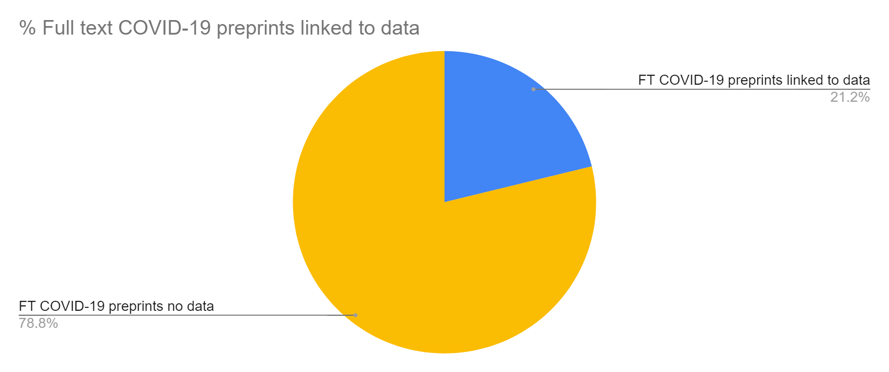
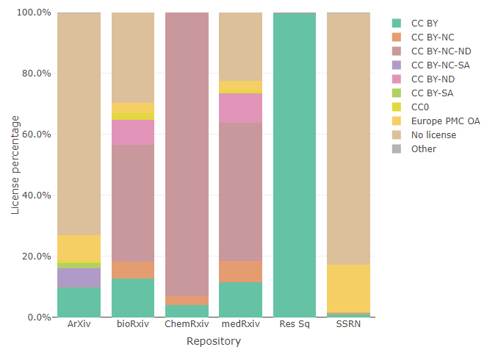
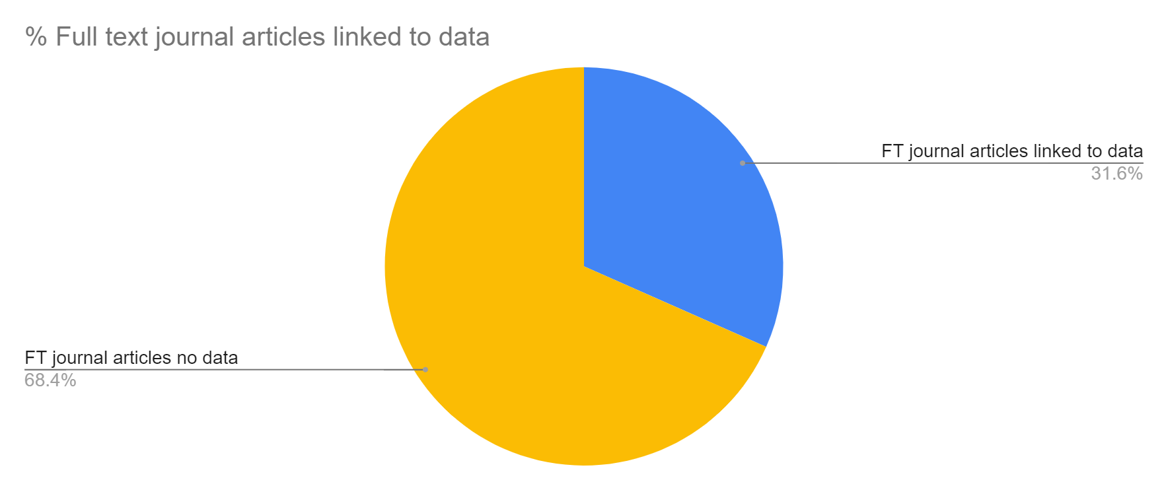
Large-scale analysis
Notes:
Although our focus has been on creating the collection, with the XMLs available in a convenient bulk download it’s very easy to do some large-scale analysis on the preprint full-text. Just by way of example, these are two things we track internally for our own interest. The left two pie charts compare the proportion of COVID-19 preprints where we’ve links to data through textmining, in comparison to journal articles. It’s just over 20% of COVID-19 preprints compared to just over 30% of journal articles, which might reflect poorer data citation in preprints. The right-hand chart shows the license breakdown by repository. Research Square is entirely CC BY, but we don’t see all that much CC BY content in the other repositories, with BY-NC-ND (non-commercial, non-derivative) being the most popular open access license.

Slide 20
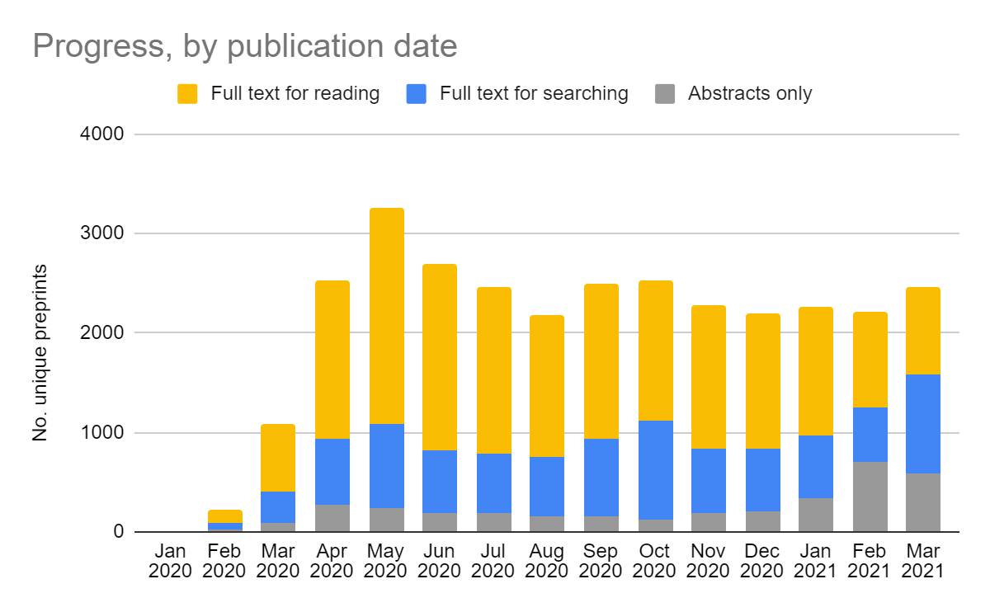
Where we are now
Servers as of April 2021:
arXiv
bioRxiv
ChemRxiv
medRxiv
Research Square
SSRN
http://europepmc.org/Preprints#preprint-indexing
Notes:
We have now tagged around 28,500 full text COVID-19 preprints. We added new servers progressively over the last year, and as of now we have COVID-19 full-text for 6 servers.
The chart reflects all COVID-19 preprints available in Europe PMC by month the preprint was published. The yellow represents COVID-19 preprints where the full-text can be read on Europe PMC, and is currently just under 20,000. The blue are full-texts we have indexed and are searchable in Europe PMC, which makes them much more discoverable, but have not yet been approved by the author in plus. The grey represents abstract-only preprints: either ones currently being processed, or from repositories that we aren’t yet creating XML for.
This is still very much a live project, and we continue to convert around 600 preprints per week, with a slight slow down in recent months with the addition of arXiv which has often theoretical and modelling studies which contain a lot of equations to tag, which has slowed down our vendors.

Slide 21
Future work
Continue the project, funding permitting
Add a couple more servers, including one based in Latin America
Work with community on standards for preprint metadata and full-text
Withdrawals and removals
Peer review and other commentary
Notes:
For our future plans, we hope to continue converting COVID-19 preprints into JATS, at the very least while the World Health Organization still considers that we are in a pandemic. Of course we don’t expect COVID-19 research, and therefore COVID-19 preprints, to suddenly disappear at that point, so it will largely come down to future funding.
We’d like to add at least a couple more servers as part of the project, including one based in Latin America which might pose some interesting challenges in terms of tagging content typically written in Spanish or Portuguese.
And finally we’d like to continue to work closely with the preprint community on standards, especially around withdrawals and removals as I’ve discussed, as well as better surfacing peer review materials and other commentary that are associated with preprints.

Slide 22
Supported by
Notes:
So that’s it from me. I’d just like to end by thanking colleagues for all their work on this project, I don’t think there was anyone in our team that wasn’t involved to some degree on this, and to acknowledge the 33 funders of Europe PMC, in particular the three that funded this work: Wellcome, the MRC and the SNSF. And finally thank you all very much for your attention.

Slide 23
Additional slides for possible Q&A

Slide 24
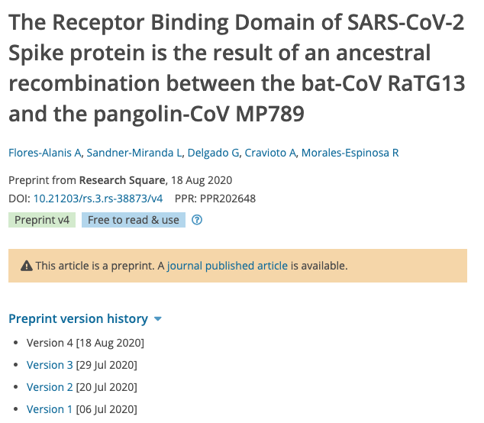
Versions and linking
Notes:
Europe PMC maintains the version history for preprints, allowing users to navigate between versions as in the left image, but only show the latest version in search results on the right. Europe PMC also bi-directionally links preprints to journal publications whenever possible as seen in the orange banner for the preprint record.

Slide 25
Community feedback
“Europe PMC is currently our favourite interface for searching for [preprints]”, Research Associate, Institute for Quality and Efficiency in Health Care
“I wanted to say how wonderful your plan to ingest COVID-19 preprints into Europe PMC is. There are plenty of websites that harvest some kind of preprint data from various servers but I’m never quite sure how they work, how comprehensive they are, are they going to keep working, etc. That makes it hard to rely on them for systematic reviews and evidence synthesis”, Medical librarian, Yale University
“COVID-19 has connected science and publishing in unprecedented ways... Europe PMC is doing an excellent job of fulfilling scientists’ needs through its full-text repository of preprinted COVID-19 research”, Preprint repository Editor in Chief
“I've switched to @EuropePMC. Searches return preprints as well as published articles.” Researcher, MRC Cambridge Stem Cell Institute
Notes:
We’ve had some excellent feedback from the community about the COVID-19 full-text project and our preprint abstract indexing in general. People appreciate that Europe PMC provides a single, comprehensive search for preprints with a simple interface, but also has advanced search features that have been built in over the years.

Slide 26
Europe PMC preprint re-use
preLights COVID-19 timeline (link) using Rest API
ASAPbio growth of preprints over time (link)
Textmining group @ SIB working with XML to generate annotations pertaining to COVID-19 related concepts
Notes:
Examples of re-use of both the preprint abstracts and full-text XML:
Firstly, preLights, an organisation that publishes written highlights of preprints, created a COVID-19 timeline that combines important events alongside the research published as preprints using preprint metadata from our API.
ASAPbio, a non-profit promoting innovation and transparency in life sciences communication, are directing readers to the first graph you saw in this presentation showing the growth in life science preprints over time
And finally a textmining group at the Swiss Institute of Bioinformatics will be using a coronavirus ontology (developed at the EBI) to generate annotations pertaining to COVID-19 related concepts which will be fed back to Europe PMC.

