Slide 1
Specimen Data Refinery
Project Overview and Update
Laurence Livermore
Natural History Museum, London, UK
26-04-2021 ISTC DWG Meeting
ORCID: 0000-0002-7341-1842
Presentation DOI: 10.6084/m9.figshare.14472570
Funder: European Commission | Project code: 823827 | Call for proposal: H2020-INFRAIA-2018-1

Slide 2
Context
~85% of specimen information resides on specimen labels or physical registers and is not digitised or publicly available
Most digitisation done in a manual way with many institutions constrained by operational (personnel) costs
SDR aims to develop a cloud-based platform of tools to processing specimen images and their labels en masse in order to extract essential data efficiently and effectively
Notes:
For a growing number of collection or preservation types the processes of transcription, interpreting, linking and georeferencing data are a bottle neck compared to the imaging step.

Slide 3
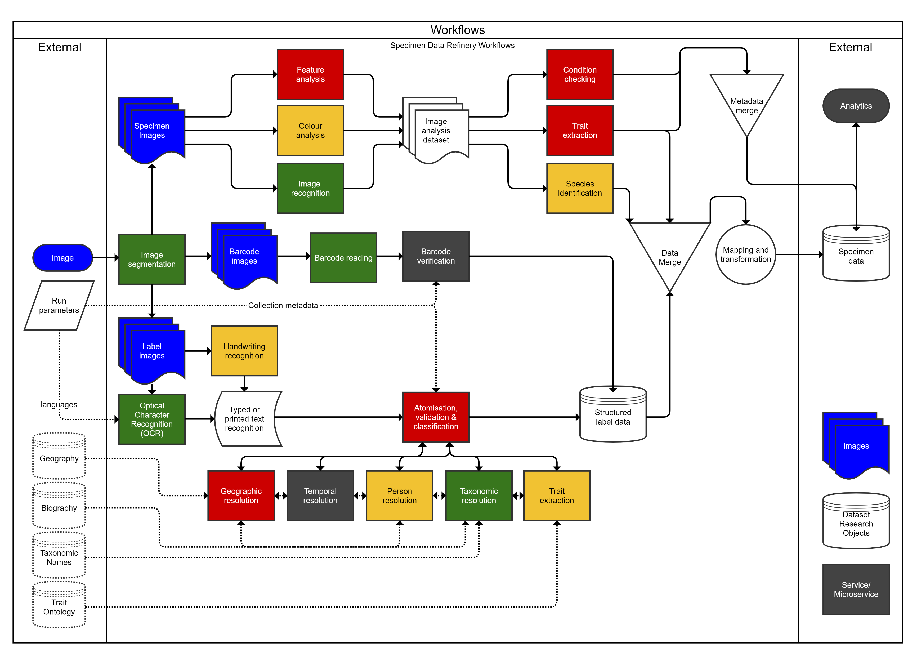
Notes:
This is an illustrative diagram of most of the potential tools and services for the SDR. We expect the main outputs to be structured specimen label data, and data about the specimen itself.
Figure from: https://doi.org/10.3897/rio.6.e57602

Slide 4
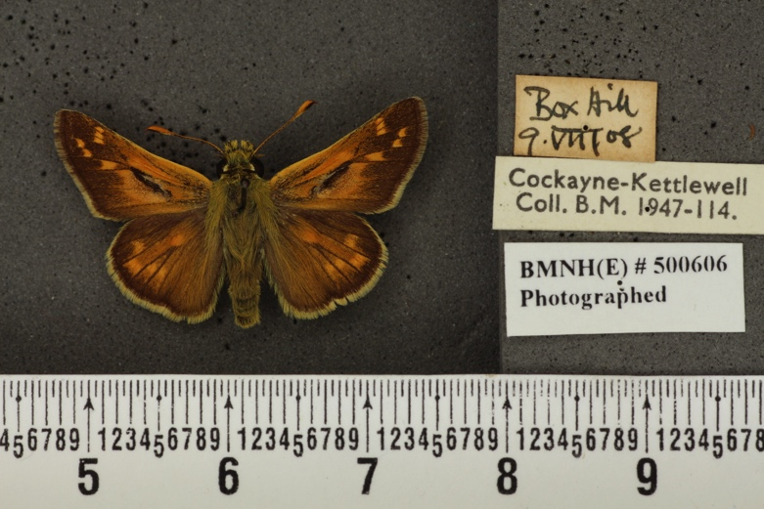
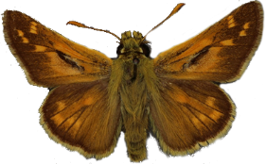
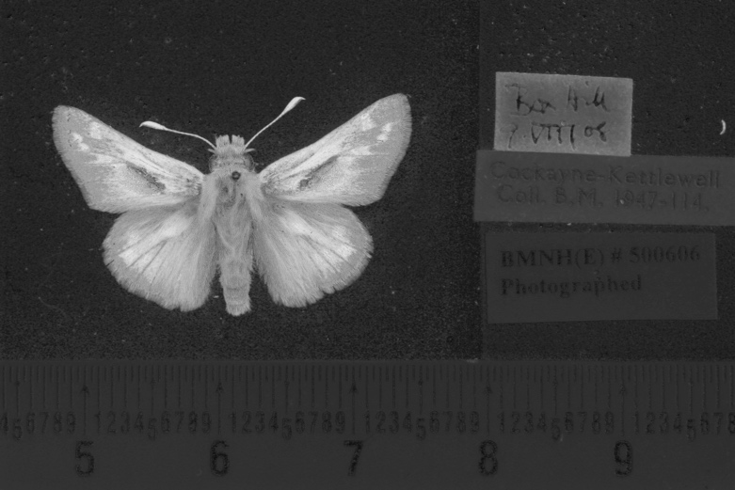
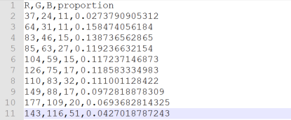
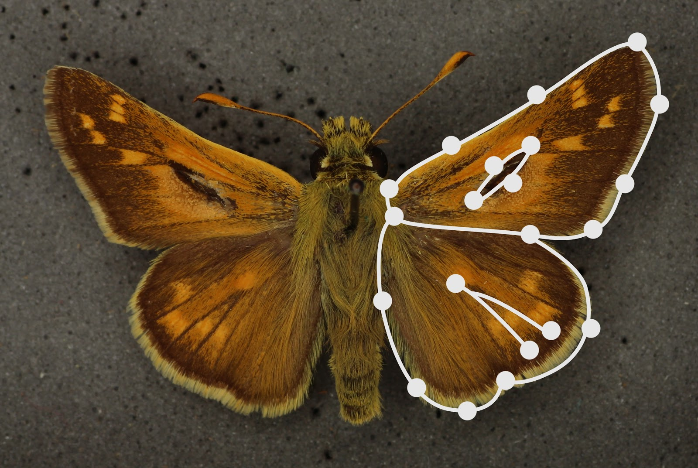
Segmentation
Data: Taxon name, Unique identifier, Location in collection
Data: +5 images: segmented specimen (mask) and 3 labels
Colour Analysis
Data: +image, colour data
Shape Modelling
Measurements
Data: +images, wing length, body length, wing area
Notes:
This is an illustrative workflow with multiple components
1) Segmentation – breaking the image into multiple parts or segments so that it is easier to do subsequent analyses
2) Colour analysis to determine dominant colour clusters
3) Shape modelling to take measurements of different points
Specimen: https://data.nhm.ac.uk/object/158f62c0-3a79-4aec-b3b4-8b6bc7a3e334/1571270400000

Slide 5
Formal Task Summary
Task 8.2
Development of tools, services & workflows
Task 8.3
Development of SDR cloud platform
Task 8.4
Data delivery & exploitation
Optical character recognition data capture and analysis
Platform will run workflows in SDR registry
User acceptance testing (against DiSSCo user stories)
Image analysis
Delivery of data to collections management systems
Data mining and linkage
Georeferencing
Task 8.1
Landscape evaluation
Evaluate platform based approaches inc. tool/service registries
Identify sources of data
Identify & create training/reference datasets
Assess potential to use EUDAT, EGI, EOSC, AWS etc
Reuse & integrate reports from previous DiSSCo-related work
Controlled user access (ELIXIR authentication & authorisation)
Create detailed standardized provenance metadata of derivative datasets
Derivative datasets and outputs packaged as Research Objectives (ROs)
Mature services will be containerized and incorporated into SDR workflow & tool registry
Services include:
Ledger log of all ROs & specimen UIDs
Training and workshops to promote use
Exploitation of data by third parties
D8.1 Complete
D8.2 Demonstrator (NHM)
D8.3 Demonstrator (UNIMAN)
D8.4 Report (Naturalis)

Slide 6
Project Timeline
Aug
Landscape Analysis Published
Jul
MVP
Demonstrator Platform
Further development of cloud platform, integration and training
JAN ‘21
JAN ‘22
JAN ‘23

Slide 7
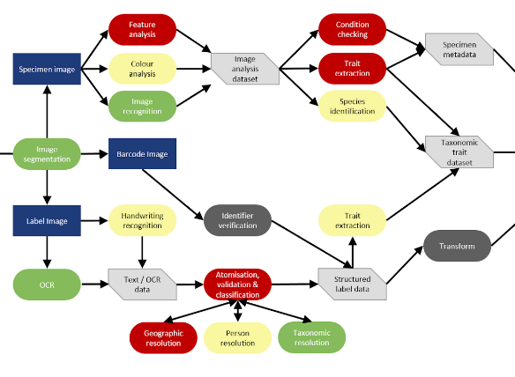
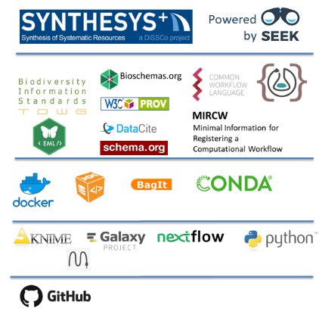
Landscape Analysis
Collate known existing technology and document specs and capabilities
Scope:
76 tools/services
Colour-code each step in the workflow to identify highways and roadblocks
Criteria:
~14 tools/services
Level of development
Existing research/papers
Use cases with NH data
Consult on a technology stack for developing computational workflow
Requirements:
HiTL capabilities
Standardised workflow language
Notes:
We began by collating known existing technology from all member institutions and compiling them into a Google Spreadsheet. Over the course of 6 months, 16 people contributed a total of 76 tools and services. Each of these tools was systematically researched for their capabilities and where they might be applicable within the workflow.
Each step in the workflow was then colour-coded based on the availability or lack of technology. Colour-coding was based on a) the number of available tools, b) their specificity for or testing with NH data.
We discussed and described a possible (and recommended) workflow technology stack with Carole and her team.
The report gave a series of conclusions and recommendations:
Priority tools and services were identified in the gap analysis, along with ones which require further testing.
Training or ground truthing datasets required for development were identified.
Sector-specific challenges were discussed including using existing data standards.
Finally, software sustainability was discussed along with some proposed considerations, especially for long-term workflow platform sustainability by utilising existing funded infrastructure (e.g. ESFRI Cluster, EOSCLife and ESFRI IBISBA).

Slide 8
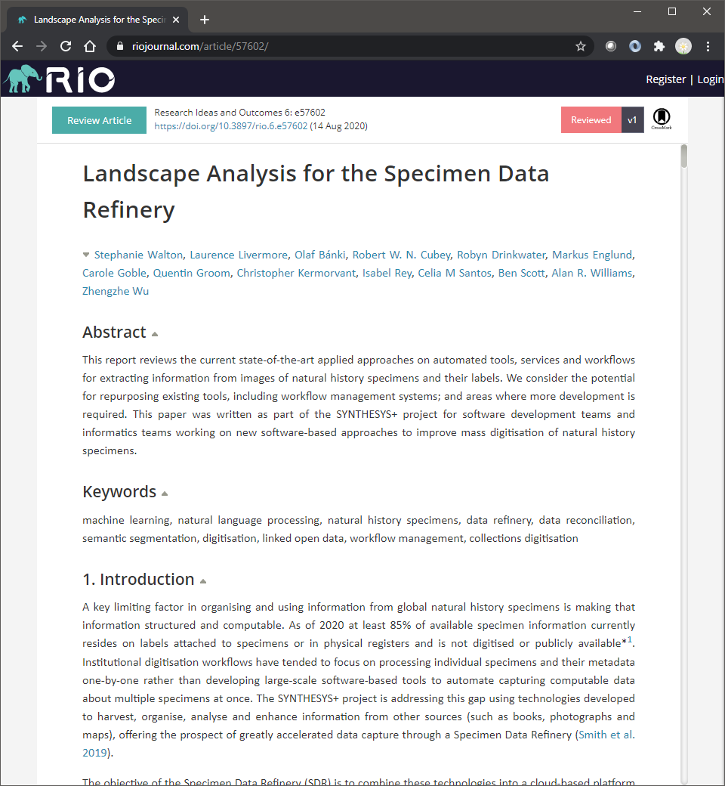
Landscape Analysis - Published
Walton S, Livermore L, Bánki O, Cubey RWN, Drinkwater R, Englund M, Goble C, Groom Q, Kermorvant C, Rey I, Santos CM, Scott B, Williams AR, Wu Z (2020) Landscape Analysis for the Specimen Data Refinery. Research Ideas and Outcomes 6: e57602. https://doi.org/10.3897/rio.6.e57602

Slide 9
Progress in 2021
Paul Brack joined the project (UNIMAN)
Fortnightly team meetings
Fortnightly workflows/standards/digital object framework meetings
Development and agreement of a “Minimum Viable Product”
Notes:
Paul Brack joined Carole Goble’s team based at The University of Manchester. Paul is focusing on the computational workflows and Galaxy platform but is speaking to users and institutes to understand broader requirements.
We have two regular fortnightly meetings – these are both open anyone who is interested
Fortnightly team meetings
Fortnightly workflows/standards/digital object framework meetings
Development and agreement of a “Minimum Viable Product”

Slide 10
Minimum Viable Product
Outline minimal functional requirements of the Specimen Data Refinery. Definition of input/output and data objects for each component in the SDR prototype.
Implementing open Digital specimen – passed between components
Provenance of modifications will be tracked (under discussion)
JSON/JSON-LD will be used to store image regions of interest and text
Users either digitisers or collections managers/curators
Scope: herbarium sheets, microscope slides, pinned insects
Functional and non-functional requirements described
Workflow components with input/outputs described
Available to read/comment on: https://docs.google.com/document/d/1sNclNbnMJrIVWeV1-9Rikd3SUX00T2x3L5-Lwqcyx6A
Notes:
We are doing as much of the work as possibly in public -
MVP Available to read/comment on: https://docs.google.com/document/d/1sNclNbnMJrIVWeV1-9Rikd3SUX00T2x3L5-Lwqcyx6A

Slide 11
Current Activities
Developing example Galaxy pipeline/workflow [due May]
Moving next steps/tasks to DiSSCo SDR GitHub as Issues [due May] https://github.com/DiSSCo/SDR/issues
Developing training corpora for object, text lines and named entities
Scheduled trial of DiSSCo image repository for staging
Discussing standards for:
FAIR Digital Objects and Digital Specimens
Provenance (and discussion at Provenance Week 2021) https://iitdbgroup.github.io/ProvenanceWeek2021/t7.html
Results from OCR/HTR/NER (on labels): https://teklia.com/blog/2021-export-formats/
Recruiting for an 18th month computer vision PDRA (based at NHMUK)
Notes:
Developing training corpora for object, text lines and named entities – likely to be in touch with some of you to create similar dataset to benchmark herbarium dataset

Slide 12
Acknowledgements
Notes:
This is a multi-partner endeavour so I would like to thank my many colleagues.

